Slide 1
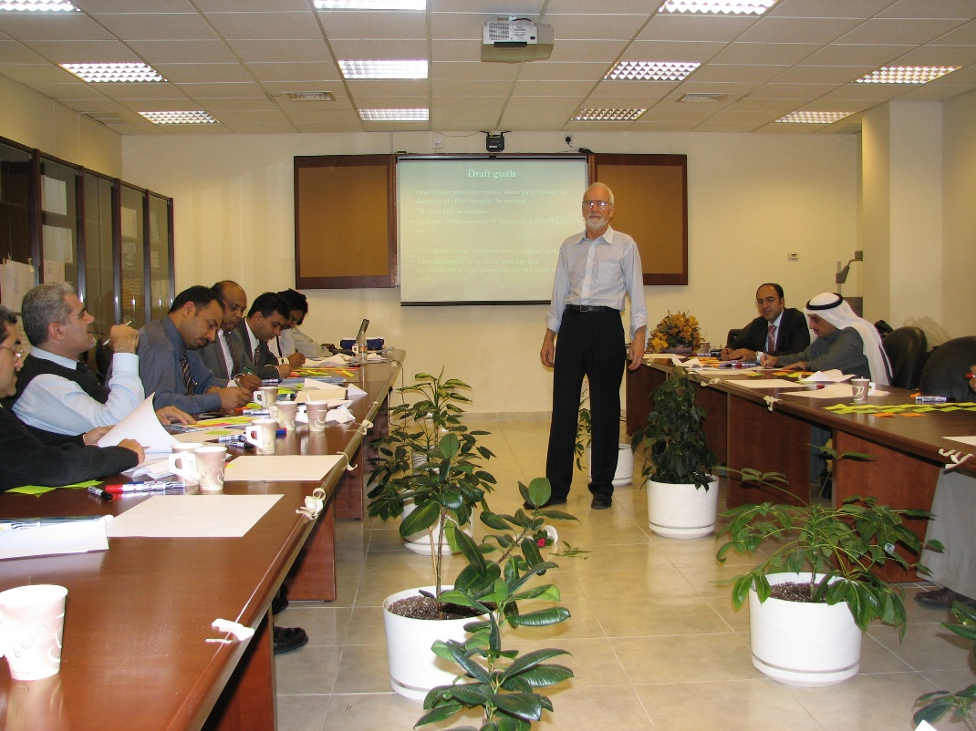
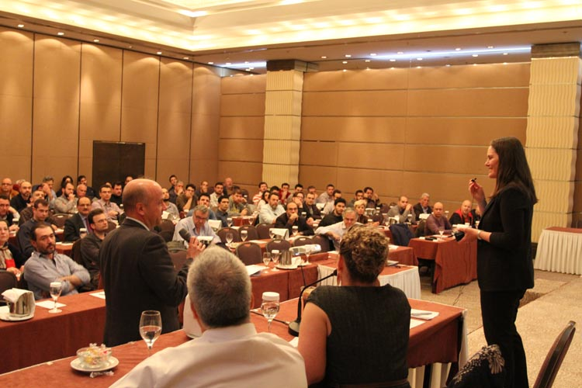

How To Schedule an
ASHRAE Distinguished Lecturer Visit

Slide 2
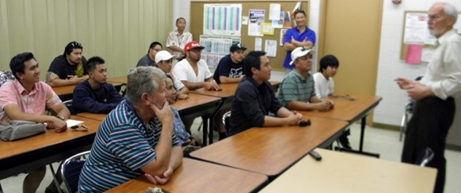
ASHRAE Distinguished Lecturer Program
  Supervised by the Society Chapter Technology Transfer Committee
  Provides qualified lecturers to local ASHRAE Chapters, Regions, and Student branches worldwide
  Stats for 2019-2020:
      480+ topics
      69 lecturers
      12 countries represented
      12 different languages

Slide 3
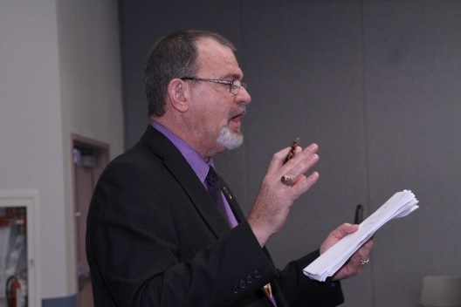
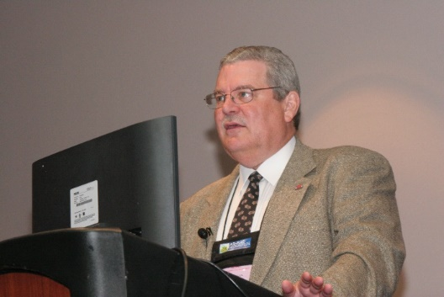
Program Benefits
  Technology Transfer
      Learn about the latest emerging concepts and industry research
  Technical Expertise
      Presentations are made by the industry’s leading experts
  Variety of Timely, Relevant Topics
      Pertinent information can take your business or career to the next level
    Increased Attendance
        Relevant information from industry leaders attracts a crowd

Slide 4
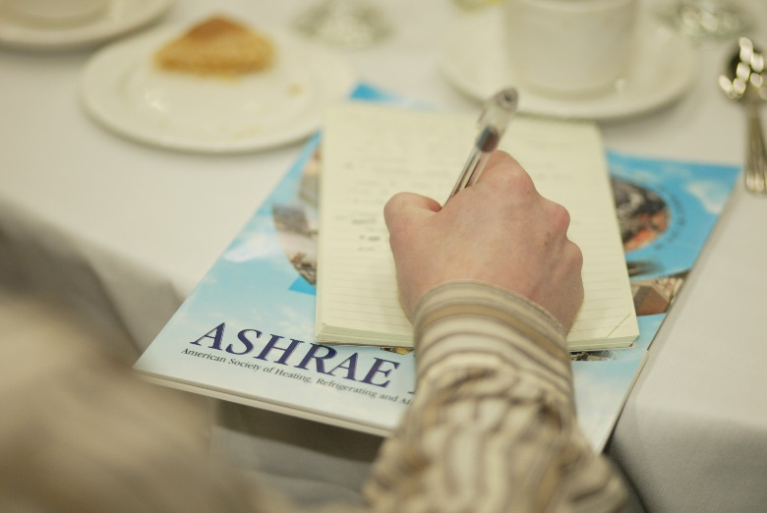
Bring a Distinguished Lecturer to Your Next Event
  Contact your CTTC Regional Vice Chair for Chapter allocation
  Select a DL and topic at www.ashrae.org/distinguishedlecturers
  Contact the DL
  Send written confirmation to the DL

Slide 5
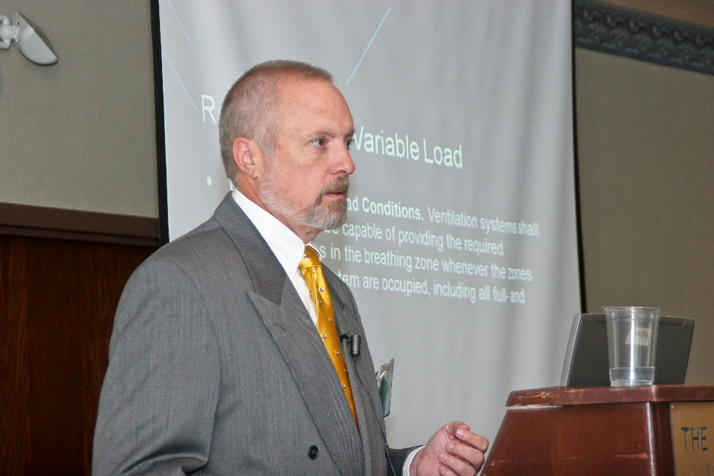
Bring a Distinguished Lecturer to Your Next Event
  Submit the Participation Form to your CTTC Regional Vice Chair
  Receive visit confirmation from ASHRAE Headquarters

Slide 6

November 30th Deadline
  Unconfirmed DL visits available after the deadline will return to a common pool available through ASHRAE Headquarters for use by any Region on a first come, first served basis.

Slide 7
Additional Information
  Contact your CTTC RVC
  Contact ASHRAE Chapter Programs Staff
    Chapterprograms@ashrae.org
  Visit www.ashrae.org/distinguishedlecturers for:
    - The listing of ASHRAE Distinguished Lecturers and topics
    - Summary of DL and Chapter Evaluations
    - Contact information for your CTTC Regional RVC
    - Instructions for Host Chapters
    - The DL Participation Form
    - The DL Media Kit
    - Event Summary Critique Form

Slide 8

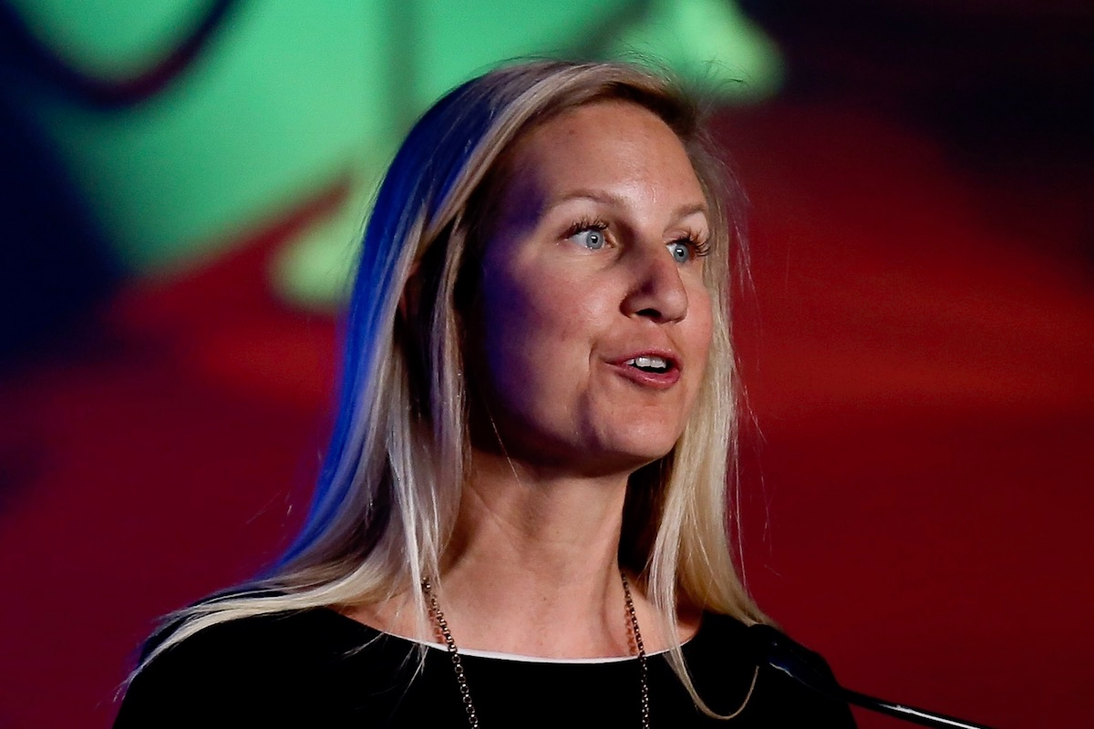
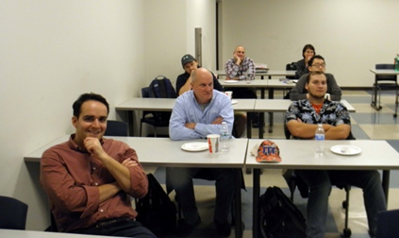
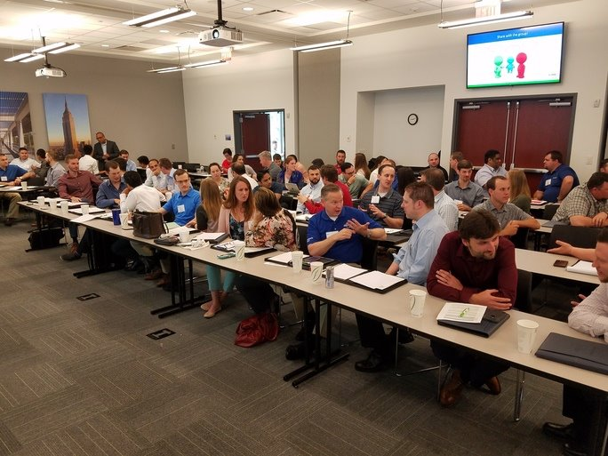
Thank You!
Chapter Technology Transfer Committee

