Slide 1


Center of Excellence for
Building Decarbonization (CEBD)
Whole-Life Carbon (WLC) :
Decarb Strategies for New Buildings

Slide 2

Agenda
Introduction
Why WLC
What is WLC
Benchmarking Comparison
Applying WLC
ASHRAE Update

Slide 3
Why Whole Life Carbon Framework?

Slide 4
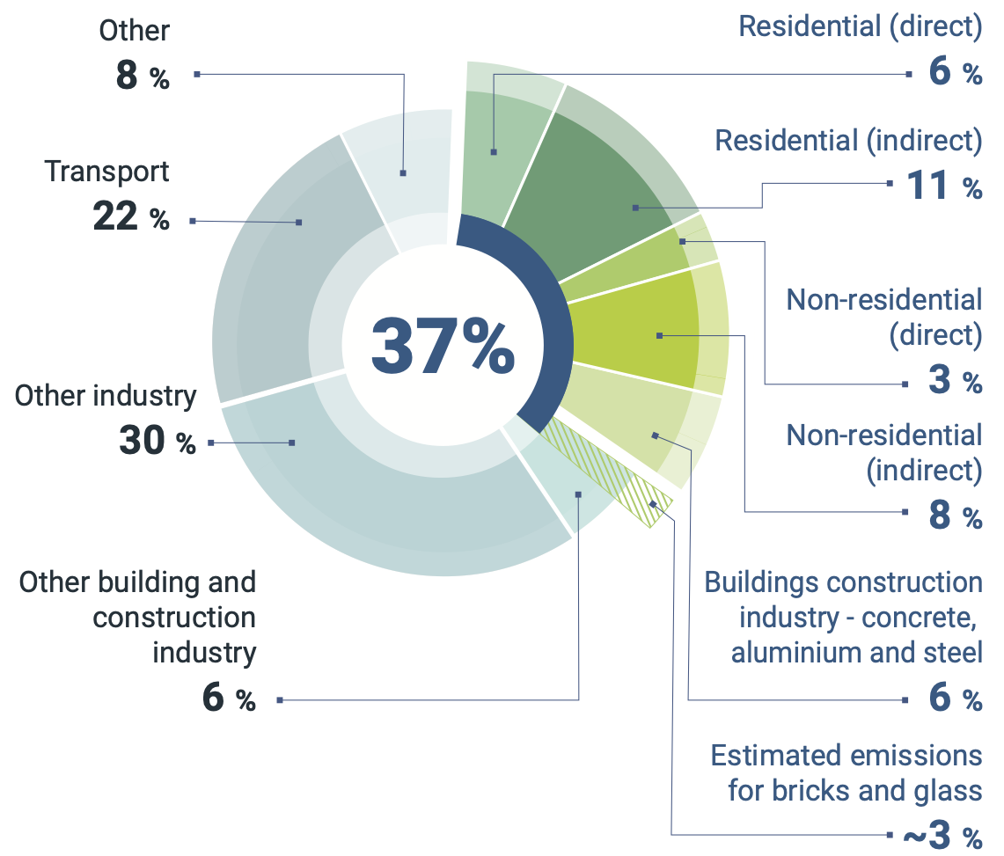
Global building sector energy-related CO₂ emissions, 2021
Source: IEA 2022. All rights reserved. Adapted from "Tracking Clean Energy Progress" (IEA 2022f), https://www.unep.org/resources/publication/2022-global-status-report-buildings-and-construction

Slide 5

ASHRAE’s position…
Eliminating GHG emissions from the built environment is essential to address climate change
Notes:
ASHRAE’s position is simple. Eliminating GHG emissions from the built environment is essential to address climate change.

Slide 6
ASHRAE goals…
2030
The global built environment must halve its 2015 GHG emissions
All new buildings must be NZE
Widespread EE retrofits of existing assets
New construction embodied carbon must be reduced by at least 40%
2050
All new and existing assets must be net zero GHG emissions across the whole life cycle
Notes:
By 2030, the global built environment must halve its 2015 GHG emissions, whereby
all new buildings must be net zero GHG emissions in operation,
widespread energy-efficiency retrofits of existing assets must be well underway, and
embodied carbon of new construction must be reduced by at least 40%.
By 2050, at the latest, all new and existing assets must be net zero GHG emissions across the whole life cycle.

Slide 7
Over 65 California jurisdictions have already adopted policies to promote or require building electrification, and the California Air Resources Board has approved a strategy to ban the sale of gas heating and water heating equipment statewide starting in 2030.
EXCEPTIONS:
Application for a building permit is submitted, accepted by the Department of Building and Safety, and building permit application fees are paid prior to April 1, 2023.
Cooking equipment contained within kitchens located in a public use area, as defined in the California Building Code Chapter 2, such as restaurants, commissaries, and cafeterias provided the electrical infrastructure is installed in accordance with Section 99.05.106.14.1.
Gas-powered emergency life-safety systems, including emergency backup.
Gas-powered process equipment in I-2, F and L Occupancy Groups provided the electrical infrastructure is installed in accordance with Section 99.05.106.14.1.
California Direction
Transition
to All-Electric Buildings
Los Angeles Municipal Code
99.05.106.14. All-electric buildings. All newly constructed buildings shall be all-electric buildings.

Slide 8



Slide 9
What is Whole Life Carbon Framework?

Slide 10
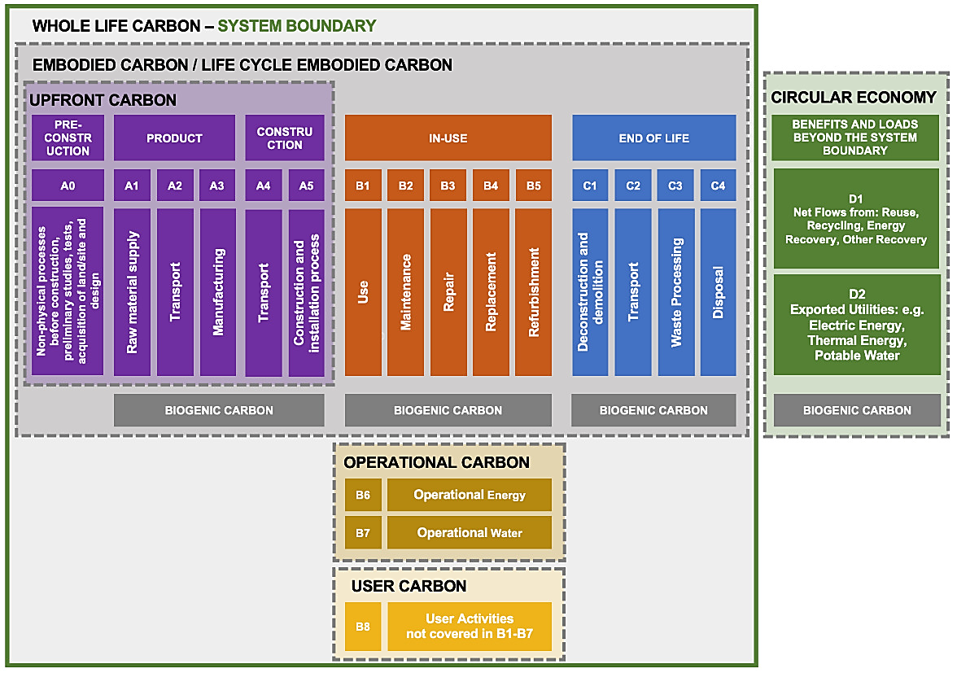
Whole Life Carbon, RICS Professional Standard, 2nd edition
https://www.rics.org/content/dam/ricsglobal/documents/standards/Whole_life_carbon_assessment_PS_Sept23.pdf

Slide 11
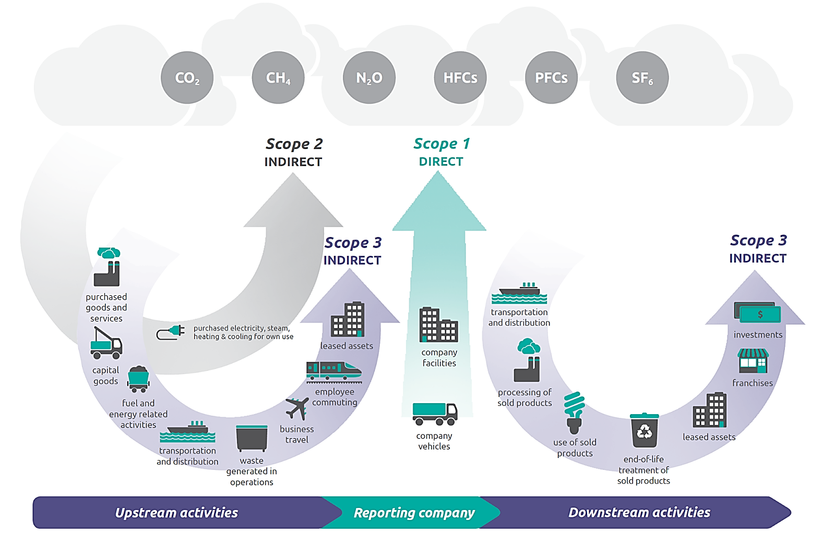
Refrigerant as Scope 1, Direct Emission
Credit: https://www.epa.gov/climateleadership/scope-1-and-scope-2-inventory-guidance

Slide 12
Refrigerant as Scope 1, Direct Emission
Fugitive
Refrigerant
Credit: https://www.epa.gov/climateleadership/scope-1-and-scope-2-inventory-guidance

Slide 13
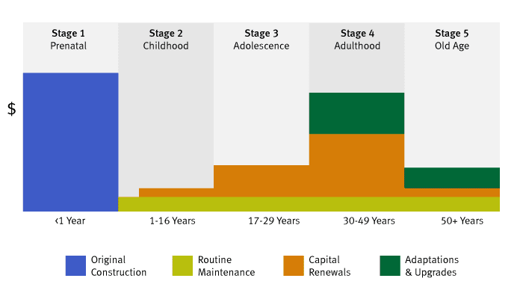
https://www.rdh.com/blog/long-buildings-last/

Slide 14
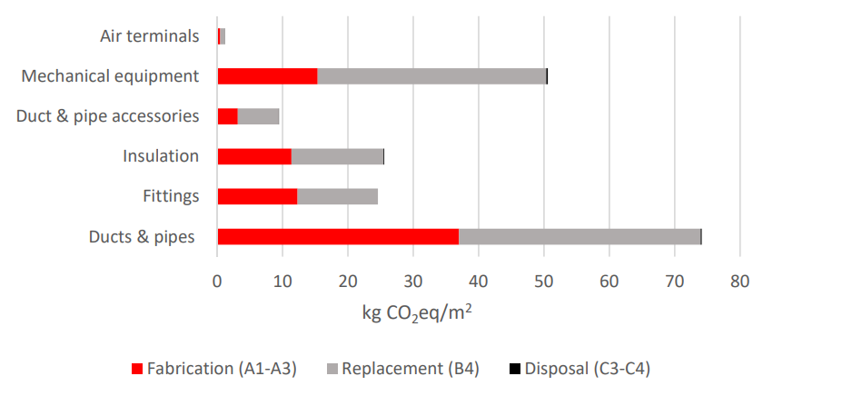
Embodied Carbon of HVAC in an office building
Credit: Kiamili, Christina, et al. “Detailed Assessment of Embodied Carbon of HVAC Systems for a New Office Building Based on BIM.” MDPI, 21 April 2020

Slide 15
Embodied Carbon of HVAC in an office building
Credit: Kiamili, Christina, et al. “Detailed Assessment of Embodied Carbon of HVAC Systems for a New Office Building Based on BIM.” MDPI, 21 April 2020

Slide 16
Whole Life Carbon, RICS Professional Standard, 2nd edition
https://www.rics.org/content/dam/ricsglobal/documents/standards/Whole_life_carbon_assessment_PS_Sept23.pdf

Slide 17
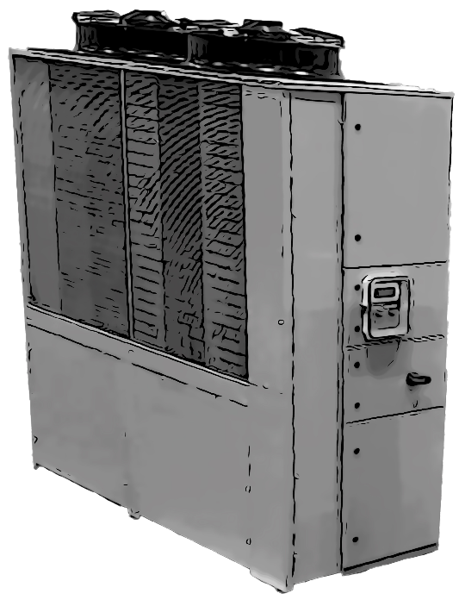
Refrigeration Equipment Greenhouse Gas Emissions EN 15978
B6: Energy
Operation Carbon
B1: Refrigerant
Embodied Carbon
CO₂e
CO₂e
A1-A5:
Embodied Carbon
CO₂e

Slide 18
Refrigerant as Scope 1, Direct Emission
Credit: https://www.epa.gov/climateleadership/scope-1-and-scope-2-inventory-guidance

Slide 19
Refrigerant as Scope 1, Direct Emission
Fugitive
Refrigerant
Credit: https://www.epa.gov/climateleadership/scope-1-and-scope-2-inventory-guidance

Slide 20
https://www.rdh.com/blog/long-buildings-last/

Slide 21
Embodied Carbon of HVAC in an office building
Credit: Kiamili, Christina, et al. “Detailed Assessment of Embodied Carbon of HVAC Systems for a New Office Building Based on BIM.” MDPI, 21 April 2020

Slide 22
Embodied Carbon of HVAC in an office building
Credit: Kiamili, Christina, et al. “Detailed Assessment of Embodied Carbon of HVAC Systems for a New Office Building Based on BIM.” MDPI, 21 April 2020

Slide 23
Whole Life Carbon, RICS Professional Standard, 2nd edition
https://www.rics.org/content/dam/ricsglobal/documents/standards/Whole_life_carbon_assessment_PS_Sept23.pdf

Slide 24
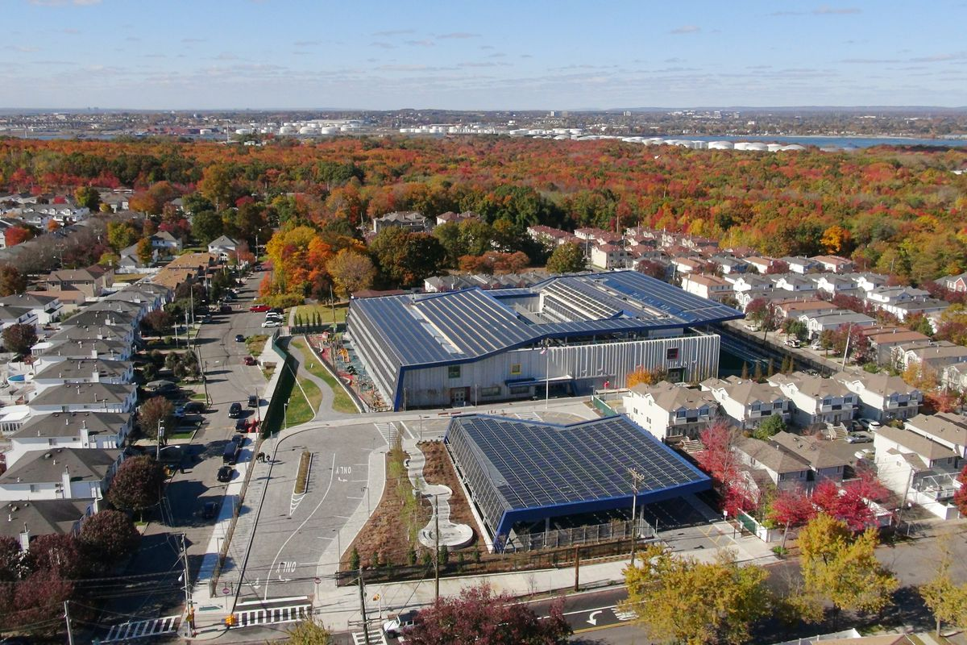
First Net Zero School in New York City

Slide 25
Whole Life Carbon, RICS Professional Standard, 2nd edition
https://www.rics.org/content/dam/ricsglobal/documents/standards/Whole_life_carbon_assessment_PS_Sept23.pdf

Slide 26


Whole Life Carbon, RICS Professional Standard, 2nd edition
+
Credit: https://wachastory.com/product/printing-paper-a4-500-sheets-80gsm-dimensions-210-x-297-mm/
https://evocharge.com/resources/how-does-ev-charging-work/
https://www.census.gov/acs/www/about/why-we-ask-each-question/commuting/

Slide 27
5 Versus 50 Stories
Location:
Refrigerant:
Central Plant:
Typology:
EUI (5 Stories):
EUI (50 Stories):
Life (5 Stories):
Life (50 Stories):
Area:
Chicago
R-134 A
Chiller and Heat Pumps
Office Building
50 kBtu/sf/yr; 150 KWH/sf/yr
67 kBtu/sf/rr 211 KWH/sf/yr
60 Years
100 Years
20,000 sf/floor; 1,859 sm/floor

Slide 28
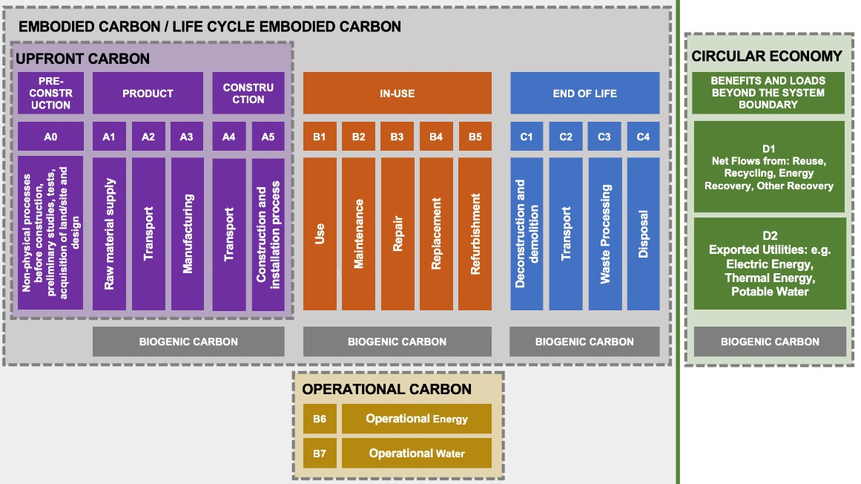
Office Building Benchmarking Life Cycle Carbon
Unit: KgCO₂e/M² (GFA, Full Building Elements)
5
Stories
50 Stories
500
30
67
540
40
67
https://www.rics.org/content/dam/ricsglobal/documents/standards/Whole_life_carbon_assessment_PS_Sept23.pdf

Slide 29
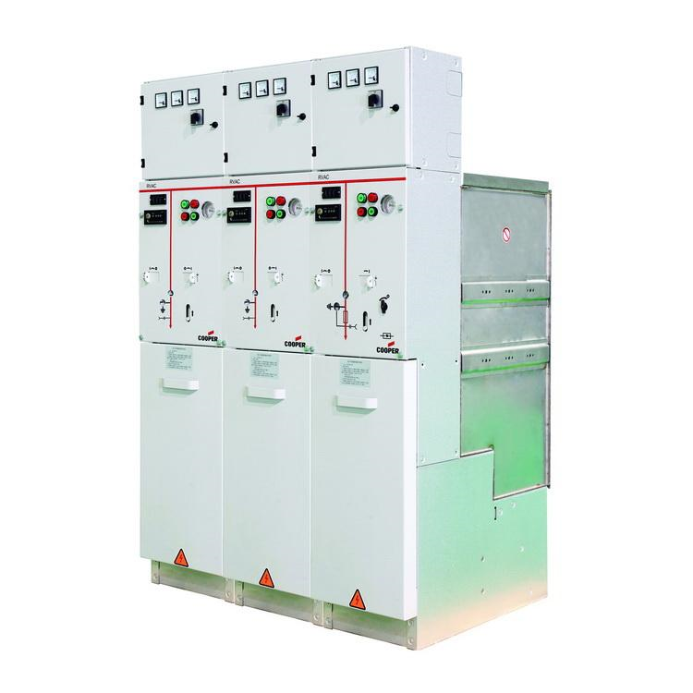
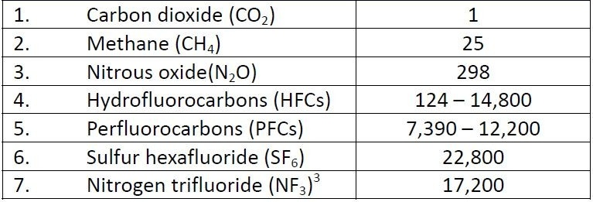
Ring Main Unit/Switchgear with SF6
Greenhouse
Gas (GHG)
Global Warming
Potential (GWP)
Credit: https://www.eaton.com/in/en-us/catalog/medium-voltage-power-distribution-control-systems/eaton-sf6-gas-insulated-switchgear.html
https://www.linkedin.com/pulse/co2-equivalents-dragisa-ristic/

Slide 30
Office Building Benchmarking Life Cycle Carbon
Unit: KgCO₂e/M² (GFA, Full Building Elements)
5
Stories
50 Stories
500
30
67
590
40
-175
540
40
67
820
40
-175
https://www.rics.org/content/dam/ricsglobal/documents/standards/Whole_life_carbon_assessment_PS_Sept23.pdf

Slide 31
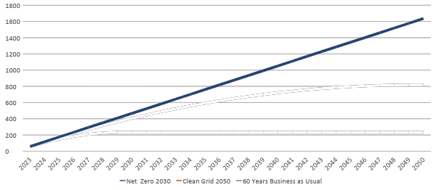
Office Building
MEP Benchmarking Life Cycle Carbon – 5 Stories Operation
Unit: KgCO₂e/M²
60 Years Business as Usual: 3506

Slide 32
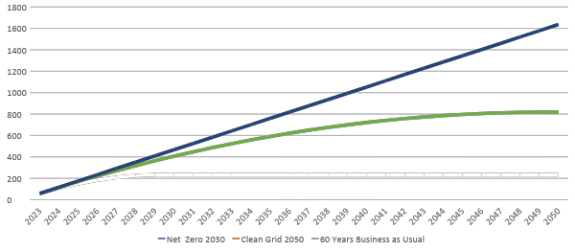
Office Building
MEP Benchmarking Life Cycle Carbon – 5 Stories Operation
Unit: KgCO₂e/M²
60 Years Business as Usual: 3506
Net Zero 2050: 818

Slide 33
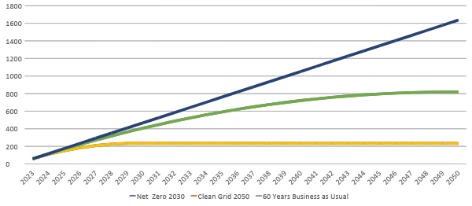
Office Building
MEP Benchmarking Life Cycle Carbon – 5 Stories Operation
Unit: KgCO₂e/M²
60 Years Business as Usual: 3506
Net Zero 2050: 818
Net Zero 2030: 234

Slide 34
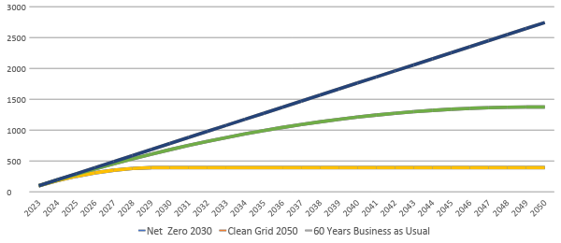
Office Building
MEP Benchmarking Life Cycle Carbon – 5 Stories Operation
Unit: KgCO₂e/M²
100 Years Business as Usual: 5894
Net Zero 2050: 1375
Net Zero 2030: 393

Slide 35
Office Building Benchmarking Life Cycle Carbon
Unit: KgCO₂e/M² (Business As Usual, Operation)
5
Stories
50 Stories
500
30
67
590
40
-175
540
40
67
820
40
-175
3516
5904
https://www.rics.org/content/dam/ricsglobal/documents/standards/Whole_life_carbon_assessment_PS_Sept23.pdf

Slide 36
Office Building Benchmarking Life Cycle Carbon
Unit: KgCO₂e/M² (2050 Net Zero, Operation)
5
Stories
50 Stories
500
30
67
590
40
-175
540
40
67
820
40
-175
818
1375
https://www.rics.org/content/dam/ricsglobal/documents/standards/Whole_life_carbon_assessment_PS_Sept23.pdf

Slide 37
Office Building Benchmarking Life Cycle Carbon
Unit: % and KgCO₂e/M² (2050 Net Zero, Operation)
5
Stories
50 Stories
500
30
67
590
40
-175
540
40
67
820
40
-175
234
393
https://www.rics.org/content/dam/ricsglobal/documents/standards/Whole_life_carbon_assessment_PS_Sept23.pdf

Slide 38
Office Building Benchmarking Life Cycle Carbon
Unit: % and KgCO₂e/M² (Business As Usual, Operation)
5
Stories
50 Stories
11%
1%
1%
12%
1%
-4%
7%
1%
1%
11%
1%
-2%
74%
80%
https://www.rics.org/content/dam/ricsglobal/documents/standards/Whole_life_carbon_assessment_PS_Sept23.pdf

Slide 39
Office Building Benchmarking Life Cycle Carbon
Unit: % and KgCO₂e/M² (2050 Net Zero, Operation)
5
Stories
50 Stories
24%
1%
3%
29%
2%
-9%
19%
1%
2%
28%
1%
-6%
40%
48%
https://www.rics.org/content/dam/ricsglobal/documents/standards/Whole_life_carbon_assessment_PS_Sept23.pdf

Slide 40
Office Building Benchmarking Life Cycle Carbon
Unit: % (2030 Net Zero, Operation)
5
Stories
50 Stories
34%
2%
5%
40%
3%
-12%
28%
2%
4%
43%
2%
-9%
16%
21%
https://www.rics.org/content/dam/ricsglobal/documents/standards/Whole_life_carbon_assessment_PS_Sept23.pdf

Slide 41
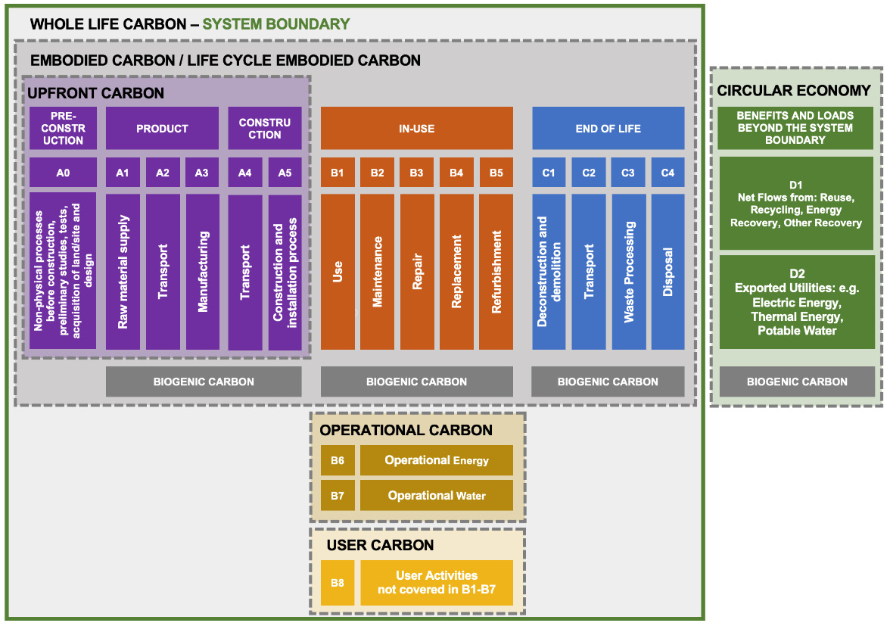
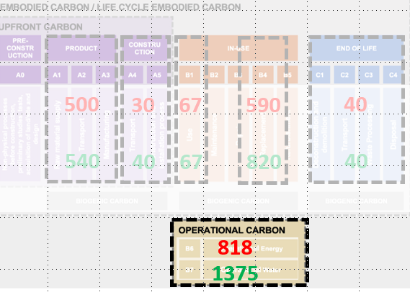
Office Building Benchmarking Life Cycle Carbon
Unit: % and KgCO₂e/M² (2050 Net Zero, Operation)
?
?
https://www.rics.org/content/dam/ricsglobal/documents/standards/Whole_life_carbon_assessment_PS_Sept23.pdf

Slide 42
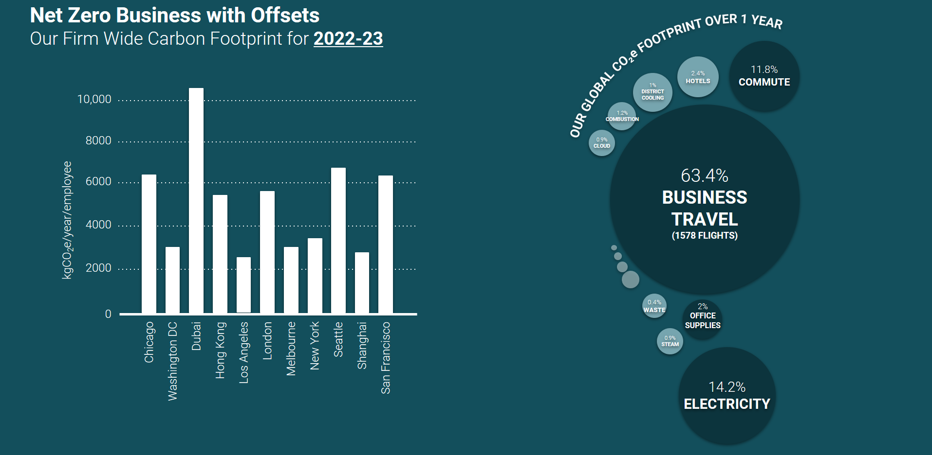

Our Own Firm Per Person Emissions
660 kgCO2e/person/year

Slide 43
Office Building Benchmarking Life Cycle Carbon
Unit: % and KgCO₂e/M² (2050 Net Zero, Operation)
1491
2485
https://www.rics.org/content/dam/ricsglobal/documents/standards/Whole_life_carbon_assessment_PS_Sept23.pdf

Slide 44
Office Building Benchmarking Life Cycle Carbon
Unit: % and KgCO₂e/M² (2050 Net Zero, Operation)
35%
29%
23%
25%
42%
46%
https://www.rics.org/content/dam/ricsglobal/documents/standards/Whole_life_carbon_assessment_PS_Sept23.pdf

Slide 45
An All-Electric New Office Building in London
 | All electric office building | PRODUCTS | CONSTRUCTION | USE |  | END OF LIFE | EMISSIONS | BEYOND LIFE
 |  | A1-A3 | A4-A5 | B1-B5 | B6-B7 | C | kgCO2e/m2 | D
BUILDING LAYERS | Structure Substructure and superstructure | 392 | 11 | 0 |  | 5 | 408 | -107
 | Skin Façade | 59 | 1 | 59 |  | 0.6 | 120 | -33
 | Space plan Partitions and internal finishes | 51 | 2 | 53 |  | 0.9 | 107 | -7
 | Services Building services, energy and water use | 120 | 1 | 240 | 620 | 1.3 | 981 | -60
 | Site emissions Waste, electricity and fuel |  | 30 |  |  |  | 30
 | Building carbon emissions Embodied and operational | 623 | 44 | 352 | 620 | 8 | 1,647 | -208

Slide 46
An All-Electric New Office Building in London
 | Residential timber tower Amsterdam, NL | PRODUCTS | CONSTRUCTION | USE |  | END OF LIFE | EMISSIONS | BEYOND LIFE
 |  | A1-A3 | A4-A5 | B1-B5 | B6-B7 | C | kgCO2e/m2 | D
BUILDING LAYERS | Structure Substructure and superstructure | 225 | 9 | 9 |  | 14.4 | 257 | -105
 | Skin Façade | 51 | 1 | 51 |  | 1.4 | 104 | -37
 | Space plan Partitions and internal finishes | 28 | 1 | 16 |  | 0.7 | 47 | -4
 | Services Building services, energy and water use | 70 | 0 | 140 | 781 | 0.8 | 993 | -11
 | Stuff Fittings, furnishings and equipment (FF&E) | 3 |  | 7 |  |  | 10 | -2
 | Site emissions Waste, electricity and fuel |  | 30 |  |  |  | 30
 | Building carbon emissions Embodied and operational | 377 | 41 | 224 | 781 | 17 | 1,440

Slide 47
How to Apply Whole Life Decarbonization Strategies to New Buildings?

Slide 48
1
A pathway to building decarbonization…
Notes:
Building decarbonization measures can help guide decision making and generally include some of the following…

Slide 49
Optimize Building Envelope
Building envelope
optimize building orientation and geometry to reduce energy use and maximize solar potential
Notes:
Let's start with the building envelope
For operational carbon, we need to optimize building orientation and geometry to reduce energy use and maximize solar potential
This lowers the required energy to heat and cool and requires smaller systems, lowering the embodied carbon in the mechanical and electrical systems.

Slide 50
Optimize Building Envelope
Material and Energy Efficiency
Material and Energy efficiency
will continue to remain #1 in the loading order of measures
Notes:
I can't over emphasize the importance of energy efficiency measures
This improves the economics of the other decarbonization measures
This could include using a mix of passive design, efficient heat pumps, and district energy systems.
Other important energy efficiency upgrades include measurement tools to provide insight into energy use, and software to optimize energy use.
We should never forget that healthy indoor environments must be maintained or improved while we implement efficiency measures.

Slide 51
Optimize Building Envelope
Material and Energy Efficiency
Waste Energy
Utilize waste energy
optimize waste energy streams to reduce energy and water use
Notes:
Utilizing waste energy from buildings will become much more important.
Waste heat recovery is also more cost effective when comparing against electric heating systems.
Air to water HPs are still roughly 6X the initial cost of a condensing boiler.
These economics change all our previous knowledge about what is cost-effective in our climate zones as we decarbonize.
Current waste energy streams that we can use could be from chillers to atmosphere or even exhaust air to atmosphere.
By utilizing this energy with heat pumps or heat recovery chillers to heat spaces and domestic hot water we can improve building efficiency and reduce carbon emissions.

Slide 52
Optimize Building Envelope
Material and Energy Efficiency
Waste Energy
Embodied carbon
review options to reduce embodied carbon with entire life cycle carbon in mind
Embodied Carbon
Notes:
As I have stated, Embodied carbon will need to be reduced.
There are great resources in the marketplace (RMI Reducing Embodied Carbon in Buildings: Low-Cost, High-Value Opportunities)
on how to significantly reduce embodied carbon in building superstructures at little to no up-front cost.
Current practice indicates that we can achieve these reductions by specifying and substituting material alternatives with lower embodied carbon during the design and specification process.
This will require information, typically in the form of EPDs, from manufacturers to understand the embodied carbon in their products.
Renovating an existing building vs tearing it down and building new can save 50-75% of the upfront embodied carbon.

Slide 53
Optimize Building Envelope
Material and Energy Efficiency
Waste Energy
Electrify loads
this step is to use low carbon energy for heating, service water heating, and cooking
Embodied Carbon
Electrify Loads
Notes:
Electrification can help decarbonize the buildings sector if the power sector is ultimately able to decarbonize as well.
Heat pumps are an option for replacing oil or natural gas-based space heating and service water heating systems with those using electricity.
Because they use electricity, their GHG impact depends on the carbon intensity of the grid.
Almost 180 million heat pumps were used for heating in 2020, as the global stock increased nearly 10% per year over the past 5 years.
Heat pumps have become the most common technology in newly built houses in many countries, but still only meet 7% of global building heating demand. In the IEA Net Zero Emissions by 2050 Scenario, the installed heat pump stock needs to triple by 2030.

Slide 54
Optimize Building Envelope
Material and Energy Efficiency
Low GWP refrigerants
lower GWP, reduce fugitive emissions, and maintain efficiency
Waste Energy
Embodied Carbon
Electrify Loads
Low GWP Refrigerants
Notes:
We need to be careful about refrigerant leakage and the global warming potential of those refrigerants.
We can reduce refrigerant emissions by: reducing refrigerant need, using low GWP refrigerants, mitigating leakage, and improving refrigerant recovery.
California is required to reduce HFC emissions 40 percent below 2013 levels by 2030 under Senate Bill 1383.
These provisions have started to phase in this year.
The state of Washington followed with HB 1050.
The bill mandates that refrigerants used in new air conditioning equipment must have a GWP no higher than 750,
and refrigerants used in new refrigeration systems with more than 50lbs of refrigerant must have a GWP no more than 150.
Implementation dates are 2023-2026

Slide 55
Optimize Building Envelope
Material and Energy Efficiency
Demand side management
software systems integrated into buildings can help coordinate supply and demand and shift energy use
Waste Energy
Embodied Carbon
Electrify Loads
Low GWP Refrigerants
Demand Side Management
Notes:
As I illustrated earlier, Demand Side Management will be important in our buildings.
Control systems integrated into buildings can help coordinate supply and demand and shift energy use.
Demand-side management systems can help save costs by optimizing use for when and where it is most needed,
but they can also drive decarbonization by shifting energy use to times of the day when zero-carbon energy is highest in the grid mix.
Buildings also have an inherent ability to store heat, which is called thermal mass, and technologies are emerging that can take advantage
of this property to balance out heating and cooling to lower costs and shift power demand away from peak time periods.

Slide 56
Optimize Building Envelope
Material and Energy Efficiency
Waste Energy
Carbon free energy
Utilize on- or off-site carbon free energy
Embodied Carbon
Electrify Loads
Low GWP Refrigerants
Demand Side Management
Carbon Free Energy
Notes:
Rounding out my short list of eight key measures is carbon free energy.
As I stated earlier, our buildings will need to move towards the availability of 24/7 carbon free energy
Most of this would come from on-site and off-site renewable energy or zero carbon energy from the electric grid.
Green hydrogen may also be required in some instances.
This last one may be one of the most challenging items, since the solution will also need to provide reliable & affordable energy throughout the world.

Slide 57


Center of Excellence for Building Decarbonization (CEBD)
Four Key Areas
Focused on strategy, thought leadership, industry collaboration, and public advocacy related to building decarbonization
Works with the ASHRAE councils to deliver projects
Technology
Education
Research
Standards

Slide 58
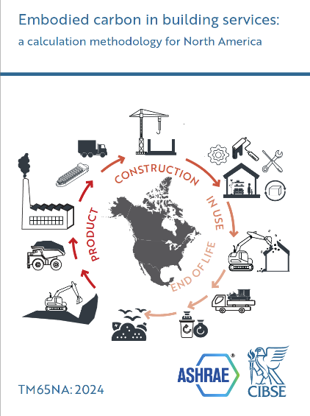
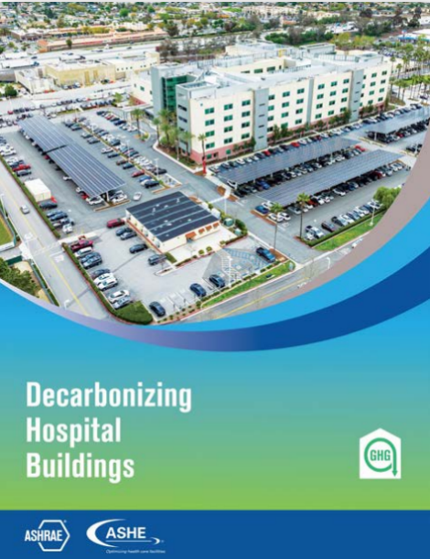
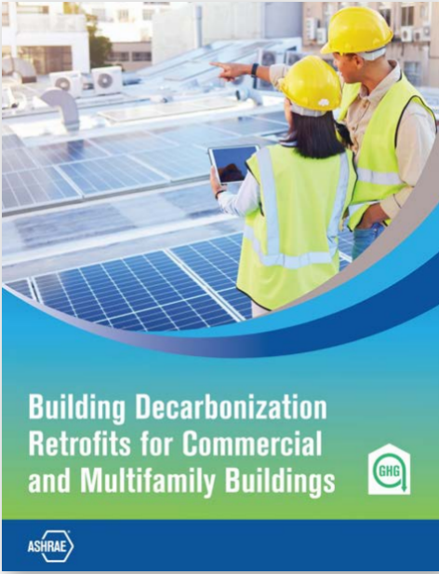


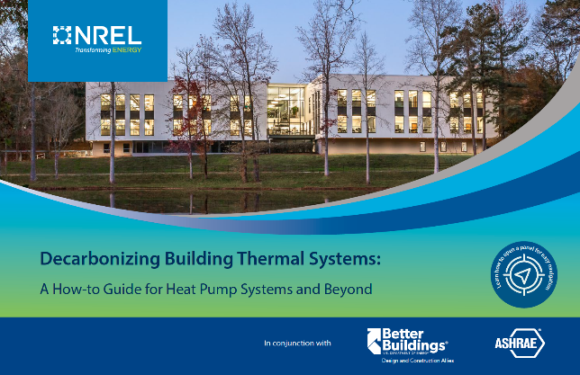
ASHRAE Published Decarbonization Guides

Slide 59

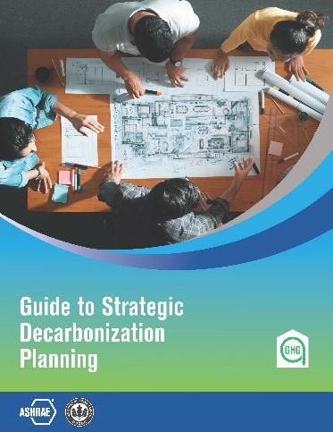

ASHRAE Decarbonization Guides COMING IN 2025!
Expanded Version 2

Slide 60


Thank You

