Slide 1
Federal Outreach Program
Advocating to State and District Congressional Offices

Slide 2
Congressional State/District Offices
U.S. Members of Congress have multiple offices in their District or State.
There are 435 House members and 100 Senators.
Reaching out at the state and local levels can provide additional opportunities for outreach.
State and District offices have staff that focus on constituent services. This includes:
Helping constituents accelerate through bureaucratic red tape (social security, veteran benefits, immigration etc.);
Working with state and local organizations;
Responding to local/state issues and constituent comments; and
Building relationship with constituents through community outreach and events.

Slide 3
Planning a Meeting
Find your U.S. House Representative or Senators
www.house.gov/representatives/find-your-representative
All you need to provide is your zip code
Review the Congressional Schedule
Try to schedule meetings when the House and/or Senate are not in session.
Members of Congress are generally back home in the District or State during those times.
Aim for a member-level meetings by reaching out in advance to their staff or scheduler.
Contact your Regional GAC Chair and ASHRAE’s Government Affairs Staff
They can help guide you through the process and provide materials and hand-outs for your meetings.
Contact: Govaffairs@ashrae.org

Slide 4
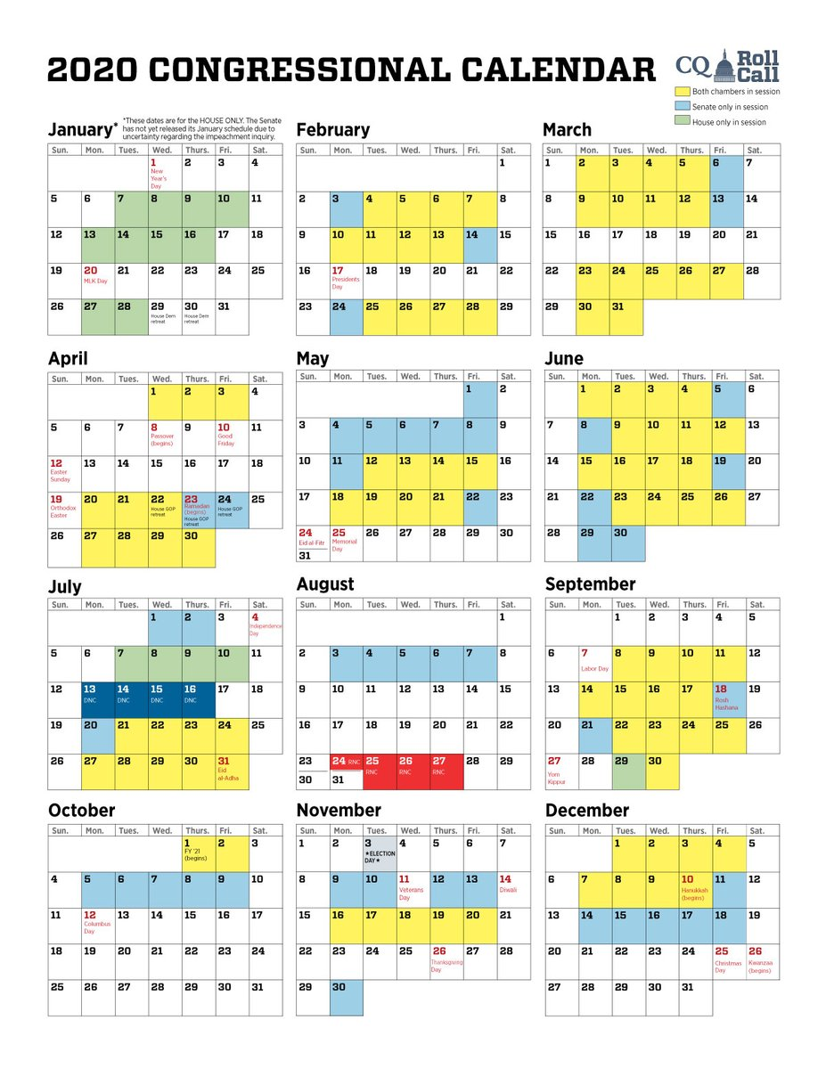
Congressional Schedule
Source: Roll Call

Slide 5
Preparing for the Meeting
Do your Research:
Has this member of Congress supported or opposed legislation that has affected ASHRAE?
Do they serve on Committees and Subcommittees relevant to ASHRAE’s mission?
House Energy and Commerce
House Transportation and Infrastructure
Senate Energy and Natural Resources
Senate Environment and Public Works
Senate Homeland Security and Governmental Affairs
Meeting participants should discuss prior to the meeting:
The Agenda
The Handouts and Packets
Reach out to ASHRAE Government Affairs staff for assistance!
Who will lead the meeting or specific portions of the Agenda:
It is important to make these assignments to keep the group on message and organized.
All participants should introduce themselves and chime in when necessary.

Slide 6
How to Conduct a Meeting
A typical Agenda includes:
Introduction to ASHRAE
Overview of ASHRAE services and membership
It is particularly important to let them know how many ASHRAE members are located in their State or District
Specific Messaging
Identify yourself and what you do
Speak about local issues
“Asks”
Make sure they know why you are meeting with them and the expertise ASHRAE members can provide.
Check out the ASHRAE Government Affairs website and learn whether there are any recent Congressional letters that ASHRAE has sent.
Q & A and Conclusion
Allow time for the staffer to ask questions.
If you don’t have an answer, don’t make up something; tell them you will get back to them. ASHRAE’s Government Affairs staff can help you get an answer.

Slide 7
Introducing ASHRAE
Every meeting should begin with an introduction of ASHRAE. It should include:
ASHRAE, founded in 1894, is a global society advancing human well-being through sustainable technology for the built environment.
The Society and its more than 56,000 members worldwide focus on building systems, energy efficiency, indoor air quality, refrigeration and sustainability.
Through research, standards writing, publishing, certification and continuing education, ASHRAE shapes tomorrow’s built environment today, and collaborates with many organizations throughout the HVAC&R industry.
Additionally, the Society focuses on public safety and health concerns and provides guidance for a safe environment during extraordinary events.

Slide 8
What to Emphasize
ASHRAE members are volunteers, and experts in their fields.
Talk about the different professions within ASHRAE to show it’s a diverse organization.
Highlight the importance of having an organization like ASHRAE and the need for consensus based standards, certification, and research.
Discuss ASHRAE’s other projects with allies/partners (DOE, NIST, USGBC, HPBC, etc.)
AEDGs, studies, outreach, and research.
IgCC Powered by 189.1

Slide 9
Messaging and Asks
Specific Messaging - Know your Audience
They will want to know:
How many members are in that district, chapter or state?
How many employees work at your company?
Tell them about how ASHRAE has over 330 student Branches
Provide information regarding involvement with nearby universities
Discuss local issues/events:
Are there issues with legionella, air quality, etc.?
Are you hosting a chapter meeting soon or an event at a local school or business?

Slide 10
Messaging and Asks
Ask them to:
Recognize ASHRAE as a resource.
Support ASHRAE’s advocacy efforts
Make sure you ask the elected/appointed official or their staff person to consider ASHRAE’s position on any future legislation impacting our industry.
To plan an event with ASHRAE, such as:
Panels;
Events at schools such as STEM Scouts; and
Address a Chapter meeting.

Slide 11
Additional Meeting Topics
ASHRAE Research
Research at local or Federal institutions (as applicable)
Example: ASHRAE-AHRI-US DOE Refrigerant Research (provided $1.3M of $5.6M in funds)
Research project in region or state
Opportunities to partner with ASHRAE on Educational STEM Activities
Engineers Week (Girl Day, STEM, Jobs in Industry, etc.)
K-12 STEM Activities
Scholarships (National & Local)
WISE Internship Program
Public Safety
Legionella - Risk Management for Building Water Systems
Refrigerant safety
Energy Efficiency
ASHRAE Standard 90.1
Advanced energy codes: ASHRAE Standard 189.1
Energy Star, Building EQ / Benchmarking & Disclosure
Standardization of Next Step after Energy Star Portfolio Manager
Provides actionable recommendations to improve energy performance

Slide 12
Tips to Keep in Mind
Make a Connection
Introduce yourself and mention any connections with the Member or staffer of which you are aware (e.g., you went to the same school; the Member’s brother is your dentist; you have mutual friends, personal, professional, or political).
Become an Advisor
Understand staffers are a “mile-wide and an inch deep” on complex public policy matters.
Establish personal credibility that will lead to a continuing discussion.
Be concise and not too detailed.
Don’t be afraid to articulate the debate.
Come back to the big picture.
Talk about ASHRAE and what you do each day
Be Memorable for being Friendly

Slide 13
After the Meeting
Debrief with meeting participants and coordinate next actions.
Follow-up and send an update to appropriate ASHRAE Government Affairs staff and ASHRAE members (GAC RVC, Chapter President, DRC).
Send a Thank You Note to the Congressional staff or Member of Congress
Thank them for their time.
Send follow up materials.
And re-emphasize ASHRAE’s mission and your “asks.”

Slide 14
Information and Support Provided
GAC Staff Support - We now have a full team, and we hope to serve you better!
Alice Yates, Director
Jeremy Pollack, Manager of Federal Government Affairs
Patricia Ryan, Office Manager
Review the most recent bi-weekly Government Affairs Updates
Contact ASHRAE Staff for packet materials and additional talking points

Slide 15
Questions?
Contact: Govaffairs@ashrae.org

