Slide 1
Government Affairs Committee
Region __ CRC Training

Slide 2
Background
ASHRAE’s Government Affairs Mission Statement:
To establish ASHRAE as a leading source for expertise in the built environment and a resource for policy-makers in the development of legislation and regulations affecting the public, the HVAC&R community, and the engineering profession.
GAC Responsibilities:
The Government Affairs Committee shall be responsible for organizing ASHRAE members to influence and educate government officials in areas of interest to ASHRAE members.
Notes:
- this may be at chapter level to influence and educate local, state, provincial officials. As well national government officials in areas of interest to ASHRAE members, in order to better coordinate efforts and understanding between ASHRAE members and government.
- as well as being responsible for developing the extent and the manner in which ASHRAE implements and pursues actions to influence government affairs and public policy.

Slide 3
Society GAC Society Structure
Six Standing Subcommittees
Executive
Policy and Programs
Member Mobilization
Global Affairs
Rules
Nominating
Members assigned to Subcommittees by Chair, and per direction in the MOP
Members
Voting Members
Chair
Vice Chair
Communications Coordinator
15 Regional Vice-Chairs
4 At-Large Members
1 Representative from each Council
Non-Voting Members
Society Treasurer (Coordinating Officer)
Board Ex Officio
Staff of the Govt Affairs Office

Slide 4
Government Outreach
Why is it important?
Builds connections
Provides important technical information to government officials to aid in decision-making
Raises awareness of issues of concern to ASHRAE
Reinforces that ASHRAE is the “go-to” organization when issues arise concerning the built environment

Slide 5
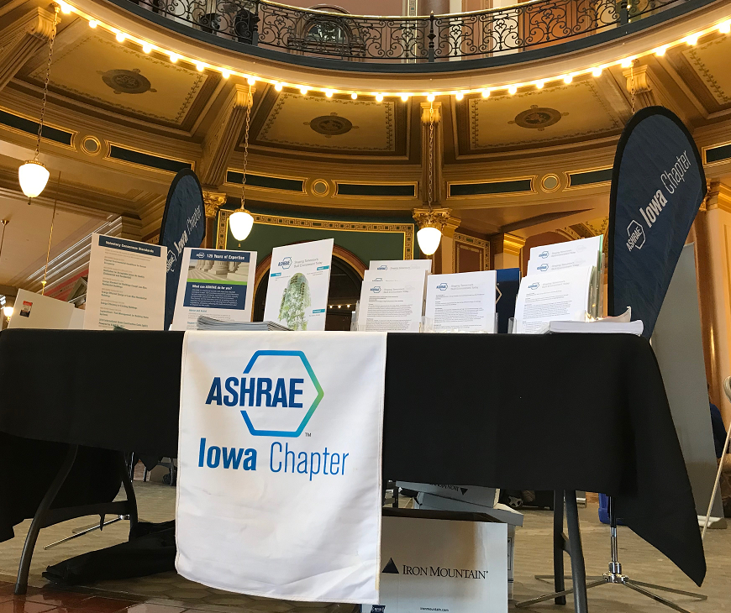
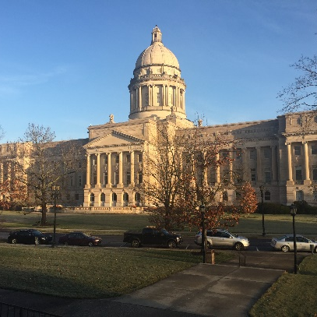
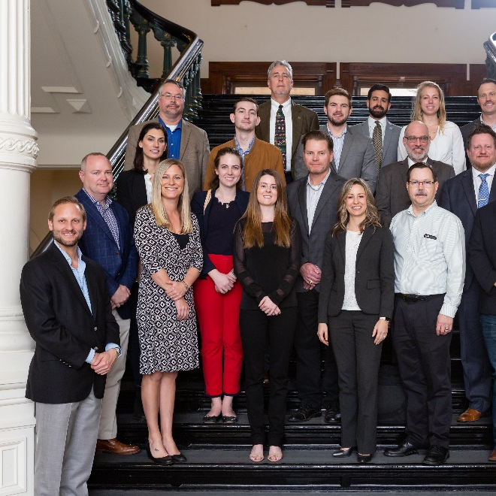
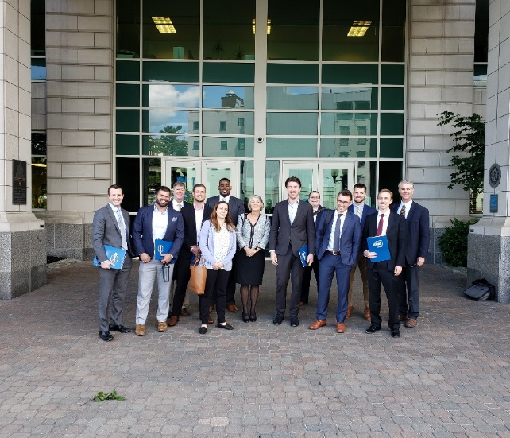
Key Activities of GAC
Develop annually a list of Public Policy Priorities (PPP)
Act to implement PPPs at all levels of government
Communicate internally and externally regarding policy matters: Government Outreach Days!
Develop capacity of ASHRAE to be effective at all levels of government and across all Regions
Develop and maintain important relationships in partnership with staff

Slide 6
Chapter Chair Responsibilities
Inform chapter members about government issues and activities
Provide information to local, provincial and state government entities on technical issues
Seek the appointment of chapter members to local, provincial and state governmental bodies
Provide tools to train and enable chapter members to have positive interactions with government entities in their communities, and in the use of Society documents to advance the Society’s Public Policy Priorities.
Maintain a list of all elected officials, government employees and code officials in the jurisdictions within the chapter’s geographical boundaries
Report PAOE points earned in accomplishing the committee’s goals
Tracking government adoptions of ASHRAE standards, guidelines, and positions
Keep your RVC, and Govt. Affairs Staff informed of any government activities
Key activity: GOVERNMENT OUTREACH DAYS!
Review Section 2.5 of the MCO
Notes:
- Serve as a conduit to keep their chapter leaders, RVC, and the Government Affairs Office staff informed on local governmental activities of interest to ASHRAE
- Work with the chapter to keep governments updated on technical issues
- Inform the chapter members of government issues
- Seek the appointment of chapter members to local, provincial and state governmental bodies
- Maintain a list of all elected officials in the jurisdictions within the chapter’s geographical boundaries
- Maintain a list of appointed or hired government employees who have a role in the enforcement or adoption of local codes or standards relevant to the building sciences.
- Provide tools to train and enable chapter members to effect positive interactions with government entities in their communities
- Be the liaison for chapter members with educational, advocacy and programs-related groups within ASHRAE
- Serving as a clearinghouse of grassroots government adoptions of ASHRAE-endorsed standards, guidelines, and positions

Slide 7
Planning a Government Outreach Event
Where to start?
Contact your GAC RVC and ASHRAE’s Government Affairs Staff.
They can help guide you through the process and provide materials and hand-outs for your event or meetings. You can email GovAffairs@ashrae.org to get started today!
Decide on the best strategy to make an impact. Events in the past have included:
Meetings with National, State/Provincial or Local government officials.
Hosting an event for a particular issue or day (e.g., World Standards Day, World Refrigeration Day, etc.) and inviting policymakers or elected officials as speakers.
Speaking at local, regional, OR national hearings or meeting.
Reach out to your fellow ASHRAE chapter members and (if relevant) other local ASHRAE chapters to help coordinate, schedule, and participate in outreach activities.

Slide 8
Planning and Reporting
The Government Affairs Department can provide:
State Legislators and staff contact lists
Day of Meeting materials
Information for any state specific fact sheets
The event organizer needs to provide to their RVC and the Government Affairs Office:
A Preliminary Plan for the Event.
This should be at least Two Months in Advance (Planning 4 months in advance is recommended)
Final Details regarding Event
This should be 3 Weeks in Advance.
If you're having a series of meetings, please send the number and type of visits
Name and Contact Information for Outreach Lead.
Advocacy Toolkits can be found on the ASHRAE Website!
Email GovAffairs@ashrae.org
to get started today!
Notes:
Staff Can Provide:
Pre-assembled packets of materials for sit-down meetings which include:
ASHRAE Flyer
ASHRAE Fact Sheet
Government Affairs Society Snapshot
Fact Sheets on Premier Standards (15, 55, 62.1, 62.2, 90.1, 100, 188, IgCC powered by 189.1)
A Subset of these Materials Provided for Drop-By Visits
Supplemental Materials Available as Appropriate for Specific Meeting Requirements
Advance Shipping to Location of Event (We will ship at least 5 business days in advance; we use 3-day ground FedEx for best shipping rate)

Slide 9
Planning a Meeting with State & Federal Legislators
Most state legislatures are NOT full time so legislative calendars should be checked to make sure they are still in session
Make sure to check with the legislative services office in advance to determine if/how to access individual offices, as they may be limited or restricted (i.e.: do you need an appointment to enter a legislator’s office?)
Target Committees that address energy/infrastructure issues and schedule appointments with those members
Encourage local volunteers to schedule meetings with their state or Federal legislators even if they are not on committees of interest
In all instances, remember that you are educating about ASHRAE and its technical resources and NOT lobbying
Notes:
CAROLINE

Slide 10
How to Conduct a Meeting
A typical Agenda includes:
Introduction to ASHRAE
Overview of ASHRAE services and membership
Tell them how many ASHRAE members are located in their State or District
Specific Messaging
Identify yourself and what you do
Speak about local issues
“Asks”
Make sure they know why you are meeting with them and the expertise ASHRAE members can provide.
Check out the ASHRAE Government Affairs website and learn whether there are any recent letters that ASHRAE has sent or testimony provided.
Q & A and Conclusion
Allow time for the staffer to ask questions.
If you don’t have an answer, don’t make up something; tell them you will get
back to them. ASHRAE’s Government Affairs staff can help you get an answer.

Slide 11
Tips to Keep in Mind
Make a Connection
Introduce yourself and mention any connections with the Member or staffer of which you are aware (e.g., you went to the same school; the Member’s brother is your dentist; you have mutual friends, personal, professional, or political).
Become an Advisor
Understand staffers are a “mile-wide and an inch deep” on complex public policy matters.
Establish personal credibility that will lead to a continuing discussion.
Be concise and not too detailed.
Share your technical knowledge.
Come back to the big picture.
Talk about ASHRAE and what you do each day
Be Memorable for being Friendly!

Slide 12
After the Meeting
Debrief with meeting participants and coordinate follow-up activities.
Send a Thank You Note
Thank them for their time.
Send follow up materials.
Re-emphasize ASHRAE’s mission and your “asks.”
Event Organizer Needs to Provide After the Event:
Return any unused materials to DC office unless follow-up visits are planned
Prompt Summary Report – Within One Week of Visit
A new form has been created by staff to make the reporting process uniform (emailed now by staff to organizer but soon to be online portal)
Include any photos taken (cell phone cameras and video are generally of a quality that we can accept but should be emailed as an attachment) Videos may be used for the year-end compilation!
Everything should be submitted electronically to GovAffairs@ashrae.org

Slide 13
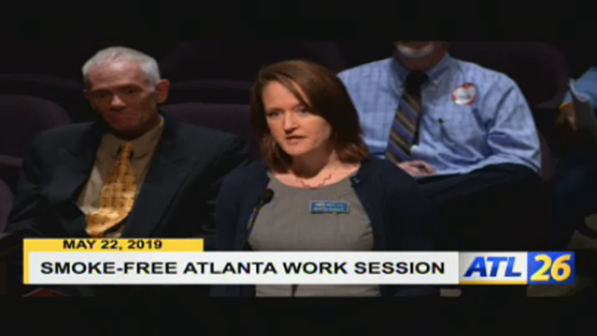
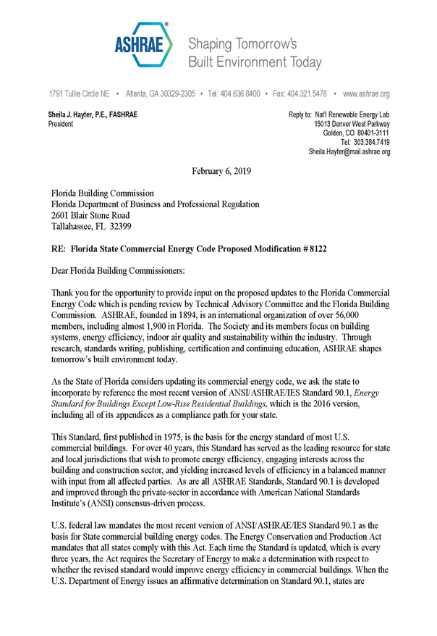
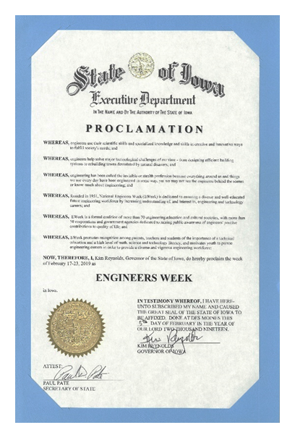
Other Types of Advocacy
Government Outreach should not end with your Government Outreach Day. Some other ways to advocate throughout the year are:
Letters related to GAC Public Policy Priorities
Testimony and Comments
Hearings and Public Forums
Work with your RVC and the ASHRAE Government Affairs Office if you are looking at any of these other advocacy options.
Notes:
Chapter Chairs should work with their RVC and the Government Affairs office to see what other sort of outreach might be appropriate and to assist in that outreach.

Slide 14
Limitations
Chapters, sections, and members may speak to technical or method of enforcement aspects of public policy only.
Must not support a political party or candidate
Chapters, sections, and members must not jeopardize chapter’s tax status (in the US).
Must not cause chapter, section, or member to exceed local, provincial or state limits regarding registration as “lobbyist” or “lobbying organization”
Chapters, sections, and members must not request or receive any travel or transportation reimbursement (as defined by ASHRAE Travel Policy)
Must not receive any reimbursement for time away from regular employment, for activity
Notes:
ASHRAE approved document to assist with advocacy include:
Published Standards and Guidelines
Public Policy Issue Briefs
Position Documents
Standard Fact Sheets
All are available on ASHRAE website

Slide 15
“Lobbying” vs. “Advocacy”
In the simplest terms…
Lobbying
Advocacy

Slide 16
Staying Out of Trouble
Laws and regulations vary state to state, jurisdiction to jurisdiction, country to country, so consult your local laws no matter what
It is YOUR responsibility to know what can and can’t be done.
Convey the same to your chapter chairs
Limitations Outlined
ROB Section 2.433
MCO Section 2.6
GAC MOP
GAC Resource Manual
https://www.ashrae.org/government-affairs/grassroots-government-advocacy

Slide 17
2019 -2020 Public Policy Priorities
Building Performance Optimization
New Construction
Codes and Standards, and supporting resources – Adoption of Current Versions
Building Design Criteria (90.1, IgCC, AEDGs, etc.)
Performance based standards/Building EQ as designed
System approach to energy efficiency
Commissioning/ongoing-commissioning (Monitoring)
Existing Buildings
Codes and Standards
Benchmark/assessment and path to improvements
Building EQ
Re-Commissioning/retro-commissioning/ongoing-commissioning (Monitoring)
B. Public Safety
Legionella
Advocate use of Standard 188 and 514
Promote New Guideline (12-2000R)
Licensure issues
Response to efforts to implement MOE or to abolish engineering licensing boards
Refrigerant safety
Educate officials on updated Standards on flammable refrigerants in commercial/industrial settings
Resiliency
Identify ASHRAE resources and programs
Notes:
These are to be approved in Houston

Slide 18
2019 -2020 Public Policy Priorities
C. Indoor Environmental Quality (IEQ)
1. Building Design Criteria – Codes and Standards (62.1, 62.2, 55)
2. Airborne and Waterborne Hazards
3. Collaborate with other organizations
E. STEM and Workforce Development
1. STEM (Long term)
Liaison with student activities
Identify other organizations to work with (e.g., DOE, UNESCO, UNEP)
2. Workforce (Short term)
Communicate the need or shortage in training for operators and technicians
Improve awareness of ASHRAE training resources and certification
Training on Refrigerants (Refrigerant Driver’s License)
D. Residential
1.Codes and Standards (90.2, 55, 62.2, design guides)
Refrigerant Safety
Collaborate with other organization (UNEP, NFPA, ACCA, SMACNA, ASP, etc.)

Slide 19
Government Affairs Award
Established to recognize an individual who demonstrates outstanding efforts in the state, provincial, and local government on technical issues important to ASHRAE.
Recognition is in the form of a plaque for first place winners.
One awarded per year.
Schedule:
Submittals due to RVC for Regional competition Date Determined by RVC
RVC submits nominations to Society Staff September 30
GAC makes recommendation to H&A Committee Winter Meeting

Slide 20
Government Affairs PAOE – Administrative and Training
Points | Responsibility
50 Points | For establishing and maintaining a chapter Government Affairs Committee with at least 2 members to promote ASHRAE with state, provincial, and local government.
50 points (minimum of 1 hour of training; 100 points maximum) | For government affairs training for chapter officers and future leaders.

Slide 21
Government Affairs PAOE – Administrative and Training
Points | Responsibility
150 points | For establishing and annually updating a list of government officials (at any level of government relevant to buildings, engineering or construction, including building officials, school system facility staff, state energy code officials, etc.) along with their contact information. (List must be sent to RVC by December 15 or date assigned by RVC)

Slide 22
Government Affairs PAOE – Administrative and Training
Points | Responsibility
100 points; (no maximum) | For each Chapter Government Affairs Award entry into Society competition (each Award entry counted only once)
50 points; (no maximum) | For each Chapter Government Affairs entry into Regional competition (each Award entry counted only once)
50 points; (no maximum) | For each article on a government affairs activities-related (e.g. state provincial, or local legislative or regulatory issue) published in a chapter newsletter or posted on a chapter website with copy sent to RVC (maximum of two articles per month)

Slide 23
Government Affairs PAOE – Meetings, Presentations and Events
Points | Responsibility
100 points; (Max 1000) | For each announced and promoted or held joint chapter meeting with local, state, or provincial government entity to discuss a built environment or HVAC&R industry-related topic
50 – 100 points; (800 points maximum) | For each documented personal contact (meeting) by a chapter member with government officials (at any level of government relevant to buildings, engineering or construction, including building officials, school system facility staff, state energy code officials, etc.) with the goal of promoting ASHRAE related subjects or Chapter goals and objectives, with notification sent to the ASHRAE Government Affairs Office (Points doubled if the chapter promotes current or recently updated ASHRAE Standards, ASHRAE certifications or bEQ) (50 points for staff level meeting and 100 points for elected/appointed official meeting)
100 points; (no maximum) | For each National Engineers’ Week or non-US equivalent activity that promotes Engineering
100 points; (Max 600) | For promotion of ASHRAE certification programs with government officials, engineers, personal presentations, newsletters
50 points; (Max 50) | For maintaining a current listing of local and state Energy code(s) for entities within chapter area; include contacts for people managing the Energy Code(s)
50 points; (Max 100) | For each Chapter program on the topic of government activities (minimum 45 minute presentation; maximum 2)

Slide 24
Government Affairs PAOE – RVC Assigns or Enters
Points | Responsibility
300 points (Max: 300) | For a complete application submitted to the GAC for the Government Affairs Award
200 points | For the incoming Chapter GAC committee chair attending the GAC CRC workshop (50 points for chapter representative other than the chair who is a senior officer or member of GAC)
100 points | For chapter GAC chair continuing a second year as chair (200 points for an additional year with a cap of 300 points in one year)
100 points (Max 400) | For chapter submitting report(s) with local issues identified to RVC
50 points (Max 100) | For planning/goal setting session with RVC (points assigned by RVC by October 1 or 2 weeks after the CRC, whichever is later)
10 points (Max 200) | For chapter interaction with local or state government to advocate policy related to buildings, engineering or construction. The total points shall be determined by the RVC based on effort
10 points; (Max 100) | For achieving goals established in goal-setting session with RVC (points assigned by RVC by June 30)
10 points; (Max 100) | For each GAC meeting to promote using an Energy Code based on ASHRAE standards with Energy Code contacts; must report to RVC

Slide 25
Information and Support Provided
GAC Staff Support: GovAffairs@ashrae.org
Alice Yates, Director
Jeremy Pollack, Manager of Federal Government Affairs
Caroline Sevier, Manager of State and Local Government Affairs
Patricia Ryan, Office Manager
Be sure to sign up for the bi-weekly Government Affairs Update

Slide 26
Questions?

