Slide 1
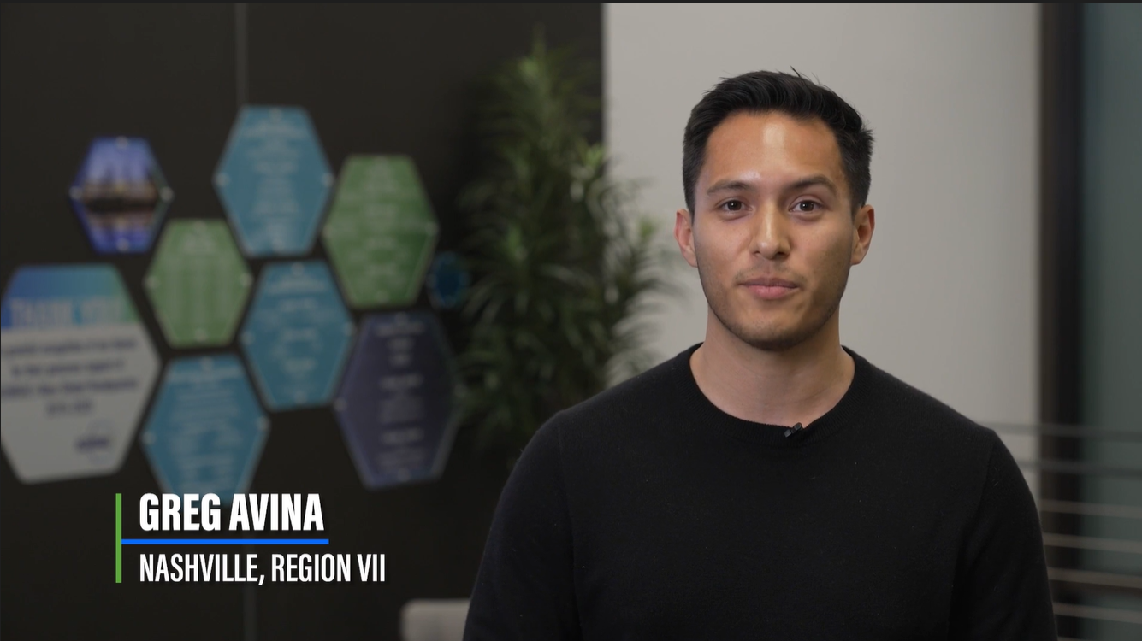
Empowering Our Workforce: Building a Sustainable Future
How can our industry recruit and retain more people?
One career conversation at a time, starting with you!
Introduce yourself, with job title and a summary.
Inspire them to grow within the HVAC&R industry.
Invite them to learn more and exchange information.
Find inspiration from Career Conversations videos
and more tools at ashrae.org/president
Notes:
The 2024-25 Society theme as introduced by Society President, Dennis Knight, is "Empowering Our Workforce: Building a Sustainable Future".
To meet the challenges we’ve accepted, our industry needs a broad range of diverse people to choose careers alongside us.
How can we recruit and retain more people? One conversation at a time, starting with you!

