Slide 1
Ginger Scoggins, P.E., Fellow ASHRAE
2023-24 ASHRAE President

Slide 3
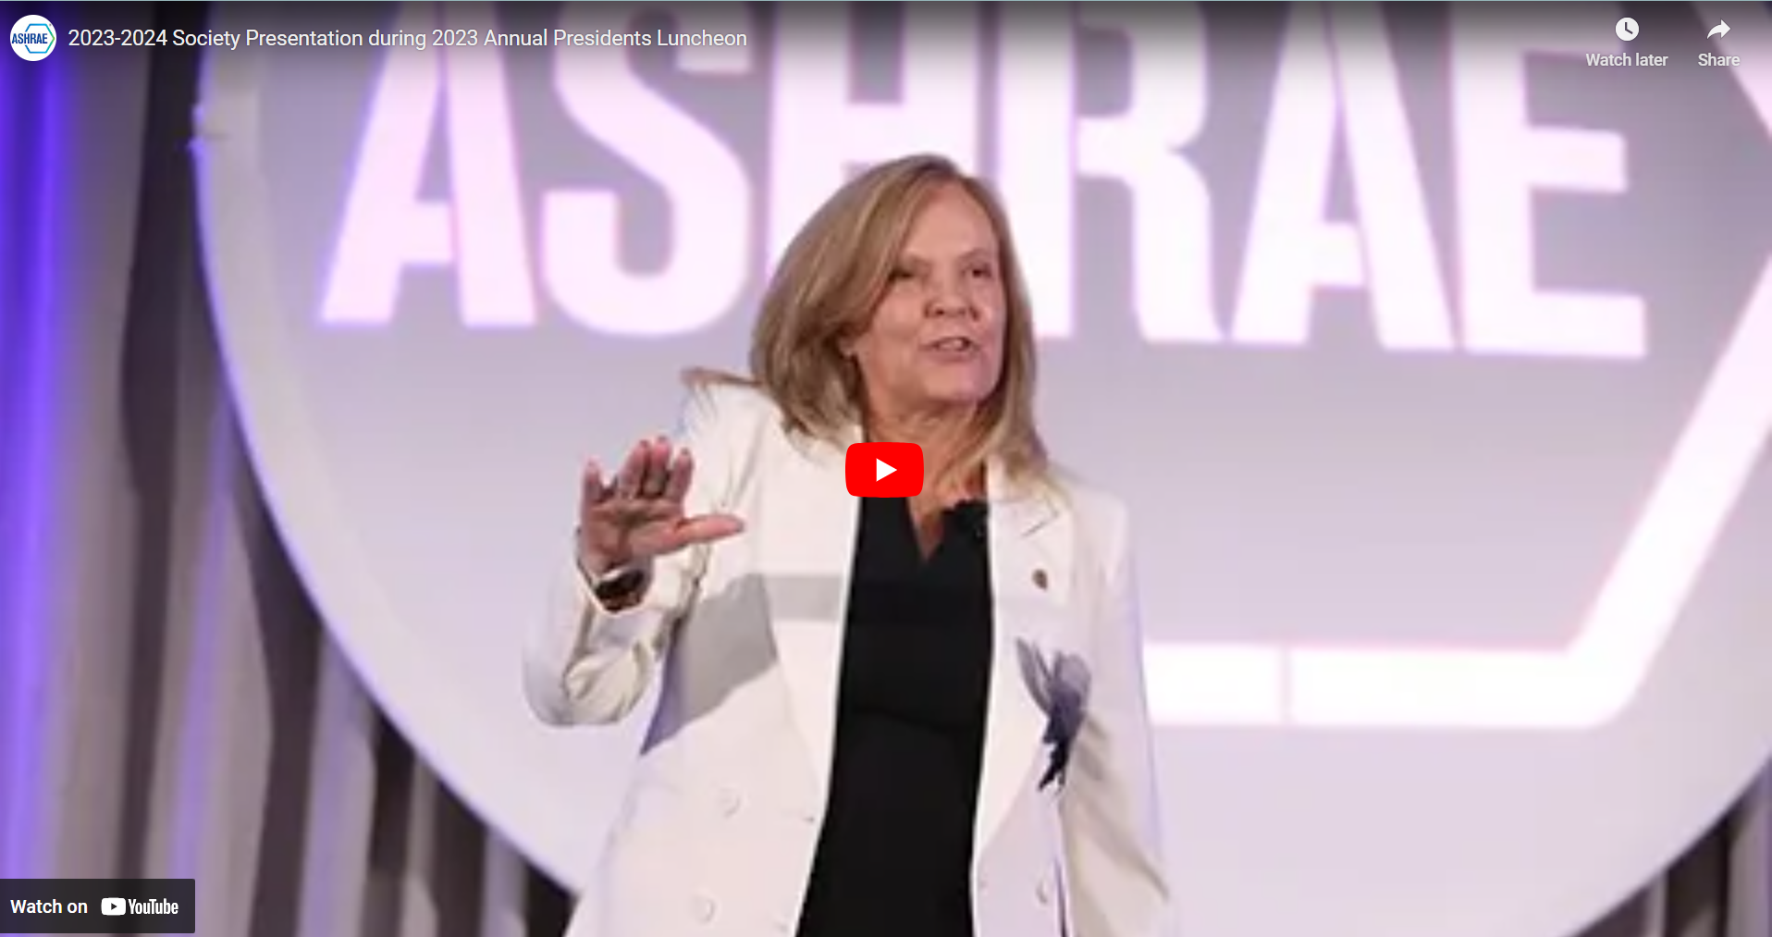
Challenge Accepted!
“Through human ingenuity and determination, we can find solutions to the global climate crisis. As ASHRAE volunteers, this is what we do! We accept challenges and we solve problems!”
Notes:
Listen to this quote: “Through human ingenuity and determination, we can find solutions to the global climate crisis. As ASHRAE volunteers, this is what we do! We accept challenges and we solve problems!”
This is a direct quote taken from my inaugural presidential address seven months ago, and since that time we have built on that declaration to be a collective body of problem solvers in tackling the global climate crisis. As you just saw in the opening video as well as your response to the Decarb Challenge Fund, ASHRAE regions and chapters have shown exemplary commitment not only to understanding how climate change affects building planning, design, construction and operation, but they have volunteered IMMENSE time and expertise to develop resources to support actionable, wide-scale building decarbonization practices.

Slide 4
EQUIP
Knowledge Tools
EXPAND
Efforts in design, Being cognizant
of all impacts
PROVIDE
Leadership, Resources
And Advocacy
Notes:
Our pursuit to action in tackling this challenge remains steadfast. If you recall from my last address, ASHRAE is committed to the following efforts:
Equipping our members with the necessary knowledge and tools to design resilient new and renovated buildings, enabling them to effectively address the impact of the built environment on climate change.
Expanding our endeavors in designing energy-efficient buildings by conscientiously considering all aspects of carbon reduction, including embodied carbon, refrigerant use and reduction, and end-of-life carbon.
and
Providing impactful leadership, taking decisive action, providing resources, and advocating for the global built environment in response to the challenges posed by the climate crisis.
ASHRAE has accepted these challenges head-on and today, during this moment together, I’m delighted to report on some of the accomplishments we’ve made since our last meeting.

Slide 5
Chapter Regional Conferences
Region II | London, Canada
Notes:
I witnessed our “Challenge Accepted” message in action through my travels as president and I’ve met with members from around the world at CRCs and Chapter visits.
I’m happy to say that after visiting eight of our CRCs, including those held in the Spring of 2023, that our carbon reduction message has been received and action has been taken. Here are some examples:
At the Region 2 CRC in London, Ontario, Canada, motions were passed to encourage members to find ways to carpool or share transportation to the CRC event.
At the Region 9 CRC in Denver, Colorado, members were encouraged to take mass transit from the airport to the CRC by simply providing extra drink tickets to their social event … and over 80% of the CRC attendees participated.
The Region 14 CRC in Galway, Ireland was combined with an Energy Summit for maximum effect and travel reduction.

Slide 6
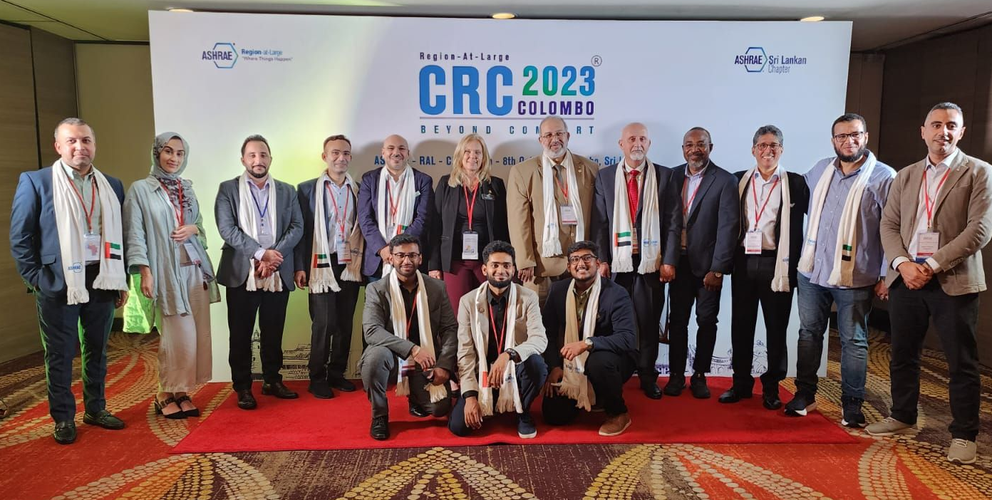
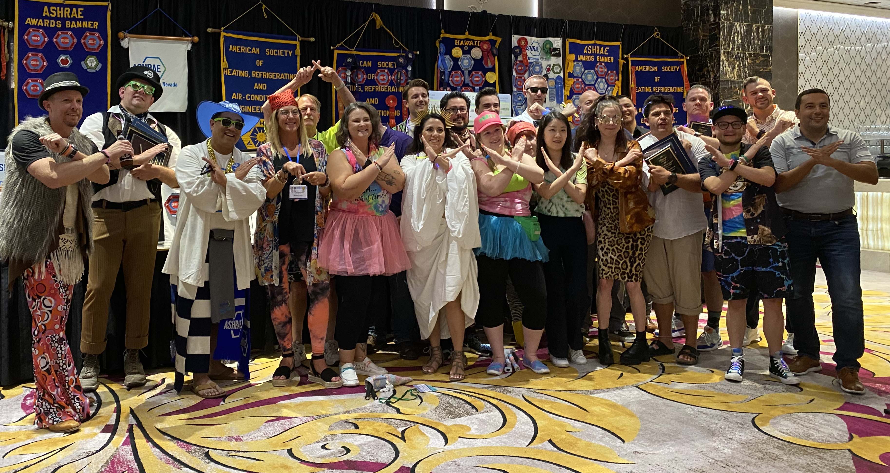
Chapter Regional Conferences
Region at Large | Colombo, Sri Lanka
Region X | Reno, Nevada
Notes:
During the Region-At-Large CRC in Sri Lanka, a motion was passed to reduce the amount of meat served at Society meetings.
and
Region 10 in Reno, Nevada not to be outdone, they promised offsets for all travel by all regional officers for this entire Society year.
These efforts and many more like them have helped ASHRAE “walk-the talk” of helping to reduce climate emissions thru our activities and to spread the word that even small efforts can make a difference.

Slide 7
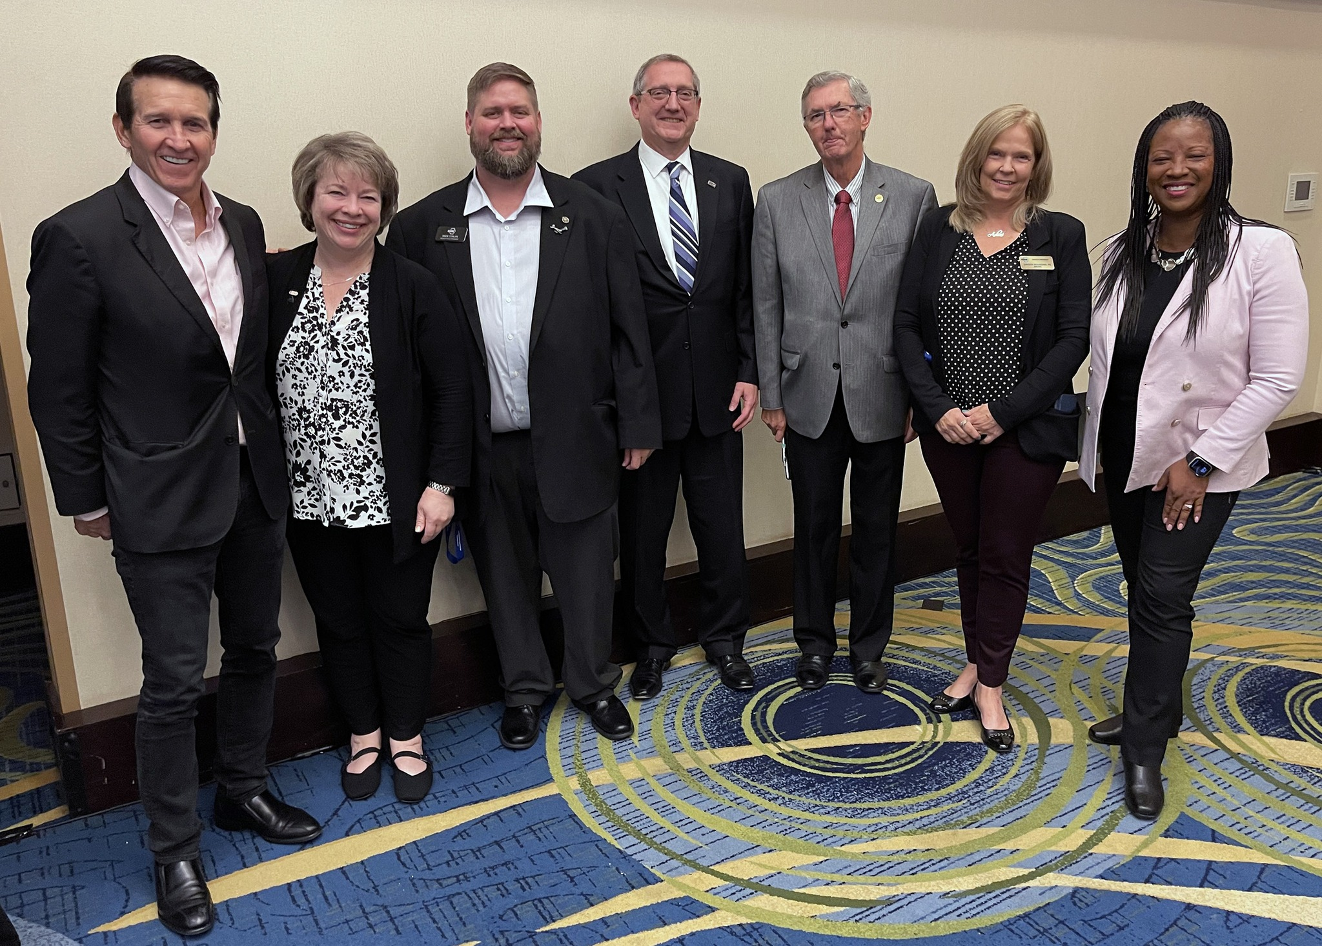
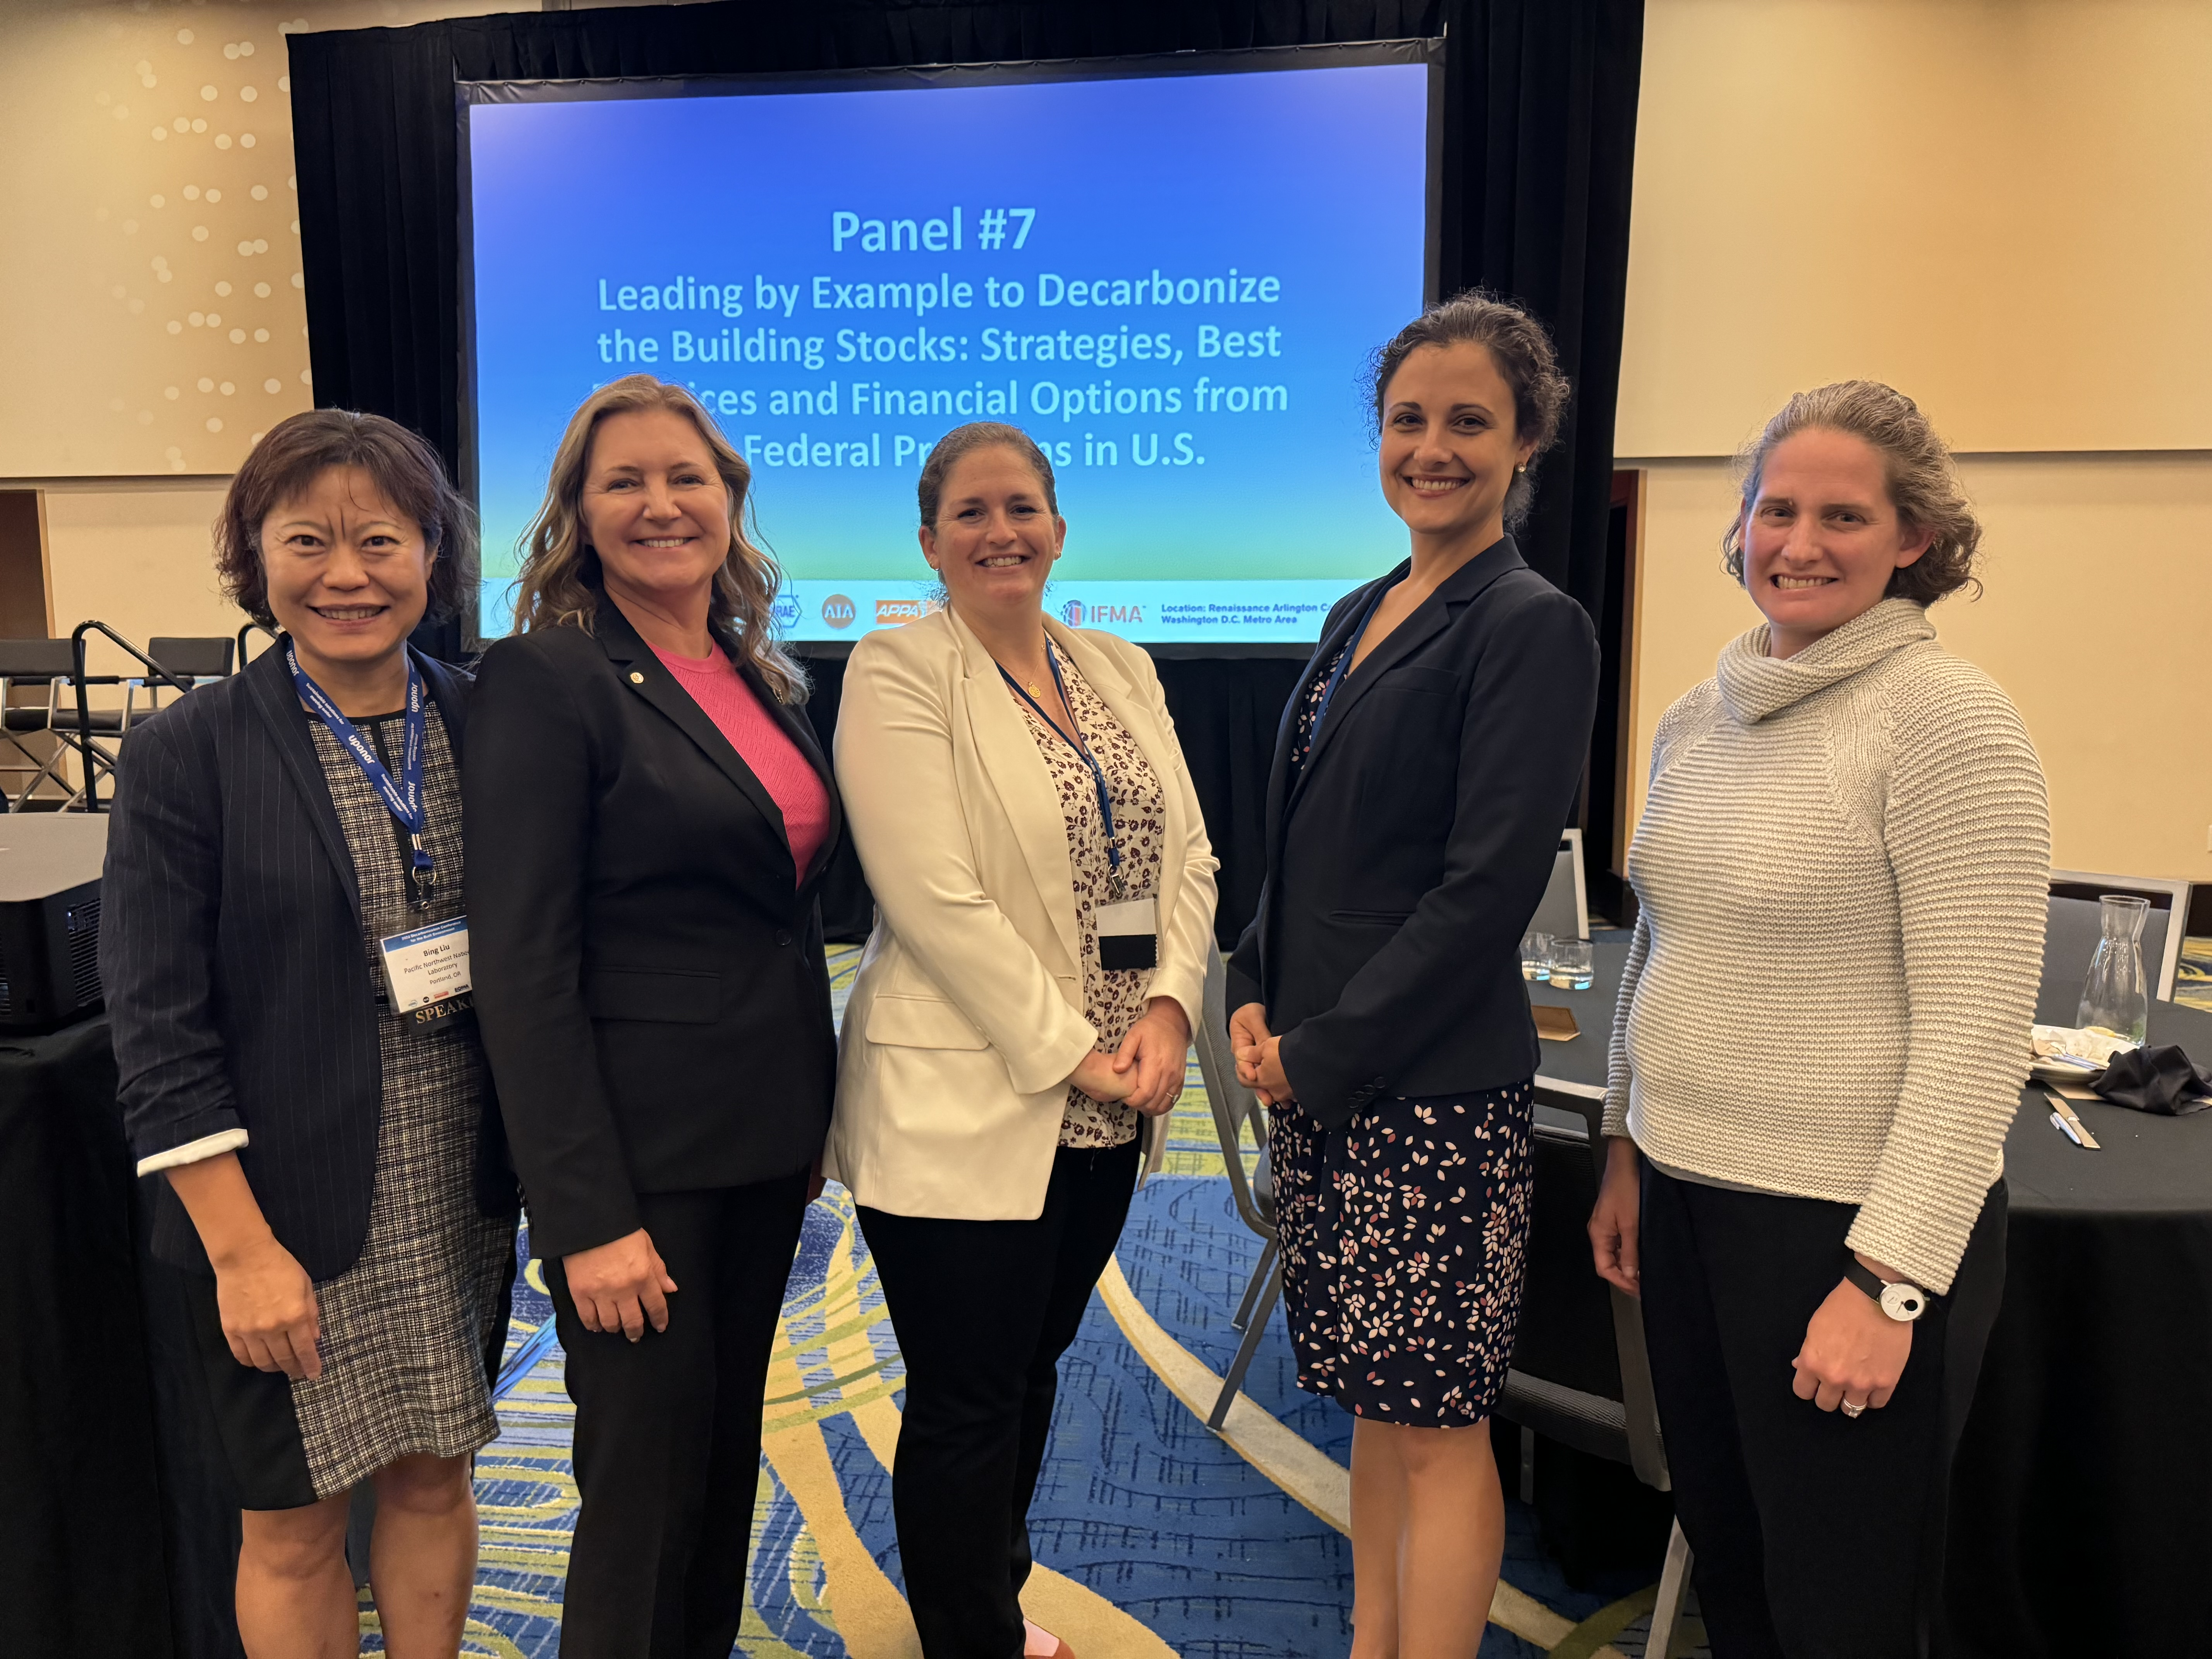
Decarbonization Conferences
2024 Building Decarbonization Conference | Washington D.C.
Notes:
This year also marked a significant milestone for us as ASHRAE, along with four industry partnering organizations, hosted our first decarbonization conference in the United States. The 2023 Decarbonization Conference for the Built Environment drew a very enthusiastic, SOLD OUT crowd of over 450 attendees, representing 10 countries. The event buzzed with energy and excitement as professionals from diverse backgrounds in the building industry came together to engage in productive discussions on measures and metrics, our role in decarbonization, as well as current and future governmental policies and regulations that buildings professionals need to be aware of to address environmentally conscious building requirements. The conference provided a constructive platform for sharing successes and addressing challenges related to the critical mission of reducing the carbon footprint of buildings.
Special thanks to The American Institute of Architects, the International Facility Management Association, APPA and the Building Owners and Managers Association for helping to make the conference a huge success.

Slide 8
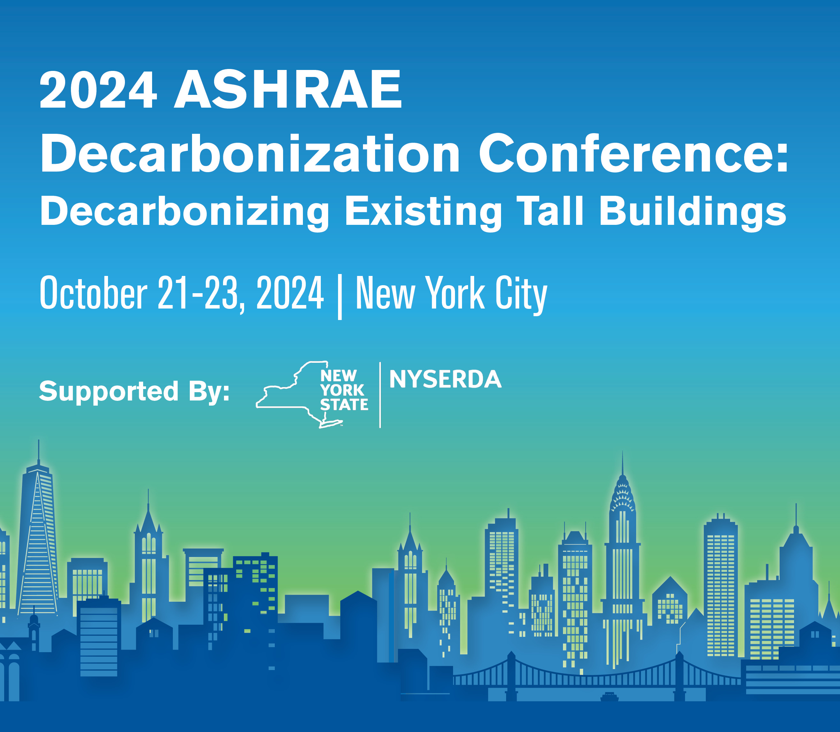
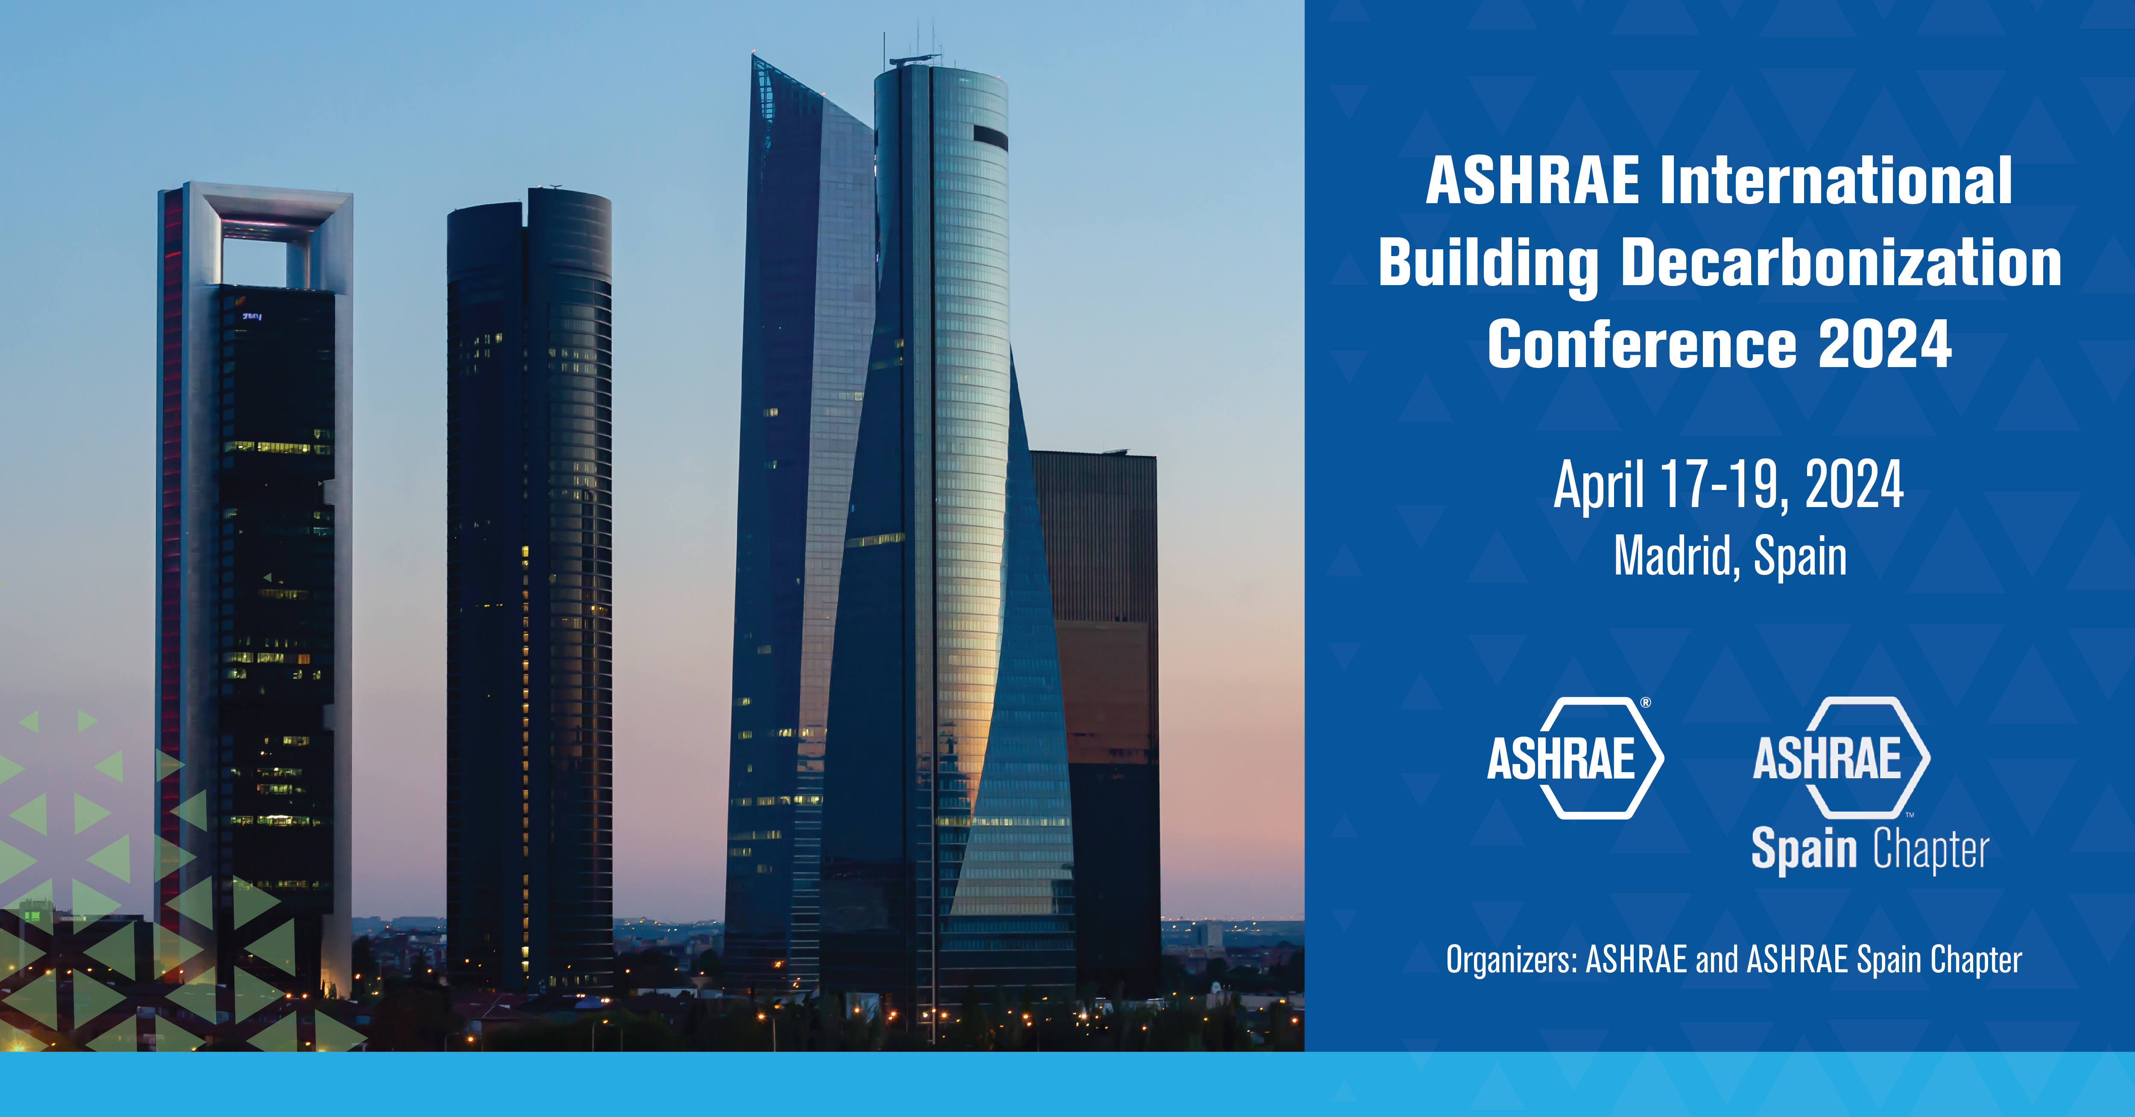
Notes:
In addition to the sold out decarbonization conference in DC, we now have two more conferences focusing on decarbonization in the works – The 2024 ASHRAE International Conference on Building Decarbonization in Madrid Spain will be held this spring, which will be more of a technical conference, and is open for registration now, and the 2024 ASHRAE Conference for Decarbonizing Existing Tall Buildings in New York City occurring in the fall of this year which is supported by NYSERDA and New York State.

Slide 9
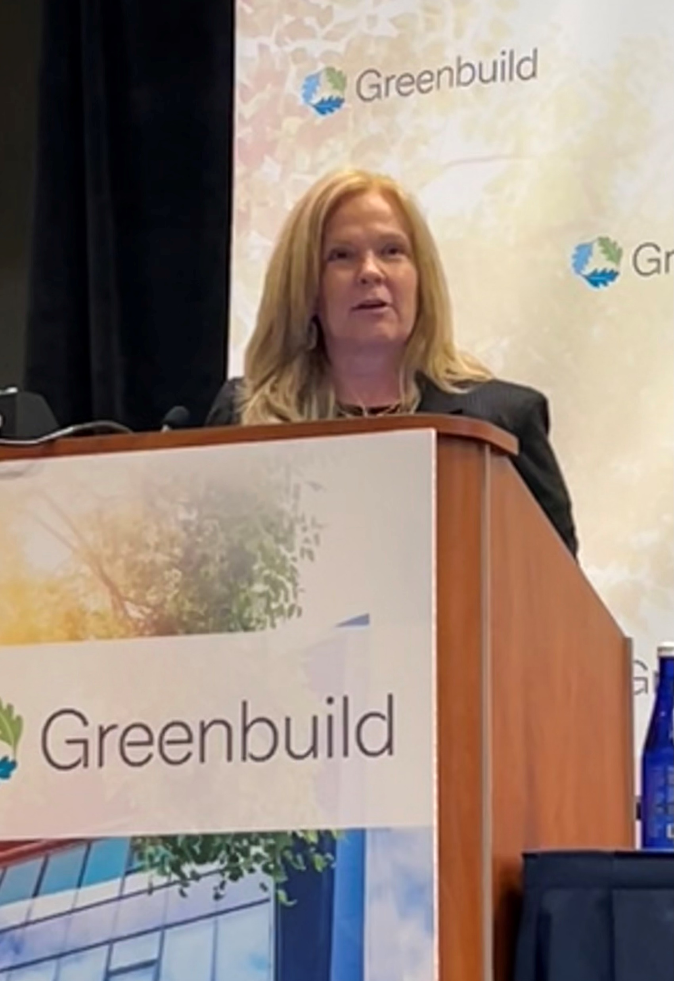
Decarbonization Conferences
Detroit Energy Forum |Detroit, Michigan
Greenbuild | Washington D.C.
Notes:
We were also invited to present ASHRAE's position on the impact of buildings on greenhouse gas emissions at various decarbonization and energy efficiency-related conferences, spanning from Greenbuild 2023 conference and expo in Washington, D.C., to the Detroit Energy Forum in Michigan..

Slide 10
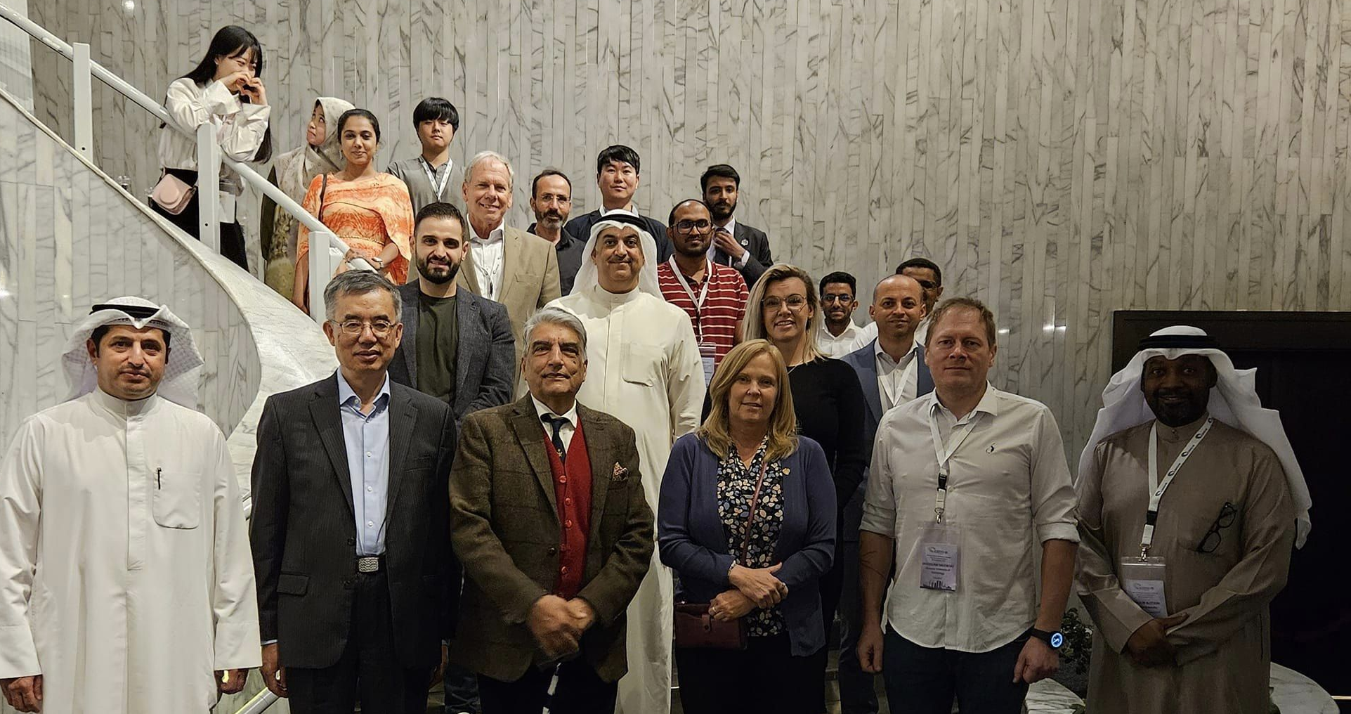
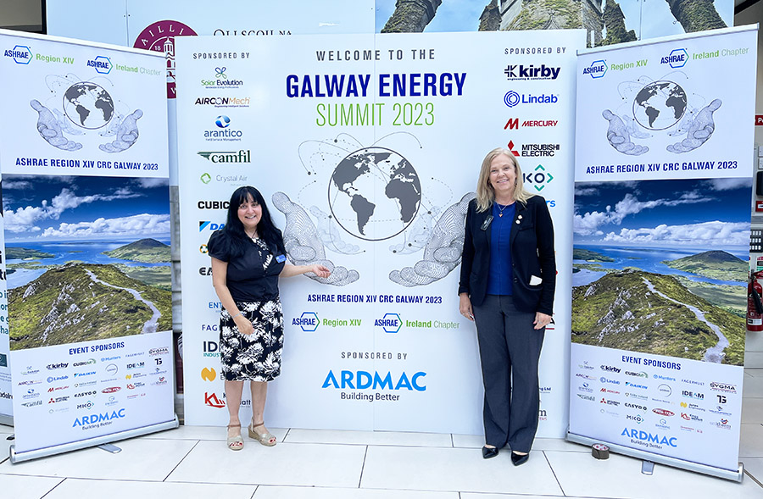
Decarbonization Conferences
8th International Conference on Energy Research and Development | Kuwait
Galway Energy Summit | Ireland
Notes:
to the 8th International Conference on Energy Research and Development in Kuwait as well as the Galway Energy Summit in Ireland and, most recently, the India Decarbonization Conference, hosted by ASHRAE’s India Chapter in New Delhi.
Every conference has been charged with sense of curiosity and energy as we collaboratively explored ways, as an industry, to minimize the influence of buildings on climate change.

Slide 11
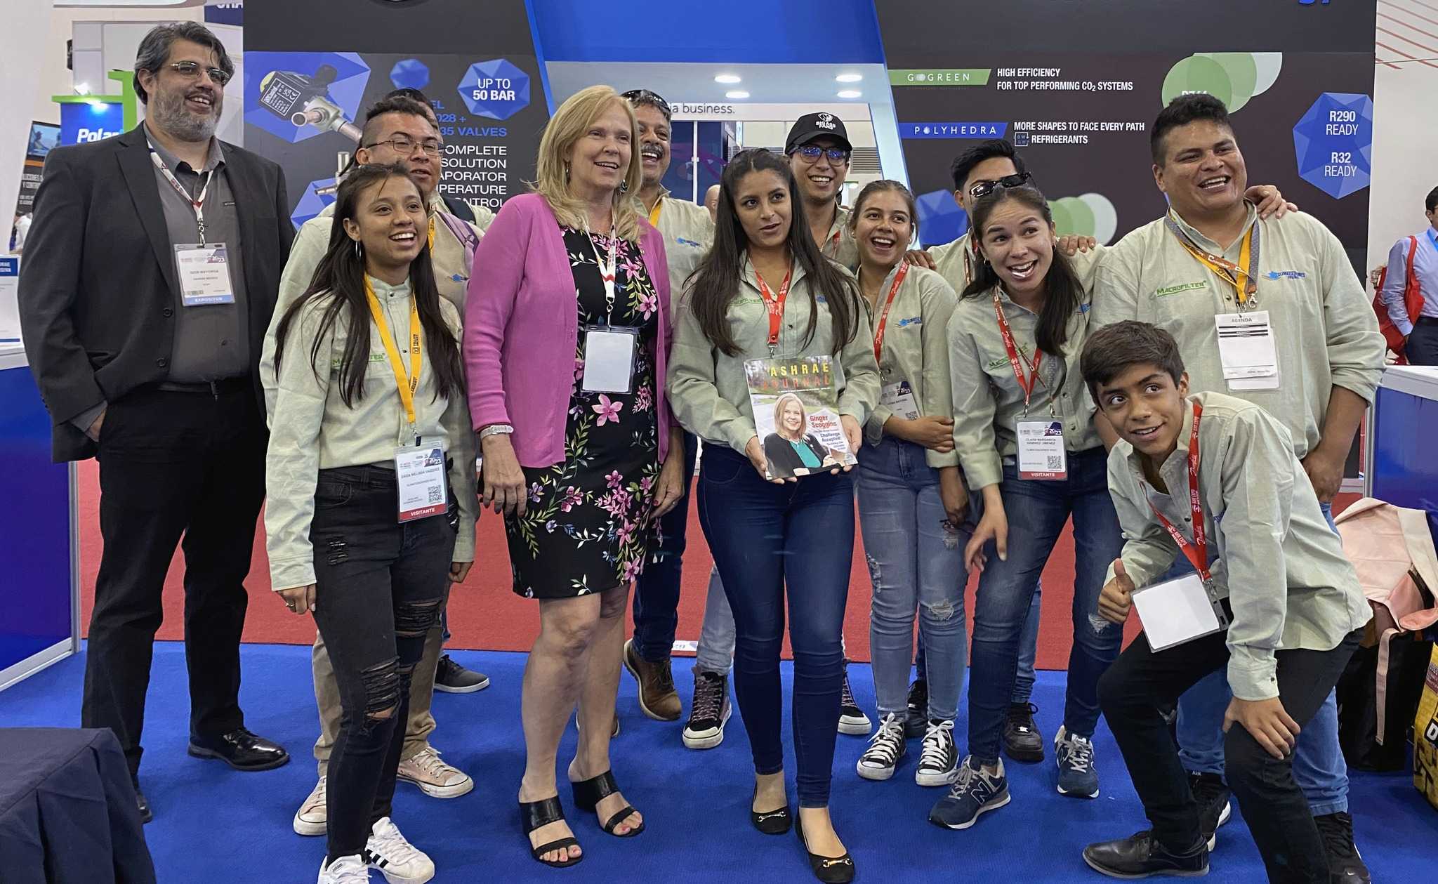
AHR Mexico
AHR Mexico, Mexico City
September 19-21
Notes:
We also had our largest AHR Expo in Mexico EVER this year, with many of the booths and technical sessions focused on low carbon options for building materials and education on how countries like Mexico can grow their building stock responsibly over the coming years.

Slide 12
Notes:
President-Elect Knight and I had the privilege of participating in the UN's COP 28 Conference on Climate Change held in Dubai in November. The outcome of this Conference of the Parties fell short of expectations, unfortunately, as the hoped-for phase-out plan of fossil fuels did not materialize. However, a compelling call for action echoed throughout many events to "Triple Renewables and Double Energy Efficiency."
To limit warming to 1.5 degrees Celsius, the world requires three times more renewable energy capacity by 2030, or at least 11,000 gigawatts, and must double the global average annual rate of energy efficiency improvements every year.
While the “Triple Renewables and Double Energy Efficiency” rallying cry resonated strongly at COP 28, we recognize that accelerated action and ambitious policy implementation will be VITAL in addressing global renewables and energy efficiency challenges that are before us.

Slide 13
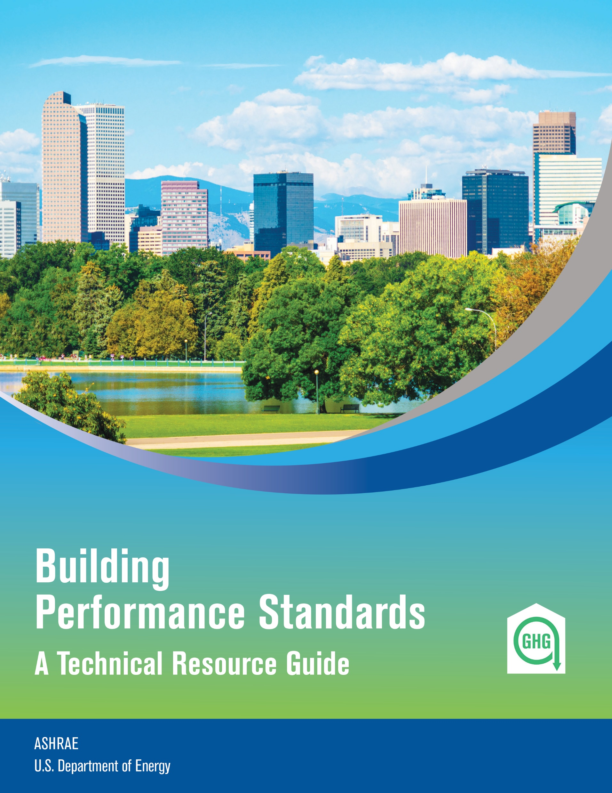
Decarbonization Guides
2 Technical Resource Guides Now Available
+ more in production
Notes:
The ASHRAE Task Force for Building Decarbonization will continue its efforts of releasing our best practice guides and videos. Our Grid-Interactive Buildings guide and our Building Performance Standards guide have been released to date with the remaining guides being released this society year. Remaining guides will focus on Whole Life Carbon, Heat Pump application, Design and Operation.

Slide 14
Lucy Goes Green
Notes:
As we contemplate ways of addressing the challenge of climate change in the future, the mantle will be passed our younger members and the generations following them. It is crucial for us to ignite the passion and inspire a new generation of climate change leaders, and ASHRAE is delighted to release the second installment in our Lucy’s Engineering Adventure series with another children’s book titled “Lucy Goes Green.” This book is available on our website and in our bookstore and you can purchase yours TODAY before supplies run out.

Slide 15
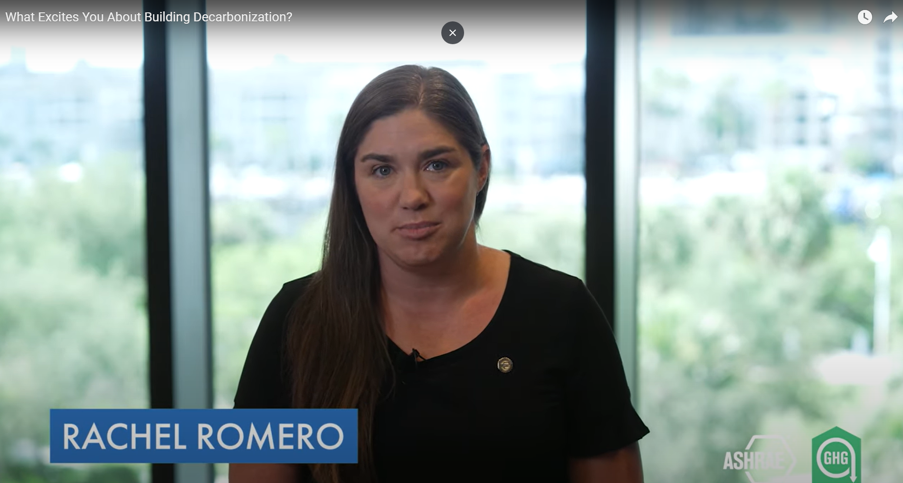
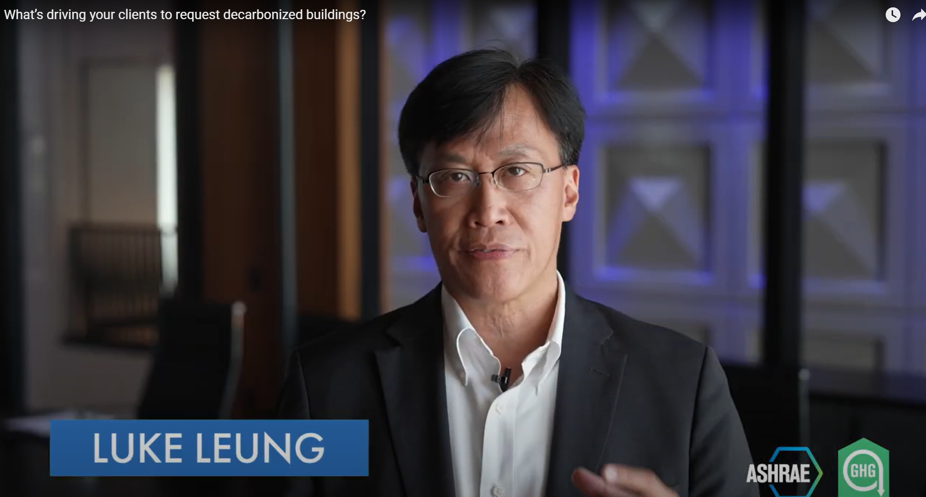
Decarbonization Video Series
What excites you about building decarbonization?
Advice for someone just starting out in the field of building decarbonization?
What’s driving your clients to request decarbonized buildings?
Notes:
We are pleased to share our latest decarbonization videos available on the ASHRAE YouTube Channel, with new content uploaded every other month. In these videos, you'll witness our engaged Society and chapter members sharing insights into what decarbonizing the built environment signifies for them personally and the significance it holds for all of us. The videos have received thousands of views on the ASHRAE YouTube channel and our viewership is expanding daily.

Slide 16
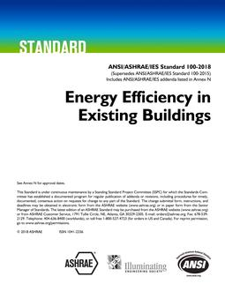
Standards Updates
Notes:
We continue to update our standards with a focus on carbon reduction as well as energy.
The new edition of Standard 100 was just released and includes a revision to include carbon emissions performance requirements for existing buildings, as well as adding emissions targets for dozens of building types.
ASHRAE has been receiving LOTS of interest in Standard 100 in the last year from numerous agencies of the federal government and briefings on the updates to Standard 100 have been requested from representatives of the General Services Administration, the Environmental Protection Agency and the White House Office of Domestic Climate Policy for consideration and potential inclusion in prospective federal regulations.
The newly released edition Standard 189.3, has also been revised to address emissions, with an explicit part of the purpose of the standard being to “support the goal of development that meets the needs of the present without compromising the ability of future generations to meet their own needs, including decarbonization of the building environment.”
ASHRAE has built a reputation as a pioneer in standards and guidelines, and we are at the forefront of the charge in carbon reduction.

Slide 17
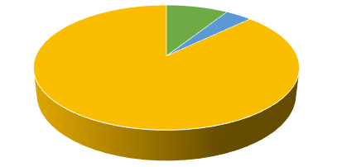
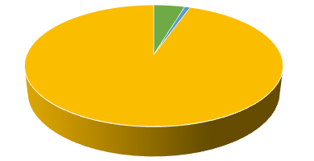
ASHRAE GHGs Per Scope Comparison
Units: Metric Ton CO2 Equivalent (MT CO2e)
Society Year 2021-2022
Society Year 2022-2023
YoY Comparison
Scope 1: 284
Scope 1: 189
Scope 1
- 33%
Scope 2: 121
Scope 2: 33
Scope 3: 2,751
Scope 3: 3,852
Scope 2
- 73%
Scope 3
+ 40%
Difference
+ 29%
Offsets Purchased: 71.71
Notes:
ASHRAE is also continuing to lead the industry by working to reduce our own Scope 1, 2, and 3 emissions, as I reported in Tampa. We have a team of members researching and understanding our Society’s carbon footprint with the goal of reducing our own impact on climate change. This team has identified that, out of Bloomberg’s 15000 profiled companies, only 20% report Environmental, Social and Corporate Governance or ESG data that includes Scope 3 emissions, so once again we are in the leader category in this effort. Scope 3 is the hardest to quantify and includes assessment of indirect emissions from the entire value chain of an organization, from business travel to employee commuting, upstream and downstream supply chain processes, and product lifecycle emissions.
Based on the analysis done by this team with the data from the past two years, they have determined that while ASHRAE’s Scope 1 & 2 emissions declined from the 21-22 Society Year to the 22-23 Society year, our Scope 3 emissions significantly increased, unfortunately.
Scope 1 and 2 reductions reflect a full year of PV operation at our ASHRAE Headquarters, which is effectively now net-positive in operations. The Scope 3 emissions increase reflects an increase in travel by our members and officers as COVID restrictions were lifted in the 22-23 Society Year. We are going to continue to monitor our year-over-year performance as the Society year 22-23 will become our baseline for Scope 3 analysis, and we can work to reduce our numbers by travelling smart in the coming years.
We have also implemented the purchase of travel offsets for our senior officers this year, which will help with our 20% reduction goal. We are calculating how many metric tons each flight or car drive that our senior officers are using on ASHRAE travel. We have offset 71.71 metric tons of CO2 to date.
I get questions and concerns about our focus on carbon reduction and our need for travel as the two efforts are somewhat contradictory. However, it’s important to recognize that ASHRAE’s mission alone helps in achieving decarbonization awareness on a global basis, and limiting our travel emissions at the expense of our broader mission is not desirable. But we can travel smart and work to offset our CO2 travel emissions moving forward.

Slide 18
ASHRAE and MEP 2040
COP 28 UN Climate Change Conference
United Arab Emirates 30 Nov – 12 Dec
Notes:
We are also happy to announce formally that ASHRAE has agreed to align with the MEP2040 challenge.
The MEP2040 challenge asks that all systems engineers advocate for and achieve net zero carbon in their projects: operational carbon by 2030 and embodied carbon by 2040. More information can be found at mep2040.org.

Slide 19
Attend an ALI course
Refer to guidance from the building decarbonization resources page
Attend the Decarbonization Conferences
Participate in a standards development committee
Learn from others
Be an advocate for change
Notes:
To summarize, YOU did it! YOU recognized the challenge and YOU found ways to accept responsibility for making changes in your activities to make a difference. Big or small, all changes help our efforts, and we appreciate you.
Passing your knowledge along to others this year – to your colleagues, to other industry professionals and to those in your community is how you’ve accepted the challenge and can continue to do so.

Slide 20
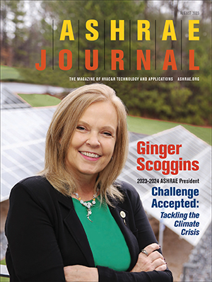
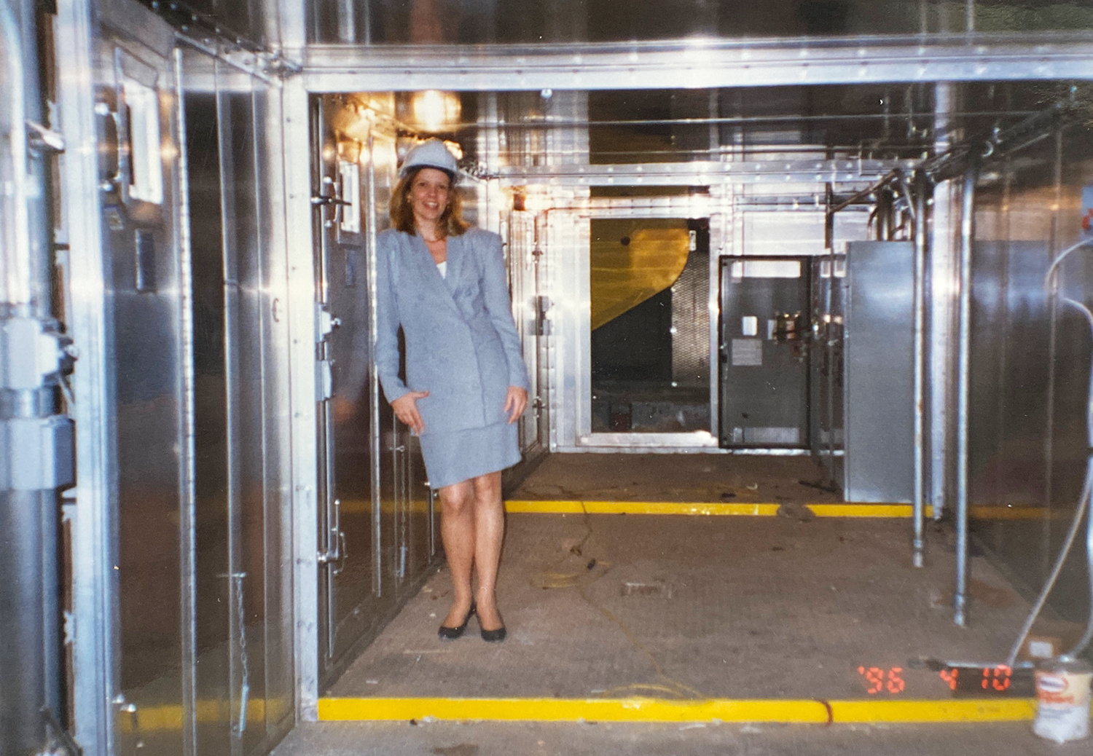
Accepting the Challenge
Notes:
When I spoke to you in June, I shared a glimpse of my journey as a child of the 1970s – a truly remarkable time to be a teenager. That decade was marked by monumental events, yet I was only vaguely aware that one of the most significant events that the world was grappling with was an energy crisis. Little did I know THEN that this great Society – ASHRAE – would rise to meet the urgency of that crisis, through the development of Standard 90 – the standard that has become a beacon for building energy codes globally and a testament to ASHRAE’s commitment to excellence.
Fast forward many years later, and here I stand as a career-long volunteer member of this extraordinary Society, working alongside dedicated and passionate experts and professionals. In the spirit of ASHRAE's impactful legacy from the 1970s, let us carry forward our tradition of providing quality technical guidance and expertise to a world that eagerly looks to us for leadership. Together, we WILL tackle the climate crisis, we will navigate the future and we will continue to foster ASHRAE's vision of a healthy and sustainable environment for all.
Thank you for accepting the challenge of building a better world.

Slide 21
ashrae.org/president

