Slide 1



Changing the Game:
Retrofitting for Resilience
Sarah E. Maston, PE, BCxP, LEED AP
2026-27 ASHRAE President

Slide 2
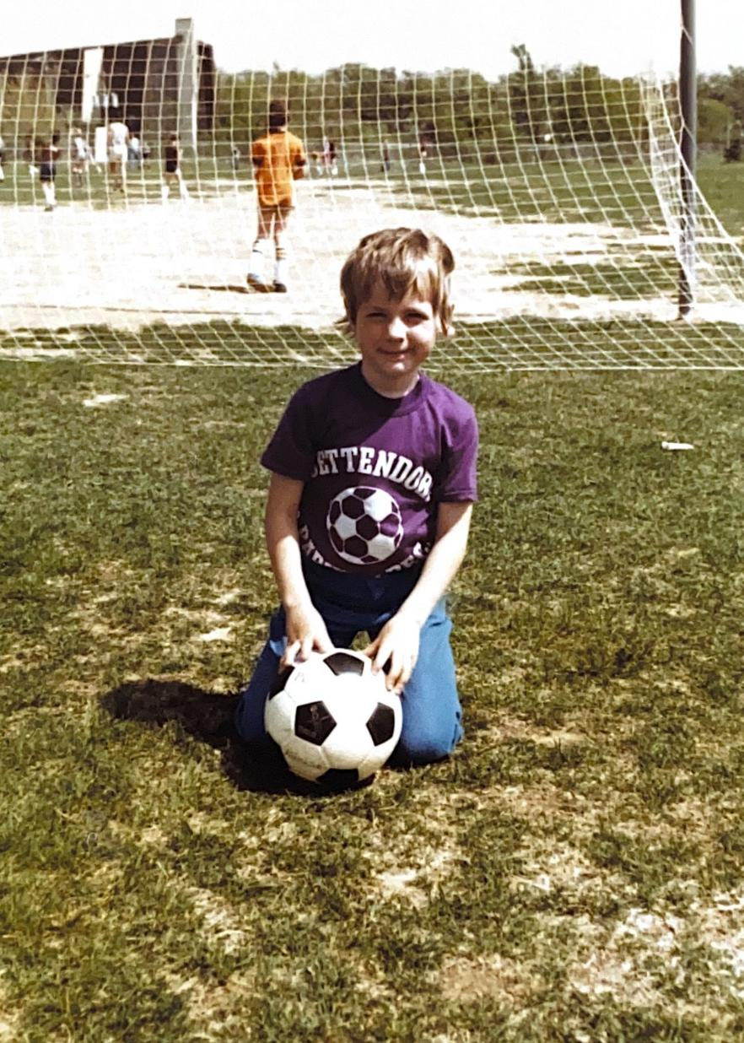
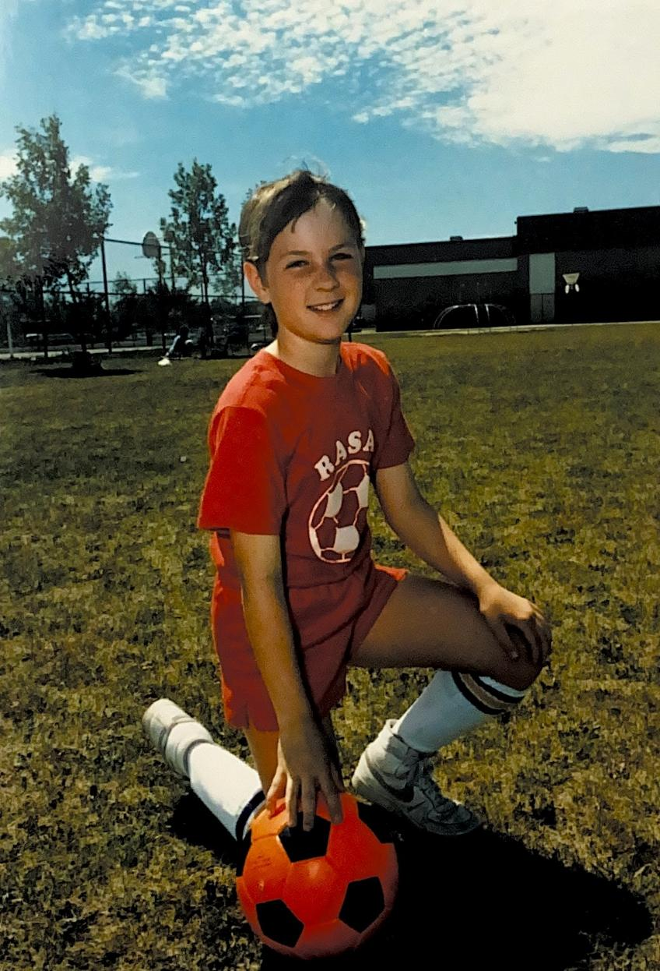
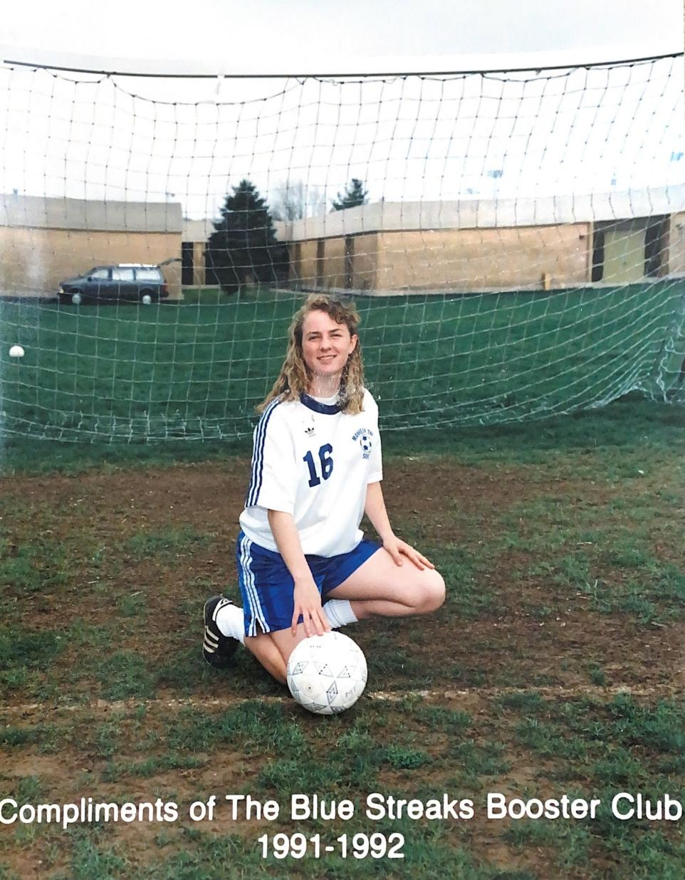

GOAL!
Notes:
GGGGGGGGGGGGGGOOOOOOOOOOOOAAAAAAAAAAAAALLLLLLLLLLLLLL!!!!!
Sports. Games. Teams. How many of us grew up playing sports – for fun, for competition?
Some of my favorite memories growing up, are from the summers when my family lived in Wisconsin. The kids in my neighborhood loved playing basketball in the driveway, baseball in the street and soccer in the backyard. I was a competitive kid, and sports were a great outlet for my energy. I loved most sports, but soccer, quickly became my favorite. I started playing in a local league when I was 5 years old and over the years, I grew to love the challenge of the competition.

Slide 3

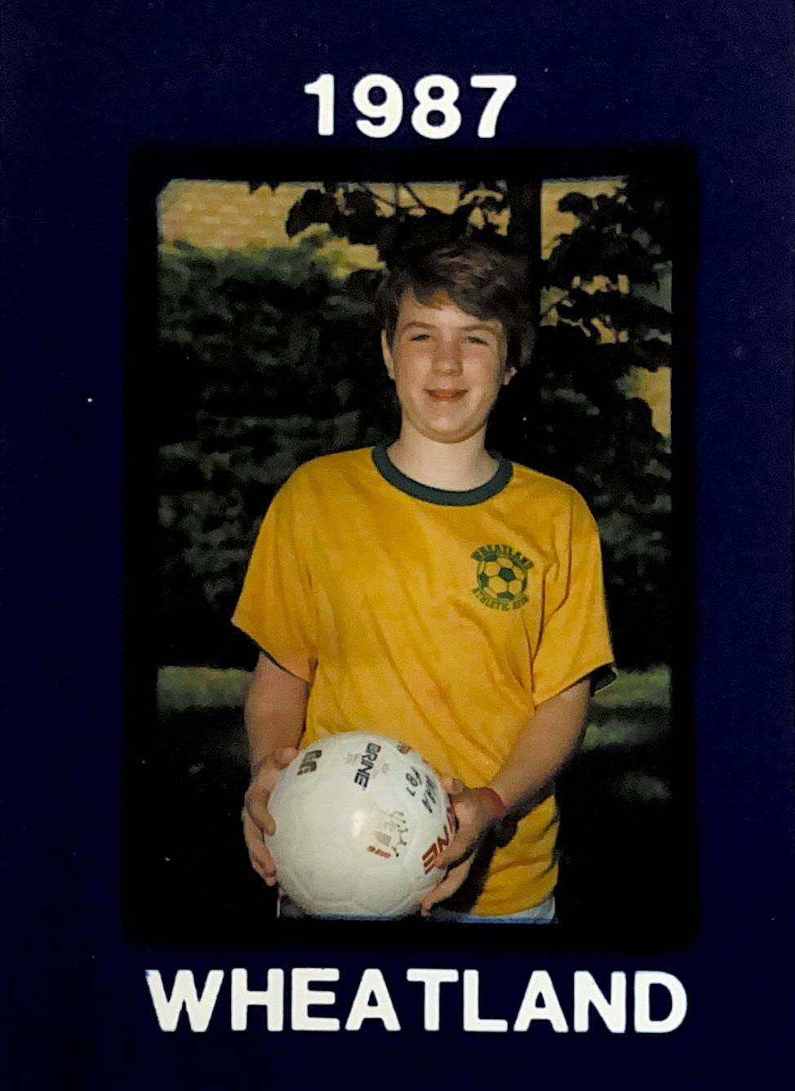
Notes:
By the time I was 10 years old, I played for the “Warriors,” a team coached by my dad’s work colleague. My dad would often come and watch the end of practice and talk with the coach. Every practice ended the same way – with a “hill charge.” We’d sprint up the big hill at the park where we practiced, as fast as we could. The coach would give us a head start and then chase us, trying to pass us before we reached the top.
Well, one day, my dad showed up and the two started talking. Coach called us over to do our hill charge, and we took off!

Slide 4

Notes:
I don’t know if their conversation went long, or if we were extra motivated, but as we neared the top, my teammates and I realized coach hadn’t passed us yet. I glanced back and he was coming up hard, but I thought I could beat him. I dug deep and pushed hard, and that day, I beat him! Victory after so many tries! Persistence paid off-I did it!// Challenges in life come in all shapes and sizes. Short-handed goals. Fourth down and twelve to go. Sports teach us resilience, perseverance, and how to push through challenges.

Slide 5


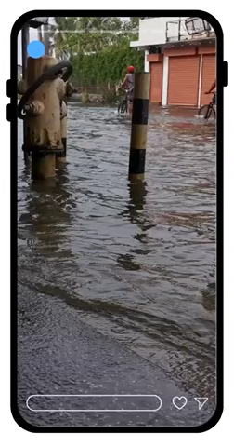
Extreme Events
What happens when best practice guidelines are exceeded by extreme events?
Notes:
These same lessons apply to more than just sports though, because today, we’re facing one of the greatest challenges of our time: climate change. We’re seeing more extreme weather – floods, wildfires, droughts, and hurricanes. These events test us- our buildings, our infrastructure, and our communities. We design buildings with data. Data that shows us how many days a year are above 95F (35C) or below 0F (-18C). Where flood plains are located. What windspeeds can be expected.
But what happens when conditions exceed those expectations? When “outliers” become common? In those moments, buildings fail. People are displaced. Communities are disrupted. And it takes time and money to rebuild and reestablish them.

Slide 6

80% of Buildings that exist today will be here in 2050.
Notes:
In an effort to slow down these climate changes, ASHRAE has committed to reducing greenhouse gas emissions to net-zero by 2050. But here’s the reality- 80% of the buildings that will exist in 2050 are already here today.
So, the question becomes, what can we do to make those buildings more energy efficient, more resilient and more sustainable?
Many buildings are already struggling with aging systems, deferred maintenance, and limited budgets. These issues don’t just affect energy use, they also impact occupant health, comfort and safety.

Slide 7

Start
Increasing awareness of building codes and their role in resilience.
Importance of cross-functional teams & creating a gameplan to improve building operations.
Gamification of education, so we can continue to attract the brightest minds to tackle the challenges we face.
Notes:
To be clear, ASHRAE has been providing leadership and guidance in energy efficiency, indoor air quality and carbon emissions reduction. So, where do we go from here?
This year, ASHRAE will focus on three key areas:
Increase awareness of the importance of building codes, and their role in resilience.
The importance of cross-functional teams & creating a game plan to improve building operations, and
Gamification of education, so we can continue to attract the brightest minds to tackle the dilemmas we face.
Let’s break these down, one at a time.
Let’s break these down, one at a time.

Slide 8

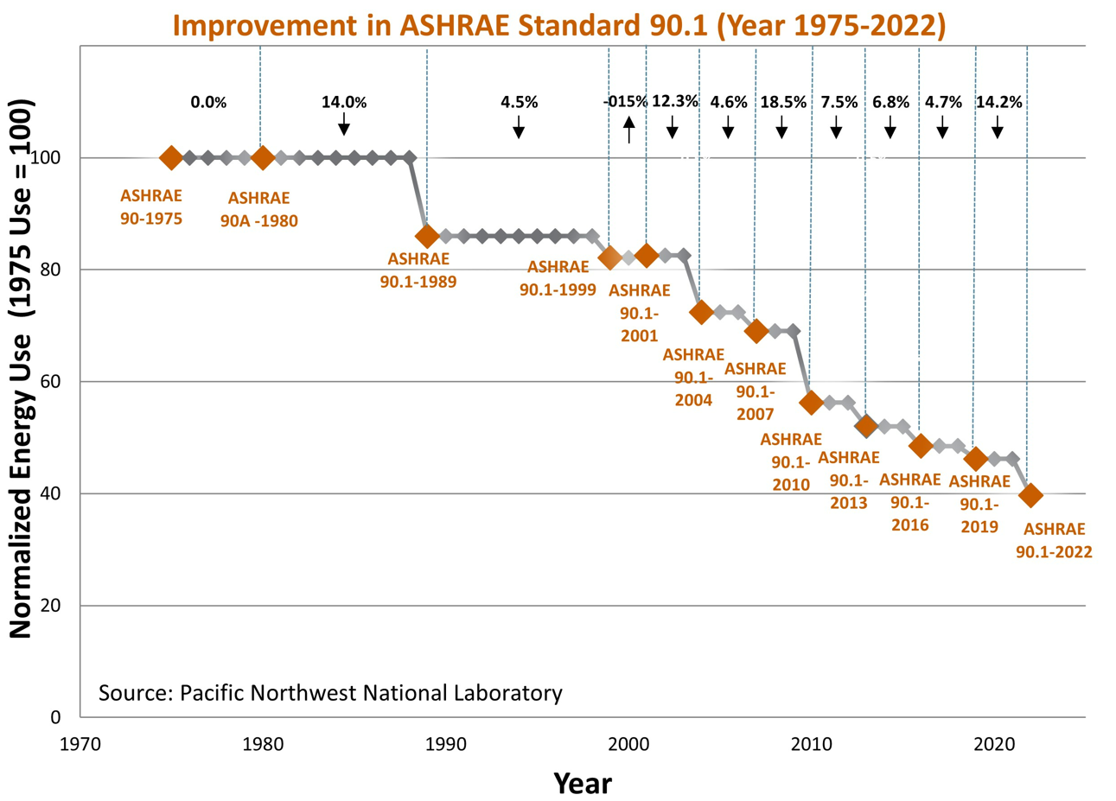
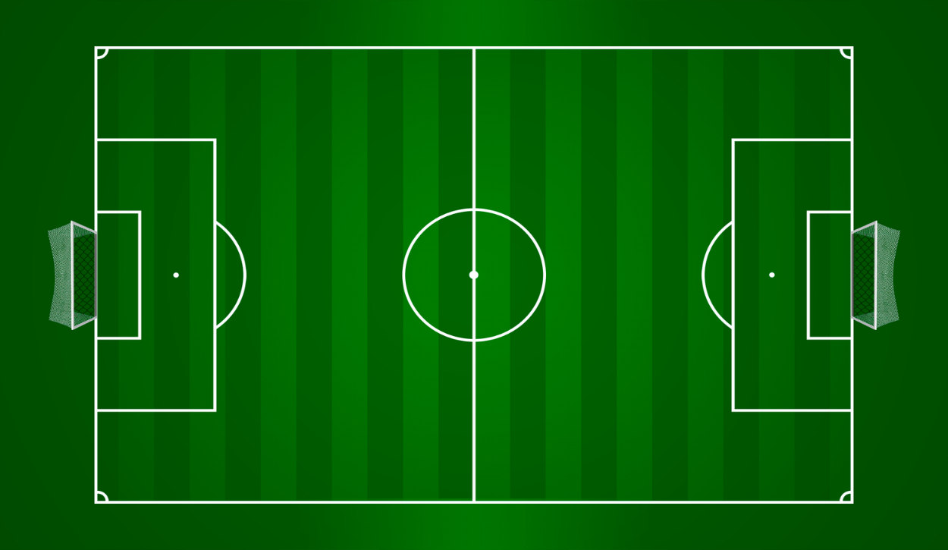
When Codes don’t exist…our ability to be resilient falters.
Codes are the rules of the game.
08
02
07
10
06
03
01
11
04
09
05
Notes:
Codes: Understanding the Rules of the Game
In sports, you can’t play if you don’t understand the rules of the game. Like, the positions on the field, what is out of bounds, how a point is scored. If you don’t know the rules, you are less likely to join in.
Building codes are our industry’s rules, but they’re not always simple or consistent. They vary by country, by state, even by municipality. Some regions adopt the latest standards, while others lag behind. And in some parts of the world, codes don’t exist at all.
Why is this important? History shows us that updating standards, like 90.1, as shown on the screen, increases energy efficiency in buildings that have adopted the latest version of the standard.

Slide 9


According to the Global Status Report for Buildings and Construction, published by the United Nations Environment Programme and the Global Alliance for Buildings and Construction: roughly half of all new buildings constructed around the world each year are built without mandatory building energy codes or performance standards.
Notes:
According to the status report, around the globe, roughly half of new buildings constructed each year, are built without mandatory energy codes or performance standards. That’s about 2.5 billion square meters, // built without consistent requirements for efficiency or resilience. Because buildings last for decades, those decisions lock in higher emissions and lower resilience for years to come.
Defining resilience for existing buildings, is a complicated issue, which is why many building industry experts are needed to create a solid plan. ASHRAE is currently working to support code development, adoption, and implementation. Through tools like the Building Code Assessment Tool, we’re helping jurisdictions understand their current position, and then create practical, locally appropriate, paths forward.
Because if we want resilient buildings, we need strong, well-understood rules of the game.

Slide 10

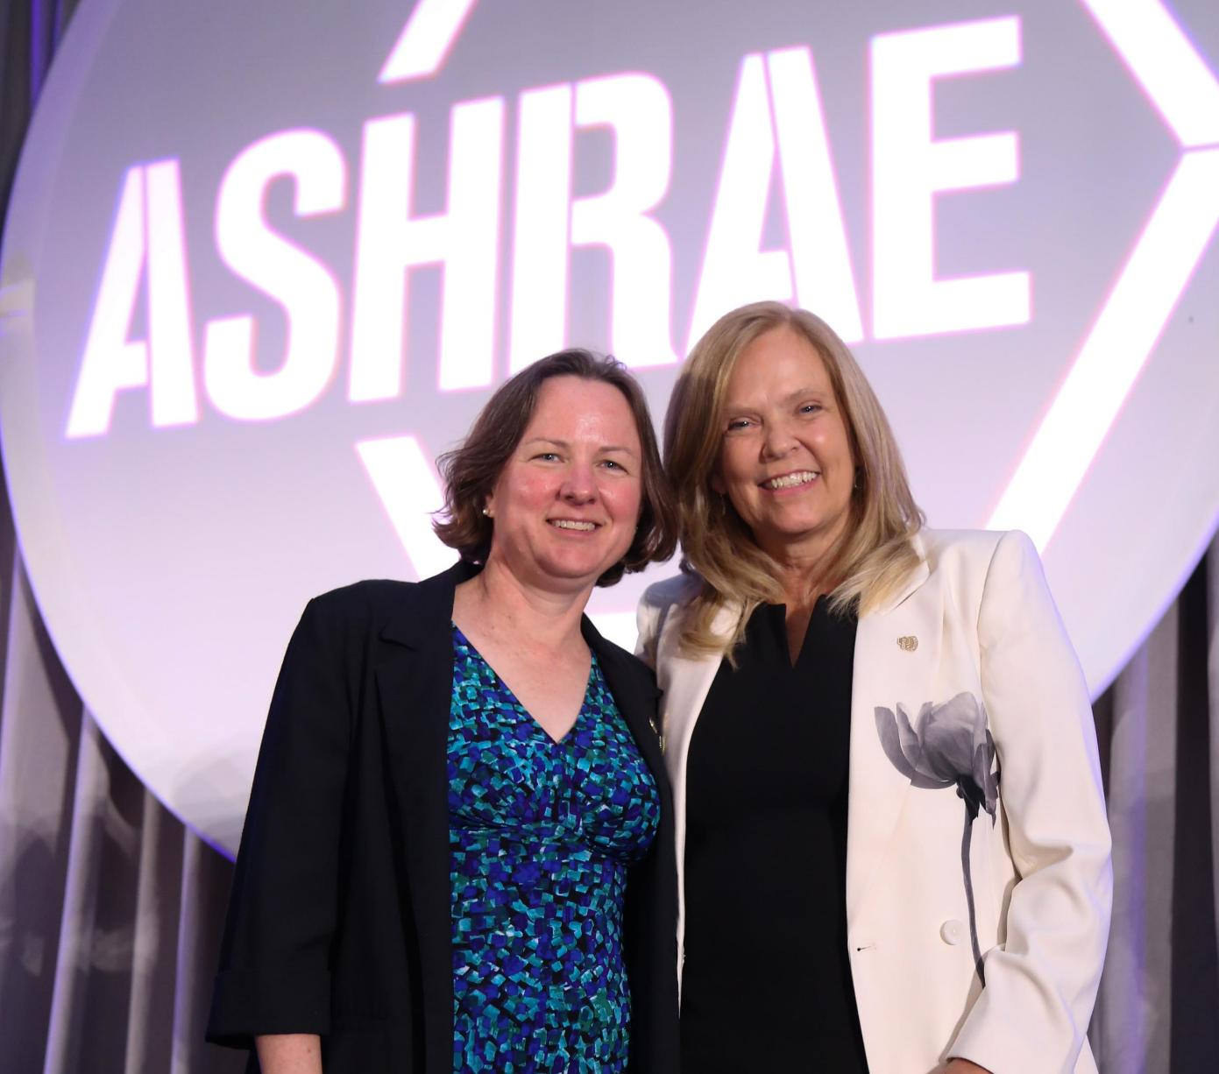
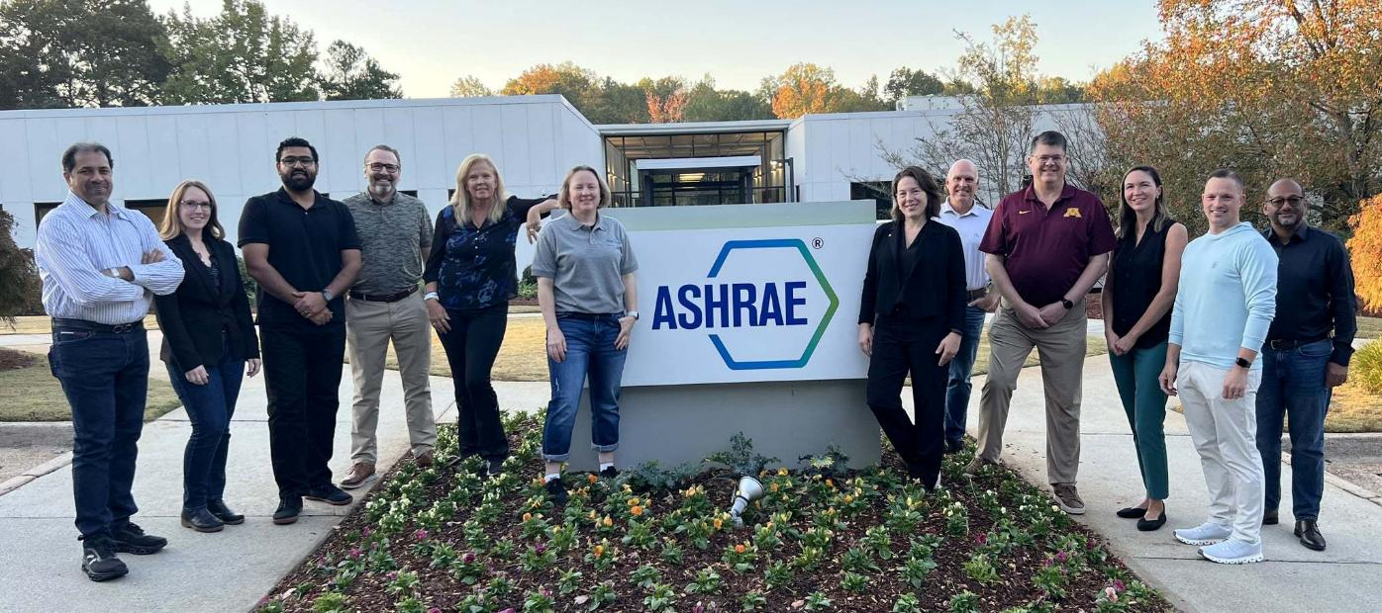
"Teamwork is the fuel that allows common people to attain uncommon results." — Andrew Carnegie
Notes:
Teamwork: Building the Right Gameplan
When I face a challenge in my work life, like when I land a new project type that I have never done before, I think about others on my ASHRAE team, who are subject-matter experts. I call them up! I ask questions! I learn from them! We can’t all be experts at everything, but together we can be. We can talk through it, define the issues and brainstorm for solutions.

Slide 11

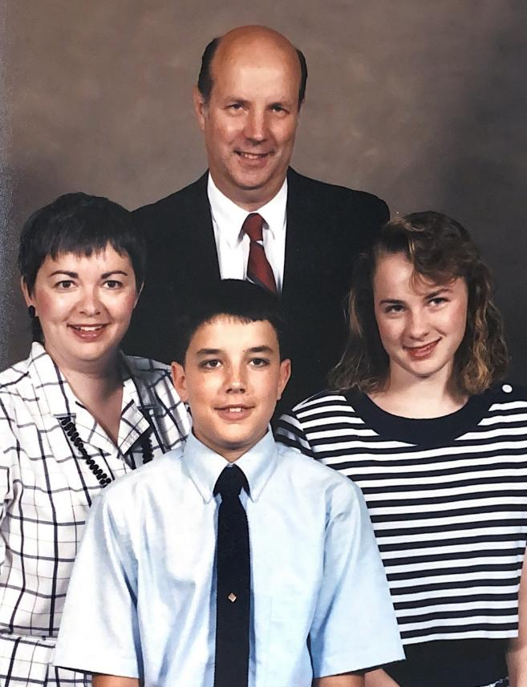
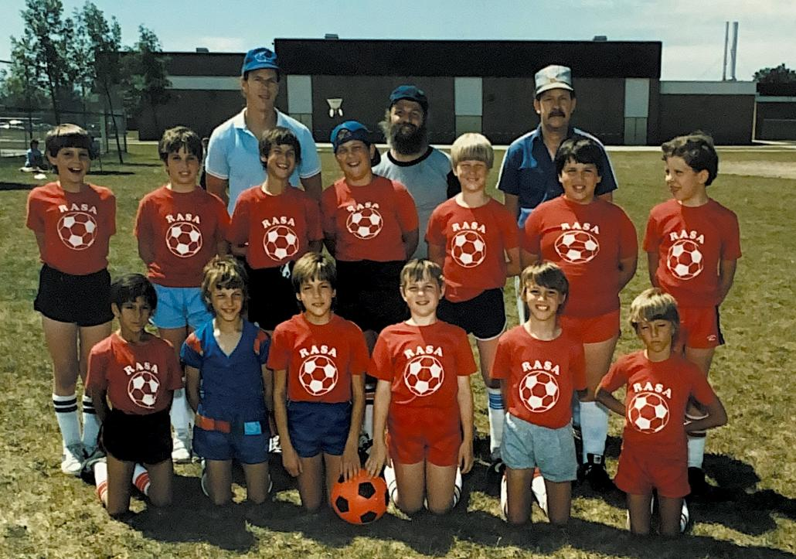
“Your goals should be out of reach, but never out of sight.”
-Felicity Luckey
Notes:
When I think about teamwork, I think about being part of something bigger than myself. I think about belonging. My family moved several times when I was growing up. Being the “new kid” was never easy, but soccer gave me a place where I immediately felt like I belonged.
The hardest move for me came during my first year of high school, when we relocated from suburban Chicago to Lancaster, Pennsylvania – two very different cultures. I dreaded moving for many reasons, but most of all because I didn’t have a soccer team to look forward to. I had been devastated to learn that the high school I would be attending didn’t offer girls soccer as a varsity sport. The one place where I knew how to connect was gone.

Slide 12
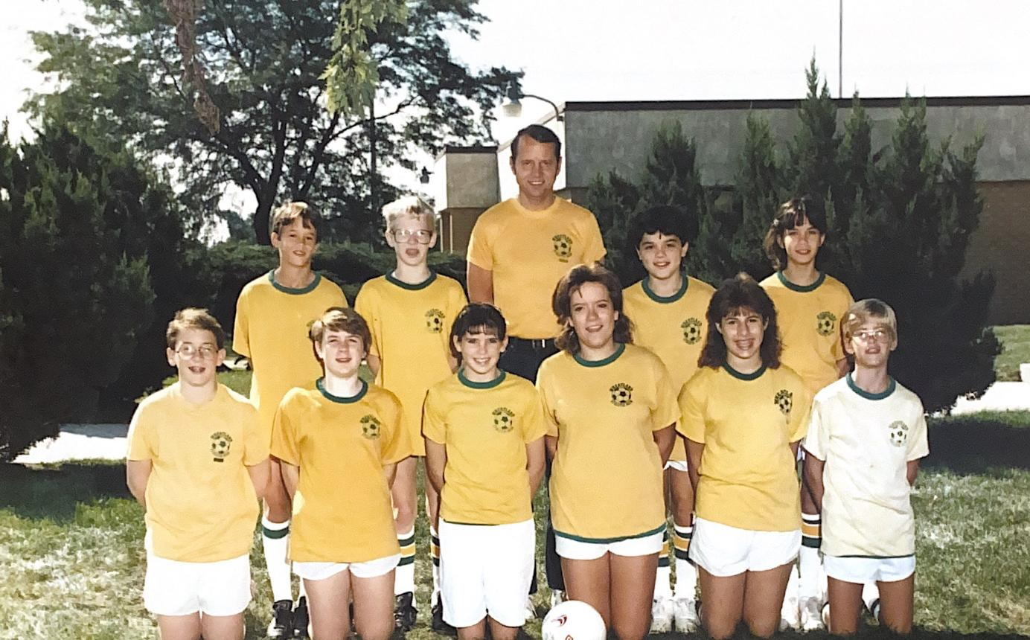
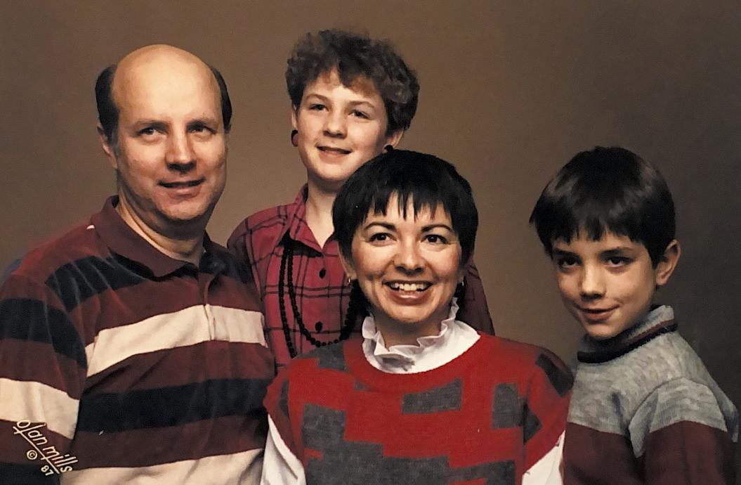
“My coach said I ran like a girl. I said if he could run a little faster, he could too.” -Mia Hamm
Notes:
But luckily within a month of our move, the district approved a new girls’ team. I tried out, made the team and found my place again – as a center defender or sweeper. I was so happy to be able to play the sport I loved again! The first few years were tough- we played stronger, more established teams and we lost way more games than we won. But we kept improving. We learned how to communicate, how to trust each other, and how to play as a team.

Slide 13
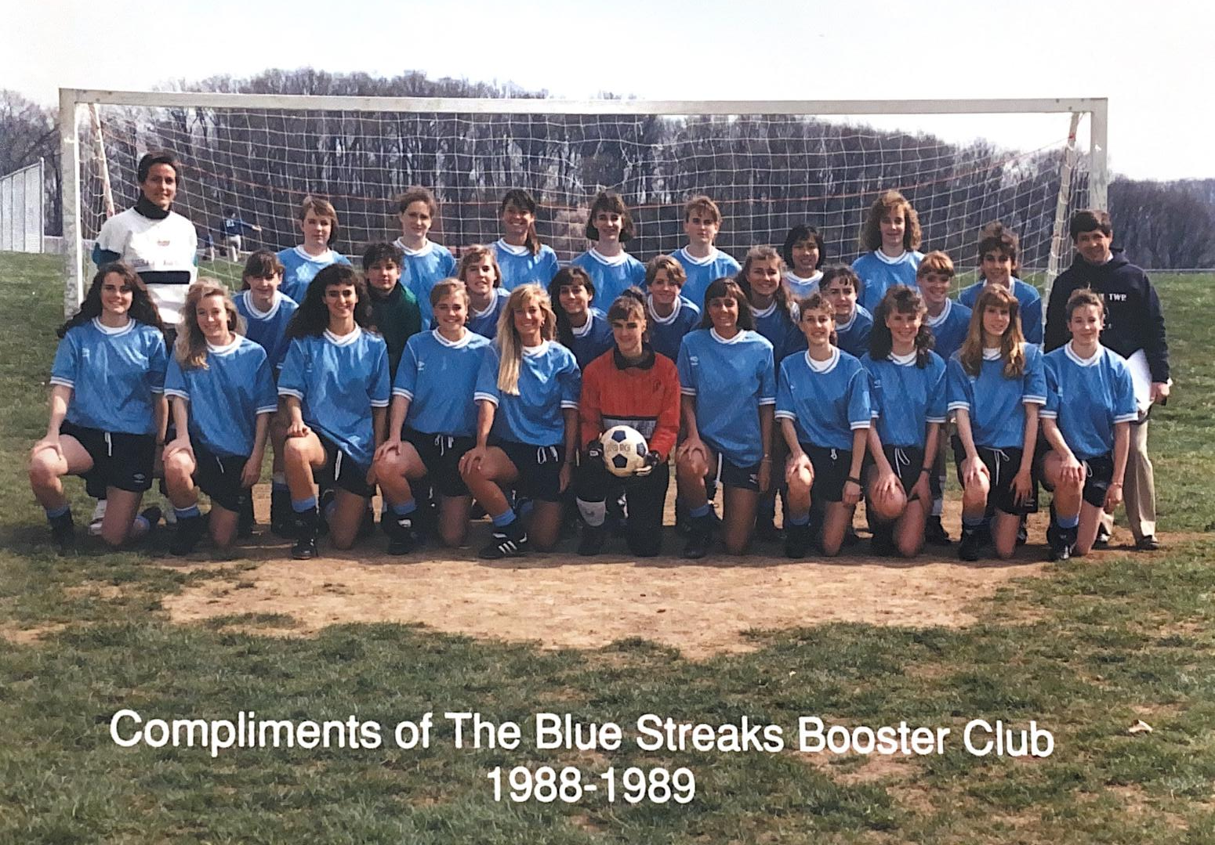

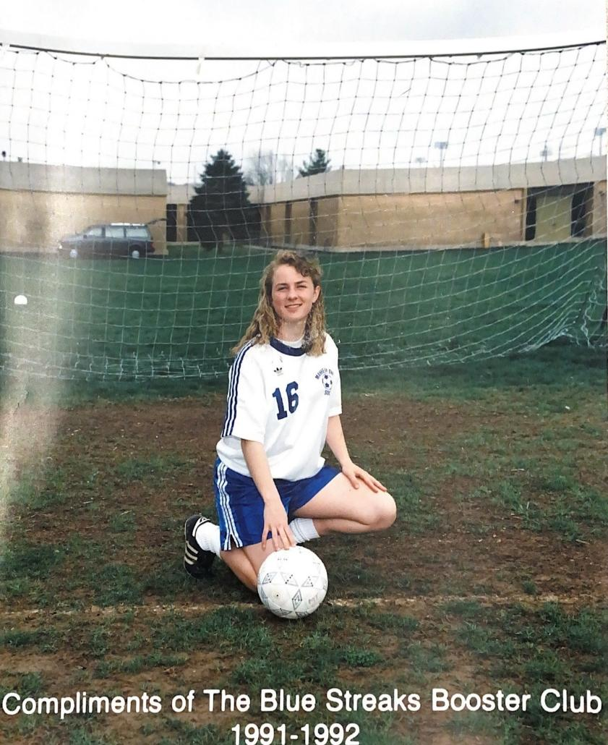
Notes:
By my senior year, we went undefeated and not only won our league, but a teammate and I were selected for the All-State Girls Soccer team for Pennsylvania. What changed wasn’t just our skill level, it was how we worked together.
The same is true for buildings.

Slide 14
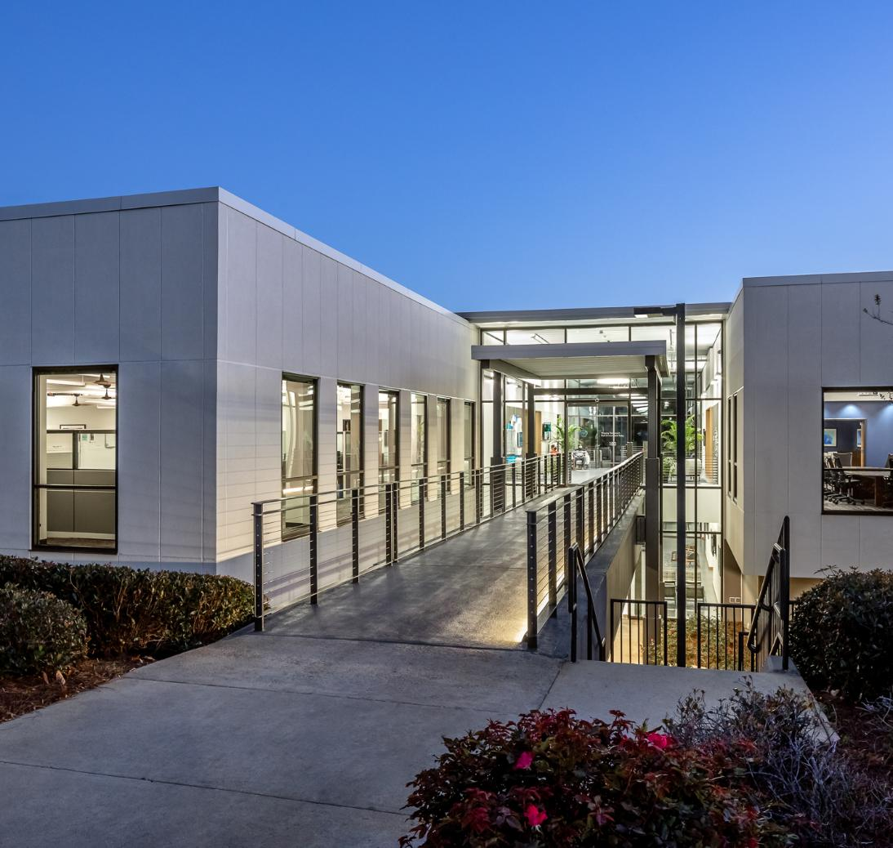
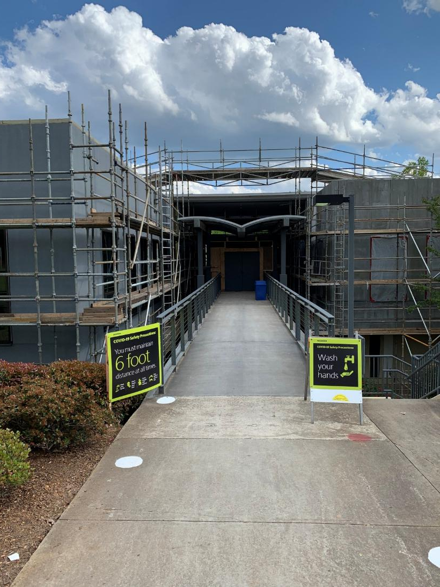
Gameplan = Resiliency Strategy of a Building
ASHRAE Headquarters during renovation
ASHRAE Headquarters
Notes:
In most sports, the coach creates a game plan or strategy before the competition, that typically plays to your team’s strengths. However, if you aren’t winning by the midpoint of the contest, the coach may rethink that game plan, in response to the other team’s play. Games aren’t won by skill alone. Strategy is key and a team’s ability to see the challenges ahead and adjust accordingly, is what leads to success.
There is no one-size-fits-all solution or game plan for retrofitting buildings. Every building has its own constraints – mechanical systems, budgets and operational needs. Also, financial constraints, or utility infrastructure, play a part in deciding the game plan or resilience strategy of a building.
That’s why teamwork is absolutely essential.

Slide 15

Gameplan = Resiliency Strategy of a Building
Understand Conditions
Build the Team
Implement Improvements
Monitor & Adjust
Notes:
Owners, operators, architects, engineers, manufacturers, utilities, financiers, and code officials all have a role to play. Together, they create the game plan.
Existing building commissioning is one of the most effective ways to do this:
Understand current conditions
Build the right team
Implement improvements
Continuously monitor and adjust
Because just like in sports, success isn’t just about skill, it’s about strategy, adaptability and collaboration.

Slide 16
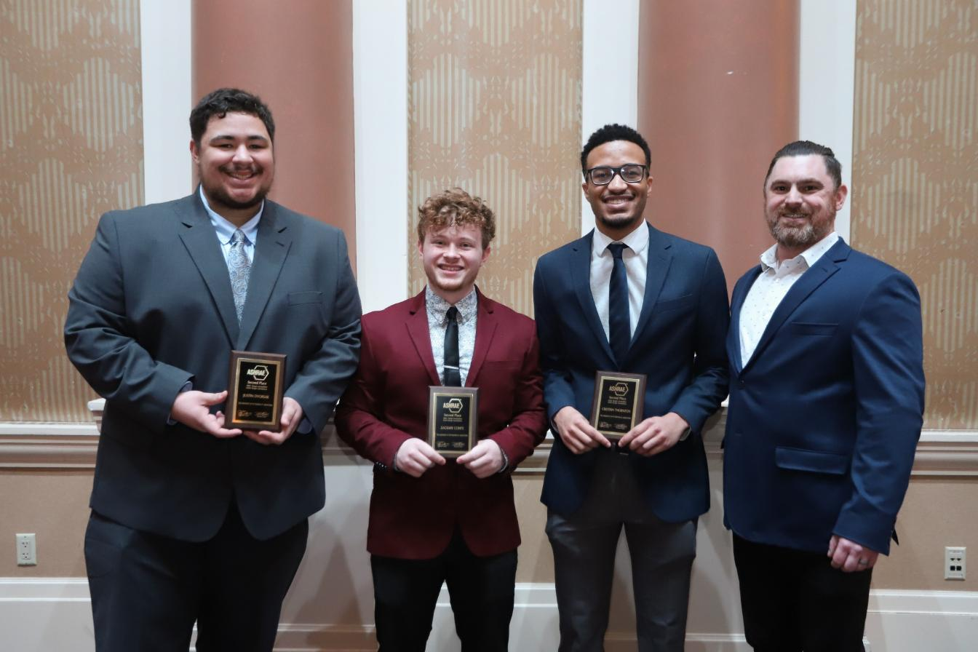
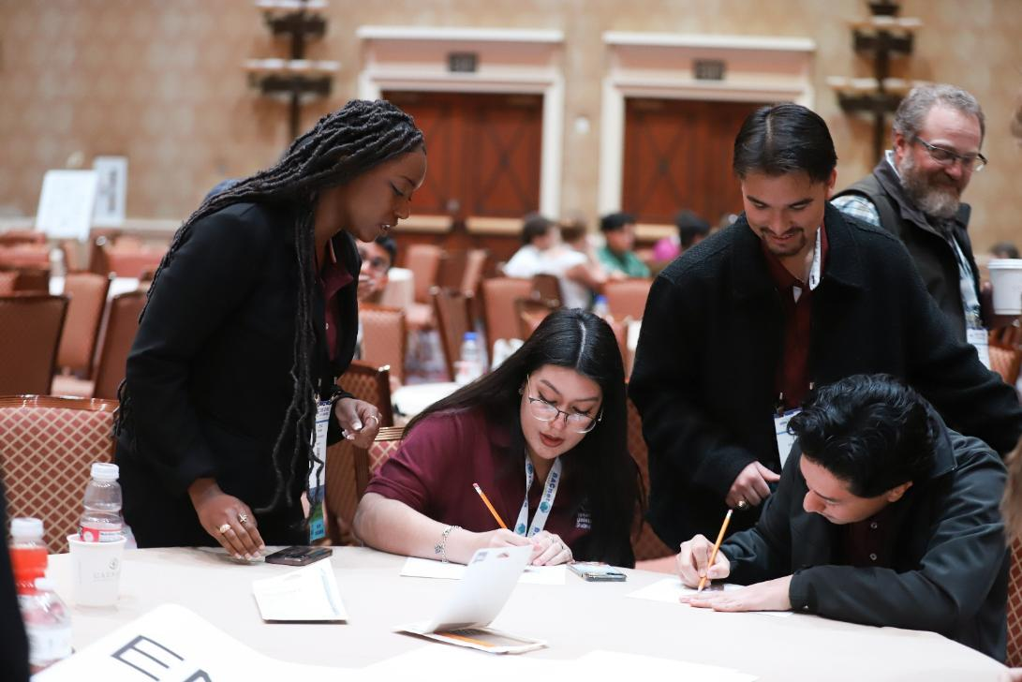
Education by Gamification
“Talent wins games, but teamwork and intelligence win championships.” - Michael Jordan
Notes:
Education: Building the Bench Through Gamification
I’ve been in the building industry for nearly 30 years, and I have found very few people planned to be here. Most didn’t know what the acronym “HVAC” meant when they started school.
I didn’t. I took an HVAC class in college as an elective, because I was working toward a minor in Energy Systems and the class fit into my schedule. // That one decision changed my career path.
HVAC&R wasn’t my first job, but it was my second, and I only pursued it because it was familiar. There are some colleges and universities that offer a degree program focused on HVAC&R, but many do not, so fewer engineers know that buildings can offer a challenging and rewarding career.
Today, we face a growing challenge:
Fewer engineers entering the field,
A wave of retirements, and
Increasingly complex buildings.

Slide 17
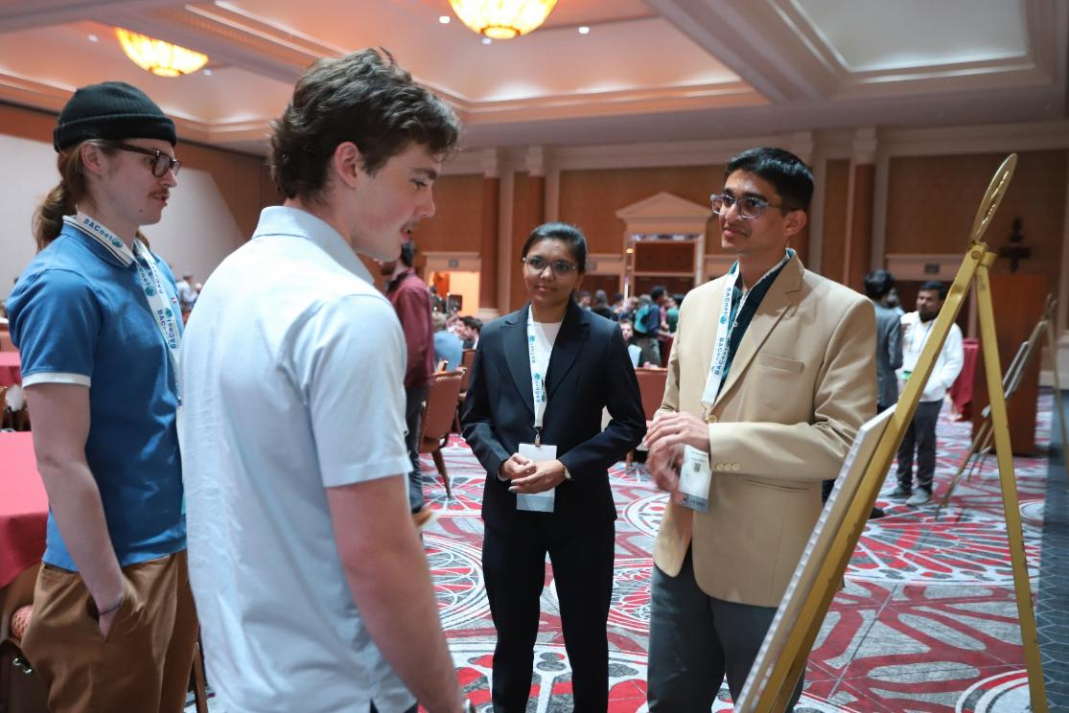
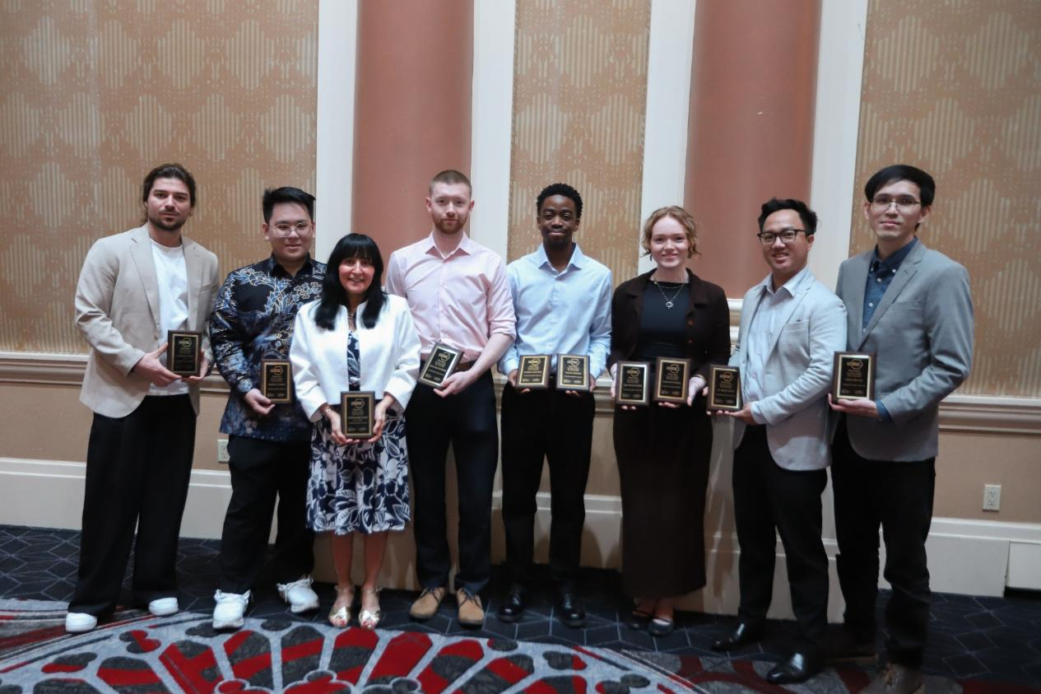
Education by Gamification
“Success is not final, failure is not fatal: it is the courage to continue that counts." — Winston Churchill
Notes:
As buildings are designed to be more efficient and leaning toward net-zero, they are inherently more complicated to operate and maintain, requiring more qualified technicians that don’t yet exist. We need new ways to attract and train talent.
A few years ago, I read an article about how back in 2017, the U.S. Navy replaced expensive joystick controllers on their periscopes with Xbox controllers. Why, you might ask? The first reason was cost. A $38,000 joystick assembly vs a $30 video game controller. Obvious, right? The second reason, though, was reduced training time. Training went from weeks-long to minutes, because it used a platform that young sailors were already familiar with. They put new concepts into a familiar context. That idea stuck with me.
So, this year, ASHRAE is doing something different.
We’re launching an interactive educational platform – a video game.
Players take on the role of a building operator, responding to maintenance issues, improving system performance, reducing energy use, and lowering carbon emissions. Along the way, they learn how buildings work and how ASHRAE standards apply.
It’s engaging, it’s practical, and it meets the next generation where they are.
Players take on the role of a building operator, responding to maintenance issues, improving system performance, reducing energy use, and lowering carbon emissions. Along the way, they learn how buildings work and how ASHRAE standards apply.
It’s engaging, it’s practical, and it meets the next generation where they are.

Slide 18

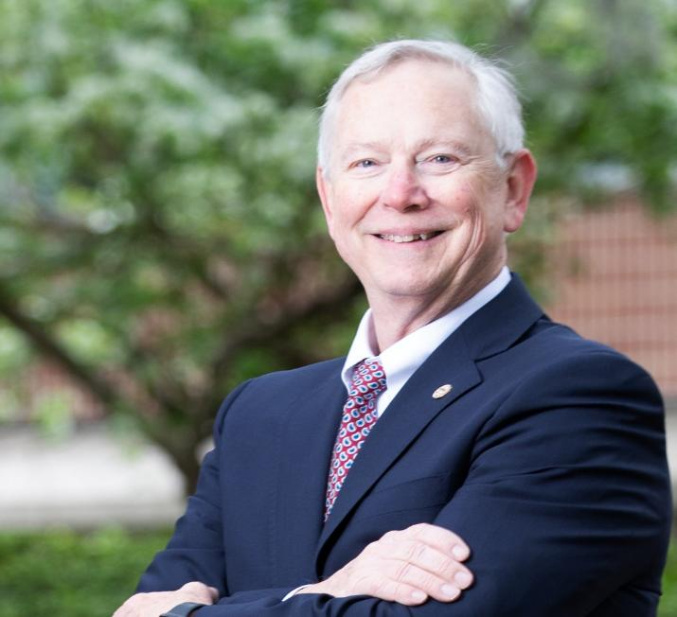

Building on Past Leadership
Ginger Scoggins, 2023-24 Society President
Dennis Knight,
2024-25 Society President
Bill McQuade,
2025-26 Society President
Notes:
Playing sports throughout my life has taught me many lessons, but the lessons that stayed with me were discipline, perseverance, and teamwork.
How to get up after being knocked down.
Working together toward a common goal.
Practicing a new skill multiple times before getting it right!
This year we are going to build on the work of our immediate past presidents, our teammates, as we strive to move the work of ASHRAE forward. In the last three years,
Ginger Scoggins encouraged us to accept the challenge of decarbonization, as we continue to see climate events that challenge our resilience.
Dennis Knight focused on ways that we can support workforce development by looking at the types and content of the technical training that we offer.
This past year, Bill McQuade emphasized the importance of indoor environmental quality, that as we work to make our buildings more resilient, we need to remember the importance of providing a healthy and comfortable indoor environment.

Slide 19

Gameplan
Resilience Guidance
Codes
Gamification
Notes:
Now it is my turn to take the lessons we have learned and apply them to the difficulties that building owners face today. We need to figure out how team ASHRAE, with its wealth of knowledge and educational offerings, can help create a game plan to make existing buildings more efficient, healthy and resilient. This year we are going to focus on codes, technical guidance and building our team. Let’s talk about our initiatives:

Slide 20
Gameplan
Work with officials to identify challenges
CODES
Identify support needs
Establish code official training plans
Notes:
#1 Strengthening Resilience Through Codes- Development & Training: As I mentioned earlier, codes are complex, but they are essential to resilience. This year, we are expanding our outreach to code officials and governments. In regions with existing codes, we will help identify the training and tools needed to support enforcement and encourage adoption of updated standards. We also recognize that retrofits can trigger costly compliance requirements, so part of this effort is helping stakeholders better navigate those challenges.
In regions without codes, we will work with governments to understand local barriers and support the development of practical, effective frameworks that improve resilience and occupant health.

Slide 21
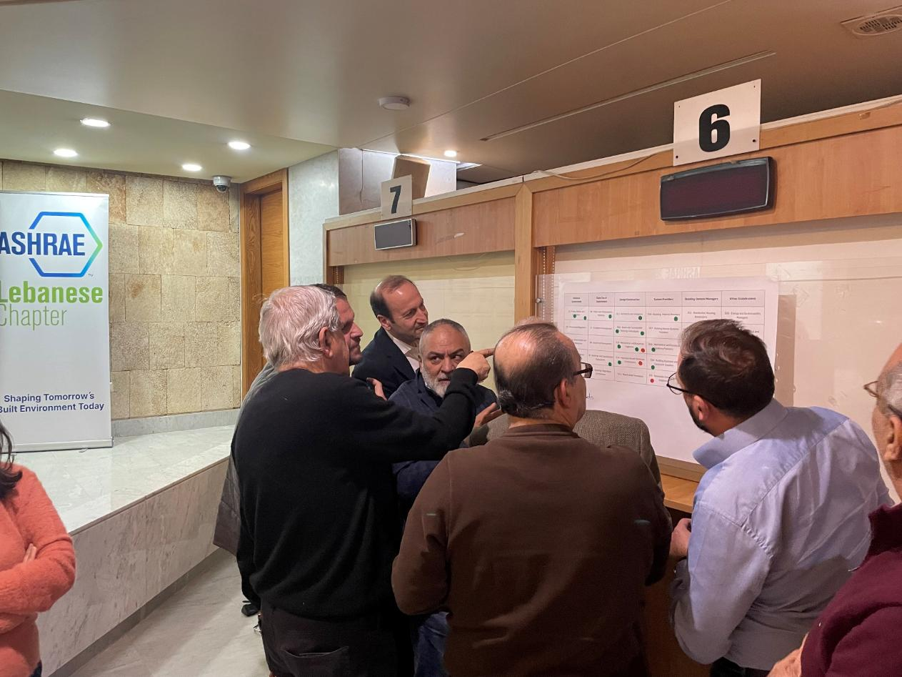
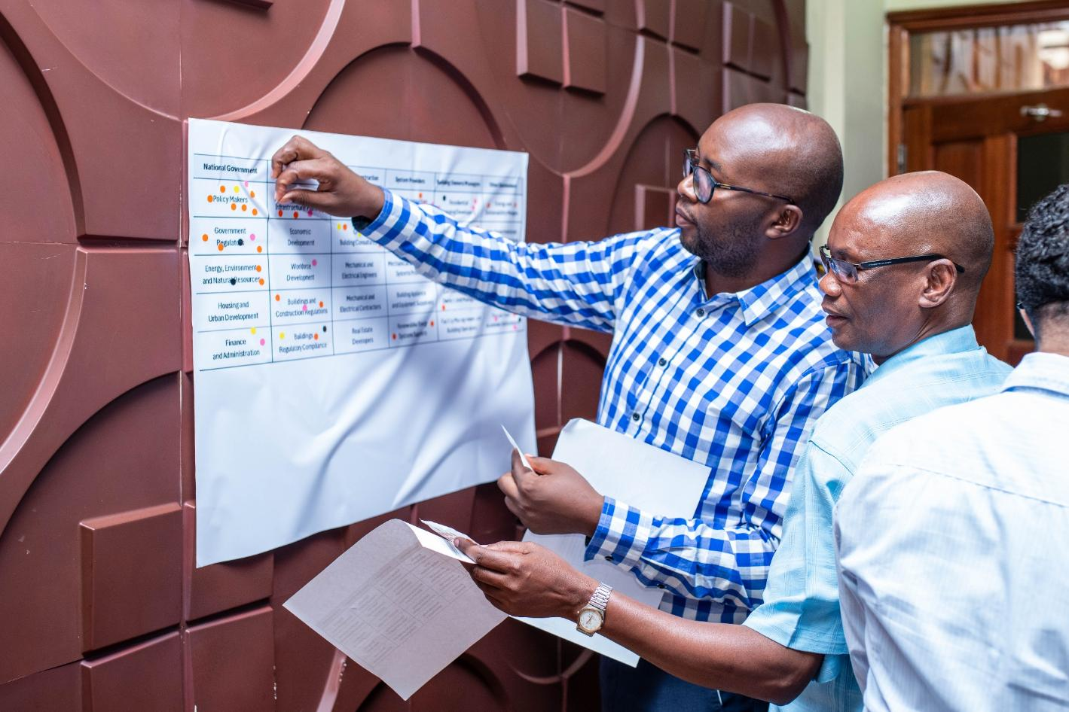
Building Code Assessment Tool (BCAT)
Participants using BCAT Tool, Lebanese Chapter
Participants using BCAT Tool, Kenya
Notes:
To support this, ASHRAE’s Center of Excellence for Building Decarbonization has developed the Building Code Assessment Tool (BCAT) – a structured process that helps jurisdictions assess climate risk, construction practices, workforce capacity, and enforcement, and then define a realistic, locally-driven path forward.
BCAT is already making an impact, with pilot workshops in Kenya and Lebanon and additional efforts underway in India and Brazil. Well-trained, engaged code officials are critical members of the team and essential to improving building performance worldwide.

Slide 22

Gameplan
Create a gameplan/current facility requirements
CODES
Resilience
Guidance
Build the team
Implement the
retro-commissioning
gameplan
Notes:
#2 Resilience Guidance Gameplan: Existing building commissioning provides a practical, all-inclusive approach to improve existing building performance. It starts with understanding where you are, assessing your equipment condition, deferred maintenance and energy and carbon goals.
Next, build the right team and a deep bench including owners, designers, operators, manufacturers, utilities, financiers, and code officials. These partners are essential to defining and achieving resilience.
Then, put the plan into action! Evaluate system performance, verify sequences, and implement monitoring -based commissioning to gather data and refine your approach over time.

Slide 23
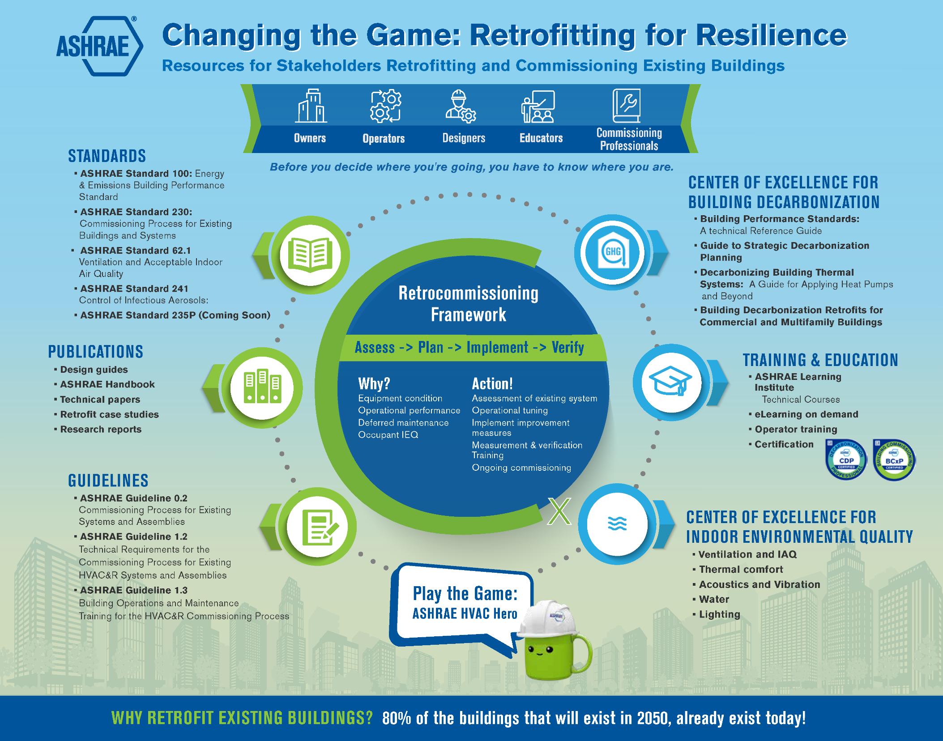
Success isn’t just about skill, it’s about strategy, adaptability and collaboration.
Download at ashrae.org/president
Notes:
ASHRAE guidance is plentiful, which is a blessing and a curse- finding it can sometimes be difficult! So, we are building a new landing page – one place for owners, operators, designers and supporting team members to find and reference these documents. It includes your ASHRAE favorites, including Guidelines 0.2, 1.2, 1.3, and Standard 100, to name a few.
After reviewing the applicable guidance, identify and implement Facility Improvement Measures, working with partners to improve performance and maximize the return on investment.
Because resilience isn’t a one-time effort. It’s an ongoing strategy.

Slide 24
Gameplan
Explain expectations
Identify operators as part of the team
Gamification
Coaching: step-by-step what actions need to be taken and why
Notes:
#3 Education by Gamification- Building our Bench: I have heard many people say that they “fell” into the building industry, and as an industry, we have struggled with an effective way to attract and train new engineers and to continue to train building operators in energy efficient practices. In addition, we have identified that we have a shortage of people who understand how buildings work. So, how do we communicate what the game plan is? By putting it in a context that they understand! By explaining what the expectations are, identifying operators as part of the team, and by coaching them, step by step, on the actions that need to be taken and why. ASHRAE has been developing extraordinary and timely technical information for decades, but historically, we have left the implementation and delivery of said information to others, sometimes to our detriment. This year, we are CHANGING THE GAME.

Slide 25
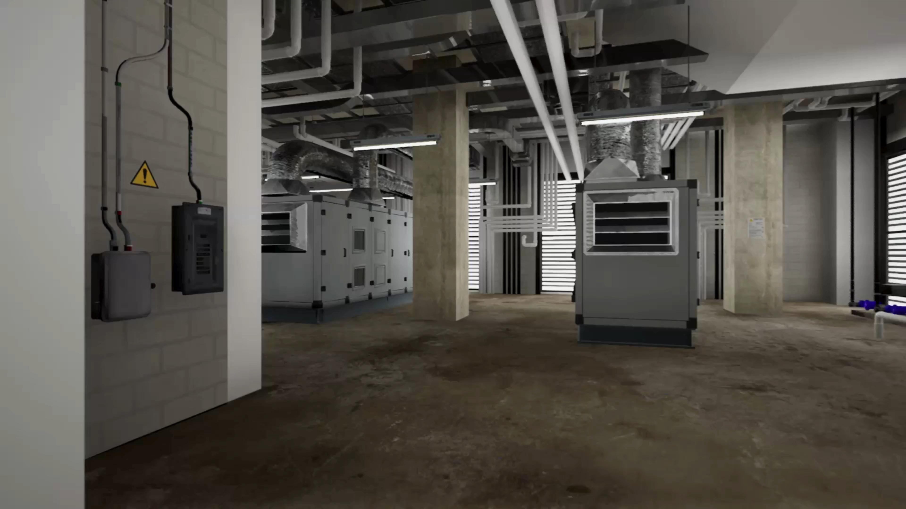
Notes:
We have developed a video game that is both engaging and educational! You will be a facility manager, working to answer maintenance calls, while trying to lower your building’s energy use and carbon footprint with the timely hints from Muggy, that you will receive along the way. You will be able to navigate around the building, click on systems and equipment to learn more about them, learn about relevant ASHRAE Standards and Guidelines, which will remind you about key concepts including energy efficiency and indoor air quality. You will compete with your friends to see who can be the fastest and most cost-effective facility manager, given different variables.

Slide 26
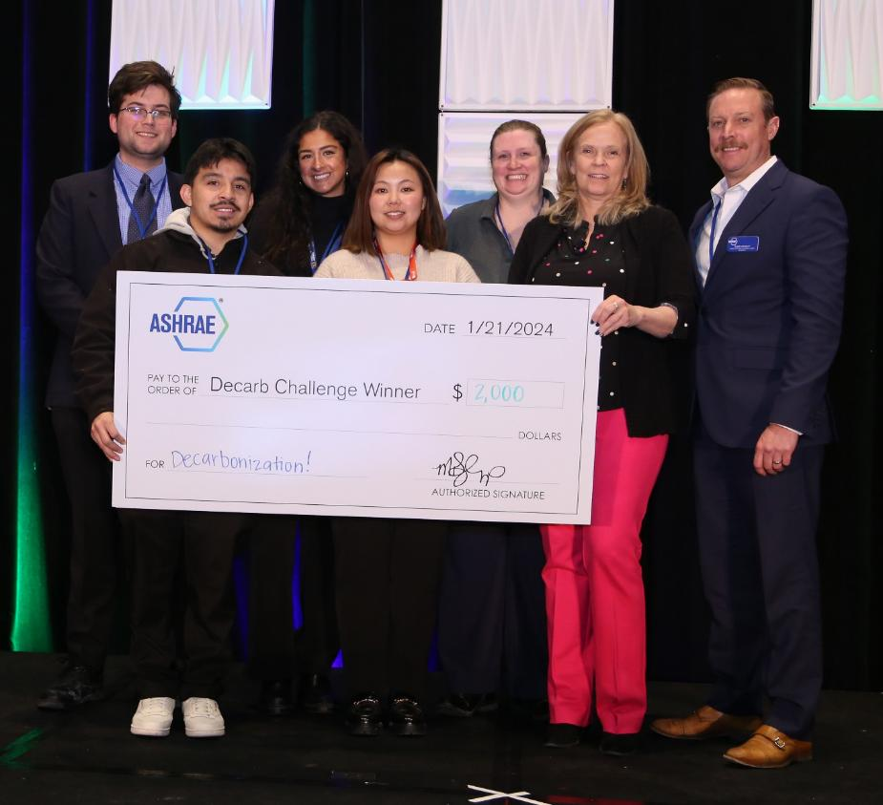
2026-27 Presidential
Initiative Challenge
Decarbonization Retrofits
Competitive grant program available to ASHRAE Chapters to implement projects related to the theme “Decarb Retrofit”
Grants available between $1,000 - $10,000 USD
Application deadline 11/2/2026, at
ashrae.org/presidentialchallenge
Notes:
Also, this year, thanks to the generosity of Presidential Member, Gordon Holness, we will be continuing the Presidential Initiative Challenge. This year’s theme will focus on decarbonization retrofits of existing buildings. You can apply on the website, but don’t delay! The deadline is 11/2/2026. The YEA Committee will hold an informational webinar in September so stay tuned!

Slide 27
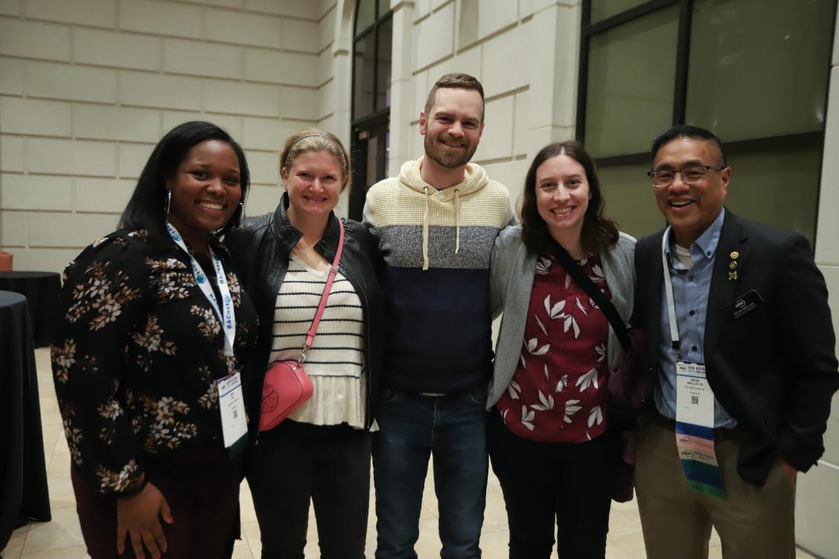
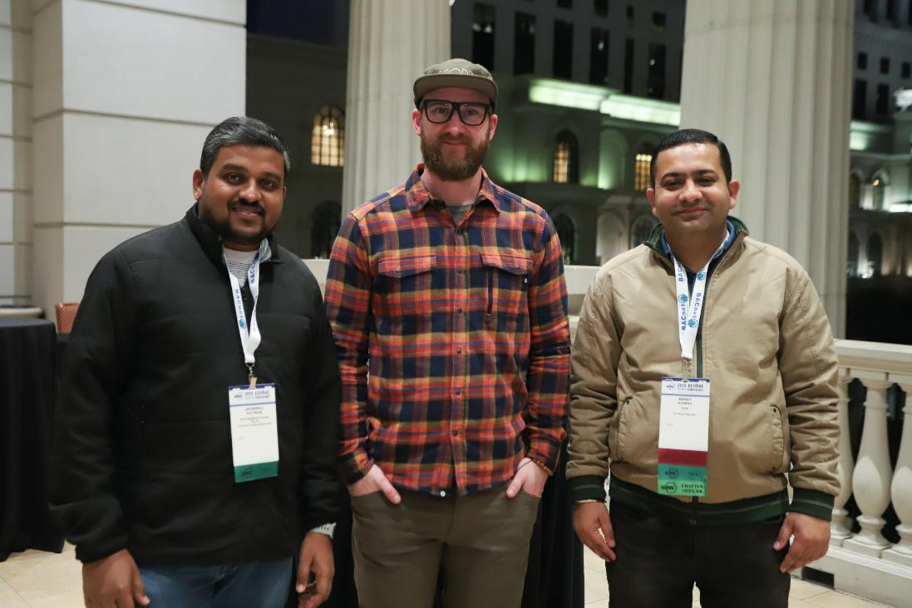
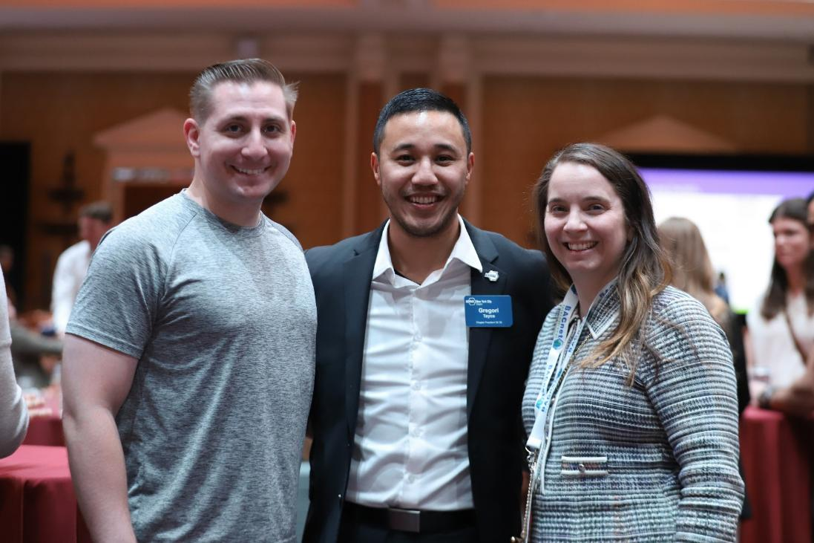

Educator
Building Owner
Building Operator
GET IN THE GAME!
Notes:
So, you may say, this is all great information, but what can I do? I want you to join the team and get in the game! As I said earlier, the best teams play to the strengths of their team members; however, if one person tries to dribble all the way up the field, they face many confrontations. Knowing when to pass the ball to a teammate is important!
If you are an educator, you are our first line of defense. You are introducing future professionals to an industry that is fast-paced, impactful, and exciting. Get in the GAME!!
If you are a building owner or operator, share data on your operations, ask questions about your systems, and work with the team to improve efficiency, comfort, and air quality. Get in the GAME!

Slide 28
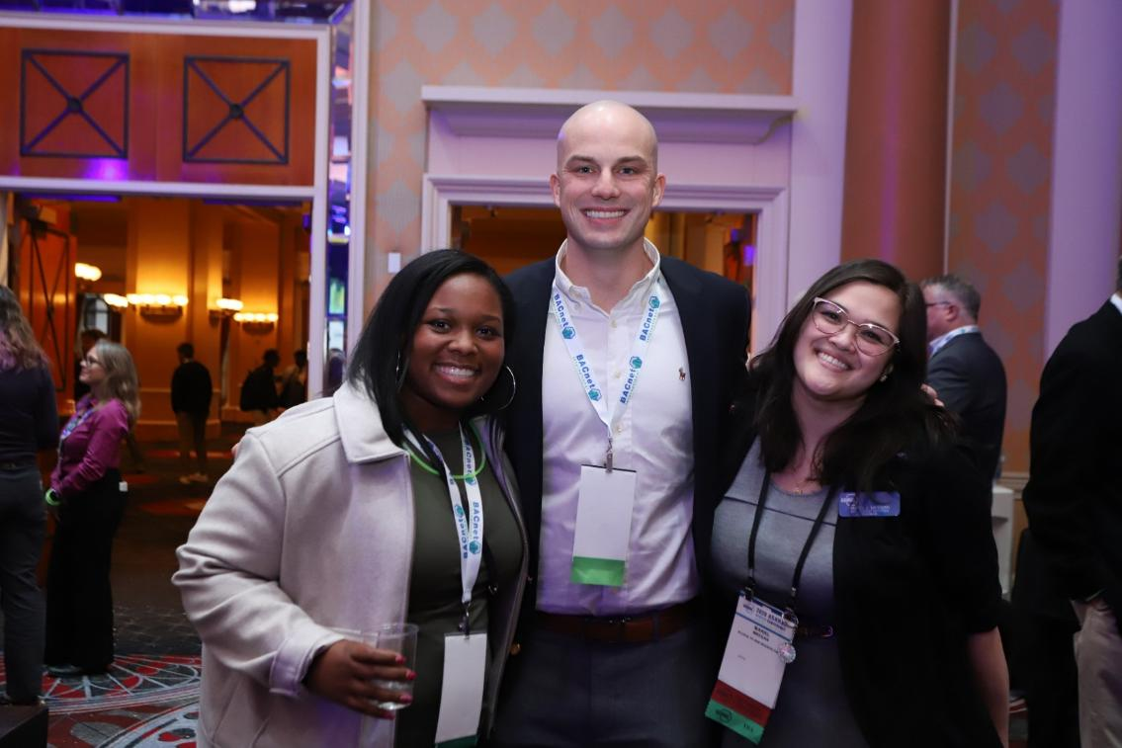
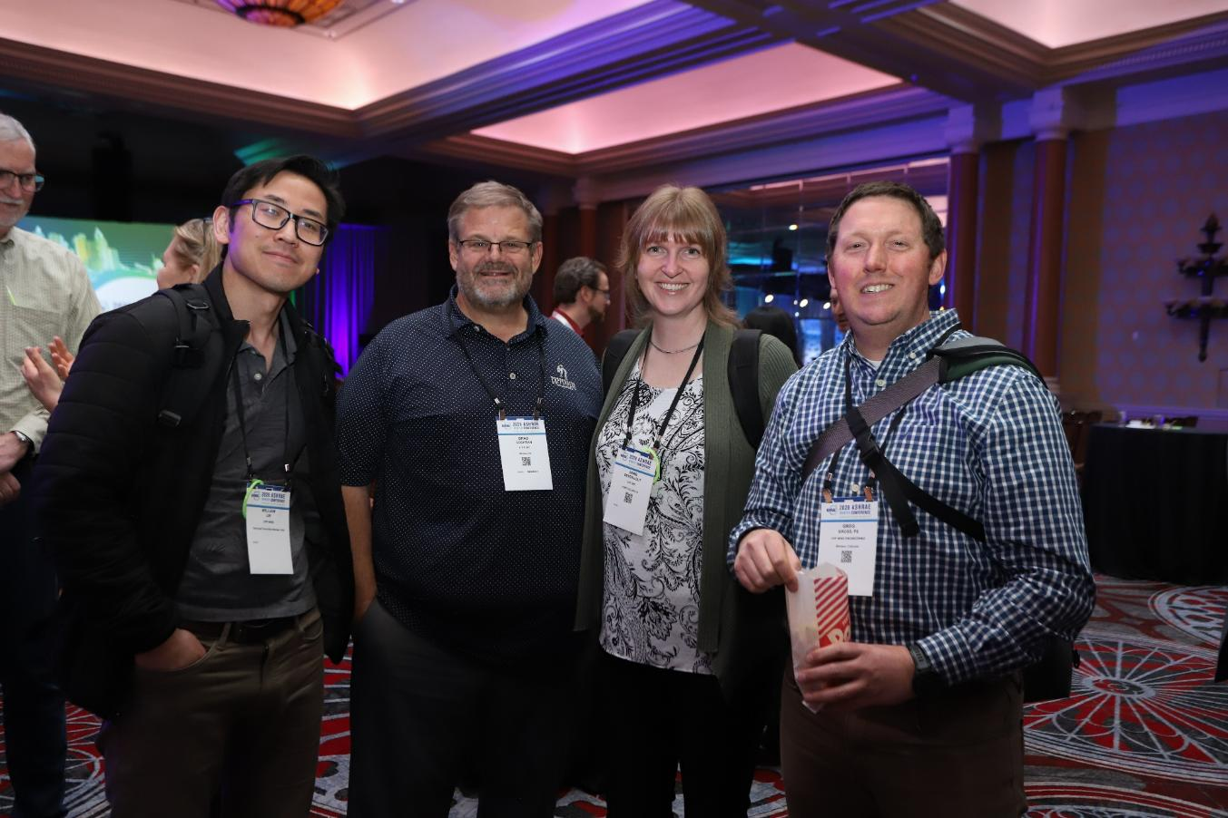


Architect
Engineer
Manufacturer
GET IN THE GAME!
Notes:
If you are an architect or engineer, your insight is critical. Bridge the gap between design intent and real-world performance. Your expertise is key to integrating updates without disrupting daily operations. Get in the GAME!
If you are a manufacturer, assist the team by providing existing equipment capacities and operational parameters. Help the team understand new technologies. Get in the GAME!

Slide 29

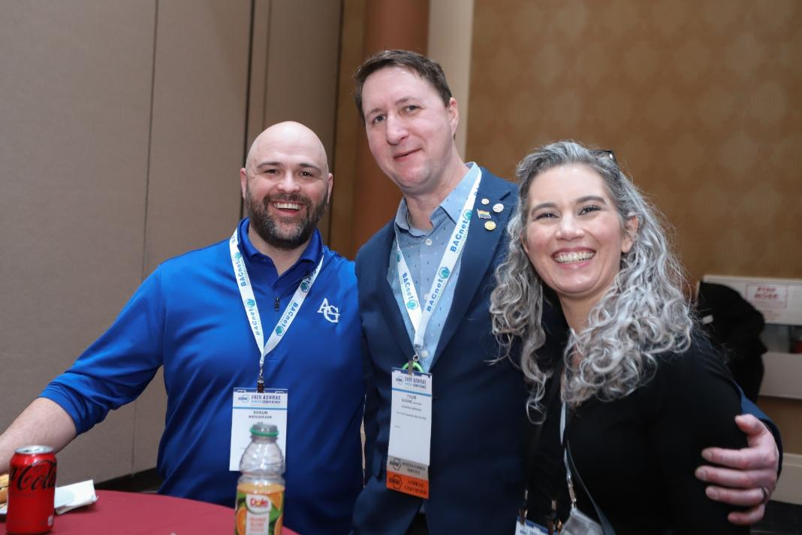
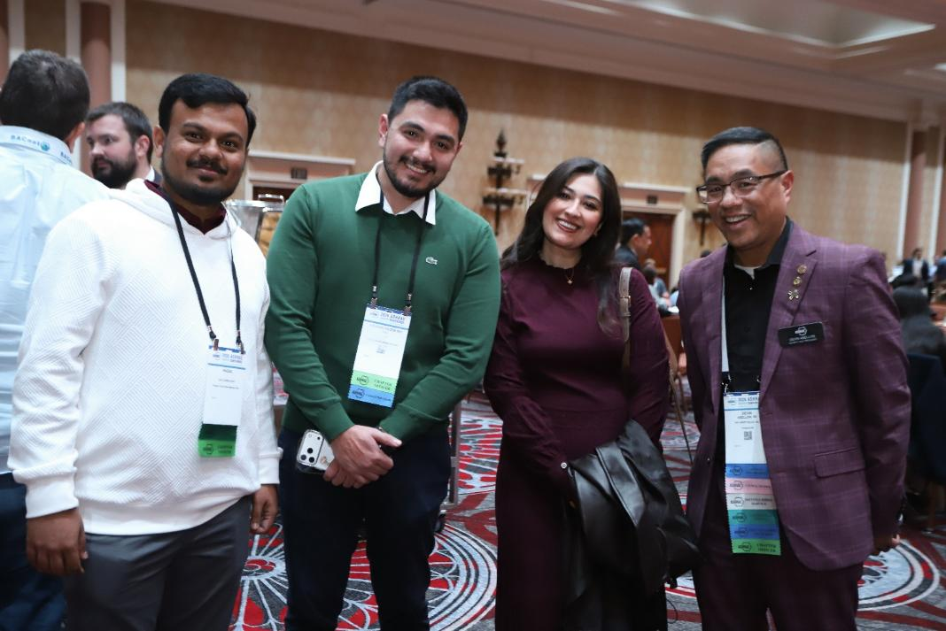

Code Official
Commissioning Provider
GET IN THE GAME!
Notes:
If you are a code official, your role ensures compliance with codes and meeting performance expectations. Understand the retro-commissioning process, from planning and investigation through implementation and verification and help raise the bar for resilience. Get in the GAME!
If you are a commissioning provider, I liken our position to a sweeper in soccer, because we see the whole field. Use that troubleshooting experience to help owners develop a smart game plan that accounts for known restrictions, to meet long-term sustainability and resilience goals. Get in the GAME!

Slide 30

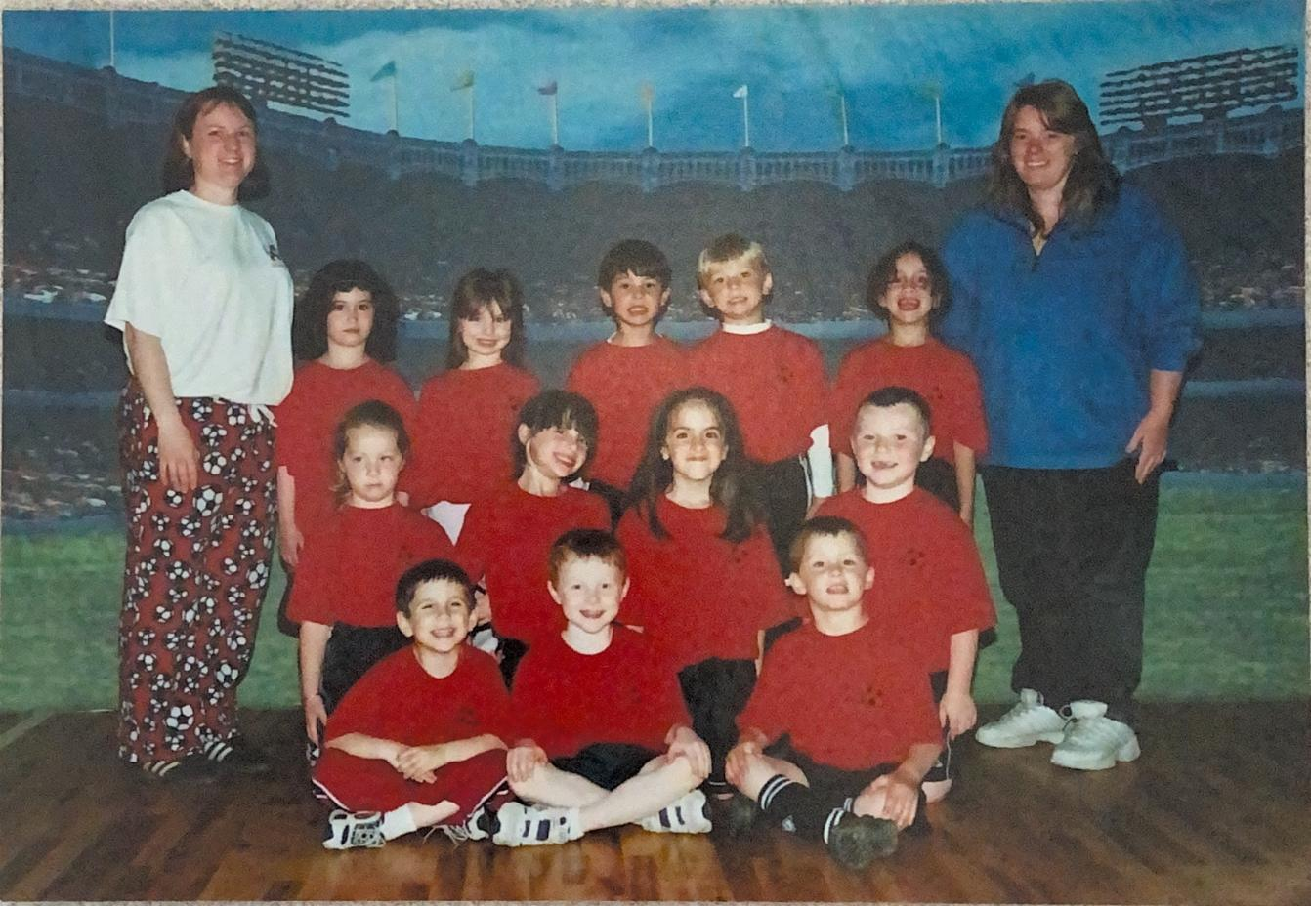
“Fall down 7 times, get up 8.” -Japanese proverb
Notes:
Put on Your Coach’s Hat!
One of the most meaningful roles I’ve had, besides being a parent, is being a coach. I coached my kids’ soccer teams for years. Coaching isn’t just about teaching skills- it’s about helping people learn how to think, adapt, and act on their own. In the real world, just like on the pitch, there isn’t always time to wait for instructions from the sidelines.
We make the best decisions we can, with the information we have, and go. It’s ok to make a mistake// but learn from it and move on. When the world throws you a “googly (curveball),” don’t panic- adapt, adjust, and play with confidence! I fully acknowledge that I don’t have all the answers, but I show up. I listen and learn, try new things, occasionally I fall down, but I get right back up again.

Slide 31
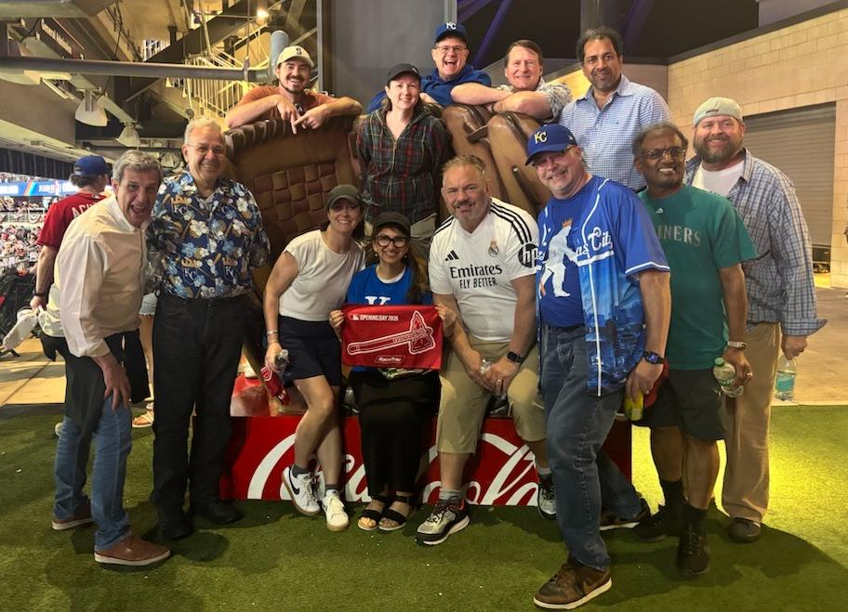
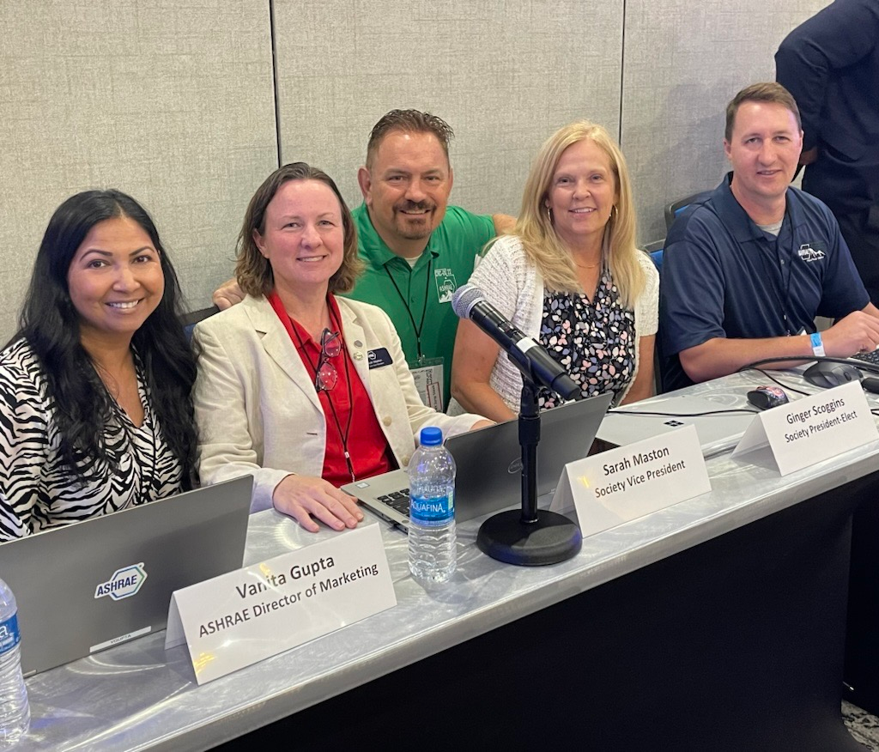
“If you want to go fast, go alone. If you want
to go far, go together.” – African Proverb
Notes:
So, this year, I encourage all of you to put on your coach’s hat! Meet our building industry partners where they are. Listen. Collaborate. Try new approaches!
And when the challenge comes, run up that hill as a team, and encourage everyone to dig deep to meet the trials ahead!
Embrace the challenge and change the game!

Slide 32
Game On!
ashrae.org/president
Notes:
Thank you!

