Slide 2
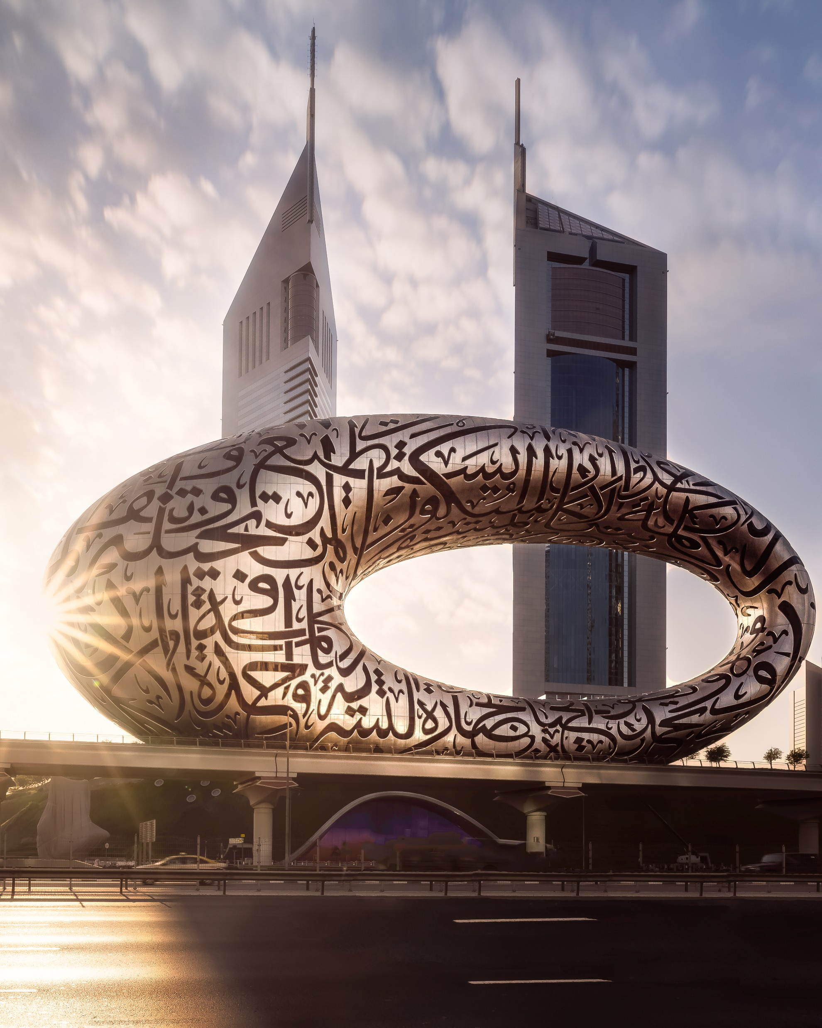
Securing Our Future
State of Society
2023 ASHRAE Winter Conference
Farooq Mehboob
Fellow Life Member ASHRAE
2022-23 ASHRAE President
Museum of the Future, Dubai

Slide 3
Shalom alai khem
May peace be upon you
Paz sea contigo
Notes:
As Salam Alaikum (click)
Shalom alai khem (click)
Paz sea contigo (click)
May peace be upon you (click)

Slide 4
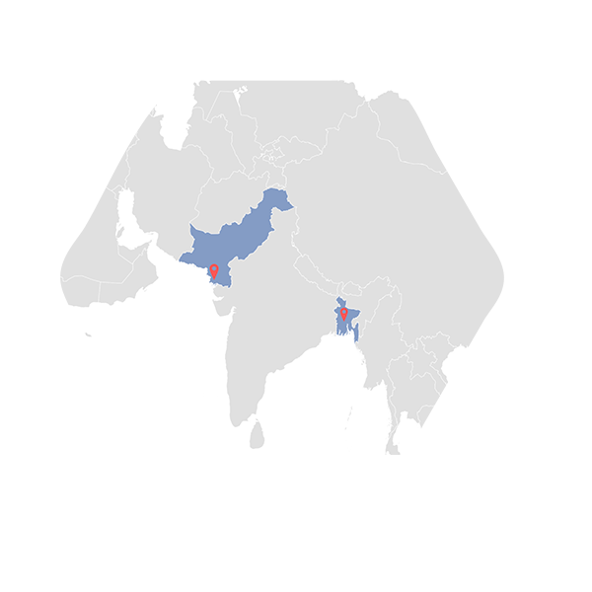
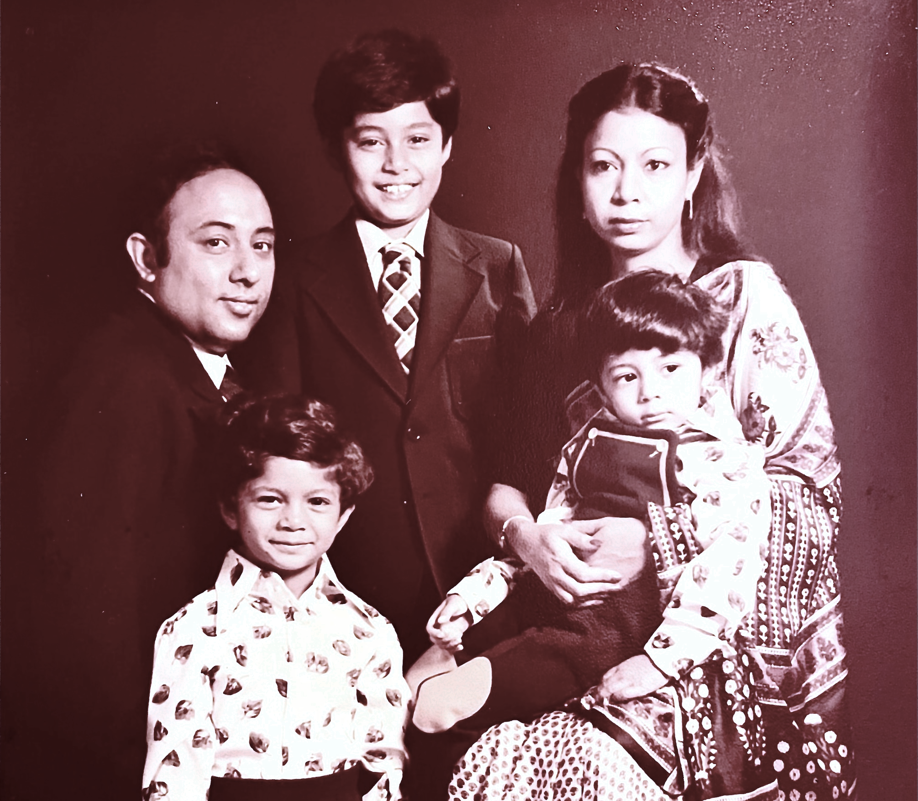
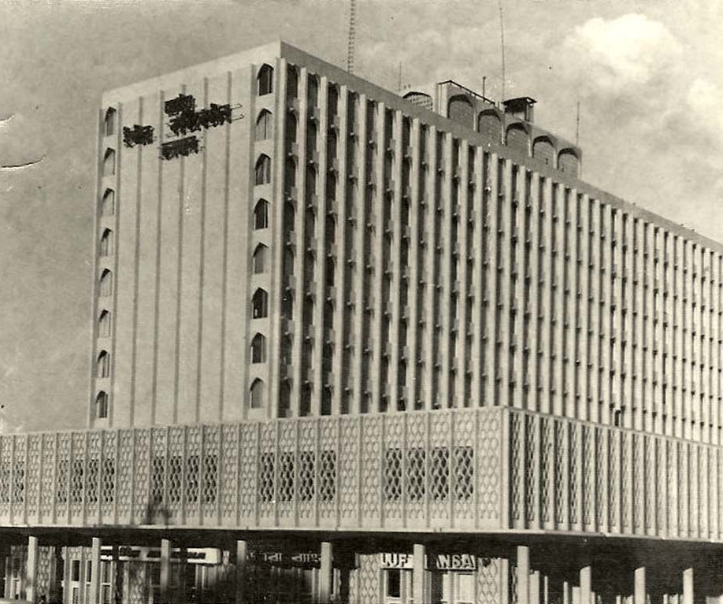
Continuing the Path to Securing Our Future
Iran
Afghanistan
China
Pakistan
Nepal
Bangladesh
(Formerly East Pakistan)
India
Notes:
When I started my term as ASHRAE President in June, we were convening in Toronto and you may recall that I addressed you by video.
I shared my story of being a twenty-five-year-old chief engineer of the InterContinental Hotel in East Pakistan during a time of great political, racial and social unrest, in what led to the breakup of Pakistan into two countries, East Pakistan became Bangladesh and West Pakistan being modern day Pakistan.

Slide 5
Continuing the Path to Securing Our Future
Seek.
Create.
Secure.
Notes:
In my inaugural presidential address, I spoke about the era of unpredictability that we are facing. I reminded you that the future does not belong to those who sit and watch, but instead we must SEEK IT, CREATE IT and SECURE IT.
And that’s what we’ll continue to do because that's who we are. It’s in our ASHRAE DNA.
For the past half year, we have been working on doing exactly that.
I’m here today to report to you on the state of our society, our progress on the initiatives we undertook, and the actions that we have taken in the last six months towards securing our future.

Slide 6
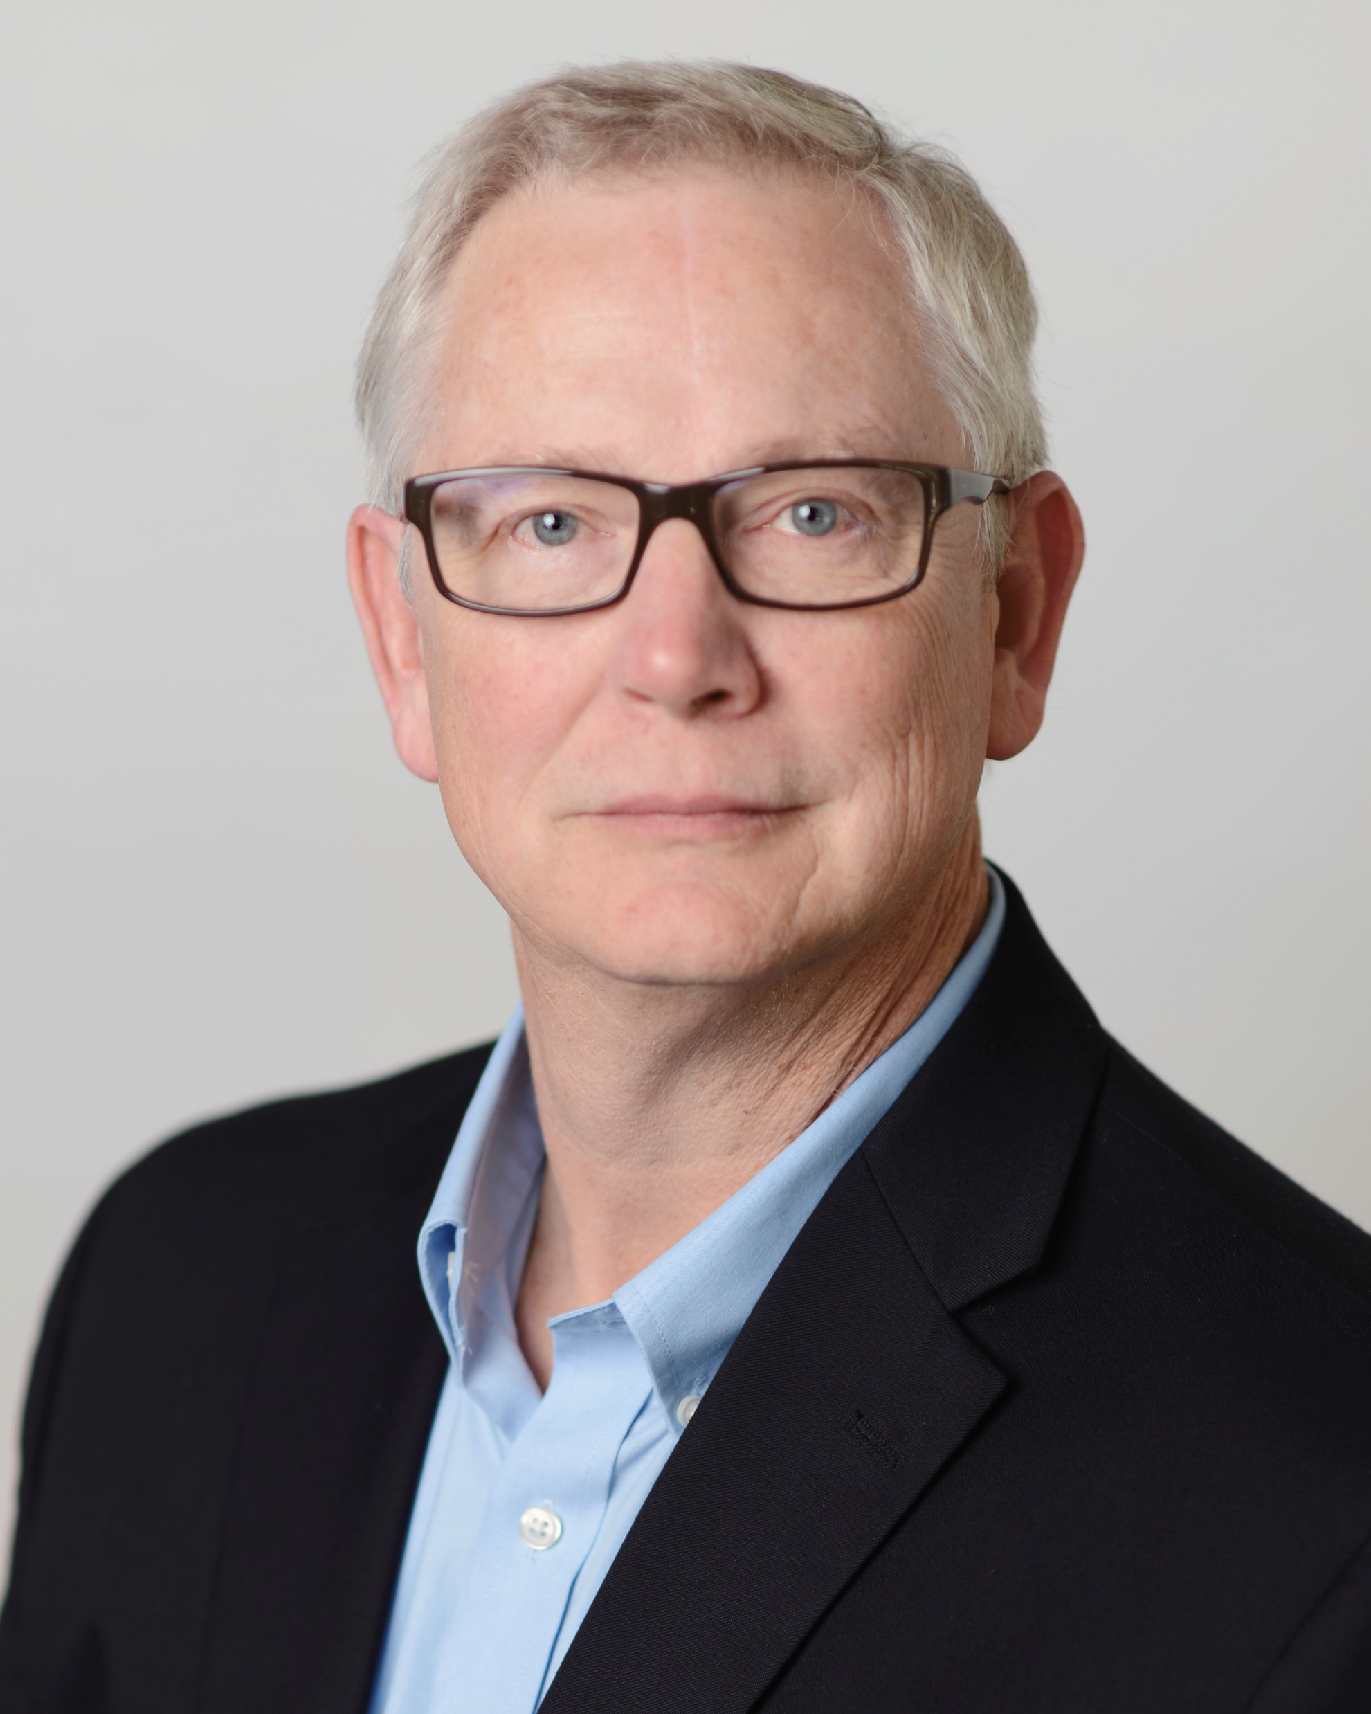
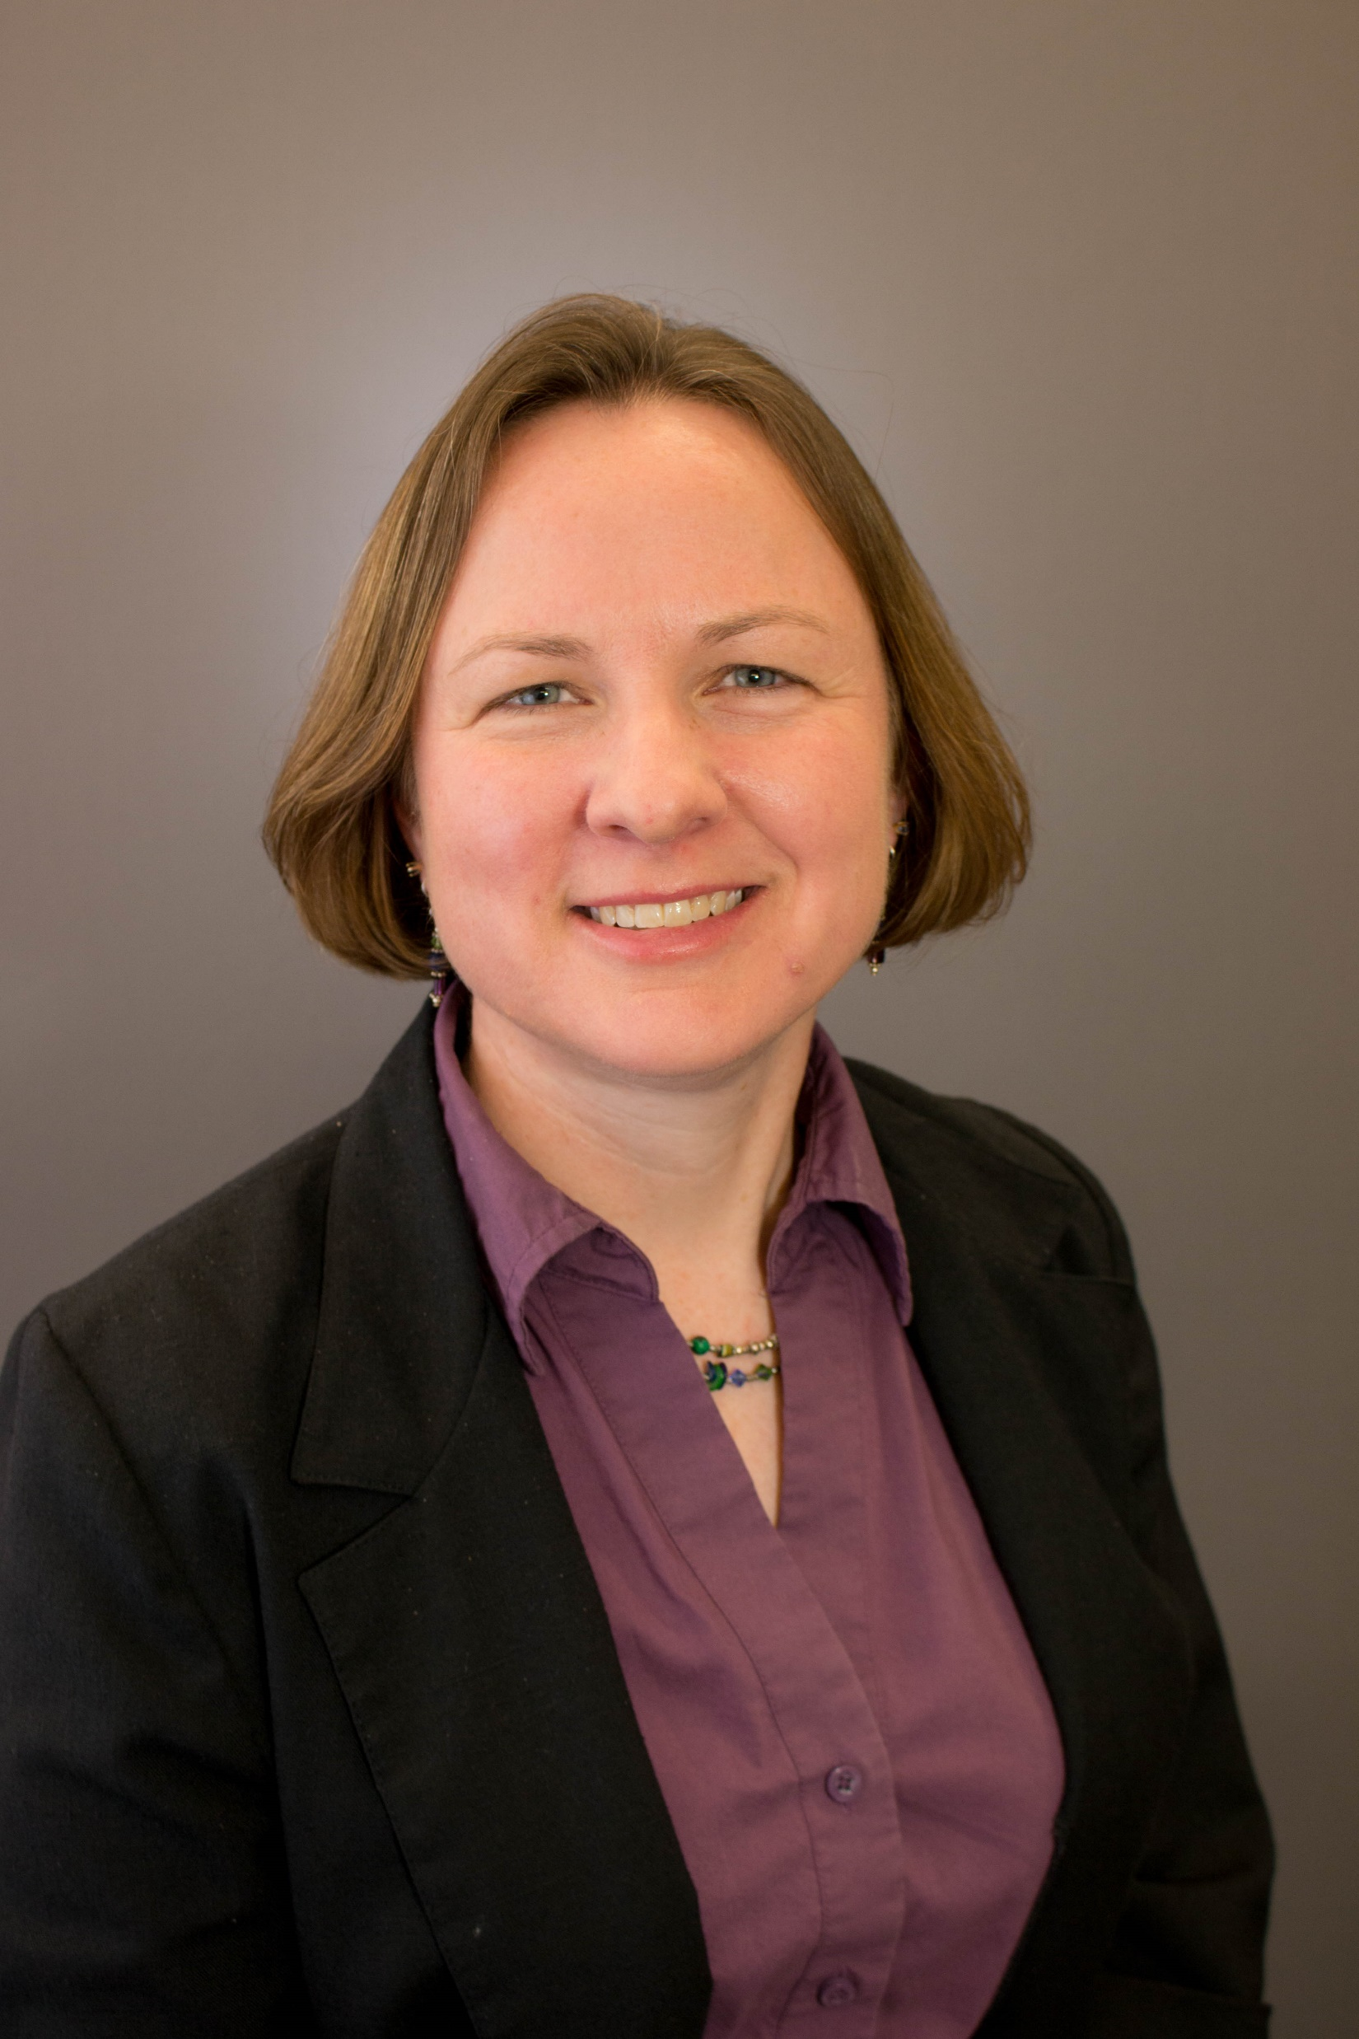
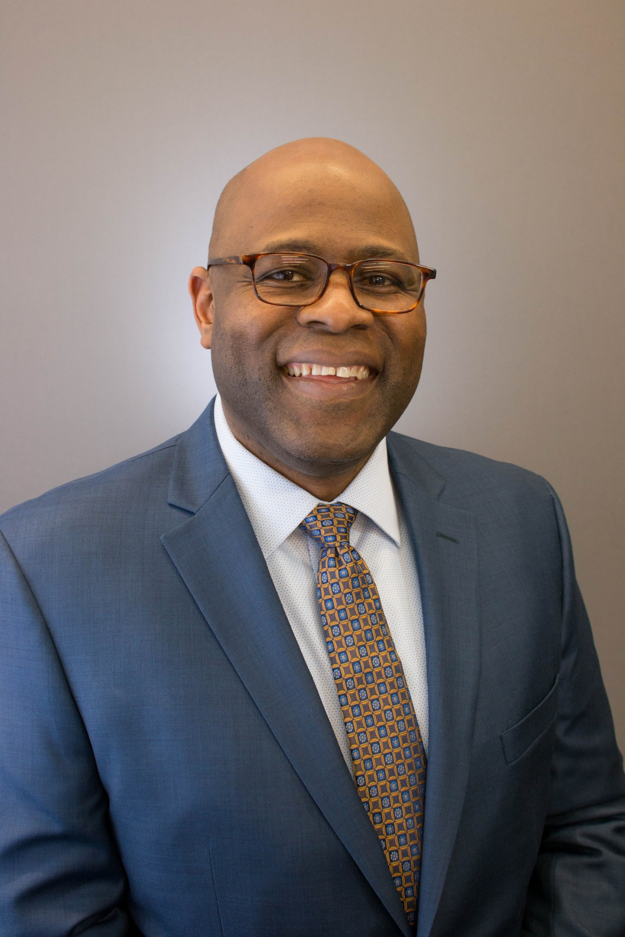
The ASHRAE Board at Work
New Board Subcommittees
Dennis Knight, ASHRAE Treasurer
Fiscal Focus Subcommittee
Sarah Maston, ASHRAE Vice President
Streamlining Subcommittee
Dunstan MacCauley, ASHRAE Vice President
Products/Services Subcommittee
Notes:
Our board of directors is hard at work on securing our future. Key areas we needed to work on were identified and board sub committees set up to address these.
Three key areas for the boards work are:
Bringing a fiscal focus to ASHRAE
Streamlining ASHRAE processes
Developing new products and services
A fiscal focus is required to evaluate that the work we do has a business case and we have key indicators of performance. The fiscal focus subcommittee is led by our Treasurer Dennis Knight and is developing and implementing policies and rules. The performance of ASHRAE is incorporated into graphic “dashboards” highlighting trends and key data. These are issued every month so that we have our finger on the pulse.
Together with fiscal focus it is important to streamline the processes of ASHRAE, we need to work at the speed of business, break down silos and move decision making lower down in the organization. This effort is led by Vice President Sarah Maston and the committee is expected to produce streamlining recommendations for the board’s consideration in the coming months.
Vice President Dunstan MacCauley is leading the subcommittee working on identifying new products and services which our members and the market need. This work is urgent given the changing needs of the market in the digital age.

Slide 7
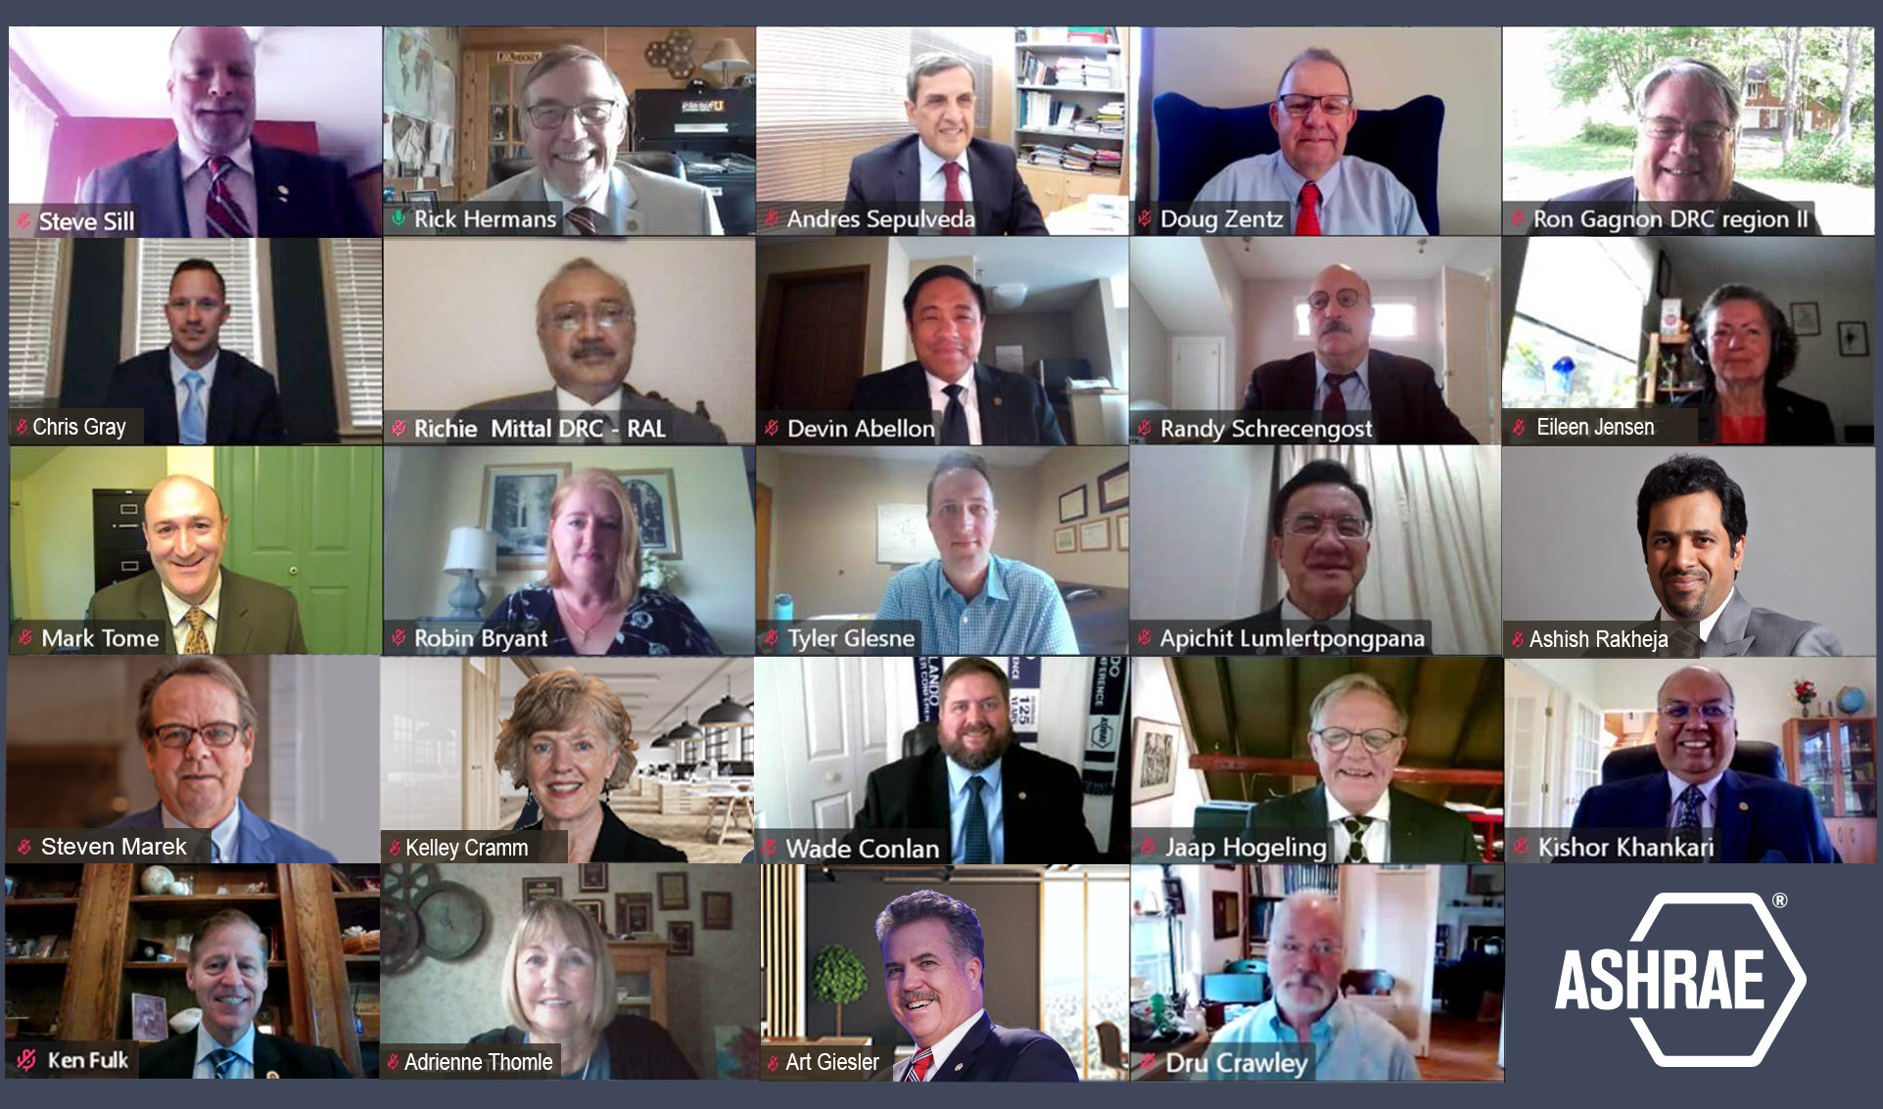
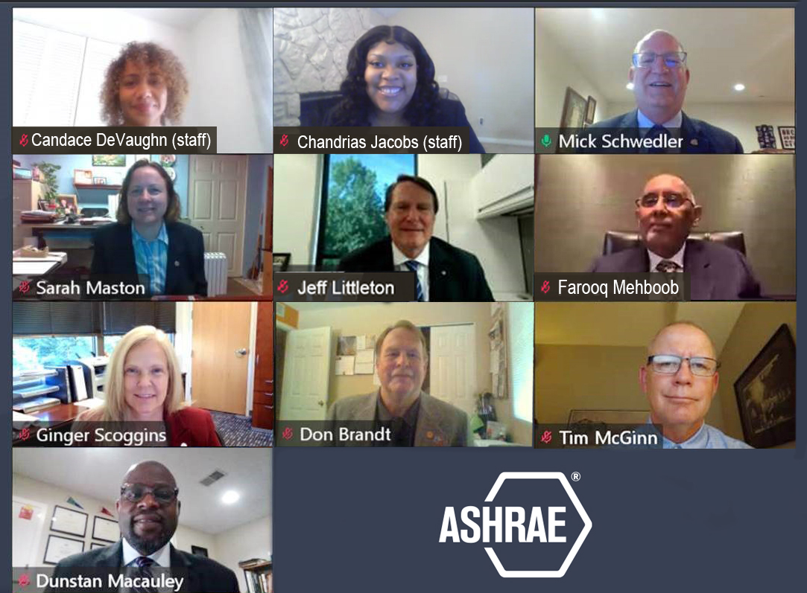
Making ASHRAE Transparent
You’re invited! ASHRAE Board meeting details including links to participate is available at ashrae.org/bod
Notes:
Diversity is critical to securing the future of ASHRAE. The two key prerequisites for ASHRAE’s diversity are transparency and participation.
ASHRAE is improving our transparency by livestreaming the board of directors’ meetings and council meetings. Hundreds have now tuned in to witness the actions of our Society firsthand. Our members can now view upcoming meeting information, find agendas and links to virtually watch board meetings at ashrae.org/bod.
You can also signup for our Board Activities email. A quarterly board newsletter to Chapter Presidents has been started.

Slide 8
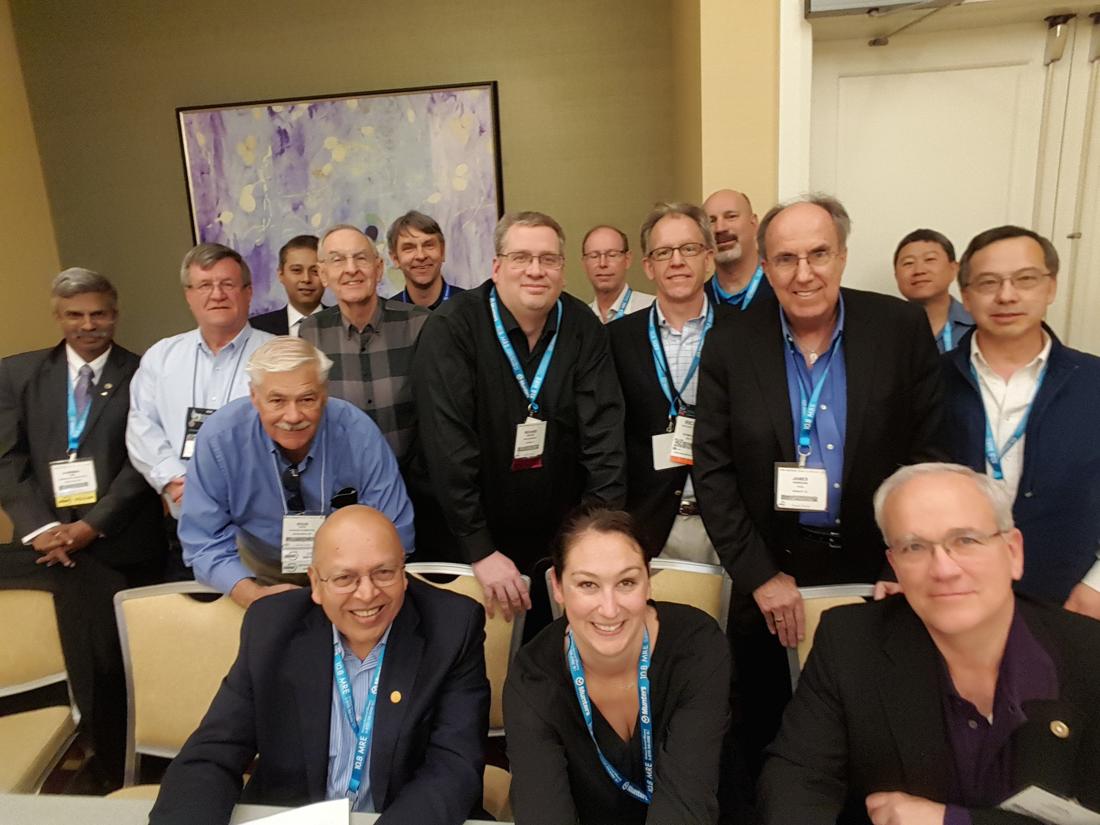
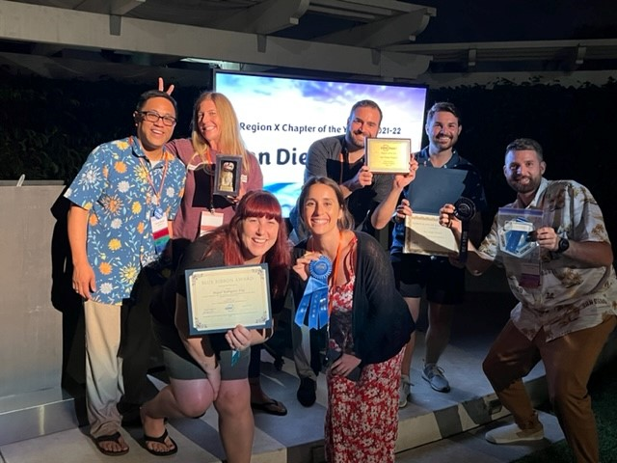
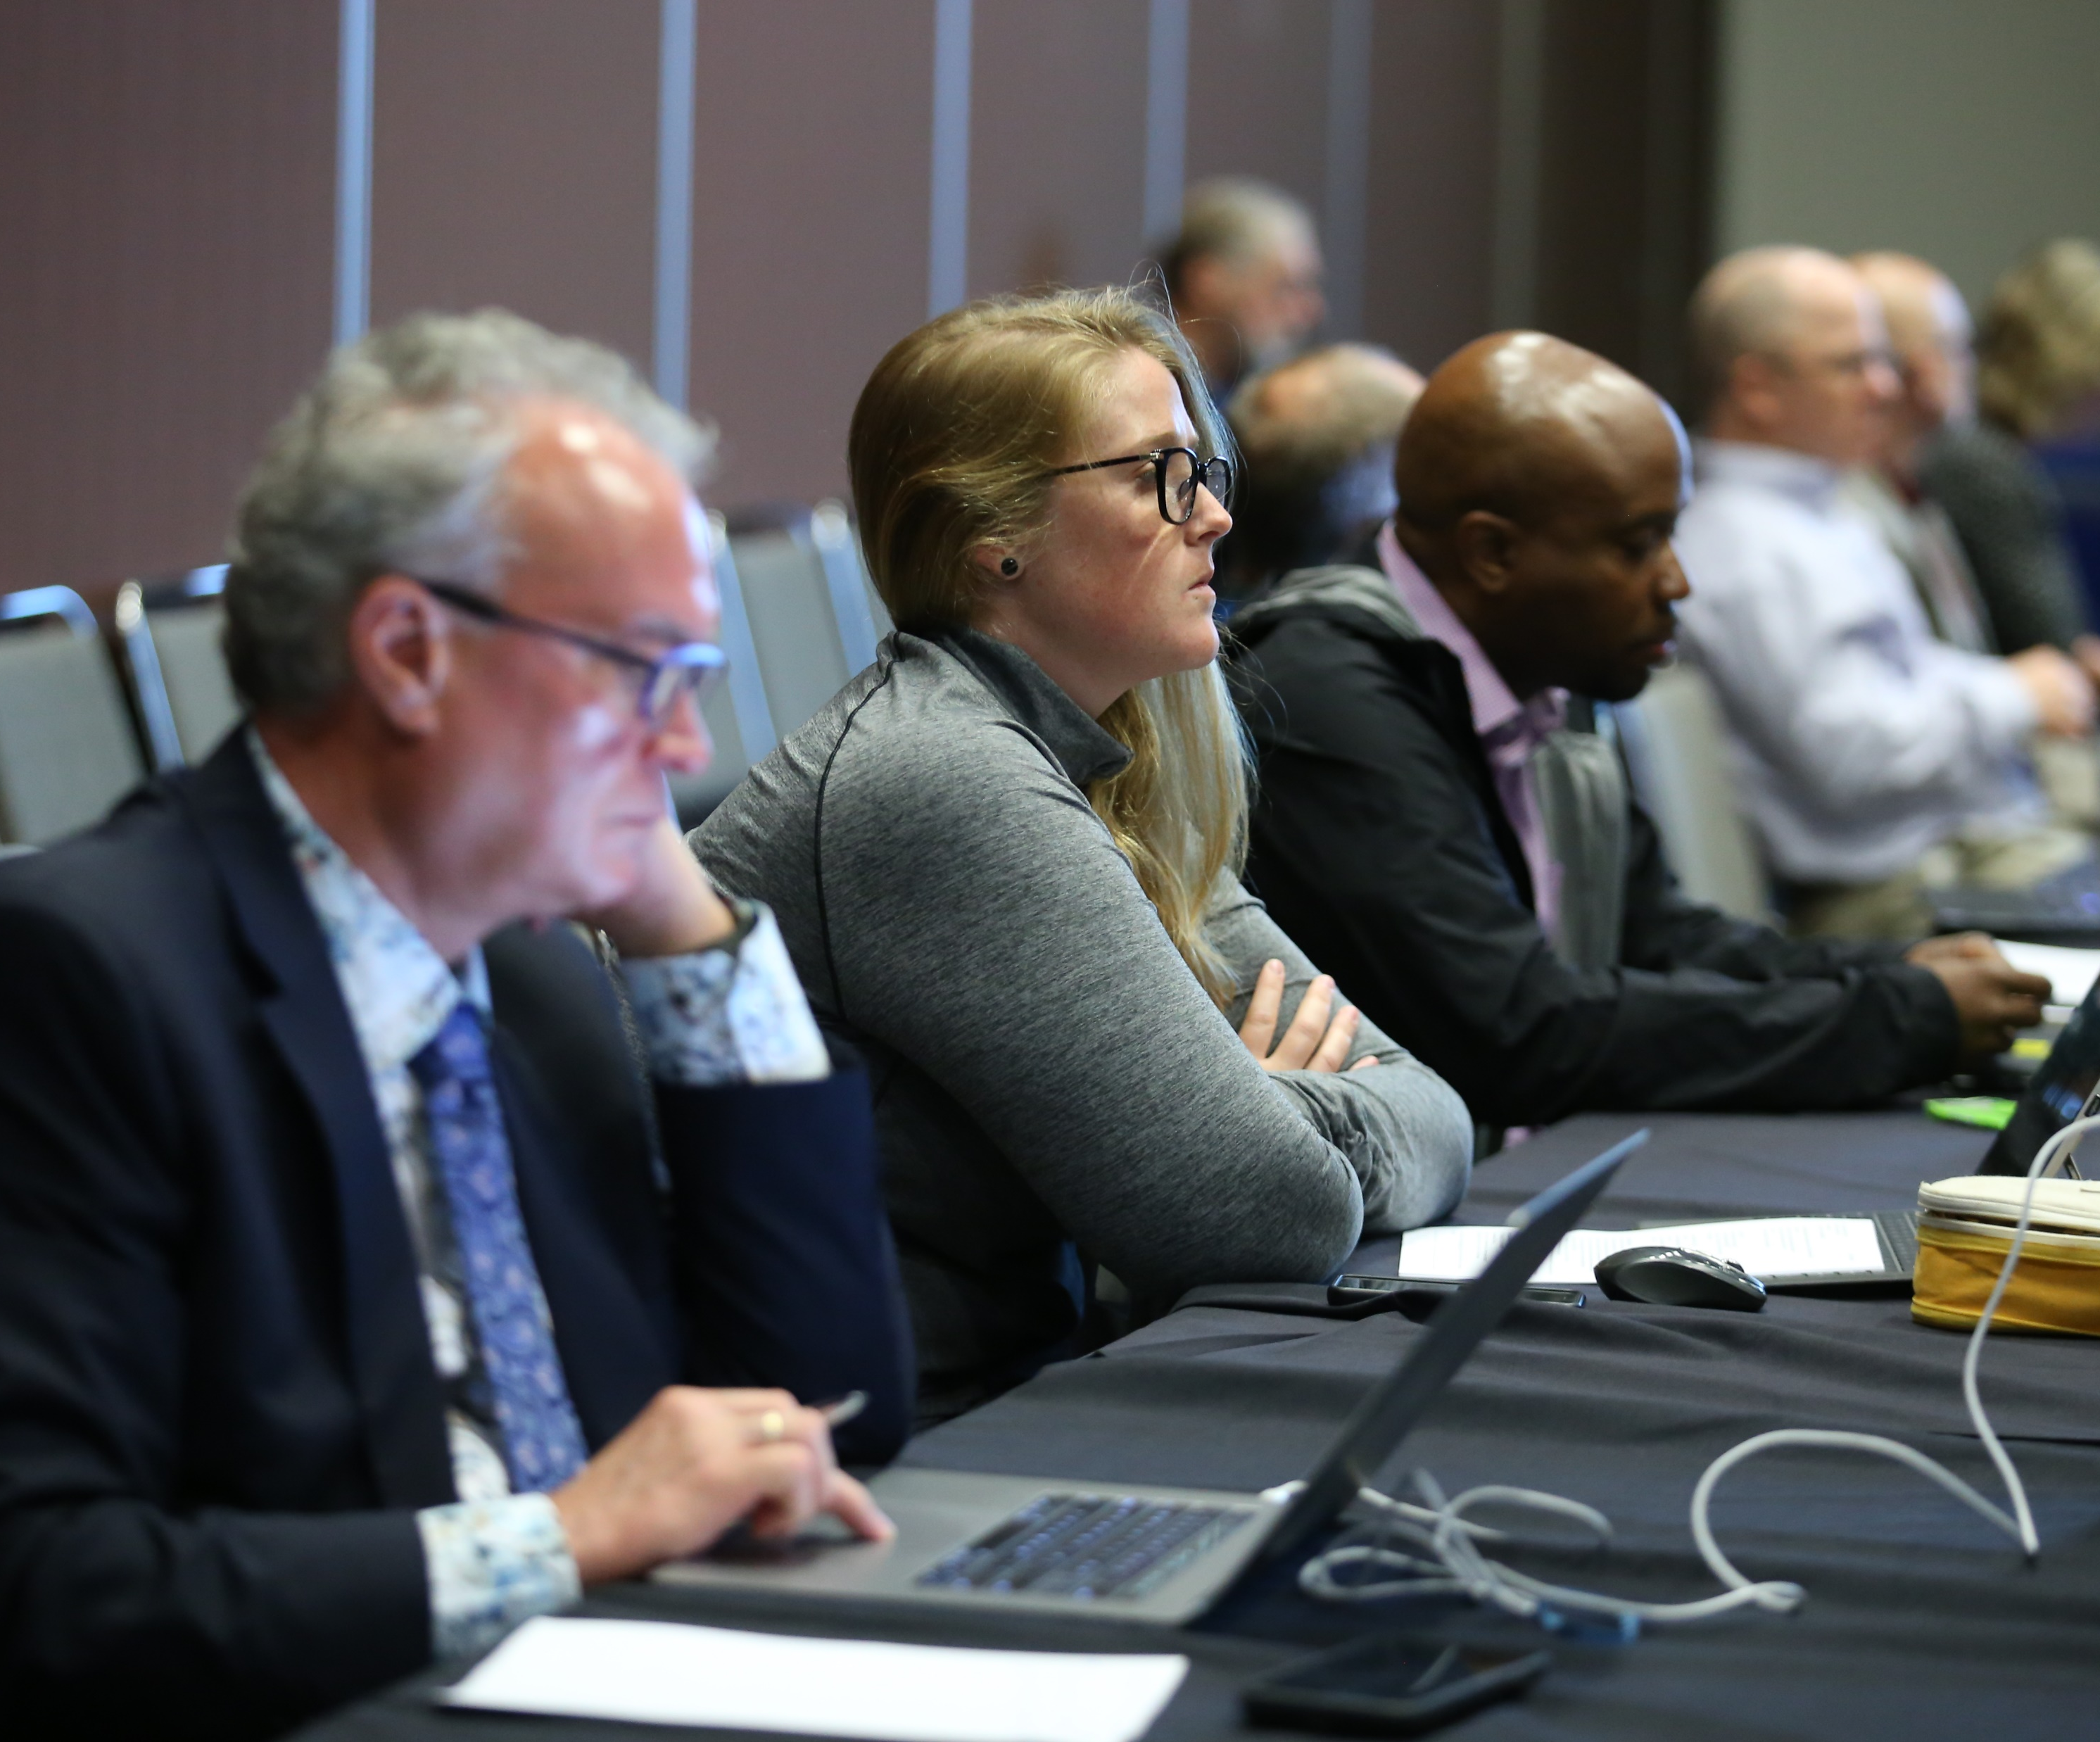
Encourage Participation
Financial Training for Chapters
New products and services in more languages
Collaboration between Chapters and Technical Committees
Notes:
We are empowering our global force of volunteers with knowledge and collaboration tools, which in turn leads to greater participation and true diversity. The Finance Committee is developing financial training for regions and chapters.
The Publication and Education Council is hard at work developing and offering even more products and services that are translated into other languages and tailored to the challenges encountered in various parts of the world.
To date, we offer 57 publications in languages other than English.
Additionally, the Publication and Education Council and the Technology Council are working together to provide a path for collaboration between the chapters and technical committees to create locally focused guides and tools.
To lower the financial barriers for volunteer participation, we will provide opportunities for members to serve as instructors for ALI courses, write content, and provide other services.
These opportunities will be widely advertised and easy to avail.

Slide 9
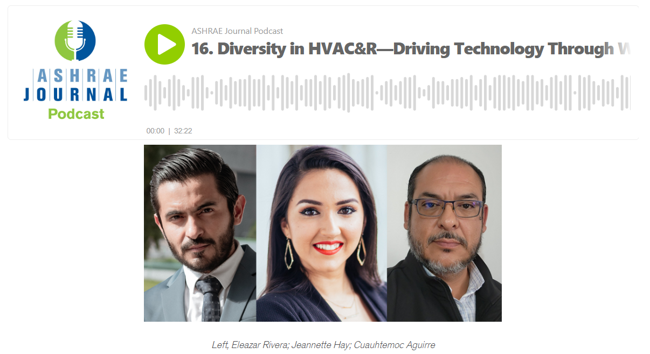
Making ASHRAE Truly Diverse
Creating DEI materials for ASHRAE Chapters
Workshops at Annual and Winter Conferences, including today’s ASHRAE Cultural Mixer Forum
ASHRAE Journal Podcast
Diversity in HVAC&R—Driving Technology
Through Workforce Development
Notes:
What determines how quickly we can react and adapt depends in great part on how well attuned we are to developments and how willing we are to embrace change. Building a stronger culture of equity, diversity and inclusion in ASHRAE will help the Society be more creative, innovative, and resilient. This requires us to grow and think beyond our comfort zone.
Our Diversity, Equity and Inclusion board subcommittee led by Director Adrienne Thomle continues to work hard, creating materials for ASHRAE Chapters and establishing workshops on pertinent topics. The subcommittee is working on a DEI strategic plan for Ashrae with prioritized training needs and tools for training, developing DEI policies relating to appointments, honors and awards, committee membership, volunteer engagement and chapter programs.
DEI training videos and podcasts have been made available to all ASHRAE members. These DEI initiatives help make ASHRAE a welcoming home for all. The work of the subcommittee will be truly transformative.

Slide 10
Diversity, Equity, Inclusion
Presidential Visits
ASHRAE Central Pakistan Chapter – Lahore, Pakistan
ASHRAE Falcon Chapter – Dubai, United Arab Emirates
53rd International HVAC&R Congress/ASHRAE Danube Chapter - Belgrade, Serbia
ASHRAE Southern California, Orange Empire and Tri-County Chapters – Los Angeles, California
ASHRAE Region XII Florida Chapters
Industry Roundtable, Orlando, Florida
Region XIII CRC – Tokyo, Japan
Region I CRC – Concord, New Hampshire
Region XIV CRC – Madrid, Spain
BOD & RAL CRC/Global HVAC&R Summit – Istanbul, Turkey COP27 – Sharm el-Sheikh, Egypt
ASHRAE Pakistan Chapter/2nd HVACR Trends Conference and Expo – Karachi, Pakistan ASHRAE Northern Pakistan Chapter – Islamabad, Pakistan
Notes:
I am privileged to have witnessed the power of diversity and engagement through my travels as president and met with Chapter members from around the world at CRCs and Chapter visits.
Our society is rich in culture and experience. Thank you for your commitment to securing our future.

Slide 11
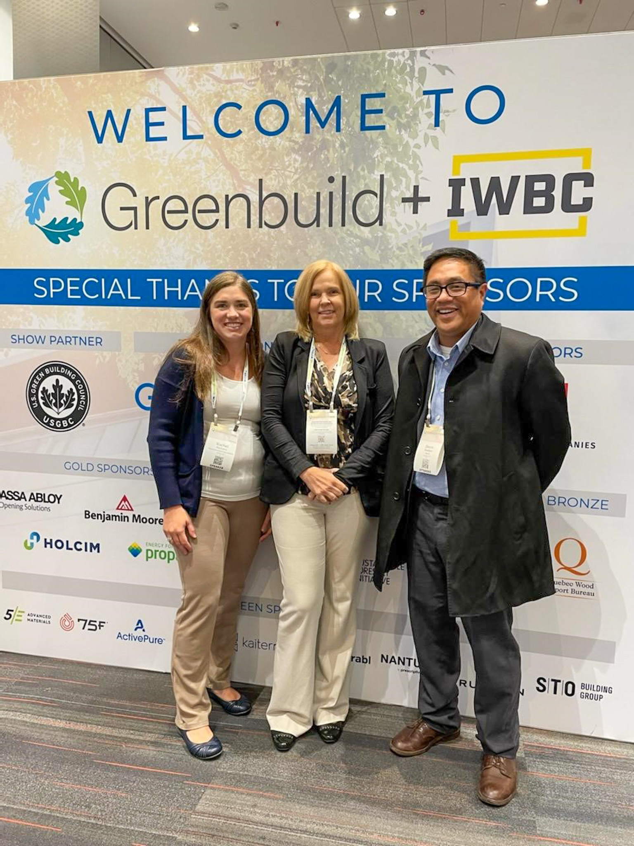
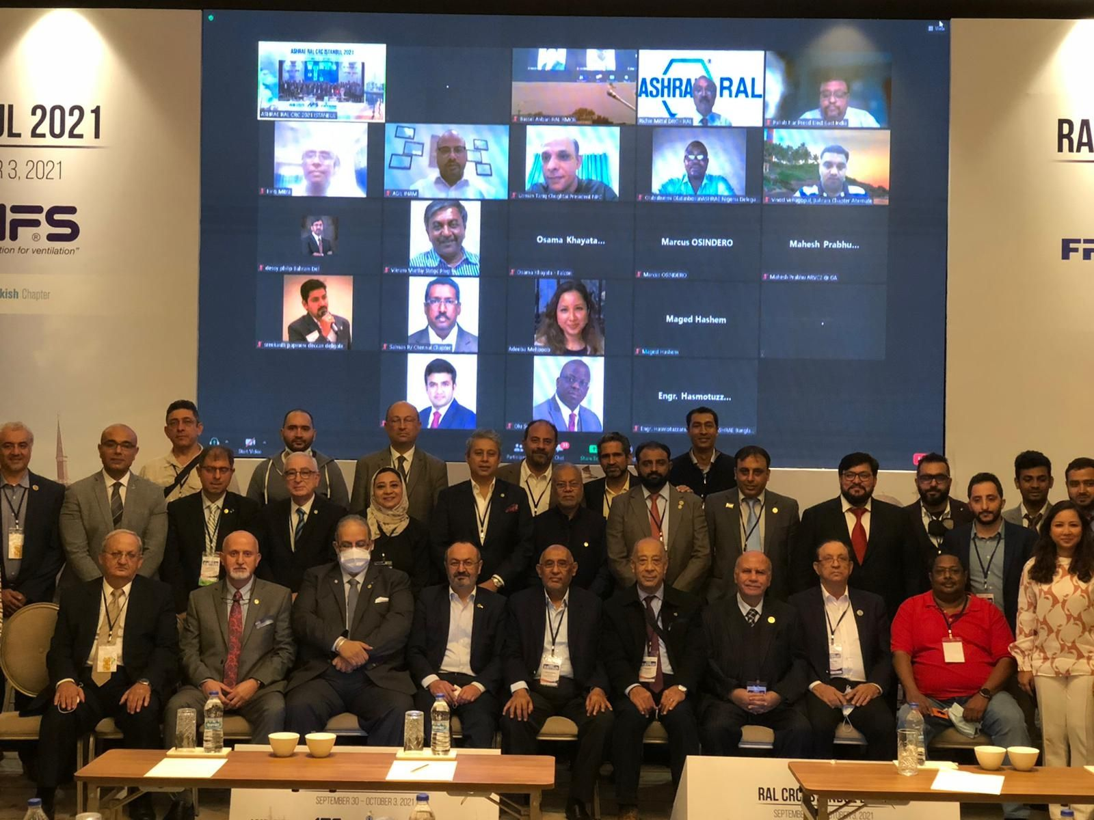
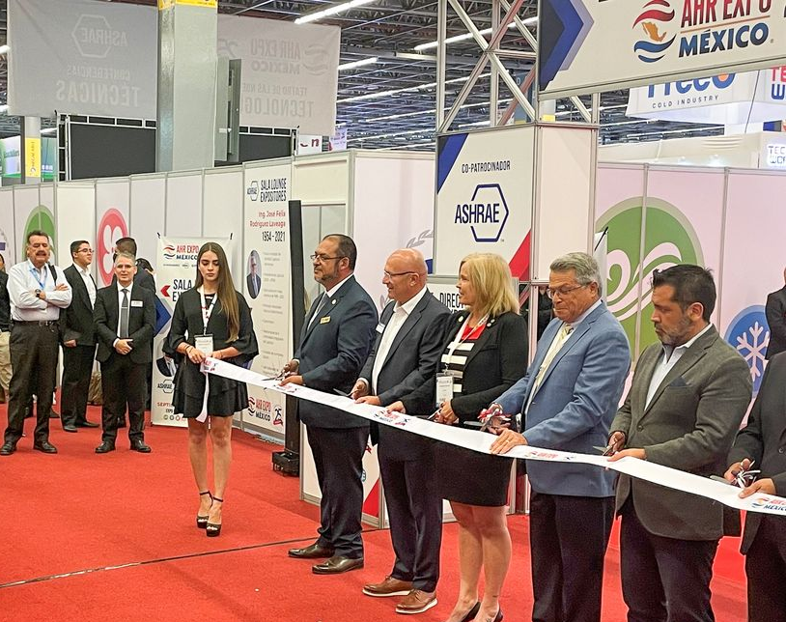
Harnessing the Power of Relationships
AHR Mexico - Guadalajara
Virtual Joint Chapter Meetings
Greenbuild - San Francisco
HVACR State of the Industry Leadership Panel Discussion
Notes:
We are harnessing the power of relationships and fostering greater participation by creating virtual joint chapter meetings between North American and International chapters focusing on critical issues. We will continue to create and nurture relationships through our participation in leading industry events around the world.
We’re raising ASHRAE’s profile by contributing our technical expertise in media features, both within the industry and mainstream outlets such as the CNN, ABC News, NPR, Newsweek, Bloomberg News, The New York Times and The Washington Post to name a few.
I had an opportunity to speak with a room full of industry and mainstream media journalists, over coffee, about how we are Securing Our Future.
I also had the pleasure of joining top industry leaders and experts to participate in leadership panel discussion on challenges and opportunities in our industry.

Slide 12
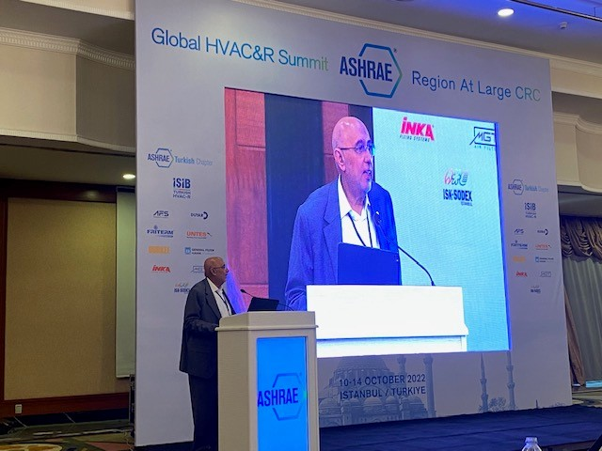
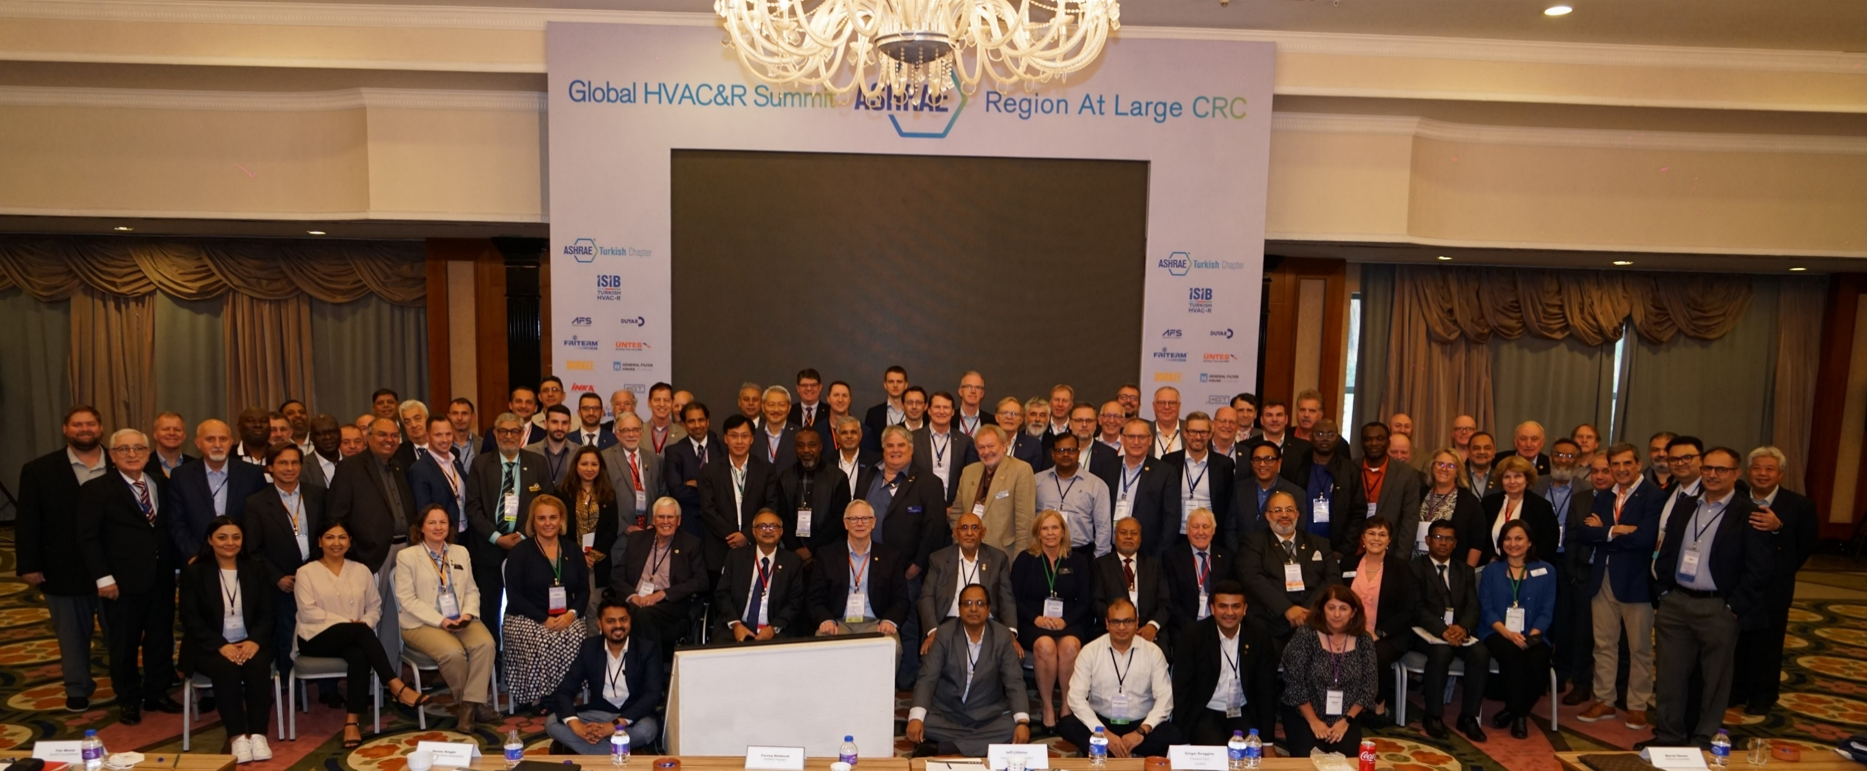
Harnessing the Power of Relationships
The Global HVAC&R Summit in Istanbul
Notes:
To harness the enormous power of our global partners and industry we brought together the ASHRAE Board of Directors, global HVAC&R associations, the architect and consulting engineering community, manufacturers, research development scientists and policy makers in Istanbul, Turkey at a global HVAC&R Summit to address the critical issues facing our industry. Our goal was to define the causes and identify ways we can work together to solve the issues.
I’m proud to report that the summit was a huge success, with more than 200 global leaders in attendance to discuss such topics as building decarbonization, climate crisis mitigation, workforce development, IEQ and wellness, food security, the cold chain and energy security. The result was the HVAC&R Global Summit final report, which was released in January and is available for download on ashrae.org.
ASHRAE will continue to work on implementing the recommendations from the Summit. We are excited about this global plan of action for the HVAC&R industry.

Slide 13
Harnessing the Power of Relationships
COP 27 Official Side Event
Planning, Design and Development in the Global South: The ‘How To’ for People + Planet
Notes:
In November, ASHRAE was invited to attend the 2022 United Nations Climate Change Conference known as COP 27, where countries came together to take action towards achieving the world’s collective climate goals as agreed under the Paris Agreement. ASHRAE Treasurer Dennis Knight and I had the honor of participating at a side event coordinated with Architecture 2030 and the International Network of Women Engineers and Scientists on Planning, Design and Development in the Global South.
Leading up to this important event, ASHRAE, along with 24 of the world’s top industry organizations, issued a statement pledging to assume a leadership role in decarbonization efforts in the built environment. This demonstrates how ASHRAE continues to raise its profile around the world and be part of the conversation on critical issues of the day.

Slide 14
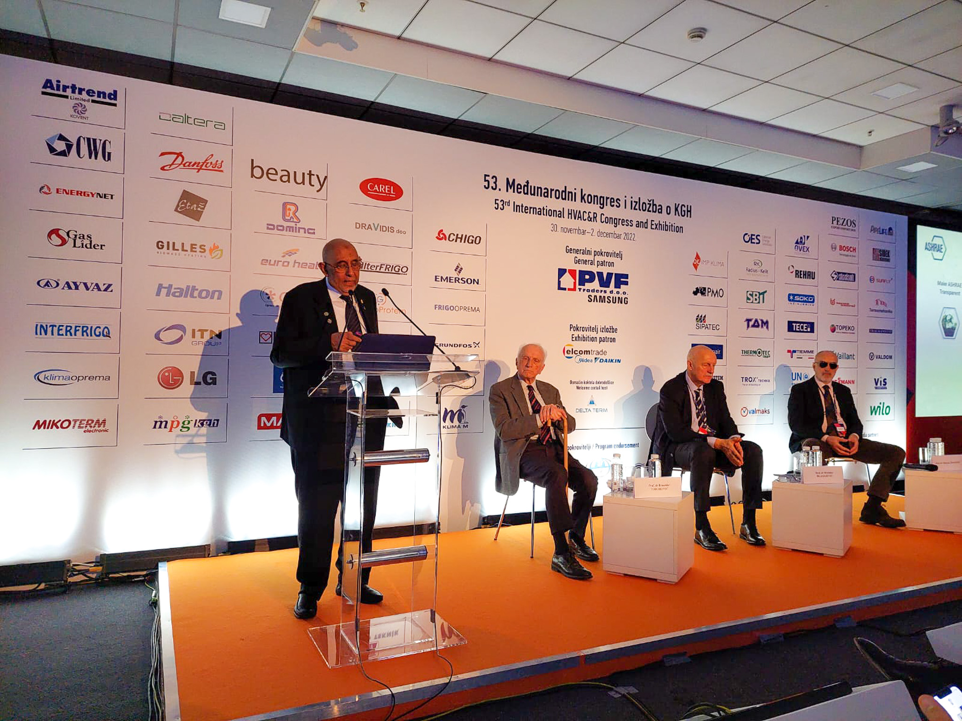
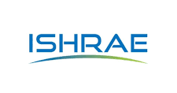
Harnessing the Power of Relationships
New and Renewed Memorandum of Understandings
World Health Organization (WHO)
Pan American Health Organization (PAHO)
Federation of European Heating, Ventilation and Air Conditioning Association (REHVA)
Indian Society of Heating, Refrigeration and Air Conditioning (ISHRAE)
Notes:
Maintaining and creating strategic alliances is an important element of harnessing the power of relationships. I am happy to report that ASHRAE has created or renewed partnership agreements with the following organizations:
World Health Organization (WHO)
Pan American Health Organization (PAHO)
Federation of European Heating, Ventilation and Air Conditioning Association (REHVA)
and
Indian Society of Heating, Refrigeration and Air Conditioning Engineers (ISHRAE)

Slide 15
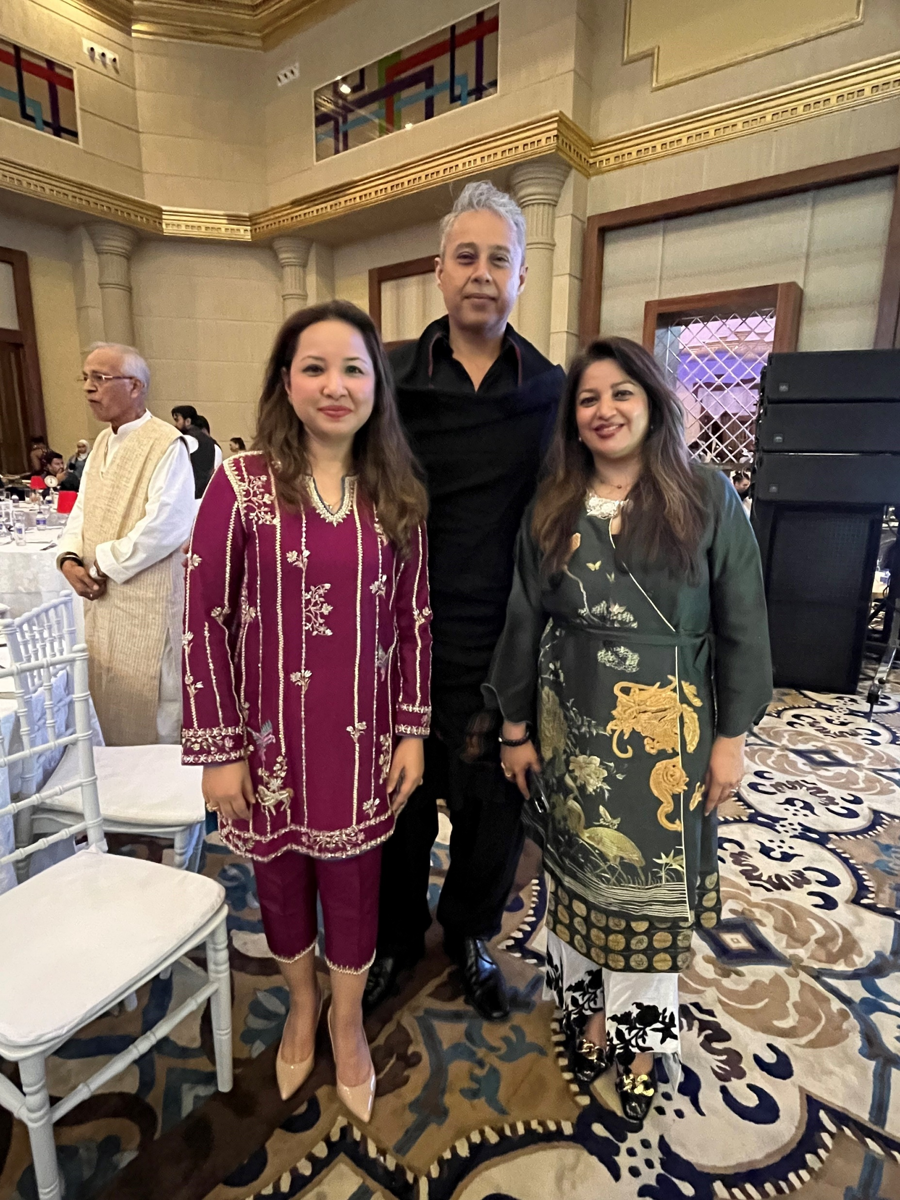
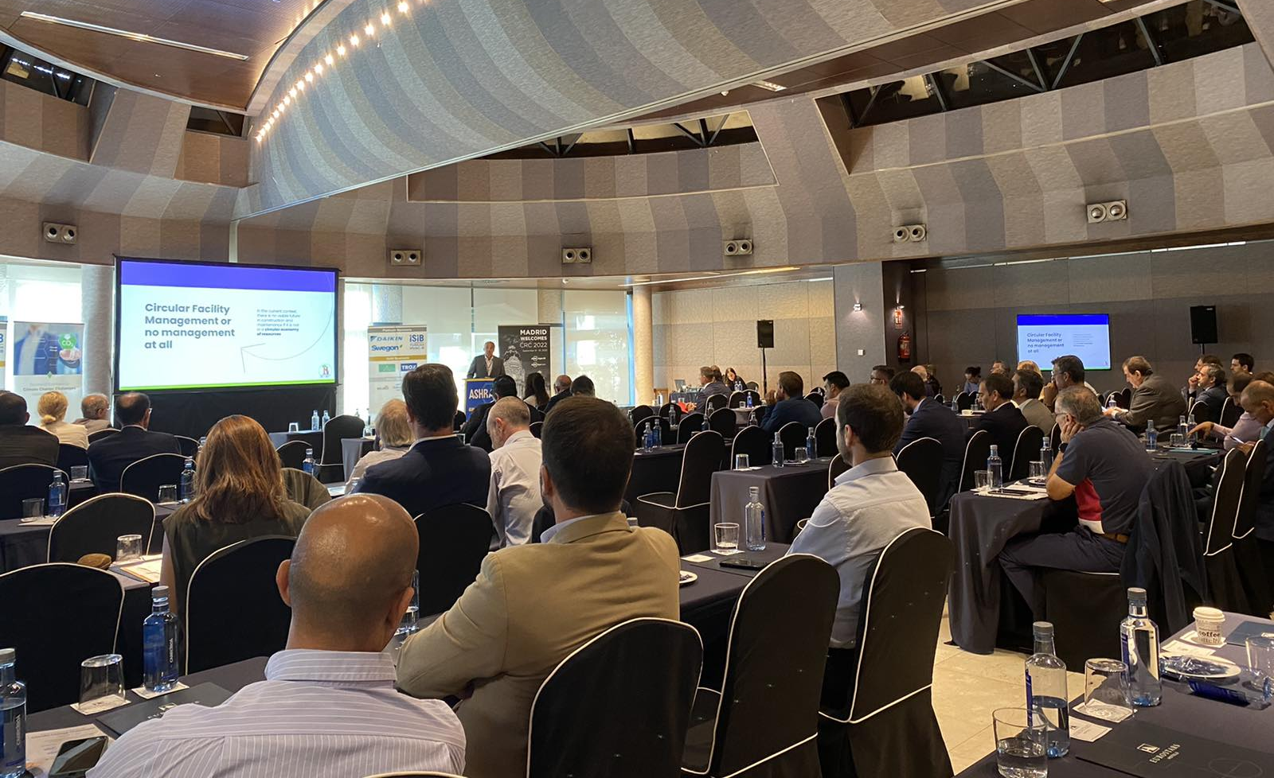
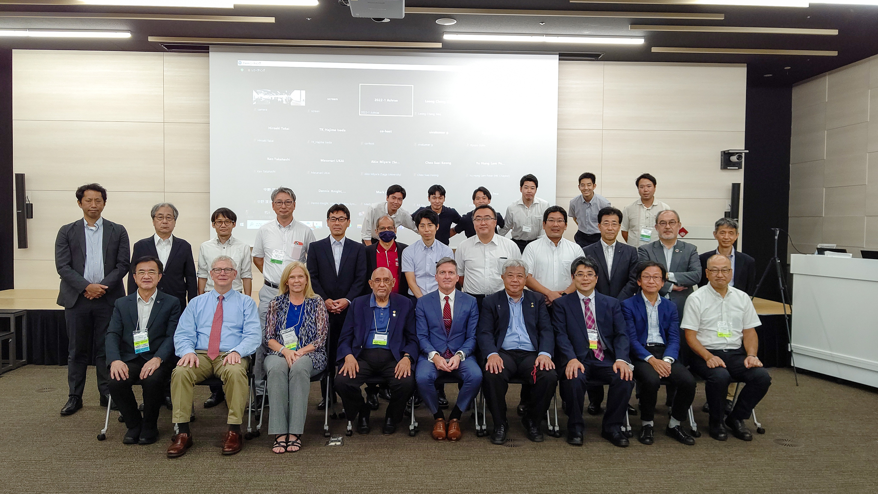
Harvesting Information
Four Industry Roundtables have taken place in Madrid, Istanbul, Tokyo and Orlando.
Two are scheduled in Atlanta and Monterrey.
ASHRAE RAL CRC
Madrid, Spain
ASHRAE Region XIII CRC
Tokyo, Japan
ASHRAE RAL CRC
Istanbul, Turkey
Notes:
Harvesting information includes the active pursuit of accurate and relevant data about the global conditions of our industry and the needs of the market and our members. This requires us not only to build a global coalition in the common cause of our industry but to have structured conversations with industry and stakeholders on trends and industry needs. This will permit ASHRAE to respond in real time and craft new products and services for industry and our members.
To this end, we have held industry roundtables with leaders in manufacturing, distribution and contracting as well as consultants and academics to harvest information and deliberate on trends. Roundtable sessions have taken place in Tokyo Japan, Madrid Spain, Istanbul Turkey, Orlando and here in Atlanta. Additional roundtables sessions are scheduled during the Spring CRCs.
What we have learned from these roundtables has been collated and is being considered for appropriate action. Reports from the roundtables will be made available on ashrae.org.
We encourage all our members to participate in a location near you.

Slide 16
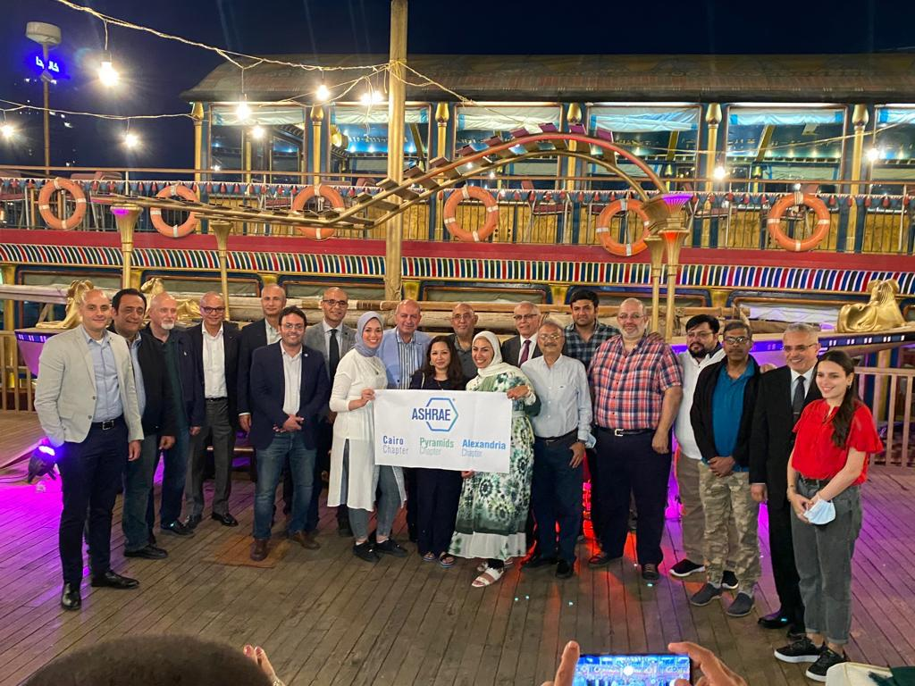
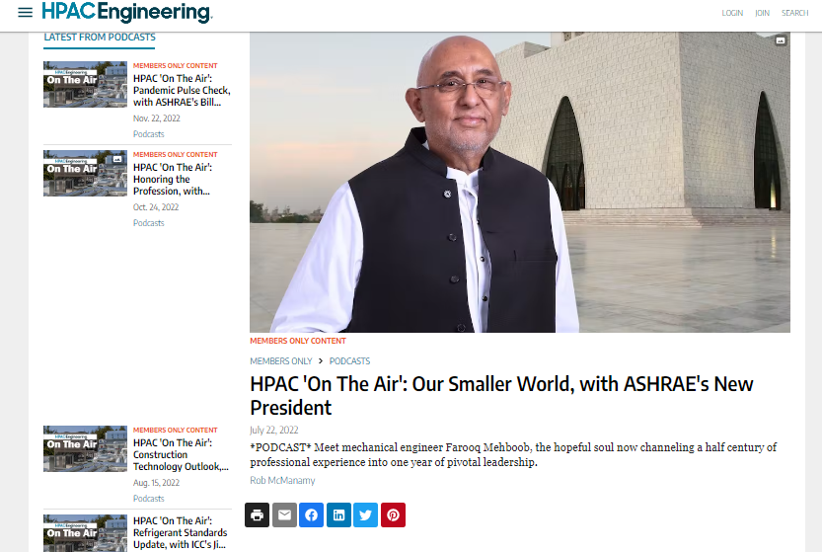
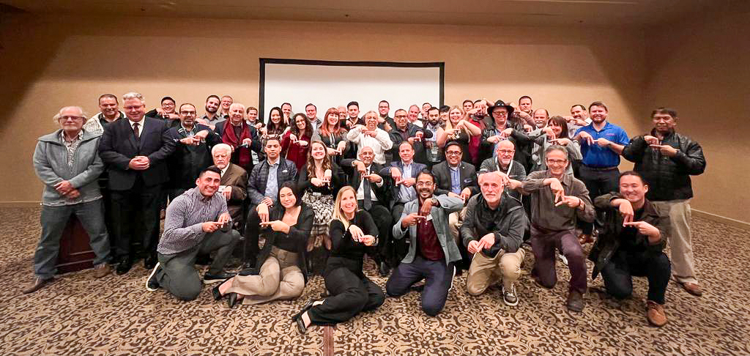
Take Action and Embrace Change
Cairo, Pyramids, Alexandria Chapters
Securing Our Future
Podcast with HPAC Engineering
Southern California Chapter
Notes:
In a podcast interview that I recorded for HPAC Engineering, I spoke about the urgent necessity of global cooperation and collaboration among engineers that can help solve our planet’s most pressing problems.
We have over 52,000 members, 199 chapters, in 132 countries. Sixty of these chapters are outside of North America. We all have the ability to take action and embrace the culture of change in our society.

Slide 17
Take Action and Embrace Change
Standard 241P
White House Ventilation Standard for Pathogen Mitigation
(Non-ANSI Standard)
Target to Publish Fall 2023
Notes:
As an industry and as individuals, we have experienced the profound and lasting impacts of a global pandemic. It is an honor to be a part of a Society that proactively faced the challenges precipitated by the pandemic, becoming a solid resource for the public, policymakers and the media in providing answers, posing solutions and preventing the spread of misinformation as it relates to HVACR.
ASHRAE Board’s announced its commitment to develop an expedited, non-ANSI pathogen mitigation standard to address the public demand for IAQ systems that reduce the risk of airborne infections.
Standard 241P will be a consensus-based, code enforceable standard.

Slide 18
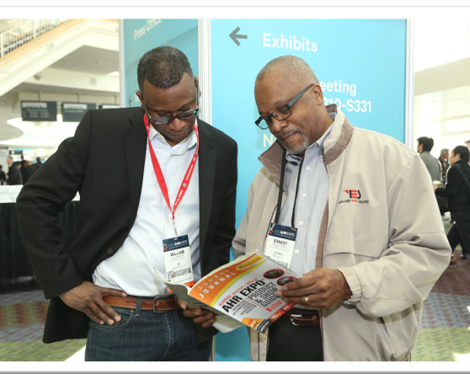
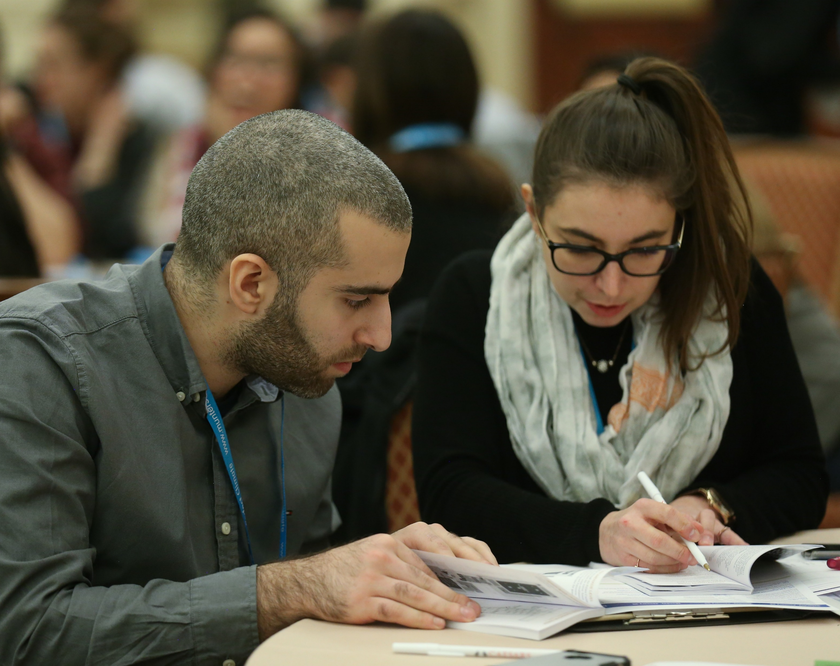
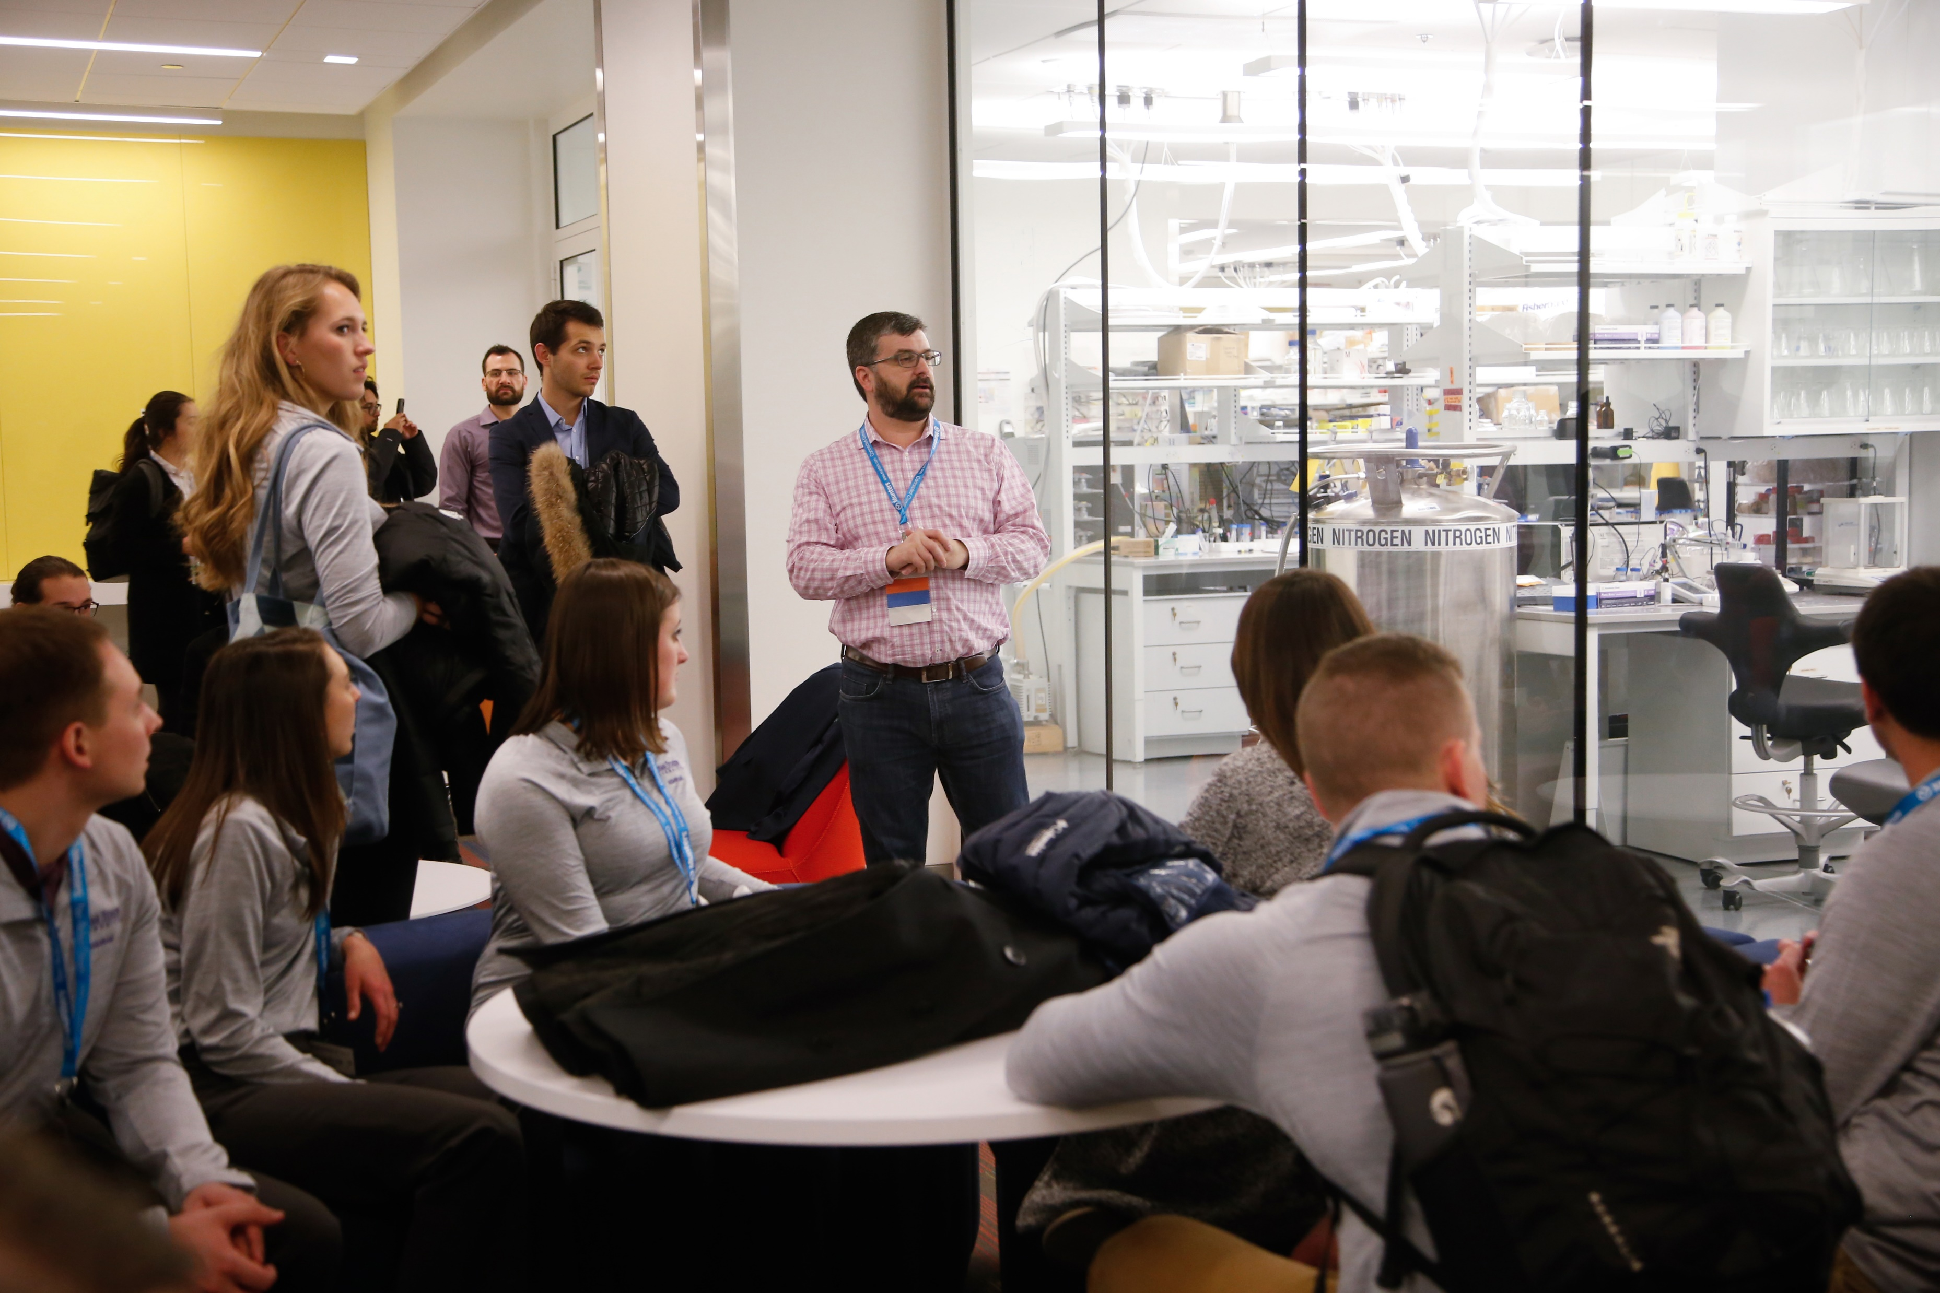
The Time to Participate is NOW
ashrae.org/president
Board and Council Meetings
Technical Committees
Chapter, Region and
Society Committees
Notes:
The challenge doesn’t stop here.
As an industry, we must remain focused and maintain our position of leadership and preparedness. Our success continues to be based on problem solving, creativity, innovation, flexibility, and a willingness to adapt. Our success stems from seeing an opportunity for improvement based on new knowledge and technology. This has made ASHRAE what it is today, the world’s leading global HVACR Society and it is what will propel us to greater heights in the years ahead.

Slide 19
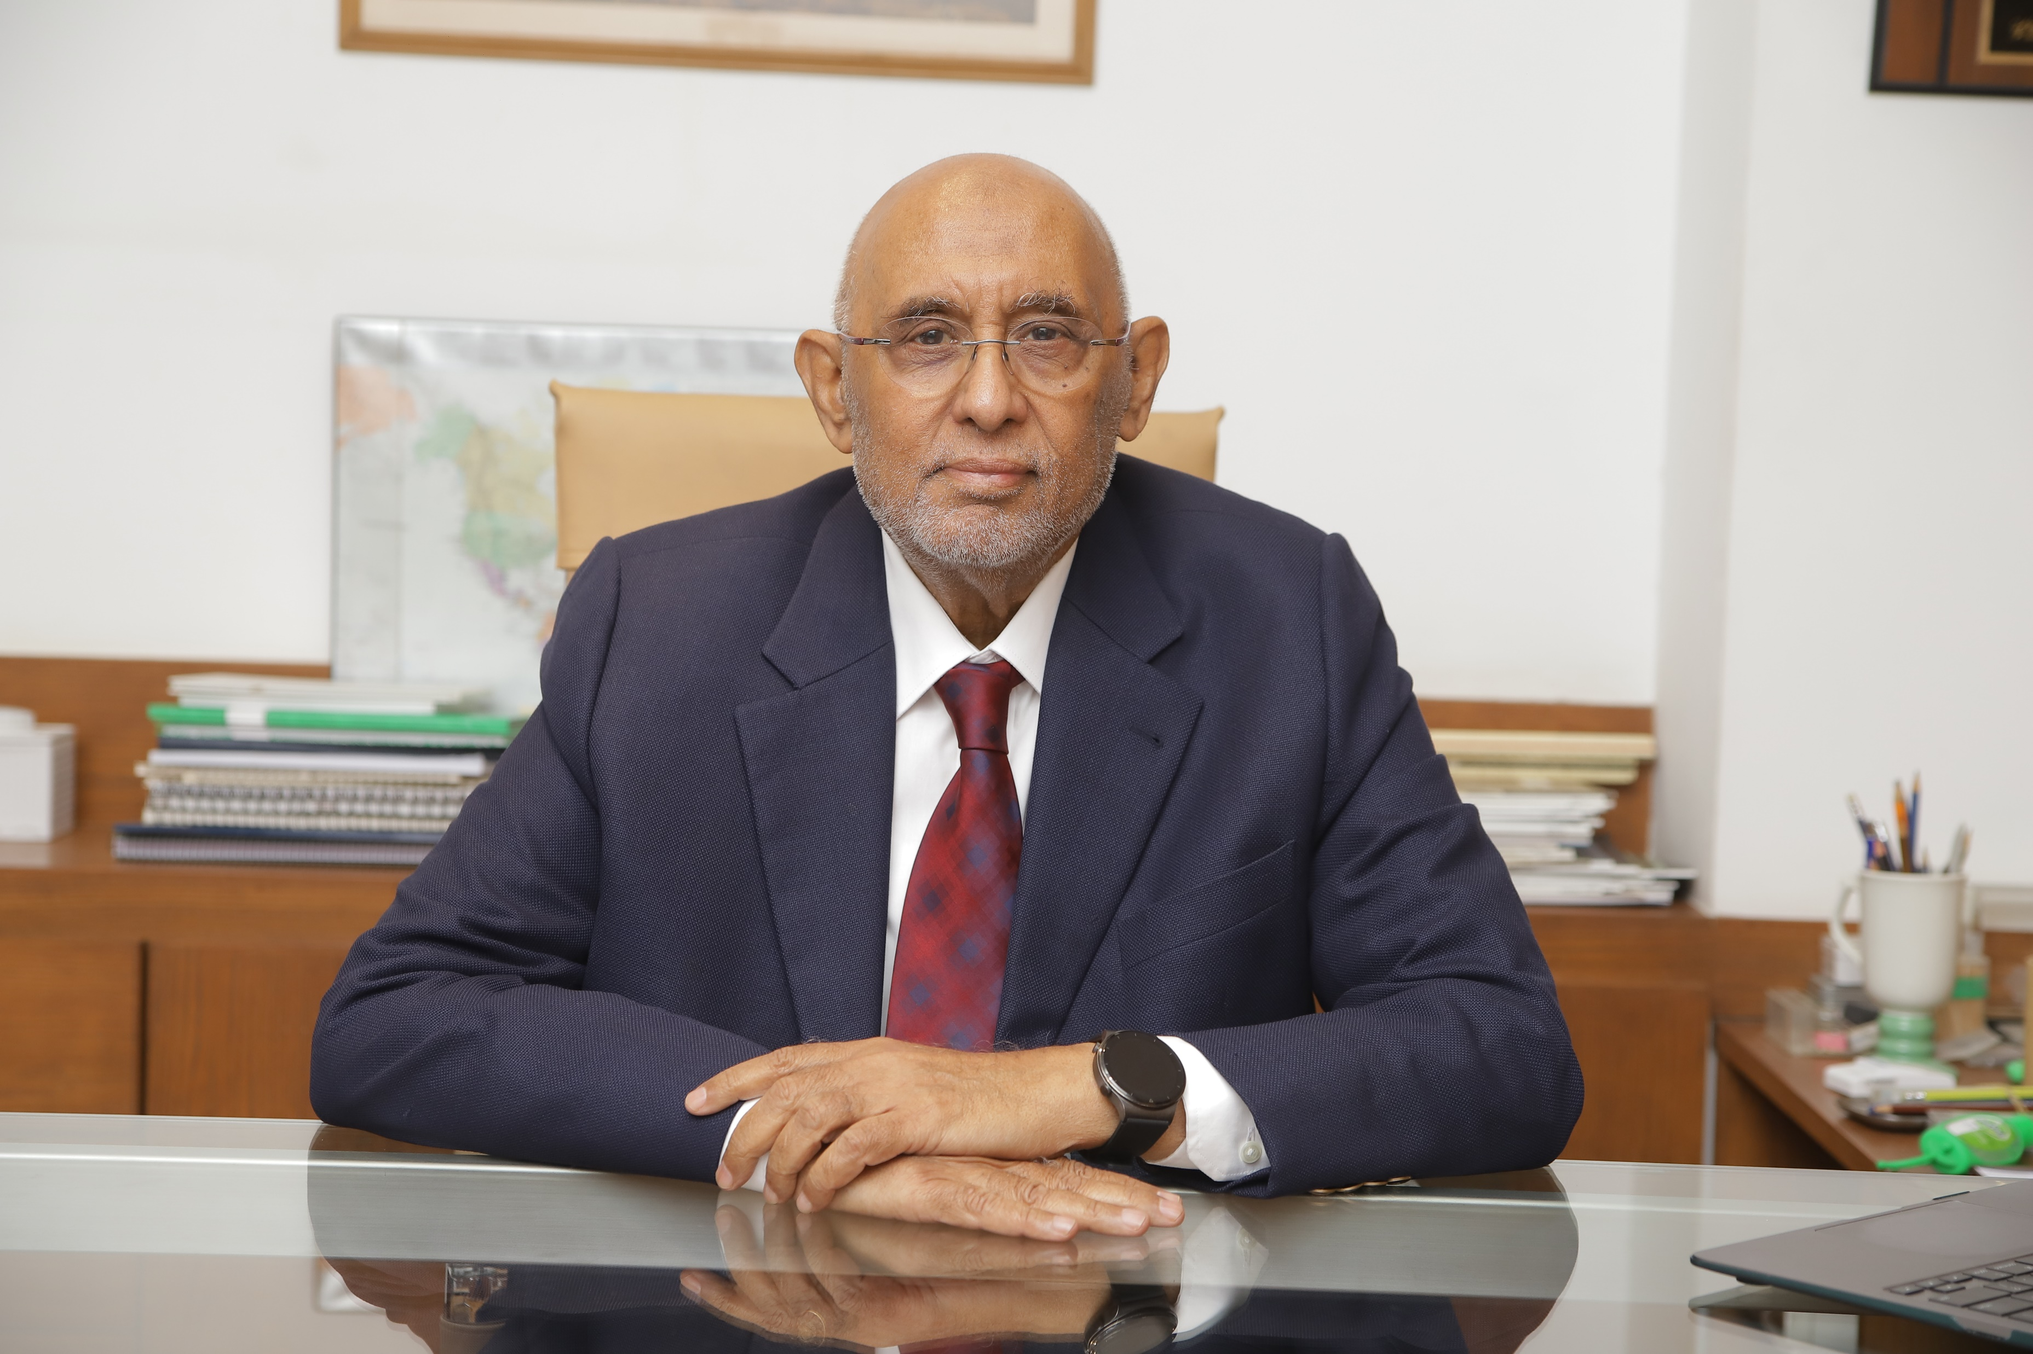
Thank You!
ashrae.org/president
“It’s imperative that we continue to hunger for, and seek information about our market, our changing world, and our technological advances.”
Notes:
The challenge doesn’t stop here. It is the obligation of our industry to provide practical information and keep building readiness top of mind as the current pandemic continues and as we prepare to face the next. The nature of the challenge may change, actual conditions at any specific building will vary, and the adjustments that should be made will depend on many factors such as local climate, complexity of systems involved and the use, occupancy and activities that occur in and around a building. As an industry, we must remain focused and maintain our position of leadership and preparedness.
Our success continues to be based on problem solving, creativity, innovation, flexibility, and a willingness to adapt. Our success stems from seeing an opportunity for improvement based on new knowledge and technology. This has made ASHRAE what it is today, the world’s leading global HVACR Society and it is what will propel us to greater heights in the years ahead.
Thank you!

