Slide 2
Empowering Our Workforce:
Building a
Sustainable Future
M. Dennis Knight, P.E., BEMP, Fellow Life Member ASHRAE,
2024-25 ASHRAE President
Notes:
I am the happiest person in the room today. Here's why!

Slide 3
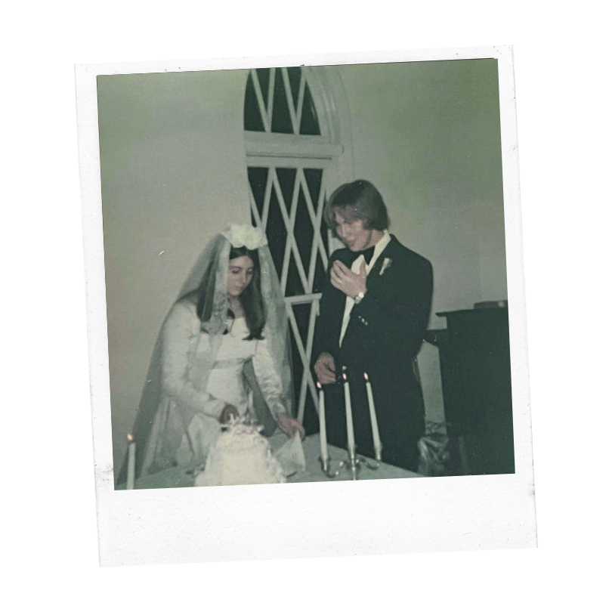
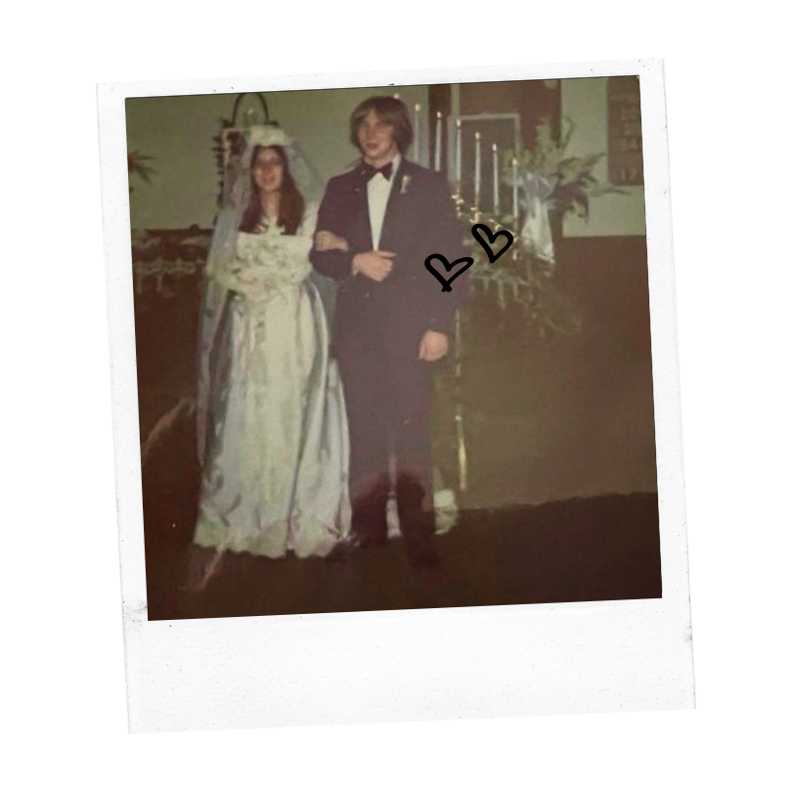
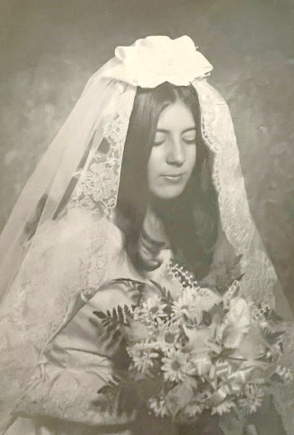
Celebrating 50 Years of Marriage!
Notes:
My wife Shirl and I are celebrating 50 years of marriage!
(PAUSE FOR APPLAUSE)
Best of all, we get to celebrate and share it with our family, friends and colleagues in ASHRAE!
When Shirl and I got married, we were kids. She was 17 and I had just turned 18. Our wedding photographer's camera of choice was a Polaroid—you know, the ones with self-developing pictures?
About an hour after our wedding, we pulled our 1965 Plymouth Sport Fury into a drive-thru restaurant to grab two hot dogs for our honeymoon meal. Then, we were off to Myrtle Beach, South Carolina, for a two-night honeymoon getaway.
If you asked me the secret to a 50-year marriage, I would tell you that it's an investment in and commitment to making our relationship work. I'd also tell you that it's not always easy…but boy, it is worth it!

Slide 4
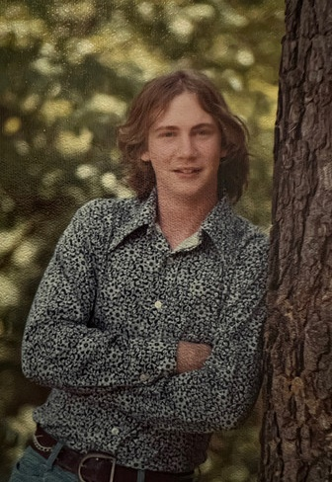
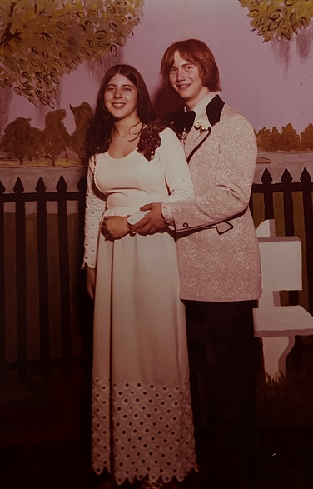
Ready
For Work!
Notes:
Our honeymoon lasted only two nights because I had to return to work first thing Monday morning.
My journey in the building industry began just two weeks after I graduated from high school. I stepped into the workforce, ready to learn and contribute.
My brand-new job title was “Power Plant Piping Systems Designer.” That’s a fancy way of saying - draftsperson. (SMALL CHUCKLE)
An engineer named Fred Howard, who visited my high school drafting class, offered me the position in my junior year when I was just 16.
Why would the largest power company in the U.S. that designed, built, owned, and operated some of the biggest power plants in the world talk to a 16-year-old kid about employment?
The answer is simple: WORKFORCE DEVELOPMENT!
They invested in and were committed to attracting and retaining people who would do the necessary work to advance their business goals.
By starting at the high school level, they were casting a wider net, accessing a larger pool of employment candidates and including students on traditional and non-traditional tracks to higher education and career development.

Slide 5
Earth video with climate change
Notes:
So, why should WE focus on WORKFORCE DEVELOPMENT?
Over the last several years, we accepted the challenge of being vital players in addressing the most severe threats to our planet in our lifetimes: The COVID-19 pandemic and the climate crisis.

Slide 6
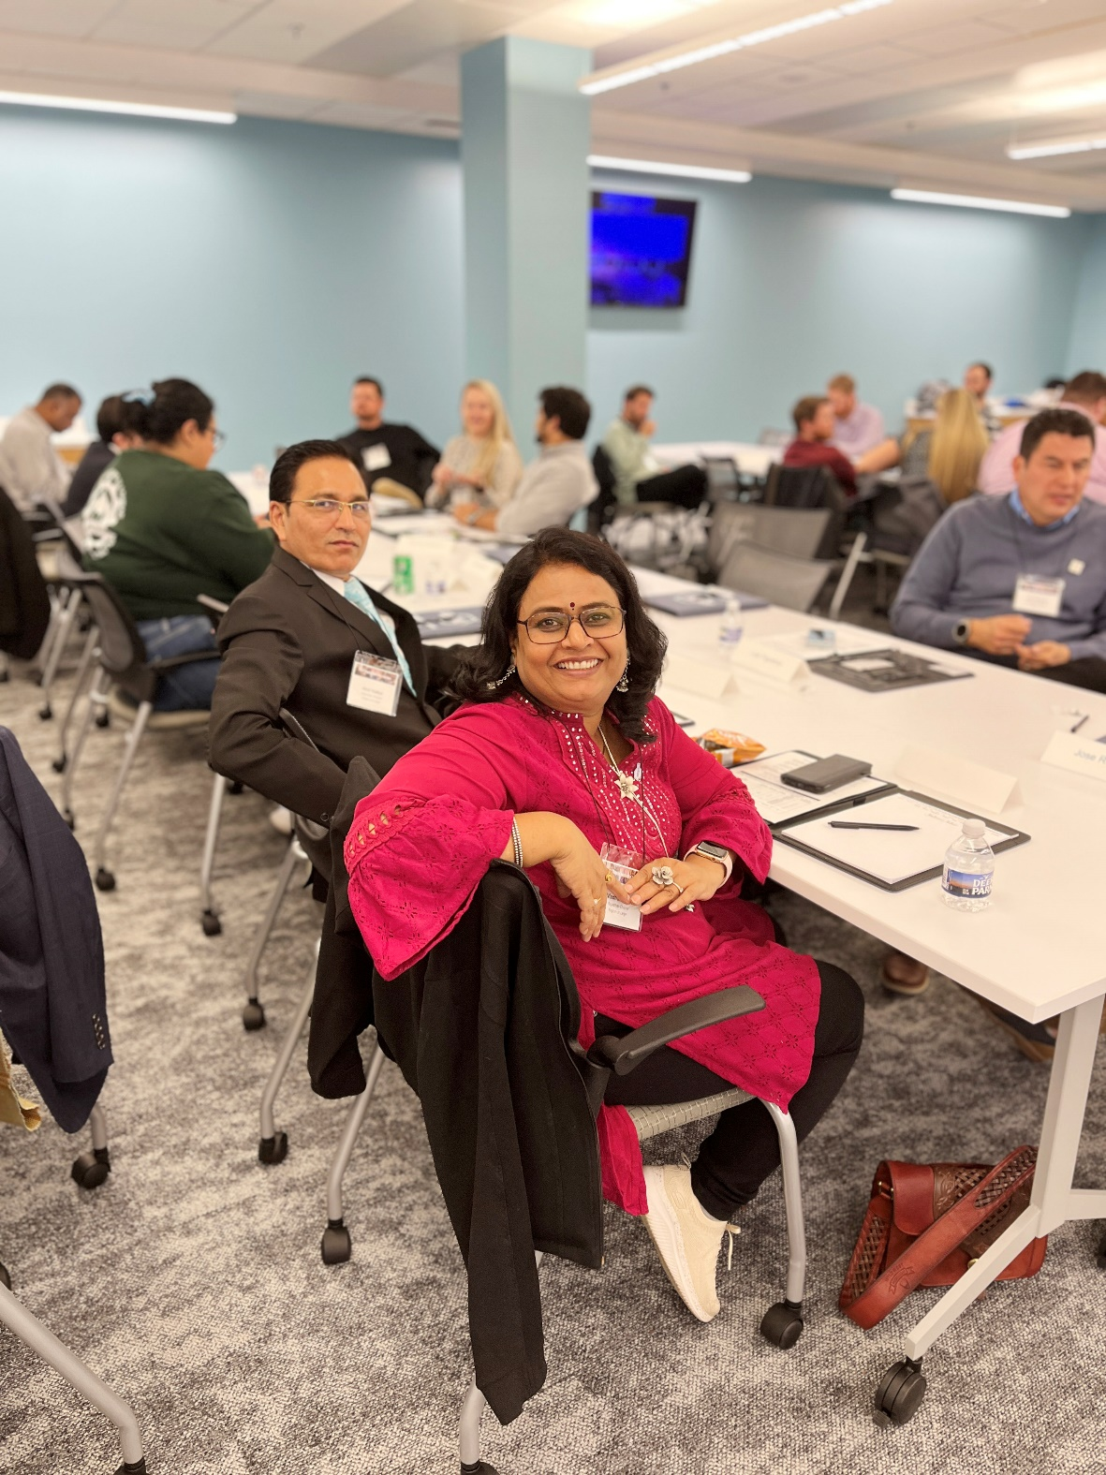
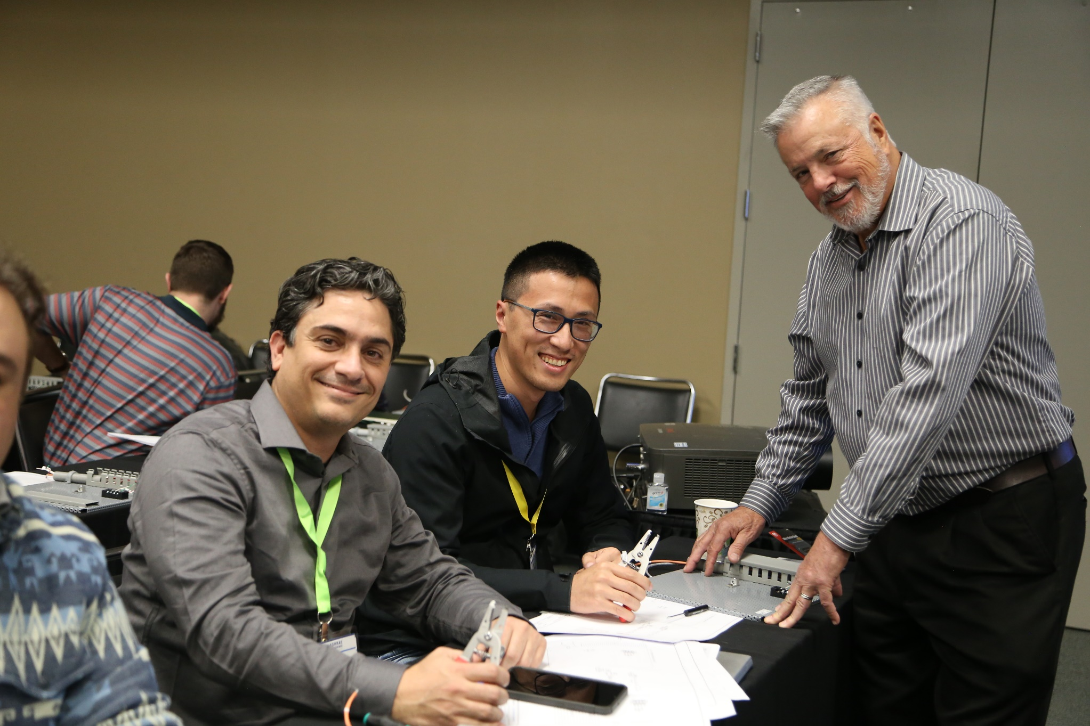
Solving the Workforce Development Problem
We need more people like you!
Notes:
That said, our industry is facing its own crisis! (PAUSE) One that will hinder our ability to meet the challenges we’ve accepted, the targets we’ve set and the commitments we’ve made.
That crisis is with our workforce – or more appropriately, the lack of skilled people like you who have the capability and desire to choose a career in Heating, Ventilation, Air-Conditioning & Refrigeration (HVACR).
The truth is, we need more people like YOU. Your skills, your passion and your commitment are what will drive our industry forward and ensure its viability for years to come.
CAPABLE people.
PASSIONATE people.
People who WANT to make a difference.
It's an issue of survival AND of our planet's sustainability for future generations.
If we are going to meet this challenge, <SLIGHT PAUSE> FIRST, we need to understand how to solve our workforce development issues.

Slide 7
Industry Growth
Current Need
2 Billion
Systems
By 2050
6 Billion Systems
Notes:
Let's start with the good news - and IT IS good news.
We are a growing industry and future demand is exceptional.
The International Energy Agency (IEA) expects the number of HVAC systems worldwide to increase from around 2 billion today to over 6 billion by 2050.
<PAUSE>
Many of those systems will be in new, large-scale, multi-family residential buildings and mixed-use developments as people begin to work more from home and within walking distance from their homes. Many buildings will connect to large district heating and cooling plants and energy storage facilities.

Slide 8
2.5 Trillion square feet of building space
over 20 years old
is currently in need of renovation.
Notes:
In addition, the United Nations Global Status Report estimates that nearly 2.5 trillion square feet of existing buildings - most over 20 years old, will need to be renovated.
Existing building projects require even more people than new construction to be involved in the work.
Renovation is complicated work. We need to design and renovate these buildings to be healthy, energy efficient and carbon neutral.
As a result, we need an expanded workforce that is more diverse and skilled in the latest technologies. Yet (SLIGHT PAUSE) our global workforce is diminishing.
So, we have to ask ourselves: Why is our fast-growing industry—with its direct ability to address the role that buildings play in improving human health and the climate crisis—experiencing an inability to attract new talent?

Slide 9
Notes:
Senior building engineers and building scientists bring a wealth of knowledge and experience to our industry – but we are aging out of the Workforce.
Unfortunately, not enough younger people are interested in pursuing this essential career path.
We have a perception problem.
Part of it is that our message about our vision for a sustainable future where buildings are energy efficient, healthy and carbon neutral and our role in that work needs to be clarified!

Slide 10
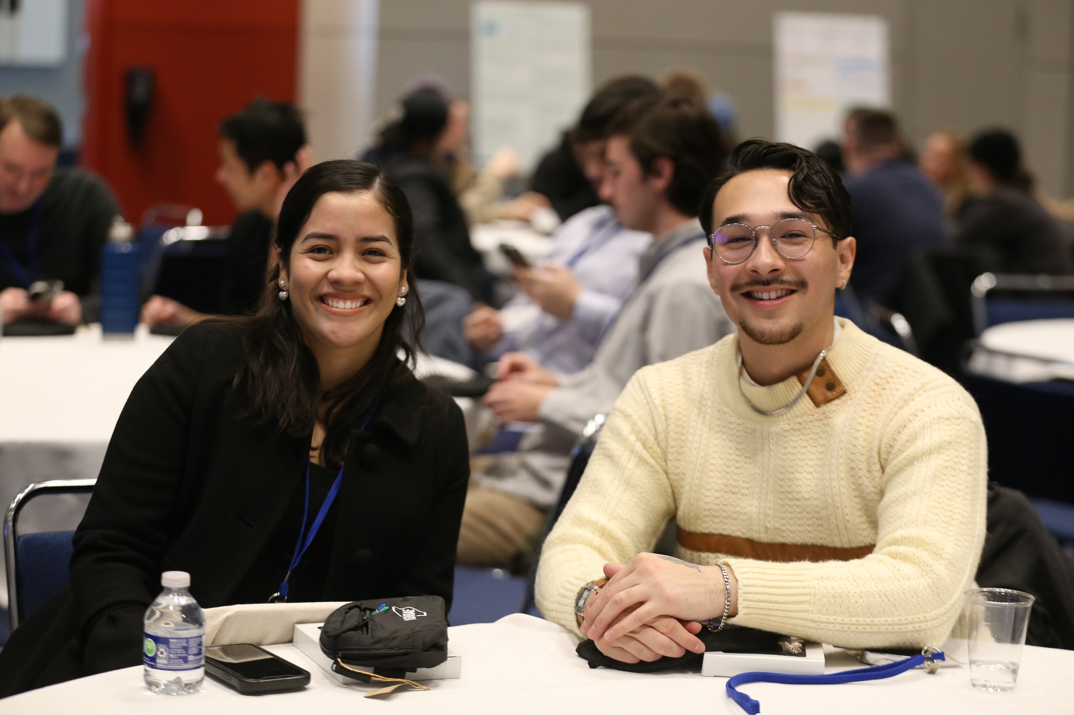
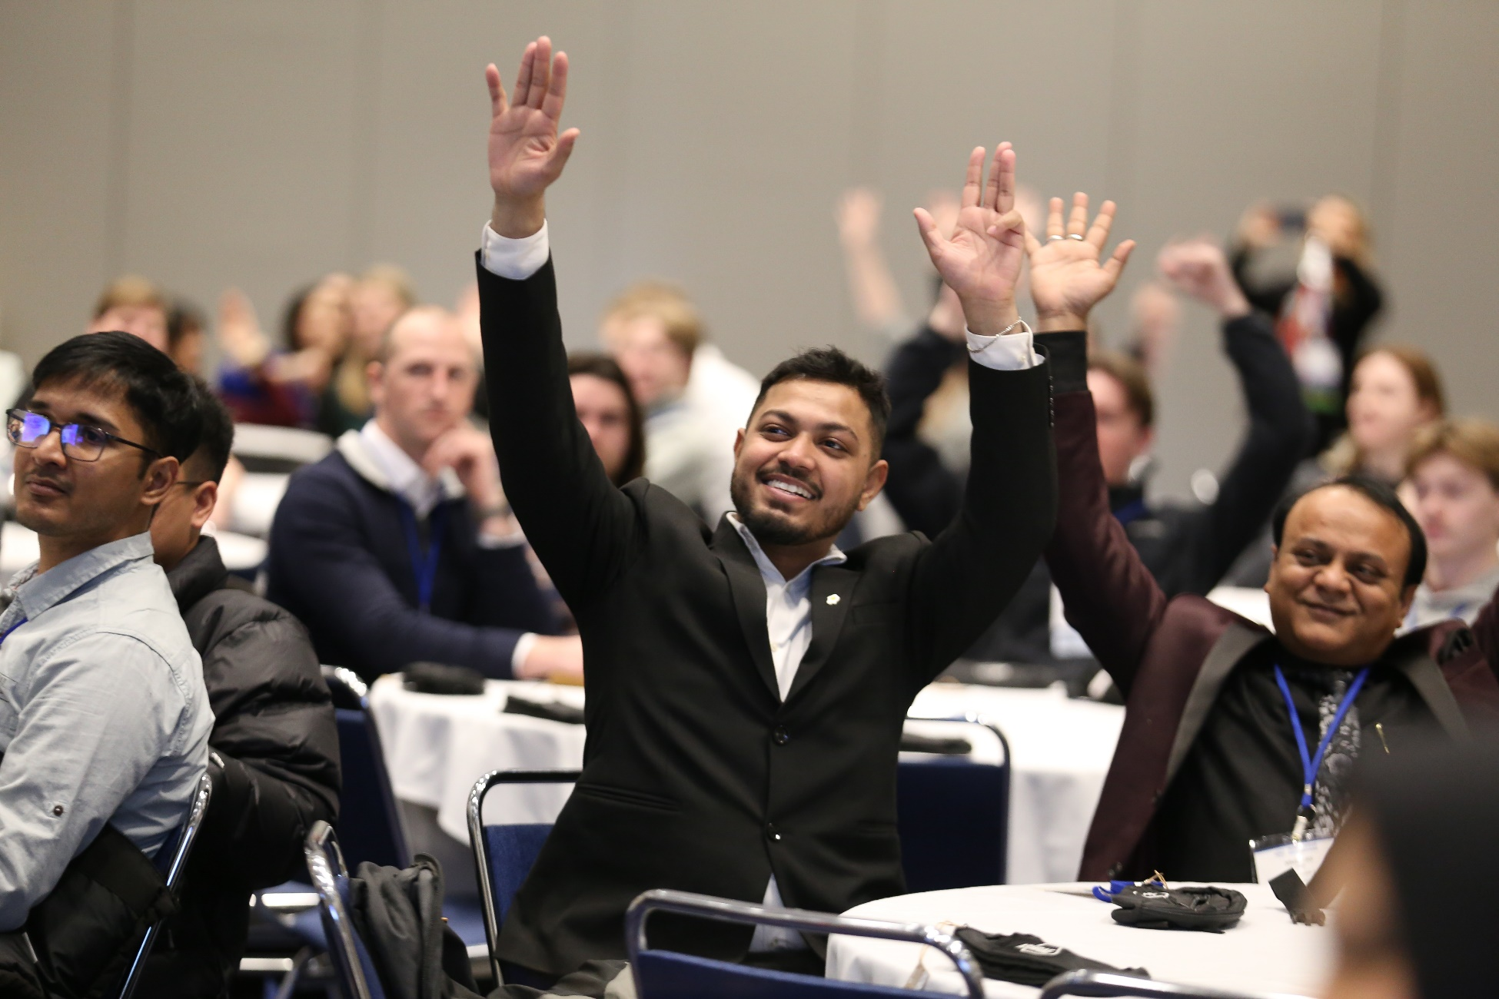
We Can Make a Difference Now!
Notes:
We all want to be involved in a career that we can be passionate about and where we can find meaning and purpose.
Maybe it comes down to this – we need to demonstrate to the world what we do (SLIGHT PAUSE) and the impact that our industry is making today and is capable of producing in the future to address indoor environmental quality, sustainable development and climate change.
We need to highlight our industry in a way that celebrates the ideas and innovations that emerge when we embrace and encourage greater diversity, equity and inclusion.
The good news is that YOU are in the right place at the right time.
Together, we can grow the ranks of committed and passionate professionals
and shape the future of our industry and our planet.
We are making a difference now, and we need to spread the word— (RAISE YOUR VOICE)
SHOUT IT FROM THE ROOFTOPS!

Slide 11
Notes:
So, Let’s go back to 1974.
That first day on the job, my tools were a graphite pencil, a couple of plastic triangles, a straightedge, and a piece of paper.
With these simple tools, I learned to describe, in two dimensions, how to construct large, complex power plants.
People have used these tools for 600 years or more, at least since the Renaissance.
Yet they’ve been made obsolete in less than 50 years.
In the late 1970s, I learned Computer-Aided Drafting (CAD), which has been almost completely displaced by Building Information Modeling.
The cycles of obsolescence and innovation get shorter and shorter.
Because of this, we need to continue to upskill and provide new tools to our existing workforce.
Continuous learning opportunities MUST be available to all of us throughout our careers.

Slide 12
Title Here
Looking at BIM?
Notes:
Today, rapidly changing technology and Artificial Intelligence (A.I.) are transforming the building science industry and presenting numerous career opportunities.
Advanced automation and AI-driven systems will offer more energy-efficient and intelligent building systems solutions while enhancing comfort and indoor environmental quality.
HVACR and building science professionals can use their skills and leverage these cutting-edge technologies, creating a demand for specialized expertise.

Slide 13
Notes:
The growing emphasis on sustainability, resilience and resource efficiency in building design and operation opens up career opportunities focused on green building technologies and renewable energy integration.
Our work has a direct impact on improving the human condition!
Numerous studies show the link between indoor environmental quality and the health and well-being of building occupants.
New career paths create opportunities to stimulate breakthroughs in sustainability, resilience, health and well-being, human comfort and productivity.
Those who understand these practices and become skilled at implementing them will have plenty of career opportunities.
As technology advances, people of all ages are becoming more accustomed to adapting to new tools and processes.
By strategically leveraging the power of technology alongside the power of human creativity, both experienced professionals AND new talent can collaborate to drive progress within our entire industry.

Slide 14
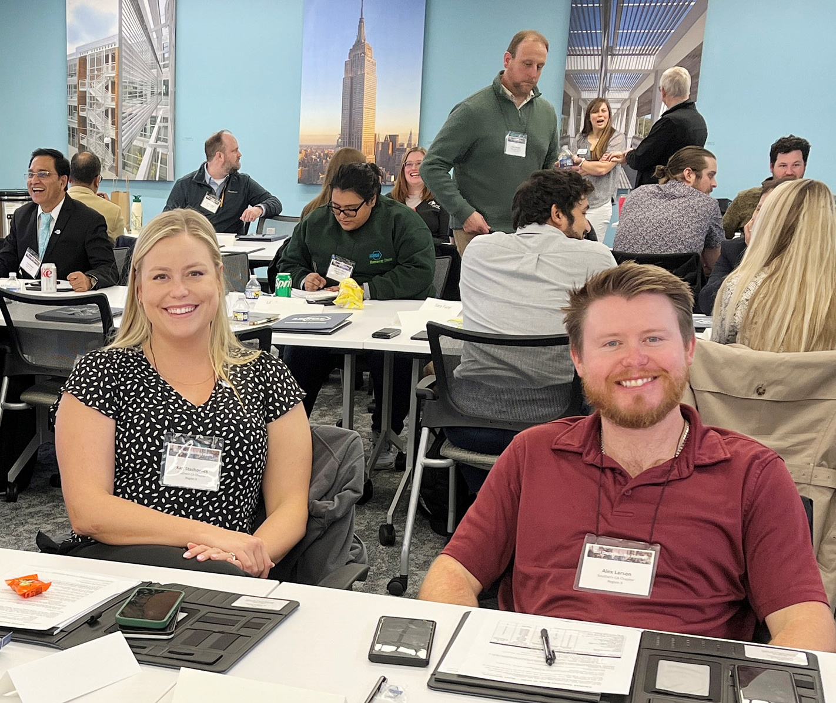
Planned Initiatives
1
Tools for Career Conversations
2
Member Resource Groups
3
Professional Development
Notes:
So, HOW CAN WE drive more talent to our industry?
ASHRAE will introduce three initiatives this Society Year to help address our workforce crisis:

Slide 15
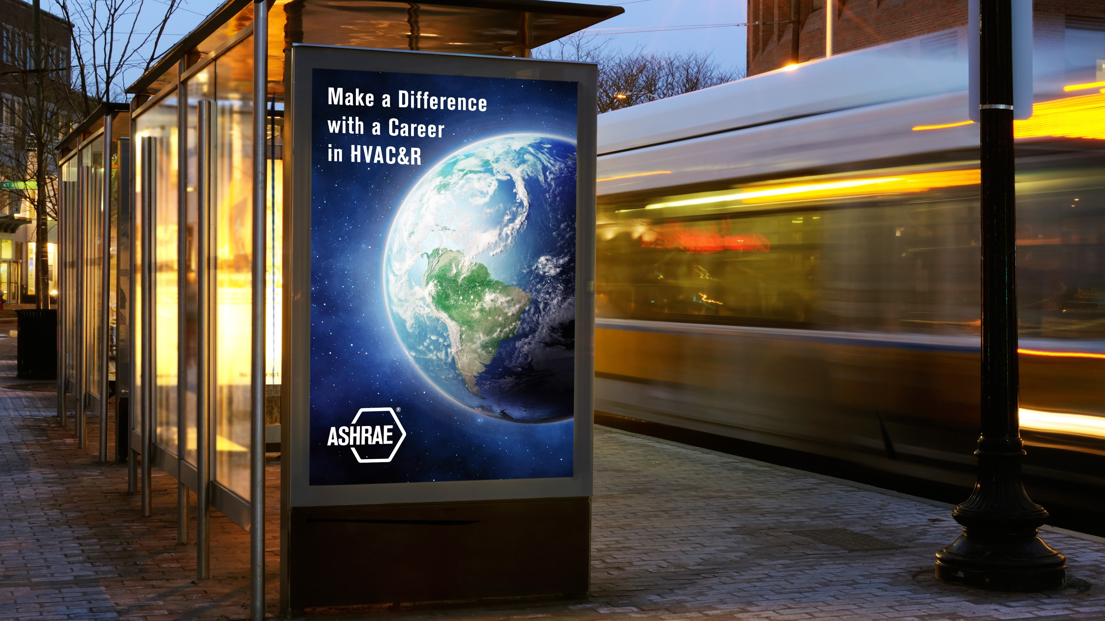
Still Video Shots from the Stories campaign
Make a Difference with a Career in HVAC&R.
Learn more at ashrae.org/president
Why is this a great career?
Why should people be interested in this work?
Why is this essential for survival?
Notes:
First, to raise our profile, staff and volunteers are collaborating on a grassroots campaign to educate others about our industry's role and contributions.
We will promote the current work and future opportunities in HVACR that will impact indoor environmental quality, climate change and sustainable development for all humanity.
This work, our work will have an even more significant impact as the world's population grows from 8 billion today to 9.7 billion in 2050.
Every ASHRAE member can be a messenger and an ambassador!
One way we will do that is by sharing new tools and resources that each of you can tailor to include your own personal stories, observations, passions, and motivations. These resources will be added to the president’s section of ashrae.org and made available to our chapters and members by July 1st.
These tools will allow us to make a case for the rewards of choosing a career in this industry.
By the end of this year, every member will be able to articulate our “Whys.”
Why is this a great “CAREER”?
Why should people be interested in this work?
Why is our field essential for survival as it commits to protecting our globe?
Just as I tell my story today, we can all tell our stories—YOUR stories.

Slide 16
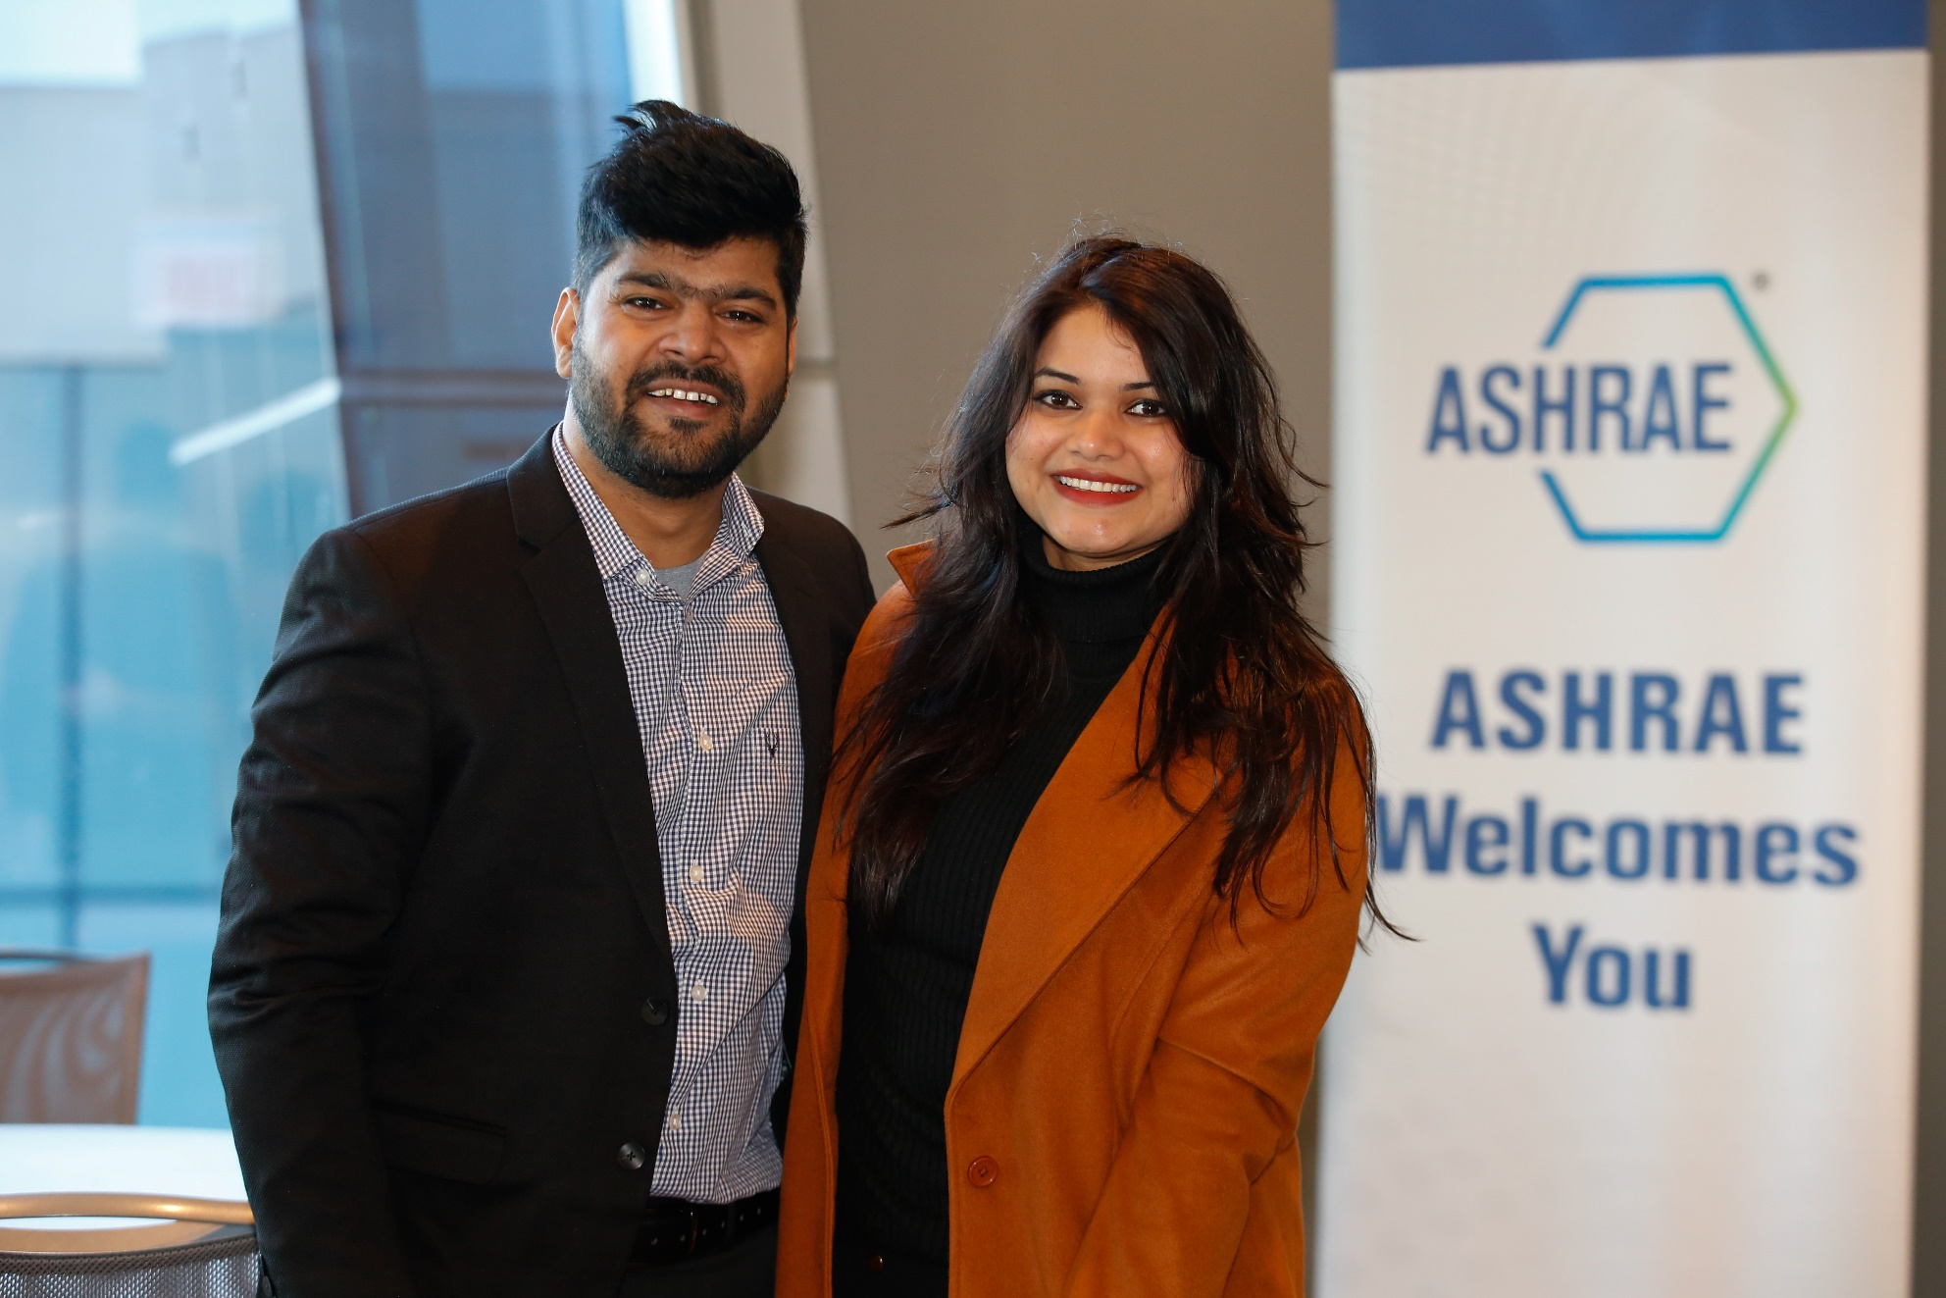
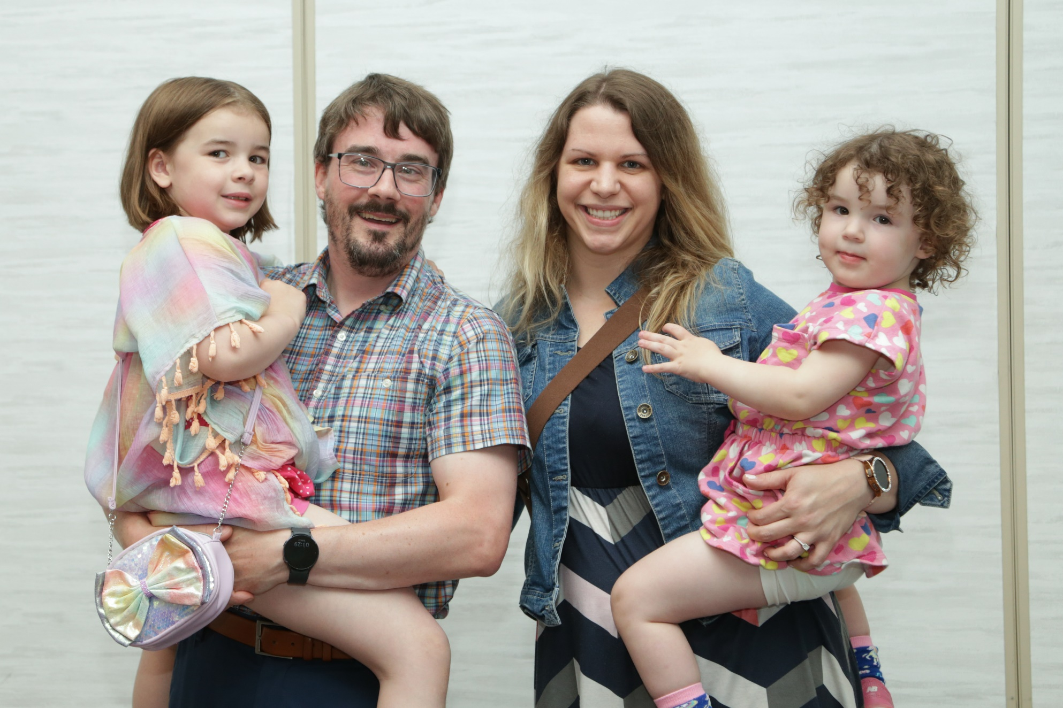
Member Resource Groups
New Members Club
Young Professionals with Children
Notes:
Second, we are creating new Member Resource Groups (MRGs) - how about that – another new acronym. (PAUSE – CHUCKLE A LITTLE TO PROMPT LAUGHTER)
MRGs help solve problems and grow interaction between similar sets of ASHRAE members.
Member Resource Groups promote a sense of belonging and enable more efficient networking.
They are not new to ASHRAE. We've successfully developed Member Resource Groups such as Young Engineers in ASHRAE, Women in ASHRAE, Student Members and our many technical committees.
The representation within these groups brings different perspectives, experiences and ideas that ultimately advance our industry.
Two new groups are being piloted here in Indianapolis: Young Professionals with Families and the New Members Club.

Slide 17
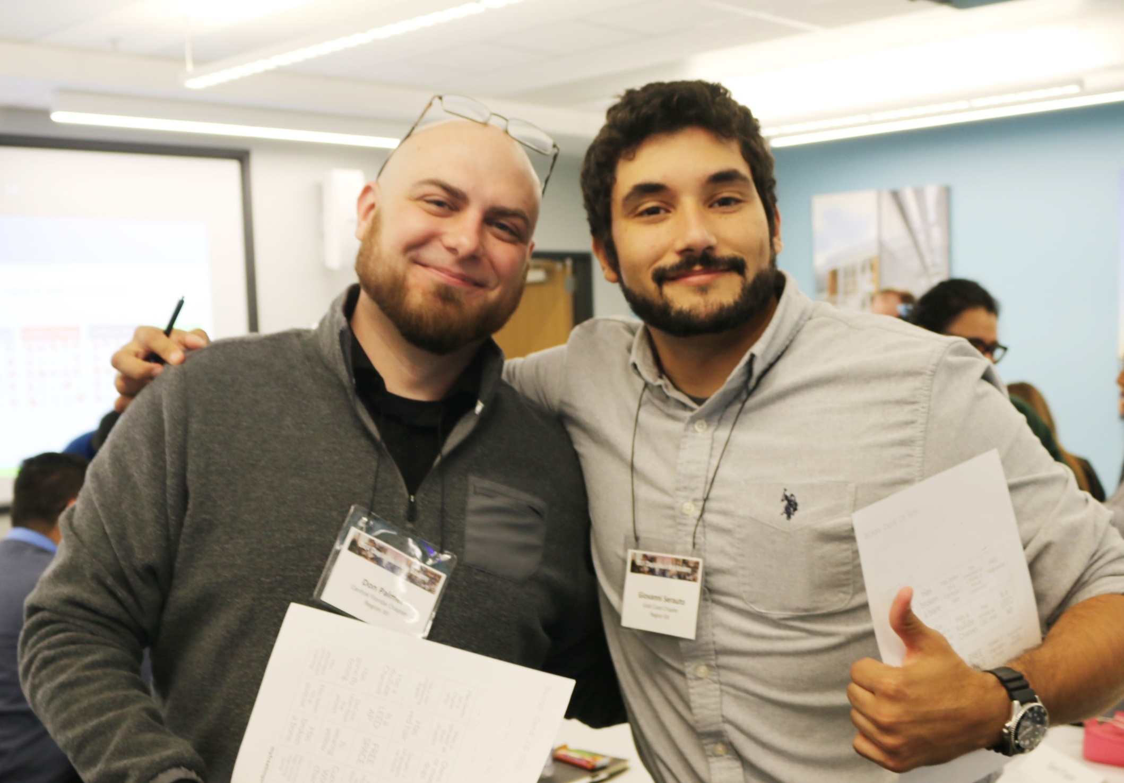
Committing to
Professional Development
Updated HVAC Fundamentals Course
Courses on how to decarbonize and sustainable building practices
Courses on whole life carbon design, construction and manufacturing practices
Notes:
Third, we are investing in and committed to individual and collective professional development.
Let's change our thinking about the value of developing people!
Data shows that investing in developing people enhances their loyalty, retention and impact.
We want employees to be motivated, highly productive, innovative and profitable for as long as they stay in our firms.
Remember my first job as a draftsperson? Fred Howard and my employer began investing in and committing to my personal growth and development nearly a year and a half before I graduated from high school.
This initiative aims to develop new programs and modernize our education delivery platforms to provide technical onboarding and training materials for mechanical engineers, contractors, manufacturers, technicians and building scientists.
Powered by ASHRAE’s 130-year reputation within the built environment, we will continue to be the industry’s go-to resource for HVACR and building science education to new employees and to maintain and increase the skills of mid-career and more senior-level professionals.

Slide 18
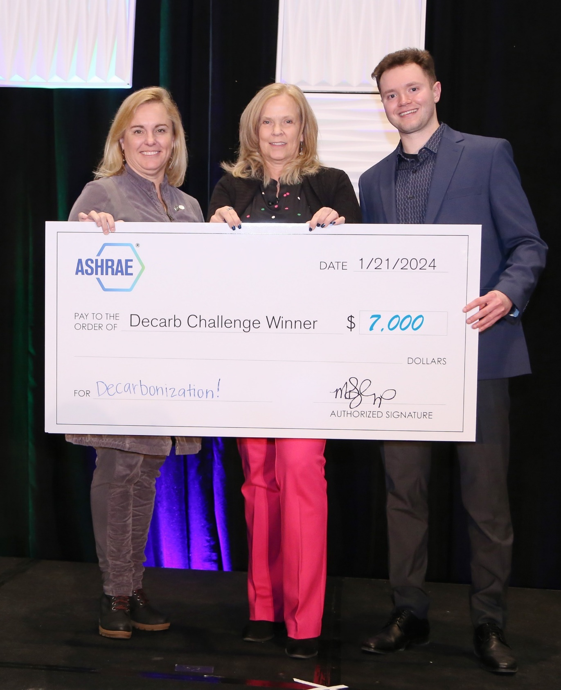
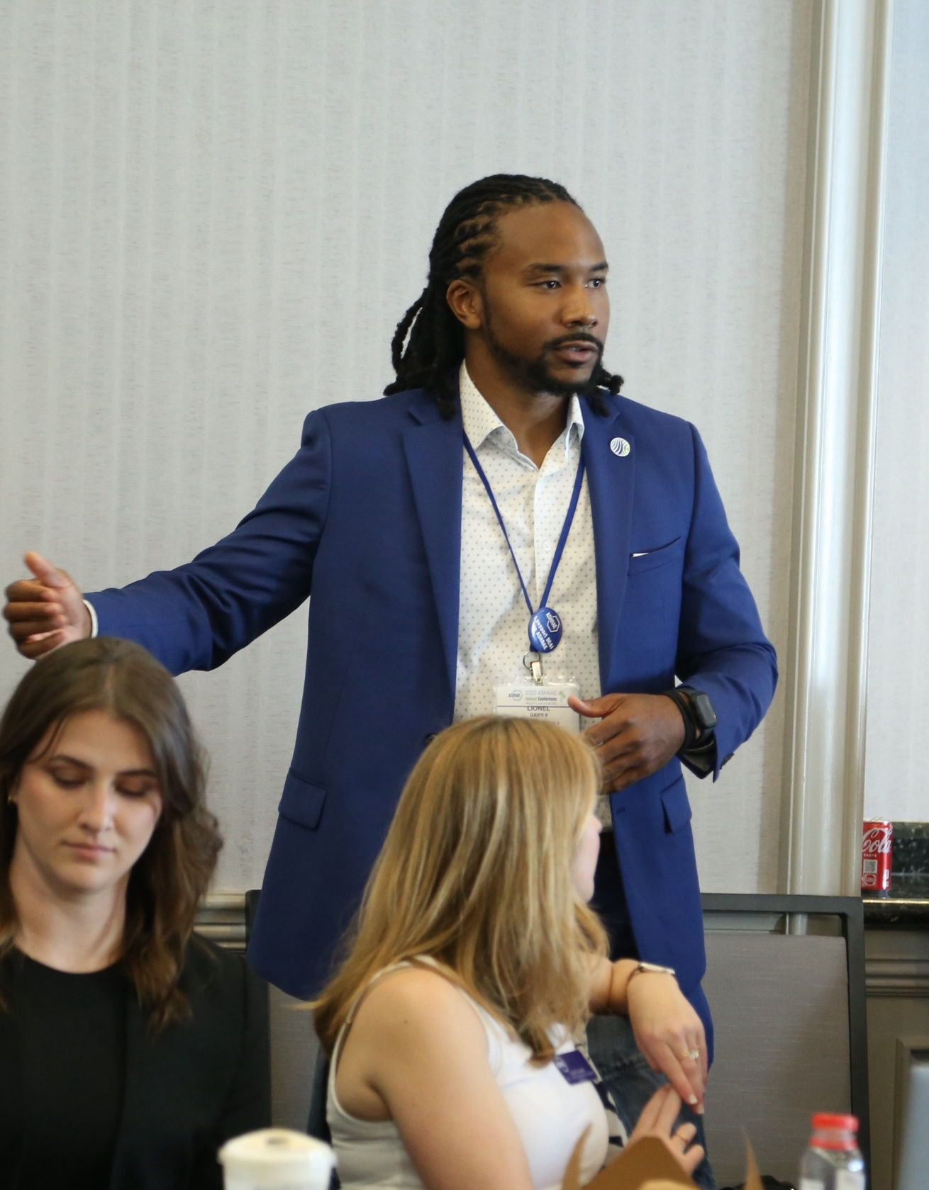
Industry Summit
Continue the Decarb Challenge
Host Industry Roundtables
Notes:
Leading up to this Society year, we’ve been fortunate to begin work on a few programs to support workforce development.
We have started building relationships with U.S. federal agencies, associate societies, and the United Nations Global Alliance for Building Construction around this topic. As a result, we will host an industry summit on a global workforce needs assessment tied to our building decarbonization conference in New York City.
We are creating new endowed scholarship funds to allow practicing professionals to take advantage of our professional development opportunities.
A focus of this Society year’s ASHRAE Decarbonization Challenge and the Presidential Award of Excellence at the chapter level will be on technical talks delivered by local practicing professionals that emphasize upskilling and reskilling, targeting young and mid-career engineers, and
4. Our Chapters' Regional Conferences will host Industry Roundtables focusing on employer engagement and the Workforce of the future.

Slide 19
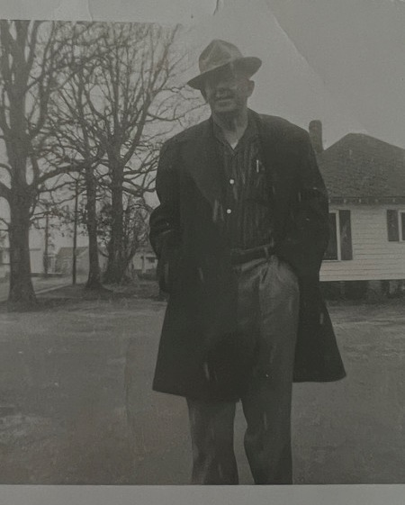
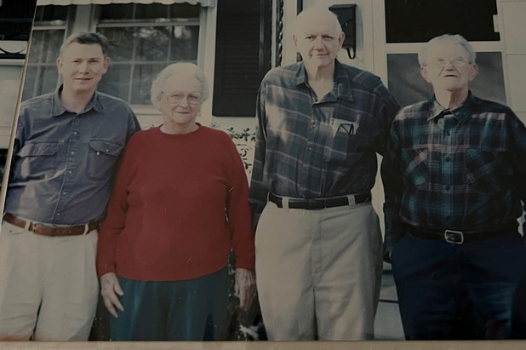
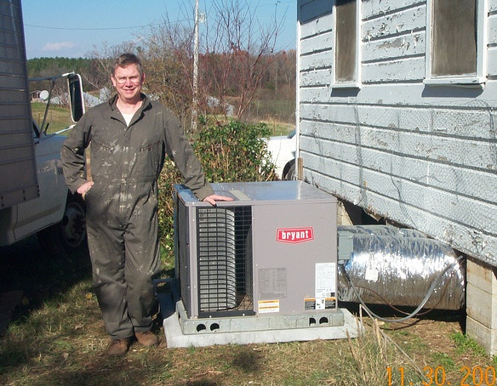
An Evolving Workforce
Notes:
(PAUSE)
One hundred years ago, workforce development seemed simple. There were fewer industries, less specialization and different educational requirements. In my world, I grew up in the southern United States, entire towns were built primarily around one industry, cotton.
Small towns and cities across the U.S. developed around the same workforce model, focusing on industries such as steel, auto and machine manufacturing, mining and farming.
For at least three generations before me, my ancestors either worked on mill-owned farms growing cotton or in cotton mills.
It was a subsistent life that my father fully intended for me to follow.
But Fred Howard changed all that. He ignited a passion that would ultimately lead to my becoming an engineer and business leader.

Slide 20
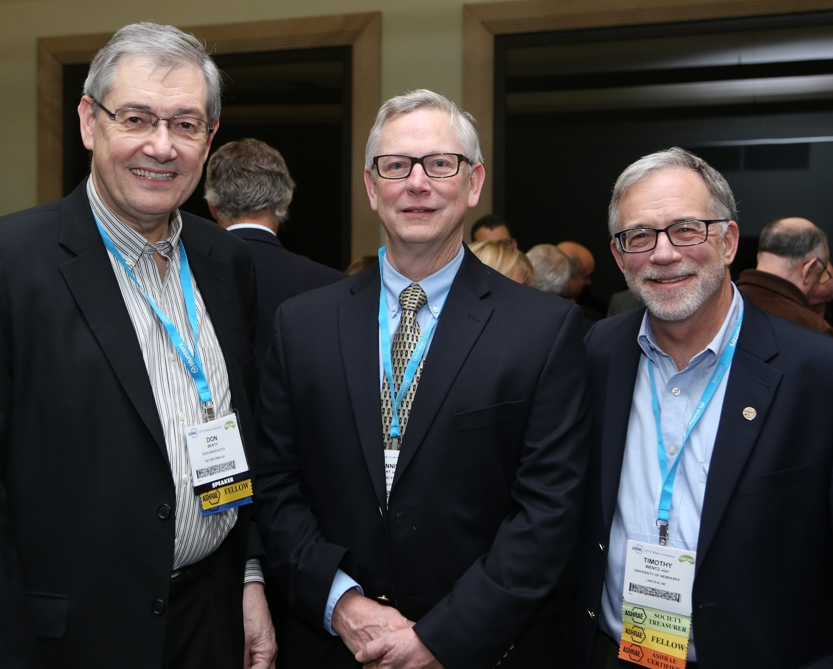
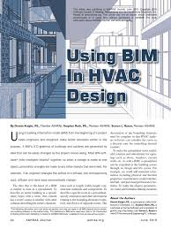
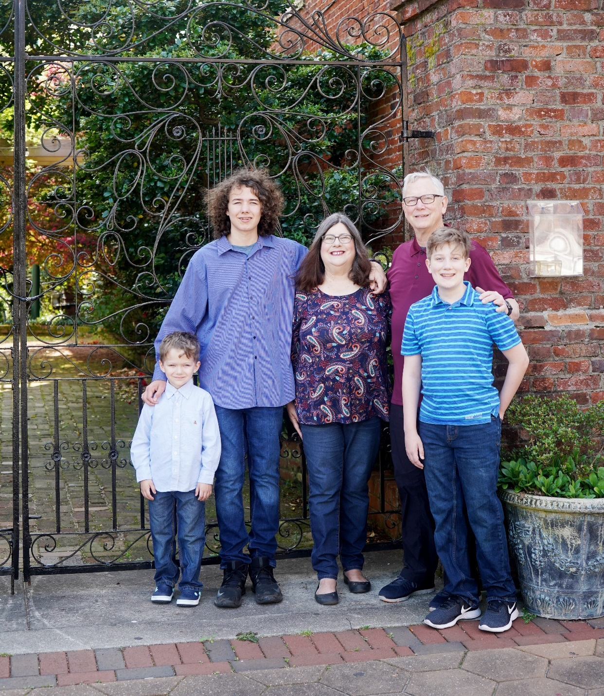
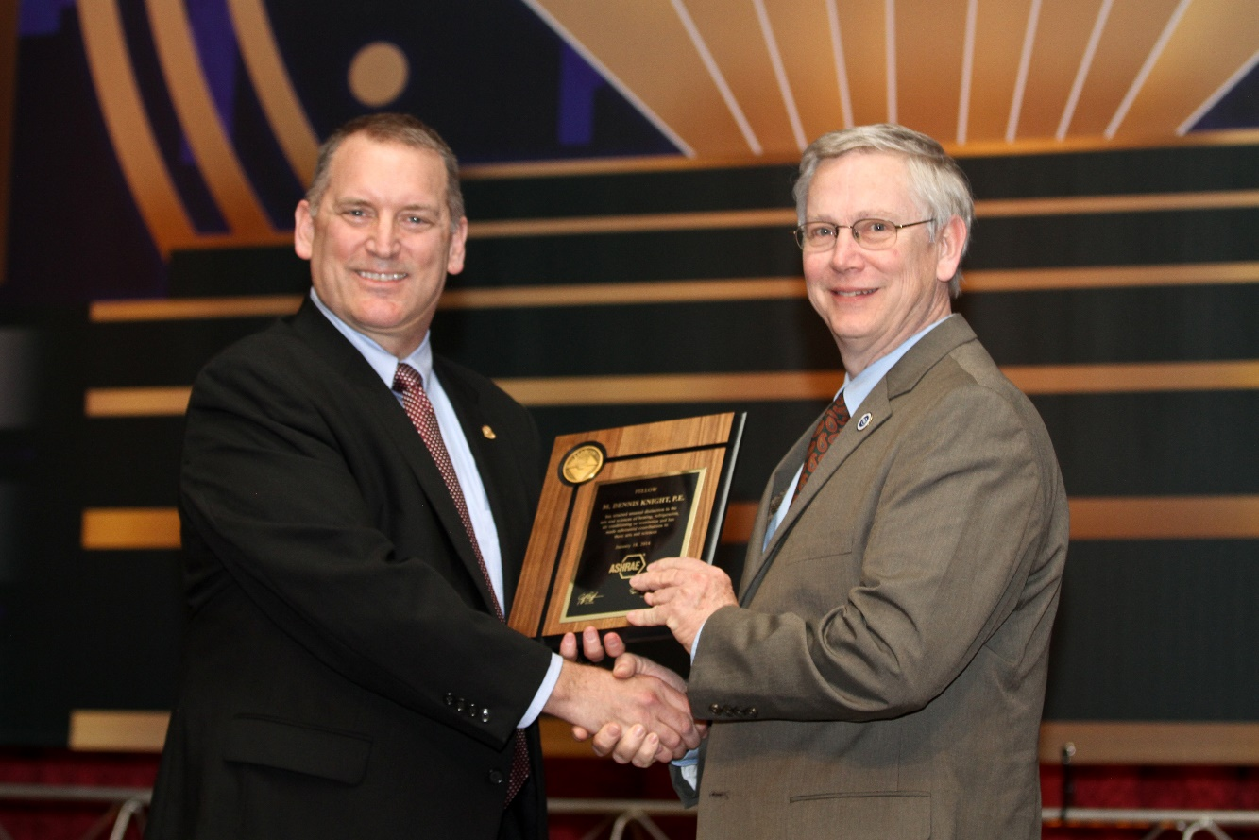
Telling Our Stories
Notes:
He recruited me into the industry using a "skills first" hiring approach. Through Fred and other employers, I took advantage of in-house training, ASHRAE courses, job-specific mentoring and generous tuition reimbursement programs.
I went on to earn my degree in physics from the College of Charleston, become a registered engineer, build a successful consulting engineering practice, work to introduce Building Information Modeling technology to our industry, help improve indoor air quality in K-12 schools and engage with my ASHRAE colleagues to produce standards and take action on global issues.
All because Fred Howard was thinking outside of the box for his time.
For us to grow and shape the HVACR and building science workforce for the next 50-100 years, we will need to think outside of the box in ways that will meet the needs of our industry, meet the needs of our prospective workforce and meet the needs of our world at large. We need to take a closer look at access to education and training and expand our concept of who could be potential workforce candidates.
We need people from every physical science, life science and business science discipline, as well as the technical trades in the HVAC&R industry and in ASHRAE.

Slide 21
Notes:
DO YOU WANT TO HAVE AN IMPACT?
DO YOU WANT TO MAKE A DIFFERENCE?
I need your help, our industry needs your help, and ASHRAE needs your help!
YOU ARE THE SOLUTION!
We’ve got to take this message to the streets - everyday.
We must prepare to engage in conversations and share our stories about how the HVAC&R industry actively creates a sustainable world for everyone.
In her book Fierce Conversations, Susan Scott writes, "Our lives succeed or fail, gradually then suddenly, one conversation at a time. And while no single conversation is guaranteed to change a life, a marriage, [an industry, the world], it can. The conversation I.S. the relationship.“
Let’s start these conversations.
Let’s build these relationships.
Let’s tell our stories.
Please share them with students, colleagues, employees, potential ASHRAE members, even family and friends.
Tell them why this industry is a place that has role models, mentors and collaborators that you want to work with and aspire to be like.
We’ve accepted the challenge!

Slide 22
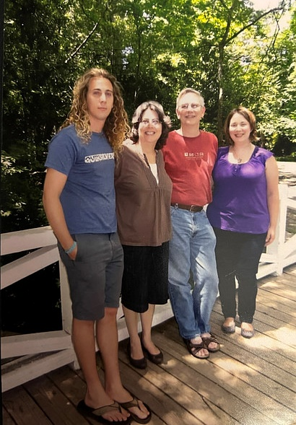
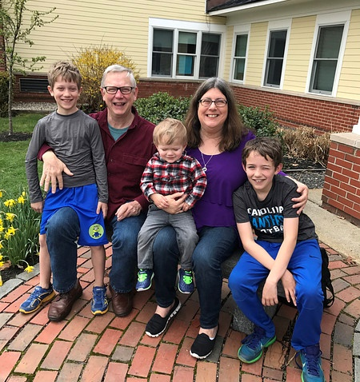
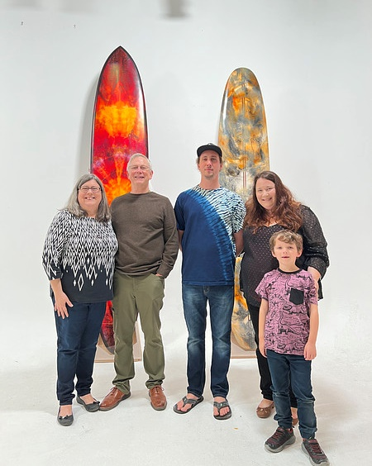
Thank you!
ashrae.org/president
Notes:
Let's take pride in our accomplishments, tell our stories, and grow our workforce!
Thank you!

