Slide 1
LEADERSHIP PRESENTATION
Notes:
Welcome! The topics presented today will follow the 6 main headers in the menu of ashrae.org to assist viewers in navigating where to learn more about information presented today.

Slide 2
ABOUT
ASHRAE Policies
TECHNICAL RESOURCES
PROFESSIONAL DEVELOPMENT
CONFERENCES
COMMUNITIES
MEMBERSHIP
Code of Ethics
Harassment and Discrimination
Commercialism
We will act with honesty, fairness, courtesy, competence, inclusiveness and respect for others, which exemplify our core values of excellence, commitment, integrity, collaboration, volunteerism and diversity, and we shall avoid all real or perceived conflicts of interest.
ASHRAE strictly prohibits and does not tolerate discrimination against members or applicants for membership because of such individual’s race, color, religion, age, sex, sexual orientation, national origin, physical or mental disability, pregnancy, genetic information, veteran status, uniformed service member status, or any other category protected under applicable law.
ASHRAE’s Commercialism Policy allows for Society activities that fulfill the mission of technological advancement with adherence to business plans that generate income to offset operational expenses such as AHR Exposition, ASHRAE periodicals, website, and Society conference events such as the Welcome Party, luncheons, registration kits, and receptions.
Notes:
View ASHRAE Governing Documents at ashrae.org/about/governance

Slide 3
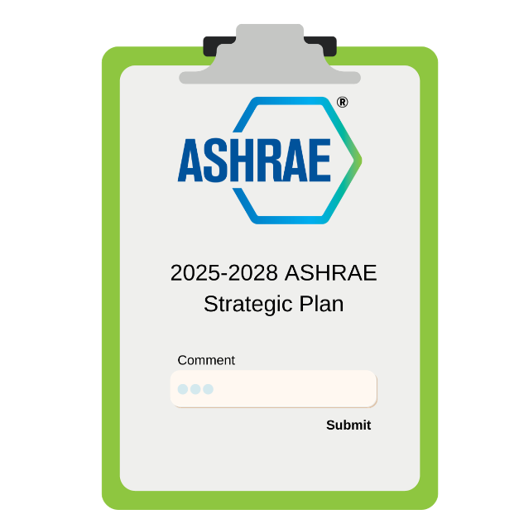
ABOUT
ASHRAE Resources
TECHNICAL RESOURCES
PROFESSIONAL DEVELOPMENT
CONFERENCES
COMMUNITIES
MEMBERSHIP
DIVERSITY, EQUITY, INCLUSION
Sunday 2:30 – 6:30 PM
Mindy Gulati will present during the Board Meeting
Monday at 7:00 AM
Women in ASHRAE Breakfast
with President Gingers Scoggins and Mindy Gulati. (ticket required)
Monday at 9:45 AM
Bring your tough questions to Forum 3: Pulling back the Curtain on DEI with Mindy Gulati for an opportunity to learn about the positive impact of DEI on organizations.
Give your feedback on the NEW direction of ASHRAE
Submit Feedback
Notes:
A few of the many resources in the ‘About’ section of ashrae.org include ASHRAE’s DEI initiatives, where you can find resources and event information, as well as information regarding the Strategic Plan.
DEI events happening here in Chicago include the Women in ASHRAE breakfast with President Ginger Scoggins, who will interview Mindy Gulati, DEI Consultant, to discuss industry trends, and share experiences and insights. Mindy Gulati will also present to the ASHRAE Board during the Sunday BOD meeting which starts at 2:30pm. She will also be answering your toughest questions Monday at 9:45 AM in Forum 3: Pulling Back the Curtain on DEI.
An important update regarding the Strategic Plan: The ASHRAE 2025-28 Strategic Planning Development cycle is currently underway and will begin officially this March during a strategic planning session with the BOD and the Planning Committee. Input is currently and will continue to be solicited regarding what items should be considered for inclusion in the next plan. As a part of this effort, the association consulting firm, McKinley Advisors, has been contracted. They will be attending the 2024 Winter Conference and will be visiting various committees to gather insight on the value of ASHRAE to its members and to observe operations. They will also be attending the strategic planning session with the BOD in the spring.
If you have any feedback/comments that you would like to be considered by the BOD and the Planning Committee for inclusion in the 2025-28 Strategic plan, please don’t hesitate to complete the Strategic Plan Feedback Form that can be accessed on ASHRAE’s home page.

Slide 4
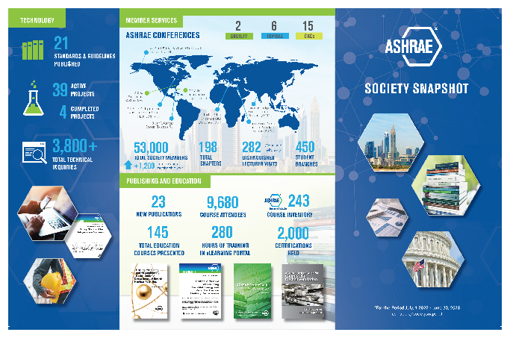
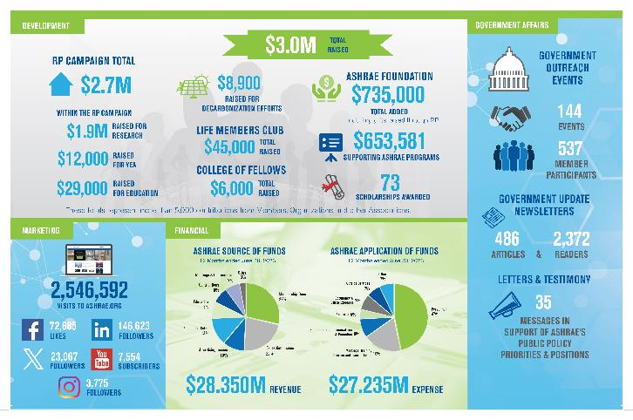
ABOUT
ASHRAE Resources
TECHNICAL RESOURCES
PROFESSIONAL DEVELOPMENT
CONFERENCES
COMMUNITIES
MEMBERSHIP
SOCIETY SNAPSHOT
MARKETING CENTRAL
Logos & Branding Guide
Flyers | Brochures
Presentations | Graphics
Canva Templates
Notes:
Additional resources in the ‘About’ section include the Society Snapshot for download and review, as well as Marketing Central. If you haven’t looked at Marketing Central it’s a wealth of information for members and chapters to assist in their promotion efforts. This page provides presentations, social media templates, branding guides, and much more.

Slide 5
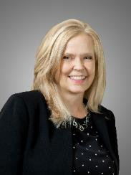
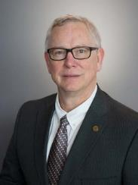
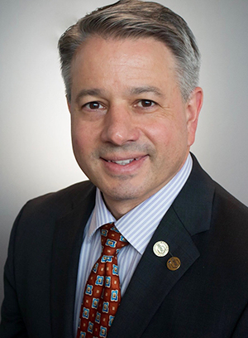
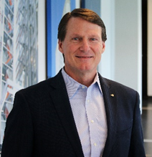
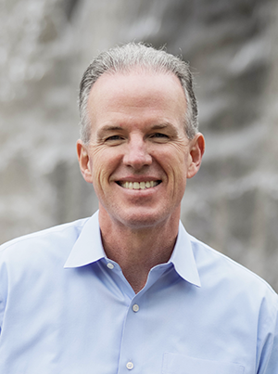
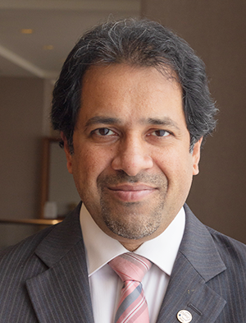
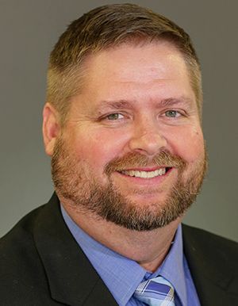
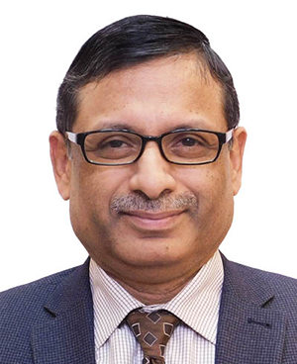
ABOUT
ASHRAE Board of Directors
TECHNICAL RESOURCES
PROFESSIONAL DEVELOPMENT
CONFERENCES
COMMUNITIES
MEMBERSHIP
President
President-Elect
Treasurer
Secretary
Ginger Scoggins, P.E.
Fellow ASHRAE,
Raleigh,
North Carolina
Dennis Knight, P.E.
BEMP, Fellow ASHRAE
Mt. Pleasant
South Carolina
Bill McQuade, P.E.
Fellow ASHRAE
Jessup,
Maryland
Jeff Littleton
Peachtree Corners, Georgia
Vice Presidents
Billy Austin, P.E.
Fellow ASHRAE, BCxP, BEAP, BEMP, HBDP, HFDP, CHD
Charlotte, North Carolina
Ashish Rakheja,
Noida, Uttar Pradesh, India
Wade Conlan, P.E.
BCxP, CxA Maitland, Florida
Chandra Sekhar, Ph.D., CPEng.
Fellow ASHRAE
Singapore
Submit nominations for others and/or yourself
ashrae.org/committee-nominations
Notes:
2023-24 Board of Directors Executive Committee
Through an elaborate committee structure, including committees and councils, ASHRAE policies are established by a Board of Directors comprised of Society members elected by the membership. Board members serve terms of one to three years, including the President who serves a one‐year term.

Slide 6
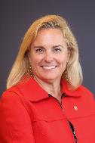
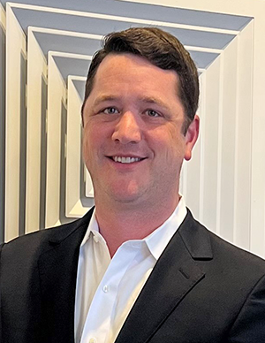
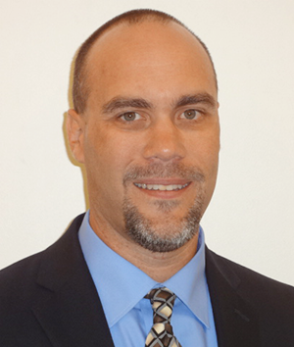
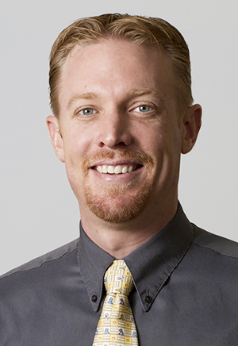
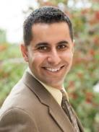
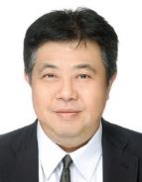
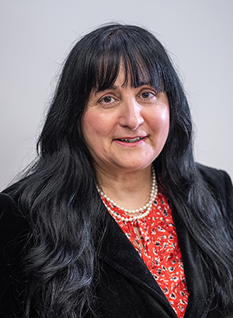
ABOUT
ASHRAE Director and Regional Chairs
TECHNICAL RESOURCES
PROFESSIONAL DEVELOPMENT
CONFERENCES
COMMUNITIES
MEMBERSHIP
Region I
Region II
Region III
Region IV
Region V
Steven C. Sill
Sterling, New York
Ronald Gagnon
Quebec, Canada
Mark Tome, P.E., HFDP
Harrisburg, Pennsylvania
Bryan Holcomb
Oak Ridge, North Carolina
James Arnold, P.E.
Dublin, Ohio
Region VI
Region VII
Region VIII
Region IX
Region X
Susanna Hanson
La Crosse, Wisconsin
Scott Peach, P.E.
Mobile, Alabama
Joseph Sanders Oklahoma City, Oklahoma
Jonathan Smith, P.E.
Lenexa, Kansas
Buzz Wright, P.E.
Tucson, Arizona
Region XI
Region XII
Region XIII
Region XIV
Region-at-Large
Submit nominations for others and/or yourself
ashrae.org/committee-nominations
Eileen Jensen, P.E.
Gaston, Oregon
John Constantinide, P.E.,
Merritt Island, Florida
Cheng Wee Leong, P.E.,
Singapore
Mahroo Eftekhari, C.Eng., CDPhil
Loughborough, England
Richie Mittal
New Delhi, India
Notes:
2023-24 Board of Directors Director and Regional Chairs

Slide 7
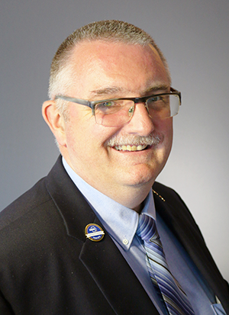
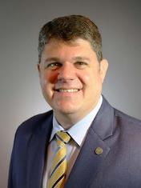
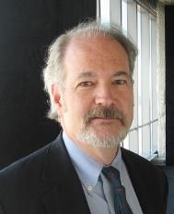
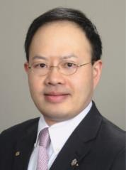
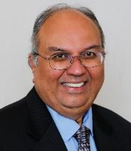
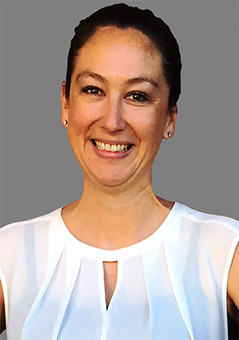
ASHRAE Directors at Large
ABOUT
TECHNICAL RESOURCES
PROFESSIONAL DEVELOPMENT
CONFERENCES
COMMUNITIES
MEMBERSHIP
Doug Cochrane, P.Eng.
Mississauga, Ontario, Canada
Blake Ellis, P.E.
Overland Park, Kansas
Dru Crawley, Ph.D., BEMP
Washington, D.C.
Corey Metzger, P.E. Ames, Iowa
Art Giesler
Colleyville, Texas
Wei Sun, P.E.
Ann Arbor, Michigan
Kishor Khankari, Ph.D.
Ann Arbor, Michigan
Luke Leung, P.E, BEMP
Clarendon Hills, Illinois
Heather Schopplein-Anderson, P.E.
Santee, California
Submit nominations for others and/or yourself
ashrae.org/committee-nominations
Notes:
2023-24 Directors-at-large

Slide 8
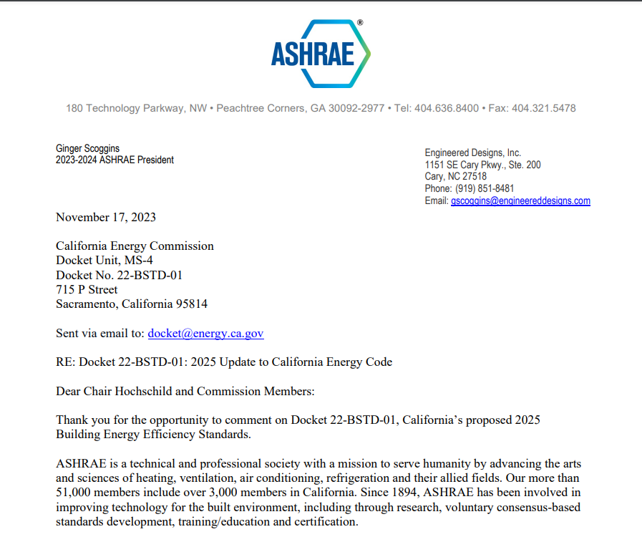
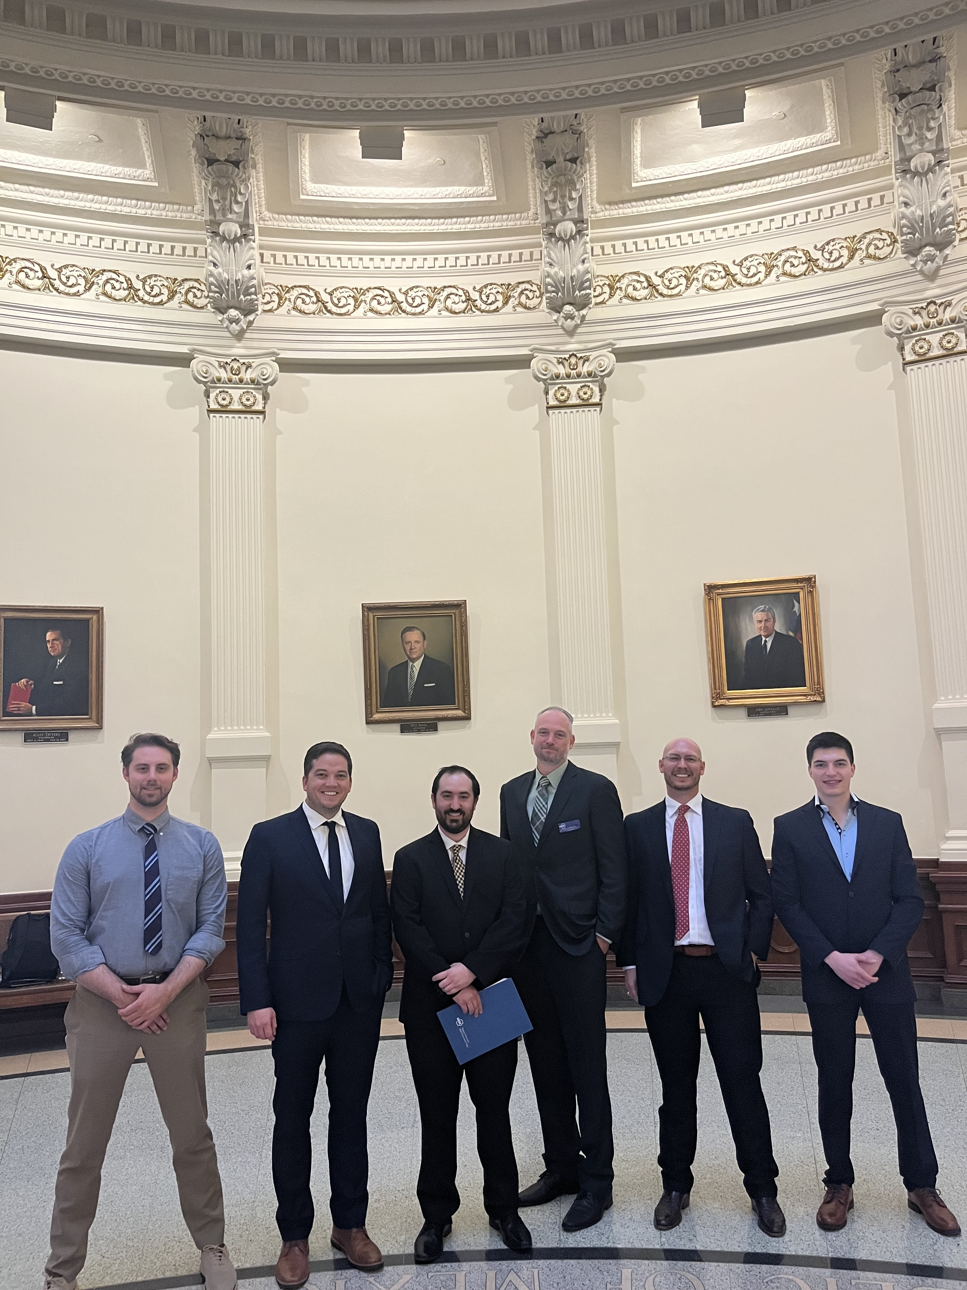
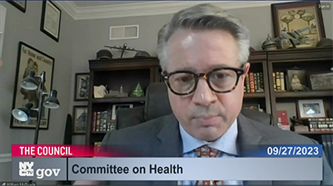
Government Affairs
ABOUT
TECHNICAL RESOURCES
PROFESSIONAL DEVELOPMENT
CONFERENCES
COMMUNITIES
MEMBERSHIP
GOVERNMENT OUTREACH
GOVERNMENT AFFAIRS UPDATE
LETTERS & TESTIMONY
BI-WEEKLY NEWSLETTER
Submit nominations for others and/or yourself
ashrae.org/committee-nominations
Sign up online or email GovAffairs@ashrae.org
Get Involved!

Slide 9
ABOUT
Research: Supporting ASHRAE’s Mission
TECHNICAL RESOURCES
PROFESSIONAL DEVELOPMENT
CONFERENCES
COMMUNITIES
MEMBERSHIP
Society Year 2022-2023
$800,000 Raised for Endowments
Research Promotion Campaign Total $2.7M
(Research, YEA, ALI, Scholarships, General)
$298,750 Awarded through 76 Scholarships
Within the RP Campaign
$2M Raised for Research
$1M Given by ASHRAE
Regions, Chapters and Sections
$50,000 Raised by College of Fellows and Life Members Club
More than 4,000 contributions from Members, Organizations and other Associations

Slide 10
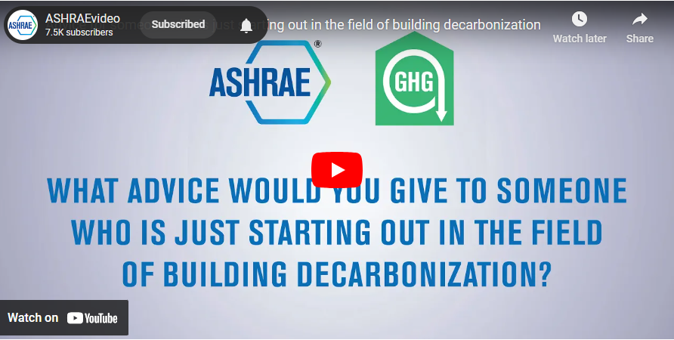
ABOUT
Task Force for Building Decarbonization
TECHNICAL RESOURCES
PROFESSIONAL DEVELOPMENT
CONFERENCES
COMMUNITIES
MEMBERSHIP
Notes:
New Technical Resources available from the Task Force for Building Decarbonization include the latest resource guide Understanding Grid-Interactive Buildings for Decarbonization which is now available for purchase.
Also available are videos from ASHRAE’s bimonthly video series which looks at the carbon problem and describes how ASHRAE is leading the way towards a solution.

Slide 11
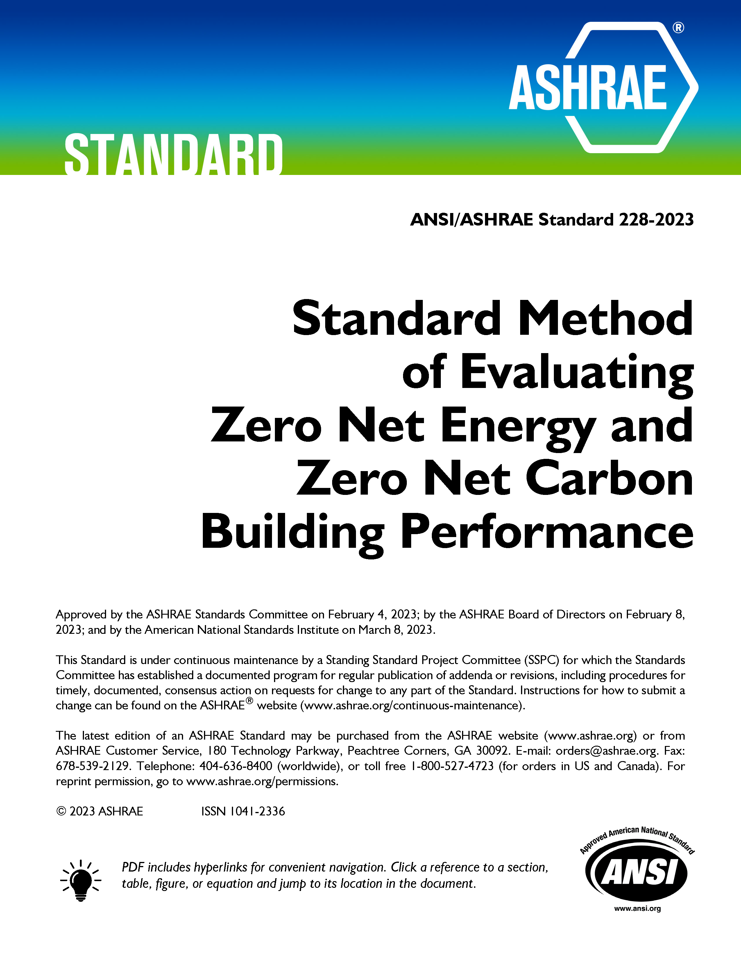
ABOUT
Standards
TECHNICAL RESOURCES
PROFESSIONAL DEVELOPMENT
CONFERENCES
COMMUNITIES
MEMBERSHIP
Notes:
Standard 241: establishes minimum requirements aimed at reducing the risk of disease transmission through exposure to infectious aerosols in new buildings, existing buildings, and major renovations. Now available in Spanish!
Standard 228: sets requirements for evaluating whether a building or group of buildings meets a definition of “zero net energy” or a definition of “zero net carbon” during building operation.
New 2024 Update of Standard 100: This essential ASHRAE resource offers over 100 typical energy efficiency measures (EEMs) that can be applied to enable buildings to meet set energy targets, identifying commonly applied elements that can improve building performance.

Slide 12
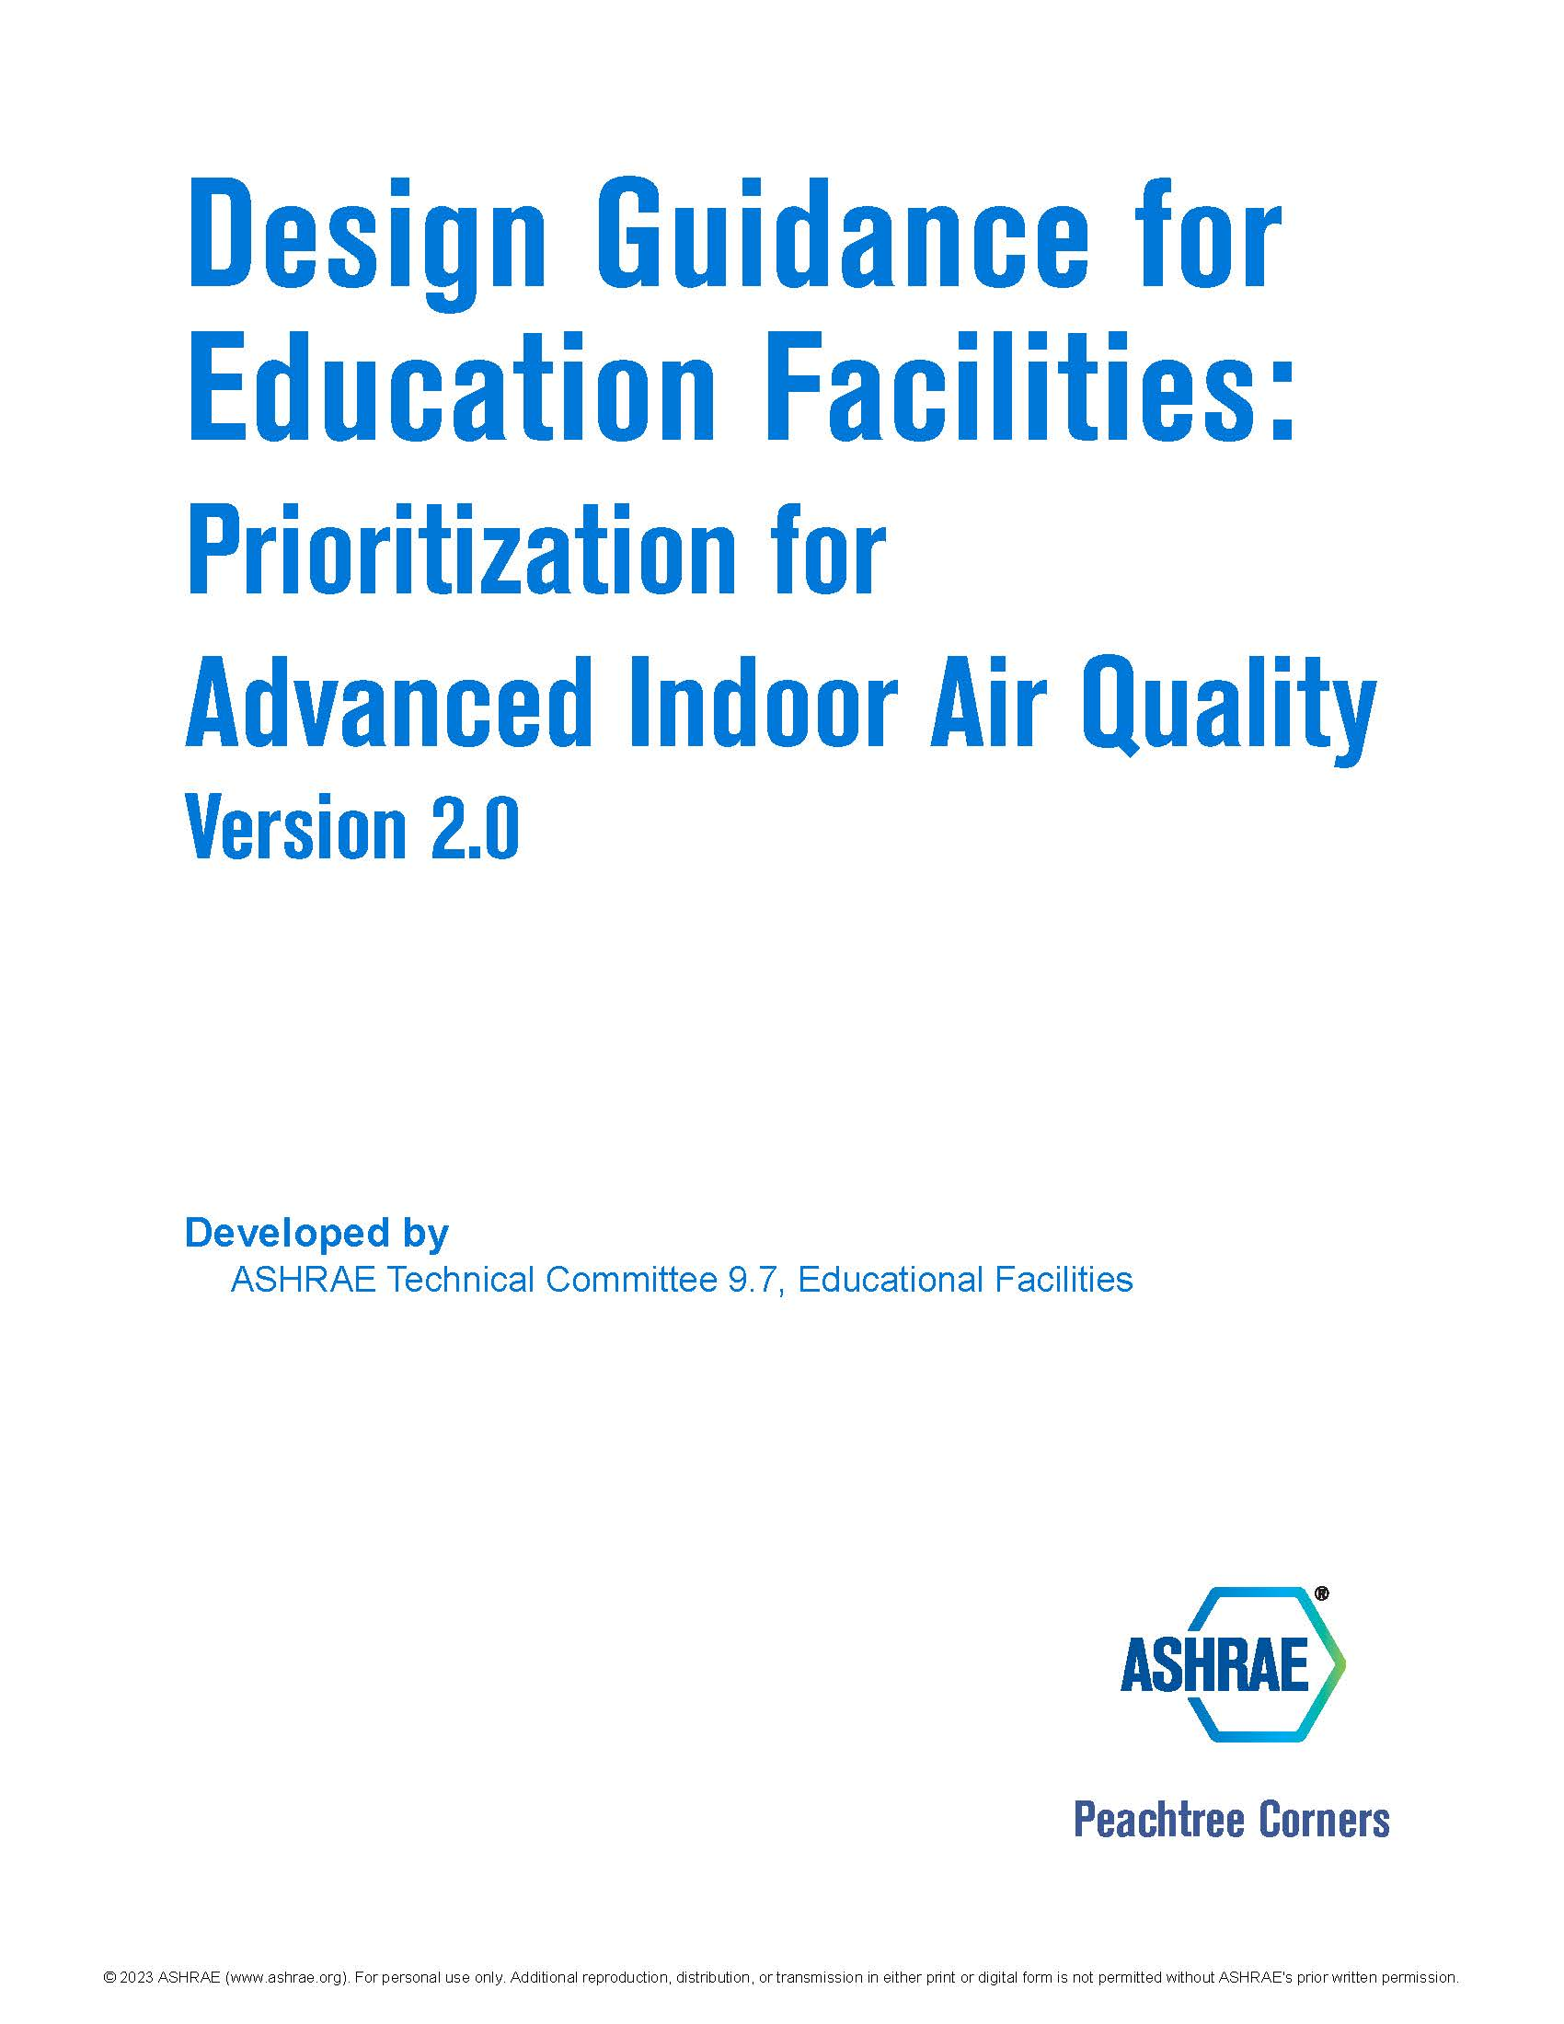
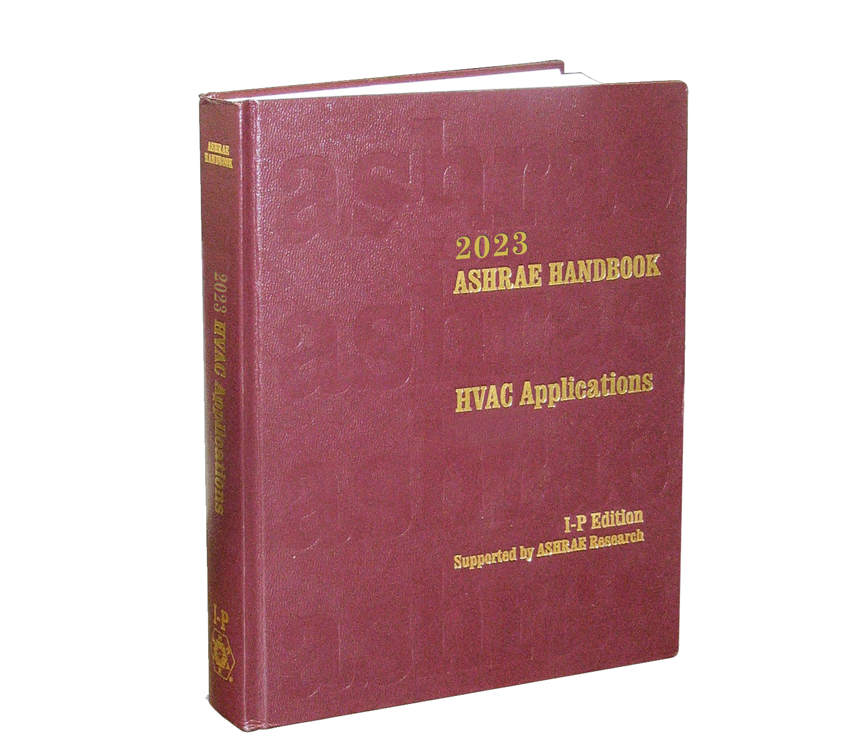
ABOUT
ASHRAE Bookstore
TECHNICAL RESOURCES
PROFESSIONAL DEVELOPMENT
CONFERENCES
COMMUNITIES
MEMBERSHIP
Lucy Goes Green
Book Signing!
ASHRAE Bookstore at the Marriott Marquis, Sunday, Jan. 21 at 9:00 AM.
Notes:
Commercial Kitchen Ventilation: One of the primary goals of this book is to share with the HVAC and food service industry the cumulation of decades of CKV research and design experience that has transformed the design and operation of CKV systems from rules of thumb into fact-based standards and best practices that are based on scientific research and practical experience.
The 2023 ASHRAE Handbook—HVAC Applications comprises 67 chapters—our most extensive volume yet—covering a broad range of facilities and topics, written to help engineers design and use equipment and systems described in other Handbook volumes
Lucy Goes Green: In the second ASHRAE children’s book, Lucy goes with her classmates on a field trip to a sustainable farm, where they learn about storing energy using solar panels and windmills and recycling water through rainwater collection. The author Danielle Passaglia will be doing a book signing at the Hotel Bookstore at the Marriott, Sunday, Jan. 21 at 9:00 AM.
Design Guidance for Education Facilities: This document provides guidance on how to best implement IAQ improvements, including risk mitigation strategies, in educational facilities and helps facilitate discussion between designers and stakeholders, identify minimum recommendations, and discuss further considerations to improve IAQ and reduce the transmission risk of infectious pathogens and other contaminants of concern.

Slide 13
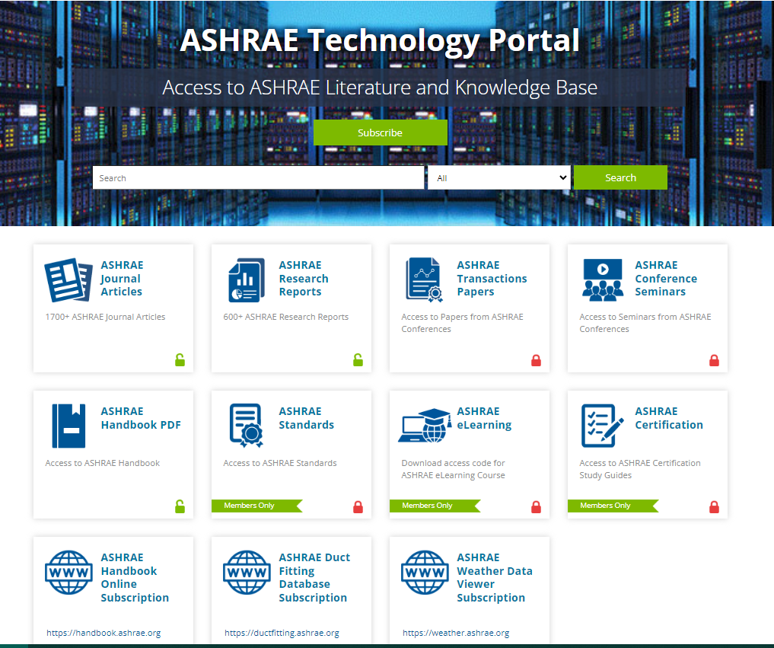
ABOUT
Technology Portal
TECHNICAL RESOURCES
PROFESSIONAL DEVELOPMENT
CONFERENCES
COMMUNITIES
MEMBERSHIP
Now even
more convenient.
Quickly access a wide range of resources and products.
Notes:
ASHRAE Members have free access to the ASHRAE Journal Articles and Research Reports sections within the Technology Portal, and now subscribers to ASHRAE Handbook Online, Duct Fitting Database, and Weather Data Viewer can find links to those resources here as well.

Slide 14
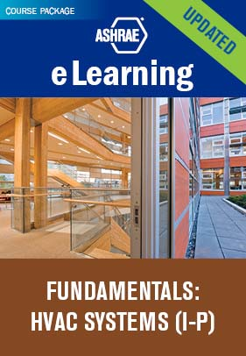
ABOUT
Professional Development
TECHNICAL RESOURCES
PROFESSIONAL DEVELOPMENT
CONFERENCES
COMMUNITIES
MEMBERSHIP
eLearning
ASHRAE Learning Institute
Certifications
Recently Updated
New Course
New Certification ​
Notes:
ELearning: Our newly updated Fundamentals: HVAC Systems eLearning course package has been meticulously crafted to provide you with the knowledge and skills you need to excel in the HVAC field.
ALI: NEW! Understanding ASHRAE Standard 241 Control of Infectious Aerosols – Background, Overview, and Key Requirements (code 78) Janaury 23| 9:00 a.m. – 12:00 p.m., McCormick Place
This course provides background on airborne transmission and airborne infection risk mitigation and gives a comprehensive introduction to Standard 241. Key definitions and requirements for compliance, including equivalent clean airflow rates and air cleaner effectiveness and safety testing, are discussed in detail, and illustrated with examples. Assessment, planning, and operation and maintenance are summarized.
A NEW ASHRAE Certification: The CDP certification will validate competency of the professional to decarbonize a building throughout its entire life cycle, including in these key job areas: Project Planning, Project Development, Construction & Renovation, Passive Efficiency, Active Efficiency, Facility Management and Distributed Energy Resources.
Development Timeline
March 1, 2024 | CDP Application Opens
June 20, 2024 | Examination Opens

Slide 15
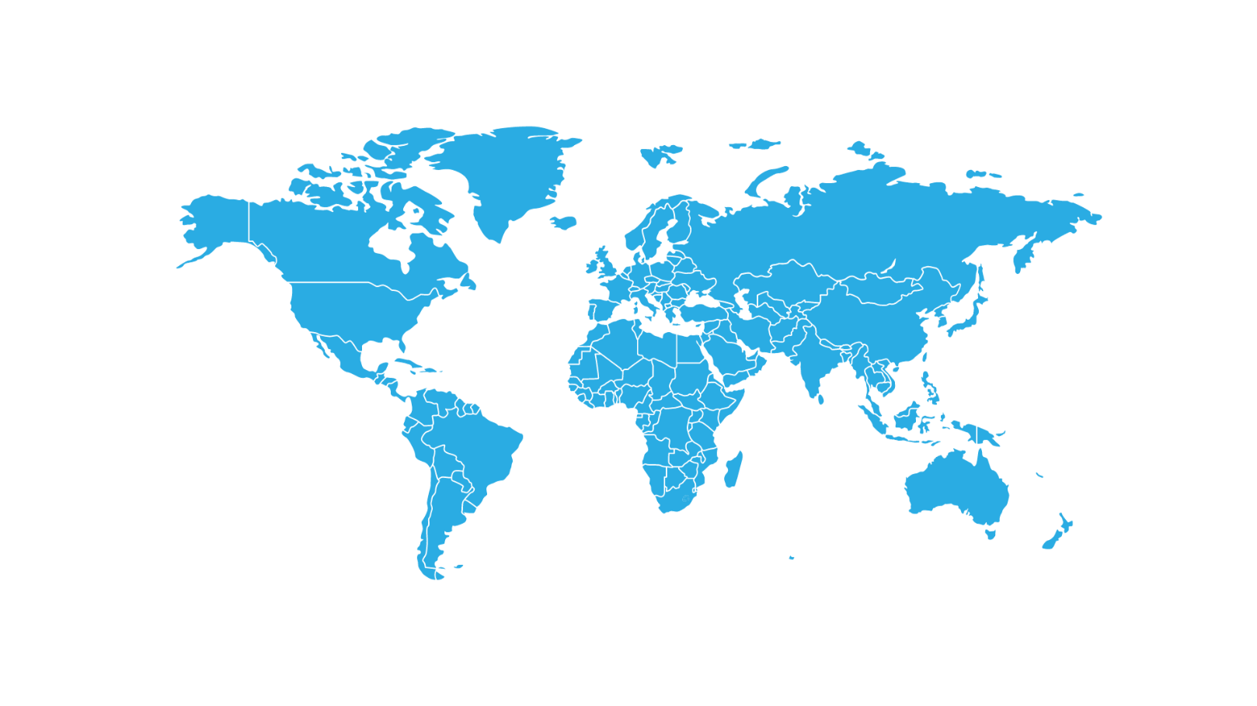
ABOUT
2024 Topical Conferences
TECHNICAL RESOURCES
PROFESSIONAL DEVELOPMENT
CONFERENCES
COMMUNITIES
MEMBERSHIP
Madrid, April 17-19
2024 ASHRAE International Conference
on Building Decarbonization
Indianapolis, June 24-26
2024 ASHRAE Conference for Integrated Design, Construction & Operations
Chicago, September 26-27
Women in ASHRAE Leadership Symposium
New York City, October 21-23
2024 ASHRAE Decarbonization Conference: Decarbonizing Existing Tall Buildings
Beirut, October 3-4
The Sixth International Conference on Efficient Building Design

Slide 16
ABOUT
Events & Conferences: Tradeshows
TECHNICAL RESOURCES
PROFESSIONAL DEVELOPMENT
CONFERENCES
COMMUNITIES
MEMBERSHIP
ASHRAE
at Industry Events
Visit ASHRAE Booths in the South Hall of McCormick Place
ASHRAE Booth
S6810
ASHRAE Bookstore
S5939
Toronto, ON | March 20-24
Visit ASHRAE at Booth 646
New Delhi, India | Feb. 15-17

Slide 17
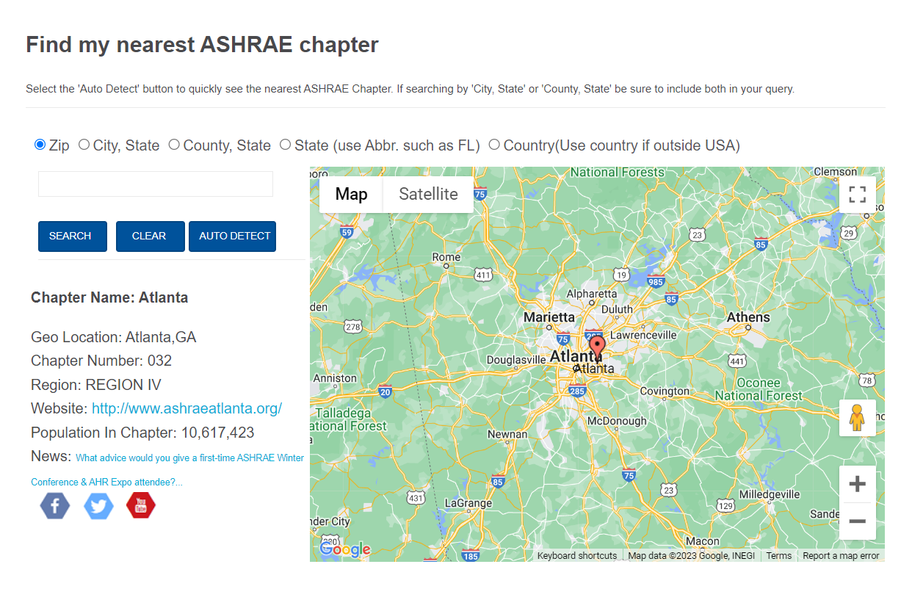
ABOUT
Get Involved with Committees & Chapters
TECHNICAL RESOURCES
PROFESSIONAL DEVELOPMENT
CONFERENCES
COMMUNITIES
MEMBERSHIP
Find Committees and Nominate Yourself or Others
Find Chapter Information Using the Chapters Map
FEB
2024
February: Nominations for appointed committees are due February 16, 2024.
JUN
2024
June: Speak with your committee ExO/CO if your current appointment/elected position ends to be nominated for another.
September: Nominations for elected positions are due. (Publications & Education Council, Tech Council, RAC, TAC,
Standards, Handbook, Nominating)
SEP
2024
Notes:
Submit nominations for others and/or yourself for council or committees in the Committee Nominations page in the Communities section.
Also in the Communities section is a convenient map to search for ASHRAE Chapters – just use autodetect or search by location to find the nearest chapter including the Chapter’s website info.

Slide 18
ABOUT
Membership
TECHNICAL RESOURCES
PROFESSIONAL DEVELOPMENT
CONFERENCES
COMMUNITIES
MEMBERSHIP
NEW Benefit!
ASHRAE Guidelines added to annual membership benefit selection for new & renewing full dues paying members.
95+
The following award nominations have a May 1 deadline:
Honors & Awards
Fellow | Honorary Member | ASHRAE Hall of Fame | F. Paul Anderson Award
ASHRAE Pioneers of the Industry | ASHRAE Award for Distinguished Public Service
Notes:
Recently the Board approved including ASHRAE Guidelines alongside ASHRAE Standards as an option for new and renewing members to choose while joining or renewing, as their Annual Member Benefit selection. Be sure to check the membership benefits section to get the most out of your membership.
The Honors & Awards page in the Membership section has everything you need to nominate someone for an award including deadlines, forms, and a great flow chart explaining who to nominate for what award.

Slide 19
Media Inquiries
Notes:
ASHRAE's PR team have tools and resources available to vet media inquires, research media contacts and arrange appropriate responses. Please send all media inquires to publicrelations@ashrae.org for support.

Slide 20
Thank you! Questions or Comments?

