Slide 1
ASHRAE Leadership Presentation 2022 Fall CRC
August 2022

Slide 2
ASHRAE Policies
Code of Ethics
Commercialism
“We will act with honesty, fairness, courtesy, competence, inclusiveness and respect for others, which exemplify our core values of excellence, commitment, integrity, collaboration, volunteerism and diversity, and we shall avoid all real or perceived conflicts of interest.”
ASHRAE’s Commercialism Policy allows for Society activities that fulfill the mission of technological advancement with adherence to business plans that generate income to offset operational expenses such as AHR Exposition, ASHRAE periodicals, website, and Society conference events such as the Welcome Party, luncheons, registration kits, and receptions.
Harassment and Discrimination Policy
ASHRAE strictly prohibits and does not tolerate discrimination against members or applicants for membership because of such individual’s race, color, religion, age, sex, sexual orientation, national origin, physical or mental disability, pregnancy, genetic information, veteran status, uniformed service member status, or any other category protected under applicable law.
ashrae.org/commercialism
View ASHRAE Governing Documents at ashrae.org/about/governance

Slide 3
Nominations Needed!
Committee Nominations
Nominations for elected positions (Councils, RAC, TAC, Standards, and Handbook) are due mid-September.
Nominations for appointed committees are due mid-February.
Speak with your committee ExO/CO if your current appointment ends in June and you wish to be nominated for another committee.
Honors & Awards Nominations​
ASHRAE's awards fall into one of six categories: ​
Personal Honors​
Personal Awards for General & Specific Society Activities​
Paper Awards​
Society Awards to Groups or Chapters​
Chapter and Regional Awards​
Learn More and Nominate Someone Today ashrae.org/honorsandawards
Learn More about Technical and Society Level Committees
ashrae.org/committee-nominations
ASHRAE Technical Committees (TCs) and Volunteer Opportunities at ashrae.org/communities
Notes:
Nominations for appointed standing committees are sought annually
Speak with your committee ExO/CO if your current appointment ends June 30 and you wish to be nominated for another committee Society Year (July 1-June 30)
Self-nomination is also encouraged
Councils are elected by the Board of Directors, but nominations are welcome
Nominations for Personal Honors and Personal Awards for General Society Activities may be made by chapters, regions, committees or individual ASHRAE members
Nominations for Personal Awards for Specific Society Activities and Society Awards to Groups or Chapters are made by the committee which sponsors the award
Recommendations for Paper Awards are made by the Society Program Committee
Nominations for Regional Awards are made by the delegate from a candidate’s chapter at the Chapters Regional Conference (CRC)

Slide 4
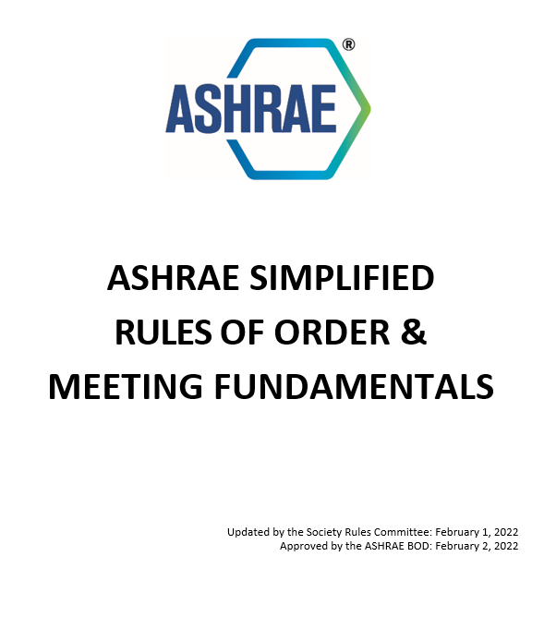
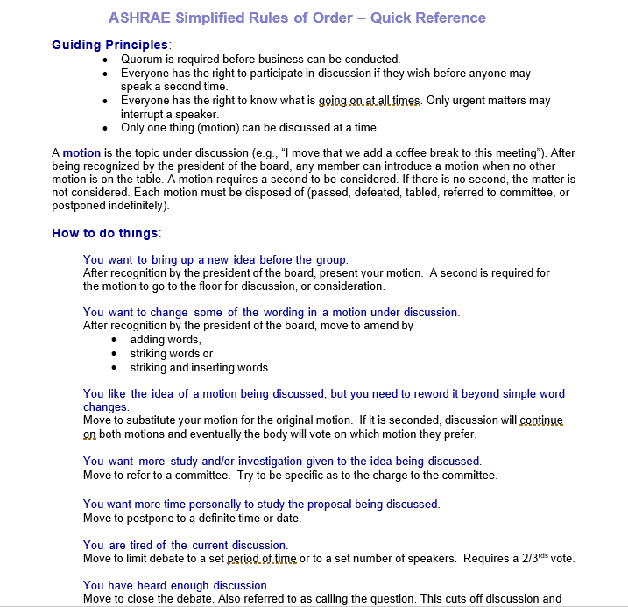
ASHRAE Simplified Rules of Order & Quick Reference
NEW!
Intent is to streamline meetings by providing simpler meeting guidance. Rules generally follow Roberts Rules of Order but are intentionally modified for the purpose of use in ASHRAE meetings.
Councils and Committees should be fully operational in the new meeting guidance as of July 1, 2022.
CHANGES APPROVED AT THE 2022 ANNUAL CONFERENCE
The meeting fundamentals and quick reference have been revised to reflect the procedure for motions made
from subcommittees and reporting bodies.
REMINDER! These are big changes for our Society, and we need your assistance to implement the approved changes at the Society
and Chapter level.
Download the rules and quick reference
ashrae.org/communities/committees/
society-rules-committee
Questions or comments regarding the new rules of order and quick reference?
Contact boardservices@ashrae.org
Notes:
The BOD approved edits to the meeting fundamentals and quick reference to provide clarity regarding when motions from subcommittees ad reporting bodies need a second.

Slide 5
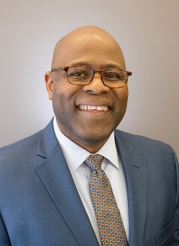
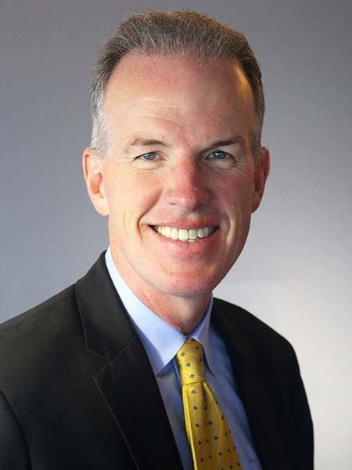
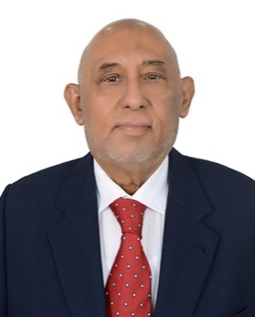
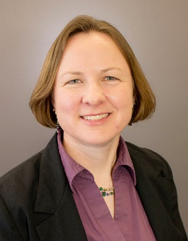
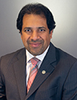
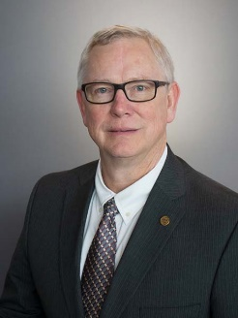
2022-23 Board of Directors
Executive Committee
Through an elaborate committee structure, including committees and councils, ASHRAE policies are established by a Board of Directors comprised of Society members elected by the membership. Board members serve terms of one to three years, including the President who serves a one‐year term.
Vice Presidents
Dunstan Macauley, P.E., HBDP
Arlington, Virginia
Billy Austin, P.E., BCxP, BEAP, BEAP, HBDP, HFDP, OPMP
Charlotte, North Carolina
President
Farooq Mehboob, P.E.
Fellow ASHRAE, Life Member
Karachi, Pakistan
Sarah E. Maston, P.E., BCxP
Hudson, Massachusetts
Ashish Rakheja
Noida, Uttar Pradesh, India
President-Elect
Treasurer
Ginger Scoggins, P.E.
Raleigh, North Carolina
Dennis Knight, P.E.
Fellow ASHRAE
Mt. Pleasant, South Carolina

Slide 6
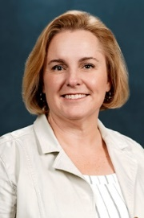
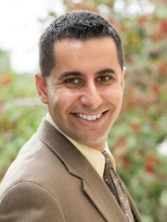
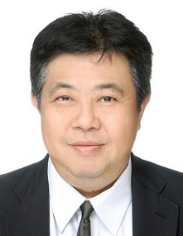
2022-23 Board of Directors Director and Regional Chairs
Region I
Region II
Region III
Region IV
Region V
Steven C. Sill
Sterling, New York
Ronald Gagnon
Quebec, Canada
Mark Tome, P.E., HFDP
Harrisburg, Pennsylvania
Bryan Holcomb
Oak Ridge, North Carolina
James Arnold, P.E.
Dublin, Ohio
Region VI
Region VII
Region VIII
Region IX
Region X
Susanna Hanson
La Crosse, Wisconsin
Chris M. Gray, Ph.D., P.E.
Atlanta, Georgia
Randy C. Schrecengost, P.E., BEAP
Austin, Texas
Tyler J. Glesne, BCxP, BEAP
Omaha, Nebraska
Devin A. Abellon, P.E.
Los Angeles, California
Region XI
Region XII
Region XIII
Region XIV
Region-at-Large
Eileen Jensen, P.E.
Vancouver, Washington
John Constantinide, P.E.,
Merritt Island, Florida
Cheng Wee Leong, P.E.,
Singapore
Andres J Sepulveda
Madrid, Spain
Richie Mittal
New Delhi, India

Slide 7
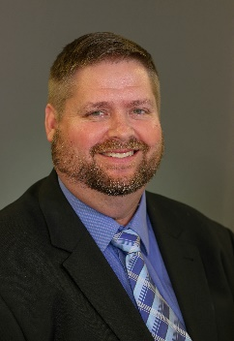
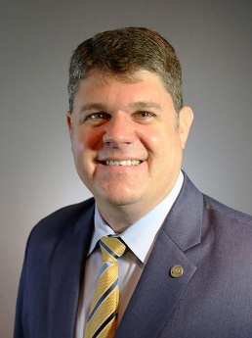
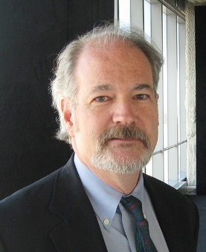
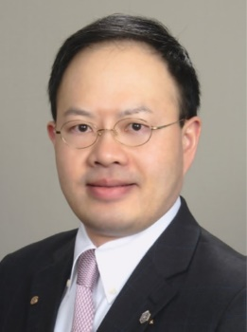
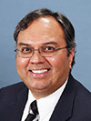
2022-23 Board of Directors Directors-at-large
Wade Conlan, BCxP
Maitland, Florida
Blake Ellis, P.E.
Overland, Kansas
Dru Crawley, Ph.D., BEMP
Washington, D.C.
Kenneth Fulk
Allen, Texas
Art Giesler
Colleyville, Texas
Wei Sun, P.E.
Ann Arbor, Michigan
Kishor Khankari, Ph.D.
Ann Arbor, Michigan
Luke Leung, P.E
Clarendon Hills, Illinois
Adrienne Thomle
Reno, Nevada

Slide 8
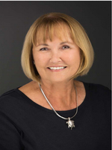
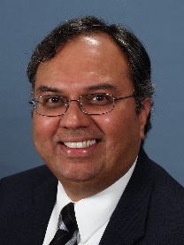
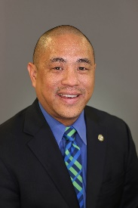
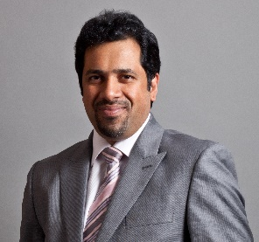
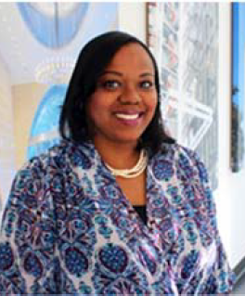
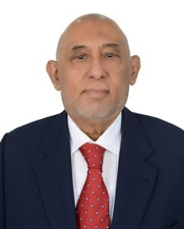
Diversity, Equity, & Inclusion (DEI) in ASHRAE BOD Subcommittee created by the Board in January 2021
The purpose of the BOD DEI Subcommittee is to advise and engage the Board of Directors on:
All matters relating to diversity, equity and inclusion - with a view to improving organizational awareness and performance in these areas amongst both staff and the Society membership
The establishment of annual budgets for DEI program and ongoing initiatives
The prioritization of inclusivity issues which have relevance to ASHRAE, together with plans for addressing these issues
Potential DEI training modules for Chapters and Committees
Members of the BOD DEI Subcommittee
Adrienne Thomle (Chair); Kishor Khankari (Vice Chair); Devin Abellon; Susanna Hanson; Wei Sun; Ashish Rakheja; Tanisha Meyers-Lisle (Staff Liaison);
Billy Austin; Dennis Knight; Farooq Mehboob (Consultant)
Download the Report
ashrae.org/DiversityEquityInclusion

Slide 9
Task Force for Building Decarbonization
The Task Force For Building Decarbonization (TFBD) is working to implement strategy, direction, and successful products and services for the industry relating to building decarbonization.
Products and Services Include:
Six Guides
Creating content for Knowledge Hub and ashrae.org
Establishing relevant training & education
Email questions or input to decarb@ashrae.org
ashrae.org/decarb
Notes:
The evolved TFBD will be developing the strategies to get decarbonization into the regular activities of ASHRAE. The TFBD ExCom consists of 7 members chaired by Presidential Member Kent Peterson. There are 2 subcommittees with 8 working groups that will be responsible for overseeing the development of six guides, new training and education products and tools, and revamping the website and knowledge hub. The 2 advisory panels will help provide guidance on what is needed on a global scale from the industry and the users.

Slide 10
Distinguished Lecturer
Do you want to be the next ASHRAE Expert in
Building Decarbonization?
ASHRAE Distinguished Lecturer (DL) will share knowledge virtually and in-person with ASHRAE Chapters about topics related to building carbon footprint reduction.
Topics associated with building decarbonization include:
Operational carbon
Embodied carbon
Building system electrification
Building performance standards
Grid-building intersection
Appliance and equipment standards
Site sequestration
Submit Nominations by December 1
To learn more, visit ashrae.org/dl

Slide 11
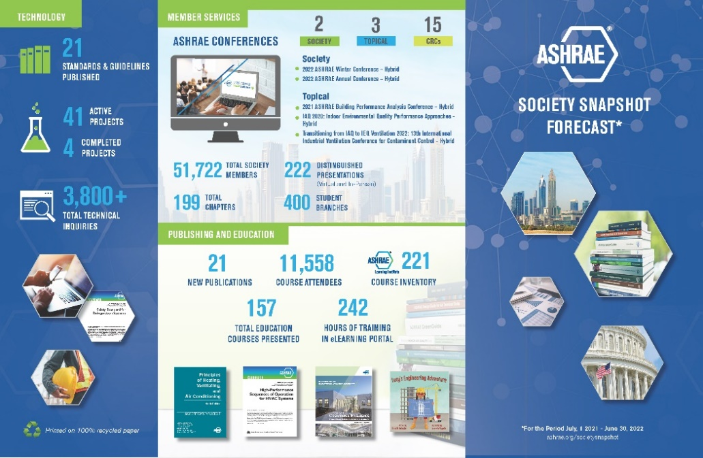
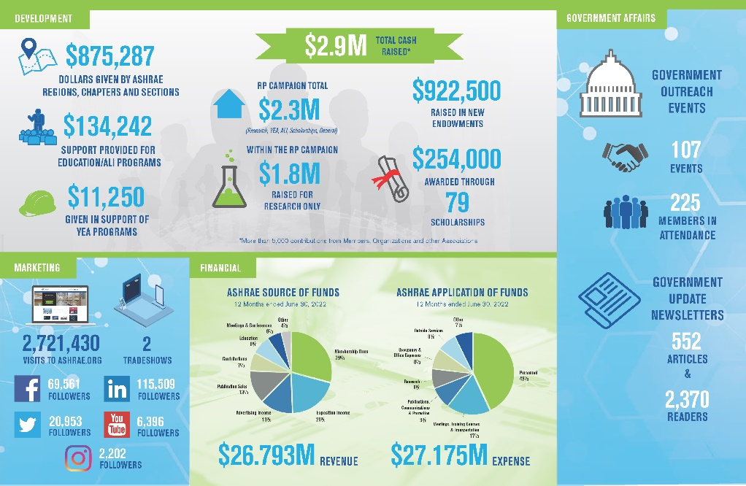
Society Updates
The Society Snapshot showcases the incredible efforts and impact of ASHRAE over the past year, as a direct result of volunteer and member support.
ASHRAE Board Activities
Stay updated with the work and efforts of the ASHRAE Board of Directors.
Join the Next ASHRAE Board Meeting
Monday, Aug 15 at 8:00 am –12:00 pm ET
Visit ashrae.org/bod for meeting login information, agendas, minutes, and a list of principal approved motions from recent meetings.
ashrae.org/society-snapshot
ashrae.org/bod

Slide 12
Membership & Communities
10% Discount for Five New Employees
Employers who submit 5 or more new membership applications in a single transaction receive a 10% discount on total dues owed. Requires paper applications available at ashrae.org/join.
Easily tell Colleagues about these exciting new benefits with Connect-A-Colleague
Invite peers to join ASHRAE in less than one minute using a
pre-written email invitation at ashrae.org/connect
Free Winter or Annual Conference Registration
New full dues paying members receive one complimentary registration to a Winter or Annual Conference to be used within the first two years of their membership.
View Benefits ashrae.org/membership
See Communities ashrae.org/communities
Notes:
10% Discount is only applied when 5 or more new full dues paying members join from the same company. Must download and submit application via email or mail.
Free conference registration can be requested within 24 months of a new full dues paying membership. Email meetings@ashrae.org once registration is open for the conference of your choice.

Slide 13
Supporting ASHRAE’s Mission
Thank You to all the donors and volunteers for your support during this challenging year.
ASHRAE’s Development Program is dedicated to seeking support for all aspects of ASHRAE’s mission. In addition, the ASHRAE Foundation, as an endowed trust, provides funding for professional development and research projects, it supplies qualified engineering students with much needed scholarship assistance, and provides grants to help support the Society’s vital work.
The Research Promotion Campaign supports ASHRAE Research, Education, YEA programs, Scholarships, Endowed Funds, the RP General Fund and Special Initiatives.
RP Campaign Total $2.5M
(Research, YEA, ALI, Scholarships, General)
$3.1M Total Cash Raised*
$1M Raised for Endowments
$234,500 Awarded through 66 Scholarships
Within the RP Campaign
$1.9M Raised for Research
$1.1M Given by ASHRAE
Regions, Chapters and Sections
*More than 5,000 contributions from Members, Corporations and other Organizations
Donate, Volunteer and Learn More at
ashrae.org/support

Slide 14
Government Affairs
ASHRAE Government Affairs program works to establish ASHRAE as a leading source of trusted expertise for policy-makers in the development of legislation and regulations affecting the public and HVAC&R industry.
Government Outreach Events
The Government Affairs Update bi-weekly newsletter provides updates on government activities. Subscribe online or by emailing GovAffairs@ashrae.org.
Government Outreach Events connect ASHRAE volunteers with policy-makers.
Letters, briefings, testimony, and comments are sent in support of ASHRAE’s Public Policy Priorities: 39 sent this year.
107*
75
Get Involved + Get Resources ashrae.org/government-affairs

Slide 15
Professional Development
eLearning
Convenient, on-demand courses for individuals or groups.
ASHRAE Learning Institute (ALI)
Instructor-led courses in a variety of formats.
Certification
Validate and promote your expertise via online examination and digital badging.
90+ online courses starting at $42 for members.
Group Rates Available
Updated Course Catalog: elearningcatalog.ashrae.org
See the Updated Schedule of In-Person and Virtual HVAC Design Courses!
Level I – Essentials
Level II – Applications
Building Design
Energy Modeling (BEMP)
Healthcare Facility Design (HFDP)
High-Performance Building Design (HBDP)
HVAC Design (CHD)
Building Performance
Commissioning (BCxP)
Energy Assessment (BEAP)
Building Operations
Operations & Performance Maintenance (OPMP)
NEW Courses Added to the
Instructor-led Online Serie ashrae.org/onlinecourses
Courses Available for ASHRAE Chapter, and In-Company Presentations.
ashrae.org/professional-development

Slide 16
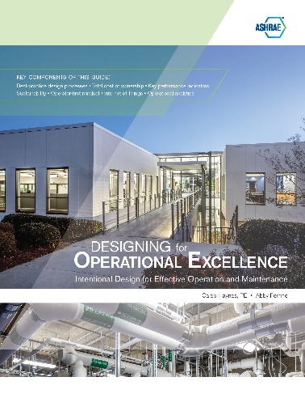
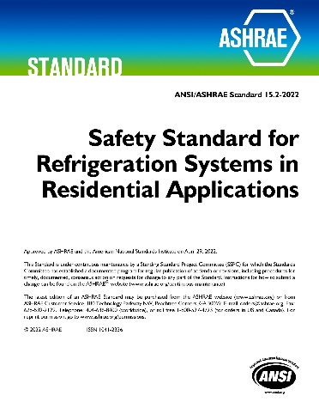
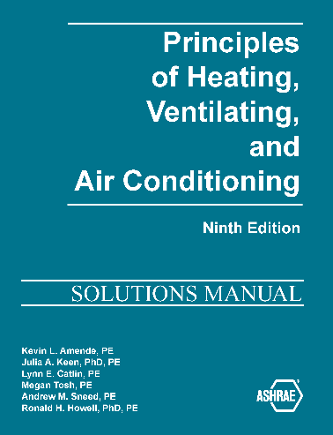
Publications Be on the lookout for updated Standards 90.1 and 62.1 later this year.
Recently published items available at ashrae.org/bookstore
Designing for Operational Excellence—Intentional Design for Effective
Operation and Maintenance
Principles of Heating, Ventilating, and Air Conditioning, Ninth Edition
ASHRAE Standard 15.2: Safety Standard for Refrigeration Systems in Residential Applications (ANSI Approved)
Lucy’s Engineering Adventure
Duct Systems Design Guide
Advanced Energy Design Guide for Multifamily Buildings – Achieving Zero Energy (AEDG)
Notes:
2022 is a code cycle year so new versions of high-profile standards like 90.1, 62.1, etc. will be released later this year.

Slide 17
Resources
ASHRAE Technology Portal | Provides a one-stop location for ASHRAE papers, articles, reports, Handbook PDFs, and seminar recordings.
Online Standards Database | Allows access to public review drafts for standards, guidelines, and addenda to submit comments, to do online balloting, and to submit proposals to standards and guidelines.
Zero Energy Advanced Energy Design Guides (AEDG) | Available for free download: NEW! NZE Guide for Multifamily Buildings, and AEDG for offices and K-12 schools.
Science and Technology for the Built Environment | Provides free online access to archival research publication offering comprehensive reporting of original research.
ASHRAE Technical Apps | Deliver mobile design, calculation, and analysis tools to the palm of your hand.
Free Technical Resources | Offer downloads of a variety of well-known resources to everyone.
ASHRAE 365 | Updates on all things ASHRAE, for free and year-round.
Find these resources and many more at ashrae.org

Slide 18
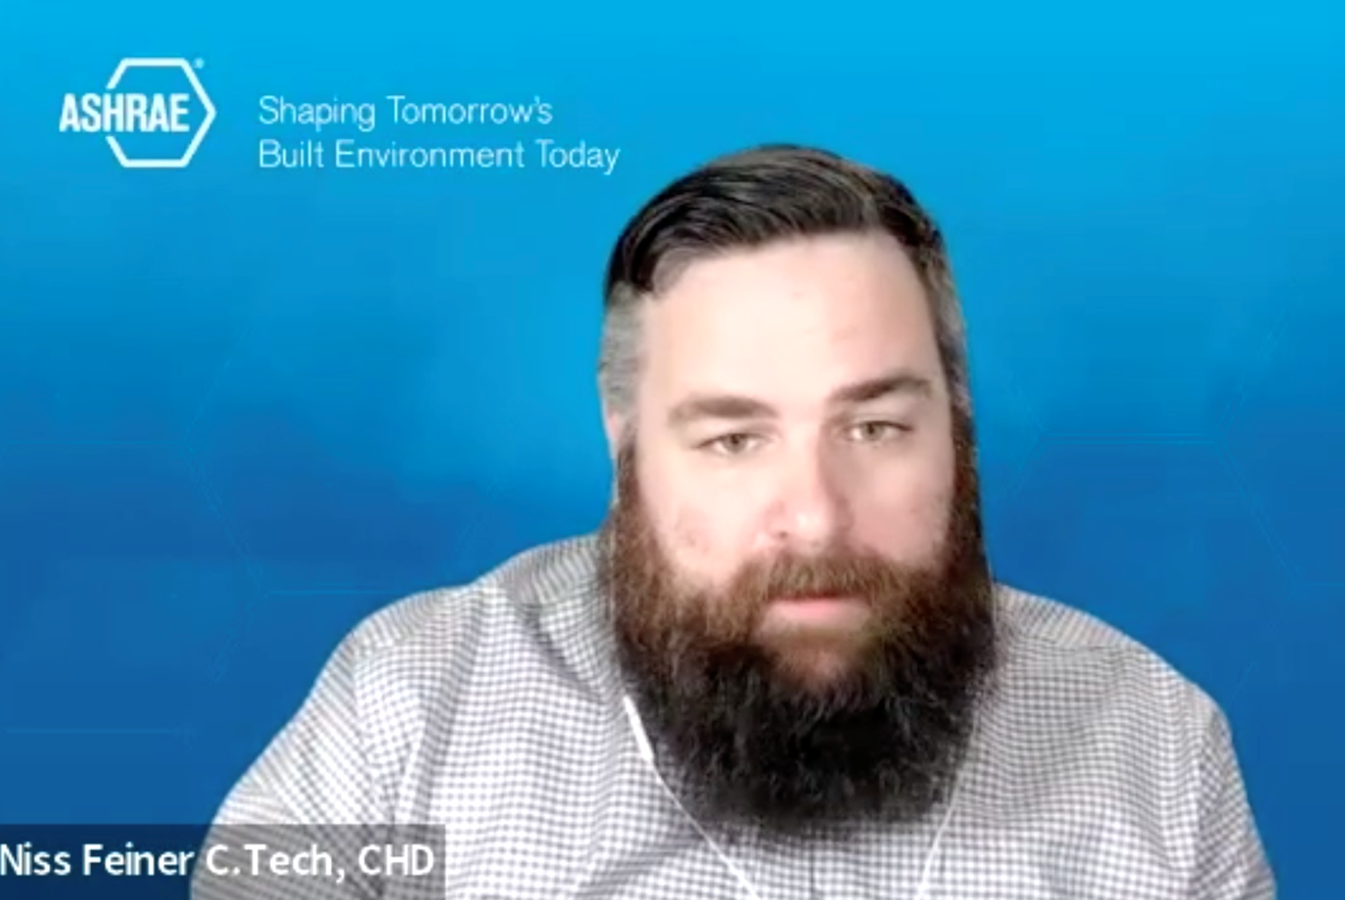
Marketing Central
Created for the busy volunteer, Marketing Central is a single page resource for Society-related marketing materials.
Request promotional freebies
Shop the logo store
Order Chapter supplies
Resources organized by file type:
Canva Templates
Forms
Logos
PDFs
PowerPoint Presentations
Templates
Toolkits
Tradeshows
Videos
Virtual Backgrounds
ashrae.org/marketingcentral

Slide 19
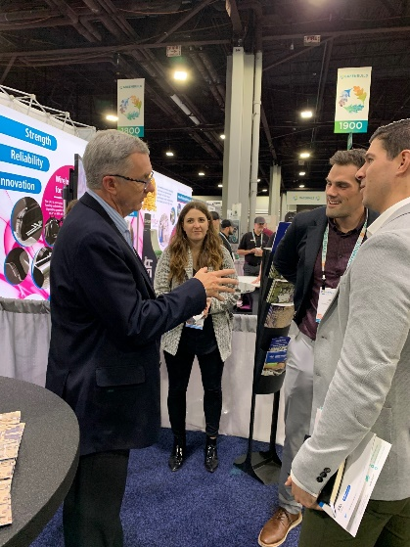
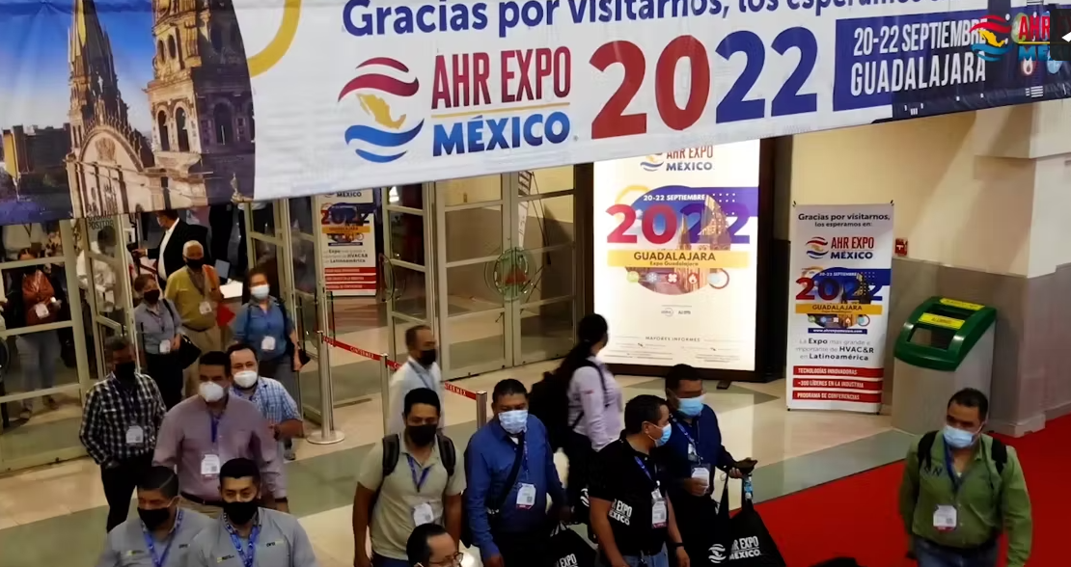
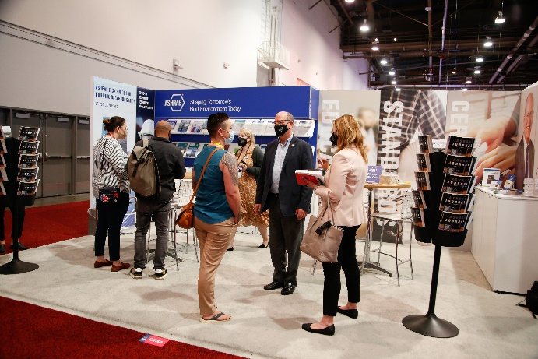
Upcoming Tradeshows
WHAT? | WHEN? | WHERE?
AHR Mexico | September 20-22, 2022 | Guadalajara, Jalisco | Booth#728
Greenbuild | November 1-3, 2022 | San Francisco, CA | Booth#2238
AHR Expo | February 6-8, 2023 | Atlanta, GA | Booth#B1638
Educational Resources
Discounts on Publications
Free ASHRAE Giveaways
ashrae.org/marketingcentral

Slide 20
ASHRAE Topical Conferences
SEP
2022
2022 ASHRAE Building Performance Analysis Conference
Sep 14 – 16, 2022 | Chicago, IL
OCT
2022
International Building Decarbonization 2022 Conference Oct 6-7, 2022| Athens, Greece
OCT
2022
The Fifth International Conference on Efficient Building Design
Oct 20–21, 2022 | Beirut, Lebanon
DEC
2022
Buildings XV Conference
Dec 5–8, 2022 | Clearwater Beach, FL
ASHRAE SCANVAC HVACC Cold Climate Conference 2023
Mar 6-8, 2023 | Anchorage, AK
Mar 9-10, 2023| Fairbanks, AK
MAR
2023
ashrae.org/conferences

Slide 21
2023 ASHRAE Winter Conference
2023 ASHRAE Winter Conference
& AHR Expo February 4-8, 2023
Atlanta, GA
Registration opens in Fall 2022 ashrae.org/2023Winter

Slide 22
Thank you! Questions or Comments?

