Slide 1



Chapter Regional Conference
Presentation for ASHRAE Volunteers
Notes:
This presentation is intended to assist volunteers in their day to day operations by including resources created specific to ASHRAE volunteers. The information is organized based on the mega menus of the ashrae.org website, which you’ll see at the top of each slide.

Slide 2
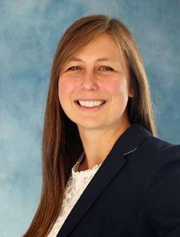



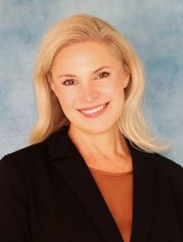
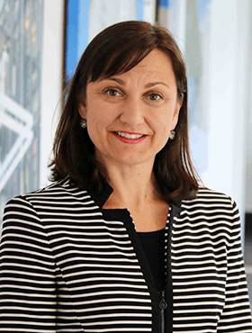

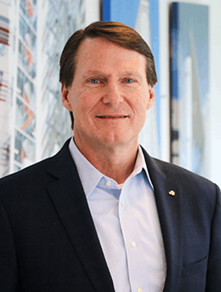
ABOUT
ASHRAE Managing Directors
TECHNICAL RESOURCES
PROFESSIONAL DEVELOPMENT
CONFERENCES
COMMUNITIES
MEMBERSHIP
Lizzy Seymour,
Managing Director of Members Services
Vanita Gupta,
Managing Director of Marketing
Craig Wright,
Managing Director of Finance & Administrative Services
Mark Owen, Managing Director of Publications & Education
lseymour@ashrae.org
vgupta@ashrae.org
cwright@ashrae.org
mowen@ashrae.org
Kirstin Pilot,
Managing Director of Development
Alice Yates,
Managing Director of Government Affairs
Stephanie Reiniche, Managing Director of Technology
Jeff Littleton, Executive Vice President, Board Secretary
kpilot@ashrae.org
ayates@ashrae.org
sreiniche@ashrae.org
jlittleton@ashrae.org

Slide 3
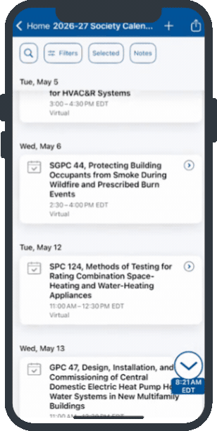
ashrae.org/Calendar
ABOUT
TECHNICAL RESOURCES
PROFESSIONAL DEVELOPMENT
CONFERENCES
COMMUNITIES
MEMBERSHIP
All ASHRAE events for the Society year in one place for a seamless experience online and on ASHRAE 365.
Contains
  In-Person and Virtual Meetings & Events
  ASHRAE BOD, Council, and Committee Meetings
  Functional Group Meetings
  Project Committee Meetings
  Centralized Trainings
  ASHRAE Training Opportunities
  Endorsed Events & Tradeshows
  ASHRAE Winter, Annual, Topical and CRCs
NOTE: ASHRAE Conferences will continue to have detailed events in
ASHRAE 365. Chapter and Region events will not be included.
ashrae.org/calendar

Slide 4



ashrae.org/Conferences
ABOUT
TECHNICAL RESOURCES
PROFESSIONAL DEVELOPMENT
CONFERENCES
COMMUNITIES
MEMBERSHIP
Seattle, WA, September 23-25, 2026
2026 ASHRAE Building
Decarbonization Conference
Guadalajara, JAL. | Sept 29 – Oct 1
Beirut, Lebanon, October 8-9, 2026
Seventh International Conference on Efficient Building Design
Kuwait University City, Kuwait, November 16-18, 2026
Ninth International Conference on Energy Research and Development (ICERD – 9)
Chicago | Jan 23-27
Dallas, TX, March 3-5, 2027
2027 ASHRAE Data Center and AI Integration Conference
Baltimore, MD, April 12-13, 2027
Women in ASHRAE Leadership Symposium

Slide 5
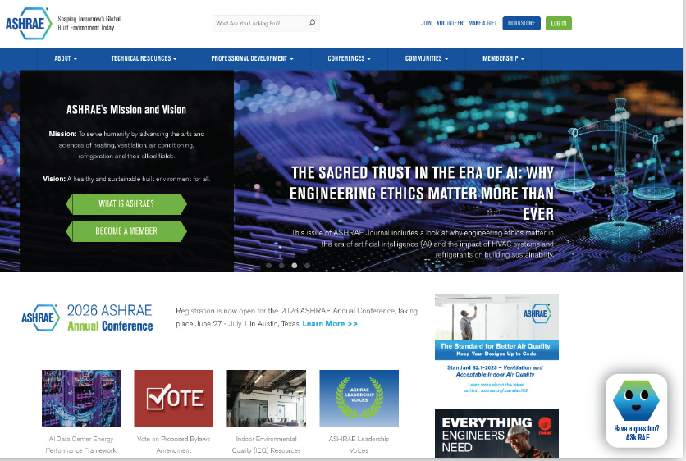


ASk RAE AI Chatbot
ABOUT
TECHNICAL RESOURCES
PROFESSIONAL DEVELOPMENT
CONFERENCES
COMMUNITIES
MEMBERSHIP
ASk RAE Chatbot
coming
October 2026
New AI Chatbot for searching
all publicly available
ashrae.org resources.
Notes:
ASk RAE AI Chatbot can be used to search through all publicly available ashrae.org resources. Ask RAE uses AI technology to find the resources you need on the ASHRAE website. If you would like human assistance instead, please reach out to us at cservice@ashrae.org.

Slide 6

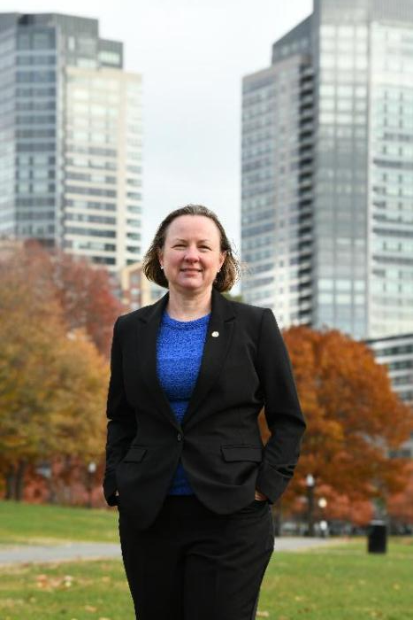

ABOUT
ashrae.org/President
TECHNICAL RESOURCES
PROFESSIONAL DEVELOPMENT
CONFERENCES
COMMUNITIES
MEMBERSHIP
Sarah E. Maston, P.E., BCxP, LEED AP 2026-27 ASHRAE President
Changing the Game: Retrofitting for Resilience
Find resources for the new Society Theme, ‘Changing the Game: Retrofitting for Resilience’ at ashrae.org/president.
Presidential presentation and manuscript
Infographic for ASHRAE resources relating to Commissioning
Access to the new ASHRAE Game, HVAC Hero!
Play the New ASHRAE Game HVAC Hero
Test your HVAC problem solving skills by playing the new HVAC Hero game! See how many kWh you can save as you navigate the building with your new friend, Muggy.
Download to play at ashrae.org/hvachero
Notes:
Visit ashrae.org/president to find videos and links to resources. HVAC Hero is available in both PC and Mac.

Slide 7

ABOUT
ashrae.org/Vision2035
TECHNICAL RESOURCES
PROFESSIONAL DEVELOPMENT
CONFERENCES
COMMUNITIES
MEMBERSHIP
Check out the new Vision 2035!
Vision 2035 and previous long-range vision plan editions serve as time-bound milestones advancing ASHRAE’s overall Mission and Vision. It provides guidance for continuity across Strategic Plans through 2035.
ashrae.org/vision2035
Focus Areas
Personalized and Resilient Environments
Regenerative Development
Human Centered and Equitable Design
Intelligent Building Lifecycle
Low Carbon and Circular Built Environments
Update: ASHRAE Strategic Plan is extended through 2030
ashrae.org/strategicplan
Notes:
Visit ashrae.org/vision2035 or search vision 2035 and check out the plans.

Slide 8
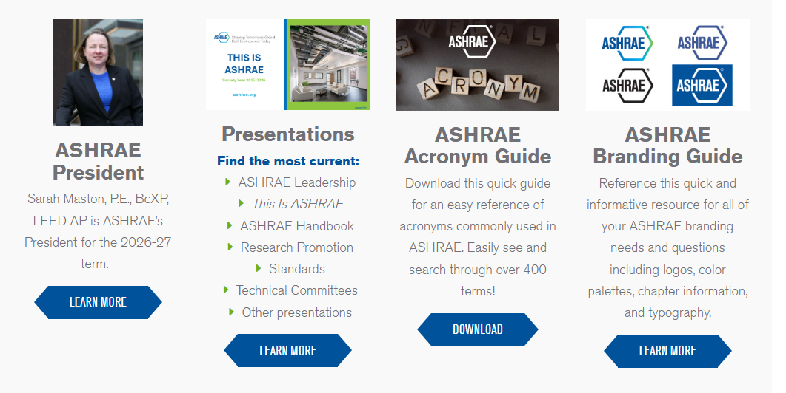
ABOUT
ashrae.org/Marketing
TECHNICAL RESOURCES
PROFESSIONAL DEVELOPMENT
CONFERENCES
COMMUNITIES
MEMBERSHIP
MARKETING CENTRAL
Get Marketing Items:
Brochures
Press Releases
Submit Request Forms
Chapter Logos
Newsletters
Staff Contact:
Vanita Gupta
vgupta@ashrae.org
Notes:
Marketing Central has your marketing needs COVERED. Visit ashrae.org/marketing for presentations you can download and edit to fit any ASHRAE topic, order forms, templates, brochures, and so much more. Reach out to Erika Cruz or just marketing@ashrae.org with any questions or requests.

Slide 9
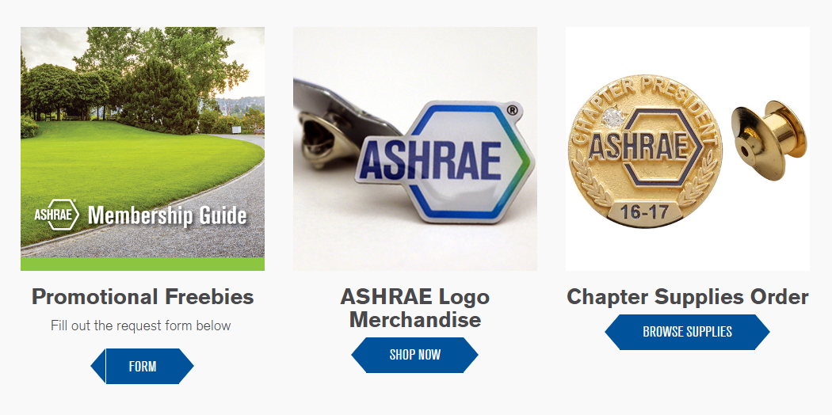

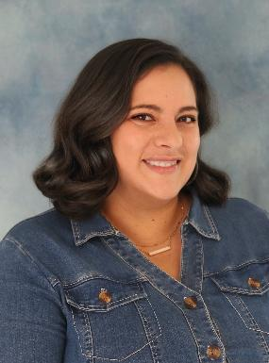
ABOUT
ashrae.org/Marketing
TECHNICAL RESOURCES
PROFESSIONAL DEVELOPMENT
CONFERENCES
COMMUNITIES
MEMBERSHIP
MARKETING CENTRAL
Get your chapter promotional items and supplies.
Log in and fill out the form.
Staff Contact: Erika Cruz
ecruz@ashrae.org
Notes:
All of your merchandise needs are in Marketing Central. Order from the logo store or request chapter supply items.

Slide 10
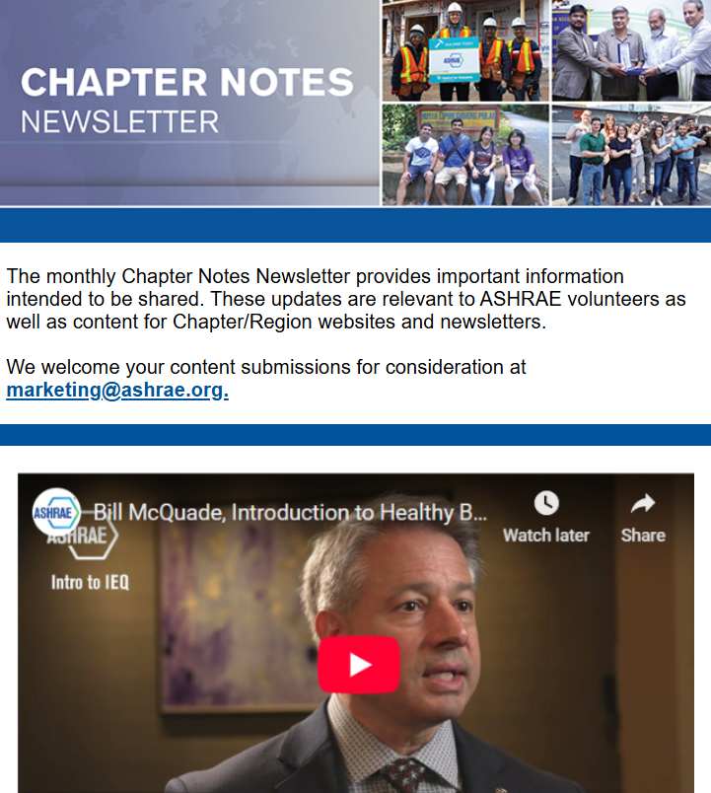



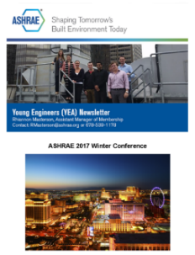

ABOUT
ashrae.org/Newsletters
TECHNICAL RESOURCES
PROFESSIONAL DEVELOPMENT
CONFERENCES
COMMUNITIES
MEMBERSHIP
Chapter Notes
Student Newsletter
Professional Development Newsletter
Monthly distribution
2,850 subscribers
Distributed to Region and Chapter officers
Monthly distribution
58,700 subscribers
Distributed to current members, online subscribers and previous course attendees
Quarterly distribution
5,700 subscribers
Distributed to Student Activities Chapter Chairs and Co-Chairs, Student Branch Advisors and Student Members
Chapter Notes is a volunteer focused newsletter created to be a welcome source of tools and resources to help ASHRAE volunteers do their job.
European Policy Update
YEA Newsletter
Government Affairs
Monthly distribution
2,300 subscribers
Distributed to ASHRAE members in Europe
Quarterly distribution
7,800 subscribers
Distributed to YEA Members (under age 35)
Bi-weekly distribution
2,400 subscribers
Distributed to opted-in subscribers
Contact marketing@ashrae.org to be added to any newsletter at any time!
Notes:
Sign up for any newsletters you’re not getting at ashrae.org/newsletters.

Slide 11

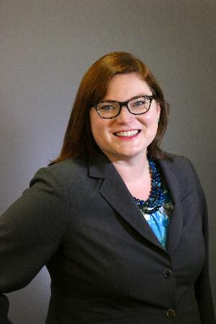

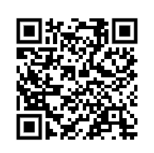
ABOUT
ashrae.org/GovAffairs
ashraeRP.com
TECHNICAL RESOURCES
PROFESSIONAL DEVELOPMENT
CONFERENCES
COMMUNITIES
MEMBERSHIP
Visit ashraerp.com to find resources, instruction videos, reports, tips and more.
Planning a Day on the Hill or other Government Affairs event?
RP = Research Promotion
ASHRAE’s annual fundraising campaign
2027 goal: $2.85 Million
Campaign ends annually on June 30
Attend your CRC RP Training!
Make a gift now
Get planning tools, presentations, fact sheets, and many more resources to help with your event.
Staff Contact:
Jacob Karson
jkarson@ashrae.org
Staff Contact:
Julia Mumford
jmumford@ashrae.org
Notes:
Planning a Day on the Hill event? Login to Member Resources Advocacy Toolkit to find everything you need for a successful event.
Check out ashraerp.com to find everything your chapter needs for a RP campaign. Please note this is a separate website from ashrae.org

Slide 12
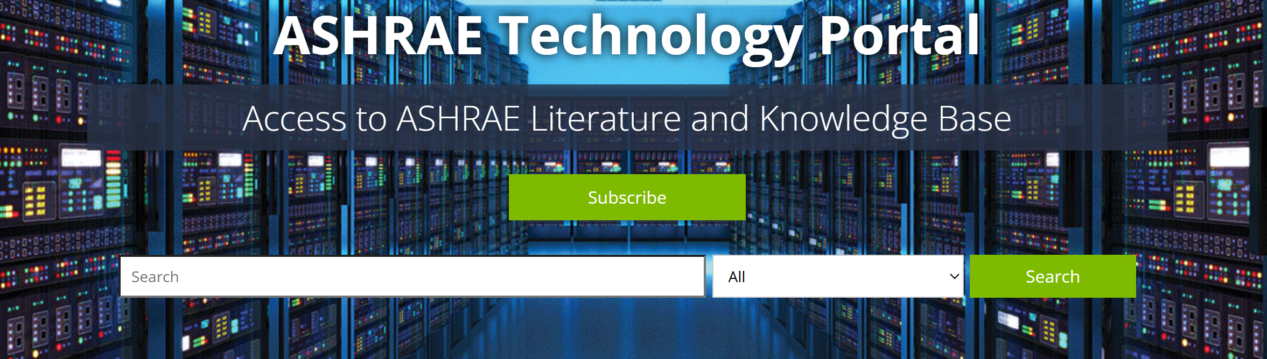
ABOUT
ashrae.org/TechnicalResources
TECHNICAL RESOURCES
PROFESSIONAL DEVELOPMENT
CONFERENCES
COMMUNITIES
MEMBERSHIP
Visit the ASHRAE Bookstore for Standards, Design Guides, Software, and much more.
ASHRAE Members get 25% off the list price on purchases in the ASHRAE Bookstore.
Chapters can get an additional 25% discount off list price on purchases of 10 or more of one title.
Go to the ASHRAE Technology Portal for Members’ free access to ASHRAE Journal articles and research reports, with subscription access to conference papers plus your selected annual Member benefits.
Contact specialsales@ashrae.org for Chapter orders!
ashrae.org/technical-resources/technology-portal
Notes:
Take advantage of your member discount in the ASHRAE Bookstore, and don’t forget Chapters can get an additional 25% off list price (total 50% off list!) for purchases of 10 or more copies of any one title.
And the Technology Portal is the place to go for access to archived, searchable ASHRAE Journal articles and research reports, plus subscription access to conference papers and other products. It’s also the place to get the annual Member benefit items that you selected when you renewed your membership.

Slide 13
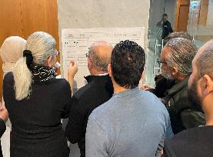
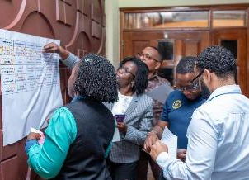
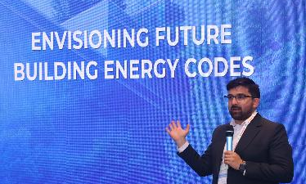

ABOUT
ashrae.org/TechnicalResources CEBD + CE IEQ
TECHNICAL RESOURCES
PROFESSIONAL DEVELOPMENT
CONFERENCES
COMMUNITIES
MEMBERSHIP
CEBD ashrae.org/decarb
Lebanon
SY 2026-2027 Strategic Initiatives
Asserting Leadership in Whole Life Carbon
Charting the Path to 2050
Accelerating Market Adoption & Insight
Enhancements to Existing Priorities
Additional Building Code Assessment Tool (BCAT) Workshops
CEBD Chapter Engagement & Ambassador Program
Strengthen Committee-to-Committee Collaboration
Building Code
Workshops
Kenya
India
CE IEQ ashrae.org/ieqresources
NEW IEQ Resources page
Videos
O&M Best Practice Checklists
IEQ Guides
Compilation of IEQ Resources
Notes:
Check out the resources available from the CEBD and CE IEQ! Available in the ‘Technical Resources’ section of ashrae.org.

Slide 14
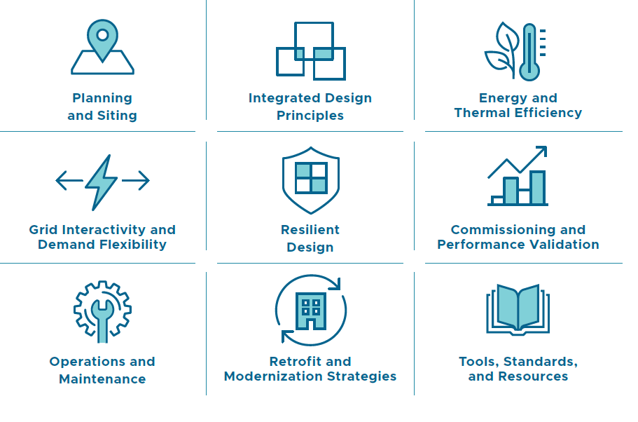



ABOUT
ashrae.org/TechnicalResources AI Data Center Framework
TECHNICAL RESOURCES
PROFESSIONAL DEVELOPMENT
CONFERENCES
COMMUNITIES
MEMBERSHIP
A one-stop shop
for AI Data Center
planning and development.
Available in ‘Technical Resources’ on ashrae.org.
Notes:
Search AI Data Center Framework on ASHRAE.org and check out this hot new resource

Slide 15

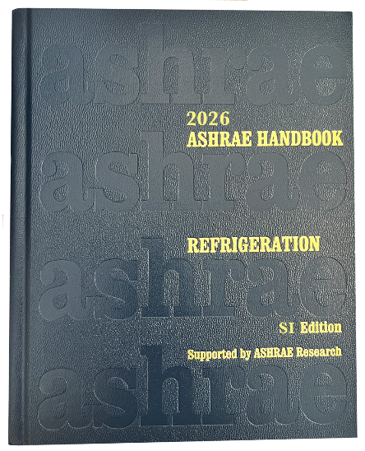

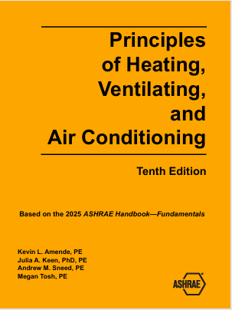

ABOUT
ashrae.org/Bookstore
TECHNICAL RESOURCES
PROFESSIONAL DEVELOPMENT
CONFERENCES
COMMUNITIES
MEMBERSHIP
Coming July and August!
Pre-order PHVAC and 2026 ASHRAE Handbook -- Refrigeration
Notes:
Pocket Guides
ASHRAE Pocket Guide for Air Conditioning, Heating, Ventilation, Refrigeration is packed with practical and useful information and designed for easy use in the office or on a job site. The 11th edition will include updates from the four current volumes of the ASHRAE Handbook series as well as the latest editions of ASHRAE Standards 15, 34, 55, 62.1, 62.2, and 90.1.
PHVAC
Principles of Heating, Ventilating, and Air Conditioning is based on content from all four volumes of the ASHRAE Handbook, pulling heavily from the 2025 ASHRAE Handbook—Fundamentals. The 10th edition will contain the most current ASHRAE procedures and definitive yet easy-to-understand treatment of building HVAC systems, from basic principles through design and operation.
2026 ASHRAE Handbook – Refrigeration
The 2026 Handbook brings critical applications into focus with updated refrigerants, new system insights, and expanded technical guidance across industries worldwide. It delivers comprehensive guidance on refrigeration systems beyond comfort cooling, covering applications from food processing and transport to cryogenic and industrial uses across the globe.

Slide 16

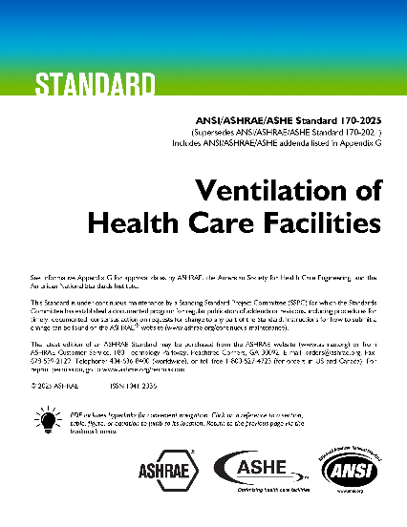


ABOUT
ashrae.org/Bookstore
TECHNICAL RESOURCES
PROFESSIONAL DEVELOPMENT
CONFERENCES
COMMUNITIES
MEMBERSHIP
New Standards
Notes:
New Standards
Standard 90.1-2025 (I-P Edition) -- Energy Standard for Sites and Buildings Except Low-Rise Residential Buildings
A benchmark for commercial building energy codes in the United States, and a key basis for codes and standards around the world, for almost half a century. This standard provides the minimum requirements for energy-efficient design of most sites and buildings, except low-rise residential buildings.
Standard 170-2025 -- Ventilation of Health Care Facilities
Developed in partnership with Facility Guidelines Institute (FGI) and American Society of Health Care Engineering (ASHE), Standard 170 provides minimum requirements for ventilation of health care industry facilities and is intended for adoption by code-enforcing agencies.
Standard 231-2026 -- A Control Description Language for Building Environmental Control Sequences
Defines and documents a Control Description Language (CDL), a standard interchange format for the control logic in control systems. This standard is tightly connected to, and intended to work with, ASHRAE Guideline 36, Guideline 13, and Standard 135 (BACnet), and other control-related standards and guidelines.
Standard 169-2025 -- Climatic Data for Building Design Standards
Provides a comprehensive source of climate data for those involved in building design. It was established to provide climatic information for designing, planning, and sizing building energy systems and equipment, and is referenced in other standards

Slide 17
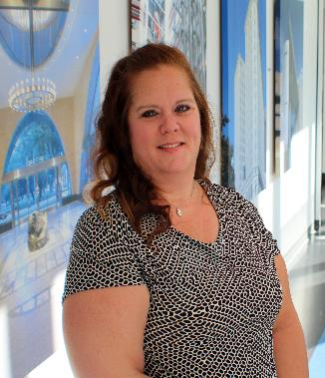
ABOUT
ashrae.org/ProfessionalDevelopment
TECHNICAL RESOURCES
PROFESSIONAL DEVELOPMENT
CONFERENCES
COMMUNITIES
MEMBERSHIP
NEW! Professional Development Scholarship Available for select courses. Scholarship information available on course page.
ASHRAE Members can now get 35% to 50% off selected ALI, AGT, or eLearning courses—thanks to the Richard and Mary Farr, the Setty Family Foundation, and Jim and Nancy Fields funds.
Apply at least 3 weeks before your course date.
Limited Scholarships Available.
NEW! HVAC Design Level I Nonmember Registrants get one-year FREE ASHRAE membership!
Membership will begin
the week following
the participants
completion of the
course.
Bill McQuade, P.E., CDP, Fellow ASHRAE, LEED AP
2025-26 ASHRAE President
Staff Contact:
Kelly Arnold
karnold@ashrae.org

Slide 18
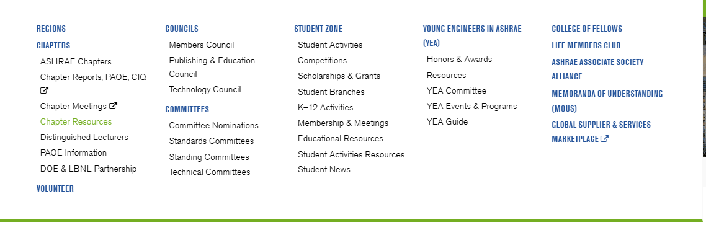
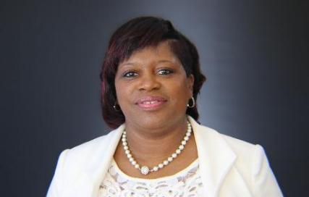
ABOUT
ashrae.org/ChapterResources
TECHNICAL RESOURCES
PROFESSIONAL DEVELOPMENT
CONFERENCES
COMMUNITIES
MEMBERSHIP
Chapter Bulk Order Form for Publications
Get 25% off when you submit the form available on the Chapter Resources page to order publications in bulk for your chapter, useful for:
Volunteer Training Presentations
Order Banners & Supplies
Schedule DL Visits
Templates & Tools
Get Chapter Data
NEW! Chapter Treasurer Training
& Resources
& MUCH MORE!
ASHRAE Distinguished Lecturer visits
Presentations
Technical tours
Panel programs or forums
Membership Promotion events
YEA and/or Student events
Chapter seminars
Contact specialsales@ashrae.org with questions.
Staff Contact: Tammy Catchings
tcatchings@ashrae.org
Notes:
In the communities section of ashrae.org you’ll find all the tools you need to run a chapter.

Slide 19

ABOUT
ashrae.org/ChapterTreasurer
TECHNICAL RESOURCES
PROFESSIONAL DEVELOPMENT
CONFERENCES
COMMUNITIES
MEMBERSHIP
NEW! Live Monthly Treasurer Training
This program features a monthly series of 30‑minute live, interactive virtual sessions focused on key financial topics. For SY 26–27, the program is designed for U.S. Chapters, with plans to expand for international chapters in the future.
Find Chapter Treasurer resources, presentation decks and training videos
ashrae.org/ChapterTreasurer
Core topics include: Treasurer roles and responsibilities, Fundraising, compliance, and state registrations and many more.
Next Training: September 17, 12:00 PM ET.
Topic: Tax Filings and IRS 990 Forms
Starting SY 2026-27
Chapter Treasurers may be eligible for Society-covered transportation to CRCs, if a Chapter Treasurer Workshop is scheduled. Contact your DRC for instructions on booking travel.
See the Full Schedule + Register for Training Sessions at ashrae.org/ChapterTreasurer
Staff Contact:
Craig Wright
cwright@ashrae.org

Slide 20


ABOUT
ashrae.org/PresidentialChallenge
TECHNICAL RESOURCES
PROFESSIONAL DEVELOPMENT
CONFERENCES
COMMUNITIES
MEMBERSHIP
The Presidential Initiative Challenge is a year-long competitive fund ($1,000 - $10,000) program to implement projects within local chapters that are tied to the year's presidential theme.
The Young Engineers in ASHRAE (YEA) Committee organizes the Presidential Initiative Challenge each year. For more information visit ashrae.org/yea.
Annual timelines are similar each year but always check the website for exact due dates:
November 2: Applications due
December 14: Intimation to selected chapter / team
January: Awards made with funds going to local chapter for use on the project
+ Winning applicants in attendance at the Winter Conference to be recognized by ASHRAE President at President’s Lunch
February and June: Projects will be completed
Staff Contact:
Jeanette McCray
jmccray@ashrae.org
All grants for project winners provided by the Gordon Holness Presidential Challenge Fund
Notes:
Does anyone in your chapter have a great idea to improve your community? Check out the Presidential Initiative Challenge, an annual competitive fund for chapters organized by the YEA committee.

Slide 21
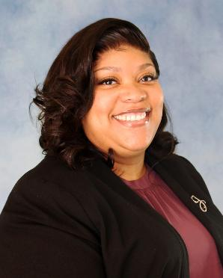
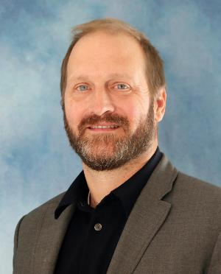
ABOUT
ashrae.org/Volunteer
TECHNICAL RESOURCES
PROFESSIONAL DEVELOPMENT
CONFERENCES
COMMUNITIES
MEMBERSHIP
How to Volunteer on Standing Committees
How to Volunteer on Technical Committees
Standing Committees: ASHRAE has more than 30 Standing Committees which require nomination.
Learn more about each committee and the nomination process at ashrae.org/volunteer
(in the Communities
section of ashrae.org.)
Technical Committees: ASHRAE has more than 200 technical committees.
Those interested in participating as a member should make sure their ASHRAE bio is updated and
email Steve Hammerling at shammerling@ashrae.org to indicate your interest.
Staff Contact:
Chandrias Jolly
cjolly@ashrae.org
Staff Contact:
Steve Hammerling
shammerling@ashrae.org
Notes:
In the communities section of ashrae.org you will also find the various types of volunteer opportunities at the Society level. Just click on the ‘Volunteer’ header and find links to the different types of committees and how to join them.

Slide 22
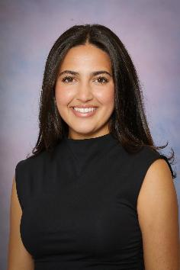
ABOUT
ashrae.org/Scholarships
TECHNICAL RESOURCES
PROFESSIONAL DEVELOPMENT
CONFERENCES
COMMUNITIES
MEMBERSHIP
ASHRAE Society Scholarships offer over $250,000 to about 50 qualified applicants per year.
Each recipient receives a free 1-year ASHRAE Student Membership.
Many student recipients are offered prestigious Engineering/HVAC&R internships. They get more involved at the Chapter Level and are presented as recipients at Chapter Meetings.
New Deadline for Society Scholarships: April 1st
To allow for more applicants and to streamline the application/award process, the scholarship program is combining the existing deadlines
(of May 1st and December 1st) and moving to April 1st of each year.
PLEASE PROMOTE WITHIN YOUR CHAPTER!
Staff Contact:
Savanna Smith
ssmith@ashrae.org
ashrae.org/scholarships
Notes:
ASHRAE Society Scholarships has a new application deadline of April 1st. This new deadline will take effect in the 2026-27 SY meaning April 1, 2027 will be the next deadline for Society Scholarship applications.

Slide 23
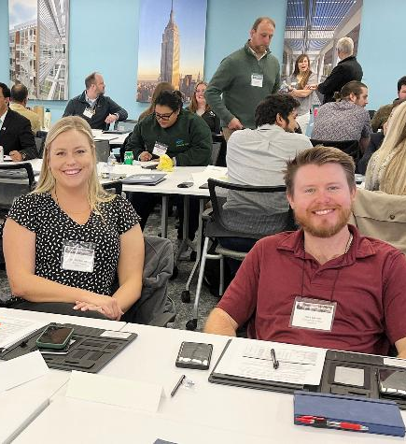
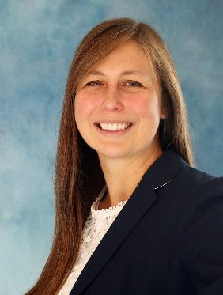
ABOUT
ashrae.org/LeadershipAcademy
TECHNICAL RESOURCES
PROFESSIONAL DEVELOPMENT
CONFERENCES
COMMUNITIES
MEMBERSHIP
Chapter Leadership Academy Timeline
(always check online for exact dates annually):
October to Mid-November: Contact your DRC about interest in attending
December: Attendees will be approved to attend
February/March: Chapter Leadership Academy is held at ASHRAE Headquarters, Peachtree Corners, GA.
Chapter Leadership Academy Topics covered include:
Navigating the ASHRAE organizational structure
Understanding the tools and resources available to help Chapters and their members succeed
Delegating to and motivating volunteers toward the ASHRAE mission
DRCs will approve attendees from their region. Each region has limited spots.
Interested? Contact your Director and Regional Chair (DRC).
Staff Contact:
Lizzy Seymour
lseymour@ashrae.org
Notes:
Chapter Leadership Academy is a 1.5-day crash course designed to simplify the learning curve of all things ASHRAE. Attendees will gain a better understanding of how ASHRAE Society functions and obtain useful and practical knowledge essential for honing ASHRAE leadership skills. The program also will include sharing tips and best practices that attendees can confidently take back to their Chapters for implementation.

Slide 24
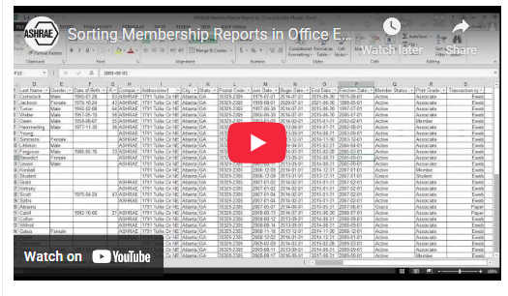

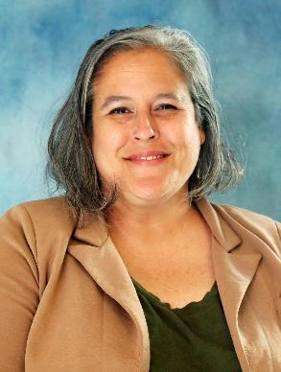
ashrae.org/MPchair
ABOUT
TECHNICAL RESOURCES
PROFESSIONAL DEVELOPMENT
CONFERENCES
COMMUNITIES
MEMBERSHIP
Everything an MP Chair Needs!
Find help videos to sort and filter membership reports, information about dues notices and managing chapter dues received in your members’ records.
ashrae.org/connect send a pre-written, customizable email to a colleague encouraging them to join.
Membership Promotion Toolkit:
Centralized Training & Promotional Videos
Templates, Brochures and Retention tools
Membership Promotion Night Guidelines
Resources to help you reach out to local companies
Staff Contact: Lisa Nichols
lnichols@ashrae.org
Notes:
What more could you dream of? Check out the many tools and resources available to you on the Membership Promotion page of ashrae.org.

Slide 25

ABOUT
ashrae.org/2026bylaws
TECHNICAL RESOURCES
PROFESSIONAL DEVELOPMENT
CONFERENCES
COMMUNITIES
MEMBERSHIP
Proposed Bylaws Amendment Passed!
This proposed model was crafted by a presidential ad hoc committee, comprised of members from all segments of Society, over a period of eighteen months. The goal of the ad hoc committee was to simplify the membership structure that provides the most equitable and inclusive ability to join ASHRAE.
More information at ashrae.org/bylaws.
What’s Next
By June 30, 2027: Staff will work on changes made to membership database, website, promotional materials, ROB, Committee/Council MOPs and training materials.
July 1, 2027: New model implemented.
Staff Contact:
Daniel Gurley
dgurley@ashrae.org

Slide 26

Media Inquiries
Notes:
ASHRAE's PR team have tools and resources available to vet media inquires, research media contacts and arrange appropriate responses. Please send all media inquires to publicrelations@ashrae.org for support.

Slide 27
Thank you!
Questions or Comments?
ashrae.org

