Slide 1


2025 FALL Chapter Regional Conference
LEADERSHIP PRESENTATION
Notes:
Welcome! The topics presented today will follow the 6 main headers in the menu of ashrae.org to assist viewers in navigating where to learn more about information presented today.

Slide 2
ABOUT
ASHRAE Policies
TECHNICAL RESOURCES
PROFESSIONAL DEVELOPMENT
CONFERENCES
COMMUNITIES
MEMBERSHIP
Code of Ethics
Harassment and Discrimination
Commercialism
We will act with honesty, fairness, courtesy, competence, inclusiveness and respect for others, which exemplify our core values of excellence, commitment, integrity, collaboration, volunteerism and diversity, and we shall avoid all real or perceived conflicts of interest.
ASHRAE strictly prohibits and does not tolerate discrimination against members or applicants for membership because of such individual’s race, color, religion, age, sex, sexual orientation, national origin, physical or mental disability, pregnancy, genetic information, veteran status, uniformed service member status, or any other category protected under applicable law.
ASHRAE’s Commercialism Policy allows for Society activities that fulfill the mission of technological advancement with adherence to business plans that generate income to offset operational expenses such as AHR Exposition, ASHRAE periodicals, website, and Society conference events such as the Welcome Party, luncheons, registration kits, and receptions.
Value Statement
In ASHRAE meetings, we will act with honesty, fairness, courtesy, competence, inclusiveness and respect for others, which exemplify our core values of excellence, commitment, integrity, collaboration, volunteerism and diversity, and shall avoid all real or perceived conflicts of interest. Our culture is one of inclusiveness, acknowledging the inherent value and dignity of each individual. We celebrate diverse and inclusive communities, understanding that doing so fuels better, more creative and more thoughtful ideas, solutions and strategies for the Society and the communities our Society serves. We respect and welcome all.
Notes:
View ASHRAE Governing Documents at ashrae.org/about/governance

Slide 3

ABOUT
Marketing Central
TECHNICAL RESOURCES
PROFESSIONAL DEVELOPMENT
CONFERENCES
COMMUNITIES
MEMBERSHIP
MARKETING CENTRAL
ASHRAE has a NEW TAGLINE! Shaping Tomorrow’s Global Built Environment Today.
Download at Marketing Central
Notes:
ASHRAE has introduced a new tagline by adding the word ‘Global’. It now reads ‘Shaping Tomorrow’s Global Built Environment Today’. You can download this graphic at Marketing Central which is in the ‘About’ section of the website.

Slide 4
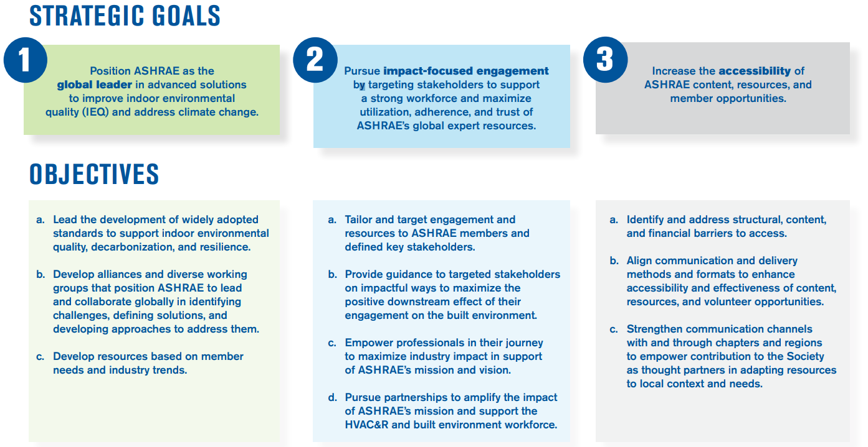
ABOUT
2025-28 ASHRAE Strategic Plan
TECHNICAL RESOURCES
PROFESSIONAL DEVELOPMENT
CONFERENCES
COMMUNITIES
MEMBERSHIP
Notes:
Outcomes
ASHRAE’s member and volunteer base maximizes the organization’s reach, foresight, leadership position, and organizational knowledge.
A broad group of stakeholders leverage ASHRAE's resources to make decisions and meet objectives that positively affect the environment.
A viable, thriving industry makes a positive global impact.
Key Enablers
Research: The value of ASHRAE’s resources is grounded in unbiased data, developed through rigorous research methods.
AI: The use of AI enables ASHRAE to improve data collection, automate internal operations, and promote agility.
Global Network: ASHRAE's global network convenes the industry to generate unparalleled knowledge and content.

Slide 5
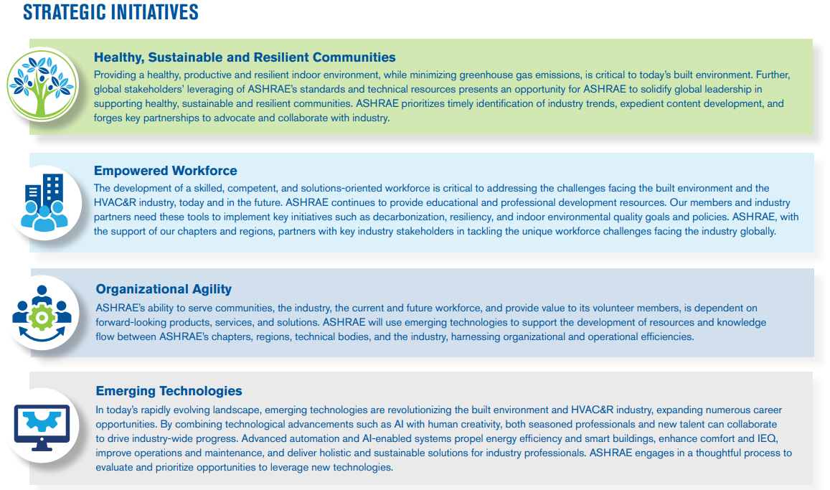
ABOUT
2025-28 ASHRAE Strategic Plan
TECHNICAL RESOURCES
PROFESSIONAL DEVELOPMENT
CONFERENCES
COMMUNITIES
MEMBERSHIP
Notes:
Highlight the following as key events that has informed the final plan
Stakeholder Interviews with ASHRAE members and other industry partners
Survey Questionnaire (distributed to both members and non-members)
BOD facilitated strategy session
The strategic plan identifies key priorities for the society over the next three years. The chapters can use this information to guide their chapter operations so that there is alignment with the society priorities.
For example, EMPOWERED WORKFORCE is a key initiative. Chapters can look to develop programs and training that strengthens the skill sets of the members in their area of operation to expand and or build capacity to serve members and member firms.
Chapter leaders can work with their DRC and regional leadership to identify key initiatives that are specific to their regions/chapters and develop the appropriate tasks so that their chapter operations align with the society’s strategic plan and direction.

Slide 6
ABOUT
2025-28 ASHRAE Strategic Plan
TECHNICAL RESOURCES
PROFESSIONAL DEVELOPMENT
CONFERENCES
COMMUNITIES
MEMBERSHIP
2025-28 ASHRAE Strategic Plan
Download in English and Spanish at ashrae.org/strategicplan
Notes:
New CRC Motions will need to include which strategic plan initiative the motion is tied to.
The Planning Committee and ASHRAE Board of Directors are asking committees and councils to reference this document for planning their 2025-26 MBOs.

Slide 7

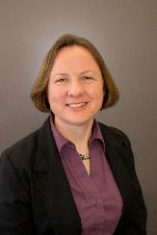

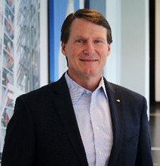
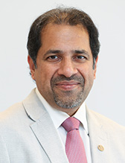
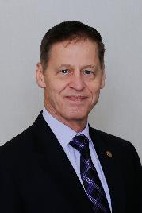
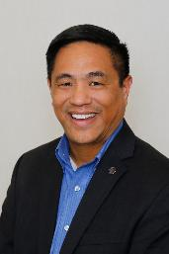


ABOUT
ASHRAE Board of Directors
TECHNICAL RESOURCES
PROFESSIONAL DEVELOPMENT
CONFERENCES
COMMUNITIES
MEMBERSHIP
President
President-Elect
Treasurer
Secretary
Bill McQuade, P.E.
CDP, Fellow ASHRAE, LEED AP
Jessup, Maryland
Sarah Maston, P.E., BCxP, LEED AP
Hudson, Massachusetts
Ashish Rakheja, B.E., M.Tech, Fellow ASHRAE
Uttar Pradesh, India
Jeff Littleton
Peachtree Corners, Georgia
Vice Presidents
Kenneth Fulk, P.E.
Allen, Texas
Trent Hunt, Fellow ASHRAE
Midvale, Utah
Andres Sepulveda, P.E.,
Fellow ASHRAE
Madrid, Spain
Devin Abellon, P.E.
Mukilteo, Washington
Notes:
2025-26 Board of Directors Executive Committee
Through an elaborate committee structure, including committees and councils, ASHRAE policies are established by a Board of Directors comprised of Society members elected by the membership. Board members serve terms of one to three years, including the President who serves a one‐year term.

Slide 8






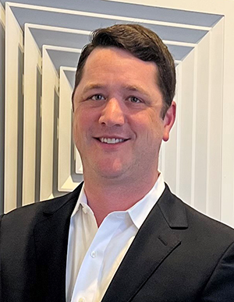


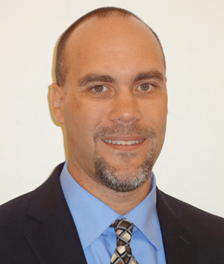
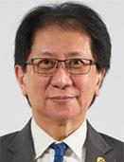


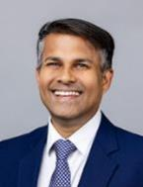
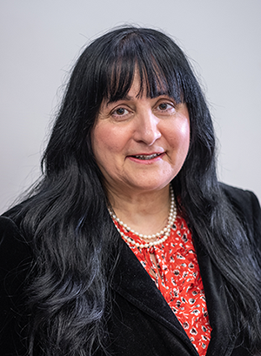

ABOUT
ASHRAE Director and Regional Chairs
TECHNICAL RESOURCES
PROFESSIONAL DEVELOPMENT
CONFERENCES
COMMUNITIES
MEMBERSHIP
Region I
Region II
Region III
Region IV
Region V
Charles Bertuch
Manlius, New York
Genevieve Lussier
Quebec, Canada
Sherry Abbott-Adkins, P.E., CPD, GPD, LEED AP Westminster, Maryland
Heather Platt Gulledge, P.E., MBA
Summerfield, North Carolina
Julia Timberman, P.E.
Columbus, Ohio
Region VI
Region VII
Region VIII
Region IX
Region X
Maggie Moninski, P.E., LEED AP, BD+C
Chicago, Illinois
Scott Peach, P.E.
Mobile, Alabama
Joseph Sanders
Oklahoma City, Oklahoma
Jonathan Smith, P.E. Kansas City, Missouri
Buzz Wright, P.E.
Tucson, Arizona
Region XI
Region XII
Region XIII
Region XIV
Region XV
Region-at-Large
Submit nominations for others and/or yourself
ashrae.org/committee-nominations
Ching Loon Ong, P.E., CMVP, Hon Fellow AFEO
Subang, Jaya, Malaysia
Bassel Anbari, P.E.
Abu Dhabi, United Arab Emirates
Rob Craddock
Saskatchewan, Canada
Jason Alphonso, P.E., OPMP, PMP
Winter Park, Florida
Mahroo Eftekhari, CEng., DPhil
Loughborough, UK
Pankaj Dharkar, Fellow ASHRAE
Ahmedabad, India
Notes:
2025-26 Board of Directors Director and Regional Chairs

Slide 9


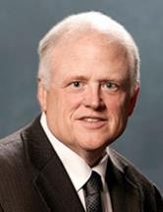




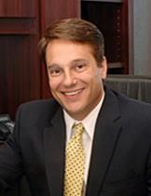
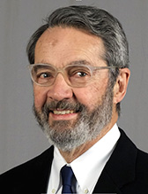
ASHRAE Directors-at-Large
ABOUT
TECHNICAL RESOURCES
PROFESSIONAL DEVELOPMENT
CONFERENCES
COMMUNITIES
MEMBERSHIP
Doug Cochrane, P.Eng., CDP
Mississauga, Ontario, Canada
Steve Kujak
Brownsville, Minnesota
Patrick Marks, P.E.
York, Pennsylvania
Corey Metzger, P.E.
Papillion, Nebraska
Carrie Brown, Ph.D.
Oakland, California
Mike Pouchak, P.E., Fellow ASHRAE
St. Anthony, Minnesota
David Yashar, Ph.D., Fellow ASHRAE
Gaithersburg, Maryland
Daniel Nall
Princeton, New Jersey
Martin Dieryckx
Ostend, Belgium
Submit nominations for others and/or yourself
ashrae.org/committee-nominations
Notes:
2025-26 Directors-at-large

Slide 10
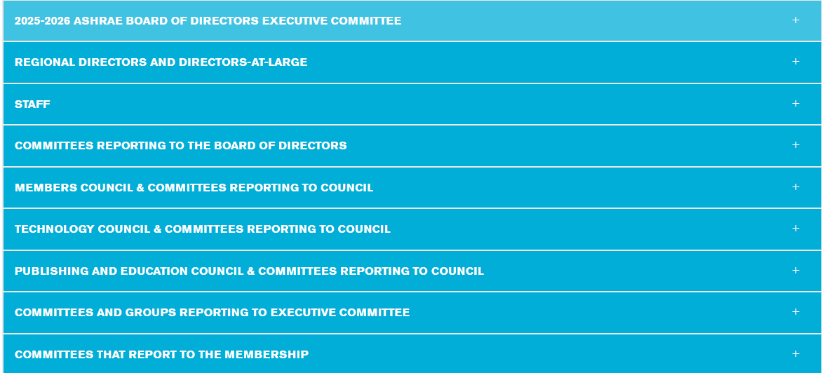
Officers, Directors, Councils, Committees, Staff
ABOUT
TECHNICAL RESOURCES
PROFESSIONAL DEVELOPMENT
CONFERENCES
COMMUNITIES
MEMBERSHIP
In the “About” Menu: Find Officers, Directors, Councils. Committees, Staff. Updated every Society Year, July 1.
Submit nominations for others and/or yourself
ashrae.org/committee-nominations
Notes:
In the “About” Menu: Find Officers, Directors, Councils. Committees, Staff

Slide 11


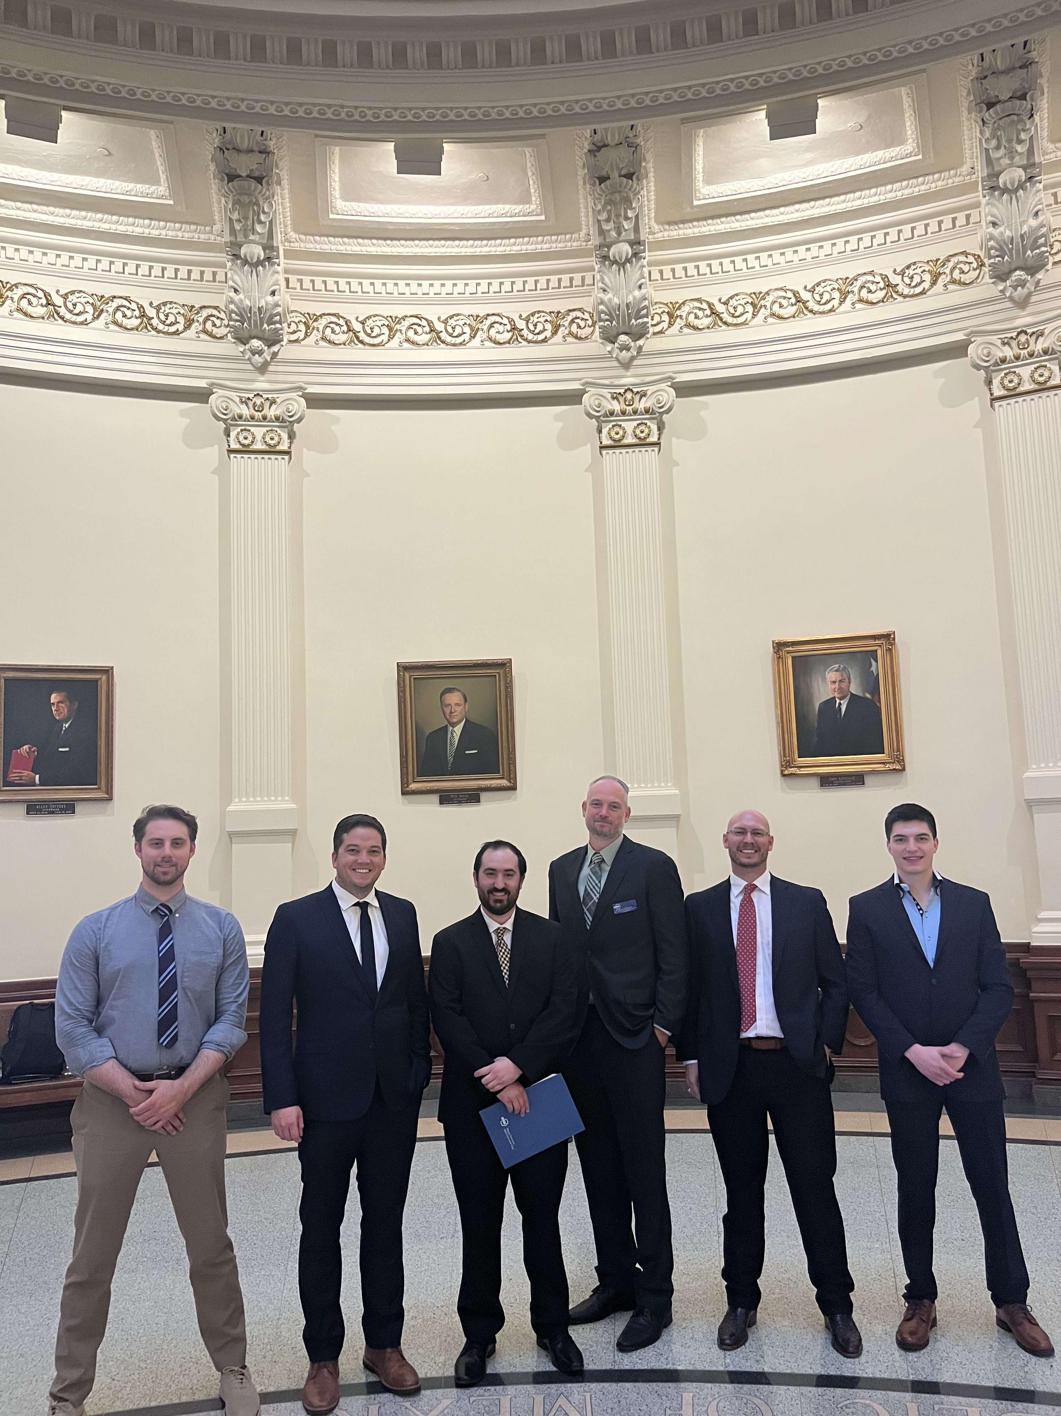
Government Affairs
ABOUT
TECHNICAL RESOURCES
PROFESSIONAL DEVELOPMENT
CONFERENCES
COMMUNITIES
MEMBERSHIP
GOVERNMENT OUTREACH
GOVERNMENT AFFAIRS UPDATE
LETTERS & TESTIMONY
BI-WEEKLY NEWSLETTER
Sign up for the Government Affairs Update
online or email GovAffairs@ashrae.org
Submit nominations for others and/or yourself
ashrae.org/committee-nominations
Get Involved!
186 Government Outreach Events during the 24-25 SY
Notes:
Government Affairs at ASHRAE has been active! There are lots of opportunities for engagement – from meeting with local elected officials, sharing information with school boards and other government entities, to testifying formally before government bodies (which needs to be approved by the ASHRAE President). To learn more about what’s going on in government and to get involved, sign up for their FREE newsletter.

Slide 12
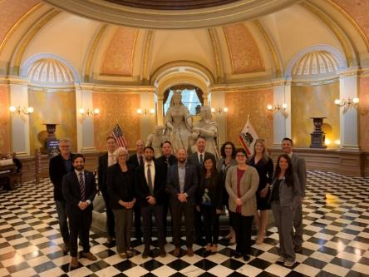

Government Affairs
ABOUT
TECHNICAL RESOURCES
PROFESSIONAL DEVELOPMENT
CONFERENCES
COMMUNITIES
MEMBERSHIP
GOVERNMENTOUTREACH
Share your Expertise with Government Officials through the new SMEs for GOEs Program
Policymakers and elected officials need your expertise to make better decisions as they craft legislation and regulations impacting HVAC&R and the built environment.
The Government Affairs Committee (GAC) has developed a new program to identify Subject Matter Experts (SMEs) who can effectively communicate with non-technical audiences such as government officials
BE THE SOURCE of technical expertise for these decisions!
BI-WEEKLY NEWSLETTER
Submit nominations for others and/or yourself
ashrae.org/committee-nominations
Sign up online or email GovAffairs@ashrae.org
Notes:
The Government Affairs Committee has a new program that aims to identify Subject Matter Experts at ASHRAE who can explain technical information in easy-to-understand language to elected officials and policy makers. This new program provides transportation funding to in-person government meetings. If you are an expert in a particular subject matter area, please be sure to apply for this exciting new program!

Slide 13

ABOUT
RP and ASHRAE Foundation: Supporting ASHRAE’s Mission
TECHNICAL RESOURCES
PROFESSIONAL DEVELOPMENT
CONFERENCES
COMMUNITIES
MEMBERSHIP
Fundraising Totals for SY 2024-25
RP Campaign Total
$4.825M
ASHRAE Foundation
$2,824,181
$1.95M
In New Endowments
ASHRAE Awarded Scholarships
Within the RP Campaign
40 Endowed Chapter Scholarships
39 Society Student Scholarships
$1,977,286 For Research
College of Fellows
$5,000 Total Raised
$494,487 For Endowed Research
Life Members Club
$257,081 For Scholarships
$46,000 Total Raised
$95,078 For YEA, ALI and other Programs
More than 4,500 contributions from Members, Organizations and other Associations

Slide 14

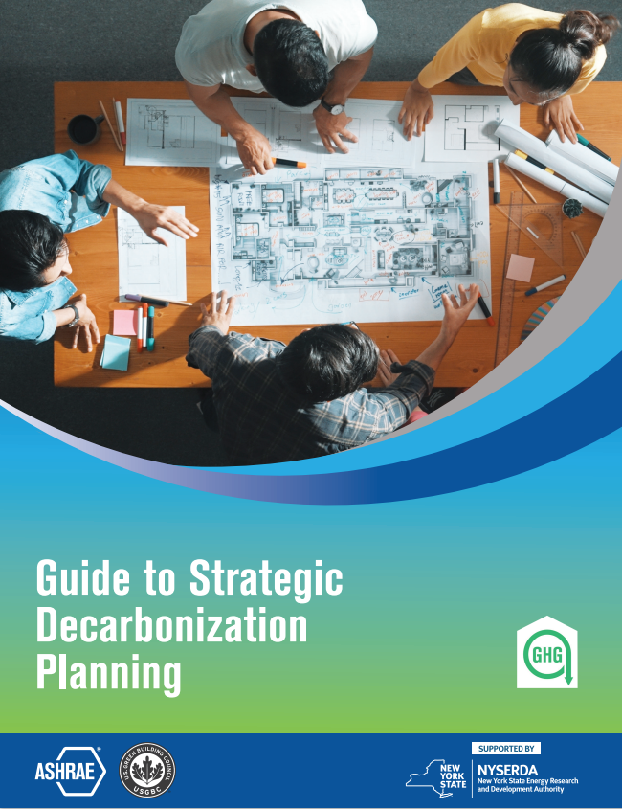
ABOUT
Center for Excellence in Building Decarbonization (CEBD)
TECHNICAL RESOURCES
PROFESSIONAL DEVELOPMENT
CONFERENCES
COMMUNITIES
MEMBERSHIP
Issued RFPs for two (2) CEBD projects in May
Additional RFPs for CEBD projects to be issued in August
Released two (2) more decarbonization guides
New Decarbonizing Building Thermal Systems eLearning Course
Suite of Decarbonization Guides:
  Grid Interactive Buildings for Decarbonization Design
  Decarbonizing Hospital Buildings
  TM65 Addendum for North America with CIBSE
  Building Decarbonization Retrofits for Commercial & Multifamily Buildings
  Decarbonizing Building Thermal Systems: A Guide for Applying Heat Pumps & Beyond with NREL
  NEW! Whole Life Carbon Guide for Building Systems
  NEW! Guide to Strategic Decarbonization Planning with USGBC
JUST RELEASED!

Slide 15
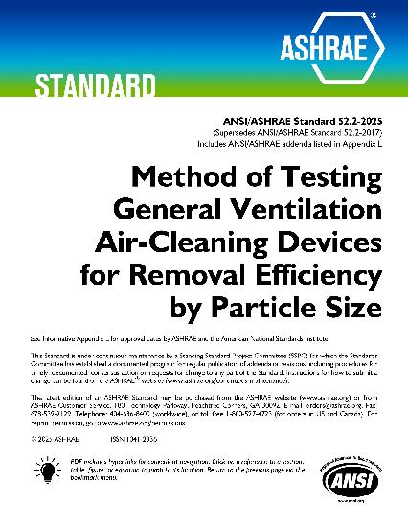
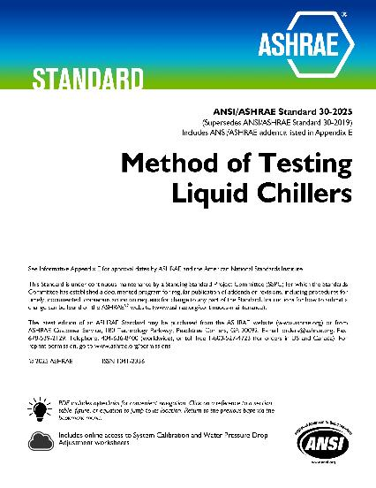
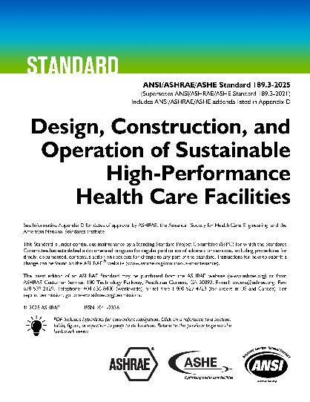
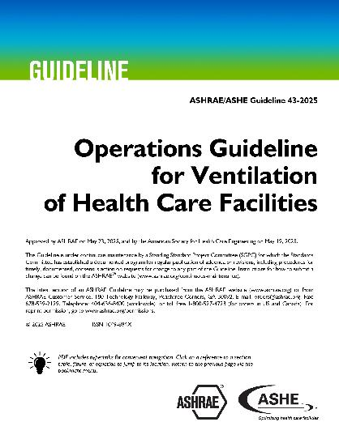
ABOUT
Standards & Guidelines
TECHNICAL RESOURCES
PROFESSIONAL DEVELOPMENT
CONFERENCES
COMMUNITIES
MEMBERSHIP
New Standards
New Guideline
Notes:
New Standards:
ANSI/ASHRAE Standard 52.2-2025, Method of Testing General Ventilation Air-Cleaning Devices for Removal Efficiency by Particle Size
Standard 52.2 establishes a test procedure for evaluating the performance of air-cleaning devices as a function of particle size.
ANSI/ASHRAE Standard 30-2025, Method of Testing Liquid Chillers
Standard 30 prescribes methods of testing to measure the thermal capacity, energy efficiency, and liquid pressure drop of packaged liquid-chiller equipment using a refrigerant vapor compression cycle.
ANSI/ASHRAE/ASHE Standard 189.3-2025, Design, Construction, and Operation of Sustainable High-Performance Health Care Facilities
Standard 189.3 provides minimum requirements for the siting, design, construction, and operation of high-performance, sustainable health care facilities.
New Guideline:
ASHRAE/ASHE Guideline 43-2025, Operations Guideline for Ventilation of Health Care Facilities
ASHRAE Guideline 43 provides recommendations for the operation of HVAC systems that provide environmental control in health care facilities for the safety and comfort of health care facility occupants.

Slide 16
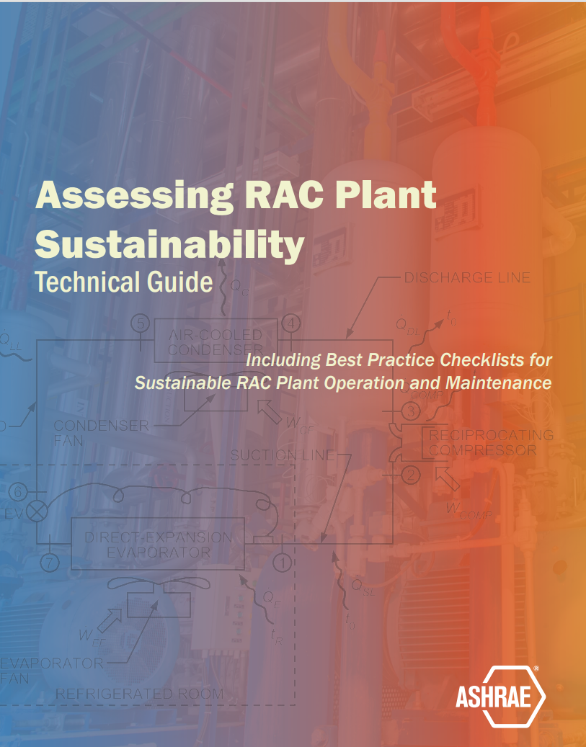
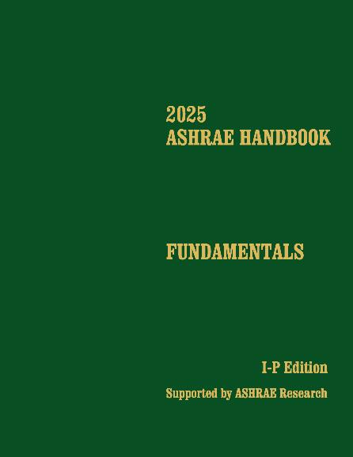
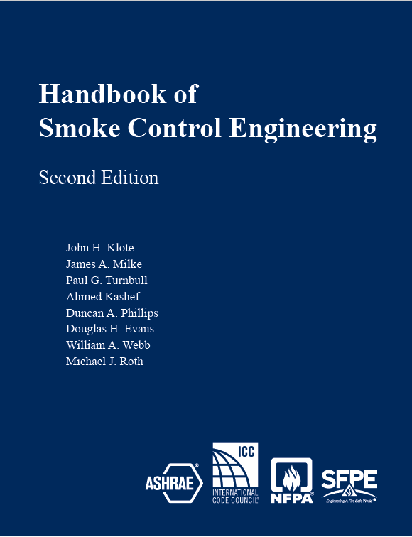
ABOUT
ASHRAE Bookstore
TECHNICAL RESOURCES
PROFESSIONAL DEVELOPMENT
CONFERENCES
COMMUNITIES
MEMBERSHIP
Get the Latest and Greatest Publications
Notes:
Assessing RAC Plant Sustainability – Technical Guide
This guide, a joint project with UNEP, provides valuable insights and best practices for the sustainable and efficient operation of refrigeration and air-conditioning (RAC) plants. It covers the key dimensions of practice related to RAC plant sustainability in guidance sheets and checklists.
The 2025 ASHRAE Handbook—Fundamentals covers basic principles and data used in the HVAC&R industry. Its more than 1,100 pages have been extensively updated and cover foundational concepts such as thermodynamics, psychrometrics, and heat transfer, and provide practical guidance on building envelopes, indoor environmental quality, load calculations, duct and piping system design, refrigerants, energy resources, sustainability, climate change, and more.
Handbook of Smoke Control Engineering, Second Edition
The revised edition of this comprehensive smoke control book incorporates considerable new information based on research and engineering experience, including the balanced approach to fire protection, the mechanisms of smoke control, a discussion of tall buildings, and system reliability.

Slide 17



ABOUT
Professional Development
TECHNICAL RESOURCES
PROFESSIONAL DEVELOPMENT
CONFERENCES
COMMUNITIES
MEMBERSHIP
eLearning
ASHRAE Learning Institute
Certification
New Course
Free Publication
New Certification ​
Empowering professionals to advance their careers and the industry.
Record Application Total
SY 2025
Notes:
Elearning
Grid-Interactive Buildings for Decarbonization dives into how buildings with controllable energy systems– like HVAC, thermal energy storage, electrical production, and battery storage can optimize energy use with the right communication and control technologies.
ALI
ASHRAE Learning Institute offers a free publication with online course registration
Starting with its 2025 online course schedule, ALI will offer a complimentary recommended ASHRAE publication to each course registrant. The free publication aims to attract a board audience, including those who may have hesitated to enroll in an ALI course in the past. By providing a tangible resource alongside expert instruction, ALI demonstrates its dedication to empowering professionals across all experience levels.
Certification
In SY 2025, ASHRAE received a record number of certification applications– over 750!– Surpassing the SY 2024
In SY 2025, ASHRAE administered the very first Certified Decarbonization Professional (CDP) certification exams. This certification validates the competency of the decarbonization professional to assess, analyze, and develop effective and sustainable strategies that reduce/eliminate the life-cycle carbon footprint of new and existing buildings.
Sit for the CDP - or any of ASHRAE’s 7 certification exams - at one of over 1,000 test centers worldwide.

Slide 18

ABOUT
Professional Development
TECHNICAL RESOURCES
PROFESSIONAL DEVELOPMENT
CONFERENCES
COMMUNITIES
MEMBERSHIP
Farr and Setty Family Foundation Funds Scholarships for ALI, AGT, and eLearning Registrants
ASHRAE Members in their first 5 years of membership get 35% off one ALI, AGT, or eLearning course—thanks to support from the Farr and Setty Family Foundation Funds!​
One-time use per Society Year​
Apply 3 weeks before your course​
Must include a chapter officer’s support letter​
Where to apply? Check the page of the course you’re interested for an application.
Notes:
ASHRAE Professional Engineering and Technology Development Funds are available to support young professionals in their first five years of their ASHRAE career who want to expand their knowledge in the heating, ventilation, air conditioning, and refrigeration (HVAC&R) industry. The available funds are designated to cover a portion of the registration fees that may be preventing you from participating in an ASHRAE Learning Institute course. Applications are reviewed on a rolling bases.

Slide 19





ABOUT
2025 Conferences
TECHNICAL RESOURCES
PROFESSIONAL DEVELOPMENT
CONFERENCES
COMMUNITIES
MEMBERSHIP
Denver, CO August 13-15, 2025
2025 ASHRAE Conference for Integrated
Design, Construction & Operations
Montreal, Canada September 24-26, 2025
IEQ 2025 Conference
Co-Organized by ASHRAE and AIVC
Chicago, IL October 22-24, 2025
2025 ASHRAE Building Decarbonization Conference
Clearwater Beach, FL December 8-11, 2025
2025 Buildings XVI Conference

Slide 20


ABOUT
2026 ASHRAE Winter Conference
TECHNICAL RESOURCES
PROFESSIONAL DEVELOPMENT
CONFERENCES
COMMUNITIES
MEMBERSHIP
Join us in Las Vegas, NV
Jan 31- Feb 4
Registration Opens in September

Slide 21


ABOUT
Committees and Student Scholarships
TECHNICAL RESOURCES
PROFESSIONAL DEVELOPMENT
CONFERENCES
COMMUNITIES
MEMBERSHIP
Find Committees and Nominate Yourself or Others
Communities > Student Zone > Scholarships
44 Society Scholarships Available for 2025-2026 SY
FEB
2026
February: Nominations for appointed committees are due.
Each year the ASHRAE Foundation awards scholarships of up to $12,500 USD each to qualified students.
JUN
2025
June: Speak with your committee ExO/CO if your current appointment/elected position ends to be nominated for another.
Spread the word to students and encourage them to apply.
September: Nominations for elected positions are due. (Publications & Education Council, Tech Council, RAC, TAC,
Standards, Handbook, Nominating)
SEP
2025
Consider donating to help support the scholarship program.
New! Find the ASHRAE-USGBC IAQ for Schools Guide in the Student Zone Resources.
Notes:
Submit nominations for others and/or yourself for council or committees in the Committee Nominations page in the Communities section.
You can also find info about Society Scholarships in the Student Zone section so be sure to remind your students about the money available to them through this program.

Slide 22
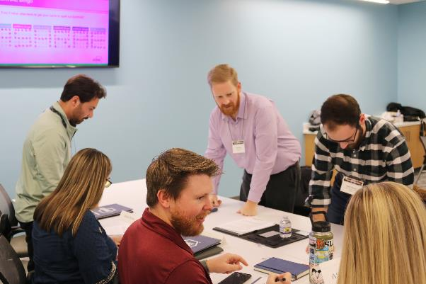


ABOUT
2026 Chapter Leadership Academy
TECHNICAL RESOURCES
PROFESSIONAL DEVELOPMENT
CONFERENCES
COMMUNITIES
MEMBERSHIP
March 6-7, 2026
ASHRAE Headquarters
Peachtree Corners, GA
Interested? Tell Your DRC by Nov. 21
Chapter Leadership Academy is a 1.5-day crash course designed to simplify the learning curve of all things ASHRAE.
Navigating the ASHRAE organizational structure
Understanding the tools and resources available to help Chapters and their members succeed
Delegating to and motivating volunteers toward the ASHRAE mission
Notes:
Chapter Leadership Academy is a 1.5-day crash course designed to simplify the learning curve of all things ASHRAE. Attendees will gain a better understanding of how ASHRAE Society functions and obtain useful and practical knowledge essential for honing ASHRAE leadership skills. The program also will include sharing tips and best practices that attendees can confidently take back to their Chapters for implementation. Attendees help shape the discussion, too! A significant part of the program will be based on hot topics and ASHRAE-related challenges that attendees have identified they would like to see addressed.
Contact your Director and Regional Chair (DRC) TODAY! DRCs will approve attendees from their region –and up to four attendees will be approved from each Region. Those interested should contact their DRC before November 21. All attendees will be approved to register by December 8.

Slide 23
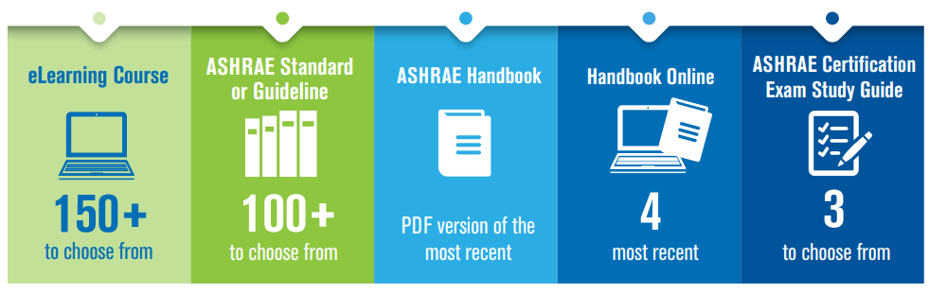

ABOUT
Membership
TECHNICAL RESOURCES
PROFESSIONAL DEVELOPMENT
CONFERENCES
COMMUNITIES
MEMBERSHIP
Have you selected your Annual Membership Benefit?
Benefits are selected during the join & renewal process. If you haven’t done so, login and select from benefit options available.
New, Full Dues Paying Members
Automatically Get:
HONORS & AWARDS
The following awards have a DEC 1 deadline:
Andrew T. Boggs Service Award | Distinguished 50 and 75-Year | Distinguished Service Award (DSA)| Eunice Foote Decarbonization Award | Exceptional Service Award (ESA)
Louise & Bill Holladay Distinguished Fellow Award

Slide 24

Current Model
Full Member Grade
Associate Member Grade
Full Member
Fellow Member*
Full Member DE
Retired Member
Retired Member DE
Life Member
Presidential Member
Associate Member
Associate Member DE
Smart Start
Associate Member
Smart Start Associate Member DE
Life Member
Professional & Early Career Member
Group Membership
100%
($285)
60%
($170)
15%
($45)
50% of RM ($25)
$0
100%
($285)
60%
($170)
FY 10% ($30)
SY 37.5% ($105)
TY 50% ($145)
FY 10% of DE ($15)
SY $37.5% DE ($65)
TY 50% od DE ($85)
$0
12 years combined experience for post high ed, work, pro engineering reg/license
*Good standing for 10+ yrs & elected by BOD
Retired from active participation in business + 10 yrs membership + ≥ 55
30 yrs cumulative member + ≥ 65
Served as Society President
Work experience and interest in design, operation, maintenance in HVAC&R
3 yr program that allows Students to transfer to Associate grade at a rate that is recent graduate friendly
Associate Member 30 yrs cumulative member + ≥ 65
Full Benefits:
Subscription to HPB, Journal, Insights + Choice of 1 annual benefit + Tech Portal + Member pricing on publications, standards, courses and conferences
Benefits:
Same as Full except subscription to digital Journal and Choice of 1 annual benefit: HB PDF, 1 STD or GDL or eLearning Course
Benefits:
Same as Full Member except NO choice of annual benefit.
Benefits:
Same as Full Member + waived dues, extreme discounts to W&A Conferences. Invitations to VIP events (Presidential only)
Full Benefits:
Subscription to HPB, Journal, Insights + Choice of 1 annual benefit + Tech Portal + Member pricing on publications, standards, courses and conferences
*DE Associate and Smart Start have same benefits as Full Member DE
Benefits:
Same as Full Member + waived dues, extreme discounts to W&A Conferences + Invitations to VIP events
Additional New Member Benefits:
Receive a Comp Winter or Annual Conference to attend in first 2 years + HBO access for 1 year
Additional New Member Benefits:
Receive a Comp Winter or Annual Conference to attend in first 2 years + HBO access for 1 year
*Associate DE and Associate Smart Start DE not eligible*
Current Model continues onto next page
Notes:
As you can see, it takes two slides to show our current model. With 8 Membership Grades, 2 discount programs, and 18 membership categories all with different benefits, qualifications, dues and age requirements, the model is confusing and expansive.

Slide 25
Current Model - Continued
Affiliate Member Grade
Student Member Grade
Other
Affiliate Member Grade
Professional & Early Career Member
Student Member
Student Member DE
Student Branch Advisor
Honorary
Member
Affiliate Member
Affiliate Member DE
Group Membership
FY 25% ($70)
SY 37.5% ($105)
TY 50% ($145)
FY $25% of DE ($45)
SY $37.5% DE ($65)
TY 50% of DE ($85)
10%
($30)
50% of Student Member ($15)
10%
($30)
$0
30 years old
OR have been honorably discharged from the Military within 5 yrs
Studying or have interest in HVAC&R industry related field + Must be currently enrolled in university, college, junior college or technical institute
Faculty member who is ASHRAE member & must submit application and submit annual report
Any notable person of preeminent professional distinction & elected by the BOD
Subscription to HPB, Journal & Insights + Tech Portal + Member pricing for publications, courses, standards and conferences
Subscription to HPB, Journal & Insights + Tech Portal + Student Member pricing for publications, courses, standards and conferences + Access to Student Bookstore for heavily discounted publications and printed HB
Full Member Benefits if requested
Cannot hold office or vote
Cannot hold office or vote

Slide 26
Simplified Model
Student Member Grade
Other
Member Grade
Professional & Early Career Member
Group Membership
Member
Young
Professional
Tenured Professional
Life Service Member
Presidential Member
Student Member
Student Branch Advisor
Honorary
Member
WB Tier 1
100%
($285)
WB Tier 2
80%
($230)
WB Tier 3
60%
($170)
WB Tier 4
40%
($115)
40%
($115)
$0
7.5%
($20)
20%
($60)
$0
Anyone interested in the building sciences industry
Anyone
≤ 35 yo who joins pays this fee first for 2 years
Anyone
≥ 65 yo with
25 years cumulative member-ship
30 yrs cumulative member + ≥ 65 + DSA or 15 qualifying service points
Served as Society President
Must be currently enrolled in university, college, junior college or technical institute
Faculty member who is ASHRAE member & must submit application and submit annual report
Any notable person of preeminent professional distinction & elected by the BOD
HBO + Journal, HPB, Insights + Tech Portal + Member Pricing + Voting Privileges and Serve as C,R,S level roles
Choice of 1:
eLearning Course, Certification Study Guide, Standard or Guideline
HBO + Journal, HPB, Insights + Tech Portal + Member Pricing
Same as Member + waived dues, extreme discounts to W&A Conferences.
Invitations to VIP events (Presidential Only)
Same as Young and Tenured Professionals
Full Member Benefits if requested
Additional New Member Benefits:
Receive a Comp Winter or Annual Conference to attend in first 2 years + HBO access for 1 year
*2025-2026 approved dues rates
Notes:
The simplified model focuses on:
the "Member" grade with tiered dues based on the four tiers outlined by the World Bank with broader qualifications and the same benefits across all tiers.
Two similar membership categories created to mirror one another for Young Professionals and Tenured Professions to provide the same significant dues discounts with access to quality benefits.
Life Service Members which rewards long-term dues paying members who have a certain level of Society participation which spans all aspects of Society (Society, Regional, Chapter service, Ad Hoc service, Standard Project Committee service, Technical Committee services, general activities such as service to Society's Winter and Annual Conferences, CRCs Intersociety assignments, Foundation and HVAC&R Research Journal, and Service as a Speaker, author of ASHRAE publications and author of ASHRAE published papers. Those who don't qualify for the waived dues still receive quality benefits at an extremely discounted dues rate as a Tenured Professional.
Students and Student Branch Advisors continue to have extremely discounted dues but access to critical technical content with Handbook Online.
EVERYONE, including Students, receives access to Handbook Online.
**The dues rates and percentages are shown as examples based on 2025-2026 dues rates. The Finance Committee is responsible for reviewing, recommending changes and interpreting fees, dues, and privileges.**

Slide 27
Simplified Model Highlighted Changes
Associate and Affiliate Member Grades and Smart Start discount program
Replaced with
Young Professionals Member Category
35 years or younger, first 2 years of membership heavily discounted
Developing Economies discount program
Transitions to
Four Tiers of Full Member Dues
based on country of residence with same benefits across all tiers
(aligned with World Bank)
Retired Member category
Tenured Professional Member Category
65 years or older + 25 years of membership heavily discounted to mirror Young Professional
Replaced with
Life Member Grade
Life Service Member Grade
65 years or older + 30 years of membership + qualification of service to Society.
Members who don't qualify are eligible for discounted Tenured Professional category.
Transitions to
Student Branch Advisor dues rate
20% of Full Membership Dues
SBAs would go from paying the same rate as Students (10% - $30) to paying slightly more at 20% of dues (currently $60). SBAs would still receive Student pricing to W&A Conferences, the same benefits and access to Handbook Online.
Increases to
Benefits: All Members, even Students, receive access to Handbook Online (all four volumes). Full Members receive additional annual benefit option.
Member Qualifications: Broadened to be more inclusive of anyone interested in the Building Sciences industry
Notes:
The biggest changes are highlighted here:
The Associate and Affiliate Member Grade and Smart Start program are replaced with the Young Professionals membership category which is offered for those 35 years or younger with heavily discounted dues for the first two years of their membership with quality benefits offered. The only benefit not offered is the annual benefit selection option. After two years they are automatically transferred to the Member Grade with full access to benefits. This serves the need to transition younger members from school to early stages of their career but doesn't limit the discount opportunity to just students. This also eliminates confusing additional dues tiers of current Affiliate grade and additional tiers of Developing Economies.
The Developing Economies discount program which currently offers a percentage discount on every single member category with limited benefits would transition to tiered dues for our Members based on country of residence. The four tiers are determined by the World Bank and would allow for some countries, like Mexico, who are currently considered "Upper-Middle Income" by the World Bank but are currently paying full dues to pay in a new tier of dues. Currently we only have about 25 members who fall into the Low Income tier at the lowest dues rate.
The Retired Member category currently made up of only 200 members and is available by request only for those who are truly retired. Replacing Retired Members with a Tenured Professional category (which mirrors our Young Professionals category in terms of dues rate and benefits) allows for more members who reach a certain age whether they are retired or not the ability to pay a reduced dues rate but still keep access to quality benefits. This change helps support Society's members who have membership tenure but are in the end-stage of their careers but are not necessarily retired.
Life Member Grade would transition to a Life Service Member Grade. Members who reach 65 years old with a cumulative membership in ASHRAE for 30 years who serve Society at any point in their 30 years and meet the service requirement (i.e. the equivalent to 10 points on the DSA tally form). This rewards members of our Society who have given back in some capacity. For those who don't qualify when they hit their 65/30 years can still qualify later on with continued service and can take advantage of the Tenured Professional category with significant dues discount while retaining quality benefits. Members who achieve DSA will automatically receive LSM status once 65/30 years are met.
To be very clear, all current Life Members will remain Life Members and will be grandfathered into the current Member Grade. In fact, the new member grade wouldn't go into effect until July 1, 2027 (if approved as is) which allows for members approaching Life Member Status in the next three years to still gain the Life Member Grade without the service component.
All members, including students, will have access to Handbook Online while their membership is in good standing. This is added benefit fulfills ASHRAE's objective to disseminate technical knowledge to its members.
The member qualifications of 12 years combined experience for post high ed, work, pro engineering reg/license are loosened to welcome anyone interested in the building sciences.

Slide 28

Reasons for the Changes
Simplification
Support Diversity, Equity and Inclusion
Young Professionals mirrors Tenured Professionals
Same benefits and same dues rate
Lift Member qualifications and restrictions
All members (except Students) can vote
All members (except Students) can hold C,R,S roles
Anyone interested in building sciences can join ASHRAE
Tiered Member Dues match all four Tiers of World Bank
Motion from Region-at-Large CRC Lebanese Chapter
Slowing the continued growth of
Non dues paying Life Members
Motion from Region VIII CRC Monterrey Chapter
MP & SAC
Added Benefit for ALL Members including Students: Handbook Online (HBO)
Motion from Region VIII Central OK Chapter
Rewards those who have served Society through different channels with waived dues
Allows members who have 30 years of membership and age 65 or older with significantly discounted dues rate to maintain HBO, Journal and Member Pricing
Motion from Region XI CRC Southern Alberta Chapter
MP
Access to HBO serves as retention tool
When 12-month subscription to HBO ends, member will renew to gain access instantly
Access for students to HBO gives incentive for joining as a Young Professional to keep access
Notes:
The reasons for these changes are summarized on this slide:
Simplification
If it's easier to explain the benefits and process to join and easier to understand more people may join! The elevator speech just got easier :)
Support DEI
Same opportunities are given members starting out and finishing up their careers through the proposed Young Professionals and Tenured Professionals categories.
By lifting the qualifications of membership (12 years of experience, professional engineering or related registration or license, etc) and allow anyone interested in ASHRAE's vision and mission to join
Expanding the opportunity for all members (expect Students) to be able to vote and hold leadership positions in the chapter
Tiered Membership Dues match the four tiers of the World Bank
This recommendation stems from CRC motions over the past few years specifically from the Lebanese Chapter and Monterrey Chapter
Current ASHRAE's Developing Economies discount program allows for those who fall into the top two tiers (High and Upper-Middle incomes) to pay full dues and those in the bottom two tiers (Lower-Middle and Low Incomes) pay the Developing Economies discounted dues. Allowing for a four tier system will better align with the income tiers specified by the World Bank. Member benefits would be the same for everyone with the Member Grade regardless of what tier they fall into. The Full Member category is the only membership category that would be tiered.
Added Benefit for ALL
This recommendation also stems from CRC motions specifically from Central Oklahoma Chapter and Southern Alberta Chapter to have Students have access to HBO and for ALL members to have HBO.
Years ago, a printed handbook was shipped to every full Member of ASHRAE. Society did away with printed handbooks for all and instead offered discounted print versions and the option to choose HBO or Handbook PDF as a free annual benefit. This recommendation provides access to HBO for free to all. HBO gives the member all four volumes of the Handbook via online access. Handbook PDF (downloadable and easy to forward) and printed Handbook would be discounted for members.
Allowing students the ability to have access to HBO to support them in their studies may also drive students to be more interested and engaged about pursing HVAC&R specific careers.
Both the Student Activities Committee and Membership Promotion Committee have reviewed these motions and recommend approving them.
Access to Handbook Online serves as a retention tool:
Once membership expires, access to HBO expires.
This could support members renewing on time to retain access and slowly reduce the amount of delinquents we have in our current 6 month grace period.
Access to HBO compliments the popular subscription service model that most products and services are leaning toward.
Slowing the continued growth of Non Dues Paying Members
Life Members continue to grow significantly year over year due to Society's aging membership.
If Society continues to automatically give those who meet the 30/65 threshold waived dues we could be missing out on added revenue.
Reward those who have served Society during their membership tenure by provided free dues and allowing those not as engaged with Society the option to join the Tenured Professionals members category to retain quality benefits and a reduced dues date. This allows Society to generate some additional revenue for those who enter the Tenured Professional category instead of automatically assigning them to Life Member.
AGAIN, those that are already Life Members would be grandfathered into that Member Grade and those approaching Life Member status of the next 3 years would also be grandfathered in since, if this is approved, it wouldn't go into affect until July 2027.

Slide 29

Timeline
February 2025: MMAH brought motion to the Board of Directors to approve plan.
  Motion tabled to allow for 60-day "cooling off period."
May BOD Meeting: BOD approved the final plan.
Fall BOD Meeting: BOD votes on Bylaws Amendment
2026 Winter Conference: Bylaws amendment read at the Meeting of the Members
Spring 2026: Proposed Bylaws amendment on Spring Ballot for membership vote
June 2026: Election results
By June 30, 2027: If Bylaws amendment are approved, all changes made to membership database, website, promotional materials, ROB, Committee/Council MOPs and training materials. (Staff and Members Council will need 1 year to implement new model changes)
July 1, 2027: New model implemented.
Visit ashrae.org/MembershipModel for more information
Or contact members@ashrae.org
Notes:
[Read slide]

Slide 30

Media Inquiries
Notes:
ASHRAE's PR team have tools and resources available to vet media inquires, research media contacts and arrange appropriate responses. Please send all media inquires to publicrelations@ashrae.org for support.

Slide 31
Thank you!
Questions or Comments?
ashrae.org

