Slide 1

THIS IS ASHRAE
Society Year 2023-2024
Photo of ASHRAE Global Headquarters Building
August 2023

Slide 2
ASHRAE Overview
MISSION
To serve humanity by advancing the arts and sciences of heating, ventilation, air conditioning, refrigeration and their allied fields.
VISION
A healthy and sustainable built environment for all.
INDUSTRY CLASSIFICATION
Consulting Engineers
Contractors
Manufacturers
Manufacturing Representatives
Government, Health & Education
Design Build
Architects
      52,000+
      Members
      130+ Countries
198 Chapters
15 Regions
5,500+
Student Members
400+
Student
Branches
Founded
in
1894

Slide 3





2019-2025 ASHRAE Strategic Plan
1
RESILIENT BUILDINGS
and COMMUNITIES
3
ORGANIZATIONAL STREAMLINING
2
INDOOR ENVIRONMENTAL
QUALITY
4
IMPROVE CHAPTER ENGAGEMENT,
CAPACITY and SUPPORT
Get the PDF, Plan at-a-Glance (English and Spanish) & PowerPoint ashrae.org/strategicplan

Slide 4


ASHRAE Core Values
Commitment
ASHRAE and its members are passionate about serving the built environment, creating value and recognizing the accomplishments of others.
Integrity
ASHRAE is committed to the highest ethical standards. We work transparently, observing essential requirements for due process and peer reviews to assure our members and stakeholders that we do the right things the right way.
Excellence
ASHRAE education, technical information and all other activities and products will always reflect the best practices that lead our industry. We strive for continuous improvement and innovation in all our practices and products.
Diversity
ASHRAE is committed to providing a welcoming environment. Our culture is one of inclusiveness, acknowledging the inherent value and dignity of each individual.
Volunteerism
Members lead ASHRAE at every level, serving ASHRAE and helping ASHRAE serve society.
Collaboration
ASHRAE seeks and embraces collaborative efforts with
organizations, agencies and individuals sharing our
commitment to sustainable built environments.

Slide 5
ASHRAE Policies
Code of Ethics
Commercialism
“We will act with honesty, fairness, courtesy, competence, inclusiveness and respect for others, which exemplify our core values of excellence, commitment, integrity, collaboration, volunteerism and diversity, and we shall avoid all real or perceived conflicts of interest.”
ASHRAE’s Commercialism Policy allows for Society activities that fulfill the mission of technological advancement with adherence to business plans that generate income to offset operational expenses such as AHR Exposition, ASHRAE periodicals, website, and Society conference events such as the Welcome Party, luncheons, registration kits, and receptions.
ashrae.org/codeofethics
ashrae.org/commercialism
Harassment and Discrimination Policy
ASHRAE is committed to educating members to eliminate all instances of sexual harassment. The Society will deploy an online training program for volunteers to help educate and protect all members, and to sustain the professional environment members deserve and expect. This training will be required prior to serving on certain standing committees and/or in leadership positions.
ashrae.org/about/governance

Slide 6

Diversity Commitment
Diversity Commitment
ASHRAE is committed to providing a welcoming environment. Our culture is one of inclusiveness, acknowledging the inherent value and dignity of each individual. We proactively pursue and celebrate diverse and inclusive communities understanding that doing so fuels better, more creative and more thoughtful ideas, solutions and strategies for the Society and for the communities our Society serves. We respect and welcome all people regardless of age, gender, ethnicity, physical appearance, thought styles, religion, nationality, socio-economic status, belief systems, sexual orientation or education.
ashrae.org/diversityequityinclusion

Slide 7

ASHRAE Structure
ExCom
AASA
ASHRAE Membership
Strategic Industry Advisory Group
Development Committee
BOD
Finance Committee
Planning Committee
Foundation Trustees
Audit Committee
Nominating Committee
DEI Advisory Subc
Scholarship Trustees
Society Rules Committee
Members Council
Technology Council
Publishing and Education Council
CTT Committee
Environmental Health Committee
Certification Committee
Communications Committee
Refrigeration Technology Committee for Comfort – Process – Cold Chain
Handbook Committee
CEC
JEPC
Research Administration Committee
Historical Committee
Life Members Club
Technical Activities Committee
Training and Education Committee
H&A Committee
College of Fellows
Publications Committee
MP Committee
Residential Buildings Committee
RP Committee
Standards Committee
SA Committee
Global Technical Interaction Committee
YEA Committee
GA Committee
August 2023

Slide 8
What We Do and How We Do It
33 Standing Committees
130+ Standards and
Guidelines Committees
100+ Technical Committees
300+ Publications
7 Certification Programs
200+ Educational Courses
Research
Scholarships
Serve as pipeline for providing technical information to members, chapters, companies and government officials
1
Develop standards and technical guidelines to improve the built environment
2
3
Offer continuing education for industry professionals
4
Serve as networking tool for industry professionals

Slide 9
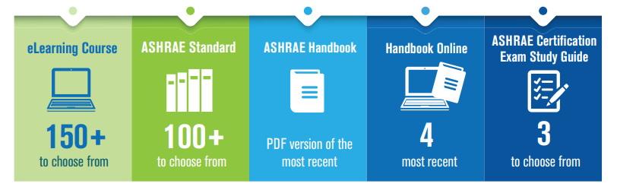

Membership & Communities
NEW! FIVE Benefit Options for New & Renewing
Full Dues Paying Members
New benefit options include ASHRAE Handbook Online and Certification Study Guides (PDF). Benefits are selected during the join & renewal process.
New, Full Dues
Paying Members
Automatically Get:
All members receive free or discounted pricing on all ASHRAE products!
ashrae.org/membership ​
Notes:
10% Discount is only applied when 5 or more new full dues paying members join from the same company. Must download and submit application via email or mail.
Free conference registration can be requested within 24 months of a new full dues paying membership.

Slide 10

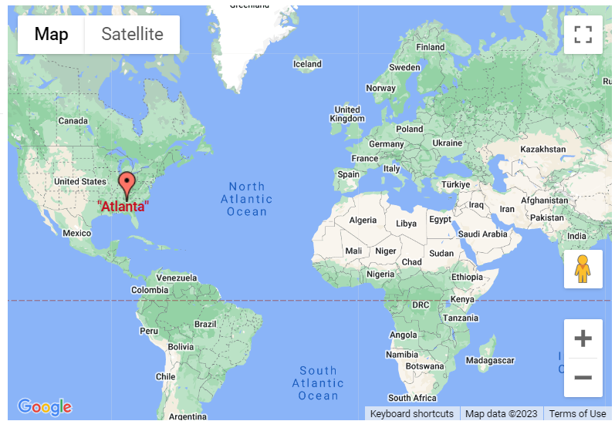

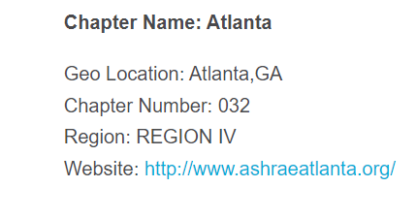

Membership & Communities
Looking for an ASHRAE Chapter? Use the new search tool at ashrae.org/chapters.
Atlanta
Notes:
Feel free to include the additional note below:
We’ve kept it simple: Enter your name and email, your colleague’s name and email, and press send.
That’s it! This pre-written invitation will be sent on your behalf, and includes options to reference an ASHRAE technical committee section, and to add a custom message.

Slide 11
Young Engineers in ASHRAE (YEA) + Student Program
ASHRAE has a robust Student Program catering to the needs of students at every age. Resources for Student Members include:
Scholarships & Grants
Awards and Competitions
Local Involvement at Student Branch and ASHRAE Chapter & Region Level
Special Discounts and resources
ASHRAE also offers resources for K-12 volunteers and educators.
The Young Engineers in ASHRAE (YEA) committee focuses on offering relevant programs and services to young professional ASHRAE members (35 years old and younger).
YEA Leadership Weekends provide the opportunity for future leaders of ASHRAE to learn more about ASHRAE Society, developing soft skills, and networking with other young professionals
Leadership U program allows YEA members to shadow ASHRAE Vice Presidents during Winter and Annual Conferences
YEA Scholarship for HVAC Design Essentials Training
ashrae.org/yea
ashrae.org/students

Slide 12
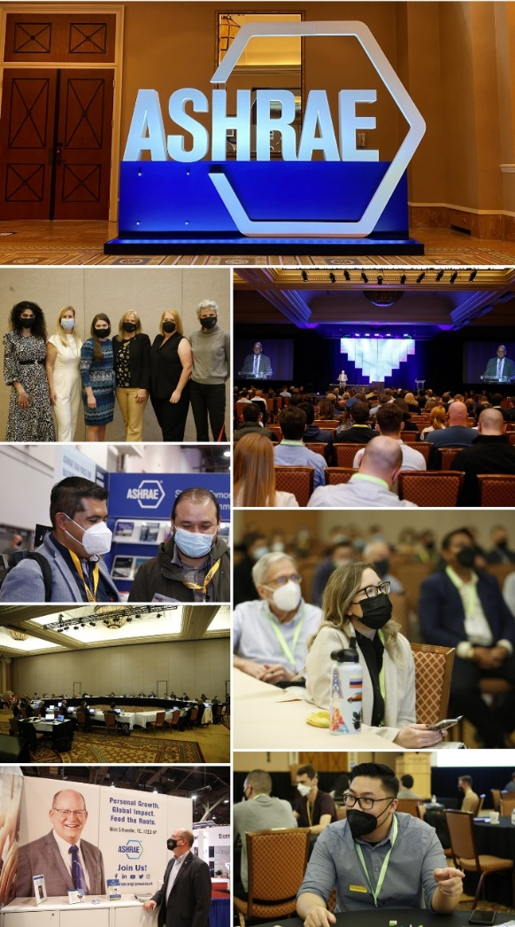
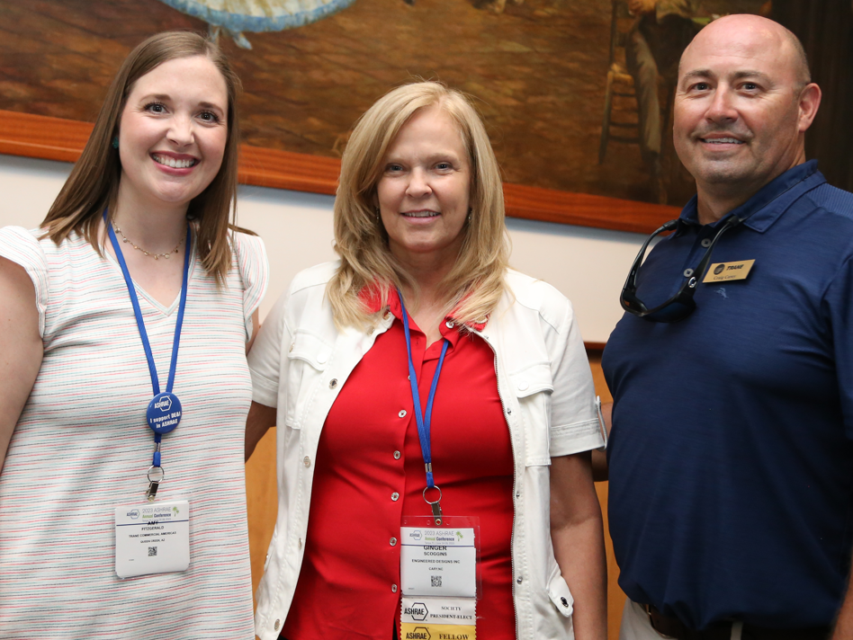
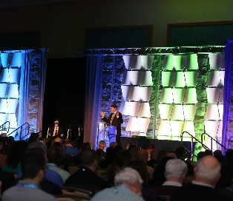




ASHRAE Conferences
ASHRAE conferences feature peer-reviewed papers and presentations with hands-on information. Attendees earn professional development hours (PDHs), keep up-to-date on the latest technologies, and network with colleagues.
AHR Mexico
Sep 19 – 21, 2023 | Mexico City, Mexico
2024 ASHRAE Annual Conference
Jun 22 – 26, 2024 | Indianapolis, IN
2023 Building Performance Analysis Conference
Sep 11 – 13, 2023 | Austin, TX
The Sixth International Conference on Efficient Building Design
Oct 3–4, 2024 | Beirut, Lebanon
International Building Decarbonization Conference
April 17-19, 2024| Madrid, Spain
2024 ASHRAE Winter Conference & AHR Expo
January 20 – 24, 2024| Chicago, IL
ashrae.org/conferences

Slide 13






Tradeshows
ASHRAE is a prominent advocate and participant in industry events and tradeshows. The Society’s participation of these events signifies its commitment to fostering innovation and collaboration with leading industry organizations.
AHR Mexico
Sep 19 - 21, 2023 | Mexico City, Mexico
ACREX
Feb 15 – 17, 2024 | New Delhi, India
CMPX
Mar 20 - 24, 2024 | Toronto, Ontario
Greenbuild
Sep 26 - 29, 2023 | Washington D.C.
COP28
Nov 30 – Dec 12, 2023| Dubai, U.A.E.
AHR Expo and ASHRAE Winter Conference
Jan 20 – 24, 2024| Chicago, IL

Slide 14



ASHRAE Journal
ASHRAE’s official monthly publication provides detailed insight on the latest HVACR technologies and applications for consulting engineers and professionals in the industry.
Articles are peer-reviewed and focus on technical topics, including green buildings, decarbonization, indoor air quality, energy management, thermal storage and alternative refrigerants.
ASHRAE Journal Podcast Discussions with leading ASHRAE experts to expand knowledge in the HVACR industry.
New! Hot Air Brief talks with ASHRAE Journal authors on HVACR content published in the Journal.
ashrae.org/ashraejournal

Slide 15
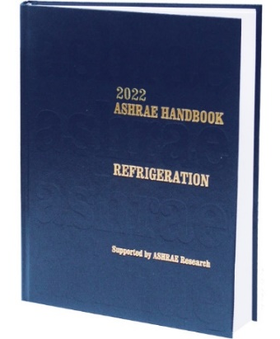

ASHRAE Handbook
ASHRAE Handbook – Print Version
Continuously refined and updated, ASHRAE has published its Handbook series since 1920s
Volumes cover HVAC&R fundamentals, systems, equipment
and a wide variety of applications
Handbooks are also available in the ASHRAE Technology Portal
ashrae.org/handbook
ASHRAE Handbook Online
Mobile device responsive
Content from all four current Handbook volumes plus extra features such as videos, animations, spreadsheets and more
Easier than ever to search across all volumes, print, ask questions about technical content, access bonus features and look up new terminology
Eligible ASHRAE members can choose an ASHRAE Handbook Online subscription at a discounted rate during membership renewal
ashrae.org/handbookonline

Slide 16
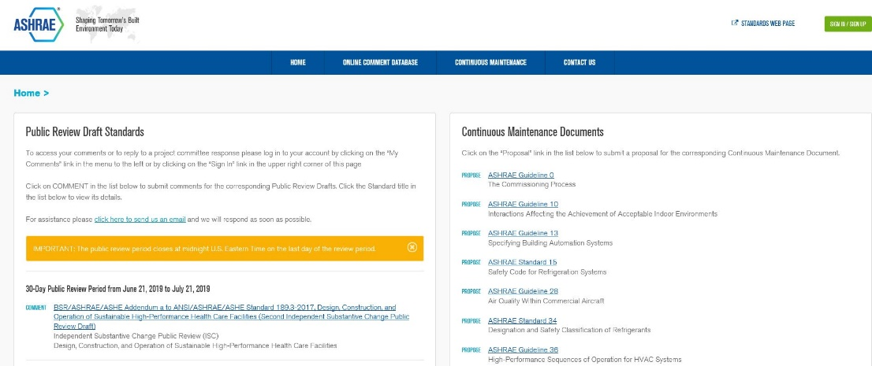
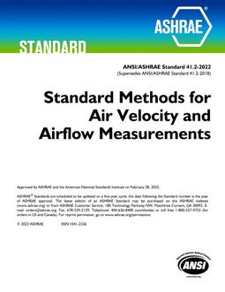
Standards and Online Standards
Review Database
The Online Standards Review Database allows
access to public review drafts for standards, guidelines
and addenda and to submit comments.
The system offers a dashboard which highlights items that require attention, provides quick links to individual and committee comments, continuous maintenance proposals and outstanding ballot results.
ashrae.org/publicreviews
Developing standards since 1922
130+ active standard or guideline projects
Standards are reviewed and republished to ensure they are up-to-date, e.g., existing code-intended standards are on a three-year review cycle
ashrae.org/standards
Notes:
All standards go through public review and comment.
Existing standards are reviewed every three years.
Standards that are on continuous maintenance are republished with new addenda every three years.
Code utilized standards are republished every three years

Slide 17
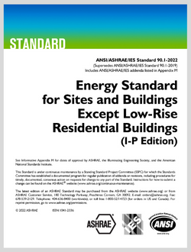

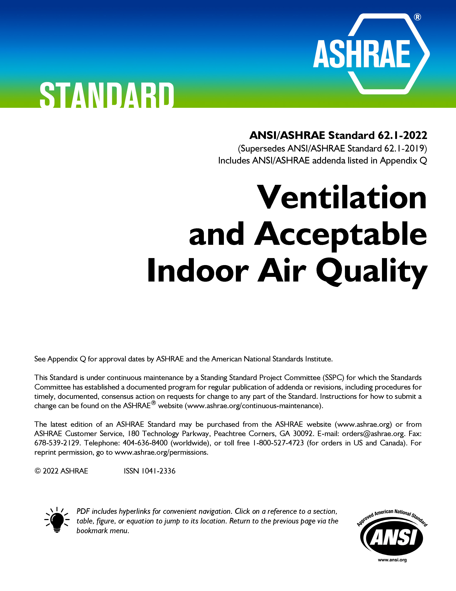
Well-Recognized Standards
ASHRAE Standard 15, Safety Standard for Refrigeration Systems and Designation and Classification of Refrigerants
ASHRAE Standard 90.1, Energy Standard for Sites and Buildings Except Low-Rise Residential Buildings
ASHRAE Standard 62.2, Ventilation and Acceptable Indoor Air Quality in Residential Buildings
ASHRAE Standard 34, Designation and Safety Classification of Refrigerants
ASHRAE Standard 55, Thermal Environmental Conditions for Human Occupancy
ASHRAE Standard 62.1, Ventilation for Acceptable Indoor Air Quality
ASHRAE Standard 188, Legionellosis: Risk Management for Building Water Systems
2021 International Green Construction Code (IgCC): Powered by ASHRAE/ICC/USGBC/IES Standard 189.1-2021
ASHRAE Standard 241, Control of Infectious Aerosols
ashrae.org/standards

Slide 18

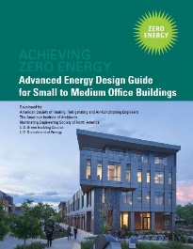


Advanced Energy Design Guides
Advanced Energy Design Guides are published in coordination with partners to promote building efficiency.
Building Specific Guidance that addresses various project aspects with multiple strategies that move the building design incrementally toward the zero-energy goal.
Zero energy goals and strategies will also move buildings towards decarbonization.
Advanced Energy Design Guide for K-12 School Buildings – Achieving Zero Energy
Applicable to all sizes and types of K-12 school construction.
Advanced Energy Design Guide for Small to Medium Office Buildings – Achieving Zero Energy
Applicable to office buildings 10,000 to 100,000 ft² with a building height of less than 75 feet.
Advanced Energy Design Guide for Multifamily Residential Buildings – Achieving Zero Energy
Applicable to construction of new multifamily buildings
covered by ANSI/ASHRAE/IES Standard 90.1
ashrae.org/freeaedg

Slide 19

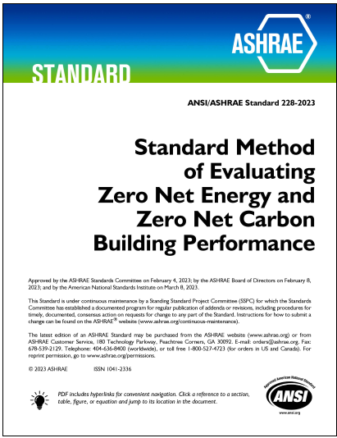
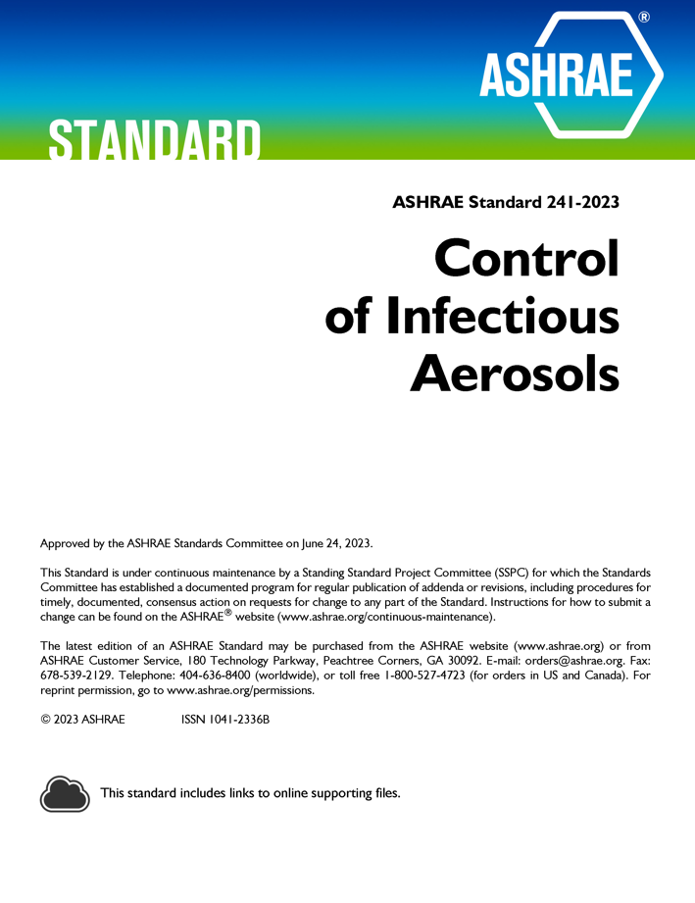
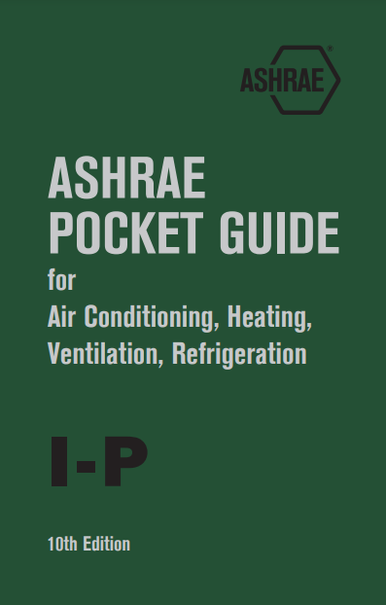
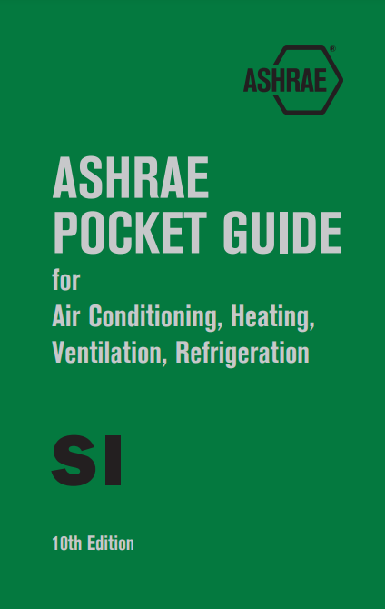
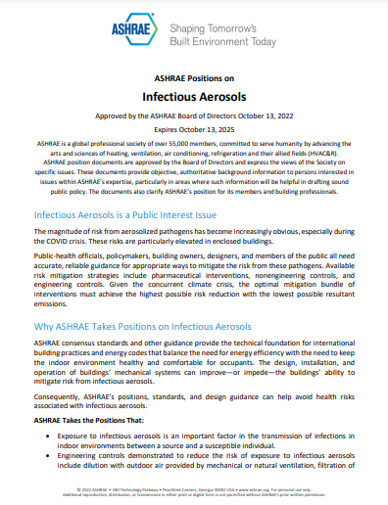

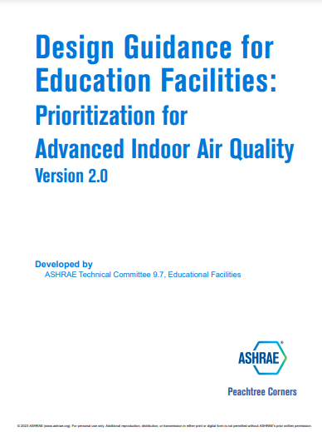
Selected Recent Publications
Standard 228-2023, Standard Method of Evaluating Zero Net Energy and Zero Net Carbon Building Performance
ASHRAE Standard 241-2023, Control of Infectious Aerosols
ASHRAE Design Guide for Commercial Kitchen Ventilation:
Best Practices for Design and Operation
ASHRAE Pocket Guide for Air Conditioning, Heating, Ventilation, Refrigeration
ASHRAE Position Document on Infectious Aerosols
ASHRAE Global HVAC&R Summit Final Report
Design Guidance for Education Facilities Version 2
Available at ashrae.org/bookstore​

Slide 20
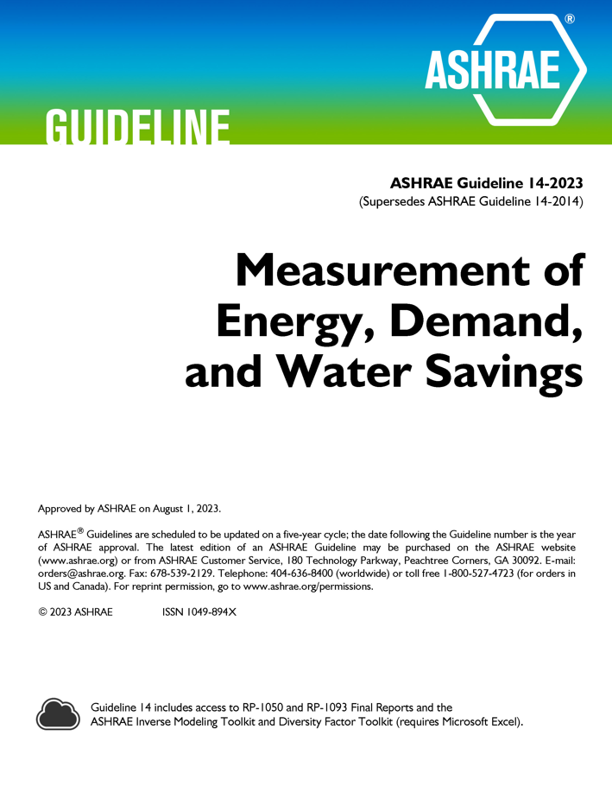

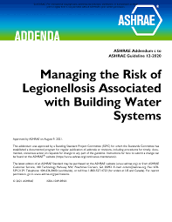
Selected Recent Publications
ASHRAE Standard 514-2023, Risk Management for Building Water Systems: Physical, Chemical, and Microbial Hazards
ASHRAE Guideline 14-2023, Measurement of Energy, Demand, and Water Savings
Standard 90.4-2022, Energy Standard for Data Centers
Guideline 12-2023, Managing the Risk of Legionellosis Associated with Building Water Systems
ashrae.org/bookstore

Slide 21
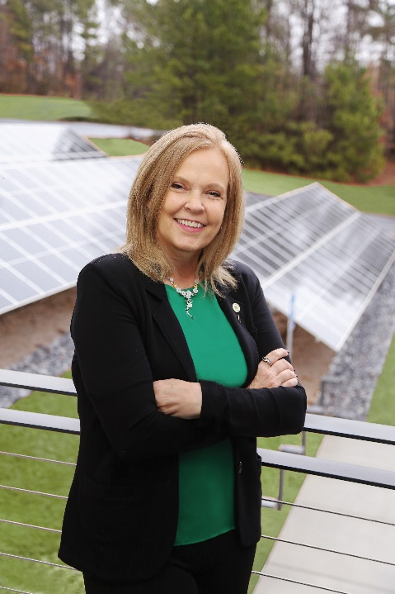

Recent Translated Publications
Lucy’s Engineering Adventure
  Arabic, Croatian, Portuguese, Serbian, Spanish
ASHRAE Standard 230-2022, Commissioning Process for Existing Buildings and Systems
  Spanish
ASHRAE Position Document on Building Decarbonization
  Portuguese, Spanish
ASHRAE Position Document on Indoor Carbon Dioxide
  Portuguese
ASHRAE Global HVAC&R Summit Final Report
  French, Romanian, Spanish
Download 2023-24 ASHRAE President Ginger Scoggins’ Presidential Presentation,
available in
French, Portuguese and Spanish
ashrae.org/president

Slide 22
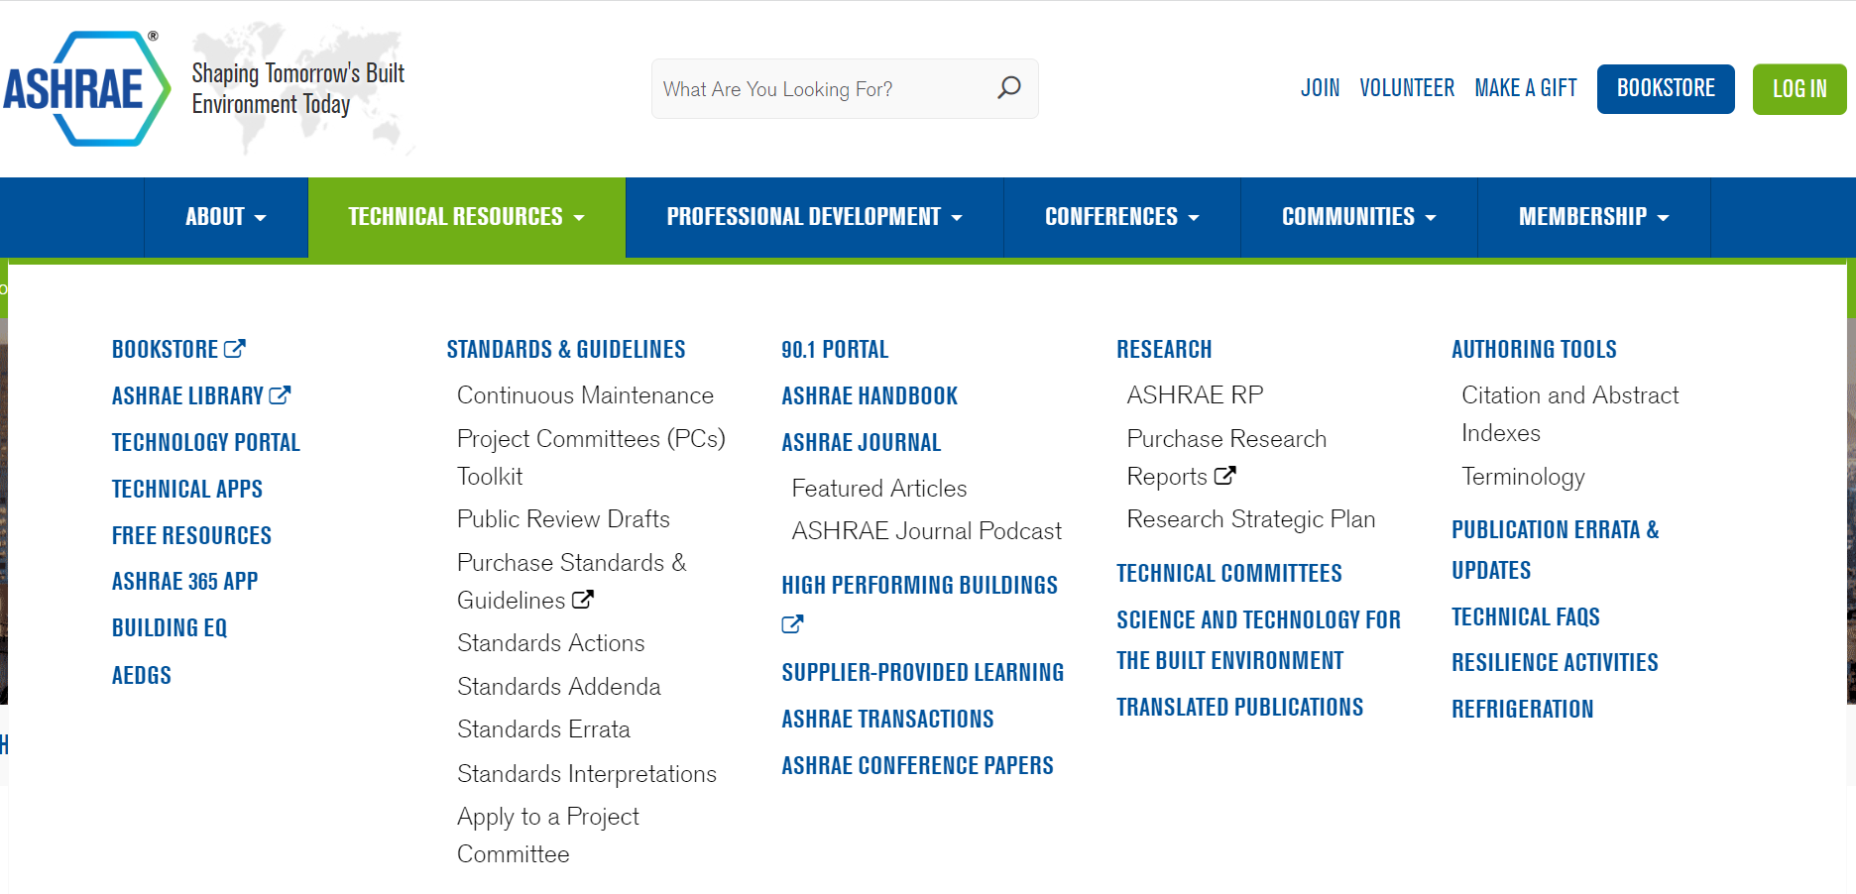
Resources
Find Technical Resources at ashrae.org
Notes:
Find free resources and other useful tools like the 90.1 portal, access to Technology Portal, STBE, Handbook products, apps and much more from the Technical Resources tab at ashrae.org.

Slide 23
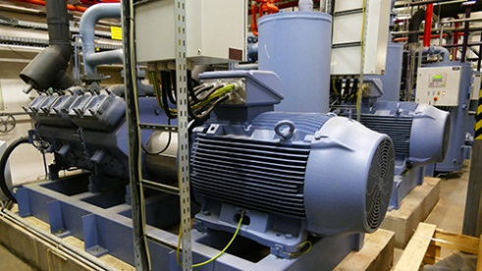
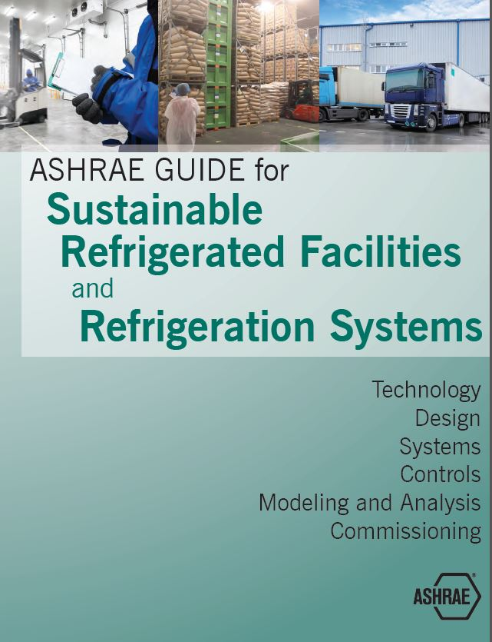
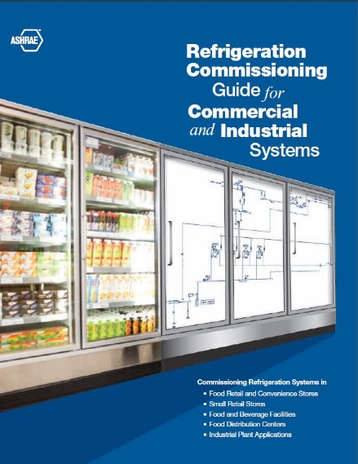
“R” In ASHRAE
With refrigeration literally in its name, ASHRAE offers a wide selection of information and publications concerning refrigeration and refrigerants – from standards and design guides to ASHRAE courses as well as a monthly column in ASHRAE Journal, and more. These items can all be found in one spot at ashrae.org/refrigeration.
In April 2019, ASHRAE and the International Institute of Refrigeration (IIR) announced the establishment of new definitions for five refrigeration keywords, which are:
Cooling
Refrigeration
Chilling
Freezing
Cold Chain
ashrae.org/refrigeration

Slide 24
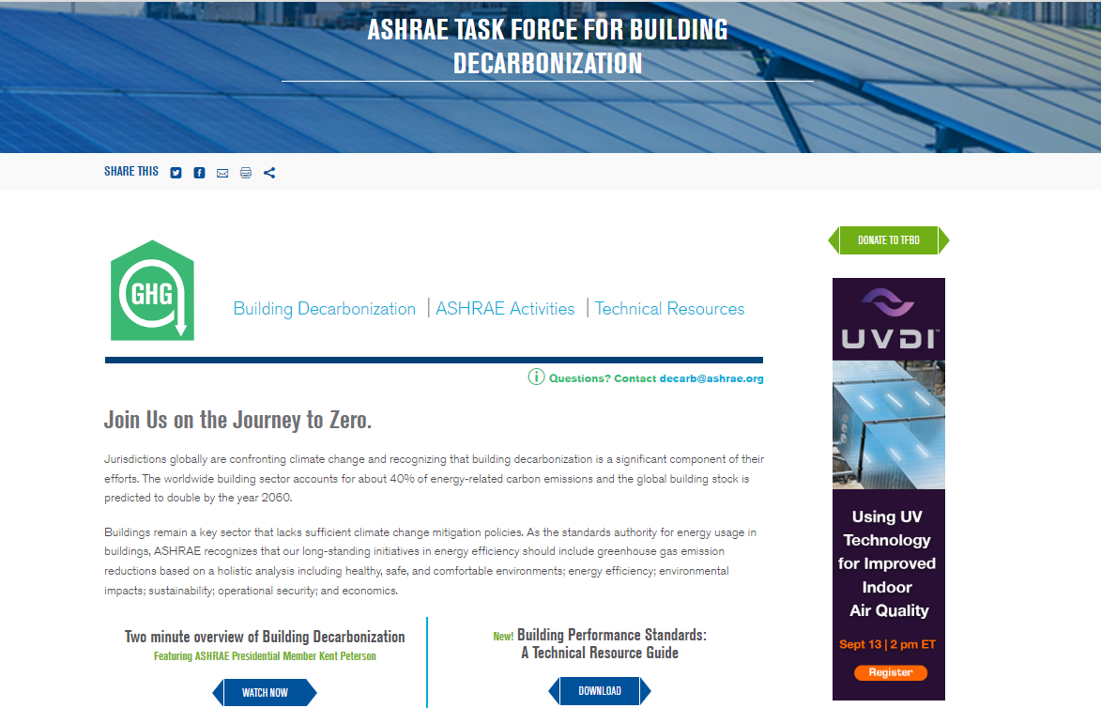

Task Force for Building Decarbonization
The Task Force For Building Decarbonization (TFBD) is working to implement strategy, direction, and successful products and services for the industry relating to building decarbonization.
Products and Services Include:
Seven Guides
Six Video Series (first video launched in August ‘23)
Creating content for Knowledge Hub and ashrae.org
Establishing relevant training & education
ashrae.org/decarb

Slide 25

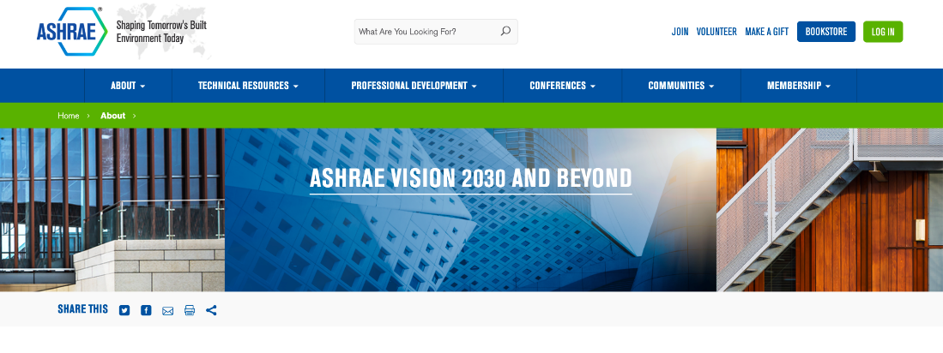
ASHRAE Vision 2030 and Beyond
    Serve as a knowledge base for defining how buildings of the future will be designed, constructed, and operated.
    Continually drive the innovative and strategic improvements needed during the revolution of the built environment.
Email questions or comments to vision2030@ashrae.org
ashrae.org/vision2030

Slide 26
ASHRAE Learning Institute (ALI)
ALI courses are taught by engineers for engineers to provide real world experience. Courses cover a wide range of professional development training with a variety of lengths and modes of delivery. ASHRAE’S training center in Dubai
extends our global reach.
ALI courses are taught by engineers for engineers to provide real world experience. Courses cover a wide range of professional development training with a variety of lengths and modes of delivery. ASHRAE’S training center in Dubai
extends our global reach.
ASHRAE Courses & Seminars | Global Training Center in Dubai
Building Decarbonization | Humidity Control
V in HVAC – Improving IAQ | Standard 62.1
Standard 90.1-2022 | Data Centers and the Internet of Everything
Energy Modeling | Commissioning
HVAC Design Essentials & Applications | Refrigeration and Cold Chain
Commissioning in New & Existing Buildings
Energy Audits
Guideline 36
New courses added regularly.
www.ashrae.org/education

Slide 27



ASHRAE eLearning
ASHRAE eLearning offers more than 90 on-demand and self-paced online courses for you to earn PDHs/CEUs at your convenience.
Most courses are accredited by AIA and GBCI.
Some of the popular courses include:
Course Package: Fundamentals of HVAC Systems (21.5 PDHs)
Course Package: HVAC Control Systems (33.5 PDHs)
Course Package: DDC Controls (10 PDHs)
Course Package: Refrigerants (SI) (6.5 PDHs)
Commissioning (4.0 PDHs)
Standard 62.1-2013: Natural Ventilation Procedure (I-P)
Using Standard 90.1-2010 to Meet LEED Requirements (Dual Units)
Building Information Modeling (Dual Units)
Standard 189.1 for High-Performance Green Buildings - Energy Efficiency (Dual Units)
School of Hard Knocks: Controlling Moisture & Humidity in Buildings (Dual Units)
ashrae.org/elearning

Slide 28

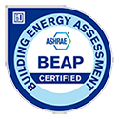




ASHRAE Certification
ASHRAE offers 6 certification programs founded to meet the industry needs of today and provide value to thousands of built environment professionals, employers and building owners.
BCxP – Building Commissioning Professional
BEAP – Building Energy Assessment Professional
BEMP – Building Energy Modeling Professional
CHD - Certified HVAC Designer
HBDP – High-Performance Building Design Professional
HFDP – Healthcare Facility Design Professional
Over 1,000 test center locations worldwide!
Share your certification online including LinkedIn profile, email signature, and more with Digital Badges.
ashrae.org/certification
Notes:
Hello! See additional information below:
CHD Notes:
Developed to validate competency of the “HVAC Designer” working under the responsible charge of an engineer.
HVAC Design Engineers may also apply
Chapter-organized Exam Administration Notes:
First step is to notify Certification staff at certification@ashrae.org
This is a great way to grow membership, as non-member recruits will want to join in order to receive the $200 Member discount on certification application.
The Chapter must recruit at least 15 Members to sit for an ASHRAE certification exam
Certification is a great way to increase participation at Chapter education events. Certificants need 30-50 PDHs every 3 years for recertification.
Enhance the sense of community and spirit of achievement and excellence.

Slide 29


Building EQ
  Take your building to the next level beyond benchmarking
  The BEQ portal compares a building’s energy performance to similar building types in same climate zone.
  In Operation Assessment
Compares actual building energy use based on metered energy information.
Aligned with ASHRAE Standard 211 to lead assessor through the requirements for a Level 1 Energy Audit.
Search Function now added to EEM pull down menus.
  As Designed Evaluation
Compares potential energy use based on buildings’ physical characteristics and systems using simulated energy information.
Aligned with ASHRAE Standard 90.1 PRM methodology using dual model approach for greater accuracy and ease of use.
  Notable Features
Building EQ Performance Scores for both energy and carbon metrics.
Provides a pathway for Green Globes certification.
An Application Programming Interface (API) is now available for testing.
Building EQ Energy Genius Award
Recognizes excellence in the assessment of building energy performance. Presented annually to deserving approved Building EQ Portal projects.
ashrae.org/buildingeq

Slide 30
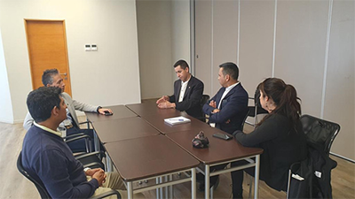
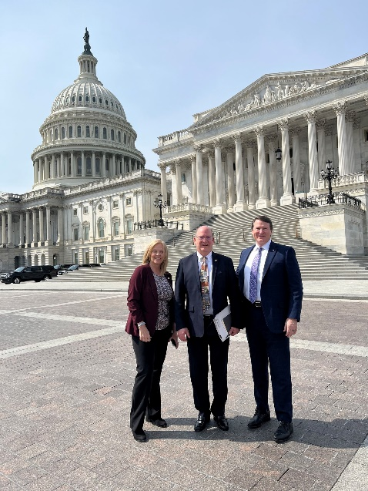
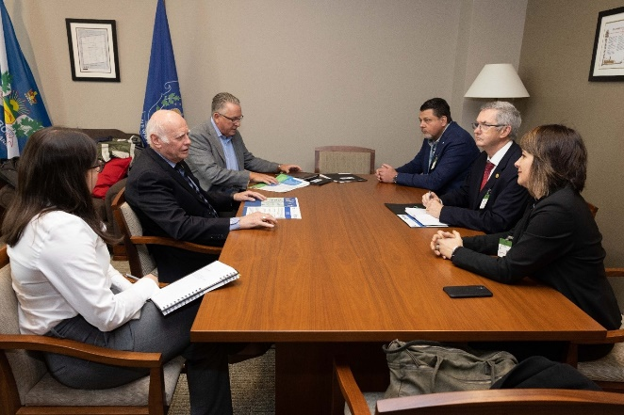
Government Affairs
The mission of ASHRAE’s Government Affairs office is to establish ASHRAE as a leading source for expertise in the built environment and a resource for policy-makers in the development of legislation and regulations affecting the public, the HVAC&R community, and the engineering profession.
Stay Informed with our bi-weekly Government Affairs Update.
Sign up at ashrae.org/newsletters
Government Outreach Events connect ASHRAE volunteers with elected officials, government agencies, and aligned organizations.
ASHRAE’s Public Policy Priorities:
  Support Sustainable Building Practices including Building Decarbonization to
  Mitigate Climate Change
  Promote Healthy Buildings and Reduce Indoor Environmental Risks
  Advance Design and Construction of Resilient Buildings and Communities
  Ensure the Orderly and Safe Phasedown of High-GWP HFC Refrigerants
  Support Adoption of the Latest Edition of ASHRAE’s Energy Standards into Building Codes
  Strengthen and Increase Diversity in the HVACR Workforce
South America
Canada
Canada
United States
South America
ashrae.org/government-affairs

Slide 31


ASHRAE Tech Hour and ASHRAE 365 App
Tech Hour videos are available within the ASHRAE 365 App. Tech Hour videos introduce the latest technical content presented by some of ASHRAE’s brightest minds. Participants may be eligible to receive one PDH.
  Tech Hour #1: Optimize Occupant Health, Building Energy Performance and Revenue through Indoor-Air Hydration
  Tech Hour #2: Where Have All the Ethics Gone?
  Tech Hour #3: Commissioning
  Tech Hour #4: Building EQ
  Tech Hour #5: Decarbonizing Healthcare
  Tech Hour #6: Emotional Intelligence
36,000+ downloads!
ASHRAE Events & Topical Conferences
Professional Development Resources
Volunteer and Member Resources
ashrae.org/365
ashrae.org/techhour

Slide 32

ASHRAE Foundation Scholarships
Society Scholarships
Chapter-Awarded Scholarships
Require a minimum of $100,000 for an individual to establish a named scholarship
Require a minimum contribution of $60,000 for chapters or regions
Selection criteria must be established in accordance with the ASHRAE Scholarship Program Guidelines
ASHRAE Scholarship Trustees select the scholarship recipients
Require a minimum contribution of $30,000
Scholarships can be funded through current fundraising efforts or with chapter assets
Chapters can establish the selection criteria
Chapters select the scholarship recipients
ASHRAE awards $450,000 in scholarships
each year!
foundation.ashrae.biz

Slide 33


Supporting ASHRAE’s Mission
ASHRAE’s Development Program is dedicated to seeking support for all aspects of ASHRAE’s mission. In addition, the ASHRAE Foundation, as an endowed trust, provides funding for professional development and research projects, it supplies qualified engineering students with much needed scholarship assistance, and provides grants to help support the Society’s vital work.
The Research Promotion Campaign supports ASHRAE Research, Education, YEA programs, Scholarships, Endowed Funds, the RP General Fund and Special Initiatives.
RP Campaign Total $2.7M
(Research, YEA, ALI, Scholarships, General)
$800,000 Raised for Endowments
$298,750 Awarded through 76 Scholarships
$50,000 Raised by College of Fellows and Life Members
Within the RP Campaign
$1.9M Raised for Research
$1M Given by ASHRAE
Regions, Chapters and Sections
*More than 5,000 contributions from Members, Corporations and other Organizations
ashrae.org/support

Slide 34
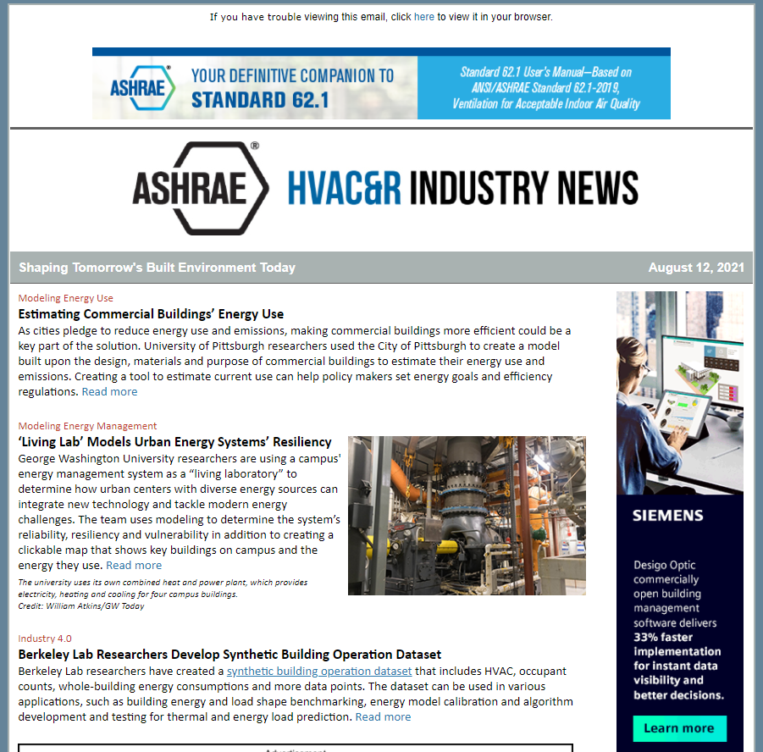
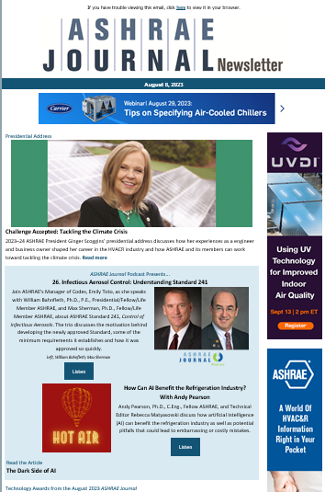
Society Newsletters
ASHRAE Journal and Insights | Government Affairs Update
HVACR Industry News | European Policy Update
High Performance Buildings (HPB) | Student News
Professional Development News | YEA Connection
Standards Actions Newsletter | Chapter Notes
Sign up at ashrae.org/newsletters
Notes:
Hello! Feel free to include the following comments about Chapter Notes
Chapter Notes is emailed monthly to: DRCs, RVC – MPs, Presidents, Vice Presidents, Newsletter Editors, Website Editors, MP Chairs/Co-Chairs, Want to subscribe or submit? Email marketing@ashrae.org
Toolkits to assist marketing Society Conferences, Annual Webcast, and more
Provides content for your Chapter/Region website and Newsletter
Need-to-know Society related updates and announcements for officers

Slide 35


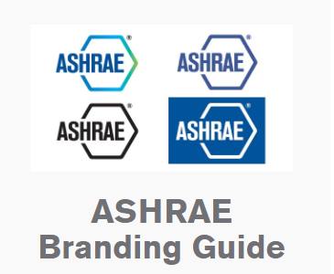
Marketing Central
Request promotional freebies
Shop the logo store
Order Chapter supplies
Created for the busy volunteer, Marketing Central is a single page resource for Society-related marketing materials.
Resources organized by file type:
Canva Templates
Forms
Logos
PDFs
PowerPoint Presentations
Templates
Toolkits
Tradeshows
Videos
Virtual Backgrounds
ashrae.org/marketingcentral

Slide 36
Questions & Comments
Questions?
Learn More at ashrae.org

