Slide 1

THIS IS
ASHRAE
Society Year 2025-2026
ashrae.org
August 2025
Notes:
Add tagline and HQ building

Slide 2


ASHRAE Overview
Mission
16 Regions
200+ Chapters
400+ Student Branches
To serve humanity by advancing the arts and sciences of heating, ventilation, air conditioning, refrigeration and their allied fields.
Vision
A healthy and sustainable built environment for all.
Industry Classification
      54,000+ Members
      130+ Countries
Consulting Engineers | Contractors | Manufacturers/Manufacturing Representatives
Government | Health & Education | Design Build | Architects
      100+ Standards
      and Guidelines

Slide 3

What We Do and How We Do It
33 Standing Committees
130+ Standards and
Guidelines Committees
100+ Technical Committees
300+ Publications
7 Certification Programs
200+ Educational Courses
Research
Scholarships
1.
  Serve as pipeline for providing technical information to members, chapters, companies and government officials
  Develop standards and technical guidelines to improve the built environment
  Offer continuing education for industry professionals
  Serve as networking tool for industry professionals
2.
3.
4.

Slide 4

Core Values: ASHRAE’s Foundation
ASHRAE's core values support its mission to advance HVAC&R for humanity's benefit and promote a sustainable built environment.
Learn more at
ashrae.org/corevalues

Slide 5
Key Policies Shaping Our Society
Value Statement
Code of Ethics Commitment
In ASHRAE meetings, we will act with honesty, fairness, courtesy, competence, inclusiveness and respect for others, which exemplify our core values of excellence, commitment, integrity, collaboration, volunteerism and diversity, and shall avoid all real or perceived conflicts of interest. Our culture is one of inclusiveness, acknowledging the inherent value and dignity of each individual. We celebrate diverse and inclusive communities, understanding that doing so fuels better, more creative and more thoughtful ideas, solutions and strategies for the Society and the communities our Society serves. We respect and welcome all.
We will act with honesty, fairness, courtesy, competence, inclusiveness and respect for others, which exemplify our core values of excellence, commitment, integrity, collaboration, volunteerism and diversity, and we shall avoid all real or perceived conflicts of interest.
ashrae.org/codeofethics
Commercialism
Harassment and Discrimination
ASHRAE’s Commercialism Policy allows for Society activities that fulfill the mission of technological advancement with adherence to business plans that generate income to offset operational expenses such as AHR Exposition, ASHRAE periodicals, website, and Society conference events such as the Welcome Party, luncheons, registration kits, and receptions.
ASHRAE strictly prohibits and does not tolerate discrimination against members or applicants for membership because of such individual’s race, color, religion, age, sex, sexual orientation, national origin, physical or mental disability, pregnancy, genetic information, veteran status, uniformed service member status, or any other category protected under applicable law.
ashrae.org/commercialism
ashrae.org/about/governance

Slide 6
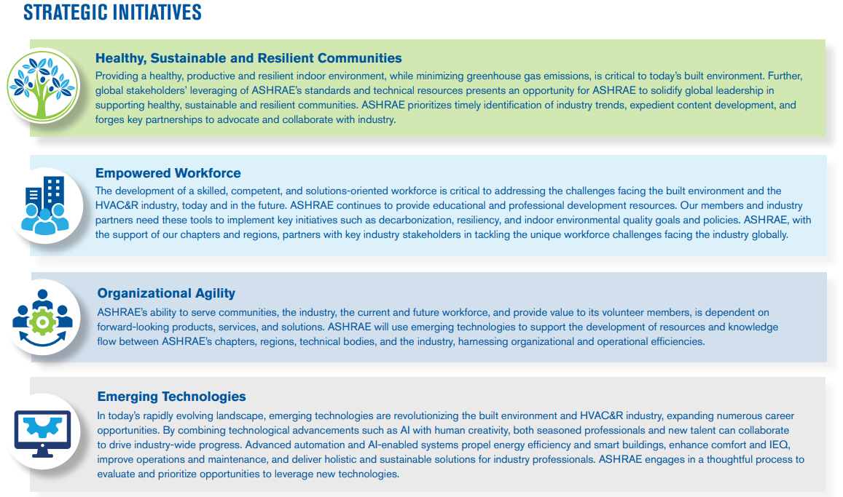
2025-28 ASHRAE Strategic Plan
Download in English and Spanish at ashrae.org/strategicplan
Notes:
The ASHRAE Strategic Plan identifies key priorities for the society over the next three years.
Outcomes
ASHRAE’s member and volunteer base maximizes the organization’s reach, foresight, leadership position, and organizational knowledge.
A broad group of stakeholders leverage ASHRAE's resources to make decisions and meet objectives that positively affect the environment.
A viable, thriving industry makes a positive global impact.
Key Enablers
Research: The value of ASHRAE’s resources is grounded in unbiased data, developed through rigorous research methods.
AI: The use of AI enables ASHRAE to improve data collection, automate internal operations, and promote agility.
Global Network: ASHRAE's global network convenes the industry to generate unparalleled knowledge and content.

Slide 7

Membership
TECHNICAL RESOURCES
ashrae.org/membership ​
Notes:
Free Winter or Annual Conference (within the first 24 months, NEW members only) = $900 average value
Free Handbook Online = $342
Free Annual Benefit Selection = up to $285
ASHRAE Journal Subscription = $95
Free STBE Access = $419
Member Access to Technology Portal (600+ ASHRAE Research Reports, 1700+ ASHRAE Journal articles archive) = $199
= $2,240 not including the Bookstore, Education, and Certification discounts.
For just $285 a year, the return on investment is certainly worth it. The best part of membership is free: A network of colleagues you can meet in your local chapter, at Technical Committee meetings, or conferences. Join today at join.ashrae.org.

Slide 8


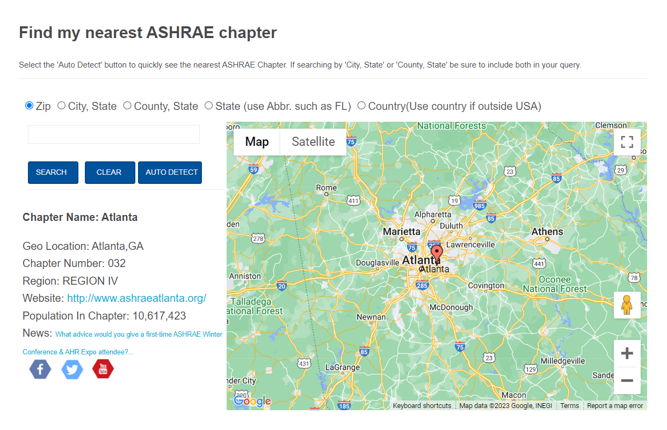
Where Can I Find My ASHRAE Chapter or Region?
Use the Chapters Map
ashrae.org/chapters

Slide 9
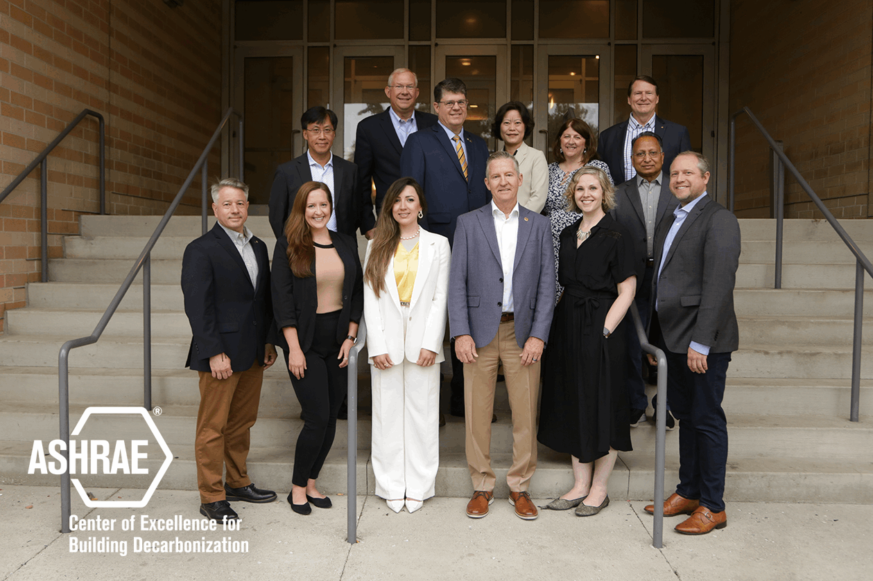
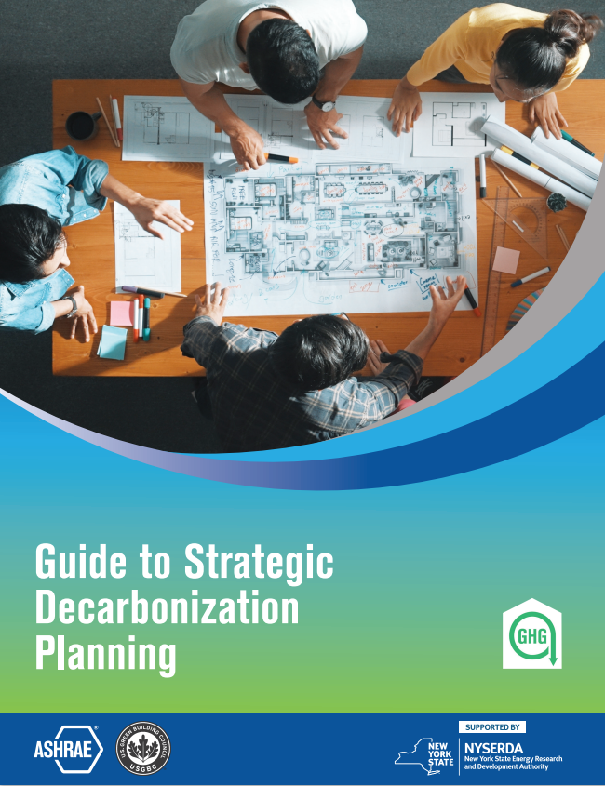
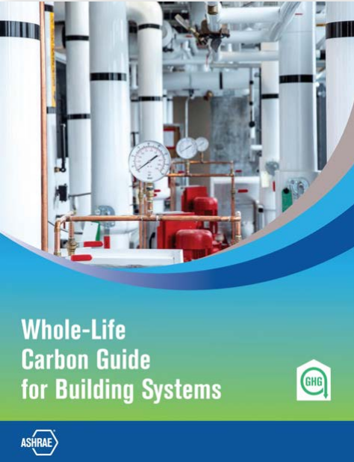

ASHRAE is Focused on Building Decarbonization
CONFERENCES
COMMUNITIES
MEMBERSHIP
Suite of Decarbonization Guides:
  Grid Interactive Buildings for Decarbonization Design
  Decarbonizing Hospital Buildings
  TM65 Addendum for North America with CIBSE
  Building Decarbonization Retrofits for Commercial & Multifamily Buildings
  Decarbonizing Building Thermal Systems: A Guide for Applying Heat Pumps & Beyond with NREL
Videos | Interviews | Publications | Education
Center for Excellence in Building Decarbonization (CEBD)
New Guides & eLearning Course
ashrae.org/decarb
Notes:
ASHRAE recognizes that the scope of building-related policies, programs and regulations needs to expand to incorporate deep energy efficiency improvements, beneficial electrification, demand flexibility, and whole building lifecycle greenhouse gas emission reductions.
To further the Society’s efforts, ASHRAE formed it’s first center of excellence – the “Center for Excellence in Building Decarbonization” (CEBD). The focus of the CEBD is to provide strategic direction on the ongoing efforts of ASHRAE to provide resources for decarbonizing the built environment, on a permanent basis.
ASHRAE’s building decarbonization webpage features resources, including technical guides, video, position documents, related events schedule and media features. Here are some of those resources:
Suite of Decarbonization Guides:
Grid Interactive Buildings for Decarbonization Design
Decarbonizing Hospital Buildings
TM65 Addendum for North America with CIBSE
Building Decarbonization Retrofits for Commercial & Multifamily Buildings
Decarbonizing Building Thermal Systems: A Guide for Applying Heat Pumps & Beyond with NREL
NEW! Whole Life Carbon Guide for Building Systems
NEW! Guide to Strategic Decarbonization Planning with USGBC

Slide 10

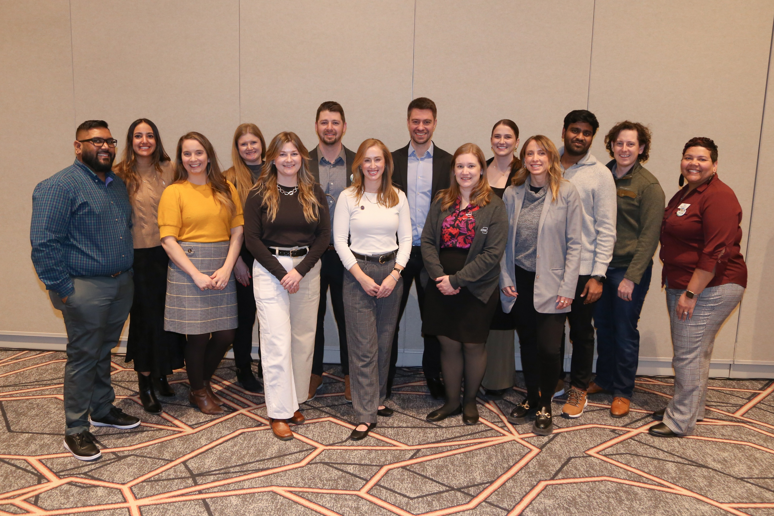
Empowering the Future
The Young Engineers in ASHRAE (YEA) committee focuses on offering relevant programs and services to young professional ASHRAE members, 35 years old and younger.
ASHRAE has a robust Student Program catering to the needs of students at every age. Resources for student members include:
YEA Leadership Weekends
Leadership U
YEA Decarbonization Challenge
YEA HVAC Design Essential Scholarships
Scholarships & Grants
Awards and Competitions
Student Branches
Student Store
ASHRAE also offers resources for K-12 volunteers and educators
ashrae.org/yea
ashrae.org/students
Notes:
A primary focus of the Young Engineers in ASHRAE committee is to attract and develop members for future membership and leadership in ASHRAE and the HVAC&R industry. This is done through an exciting range of events and programming such as:
YEA Leadership Weekends – which provides an opportunity for young engineers to learn more about the Society, develop soft skills and network with other professionals.
Leadership U – where YEA members shadow ASHRAE officers during the ASHRAE Winter and Annual Conferences. LeaDRS is an ASHRAE regional program similar to the Leadership U.
YEA Decarbonization Challenge – was created to align with ASHRAE’s focus on decarbonization. It is a year-long competitive fund ($1,000-$10,000) program granted within local chapters to implement decarbonization projects.
YEA HVAC Design Essentials Scholarships – offers YEA members free registration in ASHRAE’s HVAC Design training courses.
ASHRAE offers a wide variety of programs and resources for K-12 students and educators.

Slide 11
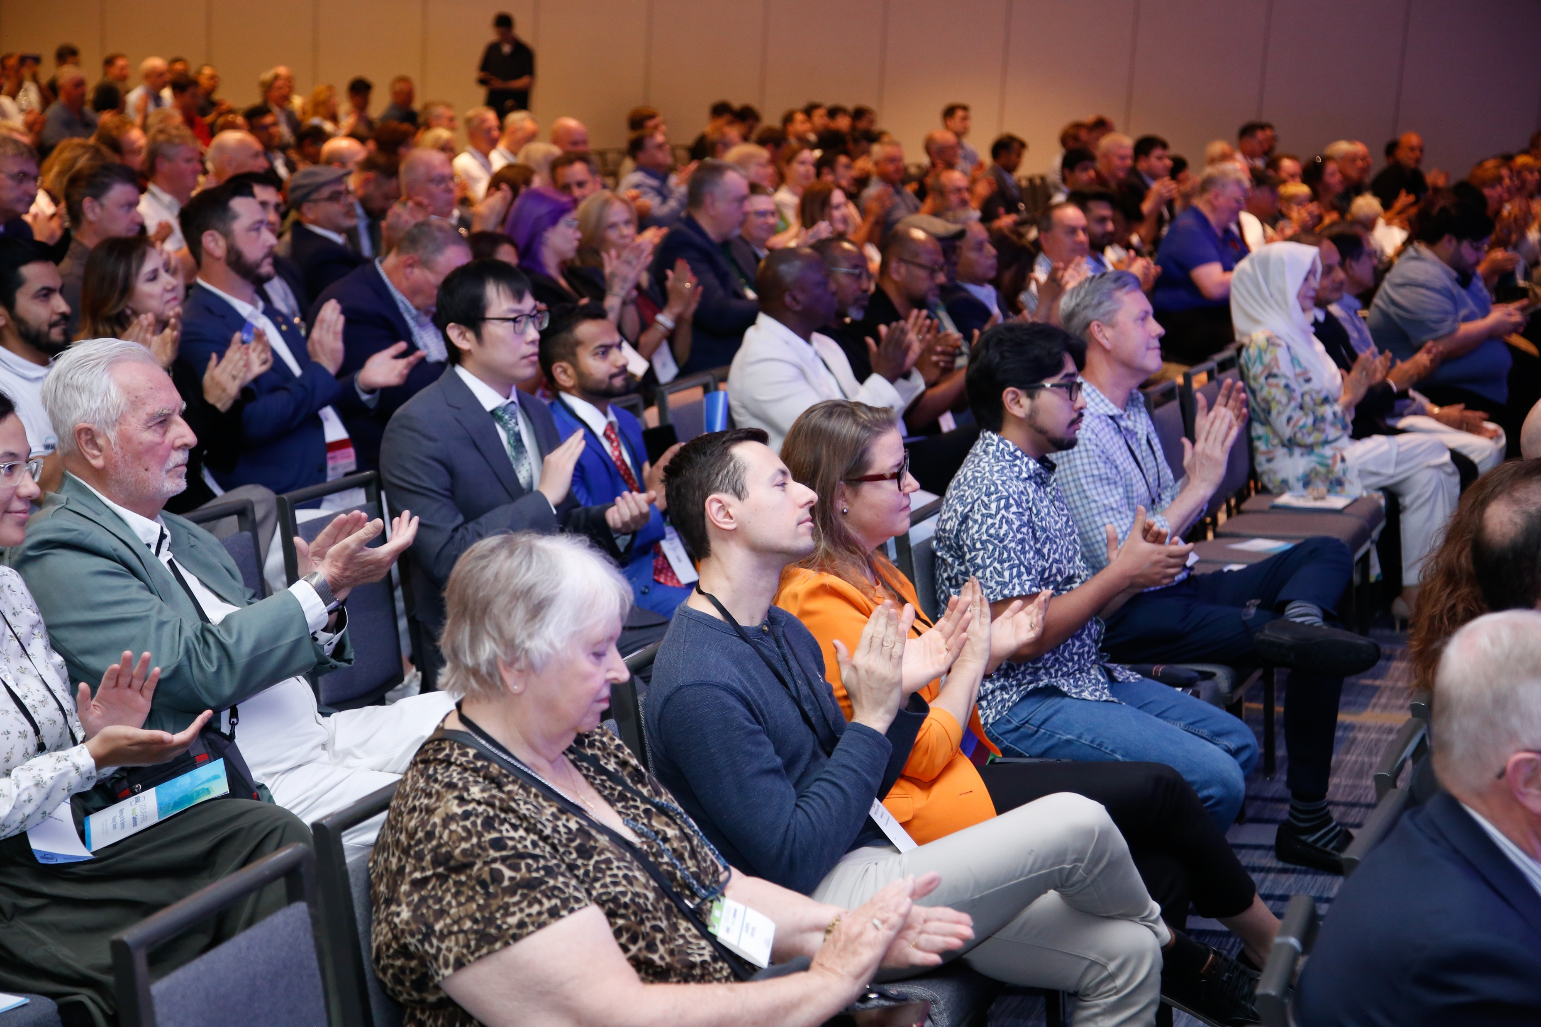
Connecting Minds at ASHRAE Conferences
ASHRAE conferences are tailored to different needs within the HVAC&R and building systems industries. Conferences feature peer-reviewed papers and presentations, and attendees earn professional development hours (PDHs).
Winter & Annual Conferences: ASHRAE major, flagship conferences on HVAC&R trends and research.
Topical Conferences: In-depth focus on specialized industry topics.
Chapter Regional Conferences (CRCs): Annual meetings hosted by ASHRAE’s global regions, providing members a regional platform to learn and network.
Endorsed Conferences: ASHRAE-supported events aligned with the Society’s mission.
ashrae.org/conferences
Notes:
ASHRAE Winter & Annual Conferences: These are the Society's two primary global conferences, attracting HVAC&R professionals, researchers, manufacturers, and policymakers to discuss the latest industry trends and research
Topical Conferences: These are specialized events focused on specific, current, and relevant themes within the HVAC&R and building sciences industries, offering in-depth exploration of a particular subject unlike the broader Winter and Annual conferences
Chapter Regional Conferences (CRCs): These are annual meetings hosted by ASHRAE's 16 global regions, providing members a regional platform to connect with peers and learn about recent industry developments at a local level
ASHRAE Endorsed Conferences: These are events not directly organized by ASHRAE but officially recognized and supported by the Society, signifying their alignment with ASHRAE's mission and technical interests within the HVAC&R field

Slide 12
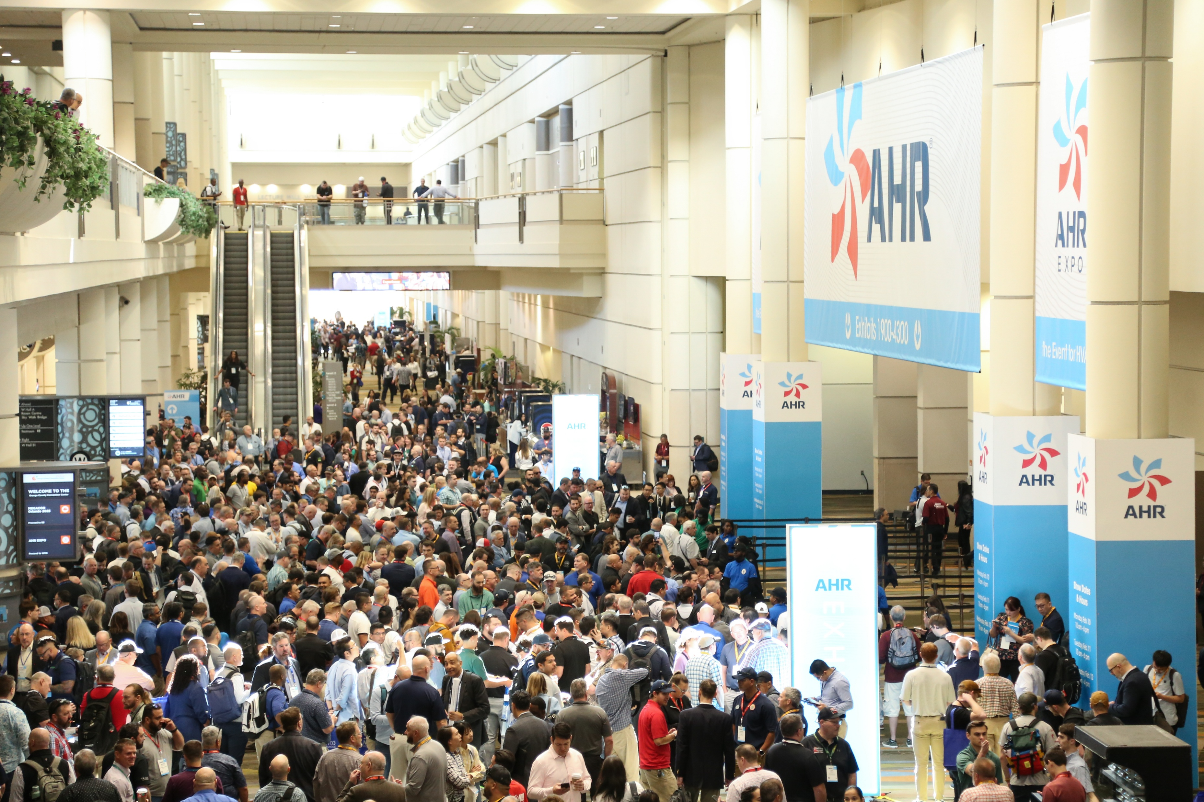





Showcasing Innovation at Leading Industry Tradeshows
ASHRAE is a prominent advocate and participant in industry events and tradeshows. The Society’s participation in these events signifies its commitment to fostering innovation and collaboration with leading industry organizations.

Slide 13



ASHRAE Journal
ASHRAE’s official monthly publication
Provides detailed insight on the latest HVACR technologies and applications for consulting engineers and professionals in the industry.
Articles are peer-reviewed and focus on technical topics, including green buildings, decarbonization, indoor air quality, energy management, thermal storage and alternative refrigerants.
Discussions with leading ASHRAE experts to expand knowledge in the HVACR
industry.
Brief talks with ASHRAE Journal authors on HVACR content published in the Journal.
ashrae.org/ashraejournal

Slide 14

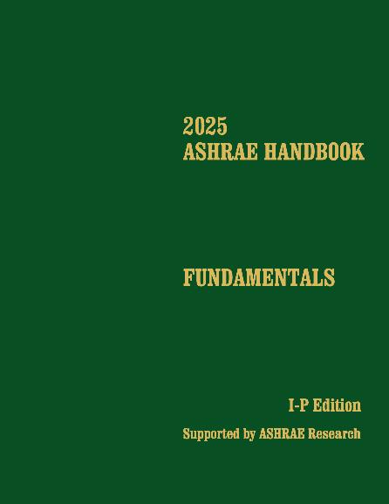
ASHRAE Handbook
ASHRAE Handbook – Print Version
Continuously refined and updated, ASHRAE has published its Handbook series since 1920s
Volumes cover HVAC&R fundamentals, systems, equipment
and a wide variety of applications
Handbooks are also available in the ASHRAE Technology Portal
Available in hardback, PDF, and as an interactive handbook online.
ASHRAE Handbook Online
Mobile device responsive
Content from all four current Handbook volumes plus extra features such as videos, animations, spreadsheets and more
Easier than ever to search across all volumes, print, ask questions about technical content, access bonus features and look up new terminology
Eligible ASHRAE members can choose an ASHRAE Handbook Online subscription at a discounted rate during membership renewal
ashrae.org/handbook
Notes:
The 2025 ASHRAE Handbook—Fundamentals covers basic principles and data used in the HVAC&R industry. Its more than 1,100 pages have been extensively updated and cover foundational concepts such as thermodynamics, psychrometrics, and heat transfer, and provide practical guidance on building envelopes, indoor environmental quality, load calculations, duct and piping system design, refrigerants, energy resources, sustainability, climate change, and more.

Slide 15
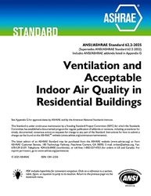
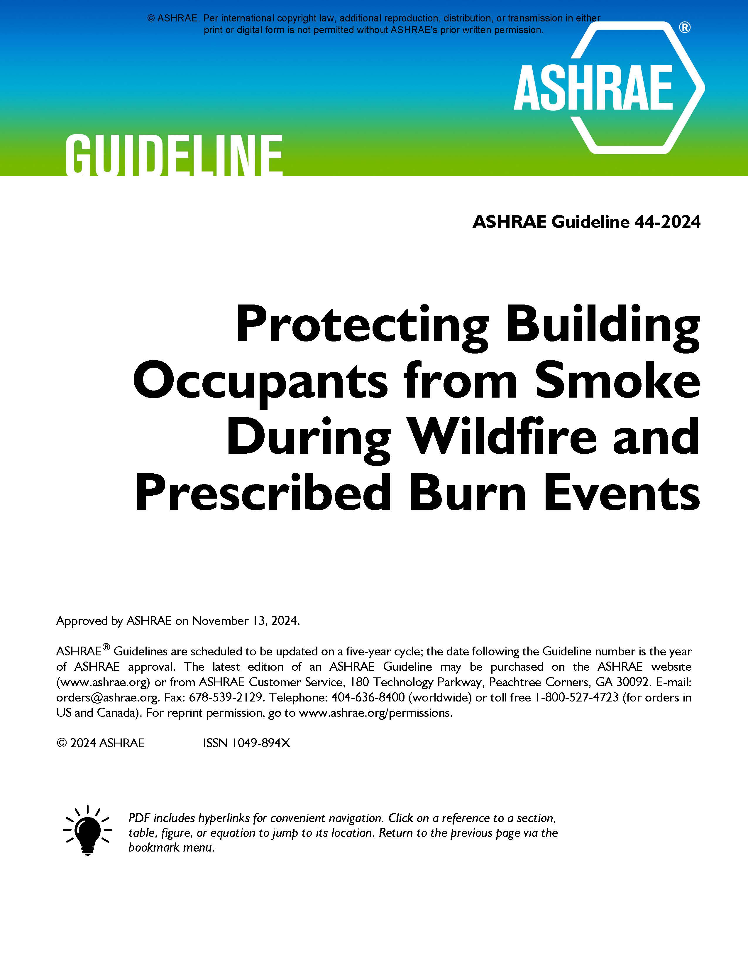
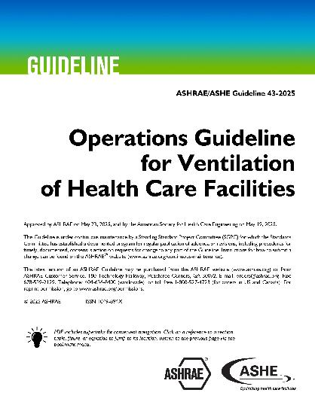
Well-Recognized Standards
PROFESSIONAL DEVELOPMENT
MEMBERSHIP
ASHRAE Standard 15, Safety Standard for Refrigeration Systems and Designation and Classification of Refrigerants
ASHRAE Standard 90.1, Energy Standard for Sites and Buildings Except Low-Rise Residential Buildings
ASHRAE Standard 62.2, Ventilation and Acceptable Indoor Air Quality in Residential Buildings
ASHRAE Standard 34, Designation and Safety Classification of Refrigerants
ASHRAE Standard 55, Thermal Environmental Conditions for Human Occupancy
ASHRAE Standard 62.1, Ventilation for Acceptable Indoor Air Quality
ASHRAE Standard 188, Legionellosis: Risk Management for Building Water Systems
2021 International Green Construction Code (IgCC): Powered by ASHRAE/ICC/USGBC/IES Standard 189.1-2021
ASHRAE Standard 241, Control of Infectious Aerosols
New Edition
Wildfire Resource
New Guideline
ashrae.org/bookstore
Notes:
Standard 241: establishes minimum requirements aimed at reducing the risk of disease transmission through exposure to infectious aerosols in new buildings, existing buildings, and major renovations. Now available in Spanish!
ASHRAE Guideline 44-2024, Protecting Building Occupants From Smoke During Wildfire and Prescribed Burn Events, outlines best practices for building design, operation and maintenance to reduce the health risks associated with prolonged exposure.
New Guideline:
ASHRAE/ASHE Guideline 43-2025, Operations Guideline for Ventilation of Health Care Facilities
ASHRAE Guideline 43 provides recommendations for the operation of HVAC systems that provide environmental control in health care facilities for the safety and comfort of health care facility occupants.

Slide 16
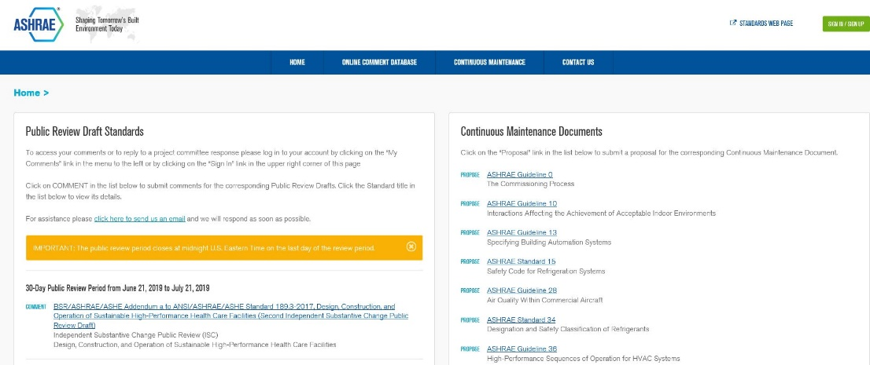
What is the Online Standards
Review Database?
The Online Standards Review Database allows
access to public review drafts for standards, guidelines and addenda and to submit comments.
The system offers a dashboard which highlights items that require attention, provides quick links to individual and committee comments, continuous maintenance proposals and outstanding ballot results.
Updated and Improved
ashrae.org/publicreviews
Developing standards since 1922
130+ active standard or guideline projects
Standards are reviewed and republished to ensure they are up-to-date, e.g., existing code-intended standards are on a three-year review cycle
ashrae.org/standards
Notes:
All standards go through public review and comment.
Existing standards are reviewed every three years.
Standards that are on continuous maintenance are republished with new addenda every three years.
Code utilized standards are republished every three years

Slide 17
Consider Participating in an ASHRAE Technical Committee
What do Technical Committees do?
Prepare the text of ASHRAE Handbook chapters
originate, coordinate, and supervise Society-sponsored research projects
present programs at ASHRAE meetings
review technical papers
evaluate the need for standards
Advise the Society on all aspects of the technology it embraces
Technical Committee Sections:
Section 1.0 - Fundamentals and General
Section 2.0 - Environmental Quality
Section 3.0 - Materials and Processes
Section 4.0 - Load Calculations and Energy Requirements
Section 5.0 - Ventilation and Air Distribution
Section 6.0 - Heating Equipment, Heating and Cooling Systems and Applications
Section 7.0 - Building Performance
Section 8.0 - Air-Conditioning and Refrigeration System Components
Section 9.0 - Building Applications
Section 10.0 - Refrigeration Systems
Network, give back and learn. ashrae.org/tcs
Notes:
ASHRAE Technical Committees consist of people who have a recognized proficiency in a specific field of interest. Participation in ASHRAE activities is an excellent way to advance your career – technically, personally, and from a business perspective. If you are involved in the HVAC&R field, or a closely related field, ASHRAE is the go-to organization for professional advancement.
Help ASHRAE shape the industry, advance research, and disseminate critical information.

Slide 18
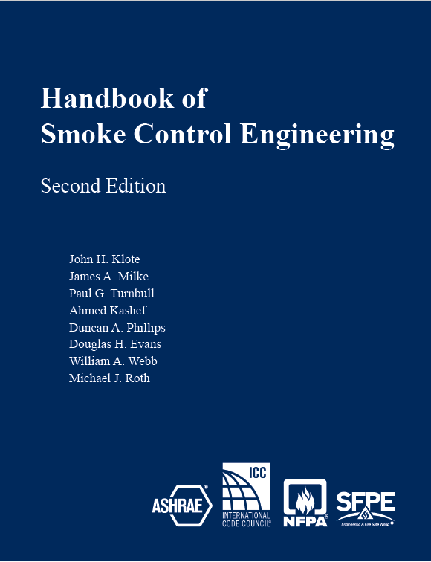
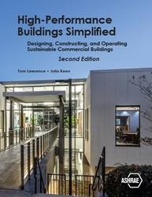

Find Thousands of Publications in the Bookstore
PROFESSIONAL DEVELOPMENT
CONFERENCES
MEMBERSHIP
Get the Latest and most Popular ASHRAE Publications
ashrae.org/bookstore
Notes:
The ASHRAE Bookstore is your go-to resource for industry-leading publications on HVAC&R, building design, energy efficiency and sustainability. Offering a wide range of technical standards, guidelines and educational materials, the bookstore supports professionals at every stage of their careers. Whether you're looking for the latest ASHRAE Standards, comprehensive handbooks or practical guides, the ASHRAE Bookstore has the tools you need to excel in the built environment industry.
Here are some of the latest titles.
Lucy Goes Green
In the second ASHRAE children’s book, Lucy goes with her classmates on a field trip to a sustainable farm, where they learn about using solar panels and windmills and conserving water through rainwater collection.
High-Performance Buildings Simplified
Explore the intricacies of high-performance building design with the newly updated edition of High-Performance Buildings Simplified. Designed for both engineering students and early career professionals, this comprehensive book offers a clear, accessible approach to the fundamental principles of sustainable building practices.
Handbook of Smoke Control Engineering, Second Edition
The most exhaustive and complete treatment of smoke control and related topics in the United States. This handbook is essential for practicing engineers designing smoke control systems or conducting related analyses because it collects all of the necessary information into a single resource of smoke control knowledge.

Slide 19
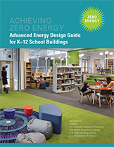
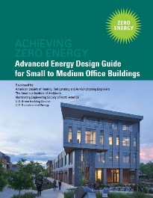


Blueprints for Energy Efficient Building Design
Advanced Energy Design Guides are published in coordination with partners to promote building efficiency.
Building-specific guidance that addresses various project aspects with multiple strategies that move the building design incrementally toward the zero-energy goal.
Zero energy goals and strategies will also move buildings towards decarbonization.
Advanced Energy Design Guide for K-12 School Buildings – Achieving Zero Energy
Applicable to all sizes and types of K-12 school construction.
Advanced Energy Design Guide for Small to Medium Office Buildings – Achieving Zero Energy
Applicable to office buildings 10,000 to 100,000 ft² with a building height of less than 75 feet.
Advanced Energy Design Guide for Multifamily Residential Buildings – Achieving Zero Energy
Applicable to construction of new multifamily buildings covered by ANSI/ASHRAE/IES Standard 90.1
ashrae.org/freeaedg
Notes:
The ASHRAE Advanced Energy Design Guides (AEDGs) are a series of publications that provide practical recommendations for achieving significant energy savings in various types of buildings. Developed in collaboration with industry experts, these guides offer strategies that are both cost-effective and easy to implement, with the goal of helping design teams create buildings that use 50% or 30% less energy than typical buildings. The AEDGs cover a wide range of building types and climates, making them valuable resources for architects, engineers and other professionals committed to sustainable design and energy efficiency.

Slide 20


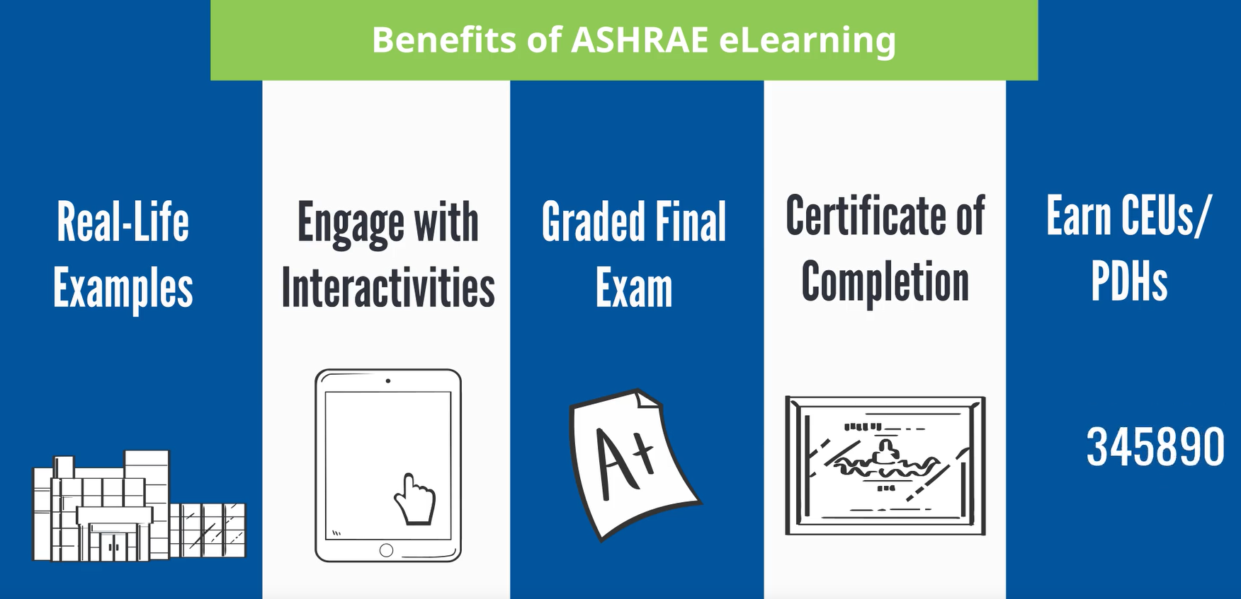
Stay Ahead of the Curve With
ASHRAE Professional Development
Sign up for the latest offerings
MEMBERSHIP
ASHRAE offers a wide range of professional development opportunities to ensure that professional remain at the forefront of industry advancements and best practices.
In-person and group training for companies and Chapters is available.
ashrae.org/education
eLearning
ASHRAE Learning Institute
Certification
7 Certifications​
Over 90 eLearning courses available
Notes:
ASHRAE's Professional Development programs provide industry-leading opportunities to enhance your career in HVAC&R and building sciences. Offering a variety of resources—including eLearning courses, certifications and hands-on instructor-led training—ASHRAE helps professionals stay ahead of the curve in technological advancements and industry best practices. Whether you aim to sharpen your technical expertise, develop leadership skills, or stay current with the latest standards, ASHRAE's comprehensive professional development offerings are designed to empower you to achieve your career goals and make a meaningful impact on the built environment.

Slide 21
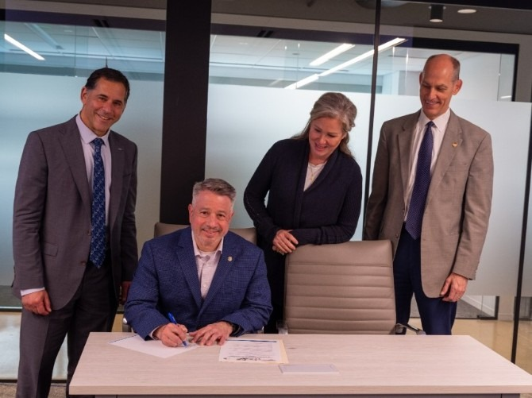
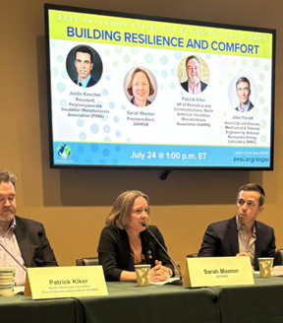
Shaping Policy with
ASHRAE Government Affairs
The mission of ASHRAE’s Government Affairs office is to establish ASHRAE as a leading source for expertise in the built environment and a resource for policy-makers in the development of legislation and regulations affecting the public, the HVAC&R community, and the engineering profession.
Stay Informed with our bi-weekly Government Affairs Update.
Sign up online ashrae.org/newsletters or email GovAffairs@ashrae.org
South America
Government Outreach Events connect ASHRAE volunteers with elected officials, government agencies, and aligned organizations.
ASHRAE’s Public Policy Priorities:
  Support Sustainable Building Practices including Building Decarbonization to
  Mitigate Climate Change
  Promote Healthy Buildings and Reduce Indoor Environmental Risks
  Advance Design and Construction of Resilient Buildings and Communities
  Ensure the Orderly and Safe Phasedown of High-GWP HFC Refrigerants
  Support Adoption of the Latest Edition of ASHRAE’s Energy Standards into Building Codes
  Strengthen and Increase Diversity in the HVACR Workforce
Canada
Canada
United States
South America
ashrae.org/government-affairs

Slide 22




Stay Current with the ASHRAE 365 App
ASHRAE 365 is a free app providing year-round
updates on all things ASHRAE. Download in your app store.
Learn more at ashrae.org/365.
Notes:
Home section where you can view the latest alerts, current promotions, and set up your personalized My Shortcuts to access the information most important to you.
Events section where you can find information on ASHRAE Conferences, Chapters Regional Conferences, Topical Conferences, Events Calendars, and Virtual Conferences as well as access exclusive technical content from ASHRAE Tech Hour.
Connect section providing notifications and news pertinent to the Society and quick access to all of ASHRAE’s social media. Ability to direct message with fellow conference attendees.
Membership & Support section offering leadership information, ASHRAE Chapter details, Distinguished Lecturers program resources, information on how to support the Society through donations or volunteering, and how to get in touch.
Resources section with access to ASHRAE volunteer resources, Standards and Guidelines information, continuing education courses as well as search features for industry jobs and materials to help you engage others with ASHRAE.

Slide 23


You Can Help Support ASHRAE’s Mission
ASHRAE Development supports
Technical Research
Programs for Young Engineers in ASHRAE (YEA)
Courses for ASHRAE Learning Institute (ALI)
Scholarships
General fund
Fundraising Totals for SY 2024-25
$4.825M
Learn More and Donate at ashrae.org/development
Notes:
ASHRAE's mission is supported through donations that fund both development and research promotion efforts. Donations help technical research, education and professional development, scholarships and other efforts that drive innovation in HVAC&R technologies and practices. By supporting these areas, donations enable ASHRAE to advance industry knowledge, improve practices, and promote sustainable and efficient HVAC&R solutions.

Slide 24
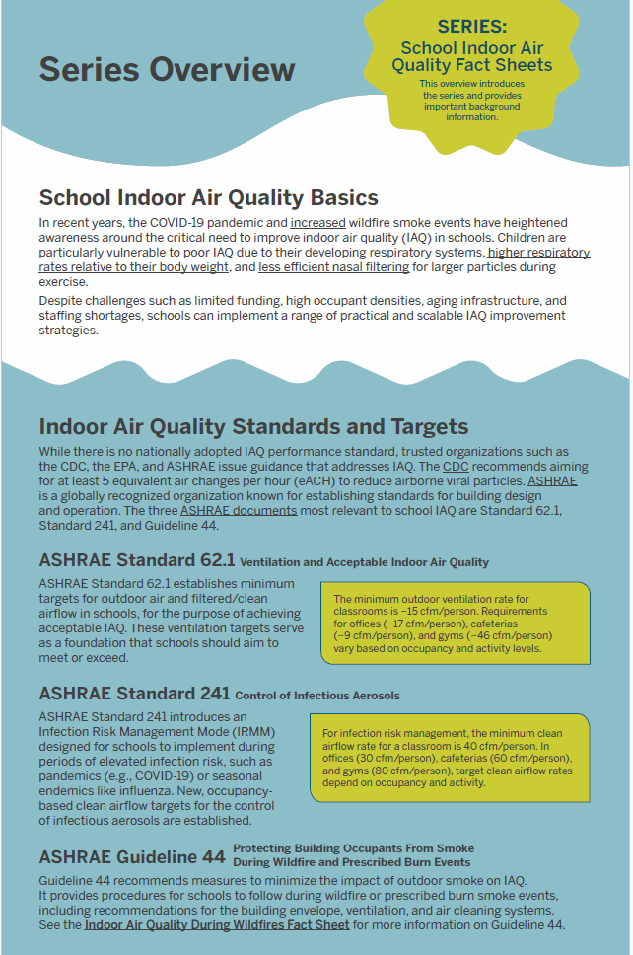


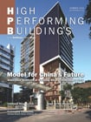

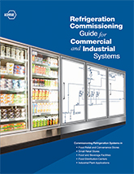

Find Resources and Stay In the Know
Get FREE resources for professionals, educators and consumers at ashrae.org/freeresources
Sign up to get ASHRAE Newsletters for the latest Society and industry updates at ashrae.org/newsletters

Slide 25
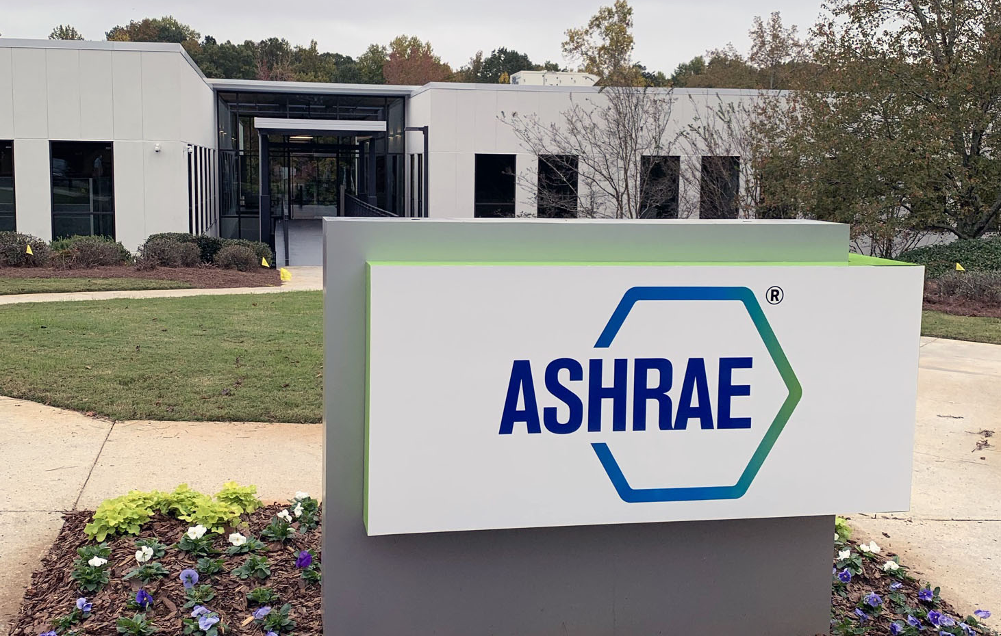




Connect With Us
ASHRAE Global Headquarters
180 Technology Parkway, Peachtree Corners, GA
ashrae.org

