Slide 1
Chapter President and President-Elect Training

Slide 2
Duties of the President – Chapter Operations
The president shall be responsible for the conduct and supervision of all activities of the chapter during his/her term of office, all in accord with the bylaws of the Society and the chapter
The president will be expected to preside at all meetings of the chapter and of the chapter's Board of Governors
As soon as possible after being elected, and prior to the first chapter meeting of the year, the president should call a meeting of the Board of Governors and invite members of the previous Board and committee chairs

Slide 3
Duties of the President – Chapter Operations, continued
At this first meeting, review the Manual for Chapter Operations (MCO) to ensure that all officers and committee chairs are familiar with their duties and explain any special assignments
Use the MCO: https://www.ashrae.org/communities/chapters/ashrae-chapters/manual-for-chapter-operations
Develop a chapter calendar for your year

Slide 4
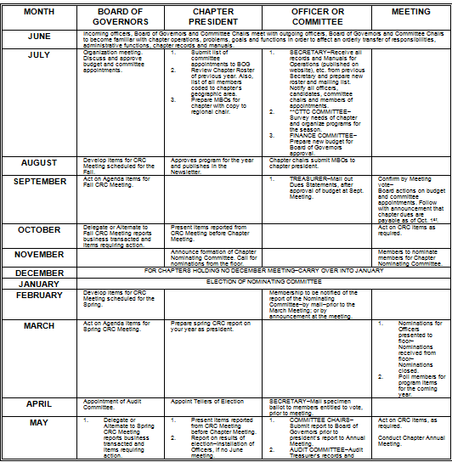
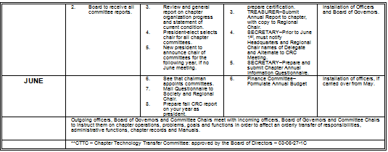
MCO Appendix 1A: Suggested Chapter Operations Calendar

Slide 5
Chapter Information Questionnaire (CIQ)
Provides Officer information for your Chapter
Review your current CIQ to make sure it is up-to-date and correct
Complete the CIQ for the following year
  30 days prior to CRC for spring CRCs
  June 1 for fall CRCs

Slide 6
Chapter Meetings
The hub of chapter activities is the monthly meeting
Crucial to member attendance and engagement
Officers and committee members should ensure
    meetings are interesting, instructive, and fun
    members, guests, and prospects feel welcome and “at home”

Slide 7
Meeting Minutes
Formal minutes of each chapter's regular and Board of Governors meetings are to be sent monthly by the secretary to the Regional Chair and the Regional Vice Chair of Chapter Technology Transfer within three weeks of the meeting
  See Section 7 of the MCO

Slide 8
Chapter Elections – Nominating Committee
Duties of Nominating Committee: The Nominating Committee shall select from the members eligible to hold office one candidate for each office except President, and for each member to be elected to the Board of Governors and shall obtain from each candidate a written statement that the candidate is a member in good standing in the Society and consents to stand for election. Not less than thirty (30) days before the April meeting the Nominating Committee shall present to the Secretary the names of the candidates selected, together with their statements.
  See Appendix 2I of the MCO

Slide 9
Chapter Elections – Secretary
Duties of Secretary: Upon receipt of names from the Nominating Committee, the Secretary shall prepare a list of the candidates and shall forward such list to all members with voting rights at least ten (10) days prior to such meeting
Nominations may be taken from the floor
If more than one candidate is nominated for an office, a ballot shall be prepared

Slide 10
Chapter Elections – Determining Winners
For offices with multiple nominations, a simple majority shall determine the winner
If there are no opposition candidates for any office, a vote by the eligible voting members at the meeting to accept the slate of officers will deem them duly elected

Slide 11
Installation of Chapter Officers and Board of Governors
Installation should take place at the last Chapter meeting prior to the start of the new society year (July 1)
  See Installation Guidelines in Appendix 1E of the MCO

Slide 12
Liability Insurance and Special Events
ASHRAE provides Comprehensive General liability insurance for Chapters in the U.S. and Canada. These Chapters do *not* need to obtain their own general liability insurance for most regular activities. This policy covers all members of the Chapters, but only with respect to their liability for activities of the Chapter.
Special Events, especially those involving water craft, contact sports, go-kart racing, ax throwing and other activities that carry risk of harm, must be covered by an additional policy paid for by the Chapter.
Contact Tammy Catchings (tcatchings@ashrae.org) at Society Headquarters prior to any special event to see if your chapter needs additional coverage.

Slide 13
IRS Reports
Chapters annual tax returns are due by November 15
Generally form 990 or 990 EZ
  See guidance in Appendix 4B of the MCO

Slide 14
State Registration as a Fund Raising Organization
THIS REGISTRATION IS MANDATORY TO MAINTAIN ASHRAE’S NON-PROFIT STATUS
Make sure your registration is completed
Contact Kirstin Pilot (kpilot@ashrae.org) at Society Headquarters if you have questions

Slide 15
Raffles and Local Gambling Laws
Chapters conducting raffles needs to check on local gambling laws to ensure they do not endanger Society’s not-for-profit status.
Review Event Hosting Vendor policies.

Slide 16
Presidential Award of Excellence (PAOE)
A new PAOE letter is sent each year by the incoming Society President
The PAOE points change each year to reflect the President’s focus
The purpose is to clearly define activities that promote successful Chapter activities that benefit your members; it is intended to be a tool for Chapters to use in defining what Chapters accomplish
Chapter Officers have overall responsibility for entering PAOE points, however some are entered by Committee Chairs, some by the DRC, and some by ASHRAE staff (Research Promotion)
The current PAOE structure always is available at
https://www.ashrae.org/communities/chapters/ashrae-chapters/presidential-award-of-excellence-paoe

Slide 17
Director and Regional Chair (DRC)
The DRC is your immediate “boss” in the ASHRAE hierarchy; you are directly responsible to the DRC for the operations of your Chapter
The DRC provides advice and information
The DRC will maintain a close relationship with you and will help you plan your year, set your objectives, make sure you stay focused on your plans, and offer guidance as necessary
The DRC is your Chapter’s voice to Society’s Board of Directors (BOD)

Slide 18
Region Members Council Representative (RMCR)
The RMCR represents your Region on Members Council
Each Region defines the relationships among its DRC, RMCR, and Chapter Presidents

Slide 19
Chapters Regional Conference (CRC) – Structure
A CRC is held annually in each Region; sometimes two Regions will agree to have a joint CRC
Each Chapter is represented by a Delegate and an Alternate
  Delegate: President, President-Elect, or Immediate Past President
  Alternate: Member of Board of Governors, preferably a Chapter Officer
All Regional Officers and Regional Vice Chairs (RVCs) attend the CRC; also in attendance will be an Officer of Society and a member of ASHRAE staff
The DRC is the Chair of all business meetings
Attendance is mandatory

Slide 20
Chapters Regional Conference (CRC) – Reports
Chapters report their activities for the previous Society Year and establish goals for the coming year
Regional officers report their activities and plans
Chapter Delegates submit motions for review and discussion
Society Officers inform the Region of Society plans, review Chapter activities within the Region, and participate in workshops
Chapter Delegates present nominees for Society and Regional positions and candidates for honors and awards
Staff representatives provide an overview of the staff structure and a few highlights of activities

Slide 21
Chapters Regional Conference (CRC) – Activities
Providing a forum for conducting Regional business
Conducting Chapter workshops that educate and prepare Officers and Committee Members to fulfill their responsibilities
Offering technical sessions on subjects that will educate as well as increase attendance
Recognizing Chapter and Region award winners and presenting awards to them
Providing social activities that increase attendance and promote camaraderie
HAVING FUN!

Slide 22
Chapter President – Society Core Values and Policies
As Chapter President, you are expected to promote ASHRAE’s Core Values and enforce Society Policies.
    Walk the Talk!

Slide 23
ASHRAE’s Core Values
Every ASHRAE member is expected to uphold these values
  Excellence
  Commitment
  Integrity
  Collaboration
  Volunteerism
  Diversity
https://www.ashrae.org/about/ashrae-s-core-values

Slide 24
ASHRAE Commercialism Policy
Make sure your Chapter Programs Chair is familiar with the policy
Make sure speakers are aware of the policy before the meeting
  ASHRAE Commercialism Policy and Guidelines | ashrae.org

Slide 25
ASHRAE Privacy Policy
Make sure your Chapter Officers are familiar with the policy
Comply with the Policy to avoid legal liability
  https://www.ashrae.org/about/governance/privacy-policy

Slide 26
ASHRAE Discrimination and Harassment Policy
Enforce the Policy in all Chapter activities
Cultivate a culture of inclusion and sense of safety for everyone
Comply with the Policy to avoid legal liability
  https://www.ashrae.org/about/governance/ashrae-discrimination-and-harassment-policy

Slide 27
ASHRAE Discrimination and Harassment Policy – Excerpt 1
  ASHRAE strictly prohibits and does not tolerate discrimination against members or applicants for membership because of such individual’s race, color, religion, age, sex, sexual orientation, national origin, physical or mental disability, pregnancy, genetic information, veteran status, uniformed service member status, or any other category protected under applicable law. ASHRAE also prohibits unlawful harassment based on any of the aforementioned legally protected categories. Examples of prohibited harassment include, but are not limited to, abusive language, slurs, jokes, or other verbal or physical conduct relating to an individual’s membership in a legally protected category.

Slide 28
ASHRAE Discrimination and Harassment Policy – Excerpt 2
  An intimidating, hostile, or offensive environment may be created by such circumstances as pressure for sexual activities, unwanted and unnecessary physical contact with another member, verbal abuse of a sexual nature, the inappropriate use of sexually explicit or offensive language in discussions with, or to describe, an individual, or the display of sexually suggestive objects or pictures. Conduct prohibited by this policy includes many forms of offensive behavior and includes gender-based harassment of a person of the same sex.

Slide 30

Thank You!

