Slide 1
How To Get the Most Out of Volunteers

Slide 2
Motivation…
You don’t actually “motivate” people… people motivate themselves…
BUT you can create a climate where they will perform

Slide 3
What motivates us?
Surprisingly….it’s not money so much.
Money is important….more as a deterrent for performance than an enhancer of performance….
The Candle on the wall test….

Slide 4
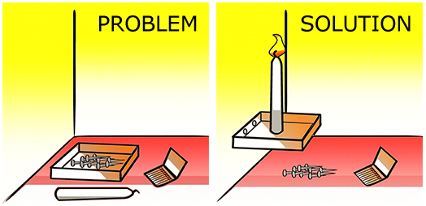
The Candle on the wall test…

Slide 5
Getting people to do it faster…
When you promised $$$ for the fastest results, the subjects were SLOWER to find the solution
Money (or the lure of more money) actually made them less focused on the problem
This was done all over the world with large sums of money
It’s as if more money was a deterrent.
More money works for repetitive, menial, brainless tasks….but we do very few of those at ASHRAE….

Slide 6
Money is important
If you don’t pay people enough, they will spend too much time complaining about their pay and not enough time working.
Paying them more will not make them work better or faster; that’s a fact.
The good news for us….we are dealing with unpaid volunteers.

Slide 7
What Can You Do to Get More Out of Your Volunteers?
3 things:
Autonomy
Mastery
Purpose

Slide 8
Autonomy
When you task someone, make sure they know that they are in charge of finishing it
“Bob, you have everything you need to get this done, right? Alright… you are the man! This thing is YOUR baby!”
Don’t micromanage
Create expectations based on your trust of the volunteer

Slide 9
Mastery
Make sure they CAN do the assignment.
Pick the right people.
Train/coach if you have to.

Slide 10
Purpose
Clarify expectations
Provide context
Think ‘big picture’
Don’t assume the purpose is known….be abundantly clear.

Slide 11
An example of Purpose…
Drawings and Specs…
Very detailed
But the big picture is sometimes inferred, not stated
The contractors often have to guess at the designer’s intent, based on the clues in the drawings and specs
It would be so much easier if the designer stated clearly what he/she wanted in the first few pages of the bid package, no?

Slide 12
Some specifics about ASHRAE
When you ask for volunteers: be specific
“Hey Jane, I’d like you to be on the Membership Promotion Committee, you’d be working with Bob, Betty and Bill. We actually want you to be our YEA chair and organize 3 events for YEA members this year…”
Target the members you want to volunteer
A general announcement in the newsletter rarely gets folks to step up and volunteer
Draw a list of people who should be volunteers

Slide 13
Questions…?

