Slide 1
SAC - SUSTAINABLE COMMUNITY PROJECT
Thanks to the SAC ASHRAE Board & Membership for their support

Slide 2
SAC - SUSTAINABLE COMMUNITY PROJECT
ASHRAE’s Community Sustainably Project program encourages members and chapters to examine ways to get more involved in their local communities. The program was designed to share the knowledge of members to improve the world around them.
The program was started in 2012-13 by Presidential Member Tom Watson, as part of his theme, Broadening ASHRAE’s Horizons.
This is our 5th Project and second at KCC Camp Kindle

Slide 3
PAST SAC - SUSTAINABLE COMMUNITY PROJECTS
SAC provided a complete furnace replacement for the KCC Program Manager’s Residence.
SAC members are providing commissioning support for new offices.
SAC has also supported 2 projects for the Boys & Girls. Club Treehouse Apartment glycol pump modification and furnace replacement at there offices.
SAC also provided funding for HVAC upgrades to YMCA Sheriff King Home ( Women’s Shelter).

Slide 4
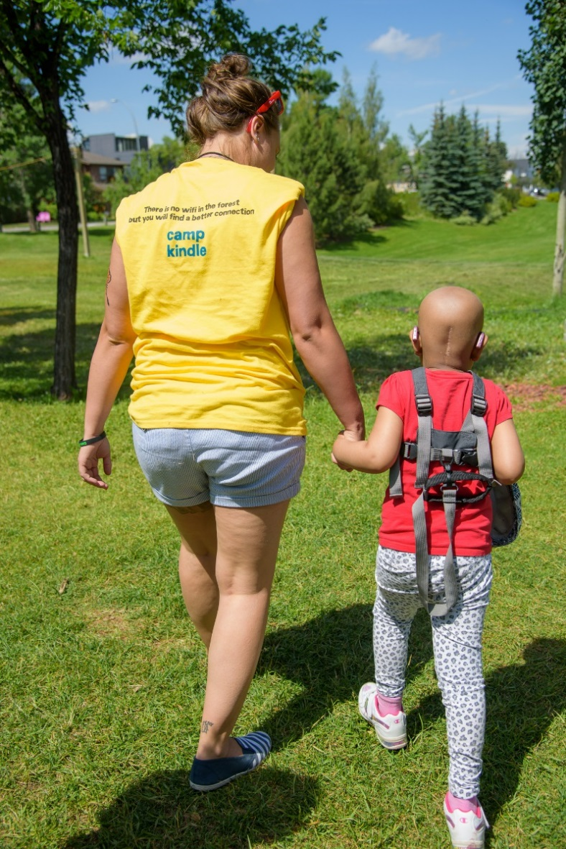
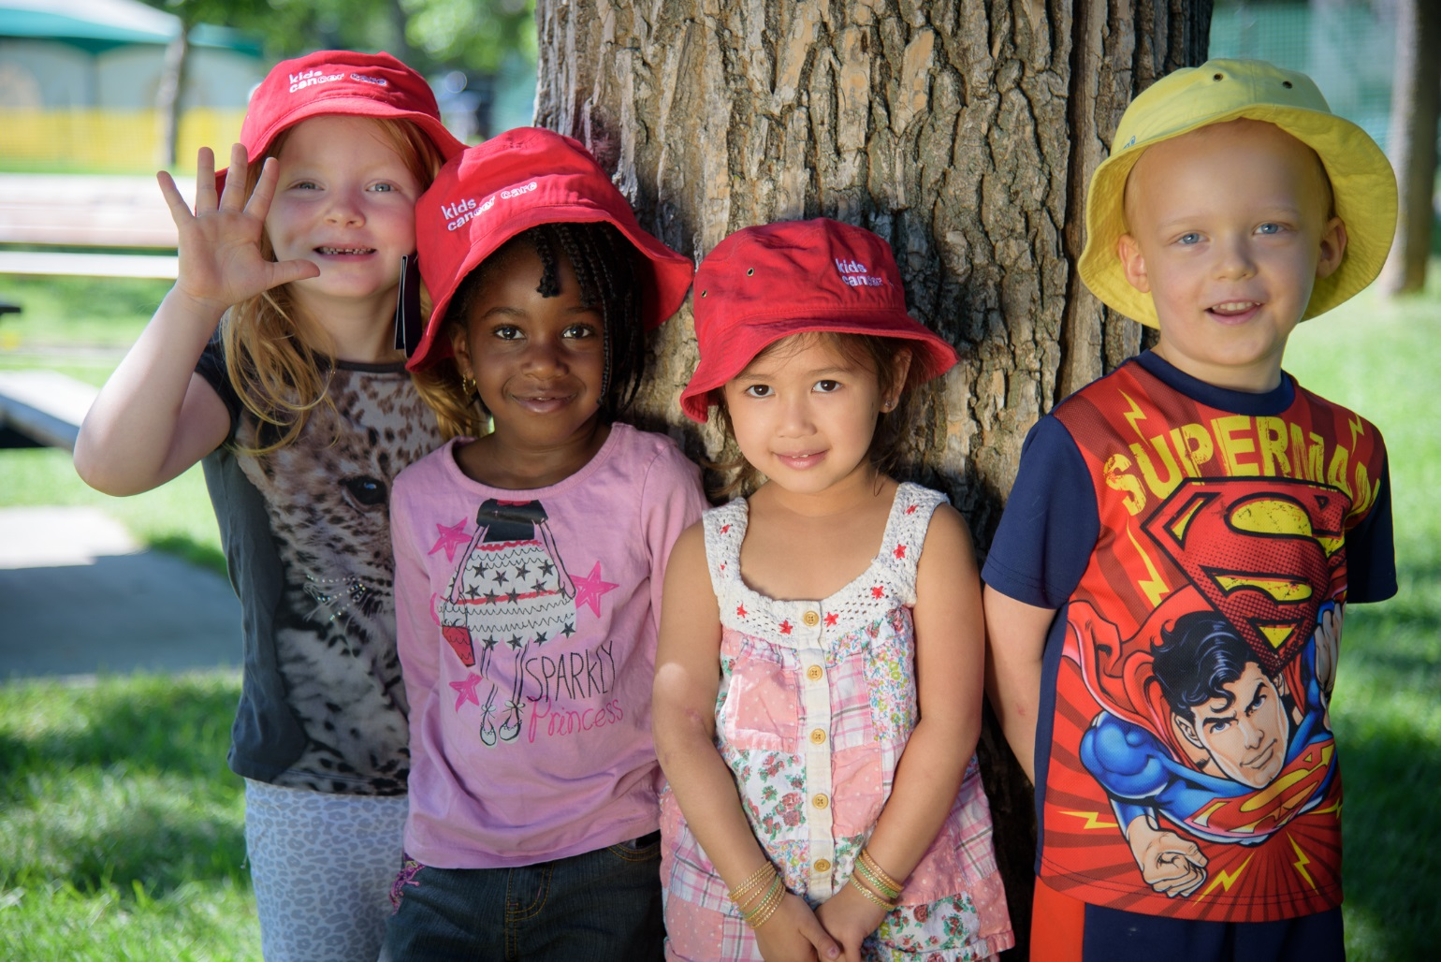
you can help kids
a cure for every child,
care for every family

Slide 5
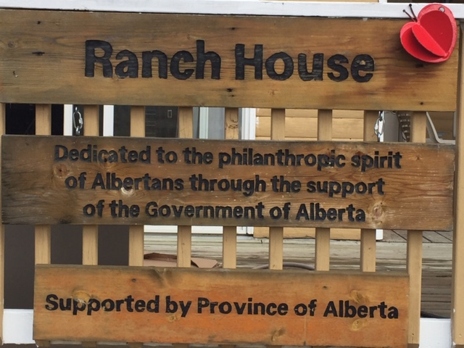
Welcome to Camp Kindle - KCC Ranch House
Located at Camp Kindle 60 mins. From Calgary and 10 K west of Water Valley.
2,500 sq ft (250m2) Residence.
Used as a Restbite for Kids with Cancer and families throughout the year.

Slide 6
Kids Cancer Care Camp Kindle - Ranch House

Slide 7
Scope of Work
Replaced existing crawlspace furnace with new energy efficient downflow furnace. Providing better maintenance access.
Added new Air Conditioning & Humidifier.
Provided IAQ Assessment & upgrade filtration system suitable for a clean environment for all buildings on site.
Replaced existing Hot Water Heater with new energy efficient model. Provided 5 slightly used electric water heaters for other buildings.
Install a new mechanical room by converting existing Laundry & Storage room.
Provided combustion, venting and outdoor air to new mechanical room.
Supplied a new Washer & Dryer.
Modify, upgrade and reconnect to supply & return air ductwork, insulate & seal ductwork.
Provide modification to existing gas service and tie into new furnace and water heaters.
Install new Setback thermostat
Test, Balance and Commission new HVAC
Upgraded Electrical panel to incorporate new furnace, AC installation.
Provided additional golf cart charging station. (Golf carts are used to transfer sick kids around camp.)
Provided electrical for bug (Mosquito) zapper around outdoor fire pit.
Provided mechanical room interior upgrades (New Floor, access door, wall and sealing patch and paint and trim as needed.)

Slide 8
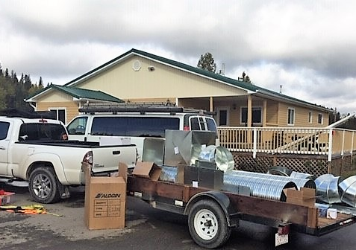

Slide 9
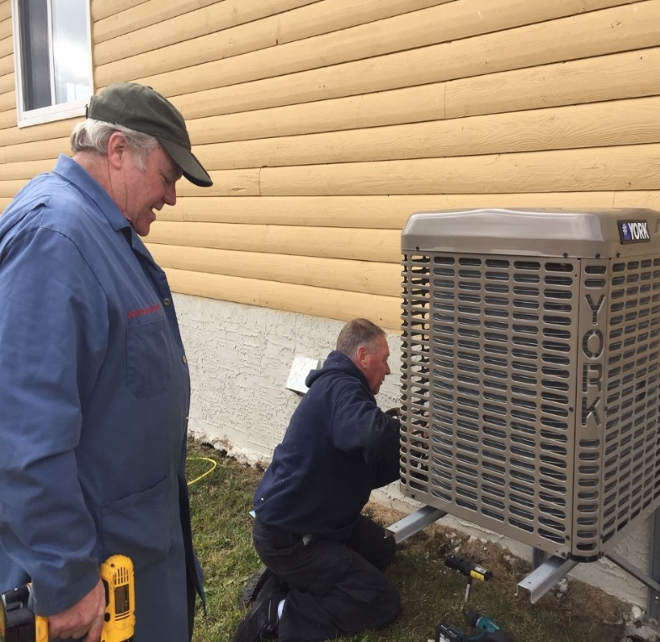
New Down Flow Furnace c/w Air Conditioning
SAC - SUSTAINABLE COMMUNITY PROJECT

Slide 10
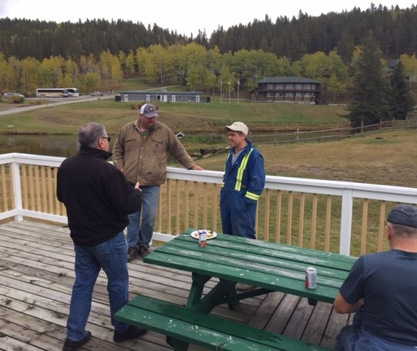
SAC - SUSTAINABLE COMMUNITY PROJECT

Slide 11
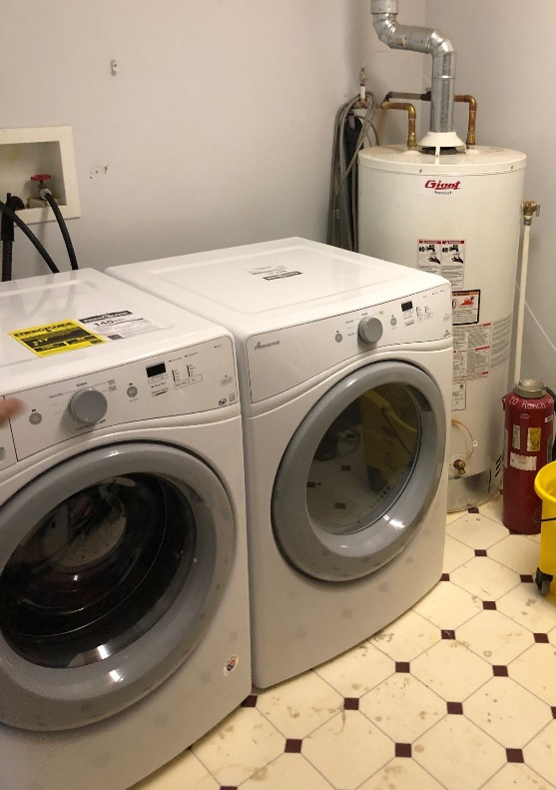
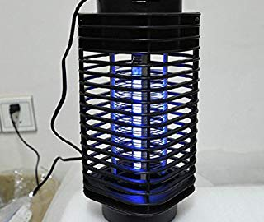
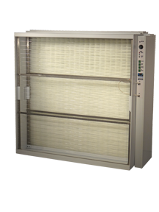
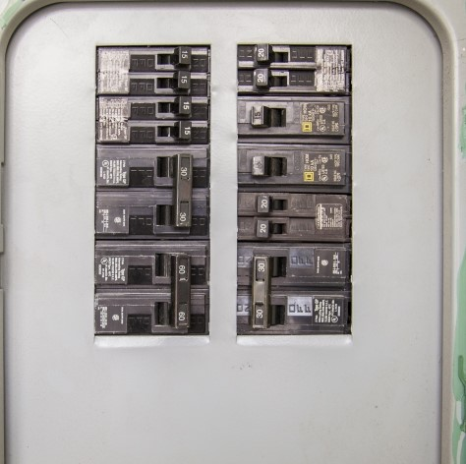
Miscellaneous Items

Slide 12
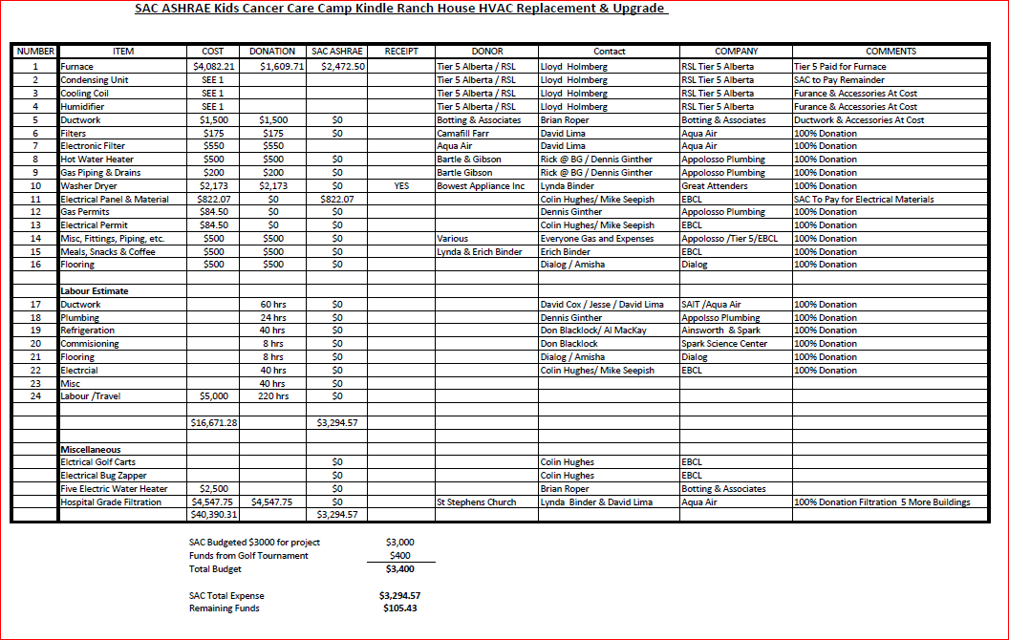

Slide 13
Thank You Plaque Unveiling

Slide 14
Thanks for your support

