Slide 1
ASHRAE and You
The perfect partnership

Slide 2
Who is ASHRAE?
≈54,000 members in more than 130 countries
176 chapters in 14 regions
31 member board
  One director and regional chair from each region
  Nine directors-at-Large
  Executive Committee
    Seven officers
    Executive Vice President (EVP)(staff)
  Staff of ≈110 led by EVP

Slide 3
ASHRAE and
Your Employees
Employees improve their technical skills and personal development
Networking and customer contact
Opportunity to strengthen employees’ leadership skills
Access to resources such as standards, Handbook, design guides, etc.

Slide 4
What Other Company
Leaders are Saying…
“I promote ASHRAE to my staff; I continue to pay my staff’s dues, meals and training to attend ASHRAE events”
“I have always believed in ASHRAE’s mission and in giving back to an organization that gives so much to the HVAC&R industry”
“[My mentor] made it clear to me that ‘giving back’ to the industry through active participation in ASHRAE was just something that you did.”

Slide 5

An Active ASHRAE Member…
“The leadership at USF have supported my involvement in ASHRAE as it bridges links among ASHRAE standards (62, 180, 189, 55, 52, etc.), new ASHRAE supported technology and research and what it means for our facilities, both new and existing.”
Jennifer Isenbeck
Mechanical Engineer,
University of South Florida

Slide 6
Professional Growth
ASHRAE provides unique opportunities to develop communication, management and leadership skills

Slide 7
Involvement on the Chapter Level
Opportunities to hold leadership positions within the chapter
Monthly meetings offer:
  Chances to network
  Guest speakers on technical topics
  A link to the Society on a wider, international level
Chapters Regional Conferences, held once a year, bring together professionals from all over the region

Slide 8
Involvement with
Technical Committees
Committee work allows members to determine future of the industry
  Originating, coordinating and supervising research projects
  Opportunities to present at ASHRAE conferences
  Members evaluate needs of standards
  Advising Society on new technology

Slide 9
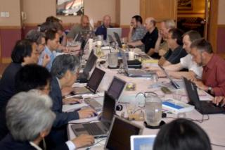
Involvement with
ASHRAE Research
ASHRAE has under contract
at university, government
and private laboratories
some 300 active research
projects
Process
  Research Administration Committee oversees
  Volunteer experts prepare work statements, select projects, select contractors and monitor
  All projects encourage graduate student participation
ASHRAE funded Research achieves significant value beyond the specific project

Slide 10
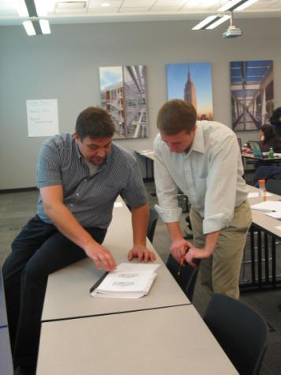
Continuing Education
Online, instructor-led short courses and seminars
Self-directed texts and eLearning
HVAC Design Workshop
Free yearly webcast
Chance to earn state continuing education credits; Learning Units; Continuing Education Hours; Professional Development Hours

Slide 11
Certification
Six certifications demonstrate knowledge and experience in building industry
  Building Energy Assessment
  Building Energy Modeling
  Commissioning Process Management
  Healthcare Facility Design
  High-Performance Building Design
  Operations and Performance Management
Developed in collaboration with other cognizant organizations

Slide 12
Technical Resources
ASHRAE is the industry’s complete resource for information about new
built environment technology

Slide 13
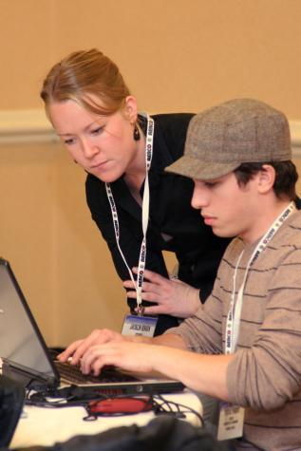
Key Resources
Standards
Handbook
Advanced Energy Design Guides, other special publications
Government advocacy
Building Energy Quotient

Slide 14
ASHRAE Standards
Developed under ANSI process
Mainly U.S. use, but supporting adoption/adaptation wherever desired
Key standards
  90.1, Energy Standard for Buildings, Except Low-Rise Residential Buildings (90.2 for residential)
  189.1, Standard for the Design of High-Performance Green Buildings Except Low-Rise Residential Buildings
  55, Thermal Environmental Conditions for Human Occupancy
  62.1, Ventilation for Acceptable Indoor Air Quality (62.2 for residential)
  170, Ventilation of Health Care Facilities

Slide 15
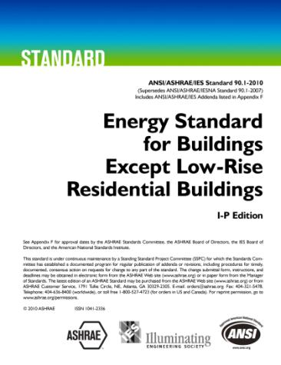
Standard 90.1
Sets design requirements for the efficient use of energy in buildings
2007 version referenced in the federal Energy Conservation and Production Act
39 states have adopted some version of 90.1 as their energy code
Notes:
Standard 90.1 sets design requirements for the efficient use of energy in buildings. Its requirements apply to:
the building envelope
distribution of energy
systems and equipment for auxiliaries
heating, ventilation, air conditioning, water heating
electric power and lighting.
The 2010 standard resulted in more than 30 percent energy savings can be achieved vs. the 2004 standard. Without plug loads, site energy savings are 32.6 percent and energy cost savings 30.1 percent. Including plug loads, the site energy savings are estimated at 25.5 percent and energy cost savings 24 percent.

Slide 16
Standard 90.1 and
Model Code Adoption
National Fire Protection Association by reference
International Code Council’s International Energy Conservation Code
  2009: Chapter 5: Commercial Energy Code
    Comply with 90.1-2007 or
    Comply with the rest of Chapter 5
  2012: Section 401.2 Application
    Comply with 90.1-2010 or
    Three paths (high equipment efficiency, high efficiency lighting or renewable energy) in Chapter 4 of IECC
Notes:
90.1 is a standard, that is written in language so it can easily be adopted into a local code. So, how does the process take this from a standard to a code in a state or city?
ASHRAE 90.1 is adopted by reference by the National Fire Protection Association, so if a locale adopts NFPA, it adopts 90.1.
The International Code Council has also developed a single set of regulatory documents for use by states and other locales. One of the International Code documents is the International Energy Conservation Code. The 2009 IECC has two paths within its chapter 5. The first is to comply with 90.1-2007. Or one can follow the prescriptive requirements of the rest of Chapter 5. Many of those requirements are similar, but not identical to 90.1-2007.

Slide 17
Standard 90.1 and USGBC, LEED
2009 (v3)
  EAp2: Minimum energy performance
    Mandatory provisions and 10% improvement over 90.1-2007
  EAc1: Optimize energy performance
    1 point for each 2% savings above 10%
    Up to 19 points (of 100)
2012 (Draft)
  EAp2: Minimum energy performance
    Mandatory provisions and 10% improvement over 90.1-2010
    Source energy 10% less
  EAc1: Optimize energy performance
    Average of site and source
    1 point for each 2% savings above 10%
Notes:
90.1 is also used by the U.S. Green Building Council’s Leadership in Energy and Environmental Design (or LEED) products.
In LEED 2009 (sometimes referred to as version 3) One’s building must use 10% lower energy cost than a building that meets the requirements of 90.1-2007. In addition, points must be earned to achieve higher levels of LEED recognition. From an energy perspective, for each 2% additional energy cost reduction, a point is earned, up to a maximum of 19 points for a 48% reduction.
It’s expected that as 90.1 is changed, local jurisdictions will move toward its adoption, either directly or through IECC, and the LEED products will also use the newer version as its basis.

Slide 18
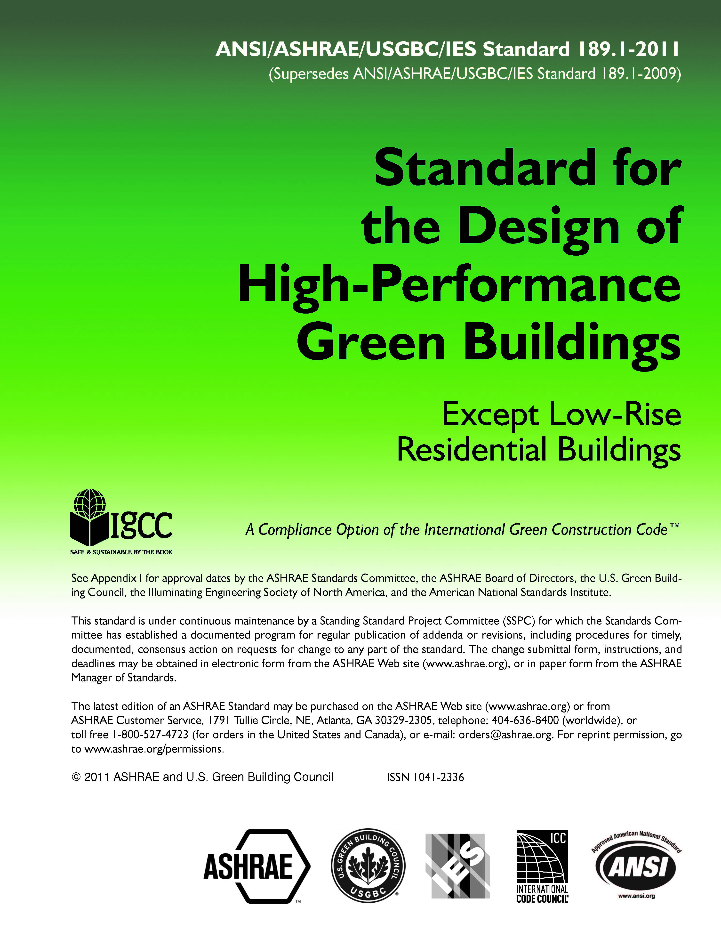
Standard 189.1
The “total building sustainability package”
Adopted by the U.S. Army as part of new sustainability policy
A compliance option of the International Code Council’s International Green Construction Code
Provide an optional project compliance path for International Green Construction Code high performance buildings
Notes:
In late 2009, ASHRAE, the Illuminating Engineering Society (IES) and the U.S. Green Building Council (USGBC) published the nation’s first code-intended standard for high-performance buildings. Standard 189.1, Standard for the Design of High-Performance, Green Buildings Except Low-Rise Residential Buildings. The standard is not a building rating system, but rather provides minimum requirements for high-performance, green buildings as developed through industry-wide consensus.
189.1 is more stringent than Standard 90.1 and contains mandatory provisions regarding indoor environmental quality. It also covers site sustainability, water use efficiency and the building’s impact on the atmosphere, materials and resources.
A few ways that people in the local community may see the effects of 189.1 are…(refer to slide)

Slide 19
189.1 Adopted by DoD
Unified Facilities Criteria (UFC) High Performance and Sustainable Building Requirements
“Standard 189.1 is an industry standard created to consolidate and address sustainability and energy requirements. This UFC incorporates the sections of 189.1 mentioned herein when appropriate and determined to be life cycle cost effective. Where the provisions of 189.1 meet the intent of the Guiding Principles, the provisions of 189.1 are referenced as a means of compliance or provided as an alternative requirement. When other standards are referenced in 189.1, use the publication date of the standard referenced in Appendix A of this document.”

Slide 20
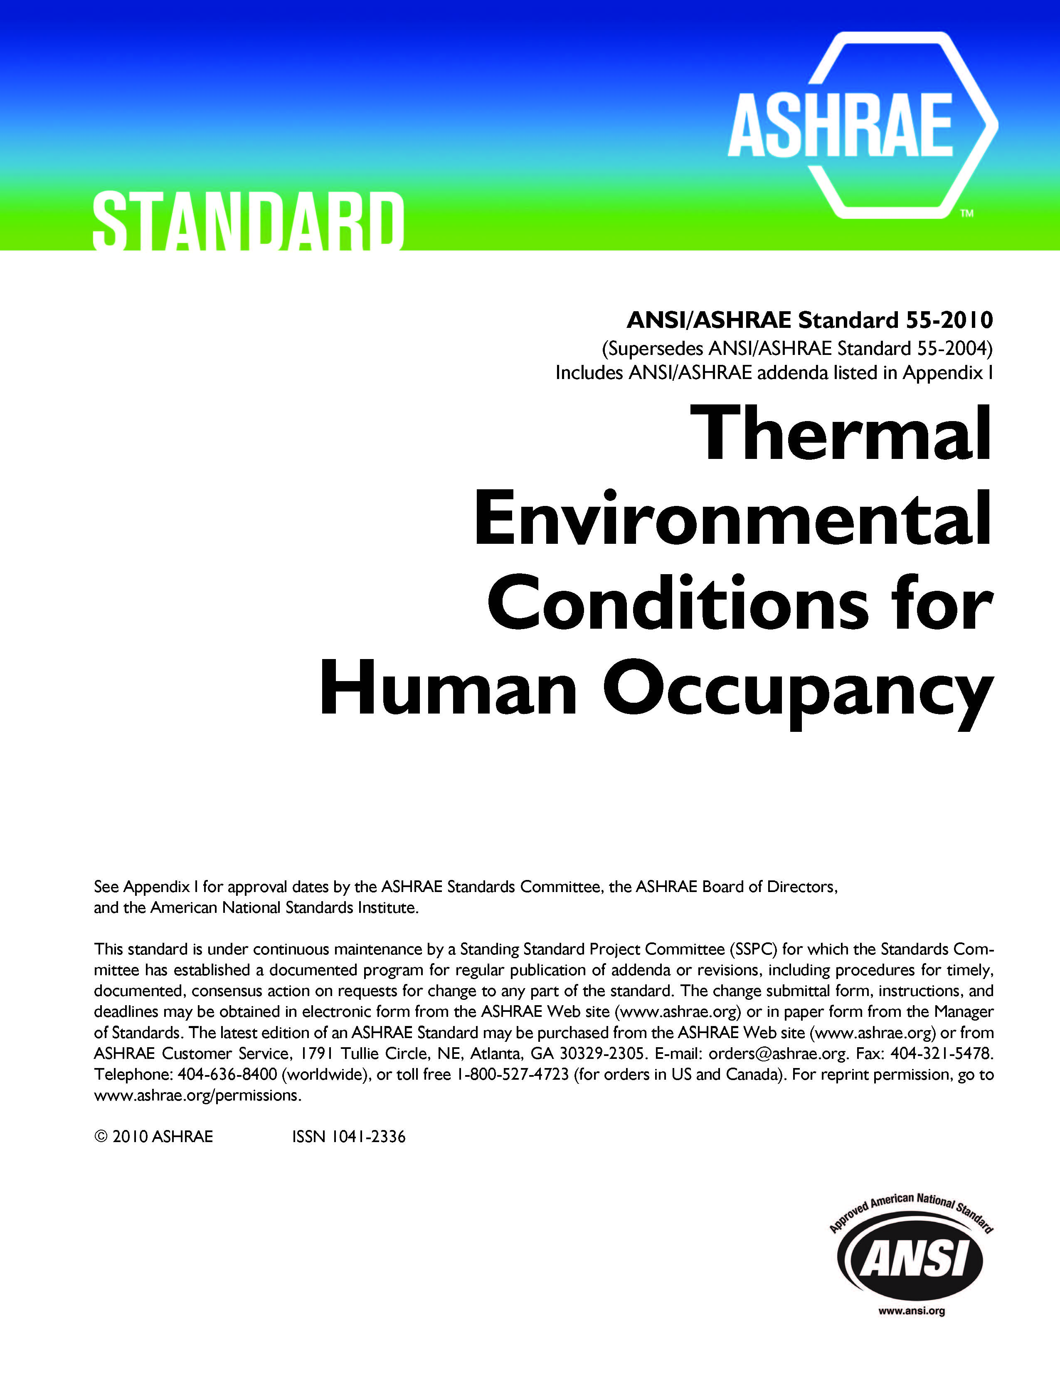
Standard 55
Design parameters to determine comfort
Indoor conditions for 80% or more of a building’s occupants
  Settles the “too hot/too cold” debate at offices across the nation
Notes:
The standard specifies the combinations of indoor thermal environmental factors and personal factors that will produce thermal environmental conditions acceptable to 80 percent or more of the occupants.
Almost everyone has had run-in with coworkers over the fight to control the thermostat—Standard 55 directly affects the comfort of a person’s indoor environment, and they probably don’t even know it’s ASHRAE putting an end to the “too hot/too cold” debate. This standard is particularly relevant to building owners and managers, who must field these complaints.
These environmental factors include temperature, thermal radiation, humidity and air speed, while personal factors are activity and clothing.
To be specific, temperatures in the winter should range from 68-74°F and 73-79°F in the summer, according to the standard.

Slide 21
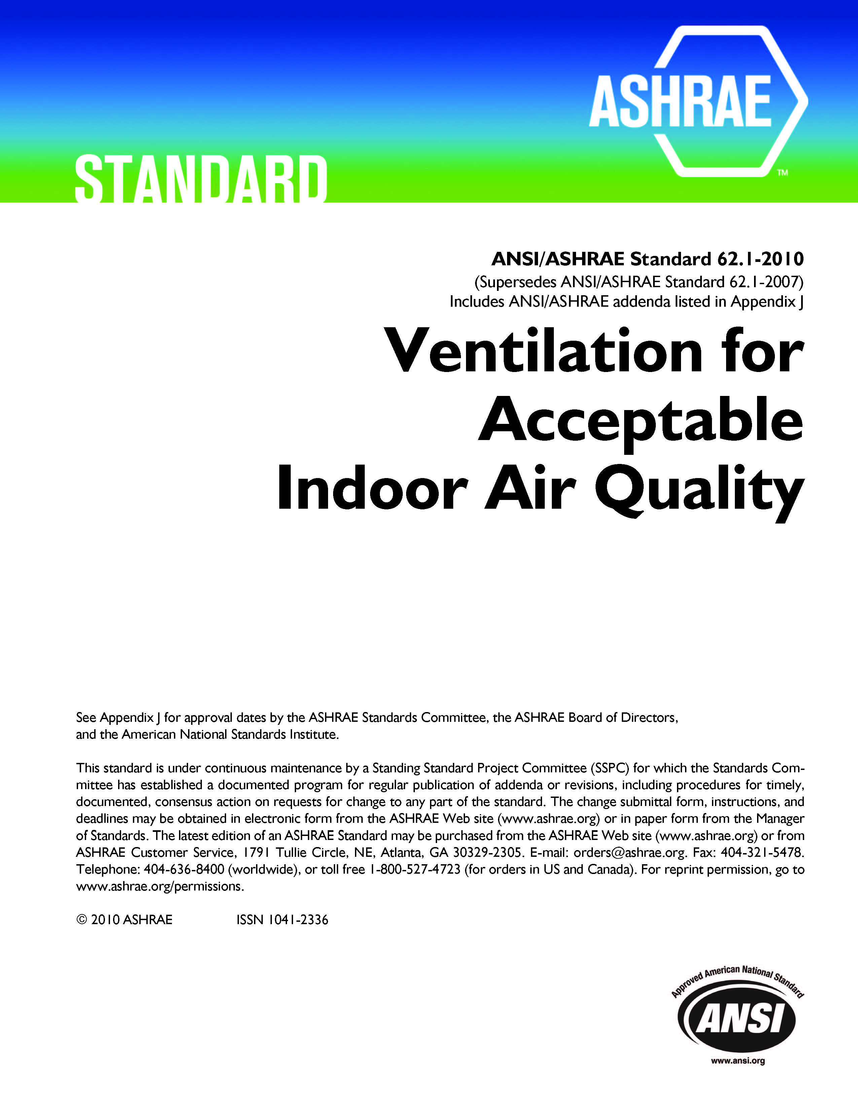
Standard 62.1
Specifies minimum ventilation rates and other measures intended to provide indoor air quality that is acceptable to human occupants and minimizes adverse health effects
Applies to all indoor or enclosed spaces that people may occupy, except where other applicable standards and requirements dictate larger amounts of ventilation
Notes:
The purpose of Standard 62.1 is to specify minimum ventilation rates and other measures intended to provide indoor air quality that is acceptable to human occupants and that minimizes adverse health effects.
The standard plays an important role around the world in providing for occupants’ well-being by improving indoor air quality. The standard provides guidance for the design and operation of HVAC systems for a range of building types and functions. It includes minimum requirements for maintaining a safe, healthy and comfortable indoor environment for building occupants.

Slide 22
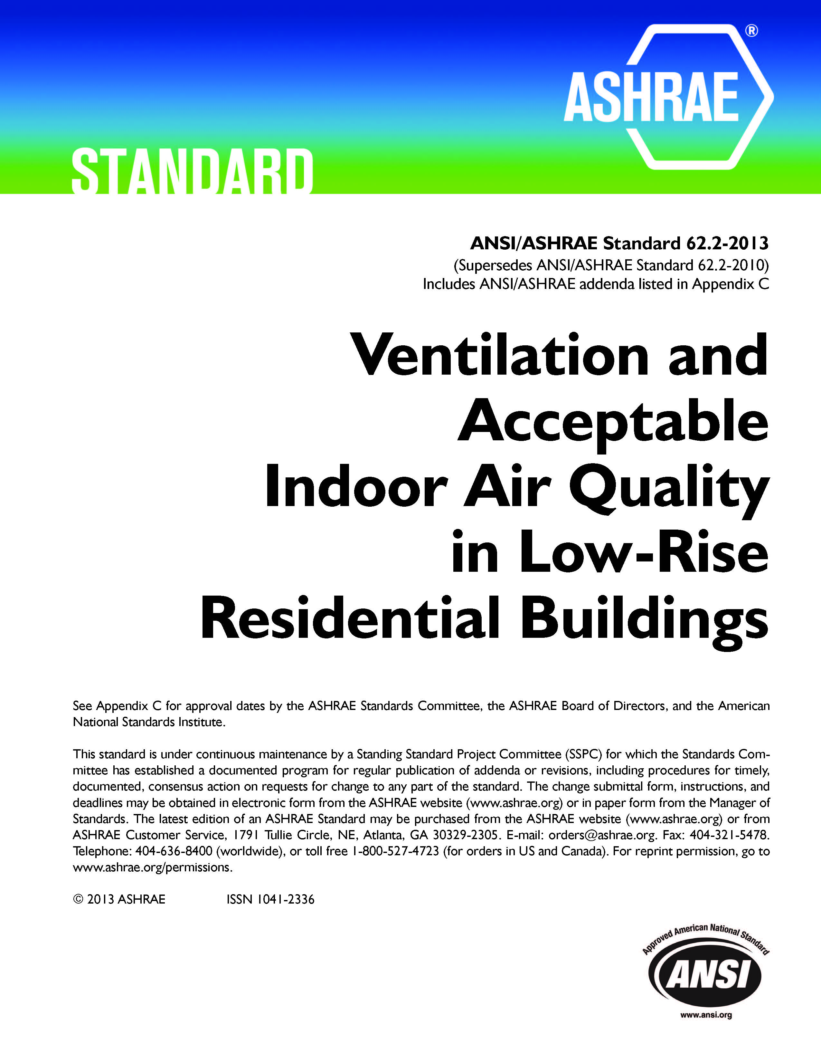
Standard 62.2
Defines the roles of and minimum requirements for mechanical and natural ventilation systems and the building envelope intended to provide acceptable indoor air quality in low-rise residential buildings
Limits sources of pollutants and requiring enough mechanical ventilation to provide dilution for unavoidable contaminants
Notes:
Standard 62.2 limits sources of pollutants and requires a small amount of mechanical ventilation to provide dilution for unavoidable contaminants in homes. The standard ensures that HVAC and other systems work together to effectively ventilate homes and minimize sources of indoor pollution.

Slide 23
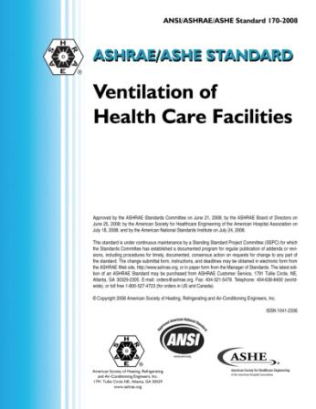
Standard 170
Provides control for comfort, infection and odor in health care facilities, including:
  Hospitals
  Nursing homes
  Outpatient facilities
Protects patients and healthcare workers from chemical, physical and biological airborne contaminants
Notes:
This standard defines ventilation system design requirements that provide environmental control for comfort, asepsis and odor in health care facilities
It provides control for comfort, infection and odor in health care facilities, including hospitals, nursing homes and outpatient facilities. The standard takes into consideration chemical, physical and biological airborne contaminants that can affect delivery of medical care to patients, the convalescence of patients and the safety of health care workers and visitors.
Standard 170 applies to new buildings, additions to existing buildings, and those alterations to existing buildings that are identified within this standard.

Slide 24
ASHRAE Handbook
Published in four volumes
  Systems and Equipment – 2012
  Applications – 2011
  Refrigeration – 2010
  Fundamentals – 2009
Knowledge base of thousands of individuals
Builds on technology, making it an evolutionary document
Puts the entire industry on the same page

Slide 25
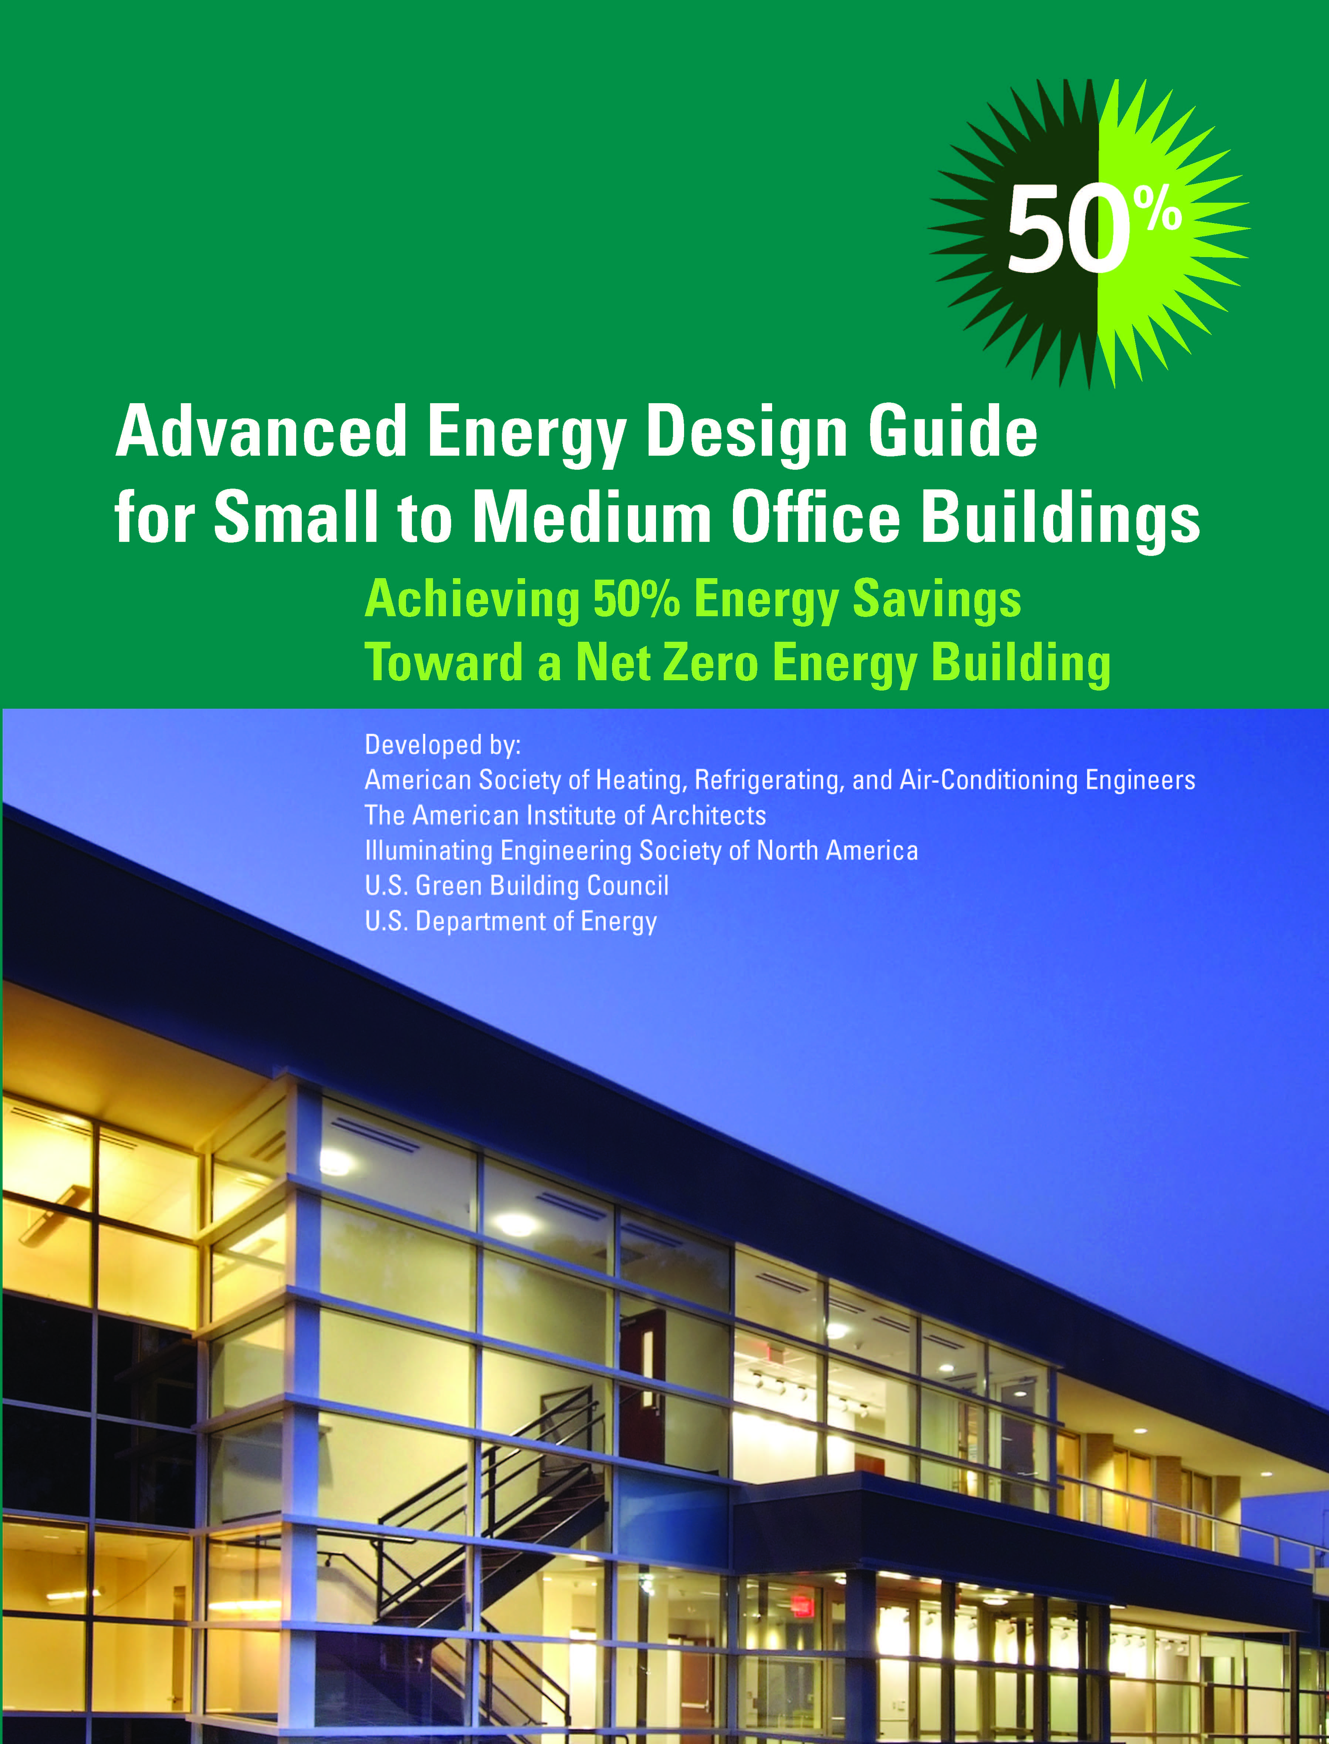
Advanced Energy Design Guides
Developed by volunteers in collaboration with partnering organizations ASHRAE, AIA, IES, USGBC
Co-funded by DOE
Prescriptive, easy to use
Based on building type, level of stringency
Series provides energy efficiency 50% beyond 90.1-2004
Free downloads – widely distributed

Slide 26
Government Affairs
Advocacy – Washington Office
  Currently four staff
  Track and communicate ASHRAE’s positions on advocacy priorities
  Provide support for development of technically sound legislation
  Established and Support High-Performance Buildings Caucus of the U.S. Congress

Slide 27
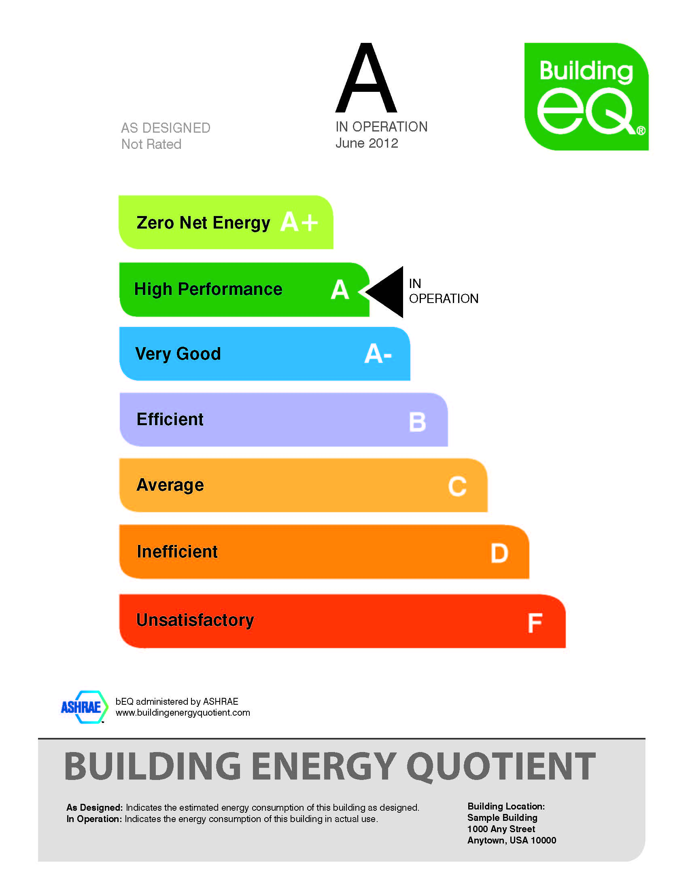
Building Energy
Quotient (bEQ)
Provides guidance on reducing energy use
Supports energy disclosure programs
As Designed (pending): Based on simulation, requires Building Energy Modeling Professional certification
In Operation (available since March 2012)
  Based on actual energy use, requires BEAP
  Level “1+” energy audit
Next step beyond ratings like ENERGY STAR

Slide 28
ASHRAE Thanks You for Contributing to the Industry and the Society
“When I think of ASHRAE, I think of the best and brightest in our industry working together to advance the arts and sciences of HVAC&R. The greatest value of membership for me is the synergistic energy of ASHRAE members working together, sharing ideas and advancing the standards of practice in the built environment.”
A vice president and chief engineer

Slide 29
Questions?

