Slide 1
Chapter Operations Workshop
Presenter
Date
Location

Slide 2
Leadership Attributes
Vision
Commitment
Enthusiasm
Curiosity
Willingness and ability to share: time, information, ideas, responsibility, the spotlight

Slide 3
Chapter Goals
Serve as liaison between an individual member and ASHRAE
Make every Chapter meeting worthwhile
Provide professional and personal growth opportunities
Attract the best graduates to HVAC&R

Slide 4
Keys to Chapter Success
Plan
What are the Chapter’s goals?
If the goals are achieved, will the Chapter be stronger than it was?
How will everyone recognize that a goal has been achieved?
President’s Award of Excellence (PAOE) can help
Delegate
Provide opportunities for other members to gain experience
Get other members involved and engaged
Set reasonable and enjoyable expectations for “next person up”
Encourage officers to focus on strategy and planning rather than implementation and execution

Slide 5
Keys to Chapter Success, continued
Ensure that volunteers’ time is spent efficiently and effectively
Manage meetings so that they are productive and all voices are heard
Offer valuable programs
Be prepared (for whatever the event is: meeting, technical program, volunteer activity)
Believe: in yourself, the Chapter’s mission, ASHRAE’s mission
If you don’t believe, why will anyone else?
Enthusiasm is contagious

Slide 6
Relationships Among Members, Chapters, and Society
Society has 52,000+ members
Most members are assigned to one of almost 200 Chapters
Each Chapter is assigned to one of 15 Regions
Each Region is represented on Members Council and the Board of Directors
Each Region holds an annual Chapters Regional Conference (CRC)
Society-level motions are sent to Members Council
Each motion is discussed and voted upon; results are reported at the next CRC

Slide 7
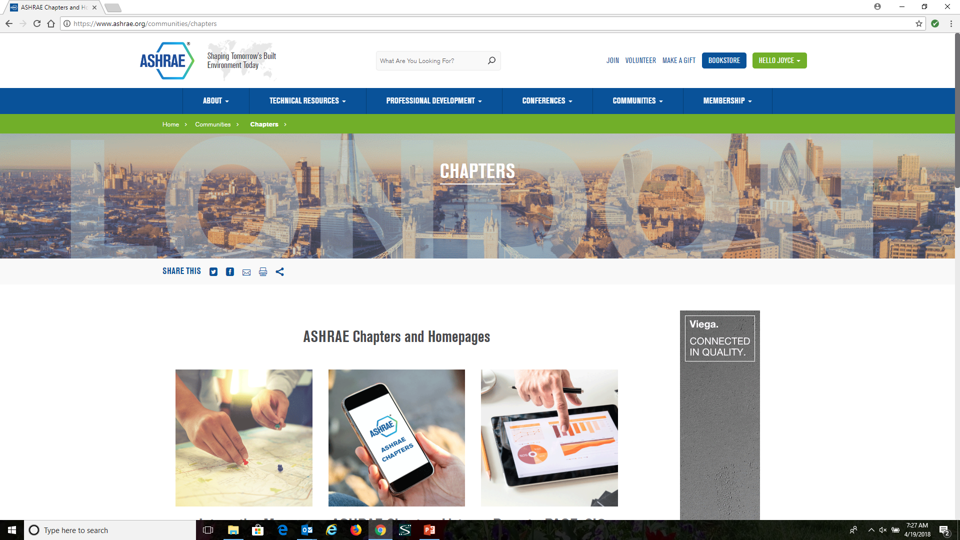
Chapter Resources
https://www.ashrae.org

Slide 8
Chapter Resources, continued
https://www.ashrae.org/communities/chapters
Manual for Chapter Operations
CRC Manual
Chapter Supplies
ASHRAE Learning Institute (ALI) Chapter Program
Chapter Scholarship Opportunities
Chapter Officer Training Materials
… and even more at https://www.ashrae.org/communities/chapters/chapter-resources!

Slide 9
Chapter Resources, continued
Manual for Chapter Operations (MCO)
Explains Chapter positions and roles
Suggests a calendar for accomplishing tasks
Provides model Chapter bylaws
Provides templates for Chapter Charter ceremony and other events
Gives guidance for Chapter programs

Slide 10
Chapter Resources, continued
Your Director and Regional Chair (DRC)
Your Regional Members Council Representative (RMCR)
Your Regional Vice Chairs
ASHRAE Staff!

Slide 11
Thank You!
ASHRAE would not exist without leaders like YOU
You have a vision, you are committed, you have enthusiasm, you want to learn, you want to be involved
You plan and you delegate, you use volunteers’ time wisely, you believe!
Your success is your Chapter’s success and your Chapter’s success is ASHRAE’s success
Thank You!

