Slide 1
Financial Risk Management
for U.S. Chapters
Updated: March 2025

Slide 2
Chapter Financial Risk Management Training
  This presentation will cover:
  Chapter Treasurer Duties
  Financial Accounting and Banking Best Practices
  Chapter Annual Financial Audits
  Revenue and Tax Reporting
  Fiduciary Duties
  Fundraising Specifics
  Most of this information is provided in the Manual for Chapter Operations

Slide 3
Chapter Treasurer Duties
Make deposits and issue checks authorized by the BOG
Balance/Reconcile monthly statements and present to BOG for review and approval
Keep financial records
  Chapter Account used for Operations Only
  Use Separate Accounts for Special Events such as CRC Fund or Scholarships
  Other special accounts?
File Taxation and Revenue Reports
Be aware of scams
Notes:
Recently, several Chapter Treasurers have received SCAM email requests that appear to come from the Chapter President, authorizing that a check be made out to an individual. Before cutting and sending a check, the Treasurer should confirm with a phone call or an independent new email (not just a reply to the one received) that the request is valid.

Slide 4
Financial Accounting and Banking Best Practices
Each Chapter should use reputable financial software
At least three Chapter officers should have signature authority
  How does your chapter provide transparency and oversight on larger checks?
Debit Cards ……. convenient, but dangerous
Chapter should have separate accounts for high dollar special events
When possible, Research Donations should be forwarded directly to ASHRAE Research
Investments should be in safe low risk investments (i.e. bonds or term deposits), the ASHRAE Foundation or a Chapter Foundation
Notes:
Society strongly recommends using the services of a CPA
We will cover specific issues related to fundraising later in this presentation

Slide 5
Phishing Email Guidance
If you receive an email that is from a Chapter President, Chapter Officer, Regional or Society Officer asking you to do something you don’t normally do (buy gifts, transfer money), it’s likely a scam. Suggested actions:
Don’t respond to the email.
Contact the person face to face, if possible, to question the email or contact them via telephone.
Do nothing until you can contact that person to confirm the request.
If you send money and are scammed, contact your company or if no policy is in place:
  Contact your bank immediately.
  Contact law enforcement.
  File a complaint.
  Brief the BOG and Regional Leadership.

Slide 6
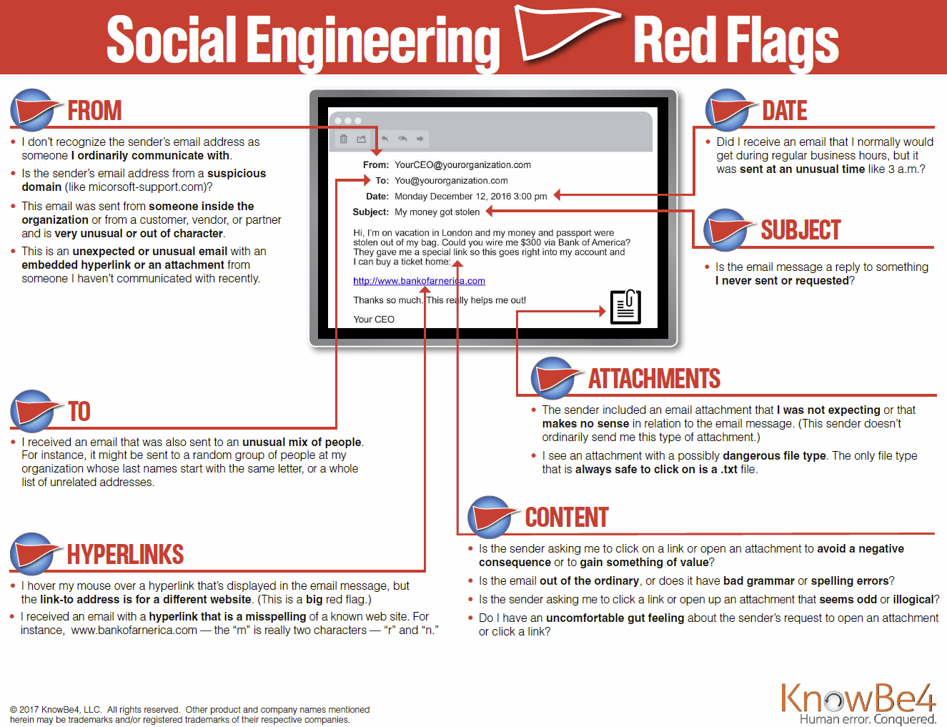

Slide 7
Chapter Annual Financial Audits
Each Chapter should set up an Audit Committee to perform annual financial audit
  Past Presidents and/or trusted senior ASHRAE members
  NOT the current Chapter Treasurer or others with signature authority on account.
  Goal should be to complete audit prior to CRC
Large Chapters might hire outside accounting firms to perform annual audits
Audit Committee should present its findings to Chapter BOG

Slide 8
Revenue and Taxation Reporting
Each U.S. Chapter must
Register with its state (Secretary of Sate, Department of Revenue, etc.)
File both federal and state tax returns to keep its non-profit status
  All Chapters must complete annual IRS 990 Form
  Small Chapters and Large Chapters complete different IRS 990 Forms
  Private Foundations complete a separate form
NOTES:
There are penalties for not filing both federal and state tax returns.
Society can be at risk if a chapter loses its non-profit status. Chapter should find out whether its state requires separate non-profit registrations and/or filings.
Tax filings must report any lobbying expenses incurred by the chapter. (Note: the vast majority of chapters will not need to report any expenses because very few chapters expend money related to such activities.)
Notes:
We will cover state registration in more detail later in this presentation.
If the Chapter covers more than one state, it should register for tax purposes in each state in which it does business and register separately to solicit contributions in each state. Most states allow a minimum amount of contributions to be raised without registration, typically $5,000 to $25,000. Some states also consider solicitation of funds from ASHRAE members to be exempt since ASHRAE is not soliciting the general public. A professional CPA will be able to provide information and guidance.

Slide 9
Revenue and Taxation Reporting, cont’d.
ASHRAE is a 501(c)(3) Charitable Organization
IRS Form 990 information and filing instructions
https://www.irs.gov/charities-non-profits/current-form-990-series-forms-and-instructions
Information about 501(c)(3) Charitable Organizations
https://www.irs.gov/charities-non-profits/charitable-organizations

Slide 10
Revenue and Taxation Reporting:
Small ASHRAE Chapter
Annual gross receipts are normally less than $50,000
  Three Year Average (preceding two years and current year)
Annual Electronic Filing Form 990-N (E-Postcard)
https://www.irs.gov/charities-non-profits/annual-electronic-filing-requirement-for-small-exempt-organizations-form-990-n-e-postcard
Notes:
Small Chapters must file using an e-postcard. Only relevant exception is if the organization is filing as part of a Group Return

Slide 11
Revenue and Taxation Reporting:
Small ASHRAE Chapter, cont’d
Information needed for Form 990-N (E-Postcard)
  Name of chapter
  Chapter mailing address
  Chapter employer/tax identification number
  Name and address of principal officer
  Certification that gross receipts are under $50,000
Notes:
Small Chapters must file using an e-postcard. Only relevant exception is if the organization is filing as part of a Group Return
Helps to have large RP donations made directly to society to prevent gross receipts exceeding $50,000

Slide 12
Revenue and Taxation Reporting:
Large ASHRAE Chapter
If annual gross receipts are normally between $50,000 and $200,000 and total assets are less than $500,000, use Form 990-EZ or 990
If annual gross receipts are normally $200,000 or more and total assets are $500,000 or more, use Form 990
If a Private Foundation, use Form 990-PF
Notes:
The Board of Governors of the chapter should review the completed 990 form before it is sent to the IRS
Consider using an outside CPA firm to complete the tax return

Slide 13
Revenue and Taxation Reporting:
All ASHRAE Chapters
Tax filing due by the end of the 15th day of the 5th month after the close of year end
ASHRAE tax year ends June 30, tax filing must be completed by November 15
Cannot file until after tax year ends
  It’s after June 30th … you can file your taxes now ☺!

Slide 14
Revenue and Taxation Reporting:
Late Filing or Failure to File
Chapters that file late (without receiving advance IRS approval) or fail to file tax returns:
Risk IRS fines
Jeopardize Society’s tax-exempt status
Could be dissolved by Society

Slide 15
Federal Taxation Reporting: Lobbying Expenses
Chapters are most likely to be involved in issues of public policy that would not be characterized as lobbying, such as:
  Conducting educational meetings
  Preparing and distributing educational materials
  Considering public policy issues in an educational manner
  Chapters that are involved in “influencing legislation” (including at the technical level) would also generally not need to report any expenses, because money and expenses are not involved.
Notes:
Source: https://www.irs.gov/charities-non-profits/lobbying

Slide 16
Federal Taxation Reporting: Lobbying Expenses (cont.)
Some chapters (likely very few, if any) may need to report such expenses.
Federal definition of lobbying: attempting to influence legislation.
“Legislation” includes:
  Action by Congress, any state legislature, any local council, or similar governing body, with respect to acts, bills, resolutions, or similar items (such as legislative confirmation of appointive office), or by the public in referendum, ballot initiative, constitutional amendment, or similar procedure. It does not include actions by executive, judicial, or administrative bodies.
“Attempting to influence” means that the organization:
  Contacts, or urges the public to contact, members or employees of a legislative body for the purpose of proposing, supporting, or opposing legislation, or
  Advocates the adoption or rejection of legislation.
Notes:
Source: https://www.irs.gov/charities-non-profits/lobbying

Slide 17
Federal Taxation Reporting: Lobbying Expenses (cont.)
Lobbying expenses include:
  Transportation/travel expenses, food/entertainment expenditures, or other expenditures associated with a Government Outreach Event at which lobbying takes place.
  Any consultant or staff hired to support lobbying conducted by the chapter.
Note: HQ staff would not be included in these expenses as they are not paid for by the chapter.
Notes:
Most activity related to government advocacy and outreach by chapters would not need to be reported to the Federal Government since the activity is not paid.

Slide 18
Federal Taxation Reporting: Lobbying Expenses (cont.)
For Federal Income Tax Reporting:
  All Lobbying expenses should be tracked.
  Form 990EZ or Form 990 (see Revenue and Taxation slides for reporting requirements); Lobbying expenses will need to be reported on Schedule C (Political Campaign and Lobbying Activities) for that respective Form.
  Form 990-N (E-Postcard) does not require a Schedule C.
For State Governments: Additional rules and reporting requirements may be required. The Chapter is responsible for adhering to those requirements.
Notes:
Question: Is there some de-minimus amount that a chapter could expend? (e.g., cookies at a legislative booth at which a lobbying letter is distributed?) Answer: There is no minimum spending unless the chapter is confident that the Chapter’s gross receipts (consistent each year – 3 year moving average) are less than $50,000. Anything higher than this is reported on a Schedule C for all expenses.

Slide 19
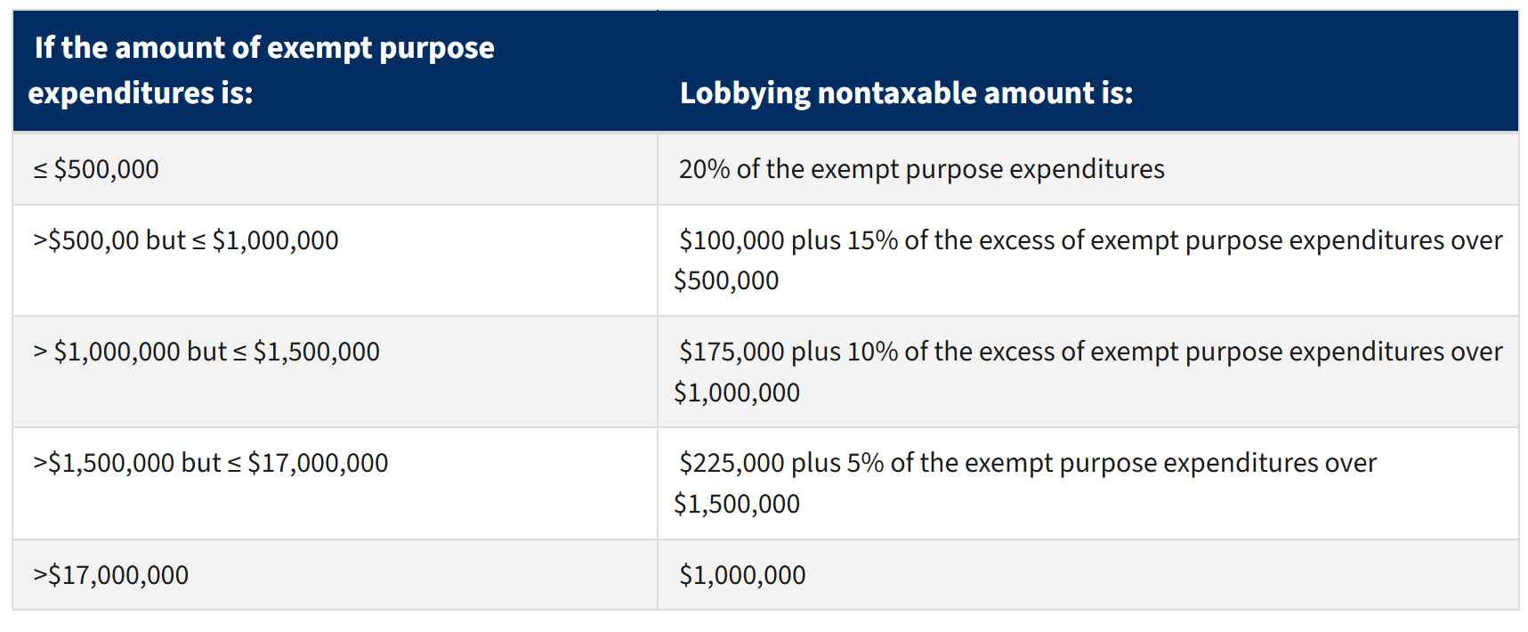
Lobbying Expenses: Do NOT Threaten the Chapter’s Not-for-Profit Status
No organization may qualify for section 501(c)(3) status if a substantial part of its activities is attempting to influence legislation (commonly known as lobbying).
“Substantial Part” can be defined through an “expenditure test”:
Source: IRS Website, “Measuring lobbying activity: Expenditure test” Downloaded on 27 January 2025. https://www.irs.gov/charities-non-profits/measuring-lobbying-activity-expenditure-test

Slide 20
Fiduciary Duties
Each Chapter Officer has a Fiduciary duty to the Chapter
https://dictionary.law.com/ defines a fiduciary as a person who has the power and obligation to act for another…under circumstances that require total trust, good faith and honesty.
Board members must exercise reasonable care in overseeing the organization’s financial and operational activities.

Slide 21
Fiduciary Duties: Loyalty
Board members must act solely in the best interests of the organization and its constituents, and not for personal gain.
Includes the obligation to avoid conflicts of interest
Step aside or abstain from voting when even an appearance of a conflict of interest
Comply with ASHRAE’s Codes of Ethics
  Code of Ethics Commitment
  This statement should be included on all agendas and read before all committee meetings:
  In this and all other ASHRAE meetings, we will act with honesty, fairness, courtesy, competence, inclusiveness and respect for others, which exemplify our core values of excellence, commitment, integrity, collaboration, volunteerism and diversity, and we shall avoid all real or perceived conflicts of interests.
  https://www.ashrae.org/about/governance/code-of-ethics

Slide 22
Fiduciary Duties: Obedience
Board members must act in accordance with the organization’s mission, charter and bylaws, and any applicable state or federal laws.
Board members who violate these duties may be held personally liable for any financial harm the organization suffers as a result.

Slide 23
Fiduciary Duties: Can a Volunteer be Liable?
Although volunteers enjoy some protection from financial responsibility, that protection varies by state and isn’t absolute
Society’s Privacy Policy does not apply to sites of any ASHRAE chapter, region, student branch, technical committee or other group affiliated or associated with the Society

Slide 24
Fundraising: Best Financial Practices
Investment funds and operating accounts must be separate
Research Promotion events should have separate accounting practices
Scholarship Funds should have a separate account within the chapter
Funds should be allocated precisely as advertised
(i.e. if an event is advertised as being for RP, then all the money raised must go to RP, not just the net amount)
Notes:
Make every effort possible for Chapter Member and others to write checks specifically to “ASHRAE Research” and not simply to ASHRAE or the local Chapter. This allows a complete tax deduction to be taken by the donor.
Operating funds should be accounted for in each of the separate committee accounts.

Slide 25
Fundraising: State Registration
Compliance Law
Provides basic information on a Chapter’s
  Finances
  Governance
  Fundraising Activities
Confirms you are working with a legitimate nonprofit that is soliciting funds in that state
Notes:
By far most of the 50 states require nonprofits to register
Fees range from $50 to several hundred dollars
If the Chapter covers more than one state, it should register for tax purposes in each state in which it does business and register separately to solicit contributions in each state. Most states allow a minimum amount of contributions to be raised without registration, typically $5,000 to $25,000. Some states also consider solicitation of funds from ASHRAE members to be exempt since ASHRAE is not soliciting the general public. A professional CPA will be able to provide information and guidance.

Slide 26
Fundraising: State Registration, cont’d
Why Register With the State? - IT’S THE LAW!!
  Failure to register can…
    Result in significant fines and penalties
    Result in state orders to cease and desist operations
    Jeopardize all fundraising activities
How does a Chapter register?
ASHRAE works with a company called URS Compliance
  URS Compliance will prepare, submit and file reports and paperwork with state agencies on the Chapter’s behalf
  ASHRAE will pay the URS Compliance fee in states in which a Chapter has 3 or more area assigned members
  Chapters will pay
    State fees
    Penalties and fines for current or past years
Notes:
Failure to register with the state can jeopardize all fundraising activities, including Scholarships, RP, CRCs, Sponsorships

Slide 27
Fundraising: State Registration, cont’d
What if I have questions?
Contact your DRC
Contact RP Staff at rp@ashrae.org
Contact a professional CPA (for questions about taxes or fundraising specific to state requirements)

Slide 28
Fundraising: Sending in Contributions
Chapters can send RP donations several ways:
Check
  Send to:
  ASHRAE HQ, Attn: Julia Mumford, 180 Technology Parkway NW, Peachtree Corners, GA 30092
  Include the donor breakdown and any other details you think will be important to include so we can quickly and accurately process the gifts.
Credit Card
  Visit www.ashrae.org/contribute and select “I am a Chapter”
  Upload the donor breakdown and input the credit card details. Please contact us with any questions before you hit submit.
Wire/ACH/Electronic Transfer
  Please reach out to RP@ashrae.org for Wire Transfer information.
  Please include your customer number, your name and chapter name on the information sheet to your bank. This will allow us to identify and apply your payment to your account in a timely fashion.
  Send your donor breakdown to RP@ashrae.org and let us know a wire is coming.

Slide 29
Dues Collection Program
As an OPTIONAL service, chapters can request that Society collect annual chapter dues during the annual Society Membership Renewal cycle. Society can invoice and collect chapter dues. The following are criteria for this program.
Members must remit Society and Chapter dues at the same time. This includes multiple year payments (i.e. three years of Society paid then three years of chapter dues must be paid to Society) or payment should be made directly to chapter each year.
The Society Renewal Notice will reflect (under Chapter Dues) the amount for chapter dues.
Members who pay only Society Dues will not receive any follow up notices for “Unpaid Chapter Dues”.
Society will reimburse Chapters for their dues collected monthly unless indicated on the form. The Chapter Dues Paid through Society Report is available on the website.
Chapters that are interested to review Section 4.8 of the Manual of Chapter Operations for more details about the program. Questions can be directed to membership@ashrae.org.

Slide 30
Things to Think About
Be public with all transactions
  Send the list of transactions monthly to the BOG
Spread out authority
  Expense reports
    Approval by one person
    Check writing by another person
  Debit card
  Dual signatures if possible
Always know who has signature authority on all accounts

Slide 31
Discussion Topics
Region communication – Basecamp
  Region support, enough or need more, mid-year check-in?
Is Treasurer part of chapter exec track?
  How long does Treasurer serve in your chapter?
Account balances
  A lot of high balances last year, what changes did your chapter make?
  Plans to utilize funds, invest, etc?
  Investment accounts
    Private
    ASHRAE Foundation: Invest $30,000, guaranteed 5% payback annually in perpetuity ($1500/year), $60,000 -> $3,000, society level scholarship.
Questions, concerns, issues?

Slide 32

Thank you!
Thank you for your service to your chapter and ASHRAE!
Enjoy your participation in ASHRAE!

