Slide 1

Chapter Technology Transfer Committee
(CTTC) Workshop
CTTC/Refrigeration Awards Program
2022

Slide 2

CTTC/Refrigeration Awards
Technology Awards
Donald A. Siller Refrigeration Award
Dan Mills Chapter Programs Award
Milton W. Garland Commemorative Comfort – Process – Cold Chain Award for Project Excellence
  Combination of the previous Milton W. Garland Award and the Comfort Cooling Award

Slide 3
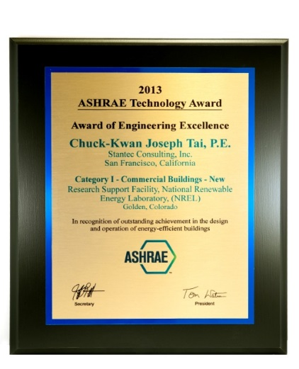
ASHRAE Technology Awards
Purpose
  Local and international recognition of ASHRAE members for innovative designs
  Communication of innovative designs to other ASHRAE members
  Highlight technological achievements of ASHRAE to others

Slide 4

ASHRAE Technology Awards - Schedule
Regional Competition Deadline
  Determined by RVC
Society Entry Deadline
  September 1
Selection Date
  October
Society Presentation
  Winter Conference

Slide 5
ASHRAE Technology Awards - Categories
Commercial Building (New, Existing, EBCx)
Institutional Buildings (New, Existing, EBCx)
  Educational Facilities
  Other Institutional Buildings
Health Care Facilities (New, Existing, EBCx)
Industrial Facilities (New, Existing, EBCx)
Public Assembly Facilities (New, Existing, EBCx)
Residential Buildings

Slide 6
Chapter/Regional Technology Awards Competition
Recognizes local members’ outstanding design and innovation for effective energy utilization
Form of competition and judging at the chapter level can be set up by the local chapter
Chapter winners in each category must complete Short Form Application and forward submittal to RVC for judging at the Regional level
More than one first place winner may be awarded in any category at the Regional level
Deadline dates are determined by the CTTC RVC

Slide 7
Society Technology Awards – Submittal Requirements
Requirements are posted on the Technology Awards webpage: www.ashrae.org/technologyawards
  No more than 13 pages – 10 narrative and 3-page Long Application Form
  Must be an ASHRAE member
  The project must have been in operation for at least one year
  Must be submitted by the CTTC RVC by September 1 to ASHRAE Headquarters

Slide 8
Society Technology Awards – Typical Entry Issues
Does not contain one year’s worth of operating data
Short Form was used instead of the Long Form Application
Claims not substantiated
Ventilation rates do not meet ASHRAE standards
No payback figures
No IAQ discussion of occupant comfort or discomfort
Innovation claimed but not really innovative
Presentation does not meet submittal guidelines
Maintenance and Operations not discussed

Slide 9
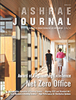
Society Technology Award – Winner Recognition
Winners of the competition are featured
in the ASHRAE Journal

Slide 10
Donald A. Siller Refrigeration Award
Purpose
  Recognition of Chapter Refrigeration Chair for planning activities and providing technology transfer in the area of Refrigeration
Schedule
  Regional competition deadline
    Determined by RVC
  Society entry deadline
    September 30
  Society presentation
    Annual Conference

Slide 11
Dan Mills Chapter Programs Award
Purpose
  This award is endowed in memory of Dan Mills of the Memphis Chapter.
  It recognizes a Chapter CTTC Chair or Vice-Chair who excels in chapter program endeavors and promoting technical and energy activities of the CTT Committee.
Schedule
  Regional competition deadline
    Determined by RVC
  Society entry deadline
    September 30
  Society presentation
    Annual Conference

Slide 12
Milton W. Garland Commemorative Comfort – Process – Cold Chain Award for Project Excellence
In 2021 the Milton W. Garland Commemorative Refrigeration Award was merged with the Comfort Cooling Award to create this new award.
This award recognizes the designer and owner of a Comfort – Process – Cold Chain application that highlights innovation and/or new technologies.
The winner is selected by the Refrigeration Committee
Schedule
  Submission to Refrigeration Committee
    May 1
  Society Presentation
    Winter Conference

Slide 13
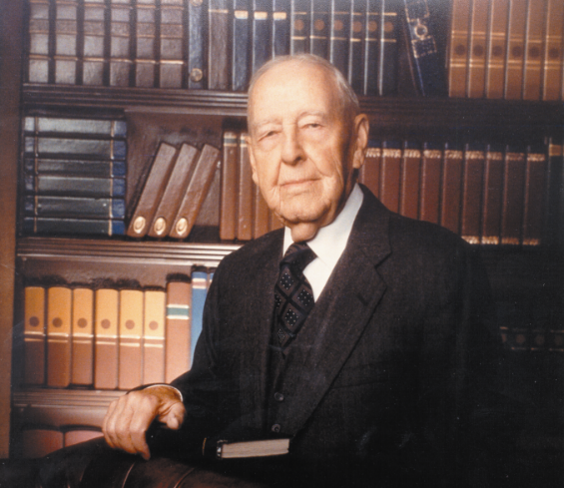
Milton W. Garland Commemorative Comfort – Process – Cold Chain Award for Project Excellence
Mr. Garland was known as “Mr. Refrigeration” for his work in the refrigeration systems for gold mines in South Africa and the ice cream factories in Philadelphia. In 1998, Mr. Garland was honored as the nation’s oldest worker. He was inducted into the ASHRAE Hall of Fame in 2003.

Slide 14
Where to get more information
CTTC web page – visit www.ashrae.org/CTTC for complete information, deadlines, forms, sample entries, etc.
Your CTTC Regional Vice Chair
Chapter Programs Manager,
Rhiannon Masterson – ChapterPrograms@ashrae.org

