Slide 1

Diversity, Equity, & Inclusion (DEI) in ASHRAE
Building a stronger culture of equity, diversity,
and inclusión in ASHRAE will help the Society to be
more creative, innovative, and resilient, drive Society
performance and improve member and staff retention.
The aim is to remove barriers experienced
by underrepresented groups to articulate the need
for their participation in ASHRAE.
Inclusion is not a matter of political correctness. It is a key to growth.
Jessie Jackson
Notes:
In 2020, ASHRAE established a Proactive Diversity Task Group to recommend programs and initiatives seeking to eliminate all forms of discrimination and social injustice, and proactively drive diversity through all levels within ASHRAE.
Some members ask “why?” As an engineering society, shouldn’t ASHRAE be focusing its efforts and that of its volunteers on research and education?
What role, if any, should ASHRAE play in diversity in the AEC community and social justice?
Is there really a problem that needs to be solved? We want to hear from you: the members.
Please provide feedback to the presenter or through your Chapter President or DRC.

Slide 2

ASHRAE
Core Values
ASHRAE´s Code of Ethics
In this and all other ASHRAE meetings, we will act with honesty, fairness, courtesy, competence, inclusiveness and respect for others, which exemplify our core values of excellence, commitment, integrity, collaboration, volunteerism and diversity, and we shall avoid all real or perceived conflicts of interests.
• Excellence
• Commitment
• Integrity
• Collaboration
• Volunteerism
• Diversity
Is equity still missing ??
Notes:
Inclusiveness and diversity have been in our Code of ethics statement that is read at all ASHRAE meetings for years.
Do we need to (should we) add equity?

Slide 3
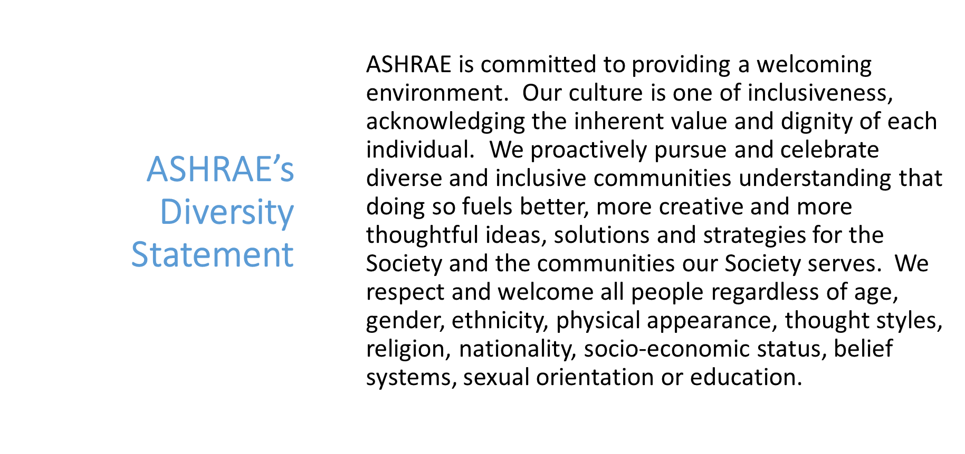
Diversity, Equity, & Inclusion (DEI) in ASHRAE
Notes:
ASHRAE Presidents Boise and Gulledge appointed a board ad-hoc in the society year 19-20 to explore ASHRAE’s comittment to Diversity, equity and inclusión. The report of the ad-hoc resulted in the ASHRAE diversity statement. A permanent Board of Directors subcommittee was approved by the board in 2021-2022.

Slide 4
What is DEI
Diversity is the presence of differences that may include race, gender, religion, sexual orientation, ethnicity, nationality, socioeconomic status, language, (dis)ability, age, religious commitment, or political perspective. Populations that have been-and remain- underrepresented among practitioners in the field and marginalized in the broader society.
Equity is promoting justice, impartiality and fairness within the procedures, processes, and distribution of resources by institutions or systems. Tackling equity issues requires an understanding of the root causes of outcome disparities within our society.
Inclusion is an outcome to ensure those that are diverse actually feel and/or are welcomed. Inclusion outcomes are met when you, your institution, and your program are truly inviting to all. To the degree to which diverse individuals are able to participate fully in the decision-making processes and development opportunities within an organization or group.
Notes:
Diversity refers to diversity of identities, such as race and gender and, in some cases ethnicity, religion, nationality, physical or mental disability, and sexual orientation. Some may think of these identities as protected classes — identities that have received (and still receive) systemic discriminatory treatment and create disadvantages and barriers to opportunity and resources.
Equity is an approach or process to ensure everyone has access to the same opportunities. It recognizes that disadvantages and barriers exist and that all members 5 do not start at the same place. Equity is the process that acknowledges that unequal starting place and introduces corrections to address the imbalance.
And inclusion is about a group (our membership) with different identities perceiving being valued, leveraged, and welcomed within a given setting (our Society or Industry). ASHRAE can have a diverse membership but it does not mean that members with marginalized identities such as women or people of color feel welcome or valued as they may not be given equal opportunities to participate and grow.

Slide 5
“Diversity, Equity, Inclusion and ASHRAE: Does it Really Matter?”
What does our membership think?
Demographics fairly represent the industry | 56% agree
Women and people of color are underrepresented in the industry | 50% agree
Chapters and regions need to improve DEI efforts | 40-40 split | 20% not knowing one way or other
ASHRAE publically communicates its goals on diversity | 50% did not know | 50% communicates adequately
ASHRAE should do more to promote diversity? | 50% yes | 37% no | 12% did not know
Notes:
It is important to understand how the membership currently views DEI and how ASHRAE supports DEI.
• Fifty-six percent of respondents feels ASHRAE’s demographics fairly represent the industry, about half feel women and people of color are underrepresented in the industry.
• Respondents are split equally on whether Chapter and Regions need to improve DEI efforts with 20% not knowing one way or the other.
• Half of respondents did not know if ASHRAE publicly communicates its goals on diversity, and of those who did have an opinion, most felt that ASHRAE does communicate adequately.
• Half of the respondents felt ASHRAE should be doing more to promote diversity, equity and inclusion in the HVAC&R Industry, 37% indicated ASHRAE should not being doing more and 12% did not know.
What do you think?

Slide 6
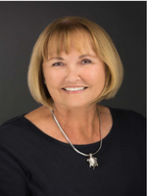
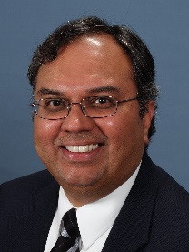
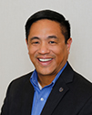
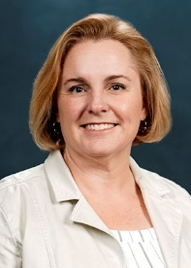
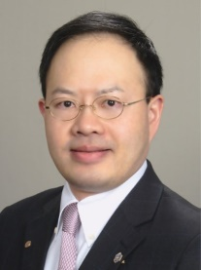
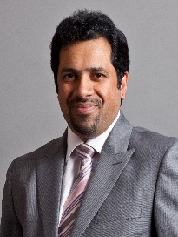
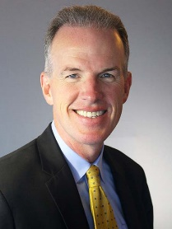
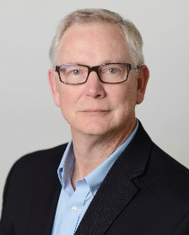

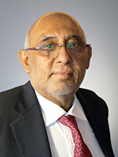
Diversity, Equity, & Inclusion (DEI) in ASHRAE
BOD Subcommittee created by the Board January 2021
DEI BOD Sub-committee 2022-2023
To advise and engage the Board of Directors on:
All matters relating to diversity, equity and inclusion - with a view to improving organizational awareness and performance in these areas amongst both staff and the Society membership
The establishment of annual budgets for DEI program and ongoing initiatives
The of inclusivity issues which have relevance to ASHRAE, together with plans for addressing these issues
Purpose of the BOD DEI Subcommittee:
Members of the 2022-2023 BOD DEI Subcommittee
Adrienne Thomle (Chair); Kishor Khankari (Vice Chair); Devin Abellon; Susanna Hanson; Wei Sun ; Ashish Rakheja; Billy Austin, Dennis Knight; Tanisha Meyers-Lisle; Farooq Mehboob (ASHRAE President)
Notes:
2022-2023 BOD appointed a DEI sub-committee that reports directly to the board for the purpose (on Slide). The members are shown here.

Slide 7
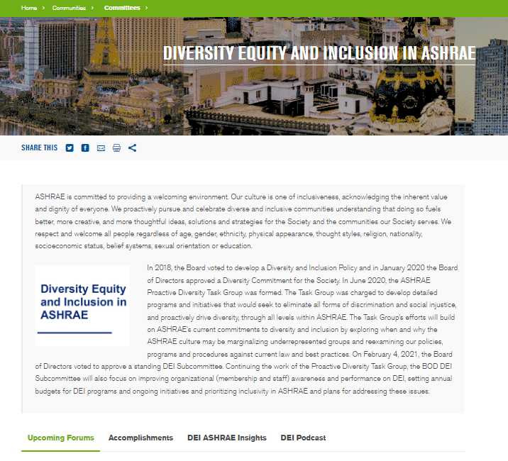
Diversity, Equity, & Inclusion (DEI) in ASHRAE
Completed
Assigned 3 task groups
    Procedures/Documents
    Survey Development/Identifying Metrics
    Program Development/ Education
Created a website and articles
Recommended ASHRAE sign CEO Action Pledge
      Commit to building diverse leadership teams (staff & volunteer leadership)
      Commit to share best practices
      Promote this work with association membership
Sponsored DEI Forum in Las Vegas and a Panel in Toronto
Held 2 DEI training session for the ASHRAE Board of Directors
Notes:
Created three smaller task groups within our committee that address Procedures/Documents, Survey Development/Identifying Metrics, and Program Development/ Education. The Procedures and Document Task Group has worked on the creation of a Manual of Procedures for the BOD DEI Advisory Subcommittee. We are working to engage and collaborate with Chapters to develop programs.
Created a website which highlights our accomplishments. It can be found here: https://www.ashrae.org/communities/committees/diversity-equity-and-inclusion-in-ashrae .
Recommended ASHRAE sign the CEO Action Pledge to participate in the NIBS Diversity Commitment:
Commit to building diverse leadership teams (staff & volunteer leadership)
Commit to share best practices
Promote this work with association membership
Organized its first forum “Diversity, Equity, Inclusion and ASHRAE: Does it Really matter?” And a panel discussion at the annual meeting in Toronto “ASHRAE and DEI: Where Are We Now, Where Do We Want to Be Tomorrow and How Do We Get There?” Both sessions were well attended
Completed 2 sessions for DEI awareness training for ASHRAE board of directors.

Slide 8
Diversity, Equity, & Inclusion (DEI) in ASHRAE
Future Plans
Collaborate with industry partners (CIBSE,INWIC, NBI)
Coordinate with ASHRAE Councils and Standing Committees to create training for regions and chapters
Recommend Chapter and Society programs on DEI (webcasts, training and education program, Insight Articles, forums, conferences, and webinars)
Notes:
Continuing to create articles to be authored in ASHRAE Insights. Our latest feature is from Ms. Karine LeBlanc and was published in the January 2022 edition.
Collaborating with Members from our BOD DEI Subcommittee and members from CIBSE on ways to promote DEI in our industry worldwide.
Co-founder with United Nations Environment Programme (UNEP) new global cooperative platform to promote increased opportunities and participation for women in the refrigeration, air-conditioning and heat-pump (RACHP) sector – the International Network for Women in Cooling (INWIC).
In the next year we will be working with the ASHRAE Councils and Standing committees to create DEI training for those members and chapters who want to include DEI in their programs.
Continue to recommend programs and articles for membership on DEI.

