Slide 1

Chapter Technology Transfer Committee (CTTC) Workshop 2025
Regional Vice Chair:
Telephone:
Email:
Notes:
It is good to test your PowerPoint with the projector you will actually use before you present. Sometimes the slides look good on the computer but look much different on a large screen once combined with a projector. The preview may be a cause to change the slide design to make the text easier to read. It is desirable to have this slide on before the meeting starts to alert people to whether they are in the correct location. It is good to edit this slide to have the correct Region, month, year and location. You are welcome to customize the slide design to your taste.
Click to add contact information.

Slide 2
ASHRAE Value Statement
ASHRAE Value Statement
  In ASHRAE meetings, we will act with honesty, fairness, courtesy, competence, inclusiveness and respect for others, which exemplify our core values of excellence, commitment, integrity, collaboration, volunteerism and diversity, and shall avoid all real or perceived conflicts of interest. Our culture is one of inclusiveness, acknowledging the inherent value and dignity of each individual. We celebrate diverse and inclusive communities, understanding that doing so fuels better, more creative and more thoughtful ideas, solutions and strategies for the Society and the communities our Society serves. We respect and welcome all.
Notes:
It is good to test your PowerPoint with the projector you will actually use before you present. Sometimes the slides look good on the computer but look much different on a large screen once combined with a projector. The preview may be a cause to change the slide design to make the text easier to read. It is desirable to have this slide on before the meeting starts to alert people to whether they are in the correct location. It is good to edit this slide to have the correct Region, month, year and location. You are welcome to customize the slide design to your taste.
Click to add contact information.

Slide 3
Regional CTTC Support
Contact Information
Recommend inserting contact information for:
  RVC CTTC
  List of CTTC Chapter Chairs in Region
Notes:
It is good to test your PowerPoint with the projector you will actually use before you present. Sometimes the slides look good on the computer but look much different on a large screen once combined with a projector. The preview may be a cause to change the slide design to make the text easier to read. It is desirable to have this slide on before the meeting starts to alert people to whether they are in the correct location. It is good to edit this slide to have the correct Region, month, year and location. You are welcome to customize the slide design to your taste.
Click to add contact information.

Slide 4
Workshop Agenda
Introductions and Sign-In
CTTC responsibilities
Chapter programs
Distinguished Lecturer Program
PAOE criteria/reporting
CTTC award programs
Refrigeration
Questions/Answers/Evaluation
Notes:
Edit this slide based on your personal preferences. Be sure to record who was in attendance and emphasize that only those on the sign in sheet and listed as a chair in the CIQ are eligible for transportation reimbursement. It helps later in the year when you try to ascertain whether the incoming Chapter Chair was actually there. If you record telephone numbers and e-mail addresses it allows you to create/update your Regional Roster. It is desirable to have a formal looking sign-in list prepared beforehand rather than rely on notebook paper.
If you have the capabilities to distribute workshop materials on a flash drive this is becoming a big request. Some people like looking at a hard copy in the workshop, but only want to take a flash drive back with them. Many of the workshop materials are available in electronic format now.
CTTC Chair Responsibilities are included in the slide presentation which will also include review of the materials in the Workshop Manual.
Continuing Education is also covered in the Slide Presentation, but it is important to highlight this opportunity and differentiate between this, Seminars, Technical Sessions, and Programs.
The workshop is a great time to highlight the benefits of the Distinguished Lecturer (DL) Program, explain how it works and to solicit requests for DL slots for the upcoming year.
The Presidential Award Of Excellence (PAOE) Criteria needs to be explained for the current year to allow people to understand how Society will judge their performance as a Chapter. How to report this information is equally important to ensure a Chapter gets credit for their hard work.
During the presentation, and especially at the end, it is beneficial to be sure that all questions are answered to the best of your ability. If you do not have the answers, you should be diligent to get the answers.
Be sure to have the attendees complete the Workshop Evaluation and turn it in to you. Complete (RVC) a CRC Workshop Evaluation Summary to send to ASHRAE Staff, within 30 days of the CRC. These are used to improve these materials each year for the benefit of those who attend.

Slide 5
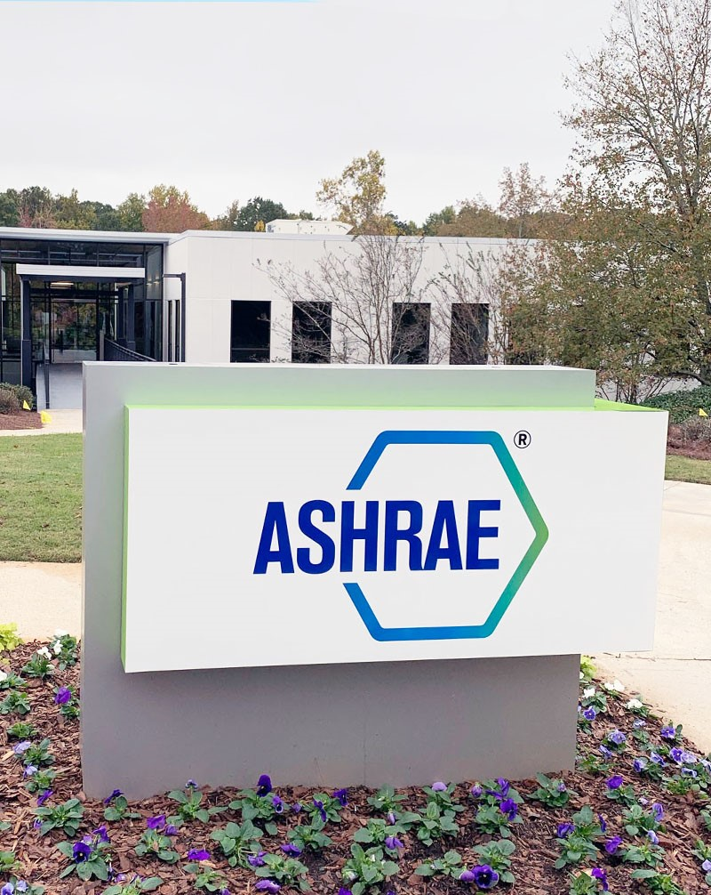
ASHRAE’s Mission & Vision
Mission
  To serve humanity by advancing the arts and sciences of heating, ventilation, air conditioning, refrigeration and their allied fields.
Vision
  A healthy and sustainable built environment for all

Slide 6
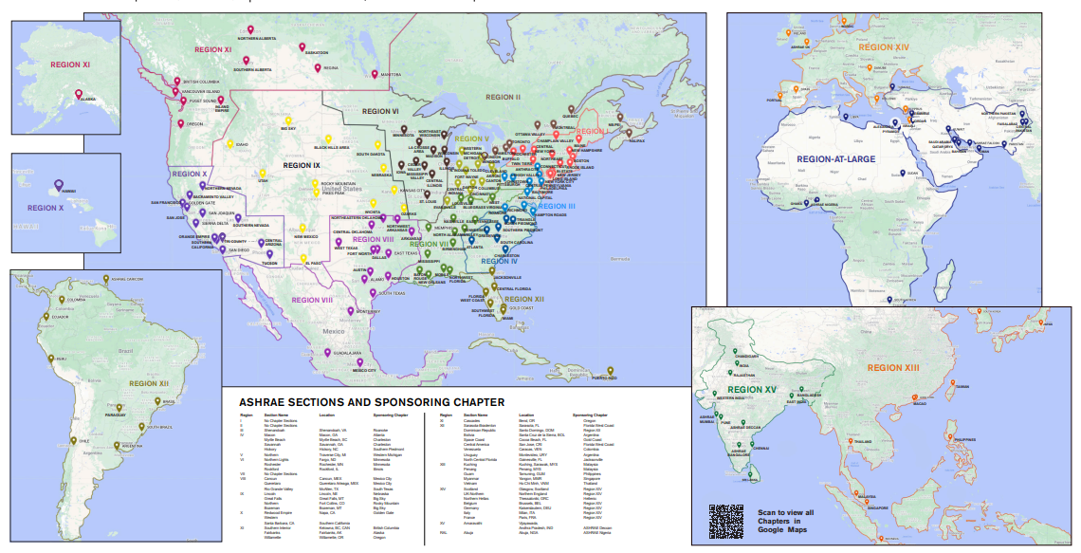
ASHRAE Organization
50,000+ members
201 Chapters
47 Sections
16 Regions
Notes:
Updated 6/20/2025

Slide 7
Chapter Technology Transfer Committee (CTTC)
ASHRAE
MEMBERSHIP
The Chapter Technology Transfer Committee (CTTC) is a general standing committee of the Society and operates under the direction of the Board of Directors and Members Council.
BOARD OF DIRECTORS
MEMBERS
COUNCIL
TECHNOLOGY
COUNCIL
PUBLISHING & EDUCATION
COUNCIL
CTTC

Slide 8
Society CTTC
Members
  One Chair and two Vice-Chairs
  16 Regional Vice-Chairs
  BOD ex-officio and Coordinating Officer
  One Programs Coordinator and one Tech Hour Coordinator
Responsibilities
  Reports to Members Council
  Identifies and develops resources for Chapter programs
  Coordinates dissemination of technical information to Chapters
  Provides featured CTTC topics in the monthly ASHRAE Chapter Notes newsletter
  Promotes and administers awards program
Notes:
Most jobs in ASHRAE are easier when you have a committee to help. Once you have been appointed, or become aware of your Chapter position as CTTC Chair (possibly comes with an officer position; many Chapters have the President-Elect serve as CTTC Chair) consider creating a committee to help you become successful. Your success largely determines the success of the Chapter.
The Committee should consist of at least three people, but that is largely open to your management style. Consider using local active Consulting Engineers (young and senior), your Refrigeration Chair, your Student Activities Chair and a Past President. It is realized that this is not always possible in smaller Chapters but should give you an idea of the possibilities.
Pre-planning is the absolute most important part of being successful. Attending this workshop (by the actual Chapter CTTC Chair) is essential to this pre-planning effort.
** Discuss the importance of reading the Chapter Notes Newsletters, which include valuable society updates as well as valuable CTTC featured topics/ articles

Slide 9
CTTC RVC Responsibilities
Encourage input to the Society from Chapters on standards, publications, handbooks, and position papers/statements
Develop, maintain, and distribute a Regional speakers list
Assist CTTC Chairs with PAOE reporting
Attend CRC and conduct CTTC workshops
Promote continuing education activities across the region

Slide 10
CTTC Chapter Chair Duties
Provide relevant programs
Coordinate distribution of technical and industry-related information
Promote CTTC and refrigeration awards
  Dan Mills Chapter Programs Award
  Technology Awards
  Donald A. Siller Refrigeration Award
  Milton W. Garland Commemorative Comfort – Process – Cold Chain Award for Project Excellence
  Energy Genius Award
Assist Chapter Refrigeration Chair with refrigeration activities
Coordinate Chapter refrigeration activities
Promote continuing education activities at the Chapter level

Slide 11
CTTC
Management by Objectives - MBO
Definition
  Objectives are things which are achieved, such as a manual, a project, sales, a plan, employee morale – things which are business related
See the Chapter CTTC Chair MBO Guide for additional information
Characteristics
  Specific
  Measurable
  Achievable
  Realistic
  Timetable
Notes:
Errors are usually made by failing to make the distinction between Objectives and Activities. Activities are things you do, such as writing, designing, selling, thinking, forecasting, training, etc.

Slide 12
Why do people attend Chapter meetings?
Learn how to access latest technical information
Develop and share knowledge of problems and solutions
Meet members and peers in the same field
Opportunities for leadership
Fellowship, enjoyment, and fun!
Notes:
To develop good programs it is essential to understand why ASHRAE Chapter members attend Chapter meetings. This slide lists some of those major reasons. These items should be considered when developing the programs. To shorten the Workshop, this slide could be deleted. However, this is good information to know and understand.

Slide 13
CTTC – Plan your Chapter Programs
April: set meeting schedule
May: first meeting/conduct survey
July: develop/budget programs
August: contact speaker and make arrangements
Use the CTTC Chapter Chair calendar available at www.ashrae.org/cttc. Send your program schedule to your CTTC RVC before October.
Publish annual program schedule in Chapter newsletter each month
Determine each speaker’s needs
Publicize speaker’s information (bio and topic summary) with photo in newsletter prior to meeting
Provide monthly meeting reminder
  Before meeting via phone calls and e-mail
DL pool opens December 1st
Notes:
It is beneficial to conduct a survey of your Chapter members every 2-3 years to see what topics interest them the most and to see which ones are most timely. Sometimes a good committee can accomplish the same end.
You should confer with your Chapter President to establish the meeting schedule for the upcoming Society year. You should also consider what other activities and interests will be emphasized by your Chapter. For example, you may want to conduct a refrigeration program in conjunction with a ½ day refrigeration seminar. This is where the refrigeration chair could help your committee. It is also a good time to verify that the meeting facilities are reserved for each of these meetings.
Once you have the frame work for meetings for the year you should meet with your recruited committee members and strategize whether you will conduct a formal or informal survey. You could, as an alternative, meet with several local consulting engineers and interview them over a lunch or breakfast meeting to get their desires and develop programs to meet these desires.
Once you have an idea on the programs you may want to determine whether there are any budget implications to the Chapter and alert the Chapter President to this need. Audio/visual costs can be somewhat expensive, especially projectors and wireless microphones. Attempt to have projectors provided by Chapter members who have them, if they are available, and if the meeting place will allow this.
Assign each committee member speakers to contact to confirm their willingness and availability. Use your Regional Speakers list and the DL list where applicable.
Send your Outline of Meeting dates, times, speakers and topics to your RVC as soon as you are complete and preferably before your first meeting of the year (you should be putting this in the first newsletter of the Chapter year before the first meeting).
This slide illustrates some of the basic things a CTTC Chair should do each month to ensure that Chapter members are well informed about upcoming programs, to get feedback on the quality of these presentations, and to forward that feedback to the RVC.

Slide 14

What to Avoid at Chapter meetings
Politics
Religion
Trade (sales/business transactions)
Commercialism
Notes:
The primary rules for good and effective programs are to avoid each of these discussion topics. This includes commercialism and specifically company logos and names on presentations beyond the introductory slide.
The first two items are fairly self explanatory. “Trade” is not as well understood. If you have trouble explaining this then you may want to delete that line. I have added “Commercialism” as it seems to fit here as well if we are stating Do’s and Don’ts.

Slide 15
Commercialism
…the promotion of one’s company or proprietary interest, is prohibited at Chapter and Regional events. There shall be no implication that ASHRAE approves or endorses a product or system because of claims of compliance with ASHRAE standards or for any other reason.
Visit ASHRAE Commercialism Policy and Guidelines | ashrae.org for ASHRAE’s Commercialism Policy and Guidelines.
(https://www.ashrae.org/about/governance/ashrae-commercialism-policy-and-guidelines)
Prior to any presentation to membership, CTTC Chapter Chairs MUST ENSRURE All presentations comply with the Commercialism Policy and Guidelines.
Notes:
This is a good time to discuss this policy. IT IS APPROPRIATE TO ALLOW A SPEAKER TO USE THEIR COMPANY NAME AND LOGO ON THE INTRODUCTORY SLIDE, BUT NOT AFTERWARDS. BE SURE THE SPEAKER CLEARLY UNDERSTANDS THIS AND DO NOT BE BASHFUL ABOUT IT. THIS IS THE BIGGEST TURN OFF TO MEMBERS WHO ATTEND MEETINGS.
All presentations MUST be viewed by the CTTC Chair prior to presentation to membership to ensure compliance with the Commercialism Policy and Guidelines.

Slide 16
Professional Development Hours (PDHs)
Chapters must comply with the continuing education requirements in their state, province or country
ASHRAE Society is not responsible for creating or validating PDHs
Chapters may distribute Certificates of Attendance
  template for use by Chapters is available at CTTC Program Resources (ashrae.org)
  https://www.ashrae.org/communities/committees/cttc-program-resources
Hard copy, blank Certificates of Attendance may be ordered at www.ashrae.org/chaptersupplies

Slide 17
Meeting Location and Facilities
Schedule consistent meeting dates and times
Provide a convenient location
Ensure adequate space for audience
Check out audio/visual and lighting control equipment in advance
Ensure adequate climate control system and good lighting
Ensure unobstructed views to speaker/podium
Notes:
This slide illustrates general criteria to be considered in regard to appropriate meeting locations/facilities. The text was revised to make it easier to discuss directly from the slide.

Slide 18
Speaker Protocol
Treat speakers and Distinguished Lecturers as special guests
Identify equipment and audio/visual needs
Prepare introduction materials
Plan for allotted program time
Audience size, room size, and expectations
Maximize speaker’s full schedule
  Especially important if speaker is travelling from outside the local area
Confirm transportation (including local travel), lodging, and honorarium
Send a thank you letter
Notes:
This slide describes the proper protocol to follow in regard to each program speaker. Be mindful of the fact that the speaker is taking time out of their own schedule to make a presentation to your Chapter. They should be treated as an honored guest. Be sure to get their biography for use in the newsletter write-up before the meeting and for the introduction at the meeting. Advise the speaker on your expectations in regard to mix of audience expected, room size, program length (actual time you expect the speaker to talk), directions to meeting location if someone is not helping the speaker with ground transportation needs (I highly encourage you to offer this assistance; someone else can actually do this for you, possibly a Chapter member who it is relatively convenient to pick up the speaker at the airport if they fly in), and ASHRAE’s policy on Commercialism (more detail to follow). Be sure to give a ride back to the airport as well. Cover the meal costs of speakers; this is much appreciated by them. Be sure to thank the speaker at the conclusion of the meeting program and follow up with a short memo with a personal touch on how well they were appreciated. If they were not well received you may want to call instead, but you should always give them feedback on their performance.

Slide 19
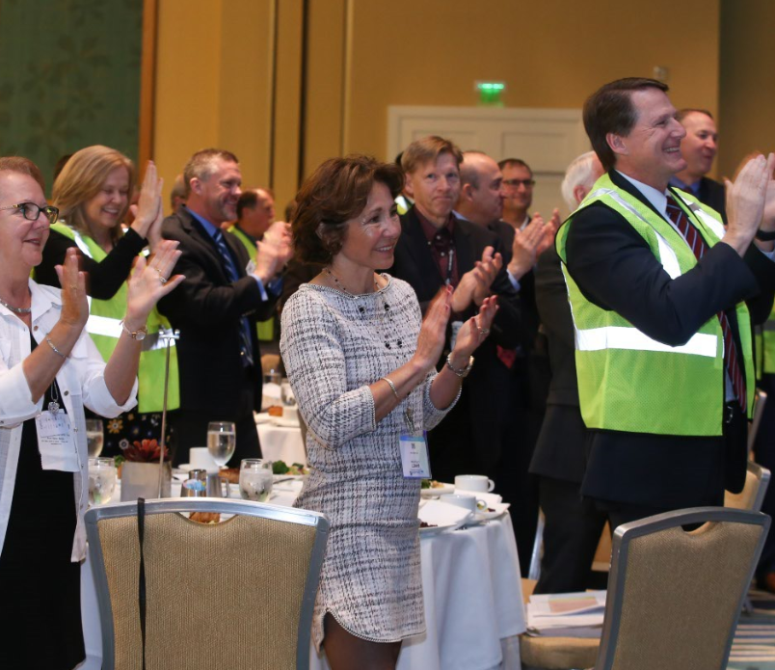
After each Chapter Program
Have members complete program evaluations after each meeting
  Digital form available at https://dlevaluation.ashrae.org/
Notes:
This slide illustrates some of the basic things a Programs Chair should do each month to ensure that Chapter members are well informed about upcoming programs, to get feedback on the quality of these presentations, and to forward that feedback to the RVC.

Slide 20
Chapter Programs Resources
ASHRAE Distinguished Lecturers: www.ashrae.org/distinguishedlecturers
Chapter programs resources: www.ashrae.org/cttc
Professional liability insurance carrier/firms
BOMA: www.boma.org
SMACNA: www.smacna.org
Municipal/State building officials
AIA Institute: www.aia.org
MCAA: www.mcaa.org

Slide 21
Monthly Program Topics/Formats
Panel programs or forums
Technical tours/field trips
Technical/research talks
Student/Membership Promotion
CTTC Tech Hours
All day Chapter seminars
Co-sponsored conferences/seminars
National Engineers Week
Non-technical talk
Joint meetings – USGBC/AIA
Facilities management
Community service activities
Notes:
Here are examples of proven successful program types. This is a good opportunity to have some Chapters discuss examples of these different type of meetings. However, there are two summary slides on monthly programs with details to be covered on later slides. As an alternate you could review the later slides and use them as your talking notes for these two slides; your choice. As such avoid too detailed discussion here unless you delete the later slides.

Slide 22
Technical Talks
Decarbonization
ASHRAE energy efficiency standards
Indoor air quality or environmental health
Ventilation/fans/pumping systems
Building moisture control
Refrigeration design
Life safety (liability/codes)
BacNet/Communications Protocol
Commissioning
Building science topic other than HVAC&R
Natural or low GWP refrigerants (Std. 15 & 34, future refrigerants, cold chain, etc.)
GAC presentation
Residential applications
Notes:
Examples of Technical Talks.

Slide 23
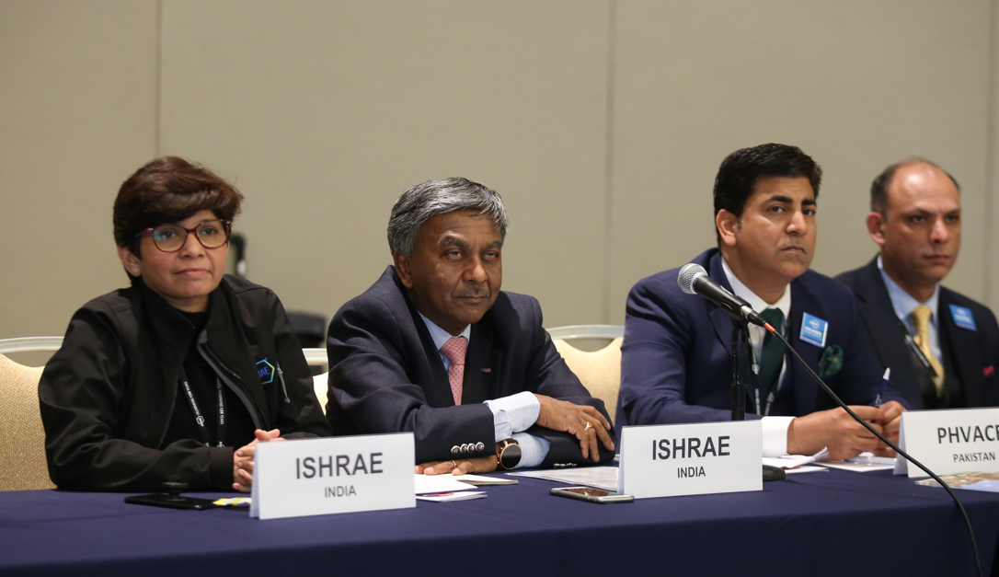
Panel Forum
Contractor, Engineer, Architect, Owner, Code Official, Developer
May draw largest attendance
Can be very entertaining and educational
Notes:
Example of Panel Discussion members; I suggest limiting to about 4 people. If promoted properly, these can quadruple attendance.

Slide 24
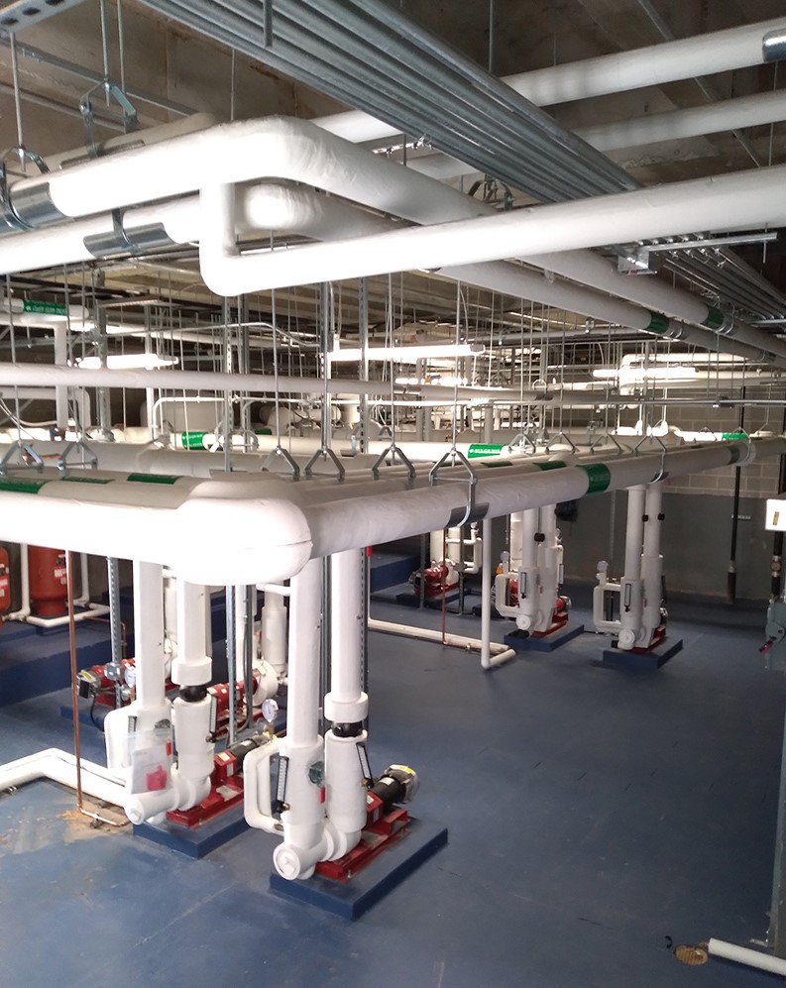
Field Trips
University research labs
Industrial food or beverage processing plant
Application installations
Laboratories
Plant tour
Breweries
Clean rooms
Low temperature manufacturing facility
Cold storage warehouse
Modern supermarket
Notes:
Examples of field trips. Let others tell their success stories.

Slide 25
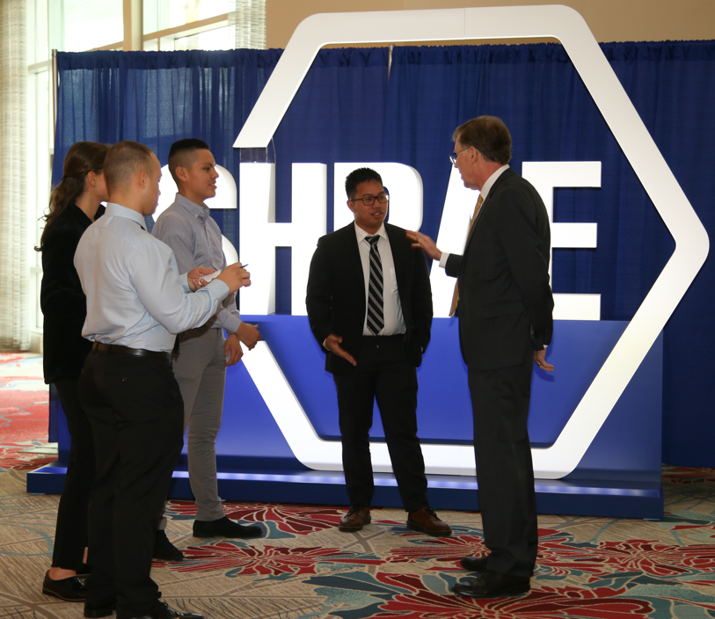
Seminars and Conferences
One or two per year
Valuable in promoting ASHRAE
Technical seminars
Co-sponsored conferences
Notes:
Conducting Seminars, half day type, dove-tailed into a meeting program can be as successful as joint meetings. I suggest including the meeting meal cost in the cost for the seminar so that seminar attendees will stay for the meeting as well. Many people that will attend a seminar will not regularly attend meetings.

Slide 26
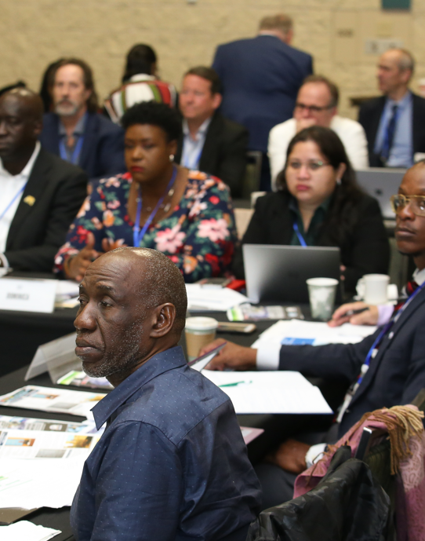
Research Talks
ASHRAE Research (Research Administration Committee Members)
University research
Trade association research
Private research
Notes:
Examples of research talks. Having a research firm or University research team report on the results of an ASHRAE research project can be quite informing. Research by others on items of interest to ASHRAE works as well. Do not let a Research Promotion Chair just present a long list of ASHRAE project topics for a program or use the entire meeting to solicit donations.

Slide 27
Joint Meetings
Other nearby Chapters
Other societies
  Engineering
  Technical
  Architects
  Construction
  Contracting
  Trade
  CSMPS/SMPS
Notes:
Your imagination can go to work here. Think of a joint engineer and Architectural Society meeting, other Engineering Societies, Contractor Organizations, Building Owners, etc. Again, without good promotion, none of these will be successful.

Slide 28
Chapter Product Shows
Maximum of three displays (4x8 table)
No restriction on number of products
Cannot interfere with Chapter meeting
No discussion of product during program
Disclaimer posted in display area and listed in published announcements
Consult Manual of Chapter Operations (MCO) for guidelines
Notes:
Product shows are less common than they used to be at Chapter meetings, but some Chapters have long traditions in having them. Here is the criteria for Product Shows should you have them.

Slide 29
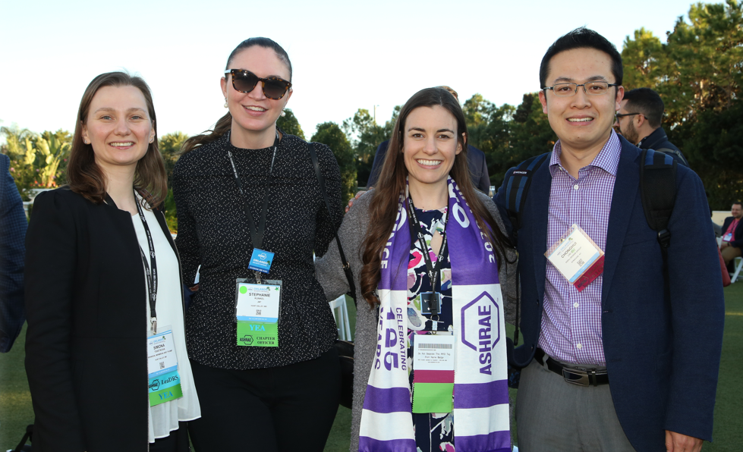
Young Members
Meeting or technical program targeted to the interests of young members
Young member breakfast, luncheon, sports day, picnic, etc.
Career mentoring by senior Chapter members
Professional development seminars
Member of MP or YEA Committee to sit on CTT Committee
Notes:
Coordinate these efforts with your Chapter Student Activities Chair. Ask your student members for ideas on programs of interest to them.

Slide 30
Non-Technical Talks
Leadership skills
Diversity, Equity and Inclusion
Environmental Social Governance
Legal issues (owner, architect, engineer, contractor, manufacturer, sales agent)
  Check with local Bar Association/Professional Liability Insurance firms for speakers
Research and Membership Promotion nights
Building manager/owner problems
Business management, developing economies, legal education
Other ASHRAE groups (Membership, Student Activities, etc)
Notes:
Examples of non-technical programs. For Research Promotion nights I suggest you have your RP Chair highlight a few funded Research project descriptions (just a few or it will get boring) and to make a ceremony out of recognizing your honor roll and higher RP contributors, especially the major contributors.
Sometimes local facilities personnel can provide their perspective on dealing with construction issues, engineers, architects and contractors.
An occasional meeting to help teach people skills or other managerial/leadership skills is a good change of pace. Carefully select speakers for these topics.

Slide 31
Distinguished Lecturer (DL) Program
www.ashrae.org/distinguishedlecturers
Chapter receives excellent lecturer to speak on relevant subjects of interest
Opportunity for joint participation of Chapters, Student Branches, and other organizations
Opportunity for continuing education credits if DL has approved presentations
Society pays lecturer’s transportation to city of event
DLs can provide program meetings, seminars, engagement with governmental or other organizations or firms as well as connection to student groups
Opportunity to work with other Chapters to combine DL visits
  Multi-chapter DL visits are an important strategy to reduce the carbon footprint of DL travel through combining trips and maximizing the DL exposure to membership
Notes:
This slide and materials should be highlighted.
Ask Chapter CTTC Chairs to make their interest known before they leave the CRC Workshop.

Slide 32
Distinguished Lecturer (DL) Program Chapter Responsibilities
Complete Participation Form and submit to RVC. RVC approval is required for ASHRAE-paid visits.
Promote DL visit as a special event
Reimburse DL for hotel, local transportation, and meals
Prepare attendance certificates for distribution to attendees
Complete the Event Summary Critique (ESC) form
Share digital DL Evaluation form with all attendees
Collect evaluation forms at the end of the meeting
Compile the attendee rating on the ESC Form
Send completed ESC form to your CTTC RVC and ASHRAE HQ
CTTC needs your feedback to continue to improve the DL Program
Notes:
Remind the chapters of the extreme importance in promoting these presentations and speakers. Also let them know that they can have a DL even though not allotted through the Region, if the they elect to cover the transportation and all other local expenses

Slide 33
Distinguished Lecturer (DL) Program
HQ Responsibilities
When Participation Form is received, the Chapter, DL, and RVCs are sent confirmation
Chapter is sent publicity materials to use in promoting event
DL is reimbursed for transportation to city of event following the visit
DLs who attend the CRC are advised to give a brief of their experience during the CTTC workshop
Notes:
Form must be sent to RVC first who then forwards it to ASHRAE.
** check if a DL is present in the CTTC Training workshop, and give him/her 5-10 minutes to share his/her experience with the attendees

Slide 34

Tech Hour
Tech Hour videos are one-hour in length and worth 1 PDH
  Note that PDHs are only available for 12 months after broadcasting
2-4 Tech Hours are published each year
Videos are first available on the ASHRAE 365 app and are posted to the ASHRAE website
Visit www.ashrae.org/techhour for more information

Slide 35
CTTC Awards Summary
Award | Entry Deadlines | Description | Comments
Donald A. Siller | Sept 30th | Outstanding Refrigeration Chair | Form with points
Dan Mills | Sept 30th | Outstanding CTTC Chair | Form with points by chapter chair Nominated by CTTC RVC
Milton W. Garland Award | April 1st for the region May 1st for society | A non-comfort cooling refrigeration application which highlights innovation and/or new technologies | Submit a form about the project
Technology Awards | Regional deadline set by RVC June 1st for society | Recognition of innovative design | There is a paper submission & application for a project that has been in use for at least 1 year
Energy Genius Award | Sept 30th | Excellence in the assessment of building energy performance using ASHRAE Building EQ | ASHRAE Building EQ In Operation project

Slide 36
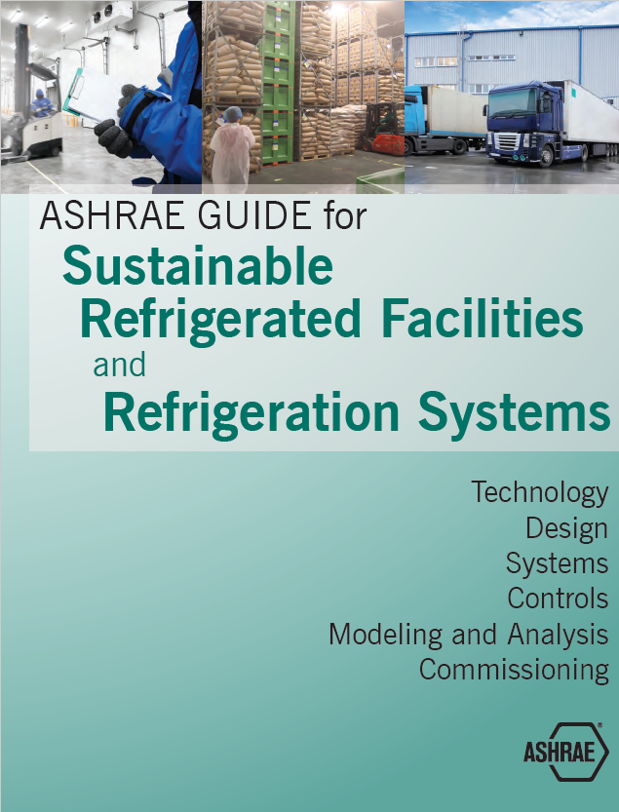
Don’t Forget the “R” in ASHRAE
Refrigeration
Assign a Refrigeration Chair
Plan a Chapter refrigeration month
Schedule a DL or other speaker with a refrigeration focused theme
Plan technical tours of ice rinks, breweries, food processing plants
Use Technical Committees (TC 10 – Refrigeration Systems) for programs topics and news
Promote ASHRAE refrigeration awards

Slide 37

ASHRAE Learning Institute (ALI)
Chapter Professional Development
Instructor-led seminars
Self-paced courses
Developed and presented by subject matter experts at discounted rates to Chapters
Each seminar uses ASHRAE peer-reviewed materials that provide practical information that can be put to immediate practice
Visit www.ashrae.org/education for more information
Discount coupons are available for Chapters to distribute as incentive for involvement
Notes:
These are resources to supplement the normal Chapter meeting programs and do provide a value to ASHRAE members.

Slide 38




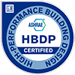

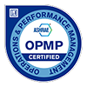

ASHRAE Certification
Chapters earn PAOE points for each member who earns or renews an ASHRAE Certification
  Points now automatically applied through Society level processes.
ASHRAE offers eight certification programs:
  Building Commissioning Professional Certification - BCxP
  Building Energy Assessment Professional Certification - BEAP
  Building Energy Modeling Professional Certification - BEMP
  Certified HVAC Designer - CHD
  High-Performance Building Design Professional Certification - HBDP
  Healthcare Facility Design Professional Certification - HFDP
  Operations & Performance Management Professional Certification – OPMP
  Decarbonization Professional Certification - CDP
Visit www.ashrae.org/certification for more information

Slide 39
Presidential Award of Excellence
(PAOE)
CTTC Chairs are responsible for coordinating with their chapters to track, record and enter CTTC PAOE points
CTTC Chairs should coordinate goals with Chapter PAOE Chair and Chapter Executive
PAOE recognizes and rewards members who perform activities to support ASHRAE Presidential initiatives
  Aligning program topics with ASHRAE Presidential initiatives helps to ensure messaging to members in in-line with Presidential objectives
The PAOE newsletter, instructions, and award descriptions are available at www.ashrae.org (typically posted in July)

Slide 40
CTTC Chair - Key Tasks
Ensure CIQ has correct contacts/positions
Establish CTTC Chair and committee
Establish Refrigeration Chair and committee
Look for Technology Award projects to submit
Review potential DL speakers in summer planning session and submit DL form to RVC in August
  Note that all DL participation forms MUST be sent to RVC
Use PAOE as a roadmap with activities to plan and set goals for a successful year
Send monthly reports to RVC

Slide 41
CTTC Chair – Key Dates
Action Item | Deadline
Complete CIQ | 60 days prior to CRC
Final PAOE Entries | July 15th
DL Allocations | Confirm DLs and submit participation forms to RVC Deadline date set by RVC (typically between August and October)
Awards (Dan Mills, Donald A. Siller, Energy Genius) | September 30th
DL Pool Visits | December 1st – Unclaimed allocations entered into pool
Chapter Technology Award Submissions to Chapter Chair | Date set by Chapter Chair – coordinate with RVC
Award (Milton W. Garland) | April 1st
Regional Technology Award Submissions to RVC | Date set by RVC
Society Technology Awards | June 1st

Slide 42

Farr and Setty Family Foundation Funds Scholarships for ALI, ACT, and eLearning Registrants
Professional Development
ASHRAE Members in their first 5 years of membership get 35% off one ALI, ACT, or eLearning course—thanks to support from the Farr and Setty Family Foundation Funds!​
One-time use per Society Year​
Apply 3 weeks before your course​
Must include a chapter officer’s support letter​
Where to apply? Check the page of the course you’re interested for an application.
Notes:
ASHRAE Professional Engineering and Technology Development Funds are available to support young professionals in their first five years of their ASHRAE career who want to expand their knowledge in the heating, ventilation, air conditioning, and refrigeration (HVAC&R) industry. The available funds are designated to cover a portion of the registration fees that may be preventing you from participating in an ASHRAE Learning Institute course. Applications are reviewed on a rolling bases.

Slide 43
Final Thoughts
CTTC is how most members connect with ASHRAE Society
"Without effective CTTC Chairs, the Society fails. If we can't get people to a meeting in a well lit, comfortable location; with an engaging, easily understandable speaker; to hear a timely topic of broad interest; with a quality meal; and in a convenient location....they won't stay in ASHRAE nor encourage their colleagues to (MP fails); they won't donate to research (RP fails); they won't encourage students or young engineers to participate (oops there go Student Activities and YEA). You get the point. We, in the CTTC business, are Society's contacts to the membership. WE make the first impression.“
-Jeff Gatlin, Former Region VII CTTC RVC and Region VII DRC
Effective CTTC Chairs are critical to the success of the Society as WE make the first impression

Slide 44
Where to Get More Information
Your CTTC Regional Vice Chair
Rhiannon Masterson – ASHRAE Chapter Programs Manager
chapterprograms@ashrae.org
CTTC webpage
www.ashrae.org/cttc
Manual of Chapter Operations (MCO)
www.ashrae.org

