Slide 1
ASHRAE TCs
Julia Keen, PE, PhD, HBDP, BEAP
Professor
Department of Architectural Engineering & Construction Science
Kansas State University
jkeen@ksu.edu
Notes:
This presentation will provide a general introduction to the ASHRAE Technical Activities Committee (TAC) and the numerous technical committees (TCs) and related committees (such as TGs, TRGs and MTGs) that support ASHRAE’s development and dissemination of knowledge. The objective of this presentation is to provide a broad roadmap of this aspect of life within ASHRAE.
The contact point is -- Mike Vaughn; E-mail: MORTS@ashrae.net; phone: (404) 636-8400

Slide 2
ASHRAE Technical Committees (TCs)
Notes:
This presentation will provide a general introduction to the ASHRAE Technical Activities Committee (TAC) and the numerous technical committees (TCs) and related committees (such as TGs, TRGs and MTGs) that support ASHRAE’s development and dissemination of knowledge. The objective of this presentation is to provide a broad roadmap of this aspect of life within ASHRAE.
The contact point is -- Mike Vaughn; E-mail: MORTS@ashrae.net; phone: (404) 636-8400

Slide 3
What is an ASHRAE Technical Committee (TC)?
Group of volunteers who provide the Society with expertise in a specific field or subject.
93 TCs organized into 10 sections
Notes:
There are currently 93 TCs organized into 10 sections. Each TC has a defined scope and is numbered and named. Examples are: TC 10.2 Refrigerant Piping; TC 7.9 Building Commissioning; and TC 4.5 Fenestration. TCs are formally structured with a chair, vice-chair, secretary, sub-committee chairs, liaisons, sub-committee members, and other specialized assignments (such as Webmaster). TC members are designated as Voting Members and non-voting members (who may include Corresponding Members and Provisional Corresponding Members). The role of liaison is to connect TCs to other elements within ASHRAE and to external organizations. TCs meet twice a year (at the Winter and Summer ASHRAE meetings).

Slide 4
Sections
SECTION 1.0 FUNDAMENTALS AND GENERAL
SECTION 2.0 ENVIRONMENTAL QUALITY
SECTION 3.0 MATERIALS AND PROCESSES
SECTION 4.0 LOAD CALCULATIONS & ENERGY REQUIREMENTS
SECTION 5.0 VENTILATION AND AIR DISTRIBUTION
SECTION 6.0 HEATING EQUIPMENT, HEATING & COOLING SYSTEMS & APPLICATIONS
SECTION 7.0 BUILDING PERFORMANCE
SECTION 8.0 AIR-CONDITIONING & REFRIG SYSTEM COMPONENTS
SECTION 9.0 BUILDING APPLICATIONS
SECTION 10.0 REFRIGERATION SYSTEMS
SECTION MTG MULTIDISCIPLINARY TASK GROUPS
Notes:
Although the sections listed here are fairly stable, TCs within the sections may merge, spin off into new TCs, or even shut down – in response to current demands within the industry and profession. MTGs are a new addition to the array of technical committee types, and have experienced rapid growth in response to ever more complex technical matters that span sections.

Slide 5
How Does an ASHRAE Technical Committee (TC) Work?
TAC
Section Head
TC
Chair
Officers
Subcommittees
TC
Vice-Chair
TC
Secretary
Handbook
TC
Webmaster
Research
TC Members
Voting Members
Corresponding Members
Provisional Corresponding Members
Program
Formal
Liaisons
Standards
Informal
Liaisons
Other
Notes:
This is a diagram of a typical technical committee. All TC members are volunteers. New members are always needed to energize the thinking and planning of the committee work. ASHRAE members who are already committed to attend the bi-annual meetings of the society are encouraged to attend a committee meeting or a sub-committee meetings and if interested in what you see -- volunteer to join a technical committee. TC membership is also open to non-ASHRAE members.
5

Slide 6
Who is on a TC?
All members are volunteers
Members represent diverse backgrounds:
manufacturers
consultants
researchers
universities
utilities
regulators
contractors
government
others
Notes:
The membership of a TC is comprised of interested parties who have been formally appointed by ASHRAE. Typically a member previously attended a TC meeting or a program sponsored by a TC, became interested in ongoing participation, and applied for membership. The typical pattern is for someone to be a corresponding member (non-voting) for a few years and then apply for voting membership. There are limits on the number of voting members on a TC (6 minimum and 18 maximum). Participation on committees is fluid, with voting members rolling on and off the committee in annual cycles (with reappointments likely). The committee officers also cycle through leadership roles. ANYONE MAY ATTEND A TC MEETING. If you have not done so, please attend one and experience this side of ASHRAE.
One restriction on TC membership is that no more than one member of a given TC may be from the same firm/corporation.

Slide 7
TCs Participate in 5 Key
Areas of the Society
Research
Standards
Handbooks
Programs
Other Technical Activities such as paper reviews
Notes:
TCs are organized into subcommittees. The key subcommittees are those dealing with research, program, Handbook, and standards. The research subcommittee is charged with developing research proposals in the area of expertise of the TC. Such proposals are submitted to the ASHRAE Research Administration Committee (RAC) for funding consideration. Program ideas developed by the programs subcommittee are discussed by the full TC and sent to the ASHRAE Conferences and Expositions Committee (CEC) for potential inclusion in subsequent ASHRAE conferences. Many TCs are responsible for the content of one or more chapters in the ASHRAE Handbook series. Many TCs serve as cognizant (parent) committees for ASHRAE standards and guidelines. Other technical needs of the Society may be channeled through TCs.

Slide 8
How to get involved in TCs
Check out the ASHRAE website for list of TCs
TC scopes posted
TC homepages
E-mail the chair about your interest
Apply for provisional corresponding membership directly on website
Attend Society meeting
TCs meet at the Winter & Annual meetings
All meetings are open to guests
Notes:
Select the Standards, Research & Technology menu on the ASHRAE homepage, then select Technical Committees from the left-hand menu list for full information on all ASHRAE TCs, TGs, TRGs, and MTGs. The websites maintained by the individual TCs are a great place to find out more about what a TC is actually doing and who to contact to get involved.
A bit of information regarding Provisional Corresponding Members, and how they differ from Corresponding Members:
Provisional Corresponding Members are temporary additions to the TC/TG/TRG roster made by ASHRAE staff between roster update cycles, usually at the request of someone wanting to participate in the technical committee. If the technical committee chair takes no action on a Provisional Corresponding Member, they are dropped from the roster after two years. For purposes of committee assignments and other work of the TC/TG/TRG committee, the status of “Provisional” should not limit an individual’s active involvement in the work of the TC/TG/TRG. To apply: e-mail MORTS@ashrae.net
Corresponding Members are expected to participate in TC/TG/TRG activities and attend meetings when possible, but may not vote on TC/TG/TRG business. They may, however, serve on and chair TC/TG/TRG subcommittees, including Proposal Evaluation and Project Monitoring Subcommittees, and may vote at the subcommittee level. A Corresponding Member may also serve as Vice Chair or Secretary of a TC/TG/TRG if he/she attends meetings regularly.

Slide 9
Opportunities for
“Remote” Participation
Historically participation in-person
Other options:
Corresponding Committee Member status
Provisional Corresponding Member status
Informal linkage to a committee
Submit program ideas to committee
Review handbook chapters for committee
Review papers for committee
Submit research ideas to committee
Provide webmaster services to committee
Other ….
Notes:
It is possible to participate in committee activities and contribute to committee efforts even if you find it impossible to attend committee meetings on a regular basis. Don’t feel excluded because you cannot attend the winter and summer conferences.
There are two formal means of remote participation: Corresponding membership and Provisional Corresponding membership. These options were discussed in slide 11 (above).
Informal participation is also possible. Committees are always looking for dependable volunteers. Contact the committee chair (via the ASHRAE web site) and express an interest in being involved. Be clear that you may not be able to attend the bi-annual committee meetings, but have time otherwise to contribute to the committee’s work. Several informal ways to participate are noted on the slide and many of these efforts do not require travel to the winter and summer conferences.

Slide 10
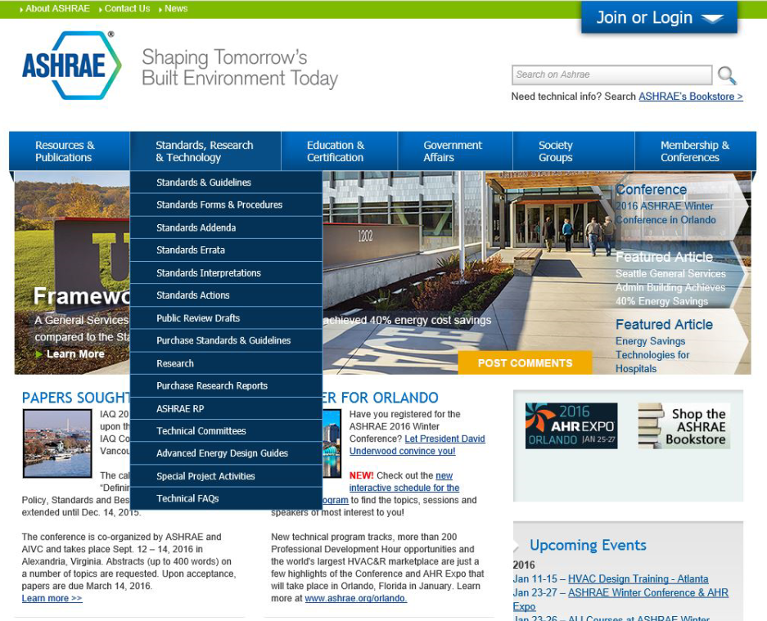

Slide 11
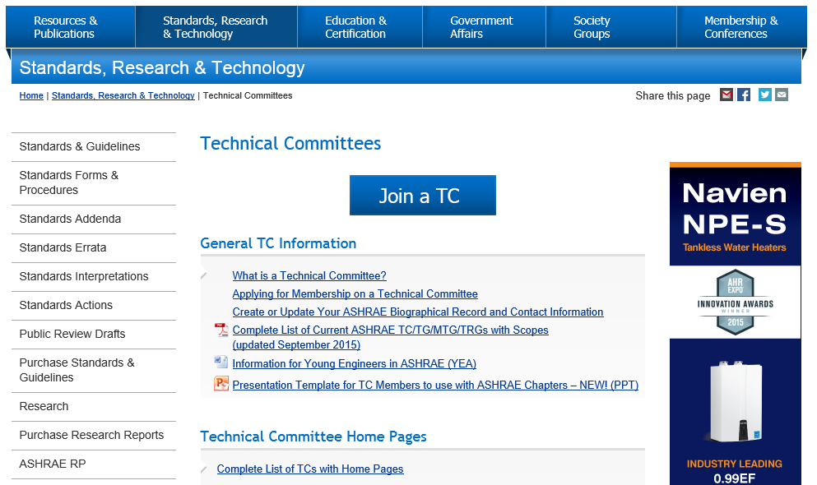

Slide 12
Notes:
This is an example showing the title and scope of Technical Committee 7.9

Slide 13
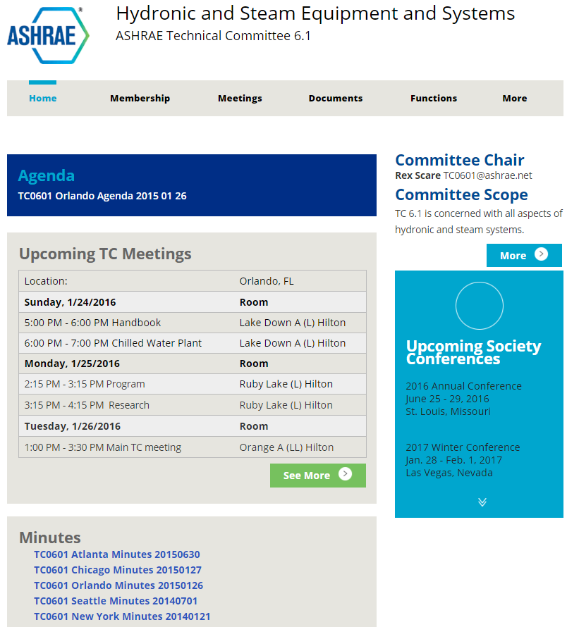
TC6.1 Website
Notes:
Here is the home page from the TC 7.9 website. Note the seminars that were sponsored at the June 2012 annual meeting in San Antonio and a schedule of the TC’s sub-committee meetings (with room locations). TC web sites are a great way to find out what is happening within the TC.

Slide 14
VOLUNTEER!
YOU ARE NEEDED FOR:
Program ideas
Research ideas
Handbook ideas
Standards ideas
Student mentoring
Find your Place in ASHRAE! Visit www.ashrae.org
Notes:
It is possible to use ASHRAE as an information resource and not contribute to the development of that information. Possible – but not nearly as fulfilling! ASHRAE thrives only through the volunteer work of thousands of professionals. Don’t treat ASHRAE as a spectator sport – participate. Opportunities are everywhere.
From the ASHRAE homepage (www.ashae.org) click one of the first two dropdown menu tabs for connections to Research, Standards, Technology, and Handbook. Click the far right menu tab for Conferences.

