Slide 1
ASHRAE Technical Committees
– The Who, What, and How
Prepared by ASHRAE’s
Technical Activities Committee
2016
For further information, please contact the Manager of Research and Technical Services at ASHRAE Headquarters
Notes:
This presentation provides a general introduction to the ASHRAE technical committees (TCs) and related committees (such as TGs, TRGs and MTGs) that support ASHRAE’s development and dissemination of knowledge. The objective of this presentation is to provide a broad roadmap of this aspect of the Society’s work.
The contact point is -- Mike Vaughn; E-mail: MORTS@ashrae.net; phone: (404) 636-8400 (CLICK NEXT)

Slide 2
ASHRAE Has Four Types of Committees Whose Focus is Primarily on Technical Information
Technical Committees (TCs)
Task Groups (TGs)
Technical Resource Groups (TRGs)
Multidisciplinary Task Groups (MTGs)
  Group of volunteers who provide the Society with expertise in a specific field or subject.
Notes:
There are four types of committees that do the day-to-day grassroots technical work within ASHRAE. (CLICK NEXT) TCs (technical committees) are the most common and address a wide range of topics. (CLICK NEXT) TGs. (CLICK NEXT) and TRGs (task groups and technical resource groups) are formed with a specific concern in mind. (CLICK NEXT) MTGs (multidisciplinary task groups) (CLICK NEXT) are temporary groups of representatives from several committees (TCs, TGs and others) which are formed to address a specific topic that is broader than the scope of any one technical committee.
The next few slides focus on TCs - the type of committee which handles the Society’s technical issues, and as such is the primary committee type supporting ASHRAE. (CLICK NEXT)

Slide 3
TC, TG, or TRG members
volunteers
All members are
Three types of membership
  Voting
  Corresponding (non voting)
  Provisional Corresponding (non voting)
Notes:
Volunteers -- the pay is terrible, the benefits are outstanding! (CLICK NEXT)
TC membership is comprised of parties who express interest in participating on the committee and then are added to the membership role by ASHRAE. (CLICK NEXT)
Voting members have the responsibility to approve actions initiated by the committee. (CLICK NEXT)
Corresponding members and provisional corresponding members do not vote but have the responsibility to provide their expertise to the committee during discussions. They may also be members of subcommittees and vote on those subcommittees. . (CLICK NEXT)
New members (Provisional Corresponding Members) are always needed to energize the thinking, planning and carrying out of the committee work.
One restriction on TC membership is that no more than one voting member of a given TC may be from the same firm/corporation. (CLICK NEXT)

Slide 4
Who is on a TC, TG, or TRG?
volunteers
All members are
Members represent diverse backgrounds:
  manufacturers
  consultants
  researchers
  universities
  utilities
  regulators
  contractors
  Government
Notes:
Volunteer members come from all facets of our industry. (CLICK NEXT) The only thing needed is an interest in and willingness to help improve the work of the committee. You don’t have to be a ‘technical guru’ or have an advanced degree to participate – everyone’s input is needed. (Keep CLICKing NEXT while talking below – stop when “government” appears – 8 clicks)
A member may have previously attended a TC meeting or a program sponsored by a TC, became interested in ongoing participation, and applied for membership, however, now an interested person may directly apply for provisional corresponding member right from the TC website or from the main ASHRAE website and be automatically added to the TC roster.
There are limits on the number of voting members on a TC (6 minimum and 18 maximum). Typically someone may be a corresponding member (non-voting) for a few years, participate in the Committee activities and then apply for voting membership. Participation on committees is fluid, with voting members rolling on and off the committee in annual cycles (with reappointments likely). The committee officers also cycle through leadership roles. ANYONE MAY ATTEND A TC MEETING. If you have not done so, please attend one and experience this side of ASHRAE. (CLICK NEXT)

Slide 5
How Does an ASHRAE
Technical Committee (TC) Work?
TAC
Section Head
TC
Chair
Officers
Subcommittees
TC
Vice-Chair
TC
Secretary
Handbook
TC
Webmaster
Research
TC Members
Voting Members
Corresponding Members
Provisional Corresponding Members
Program
Formal
Liaisons
Standards
Informal
Liaisons
Other
Notes:
This is the typical structure of a technical committee. The majority of the TC’s work is initiated in its subcommittees. The key subcommittees are those dealing with Research, Standards, Handbook, and Program. The next few slides will talk about these principal duties.
When you attend a bi-annual meeting of the society, attend a committee meeting or a sub-committee meeting and if interested in what you see -- volunteer to join a technical committee.
Participation in a subcommittee is typically a pathway to active participation in the TC.
TC membership is open to non-ASHRAE members as well. (CLICK NEXT)
5

Slide 6
ASHRAE Research - Initiated
& Monitored
Identify needed research
Develop research work statements
Evaluate proposals
Monitor the research project
Ensure results are disseminated
to the Society
Notes:
ASHRAE TCs play a vital role in (CLICK NEXT) developing ideas for ASHRAE-funded research projects, (CLICK NEXT) converting these ideas into viable proposals, (CLICK NEXT) reviewing and evaluating proposals from contractors bidding on such proposals, (CLICK NEXT) monitoring the progress and quality of ongoing research projects, and (CLICK NEXT) ensuring that the results of ASHRAE research are appropriately included in programs, the ASHRAE Handbook, and journal articles. . (CLICK NEXT)

Slide 7
Participate in the ASHRAE Standards Process
Primary responsibility for document development lies with Standards Project Committees (SPCs)
Recommend topics needing a standard
Regularly review the TC’s standards
May be asked to be members of the SPC
Provide liaisons to SPCs
May be asked to provide concurrence with
non-ASHRAE standards (e.g. ASTM or ISO)
Notes:
ASHRAE Standards (CLICK NEXT) While Standards Project Committees are tasked with developing an ASHRAE standard or guideline, TCs are most often the birthplace. (CLICK NEXT)
A TC identifies a need for a standard, prepares a proposal for standard development, suggests membership for the project committee, seeks approval through the ASHRAE Standards Committee, and serves as a formal or informal technical resource for the resulting Standard Project Committee (SPC). (CLICK NEXT)
ASHRAE also requires cognizant TC’s to review their standards on a five year cycle and to recommend whether to keep, update, eliminate, or otherwise change the standard based on the technical needs of the HVAC/R industry. (CLICK NEXT)
The chair and/or members of the standard project committee may be members of the TC although they do NOT represent the TC but represent their area of the Society’s membership, i.e. industry, manufacturer, government, user, and the public. (CLICK NEXT)
Sometimes a TC member may be asked to be a liaison to provide a particular expertise to the SPC. . (CLICK NEXT)
Occasionally a TC may be asked to look at non ASHRAE standards and make a recommendation. (CLICK NEXT)

Slide 8
Handbook Chapters
Assigned chapters consistent with their expertise/scope
Most have standing handbook subcommittees to write and revise chapters and may be responsible for multiple chapters.
Responsibility for chapters is listed in the Handbook (as are major content contributors)
Notes:
(CLICK NEXT) The ASHRAE Handbooks (Fundamentals; Refrigeration; HVAC Applications; and HVAC Systems and Equipment) are a critical part of ASHRAE’s information dissemination mission. (CLICK NEXT) A Handbook Subcommittee is responsible for this work within the committee.
Each Handbook volume is published on a four-year cycle and responsibility for maintaining the accuracy and currency of the majority of the chapters in the Handbooks resides with a TC, TRG, or TG. (CLICK NEXT)
Look in the Handbook to find out who is responsible for each chapter as well as who contributed to its development and maintenance. (CLICK NEXT)

Slide 9
Programs for ASHRAE Conferences
The committees and their members suggest topics and sessions for presentation, thus almost all of the conference programs are sponsored by the TCs, TGs, and TRGs.
Technical & Conference Paper Sessions (Symposia)
  Paper sessions on specific topics that are published in ASHRAE Transactions usually initiated by TCs or TGs and reviewers are usually from TCs, TGs, or TRGs
Seminars and Forums
  Majority of these sessions are proposed, developed, and presented by committee members.
  Seminar topics include basics, recent advances, and on-going research of members and their organizations.
  Forums involve audience participation on questions posed by TCs to identify members’ technical needs.
Notes:
While the ASHRAE Handbooks provide archival-quality information for the professions, (CLICK NEXT) the biannual ASHRAE conferences provide the opportunity for a range of presentations of materials covering a wide spectrum of interests. This part of the TC effort is led by the Programs Subcommittee. As with all ASHRAE TC subcommittees, membership is open to both voting and non-voting TC members.
There are several types of programs. (CLICK NEXT) Technical and conference papers, (CLICK NEXT) presenting written papers, (CLICK NEXT) Seminars and forums. (CLICK NEXT) proposed by TC members (CLICK NEXT) several levels of topics (CLICK NEXT) informal meetings.
TCs and TGs play an important role in shaping these conferences through the development of session ideas, the identification of qualified presenters, the review of technical papers, and the promotion of sessions among their members. (CLICK NEXT)

Slide 10
How to get involved
  Cruise the ASHRAE website to see which are most relevant to your interests and expertise
(https://www.ashrae.org/standards-research--technology/technical-committees)
  TC scopes available for all
  TCs have websites
Then choose a way to get involved
  E-mail the secretary or chair about your interest (see TC website for specific email address)
  Apply for provisional corresponding membership directly from the TC website(s).
  Attend Society Winter and Annual meetings and the TC(s) you are interested in – volunteer!
Notes:
How do you get involved? (CLICK NEXT) Select the Standards, Research & Technology menu on the ASHRAE homepage, (CLICK NEXT) then select Technical Committees from the left-hand menu list (CLICK NEXT) for full information on all ASHRAE TCs, TGs, TRGs, and MTGs. (CLICK NEXT) The websites maintained by the individual TCs are a great place to find out more about what a TC is actually doing (CLICK NEXT) and who to contact to get involved. (CLICK NEXT)
Email the TC chair (CLICK NEXT)
Provisional Corresponding Members are a little different than Corresponding Members:
Provisional Corresponding Members are additions to the TC/TG/TRG roster made by ASHRAE staff between roster update cycles, usually at the request of someone wanting to participate in the technical committee. If the technical committee chair takes no action on a Provisional Corresponding Member, they are dropped from the roster after two years. For purposes of committee assignments and other work of the TC/TG/TRG committee, the status of “Provisional” does not limit an individual’s active involvement in the work of the TC/TG/TRG.
Corresponding Members are expected to participate in TC/TG/TRG activities and attend meetings when possible, but may not vote on TC/TG/TRG business. They may, however, serve on, chair and vote on TC/TG/TRG subcommittees, including Proposal Evaluation and Project Monitoring Subcommittees. A Corresponding Member may also serve as Vice Chair or Secretary of a TC/TG/TRG if they attend meetings regularly. (CLICK NEXT)
Go to a meeting (CLICK NEXT)

Slide 11
“Remote” Participation
Participation has historically been based upon attendance at the winter and summer conferences
Committee members (Voting, Corresponding, Provisional Corresponding) get all minutes and other documents distributed by the committee.
Remote Participation in Meetings (RPM) enable some committees to include members and others who are unable to be physically present
  Happens at the time of the committee meeting
  Not all committees do this – need to find out ahead and sign up
  Webinar – can see info being shown
Volunteer to help
Notes:
How can you participate? (CLICK NEXT) While being physically present is the most common means of participation, It is possible to participate in committee activities and contribute to committee efforts even if you find it impossible to attend committee meetings on a regular basis. (CLICK NEXT)
There are two formal means of remote participation: Corresponding membership and Provisional Corresponding membership as discussed. This allows you to receive all of the minutes and correspondence from the committee, the opportunity to correspond with the committee leadership and participate in the activities of the committee (Handbook chapter revision for instance). (CLICK NEXT)
ASHRAE is working to provide the ability for anyone to participate in a committee meeting via an audio only conference call similar to a web meeting. These are known as “RPMs”. (CLICK NEXT)
The calls happen at the time of the meeting (CLICK NEXT) At this time not all committees participate (CLICK NEXT) And It a webinar so that you get to see all of the information being shown to the committee members present (CLICK NEXT)
Committees are always looking for dependable volunteers. Contact the committee chair (via the TC web site) and express an interest in being involved. Be clear that you may not be able to attend the bi-annual committee meetings, but have time otherwise to contribute to the committee’s work. You will probably be made a provisional or corresponding member at this point. (CLICK NEXT)

Slide 12
Technical Committee Sections
SECTION 1.0 FUNDAMENTALS AND GENERAL
SECTION 2.0 ENVIRONMENTAL QUALITY
SECTION 3.0 MATERIALS AND PROCESSES
SECTION 4.0 LOAD CALCULATIONS AND
ENERGY REQUIREMENTS
SECTION 5.0 VENTILATION AND AIR
DISTRIBUTION
SECTION 6.0 HEATING EQUIPMENT,
HEATING & COOLING SYSTEMS
AND APPLICATIONS
SECTION 7.0 BUILDING PERFORMANCE
SECTION 8.0 AIR-CONDITIONING &
REFRIGERATION SYSTEM
COMPONENTS
SECTION 9.0 BUILDING APPLICATIONS
SECTION 10.0 REFRIGERATION SYSTEMS
SECTION MTG MULTIDISCIPLINARY TASK GROUPS
Notes:
Currently, the ASHRAE technical committees are organized in these 10 sections.
Although the sections listed here are fairly stable, TCs within the sections may merge, spin off into new TCs, or even disband– in response to current demands within the industry and profession. MTGs, a new addition, have experienced growth in response to ever more complex technical matters that span sections. (CLICK NEXT)

Slide 13
ASHRAE Will Give You the World
TEACH
Give Back to ASHRAE
NETWORK
GROW
LEARN
SHARE
Notes:
Participation in ASHRAE activities is an excellent way to advance your career – technically, personally, and from a business perspective. If you are involved in the HVAC&R field, or a closely related field, ASHRAE is the go-to organization for professional advancement.
Help ASHRAE shape the industry, advance research, and disseminate critical information. (CLICK NEXT)

Slide 14
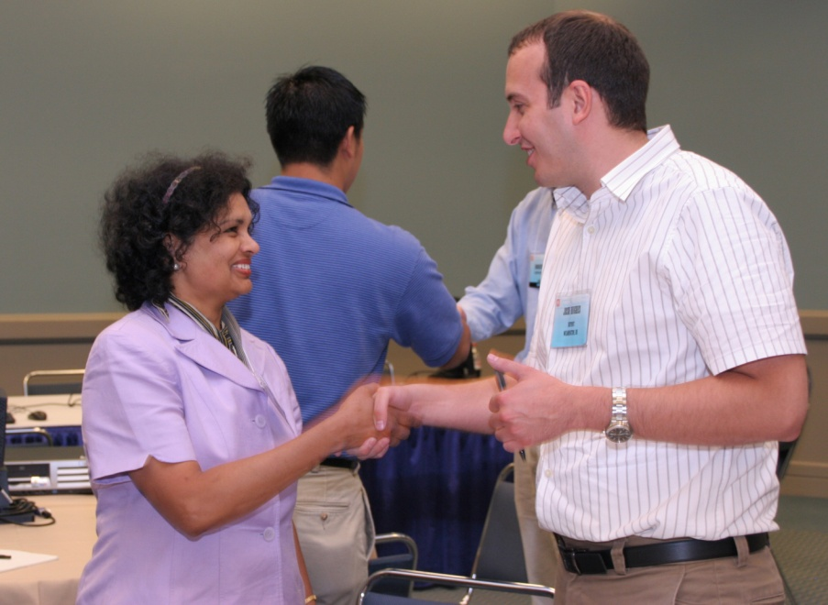
VOLUNTEER!
Become A Future Leader in ASHRAE – Write the Next Chapter In Your Career
ASHRAE members who participate in technical activities become leaders and bring information and resources back to their jobs and their chapters.
YOU ARE NEEDED FOR:
Program ideas
Research ideas
Handbook ideas
Standards ideas
Student mentoring
Find your Place in ASHRAE! Visit www.ashrae.org
Notes:
It is possible to use ASHRAE as an information resource and not contribute to the development of that information. Possible – but not nearly as fulfilling! ASHRAE thrives only through the volunteer work of thousands of professionals. Don’t treat ASHRAE as a spectator sport – participate. Opportunities are everywhere.
Explore the ASHRAE web site. From the ASHRAE homepage (www.ashae.org) click one of the first two dropdown menu tabs for connections to Research, Standards, Technology, and Handbook. Click the far right menu tab for Conferences.
Whether you realize it or not, you are ‘the expert’ in something that could be a valuable addition to ASHRAE and its members.
This is the end of the presentation (CLICK NEXT)

