Slide 1



Chapter Regional Conference
Presentation for ASHRAE Volunteers
Notes:
This presentation is intended to assist volunteers in their day to day operations by including resources created specific to ASHRAE volunteers. The information is organized based on the mega menus of the ashrae.org website, which you’ll see at the top of each slide.

Slide 2
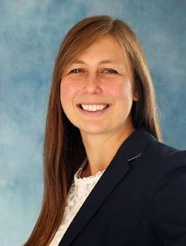

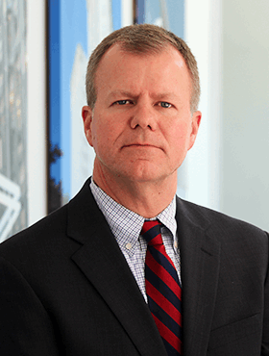

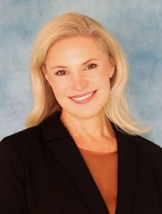
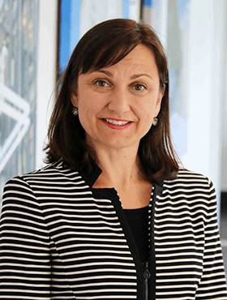

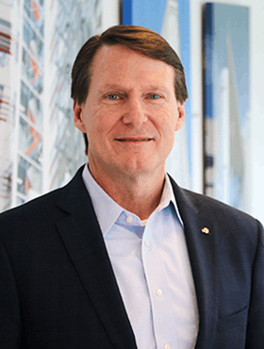
ABOUT
ASHRAE Staff Directors
TECHNICAL RESOURCES
PROFESSIONAL DEVELOPMENT
CONFERENCES
COMMUNITIES
MEMBERSHIP
Lizzy Seymour,
Director of Members Services
Vanita Gupta,
Director of Marketing
Craig Wright,
Director of Finance & Administrative Services
Mark Owen, Director of Publications & Education
lseymour@ashrae.org
vgupta@ashrae.org
cwright@ashrae.org
mowen@ashrae.org
Kirstin Pilot,
Director of Development
Alice Yates,
Director of Government Affairs
Stephanie Reiniche, Director of Technology
Jeff Littleton, Executive Vice President, Board Secretary
kpilot@ashrae.org
ayates@ashrae.org
sreiniche@ashrae.org
jlittleton@ashrae.org

Slide 3
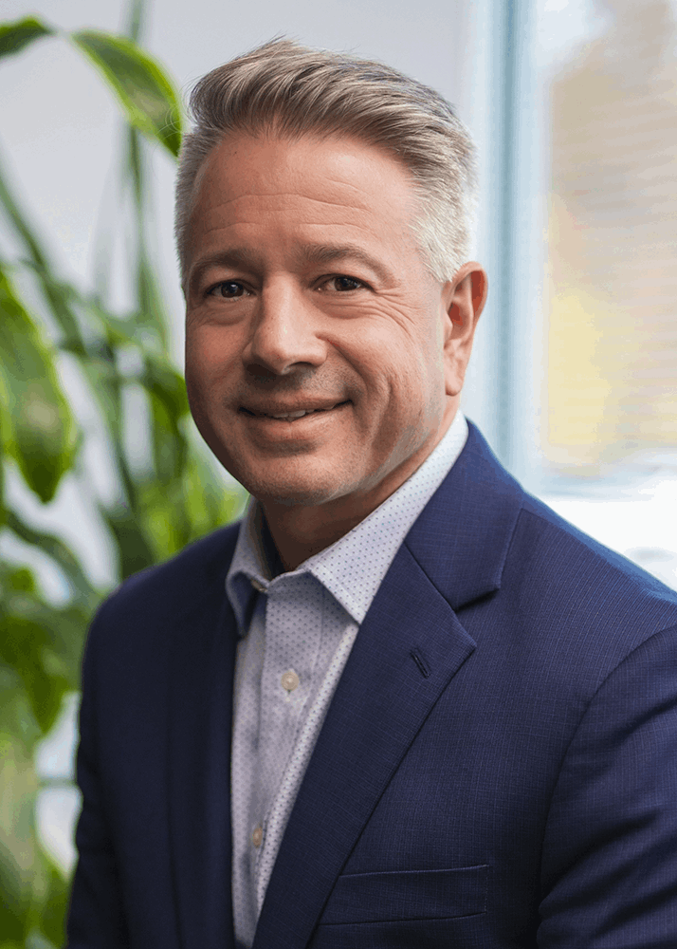
ABOUT
ashrae.org/President
TECHNICAL RESOURCES
PROFESSIONAL DEVELOPMENT
CONFERENCES
COMMUNITIES
MEMBERSHIP
Indoor Environment Quality Resources ashrae.org/president
Videos | Presentations | Vocabulary | Checklists | References
NEW! Center of Excellence for Indoor Environmental Quality
Approved by the BOD in November 2025, this Center of Excellence will be created to provide quality, in-depth industry resources covering all topics under the IEQ umbrella. Additional information about this exciting new resource coming soon.
Bill McQuade, P.E., CDP, Fellow ASHRAE, LEED AP
2025-26 ASHRAE President
Notes:
Visit ashrae.org/president to find videos and links to IEQ resources. Additionally, ASHRAE will be rolling out a new Center of Excellence for IEQ soon, so be on the lookout for that later this year.

Slide 4
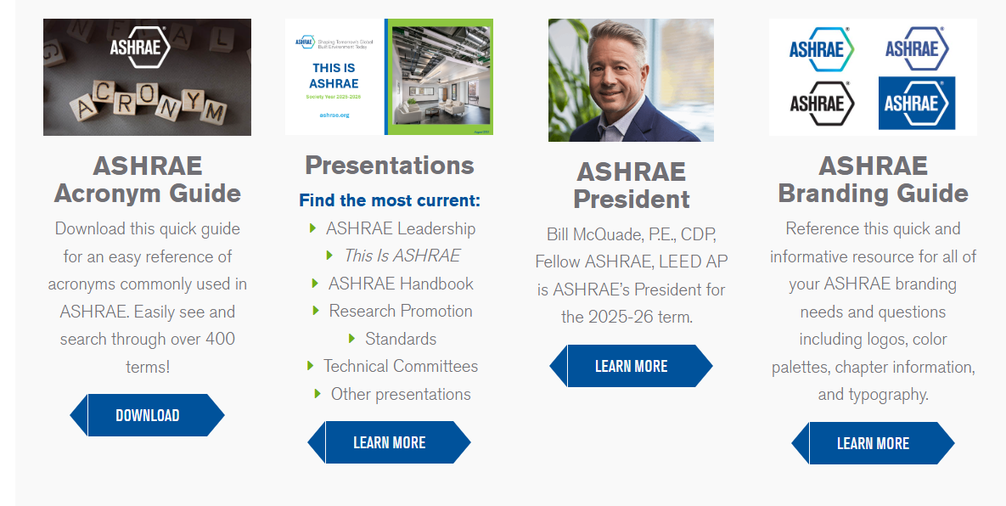
ABOUT
ashrae.org/Marketing
TECHNICAL RESOURCES
PROFESSIONAL DEVELOPMENT
CONFERENCES
COMMUNITIES
MEMBERSHIP
Get Marketing Items:
Brochures
Press Releases
Submit Request Forms
Chapter Logos
Newsletters
MARKETING CENTRAL
Staff Contact:
Vanita Gupta
vgupta@ashrae.org
Notes:
Marketing Central has your marketing needs COVERED. Visit ashrae.org/marketing for presentations you can download and edit to fit any ASHRAE topic, order forms, templates, brochures, and so much more. Reach out to Erika Cruz or just marketing@ashrae.org with any questions or requests.

Slide 5


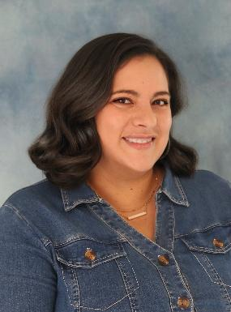
ABOUT
Marketing Central
TECHNICAL RESOURCES
PROFESSIONAL DEVELOPMENT
CONFERENCES
COMMUNITIES
MEMBERSHIP
Get your chapter promotional items and supplies at Marketing Central!
MARKETING CENTRAL
Log in and fill out the form.
Staff Contact: Erika Cruz
ecruz@ashrae.org
Notes:
All of your merchandise needs are in Marketing Central. Order from the logo store or request chapter supply items.

Slide 6
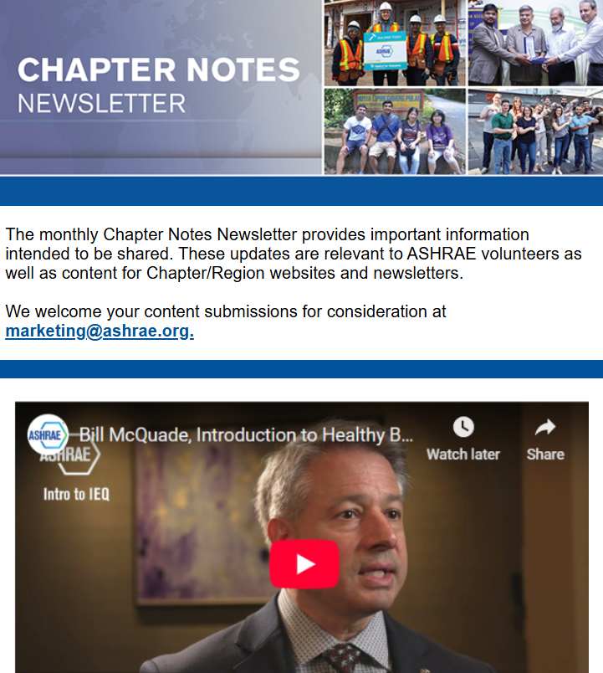





ABOUT
ashrae.org/Newsletters
TECHNICAL RESOURCES
PROFESSIONAL DEVELOPMENT
CONFERENCES
COMMUNITIES
MEMBERSHIP
Chapter Notes
Student Newsletter
Professional Development Newsletter
Monthly distribution
2,850 subscribers
Distributed to Region and Chapter officers
Monthly distribution
58,700 subscribers
Distributed to current members, online subscribers and previous course attendees
Quarterly distribution
5,700 subscribers
Distributed to Student Activities Chapter Chairs and Co-Chairs, Student Branch Advisors and Student Members
Chapter Notes is a volunteer focused newsletter created to be a welcome source of tools and resources to help ASHRAE volunteers do their job.
European Policy Update
YEA Newsletter
Government Affairs
Monthly distribution
2,300 subscribers
Distributed to ASHRAE members in Europe
Quarterly distribution
7,800 subscribers
Distributed to YEA Members (under age 35)
Bi-weekly distribution
2,400 subscribers
Distributed to opted-in subscribers
Contact marketing@ashrae.org to be added to any newsletter at any time!
Notes:
Sign up for any newsletters you’re not getting at ashrae.org/newsletters.

Slide 7
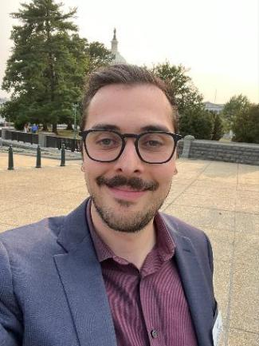
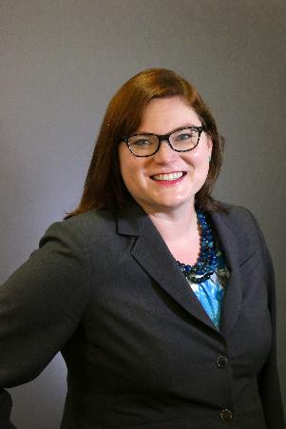

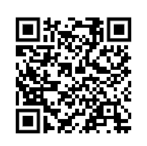
ABOUT
ashrae.org/GovAffairs
ashraeRP.com
TECHNICAL RESOURCES
PROFESSIONAL DEVELOPMENT
CONFERENCES
COMMUNITIES
MEMBERSHIP
Visit ashraerp.com to find resources, instruction videos, reports, tips and more.
Planning a Day on the Hill or other Government Affairs event?
RP = Research Promotion
ASHRAE’s annual fundraising campaign
2026 goal: $2.72 Million
Campaign ends June 30
Attend your CRC RP Training!
Make a gift now
Get planning tools, presentations, fact sheets, and many more resources to help with your event.
Staff Contact:
Jacob Karson
jkarson@ashrae.org
Staff Contact:
Julia Mumford
jmumford@ashrae.org
Notes:
Planning a Day on the Hill event? Login to Member Resources Advocacy Toolkit to find everything you need for a successful event.
Check out ashraerp.com to find everything your chapter needs for a RP campaign. Please note this is a separate website from ashrae.org

Slide 8
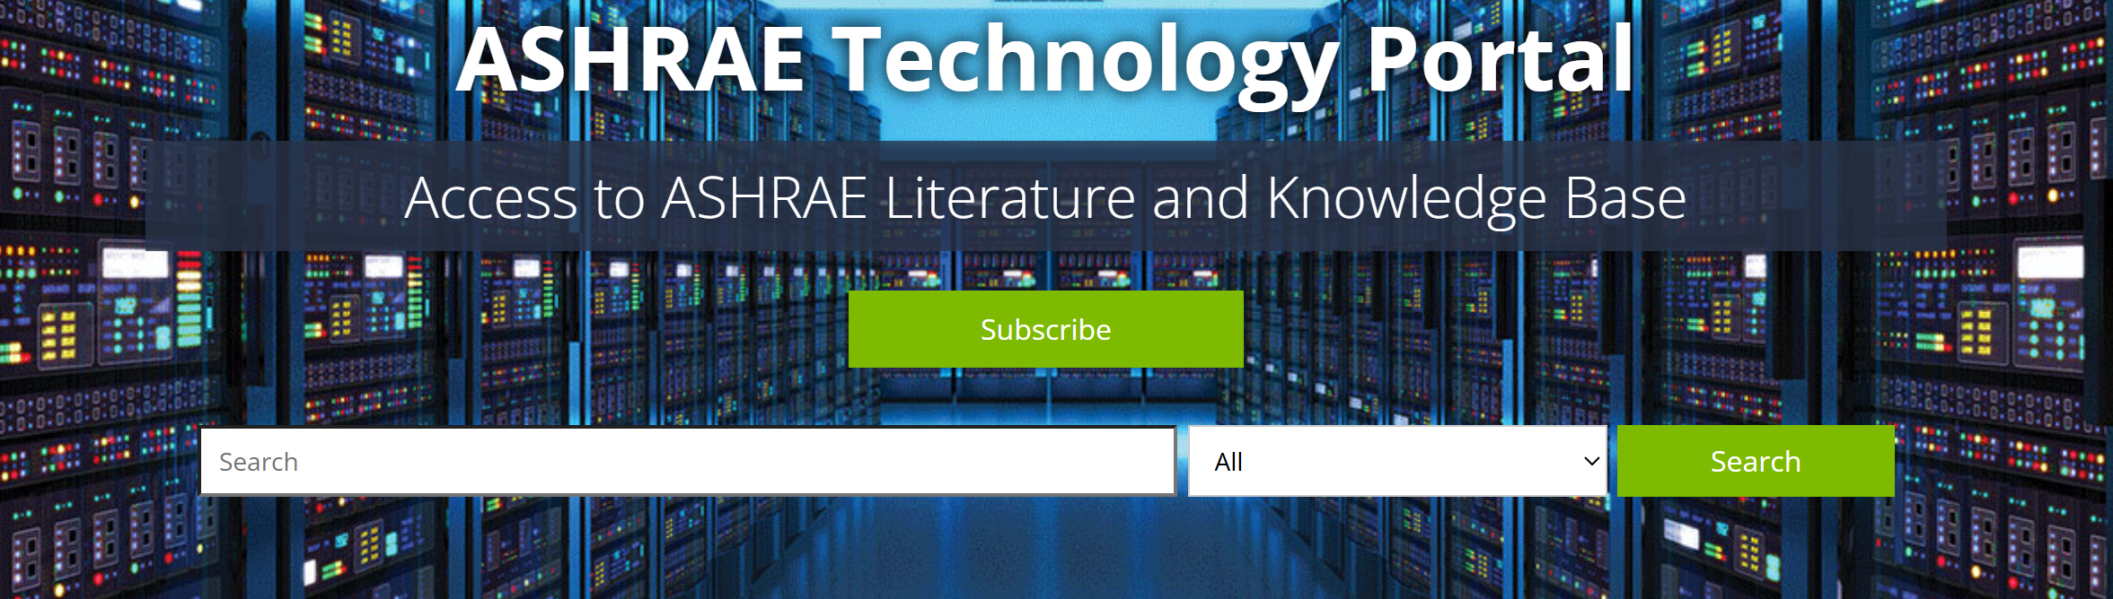
ABOUT
ashrae.org/Technical Resources
TECHNICAL RESOURCES
PROFESSIONAL DEVELOPMENT
CONFERENCES
COMMUNITIES
MEMBERSHIP
Visit the ASHRAE Bookstore for Standards, Design Guides, Software, and much more.
ASHRAE Members get 25% off the list price on purchases in the ASHRAE Bookstore.
Chapters can get an additional 25% discount off list price on purchases of 10 or more of one title.
Go to the ASHRAE Technology Portal for Members’ free access to ASHRAE Journal articles and research reports, with subscription access to conference papers plus your selected annual Member benefits.
Contact specialsales@ashrae.org for Chapter orders!
www.ashrae.org/technical-resources/technology-portal
Notes:
Take advantage of your member discount in the ASHRAE Bookstore, and don’t forget Chapters can get an additional 25% off list price (total 50% off list!) for purchases of 10 or more copies of any one title.
And the Technology Portal is the place to go for access to archived, searchable ASHRAE Journal articles and research reports, plus subscription access to conference papers and other products. It’s also the place to get the annual Member benefit items that you selected when you renewed your membership.

Slide 9
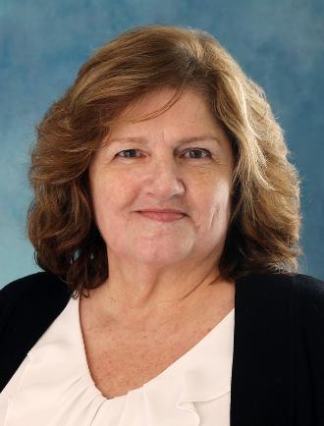
ABOUT
ashrae.org/ProfessionalDevelopment
TECHNICAL RESOURCES
PROFESSIONAL DEVELOPMENT
CONFERENCES
COMMUNITIES
MEMBERSHIP
NEW! Professional Development Scholarship Available
ASHRAE Members can now get 35% to 50% off selected ALI, AGT, or eLearning courses—thanks to the Richard and Mary Farr, the Setty Family Foundation, and Jim and Nancy Fields funds.
Apply at least 3 weeks before your course date.
NEW! HVAC Design Level I Nonmember Registrants get one-year FREE ASHRAE membership!
Membership will begin
the week following
the participants
completion of the
course.
Bill McQuade, P.E., CDP, Fellow ASHRAE, LEED AP
2025-26 ASHRAE President
Staff Contact:
Karen Murray
kmurray@ashrae.org
Notes:
Visit ashrae.org/president to find videos and links to IEQ resources. Additionally, ASHRAE will be rolling out a new Center of Excellence for IEQ soon, so be on the lookout for that later this year.

Slide 10
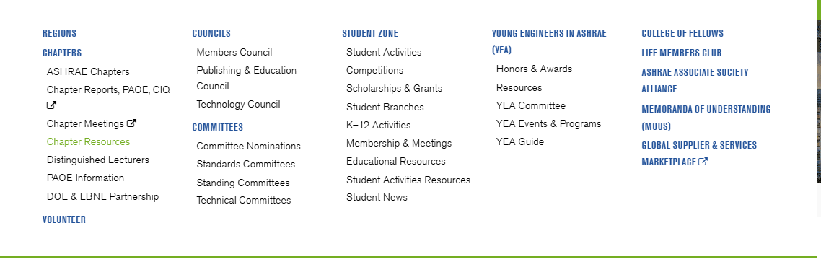
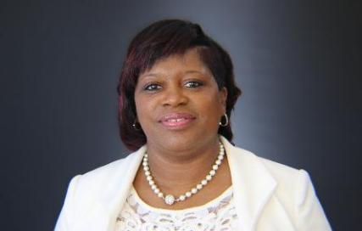
ABOUT
ashrae.org/ChapterResources
TECHNICAL RESOURCES
PROFESSIONAL DEVELOPMENT
CONFERENCES
COMMUNITIES
MEMBERSHIP
Chapter Bulk Order Form for Publications
Submit the form available on the Chapter Resources page to order publications in bulk for your chapter, useful for:
Volunteer Training Presentations
Order Banners & Supplies
Schedule DL & President Visits
Templates & Tools
Get Chapter Data
Chapter Treasurer Training
Presentations
& MUCH MORE!
ASHRAE Distinguished Lecturer visits
Presentations on specific topics by local experts
Technical tours
Panel programs or forums
Membership Promotion events
YEA and/or Student events
Chapter seminars
Staff Contact: Tammy Catchings
tcatchings@ashrae.org
Notes:
In the communities section of ashrae.org you’ll find all the tools you need to run a chapter.

Slide 11
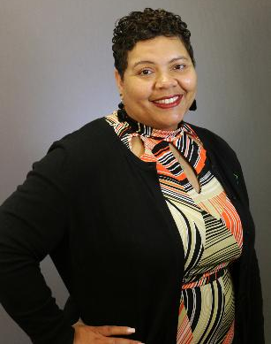

ABOUT
ashrae.org/PresidentialChallenge
TECHNICAL RESOURCES
PROFESSIONAL DEVELOPMENT
CONFERENCES
COMMUNITIES
MEMBERSHIP
The Young Engineers in ASHRAE (YEA) Committee organizes the Presidential Initiative Challenge each year. For more information visit ashrae.org/yea.
The Presidential Initiative Challenge is a year-long competitive fund ($1,000 - $10,000) program to implement projects within local chapters that are tied to the year's presidential theme.
Annual timelines are similar each year but always check the website for exact due dates:
November: Applications due
December: Intimation to selected chapter / team
January: Awards made with funds going to local chapter for use on the project
February: Winning applicants in attendance at the Winter Conference to be recognized by ASHRAE President at President’s Lunch
February and June: Projects will be completed
Staff Contact:
Jeanette McCray
jmccray@ashrae.org
All grants for project winners provided by the Gordon Holness Presidential Challenge Fund
Notes:
Does anyone in your chapter have a great idea to improve your community? Check out the Presidential Initiative Challenge, an annual competitive fund for chapters organized by the YEA committee.

Slide 12
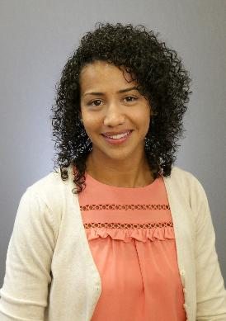
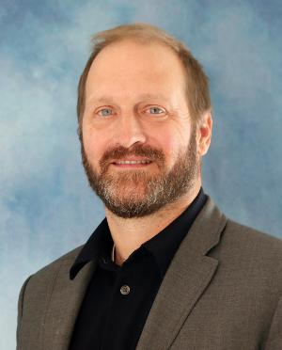
ABOUT
ashrae.org/Volunteer
TECHNICAL RESOURCES
PROFESSIONAL DEVELOPMENT
CONFERENCES
COMMUNITIES
MEMBERSHIP
How to Volunteer on Standing Committees
How to Volunteer on Technical Committees
Standing Committees: ASHRAE has more than 30 Standing Committees which require nomination.
Learn more about each committee and the nomination process at ashrae.org/volunteer
(in the Communities
section of ashrae.org.)
Technical Committees: ASHRAE has more than 200 technical committees.
Those interested in participating as a member should make sure their ASHRAE bio is updated and
email Steve Hammerling at shammerling@ashrae.org to indicate your interest.
Staff Contact:
Candace Denton
cdenton@ashrae.org
Staff Contact:
Steve Hammerling
shammerling@ashrae.org
Notes:
In the communities section of ashrae.org you will also find the various types of volunteer opportunities at the Society level. Just click on the ‘Volunteer’ header and find links to the different types of committees and how to join them.

Slide 13
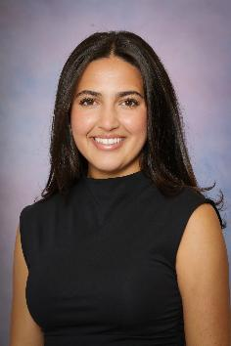
ABOUT
ashrae.org/Scholarships
TECHNICAL RESOURCES
PROFESSIONAL DEVELOPMENT
CONFERENCES
COMMUNITIES
MEMBERSHIP
ASHRAE Society Scholarships offer over $250,000 to about 50 qualified applicants per year.
Each recipient receives a free 1-year ASHRAE Student Membership.
Many student recipients are offered prestigious Engineering/HVAC&R internships. They get more involved at the Chapter Level and are presented as recipients at Chapter Meetings.
Starting in 2026-27 Society Year
New Deadline for Society Scholarships: April 1st
To allow for more applicants and to streamline the application/award process, the scholarship program is combining the existing deadlines
(of May 1st and December 1st) and moving to April 1st of each year.
PLEASE PROMOTE WITHIN YOUR CHAPTER!
Staff Contact:
Savanna Smith
ssmith@ashrae.org
Notes:
ASHRAE Society Scholarships has a new application deadline of April 1st. This new deadline will take effect in the 2026-27 SY meaning April 1, 2027 will be the next deadline for Society Scholarship applications.

Slide 14
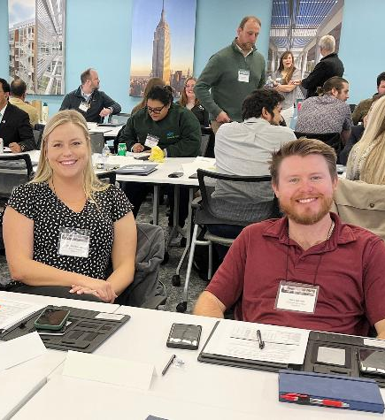
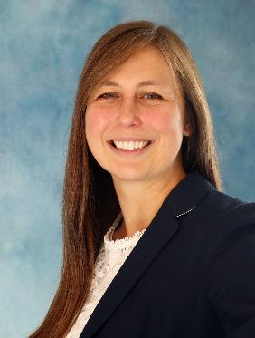
ABOUT
ashrae.org/LeadershipAcademy
TECHNICAL RESOURCES
PROFESSIONAL DEVELOPMENT
CONFERENCES
COMMUNITIES
MEMBERSHIP
Chapter Leadership Academy Timeline
(always check online for exact dates annually):
October to Mid-November: Contact your DRC about interest in attending
December: Attendees will be approved to attend
March: Chapter Leadership Academy is held at ASHRAE Headquarters, Peachtree Corners, GA.
Chapter Leadership Academy Topics covered include:
Navigating the ASHRAE organizational structure
Understanding the tools and resources available to help Chapters and their members succeed
Delegating to and motivating volunteers toward the ASHRAE mission
DRCs will approve attendees from their region. Each region has limited spots.
Interested? Contact your Director and Regional Chair (DRC)!
Staff Contact:
Lizzy Seymour
lseymour@ashrae.org
Notes:
Chapter Leadership Academy is a 1.5-day crash course designed to simplify the learning curve of all things ASHRAE. Attendees will gain a better understanding of how ASHRAE Society functions and obtain useful and practical knowledge essential for honing ASHRAE leadership skills. The program also will include sharing tips and best practices that attendees can confidently take back to their Chapters for implementation.

Slide 15
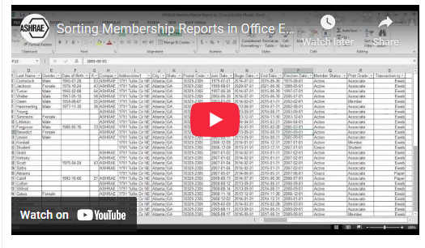

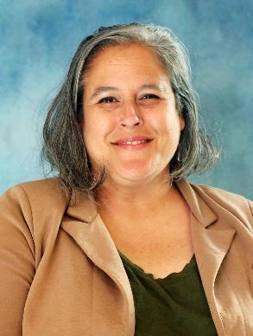
ashrae.org/MembershipPromotion
ABOUT
TECHNICAL RESOURCES
PROFESSIONAL DEVELOPMENT
CONFERENCES
COMMUNITIES
MEMBERSHIP
Everything an MP Chair Needs!
Find help videos to sort and filter membership reports, information about dues notices and managing chapter dues received in your members’ records.
ashrae.org/connect send a pre-written, customizable email to a colleague encouraging them to join.
Membership Promotion Toolkit:
Centralized Training Videos
Templates, Brochures and Retention tools
Membership Promotion Night Guidelines
Resources to help you reach out to local companies
Staff Contact: Lisa Nichols
lnichols@ashrae.org
Notes:
What more could you dream of? Check out the many tools and resources available to you on the Membership Promotion page of ashrae.org.

Slide 16

ABOUT
ashrae.org/2026bylaws
TECHNICAL RESOURCES
PROFESSIONAL DEVELOPMENT
CONFERENCES
COMMUNITIES
MEMBERSHIP
Proposed Bylaws Amendment
The following three slides review the proposed Bylaws Amendment that appears on your spring ballot.
Bylaws Amendment:
Amend the Society Bylaws to implement the proposed revision to the ASHRAE membership structure. This proposed model was crafted by a presidential ad hoc committee, comprised of members from all segments of Society, over a period of eighteen months. The goal of the ad hoc committee was to simplify the membership structure that provides the most equitable and inclusive ability to join ASHRAE.
More information about the proposed changes can be found at www.ashrae.org/2026bylaws and any specific questions may be directed to ballot@ashrae.org.
Staff Contact:
Daniel Gurley
dgurley@ashrae.org

Slide 17

Simplified Model
Learn More at ashrae.org/2026Bylaws
Student Member Grade
Member Grade
Other
Professional & Early Career Member
Group Membership
Member
Young
Professional
Tenured Professional
Life Service Member
Presidential Member
Student Member
Student Branch Advisor
Honorary
Member
WB Tier 1
Standard Dues
WB Tier 2
80%
of dues
WB Tier 3
60%
of dues
WB Tier 4
40%
of dues
50%
(+ tier discount)
FREE
90%
(+ tier discount)
80%
(+ tier discount)
FREE
Anyone involved in the building sciences industry
Anyone
≤ 35 yo who joins pays this fee first for 2 years
Anyone
≥ 65 yo with
25 years cumulative member-ship
30 yrs cumulative member + ≥ 65 + DSA or 15 qualifying service points
Served as Society President
Must be currently enrolled in university, college, junior college or technical institute
Faculty member who is ASHRAE member & must submit application and submit annual report
Any notable person of preeminent professional distinction & elected by the BOD
Handbook Online + *Journal , HPB, Insights + Tech Portal + Member Pricing + Voting Privileges and Serve as C,R,S level roles
Choice of 1:
eLearning Course, Certification Study Guide, Standard or Guideline
Handbook Online + *Journal, HPB, Insights + Tech Portal + Member Pricing
Same as Member + waived dues, extreme discounts to W&A Conferences.
Invitations to VIP events (Presidential Only)
Same as Young and Tenured Professionals
Full Member Benefits if requested
Additional New Member Benefits:
Receive a Comp Winter or Annual Conference to attend in first 3 years + Handbook Online access for 1 year
Notes:
The simplified model focuses on:
the “Full Member" grade with discounts based on the four tiers outlined by the World Bank with broader qualifications and the same benefits across all tiers
Two similar membership categories created to mirror one another for Young Professionals and Tenured Professions to provide the same significant dues discounts with access to quality benefits.
Life Service Members which rewards long-term dues paying members who have a certain level of Society participant which spans all aspects of Society (Society, Regional, Chapter service, Ad Hoc service, Standard Project Committee service, Technical Committee services, general activities such as service to Society's Winter and Annual Conferences, CRCs Intersociety assignments, Foundation and HVAC&R Research Journal, and Service as a Speaker, author of ASHRAE publications and author of ASHRAE published papers. Those who don't qualify for the waived dues still have the option to receive quality benefits at an extremely discounted dues rate as a Tenured Professional.
Current Life Members will be grandfathered in and continue to receive complimentary dues and benefits.
Students and Student Branch Advisors continue to have extremely discounted dues but access to critical technical content with Handbook Online.

Slide 18
Proposed Dues Rates
Career and Economic discounts off main dues rate as set by the Board of Directors.
Economic discount based on country of residence as defined by the World Bank.
High Income = Tier 1, Upper Middle Income = Tier 2, Lower Middle Income = Tier 3, Low Income = Tier 4
ASHRAE Membership Dues Rate Table |  | Career Based Discount
 |  | All Others | Young Pro OR Tenured Pro | Student Branch Advisor | Student | Life Service & Honorary
Economic Discount |  | 0% | 50% | 80% | 90% | 100%
World Bank Tier 1 | 0% | $290 | $145 | $60 | $30 | FREE
World Bank Tier 2 | 20% | $230 | $115 | $45 | $25 | FREE
World Bank Tier 3 | 40% | $175 | $90 | $35 | $20 | FREE
World Bank Tier 4 | 60% | $115 | $60 | $25 | $10 | FREE
The dues rates and percentages are for illustrative purposes only, based on 2026-2027 dues rates. The Finance Committee is responsible for reviewing, recommending changes and interpreting fees, dues, and privileges. (ROB 2.408.004)
Notes:
Discounts will be based off the main dues rate, set annual by the Board of Directors. The discounts will be on the economic classification by The World Bank and the where members are in the career, i.e., young professionals just starting out, and tenured professionals nearing retirement.
The amounts shown in the chart are for illustrative purposes only based off the 2026-2027 dues rate. The dues rate for the 2027-2028 year (if approved, when this would go into effect) will be different than those presented here.

Slide 19
Timeline
PLEASE VOTE!
NOW/Spring 2026: Proposed Bylaws amendment on Spring Ballot, emailed to you in late April from ballot@ashrae.org.
This is how you vote!
June 28, 2026: Election closes
By June 30, 2027: If Bylaws amendment are approved, all changes made to membership database, website, promotional materials, ROB, Committee/Council MOPs and training materials.
July 1, 2027: New model implemented.
Staff Contact:
Daniel Gurley
dgurley@ashrae.org
Learn More at ashrae.org/2026Bylaws
Notes:
[Read slide]

Slide 20

Media Inquiries
Notes:
ASHRAE's PR team have tools and resources available to vet media inquires, research media contacts and arrange appropriate responses. Please send all media inquires to publicrelations@ashrae.org for support.

Slide 21
Thank you!
Questions or Comments?
ashrae.org

