Slide 1
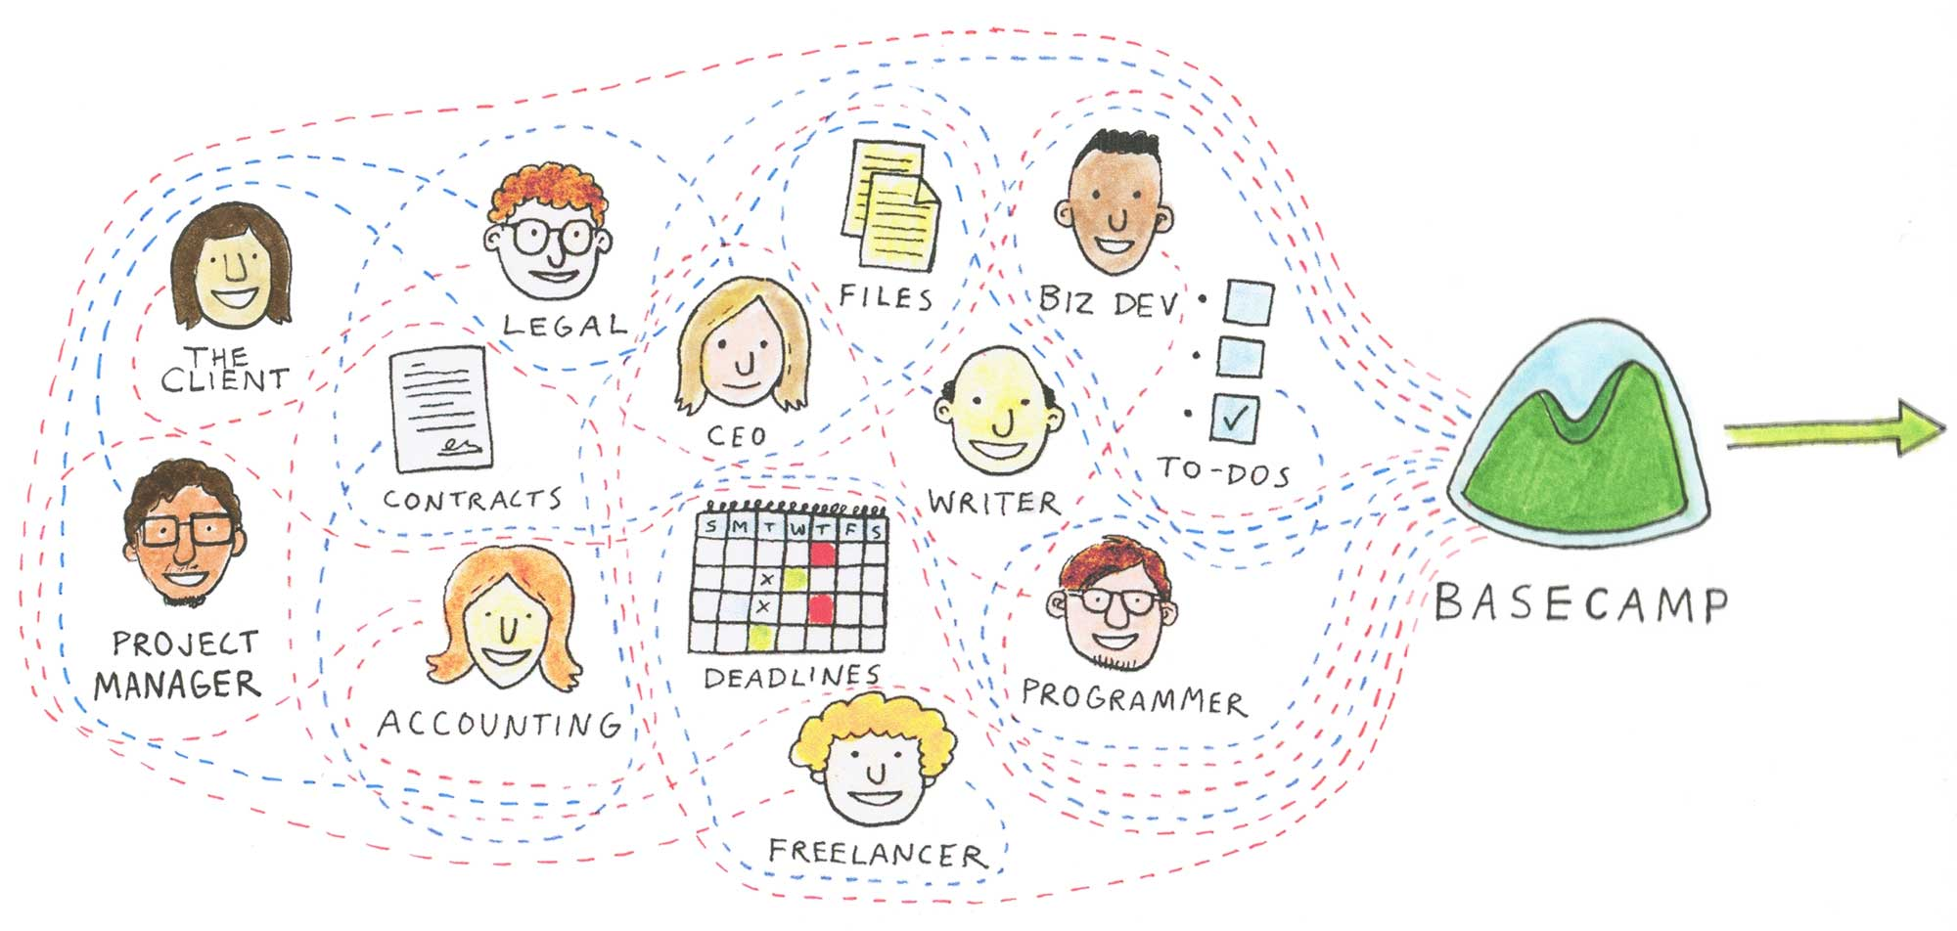
Electronic Collaboration
Introduction to Basecamp

Slide 2
History
Method determined and controlled by each ASHRAE group
Notes:
Collaboration method was determined and controlled by each ASHRAE group: committee, council, region, chapter, TC.
If you belong to more than one group you would need to understand the preferred method for each group.

Slide 3
History
Default was email
Notes:
Email become the default collaboration tool due to its wide use and ease of access.
While this made communication easier it meant emailing multiple versions of documents with each person utilizing their own local filing system to manage the versions.
At some point the versions would need to be combined by one of the group members.
If that person moved, changed jobs or just dropped the ball the remaining group members would be left with the task of trying to piece together the email string and document trail.

Slide 4
History
More tech savvy utilized free web based tools, usually Google Groups
ASHRAE had no input regarding T&C – loss of document ownership
Notes:
Internet companies started to develop free web based tools.
Not that long ago, ECC encouraged the use of these tools, primarily Google Groups, as a way to manage the need for central storage of a group’s documents.
As we all know, there is no free lunch. Each of these free tools come with Terms and Conditions with are not negotiable. To use the tool you must accept them which is most often done without reading them.
This opens ASHRAE to potential loss of document ownership and/or subjects our work product to data mining. Frequently where ownership is retained there are clauses that allow the Internet company that owns the tool to search and extract content as they see fit.
The security of the organization’s intellectual property is now at risk.

Slide 5
Why Electronic Collaboration?
Common repository for business documents
Revision control
Discussion groups
Email groups
Archive
Improved use of volunteer and staff time
Protection of intellectual property
Notes:
What do we want from an electronic collaboration tool?
The ability to find all pertinent group documents in one place.
To easily manage which version of a document is the most current.
To be able to generate discussion strings that are centrally located.
Email some or all of the group from a central location.
Have the ability to periodically archive some or all of the content.
Standardize on one platform so volunteers and staff don’t have to learn a different method for every group they belong to.
Makes it easier for new group members to get up to speed with group activities.
Have proper vetting of the tool prior to adoption to ensure our intellectual property is protected.

Slide 6
Electronic Communication Committee
2013 SY Research EC options: programs, features, cost
Conducted survey of select members on EC use, needs, obstacles
Notes:
In 2013 Society year ECC was tasked with researching electronic collaboration options: programs, features, cost.
A survey of select members was conducted to find out what collaboration tools were being used, the needs of individuals and groups and the potential obstacles to using the tools currently in use or another tool. Main obstacle was ease of access as some employers limit installation of additional software, including browser plug-ins.

Slide 7
Electronic Communication Committee
Made recommendation, received funding for one year trial across representative committee types.
2014 SY started trial
Notes:
As a result of the research and survey a recommendation and budget was presented to Publishing and Education Council to conduct a one year trial across representative committee types.
Funding for the trial was received.
The trial started with the 2014 Society Year: 6 standing committees, 3 regional committees, 1 council, 5 standards committees, 3 technical committees, 1 research project, 1 publication

Slide 8
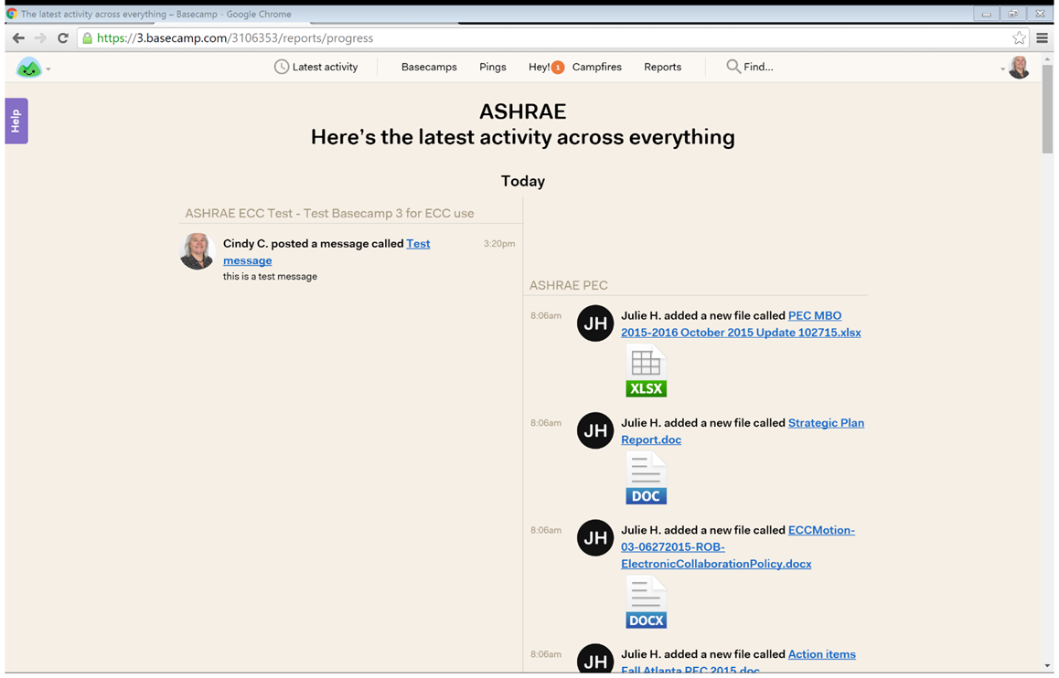
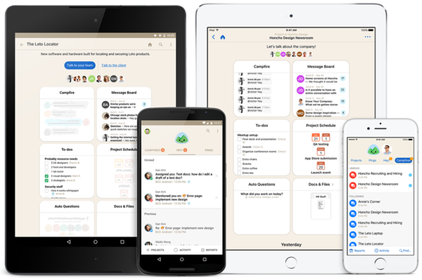
Web based – no software to install
Notes:
Tool is web based – no software of any kind to install.
Easily accessible anywhere with mobile app.
Get Basecamp 3 for iOS in the App Store. You’ll need to be on the latest iOS 9.
Basecamp 3 is available for Android phones and tablets on the Google Play store. Make sure you’ve got Android 4.4 “KitKat” or newer.

Slide 9
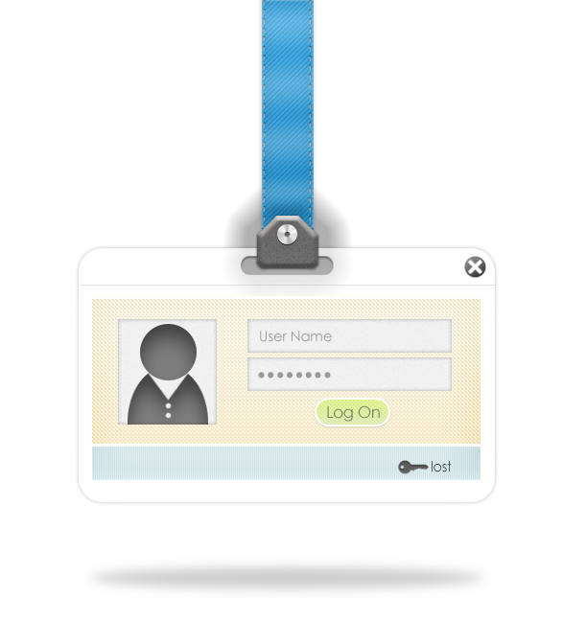
Project access limited and controllable
Single platform for members and staff with multiple committee assignments
Notes:
Project access is limited and controllable – by invitation only with user log in. Members have full access to project content. Clients have access only to what you want them to see.
Membership list can be easily modified as members roll on/off a committee
Provides a single platform for members and staff with multiple committee assignments – all projects in one place with one user log in.

Slide 10
Features meet most needs from survey
Scalable
Reasonable cost
Notes:
Program features meet most of the needs from the 2013 member survey
Program is scalable – can be implemented throughout the organization, from top to bottom
Cost is reasonable - $3,000/year total, no per-user fees, enterprise plan. 1TB storage, guaranteed uptime SLA, personal account manager

Slide 11
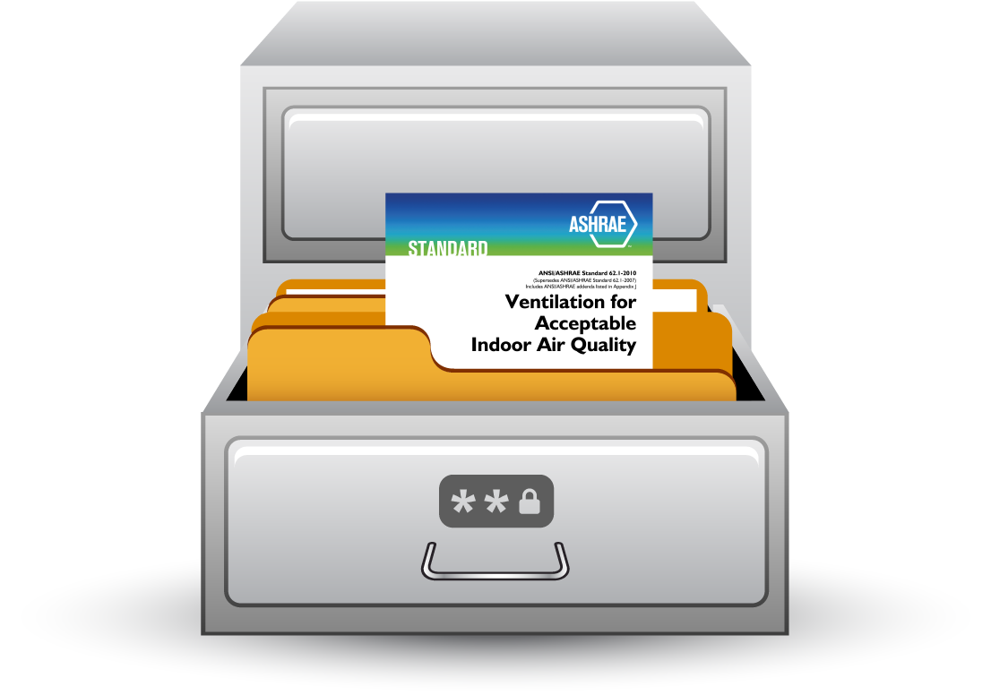
Archive for knowledge retention
No T&C issues re ownership of posted content
Notes:
Project information can be archived to retain knowledge. Archives can be easily accessed should the need arise.
Terms and conditions do not pose ownership or data mining risk to posted content.

Slide 12
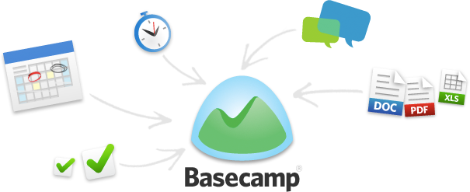
Basecamp Features
Group email – some or all
Discussion groups
Interested parties – controlled access
Action items
Document posting
Calendar
Reminders

Slide 13
Basecamp Application
Basecamp2 - Designed for single “project” not subcommittee structure utilized by ASHRAE. The flat structure required using discussion strings to categorize and group files in order to find them easily later.
Basecamp3 – Capable of having a more vertical structure similar to other commonly used applications. Addresses the major concern expressed by trial users.
Roster control by staff with input from committee chair – always current
Archiving by staff – regular interval

Slide 14
Basecamp Features – Latest Activity
Notes:
The summary screen of all activity for the Basecamps where you are a member. Initial log-in takes you to this screen.
You can get back to this screen by clicking the “Latest Activity” link.

Slide 15
Basecamp Features – Basecamps
Notes:
Basecamps (formerly Projects) – central area for all projects of which you are a member. You must be invited to a project. Staff member does initial project creation. For committees with staff support, the staff member invites committee members to the project and maintains the project member area. Committees that do not have regular staff support (TCs, SPCs), ECC staff creates project and invites committee chair who is then responsible for inviting remaining committee members and maintaining the project member area.
Project naming convention: All names start with ASHRAE
Standing committees – ASHRAE “standing committee name”
Chapter – ASHRAE Chapter – “chapter name”
Region – ASHRAE Region “region #”
TC – ASHRAE TC “tc #”
Standards/Guidelines – ASHRAE SPC “spc #”

Slide 16
Basecamp Features – Pings
Notes:
Pings are a new feature in Basecamp3. They are personal back channels. Pings are like instant messages or direct messages. Want to get someone’s take on something before sharing it with everyone else? Just ping them!

Slide 17
Basecamp Features – Hey!
Notes:
The catch-all Basecamp inbox
The Hey! menu is a single inbox for nearly every kind of Basecamp notification. @mentions, new messages, to-do assignments and completions all show up nice, neat, organized, and threaded in the Hey! menu.

Slide 18
Basecamp Features – Campfires
Notes:
When you need to hash stuff out quickly without a lot of fuss, gather around the Campfire - a group chat at the center of every Basecamp. Perfect for casual conversations, quick Q&As, link sharing, and fast riffs.

Slide 19
Basecamp Features – Reports
Notes:
You can stay on top of everything with reports, a new feature in Basecamp 3. Reports cut across everything and let you know what’s late, what’s coming up, what someone’s been up to, if you’re adding to the pile of work or chipping away at it, what’s on someone’s plate, etc.
The overdue report shows you anything that’s late, who’s responsible, the original due date, and just how overdue it is. You can click/tap on anything to jump right into it and find out why it’s late, ask a question about it, or update it.
What’s Coming Up or Due Soon: Anything that’s dated in the future shows up here. To-dos, events, milestones, deadlines, whatever. If it’s got a date, and it’s coming up, you’ll see it here.
What’s new to-do and what’s to-done?
Think of this one like a win-loss column. New work added on a given day shows up on the left, completed work on the right. Now you’ll know if you’re adding more to the pile or chipping away at it.
What’s on someone’s plate?
This report shows you everything that’s been assigned to someone on a single page.
What has someone been up to?
Curious what Joan has been working on? How about Bryan? Want to see the work they’ve added, stuff they’ve done, comments they’ve posted, conversations they’ve kicked off, files they’ve shared, and questions they’ve answered? Just run a report on someone and you’ll see their full history across all their projects in Basecamp. If they’ve done it, it’s documented here.

Slide 20
Basecamp Features – Search
Notes:
All new search in Basecamp3. Now you can “show me all Jonas’s comments in the Mobile project” or “Show me every image uploaded by Ann”. Sometimes you know who but not what. Other times you know the what, but not the who. And other times you know what it looks like but you can’t describe it in words. Basecamp will find it.

Slide 21
Basecamp Features – Me
Notes:
The place to update your personal information and Basecamp settings.
Provides links to notification settings, your assignments (displays quantity), items you have assigned to others, drafts you have saved, what you have been up to (activity) and your personal information.

Slide 22
Basecamp Features – Me > Notifications
Notes:
Always on or on your schedule.

Slide 23
Basecamp Features – Me > My Assignments
Notes:
Not sure what to work on next? Check out your "My assignments" page to see everything that's been assigned to you.

Slide 24
Basecamp Features – Me > Stuff I’ve Assigned
Notes:
Check to see if tasks you've assigned have been completed.

Slide 25
Basecamp Features – Me > Saved Drafts
Notes:
If you worked on a doc or message but did not yet publish it to a Basecamp, go to your "Saved Drafts" section to find all your drafts across all your Basecamps in that account.

Slide 26
Basecamp Features – Me > What Have I Been Up To?
Notes:
Want to see exactly how productive you were today or this week? Go to your "What have I been up to?" page to check it out. That's also what others will see if they're curious about what you've been working on (only for the Basecamps you're both in).

Slide 27
Basecamp Features – Me > Personal Info
Notes:
Here, you can change your profile photo, update your name and title and change your time zone.

Slide 28
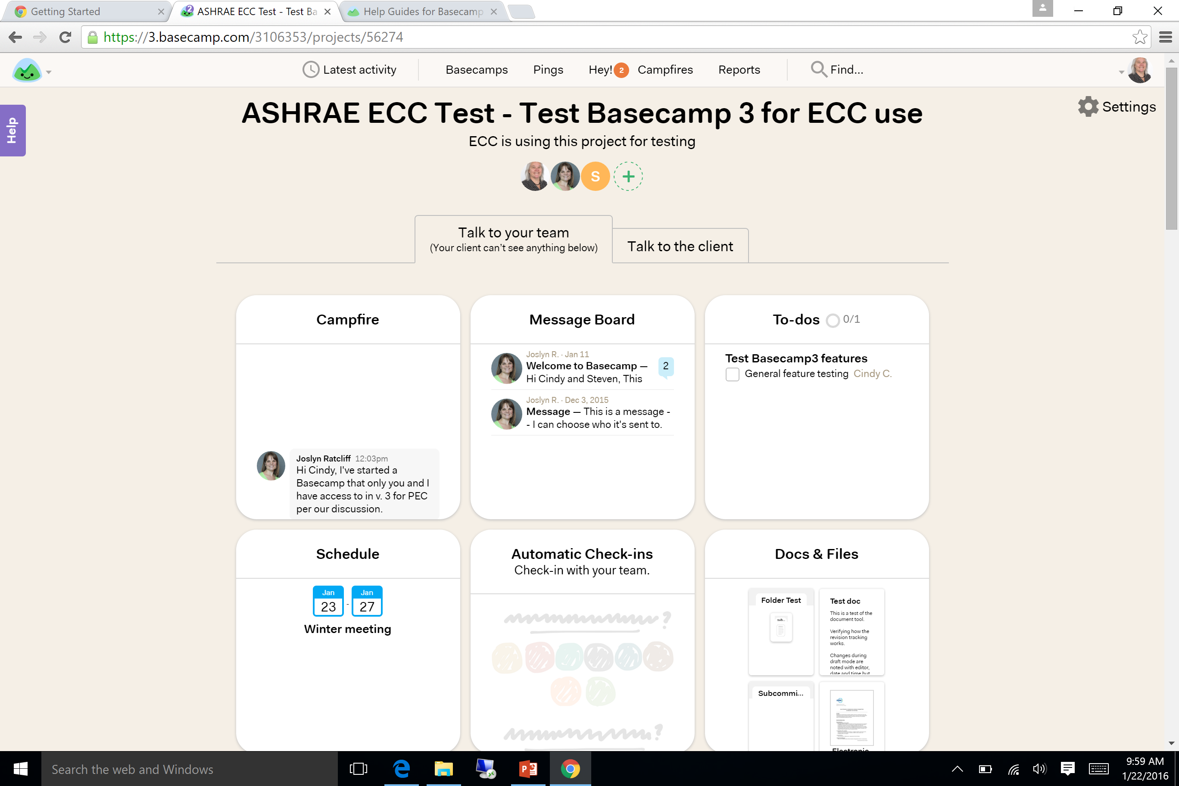
Basecamp Features – Basecamp Page
Notes:
Selecting a specific project takes you to that project’s main page and core tools. At the bottom of the page is the project timeline with all of the project activity in chronological order.
Each Basecamp project is a unique blend of six tools that every group needs to do any kind of work together. All in one place.
Campfire
Message Board
To-dos
Schedule
Automatic Check-in
Documents and Files
Each tool can be turned off if your group isn’t using it. Later if you decide you need it, turn it back on.
The tool order can be rearranged. Put the ones you use the most next to each other.

Slide 29
Basecamp Features – Basecamp Page > Invite more people
Notes:
Used to add project members and clients to the project. Staff members and committee chair can add and remove project members.
ASHRAE – people who have previously been invited to a Basecamp3 project.
Other People – Use this for committee members that haven’t previously been invited to an ASHRAE Basecamp3 project. Note that everyone invited to a project this way has full access to the project and is considered part of the project team. If you want to limit someone’s access use the Client area of the project to invite them.

Slide 30
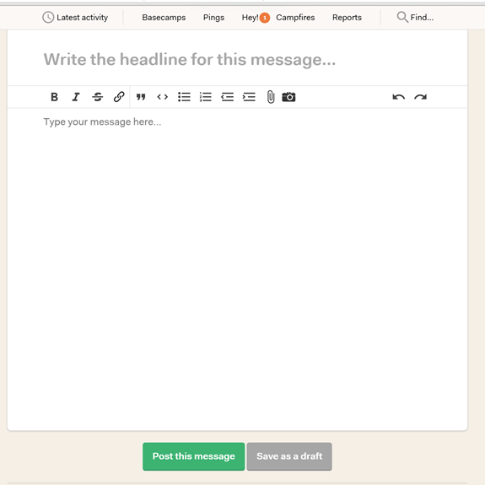
Basecamp Features – Basecamp Page > Message Board
Notes:
When you need to make a big announcement, post an update, make a pitch, or keep a discussion focused and on-topic, post it to the Message Board. Discussions are threaded, organized, and easy to reference later on. The Message Board doesn't aggregate conversations that happen elsewhere — it's only for messages and discussions posted here. Message Board is similar to Discussion in Basecamp2.
To contribute to an existing discussion, select the discussion. The complete discussion string will be displayed with a place at the bottom for you to comment and/or upload a file to the discussion.
At the bottom of the comment box you can see who the comment will be emailed to and change the recipients if necessary.
To create a new discussion, select the “post a message” button at the top of the Message Board. Add your comment and attach any required files, similar to contributing to an existing discussion. Select which project members should get an email regarding the discussion. Select “post this message” button at bottom when complete or save it as a draft and come back to it later.
New for Basecamp3
You can embed images into your message. Click and drag pictures from your computer into the message to embed them in-line. (JPG, GIF, and PNG supported.)
The camera icon will activate your device's camera so you can take a picture and attach it to the discussion.

Slide 31
Basecamp Features – Basecamp Page > To-dos
Notes:
Each item on a to-do list is a discussion string. These strings only appear as part of the to-do list. Select an item to access its string. Add comments and files just as you do in the Message Board section.
Multiple lists can be created and are differentiated by their title.
To add items to a list select the “make another list” link on the To-do List page.
When an item has been completed select the check box next to the item to remove it from the list. To see past items that have been completed and the associated discussion string go to the to-do page. Completed items are shown below the open to-dos.
When you assign a to-do to someone else, they'll receive a notification. Once it's done, they can click in the checkbox next to the to-do to mark it as complete.
To-dos can also be assigned a due date or a span of dates.
The number of completed items and total items is displayed next to the To-dos header at the top of the page and on the project main page.

Slide 32
Basecamp Features – Basecamp Page > Schedule
Notes:
Add important milestones, deadlines, or events to the schedule so everyone knows what’s happening when. Integrates with Google Calendar, Outlook, or iCal.
Click the "Add an event" button. Enter the details about your event. Events can be single day or multi-day. You can have full-day events, or events with a start and end time. Select the members who are involved. Basecamp 3 can send them a notification about the event. Add a note to give your team more info.
Your schedule lists all your events, along with to-dos with a due date. You'll see who's involved with your events, and who is assigned to the to-do. Click the title of the event or to-do to view it. Click the "looking back" tab to view events and to-dos from the past.

Slide 33
Basecamp Features – Basecamp Page > Check-ins
Notes:
Basecamp can help you check-in with your team by automatically asking questions on a recurring schedule. Set up any question, pick the frequency (daily, once a week, etc), and Basecamp will ask your team and report back with answers.

Slide 34
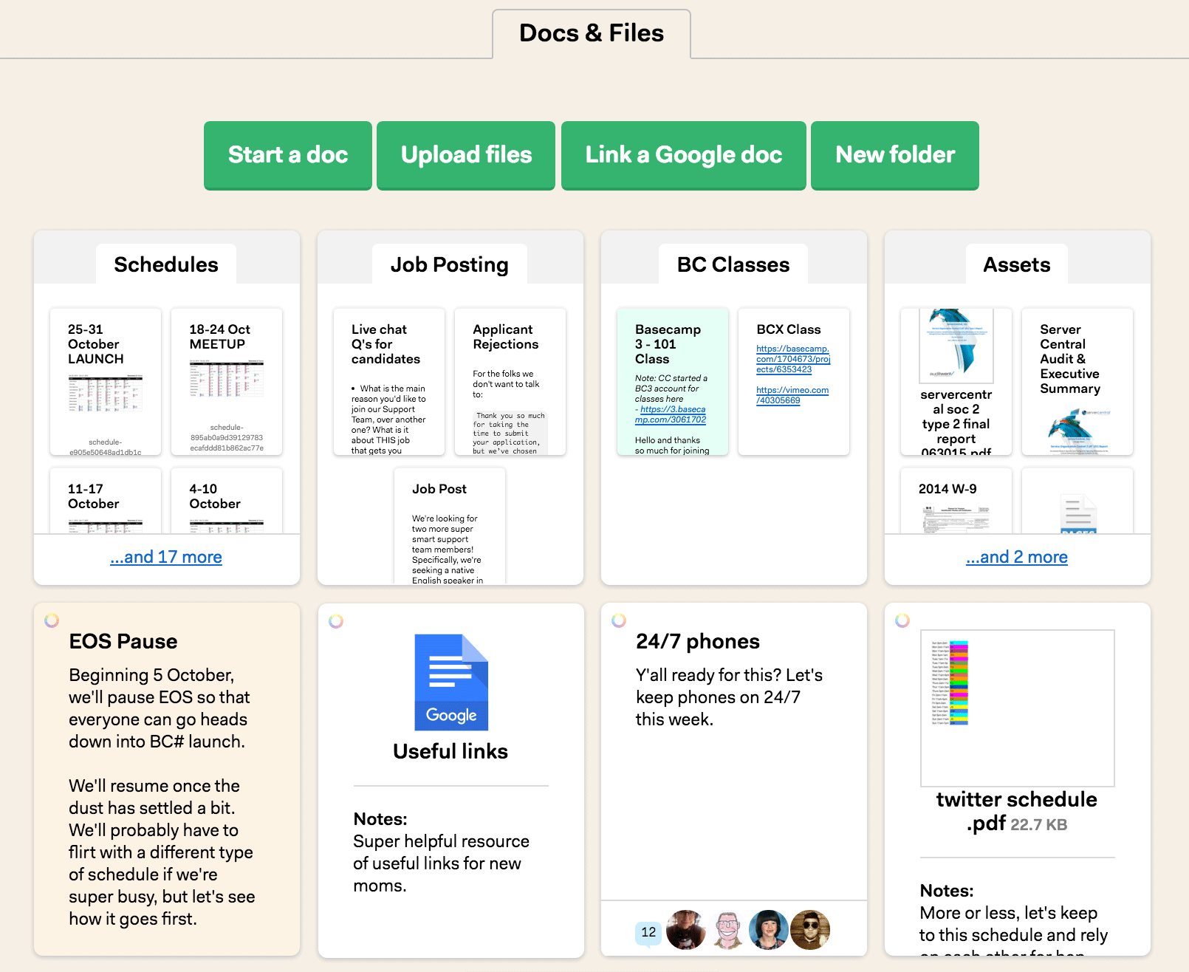
Basecamp Features – Basecamp Page > Docs & Files
Notes:
Need a place to put the PDFs, artwork, font files, docs, spreadsheets, etc. so everyone knows where they can find stuff? Put them in any order you want, organize them into folders, even color-code them: they’re always easy to find. This area contains all files associated with the project no matter how the file was added: through Message Board, To-dos or directly to the Docs & Files section.
Selecting a document opens a screen where the document can be viewed or downloaded. Only pdf format files can be viewed. Existing comments on the document can be accessed from this screen. A new discussion string related to the document can be started from this screen.
If you made changes to a file and need to add a new version, no worries! Go to the file in the project, and click to "Replace with a new version.“
Text documents can be created by clicking on the "Start a Doc“ button.
New to Basecamp3 – folders! To create a new folder, click on the white "Docs & Files" card and then click the green "New folder" button. Folders can have sub-folders. You can drag a previously posted document or existing folder into a folder.
Documents can be color coded by clicking on the colored circle at the upper left corner of the document card, selecting a color and saving the color setting.

Slide 35
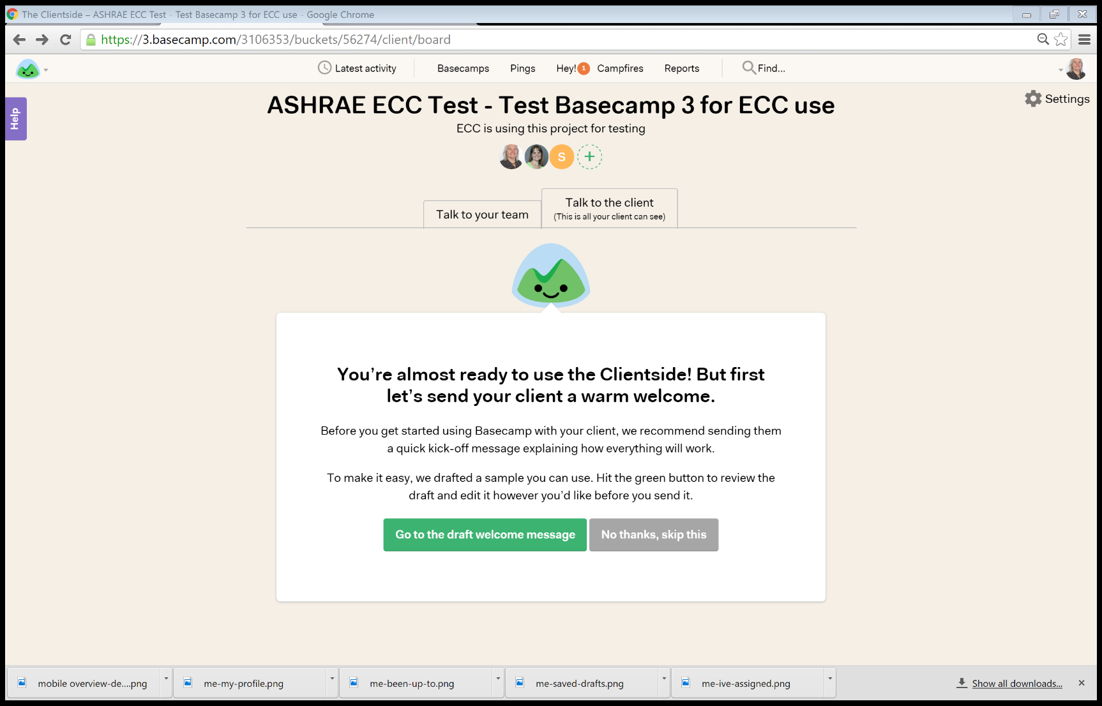
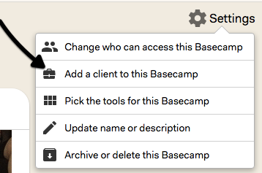
Basecamp Features – Clients
Notes:
“Clientside” feature keeps client feedback on the record and completely separate from the rest of your project. This means your client never sees anything they shouldn’t, and your team doesn’t have to tip toe around worried about saying the wrong things.
The “Talk to your team” section is where you outline and divvy up work, riff, hash things out over chat, share unfinished thoughts, discuss deadlines and strategy, etc. The client can’t see any of this stuff. This is your safe place for your team to talk openly about anything you’re working on together.
Everything you send to the client will be sent via email. The client doesn’t need to create any accounts, sign into anything, buy into any system, or install any apps.
Clients only see what you send them and they can reply directly from their email app. Their replies get sent right into Basecamp so you have every conversation saved on the record.
When a client emails you something important from outside Basecamp - maybe a question or request - you can forward it to Basecamp and it’ll be stored in the Clientside. Then you can respond right from Basecamp, the client will get your response via email, they can just respond to the email, and the rest of the conversation will be stored right in Basecamp. Now the entire conversation is on the record in Basecamp even though it started with the client emailing you outside of Basecamp.
All ASHRAE Basecamp3 projects will be set up with the client side enabled for you. In the event you need to use it go to Settings to add a client.

Slide 36
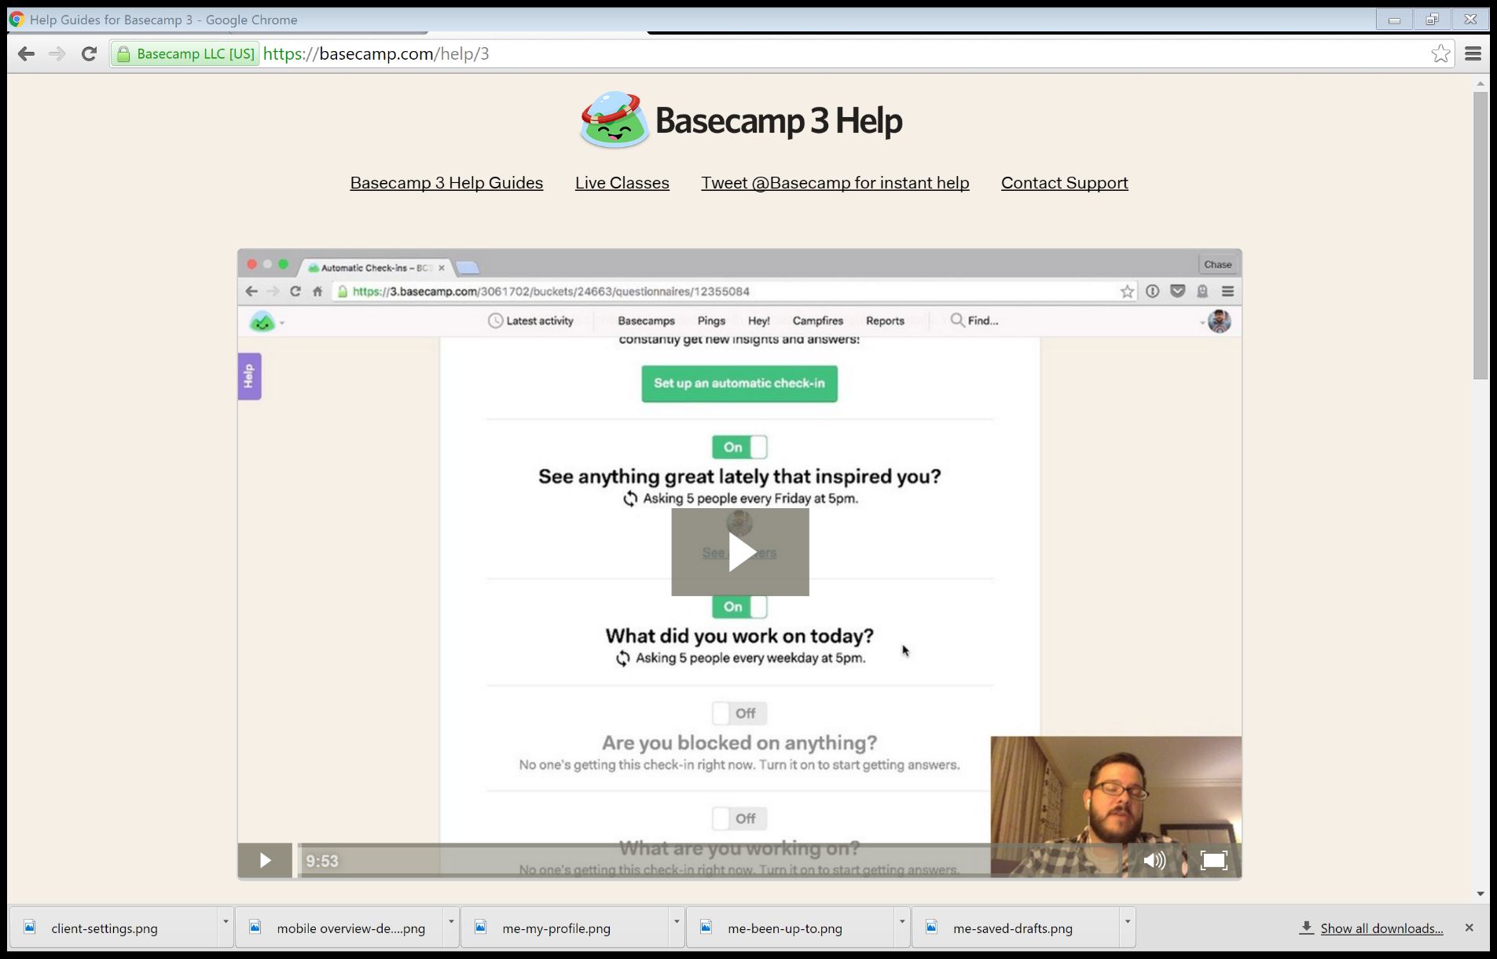
Basecamp Features – Help
Notes:
Basecamp has excellent online help which can be accessed from the “Help” button on the left side of the screen. Help options include Help Guides, tweeting for instant help and contacting support via email (see links at top of help page).
The initial help page has a general video to introduce the features of Basecamp3.
Email help is available 24/7/365.

Slide 37
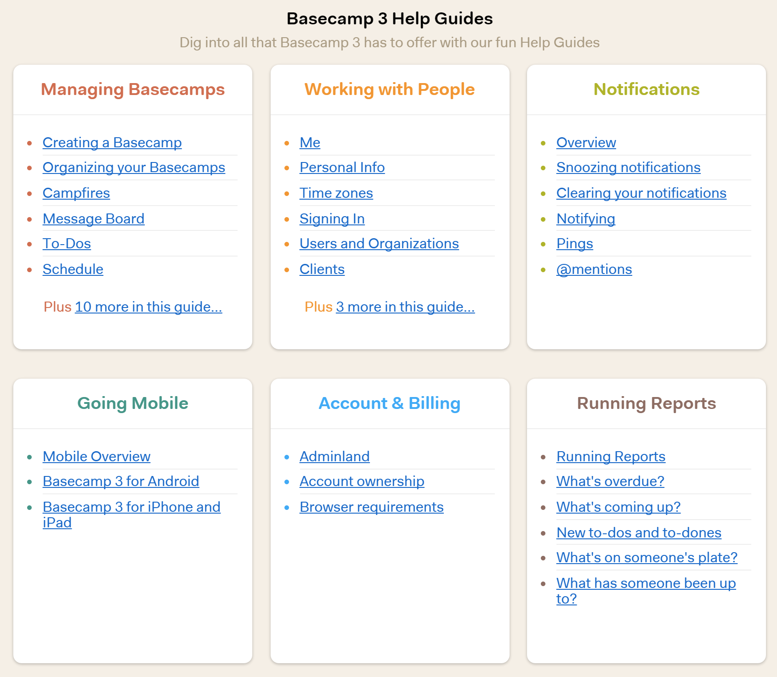
Basecamp Features – Help
Notes:
The lower portion of the initial help page has links to the help guides. These guides contain step-by-step instructions on using the various features and many contain videos.

Slide 38
Basecamp Practices
Use designators at the beginning of titles for Messages, To-Dos and Schedule items.
Don’t send every Message Board item to all members.
Edit your email preferences.
Get familiar with the application and give some thought to how your committee works to develop specific best practices.
Notes:
To make it easier to find/sort Message Board items use designators at the beginning of the discussion title. For a TC that has subcommittees for programs, handbook and research this may look like PSC, HSC and RSC which would be first in the discussion title to designate ownership. For Councils that have fiscal and functional subcommittees this may look like FISC and FUNC. While each committee can determine these it is preferable to standardize so project members don’t have to learn different designators for each project they are on.
The initial default on a Discussion is to email everyone on the project. Be courteous of members time and don’t inundate them with emails that are not applicable to them. This is particularly applicable to subcommittee work. Before posting use the Add/remove People button at the bottom of the page.
If you are on multiple projects you can get inundated with email. There are options to see summaries periodically during the day and to get a daily recap of all activity on your projects. New to Basecamp3 is the “Work can Wait” feature that limits the hours/days the system will send you notifications.
Give some thought as to how your committee works: subcommittees, current work in progress, documents everyone needs to access, collaborative document development. Then implement the various sections of Basecamp. A TC for example may want to use Text Documents to develop the language for a research project work statement prior to copying it onto the official forms.
Don’t be afraid. You can always modify how your committee works within Basecamp.

Slide 39
Basecamp Migration – Version 2 to 3
Trial participants - there is no requirement to upgrade your Basecamp2 project.
All new requests will be created in Basecamp3.
Migration tool is expected to be available mid-2016.
People and companies in Basecamp2 do not automatically appear in Basecamp3. Using the same email allows access across versions with existing log in.
Notes:
The launch of Basecamp 3 has no effect on current Basecamp2 accounts. Nothing changes, nothing goes away. Everything you have in Basecamp2 today is exactly the same - safe and sound, working like it always has. It’ll continue this way. You can keep using your current version forever. Basecamp 3 is entirely separate from what you already have. This only affects those groups that were part of ASHRAE’s limited trial. All new project requests will be created in Basecamp3.
Migration tools for version 2 to version 3 are expected to be available in mid-2016.
People from previous versions of Basecamp will not automatically show up on your Basecamp 3 account, but if you invite someone to Basecamp 3 using the same email address they used in Basecamp Classic or Basecamp 2, they won't have to create a new account.

Slide 40
Basecamp Rollout Plan
BOD & Council Staff, Chair & VC Today
BOD & Council Members April 2016
Standing Committee Staff, Chair & VC Late July 2016
Standing Committee Members Late Sept 2016
Notes:
Society Level Committees (BOD, Councils)
Initial introduction would be with the ASHRAE staff that supports the group and the current committee chair and vice chair. The “Introduction to Basecamp” presentation would be conducted via a web meeting followed by discussions regarding rollout to committees that report to the BOD and Councils, “client” relationships and communications crossing committees. The intent at this stage is to get the support staff, who will eventually be fielding questions, and the committee leadership to start using the application, thinking about how their project should be organized and how they want to introduce the application to the standing committees that report to them.
Initial introduction of all members of the BOD and councils would follow using the introduction presentation via a separate web meeting for each group.
Standing Committees
Committees that report to the BOD or a Council would be trained as a group. The Initial introduction would be with the ASHRAE staff that supports the committee and the current committee chair and vice chair. The “Introduction to Basecamp” presentation would be conducted via a web meeting followed by discussions regarding “client” relationships, rollout to committees that report to the Standing Committees and communications crossing committees.
Initial introduction of all members of the standing committees would follow using the introduction presentation via a separate web meeting for each group.
Remaining Committees
Introduction of the application to the remaining groups within ASHRAE (TC, SPC/GPC, Regions, Chapters, etc.) will occur after the Standing Committees in order to incorporate lessons learned, to allow the oversight bodies to get experience with Basecamp3 and coordinate rollout with the applicable oversight bodies.
ECC is started discussions with TAC at the Orlando meeting regarding rollout to the TCs. This was done due to TAC member exposure to Basecamp2 as part of the TC Web Site Upgrade project and the large number of TCs.
Ideally introduction of Basecamp3 to these groups would occur in late 2016. This will need to be reviewed based on the rollout experience and lessons learned from the earlier groups.

Slide 41
Electronic Collaboration
Questions?

