Slide 1
202_-202_ (Update This)
ASHRAE REGION ___
HISTORIAN’S WORKSHOP
CHAPTERS REGIONAL CONFERENCE
HOSTED BY: _______________ CHAPTER
Located in _______________

Slide 2
CHAPTERS REGIONAL CONFERENCE
Why are we here?
Keep history alive!!

Slide 3
202_-202_ REVIEW & DISCUSSION
Highlights of
SOCIETY HISTORICAL COMMITTEE MINUTES

Slide 4
ACTION ITEMS FOR ASHRAE HISTORICAL COMMITTEE FROM (last winter or annual MEETING
COMMITTEE CHAIR MEMBERS
ADMINISTRATIVE/ Comm Member __/__/Chair(ExO)
ARCHIVES
COMMUNICATIONS/ Vice Chair __/Chair (ExO)
RVC GUIDELINES
AWARDS/ Comm Member __/__/Vice Chair (ExO)
LEADERSHIP VOICES

Slide 5
202_-202_
PRESIDENTIAL AWARD OF EXCELLENCE (PAOE)
HISTORICAL CRITERIA (300 PAR - 100 MIN)

Slide 6
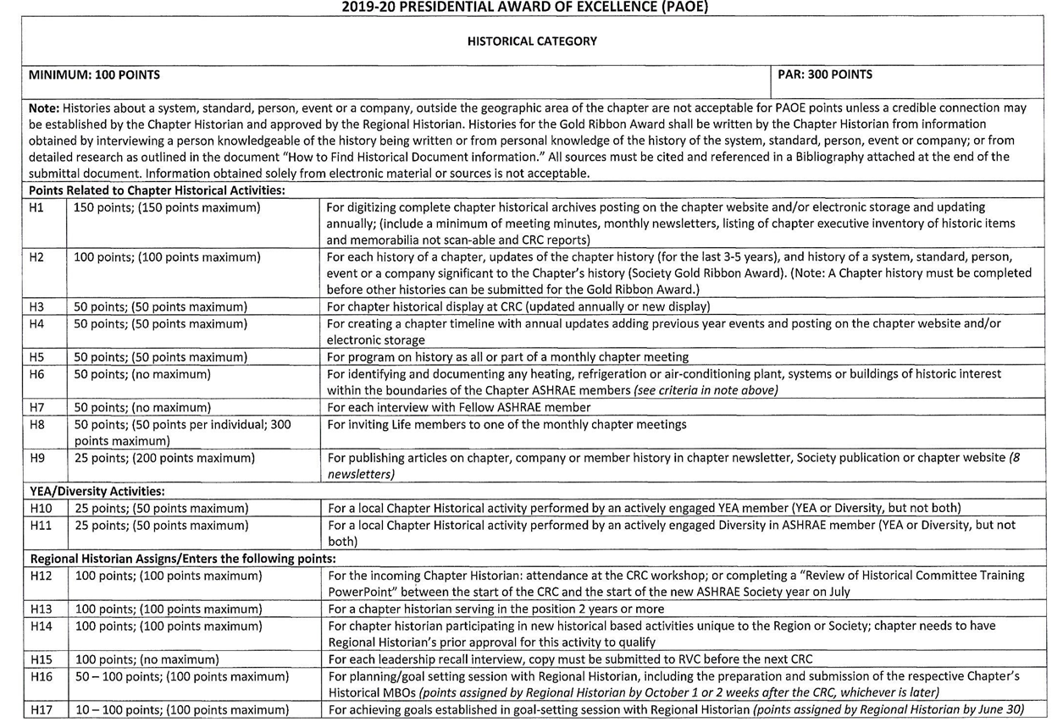

Slide 7
PAOE HISTORICAL CRITERIA (2019-20)
H1. For Digitizing Complete Chapter Historical Archives And Electronically Posting And Updating Annually
  Include a minimum of meeting minutes, monthly newsletters, listing of chapter executive inventory of historic items and memorabilia not scan-able and CRC reports
  150 points (150 maximum)
Notes:
150 points for digitizing complete chapter historical archives posting on the chapter website and/or electronic storage and updating
annually. (Include a minimum of meeting minutes, monthly newsletters, listing of chapter executive inventory of historic items and
memorabilia not scan-able and CRC reports (150 points maximum)

Slide 8
PAOE HISTORICAL CRITERIA
H2. For each history of a chapter, updates of the chapter history, (Society Blue Ribbon Award) (Note: A Chapter History must be completed before other histories can be submitted for the Gold Ribbon Award ; see upcoming slides for details for Gold Ribbon).
  100 points (no limit)
Notes:
100 points for each leadership recall interview, copy must be submitted to RVC before the next CRC (no limit)

Slide 9
PAOE HISTORICAL CRITERIA
H3. For a historical display at CRC (updated annually or new display)
  50 points (50 maximum)
Notes:
100 points for each history of a system, standard, person, event or a company significant to the Chapter’s history (Society Gold Ribbon Award) (100 points maximum)
Note: Histories about a system, standard, person, event or a company, outside the geographic area of the chapter are not acceptable

Slide 10
PAOE HISTORICAL CRITERIA
H4. For creating a chapter timeline with annual updates adding previous year events and posting on the chapter website and/or electronic storage.
50 points (50 maximum)
Notes:
50 points for chapter historical display at CRC (updated annually or new display) – (50 points maximum)

Slide 11
PAOE HISTORICAL CRITERIA
H5. For program on history as all or part of a monthly chapter meeting.
  50 points (50 maximum)
Notes:
50 points for creating a chapter timeline with annual updates adding previous year events and posting on the chapter website and/or electronic storage (50 points maximum)

Slide 12
PAOE HISTORICAL CRITERIA
H6. For identifying and documenting any heating, refrigeration or air-conditioning plant, systems or buildings of historic interest within the boundaries of the Chapter ASHRAE members (see criteria in note above).
  50 points (no maximum)
Notes:
50 points for program on history as all or part of a monthly chapter meeting (50 points maximum)

Slide 13
PAOE HISTORICAL CRITERIA
H7. For each interview with Fellow ASHRAE Member
  50 points (no maximum
Notes:
50 points for identifying and documenting any heating, refrigeration or air-conditioning plant, systems or buildings of historic interest to ASHRAE members

Slide 14
PAOE HISTORICAL CRITERIA
H8. For inviting Life Members to one of the monthly chapter meetings.
  50 points (50 points per Life Member; 300
  points maximum)
Notes:
50 points for each interview with Fellow ASHRAE member

Slide 15
PAOE HISTORICAL CRITERIA
H9. For publishing articles on chapter, company or member history in chapter newsletter, Society Publication or chapter web site (8 newsletters)
  25 points (200 maximum)
Notes:
50 points for inviting Life members to one of the monthly chapter meetings (50 points max)

Slide 16
PAOE HISTORICAL CRITERIA – YEA/Diversity Activities:
H10. For a local Chapter Historical Activity performed by an actively engaged YEA member (YEA or Diversityl but not both)
  25 points each (50 points maximum)
Notes:
25 points for publishing articles on chapter, company or member history in chapter newsletter, Society publication or chapter website
(200 points maximum [8 newsletters]

Slide 17
PAOE HISTORICAL CRITERIA
H11. For a local Chapter Historical activity performed by an actively engaged YEA or Diversity in ASHRAE member (YEA or Diversity, but not both).
  25 points each (50 maximum)
Notes:
YEA Activities
25 points for a local Chapter Historical activity performed by an actively engaged YEA member – (50 points maximum)
Note: Histories about a system, standard, person, event or a company, outside the geographic area of the chapter are not acceptable for
PAOE points. Histories for the Gold Ribbon Award shall be written by the Chapter Historian from information obtained by interviewing a
person knowledgeable of the history being written or from personal knowledge of the history of the system, standard, person, event or
company. Information obtained from electronic material is not acceptable.

Slide 18
PAOE HISTORICAL CRITERIA Regional Historical Assigns/Enters the following points:
  H12. For the incoming Chapter Historian; attendance at the CRC worshop; or completing a “Review of Historical Committee Training Power Point” between the start of the CRC and the start of the new ASHRAE Society year in July.
  100 points; (100 points maximum)

Slide 19
PAOE HISTORICAL CRITERIA
H13. For a Chapter Historian serving in the position 2 years or more.
  100 points (100 maximum)
Notes:
Regional Historian Assigns
100 points for the incoming Chapter Historian attending the CRC workshop (100 points maximum)
…..

Slide 20
PAOE HISTORICAL CRITERIA
H14. For Chapter Historian participating in new historical based activities unique to the Region or Society; chapter needs to have Regional Historian’s prior approval for this activity to qualify.
  100 points each year (100 maximum)
Notes:
….
Regional Historian Assigns
100 points for a chapter historian holding the position for a second and third year

Slide 21
PAOE HISTORICAL CRITERIA
H15. For each leadership recall interview, copy must be submitted to Regional Historian before the next CRC.
  100 points; (no maximum)
Notes:
….
Regional Historian Assigns
100 points for a chapter historian holding the position for a second and third year

Slide 22
PAOE HISTORICAL CRITERIA
H16. For planning/goal setting session with Regional Historian, including the preparation and submission of the respective Chapter’s Historical MBO’s (points assigned by Regional Historian by October 1 or 2 weeks after the CRC, whichever is later)
  50-100 points (100 maximum)
Notes:
….
Regional Historian Assigns
100 points for a chapter historian holding the position for a second and third year

Slide 23
PAOE HISTORICAL CRITERIA
RH ASSIGNMENTS
H17. For achieving goals established in goal‐setting session with Regional Historian (Points assigned by Regional Historian by June 30 on receipt of evidence from Chapter)
  10-100 points (100 maximum)
Notes:
….
Regional Historian Assigns
100 points for a chapter historian holding the position for a second and third year

Slide 24
GOLD RIBBON AWARD
For chapters and historians that accomplish certain goals to the satisfaction of the Regional Historian and DRC
Approved by the Honor and Awards Committee and Board of Directors in January 1981

Slide 25
GOLD RIBBON AWARD
GOLD RIBBON awarded to chapter for mounting on their chapter banner
A certificate is awarded to the chapter historian
Awards made annually at the CRC

Slide 26
GOLD RIBBON AWARD
Chapter historians, initially, must complete a minimum of five years of history of their chapter
Thereafter the Gold Ribbon Award can be won for each additional minimum of five-year chapter history update
Ultimate goal is eventually recording or completing the chapter’s history back to its founding, as well as describing key events that led up to the formation of the chapter

Slide 27
GOLD RIBBON AWARD
HISTORY OF A CHAPTER
In a narrative format, and in chronological order, for example ….
  Society and CRC events
  Chapter Charter
  Chapter events
  List of chapter officers and Fellows
  Honors and Awards
  Photographs and brief description of chapter's members contribution to Society as well as HVAC&R and the community

Slide 28
GOLD RIBBON AWARD
UPDATE OF THE CHAPTER HISTORY
This is the continuing update of the chapter history
Includes any prior information obtained as well as continuing to build for the current year
The bits and pieces of happenings that make history interesting start here
A minimum five year update is required for the Gold Ribbon award

Slide 29
GOLD RIBBON AWARD
3. History of a Person, Company, or System
May include, for example ….
  a piece of equipment
  an artifact
  technology
  project
  …..particularly at a site with a heritage interest

Slide 30
GOLD RIBBON AWARD
Background to historic articles etc
Information can be, for example, from ….
  within an organization
  retired employees
  libraries
  museums
  publications
  company files
Source of information must be given
Information should be of significant value

Slide 31
GOLD RIBBON AWARD
Background to historic articles etc
Include photographs and text and graphics
Clearly identify objects and people
Material presented in historical perspective

Slide 32
GOLD RIBBON AWARD
Background to historic articles etc
Authors of ASHRAE historical presentations and articles published in ASHRAE Journal and other technical magazines and journals can be considered for Gold Ribbon award
Chapter history and historical presentations to be published on Chapter website and in newsletters
Prior to presenting historical material at CRC it can be presented at Chapter meetings

Slide 33
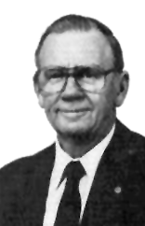
LOU FLAGG HISTORICAL AWARD
Society President in 1988-89
The Lou Flagg Historical (Gold Ribbon) Award approved by ASHRAE Board of Directors in June 2002
“to recognize a Chapter Gold Ribbon Award winner for compiling information on outstanding historical projects or persons related to HVAC&R”
Award consists of a plaque and lapel pin

Slide 34
LOU FLAGG HISTORICAL AWARD
Recognizes the vital role historians play in identifying and preserving the accomplishments of its members and the industry
Recognizes the most outstanding history on projects or persons

Slide 35
LOU FLAGG HISTORICAL AWARD
Presented at the Society’s Annual Conference
…..winner receives free transportation
Recipient selected from nominations submitted to, and judged by, the Historical Committee.
Nominations submitted yearly from each Region and from Historical Committee
Nominations to be received at ASHRAE Headquarters by Dec. 1st

Slide 36
LOU FLAGG HISTORICAL AWARD
Judging Criteria
  Historical significance 35 points
  Innovation 25 points
  Photographs 20 points
  Quality of presentation 20 points

Slide 37
LOU FLAGG HISTORICAL AWARD
Historical Significance
  History of a person, company, project, event, system or object invented or created
  Significant contribution to the progress of HVAC&R industry
  The relevance of the historical value or significance shall be clearly addressed.

Slide 38
LOU FLAGG HISTORICAL AWARD
Innovation
  The depth to which the individual went, during the information gathering process, to locate and to identify the information should be emphasized.
  Project should describe the facts pertaining to the preparation of the article.

Slide 39
LOU FLAGG HISTORICAL AWARD
Photographs or Duplicates of Photos
  Encourage to use photos or illustrations in the submittal
  Illustrations and photos should enhance the presentation
  All photos should be identified (who, what, when, where and why)
  NOTE: Do not submit original photographs.

Slide 40
LOU FLAGG HISTORICAL AWARD
Quality of Presentation
  Presentation should be logical, concise and effective with significant features clearly highlighted.
  Simple to read system schematics or charts and easy-to-follow series of photos
  A presentation in electronic format is required.

Slide 41
LOU FLAGG HISTORICAL AWARD
Presented annually at the Society’s Annual Conference.
Winner receives free transportation to the Society’s Annual Conference.

Slide 42
HOW TO ARCHIVE
Decide what you are trying to document: the chapter history, history of industry, company or person? It will probably be a combination.
Set a time frame to achieve your goals – allow enough time, but not too much for the entire process. Try not let the project linger.
Keep objective

Slide 43
HOW TO ARCHIVE
Inventory materials to be archived, involving other people if necessary for decision-making
  Become familiar with everything that is scheduled to be archived
  Weed out any duplicates
  Save copies of formal programs, announcements, newsletters, or brochures that reflect the chapter’s meetings, membership, etc. Preferably keep originals, not photocopies
  Make a decision about roughly how many items you want to keep, protect and/or digitize.

Slide 44
HOW TO ARCHIVE
Triage the materials into three piles:
  Toss/throw away: Toss anything without obvious value. If you decide to keep a common item for interest’s sake, only keep one or two at most.
  Keep: Decide what is of enough value that it would have importance in five-ten years (role play with yourself or others: in 10 years time, would this have any bearing on the history of my chapter or the industry or a particular individual – not always easy to decide)
  Undecided: Hardest of all. Place anything in this pile that you are not sure about the wisdom of keeping, but have a feeling that maybe you should.

Slide 45
HOW TO ARCHIVE
Triage again:
  Keep pile: Go through this pile again; make sure that there isn’t any redundancy
  Undecided pile: Go through again with an eye to further removals
  Create new toss/throw away pile: This is for your new discards.
  Walk away for a period of time, so that you can think about the decisions you have made and also to consult with others who may have more knowledge about the items. A distance of space and time will provide further clarification for the decisions that you must make.

Slide 46
HOW TO ARCHIVE
Triage one more time: Continue to narrow your selection until you reach the number and quality of items you have planned to keep.

Slide 47
Chapter historians Workshop
Thanks for coming
Email: XXX@XXXXXX.XXX
Your Name______________
Regional Historian

