Slide 1
ASHRAE Region VII
Update
Name
Director and Regional Chair

Slide 2
Thank you
For coming to our CRC
10 of 14 ASHRAE Regional Conferences occur in August
  Thanks to the Name Chapter
  Special Thanks to Name and
  his team!

Slide 3
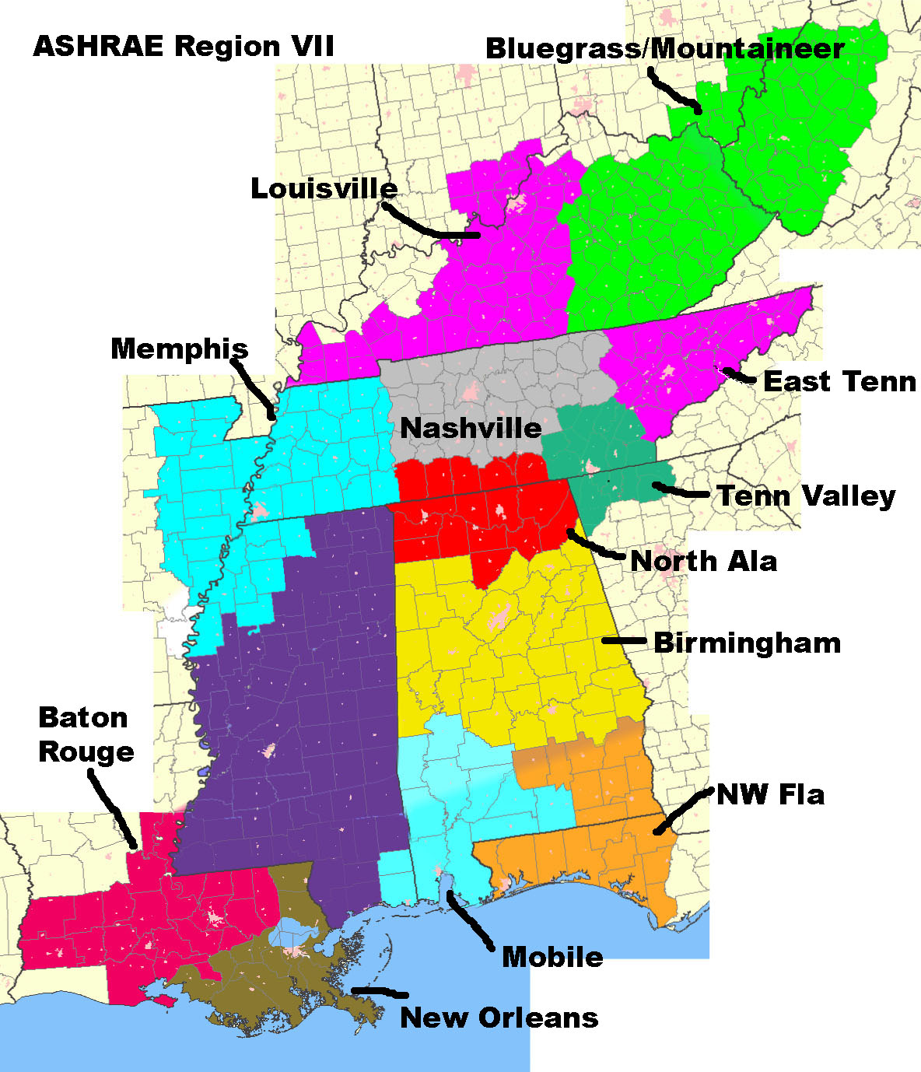
North
Central
Mississippi
South East
South West

Slide 4
Sample Past and Future CRC’s
1994 | mobile | 2005 | tenn valley
1995 | jackson | 2006 | birmingham
1996 | birmingham | 2007 | north alabama
1997 | memphis | 2008 | Memphis
1998 | baton rouge | 2009 | Mobile
1999 | new orleans | 2010 | New Orleans
2000 | nashville | 2011 | Bluegrass/Mountaineer
2001 | bluegrass | 2012 | East Tenn
2002 | east tenn | 2013 | Louisville
2003 | louisville | 2014 | Nashville
2004 | nashville | 2015 | Tennessee Valley

Slide 5
ASHRAE REGION VII
Director and Region Chair (DRC)
Nominating
Chapter Presidents (13)
RVC Membership Promotion (MP)
RVC CTTC
Assistant Regional Chair (ARC)
Chapter Programs
RVC Research Promotion (RP)
Refrigeration
RVC Student Activities (SA)
Historian
Regional Electronic Communications (ECC)
Regional Treasurer
Regional Meetings

Slide 6
Regional goal 20xx-20xx
MAKE ONE small
CHANGE
+ 2
It truly adds up!
20xx was a BANNER PAOE Year

