Slide 1
Chiller Control training Board & simulator
2017
Instructor: RusselL Marcks
Students: Paul Hawkins, Kenneth Wooten

Slide 2
Purpose and Objectives
Design and Construction of Control Boards Simulating the controls for a Carrier 30HWB018 Chiller
Boards to be used to teach troubleshooting a chiller control circuit
Avoids potential damage to expensive equipment
allows students to troubleshoot different problems on identical circuits simultaneously

Slide 3
Components
Transformer and power switch
Terminal Blocks
Temperature Controller
Bypass relay
Control module
relay
Decade Box/potentiometer/digital display
Indicator Lights
Switches and Buttons
18g Control wire
Stake-ons
Tools
Wire stripper/crimp/cutter, Drill, Screw Drivers, multimeter

Slide 4
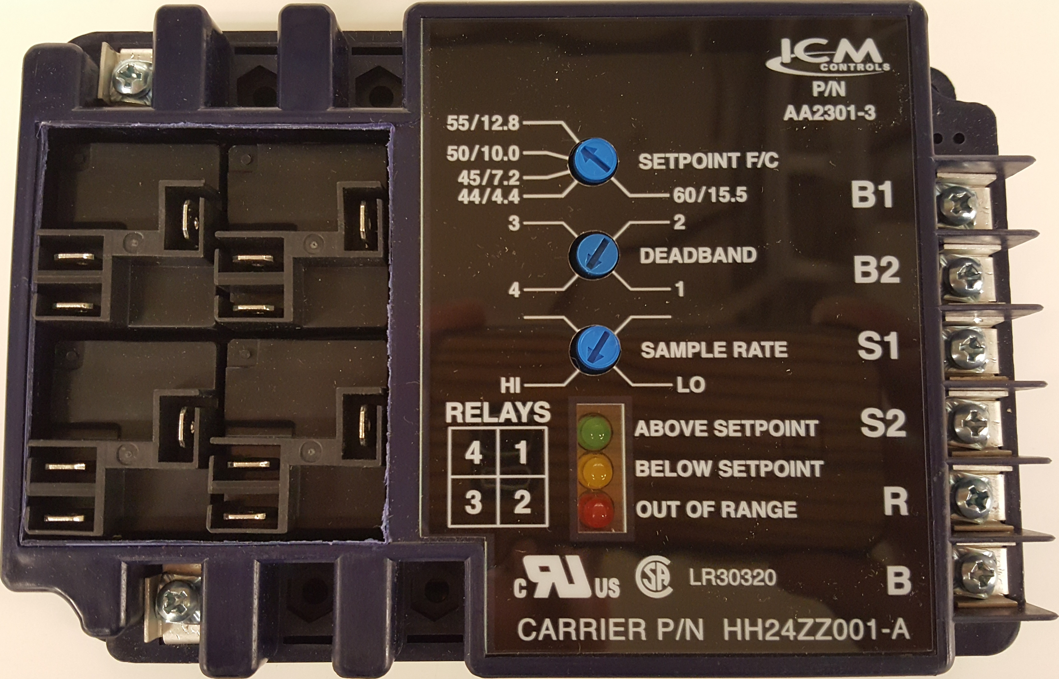
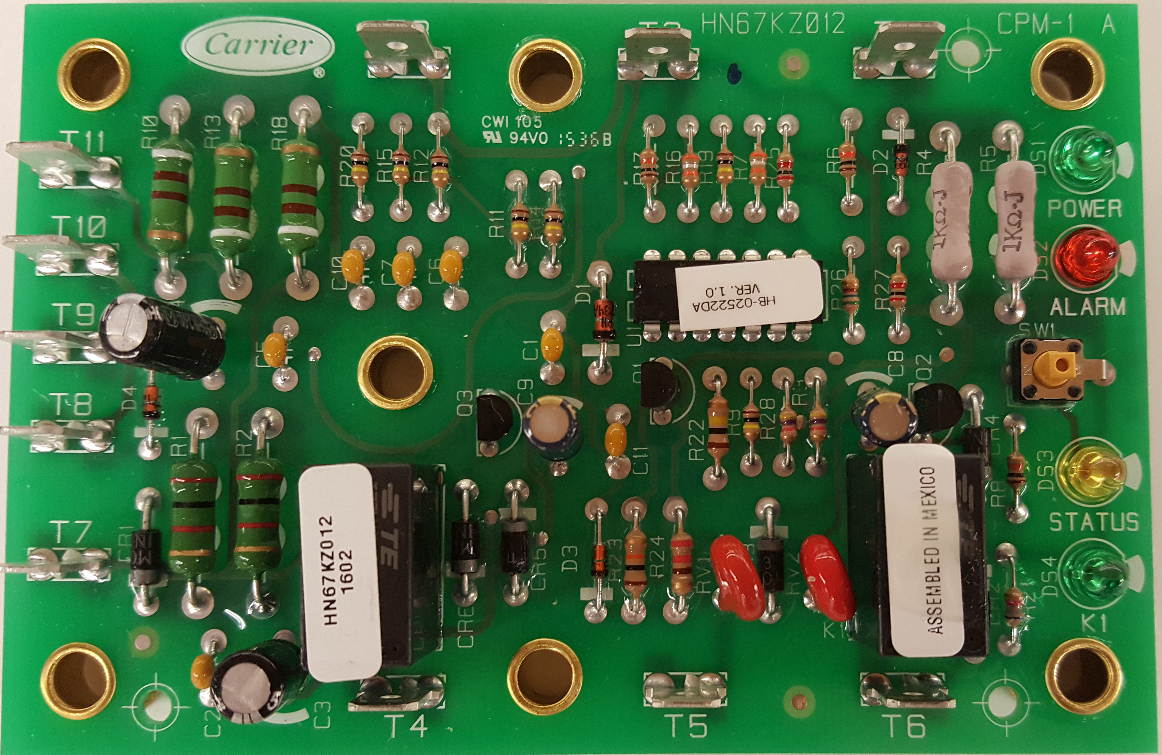
Components in Cabinet
TEMPERATURE CONTROLLER
TERMINAL BLOCK
CONTROL MODULE
BYPASS RELAY
CONTACTOR

Slide 5
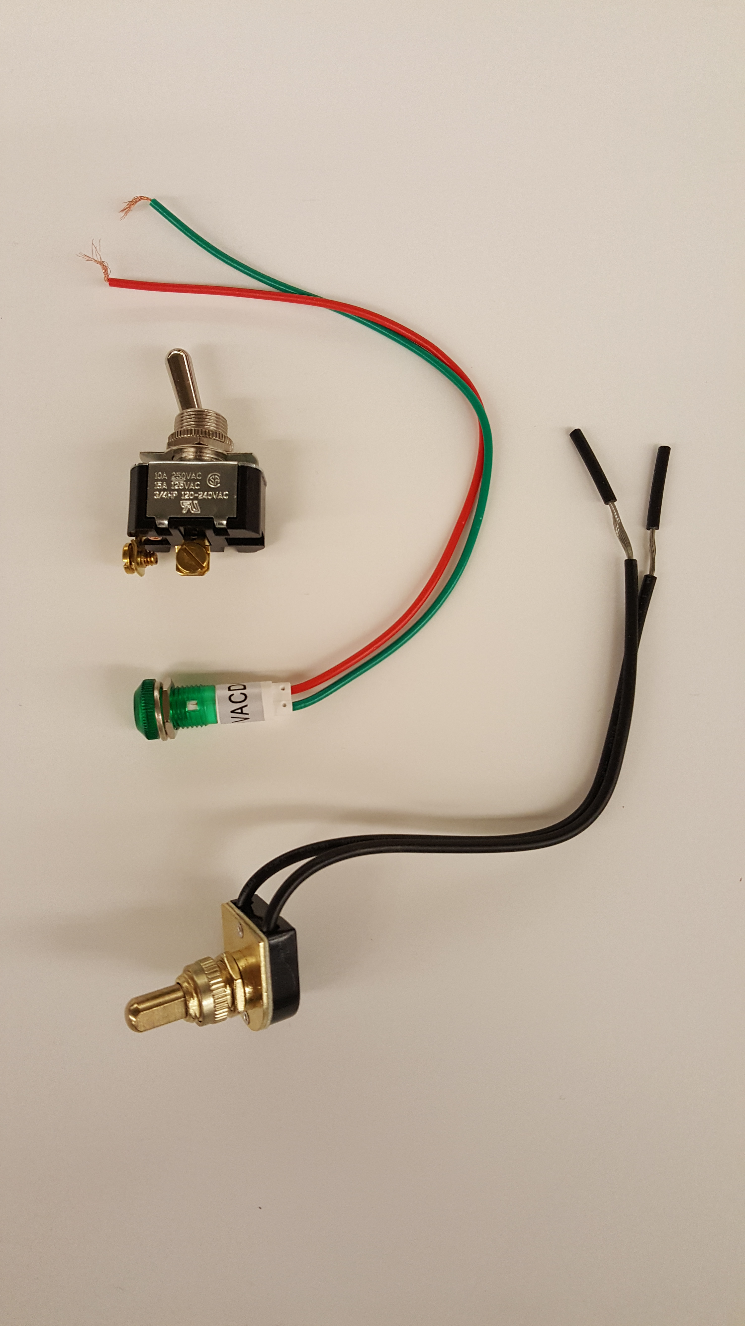
Necessary Additional components

Slide 6
Process
Analyze and trace wires on chiller and on control wire ladder diagram
Mount components to wood backboard with switches and instructor fault buttons
Replicate wiring from chiller to simulator
Test board with Decade Box*
Retest Board with Potentiometer

Slide 7
Instructor faults and indicator lights
Faults
Chilled water flow switch
Chilled water pump switch
Condenser interlock
Low pressure
High pressure
Discharge Thermostat
Demand limit
Alarm
Indicator lights (represent operation)
Compressor
Oil Heater
Compressor Unloader 1
Compressor unloader 2
Hot gas bypass

Slide 8
*Problems encountered and resolved
Decade box provided too much step change between resistances
Needed smoother more realistic change in temperature to interact with Temperature controller properly
Potentiometer used with accompanying digital display for smoother, more gradual change in resistance with “temperature” display

Slide 9
Outcomes
Gained knowledge of control circuitry Layout
chiller control sequence of operation
Reading and interpreting ladder diagrams
Wiring Experience
Troubleshooting approach and methodology

