Slide 1
“Development of a Laboratory Solar Refrigerator”
by Cláudia Nunes and Laura Bento, under the guidance of Eusébio Conceição

Slide 2
Summary
Project goals
Methodology
Refrigerator description
Main Results
Conclusions
Research Team
Student Branch at The University of Algarve

Slide 3
Project goals
This project aims to:
Experimental
Adapt a traditional refrigerator with absorption system to operate using solar radiation;
Build a solar system;
Optimize and validate the numerical model.
Numerical
Develop a numerical model that simulates the refrigerator, the air-conditioning system and its components operating using a solar system;
Apply the numerical methodology on buildings using air conditioning systems with absorption systems.
Student Branch at The University of Algarve

Slide 4
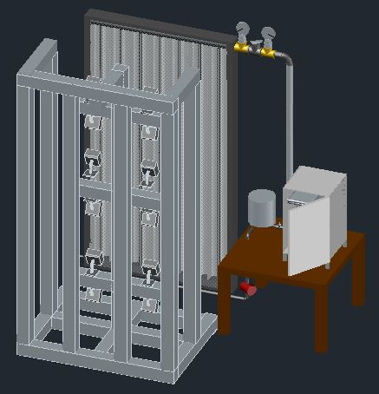
Methodology - refrigerator
Student Branch at The University of Algarve

Slide 5
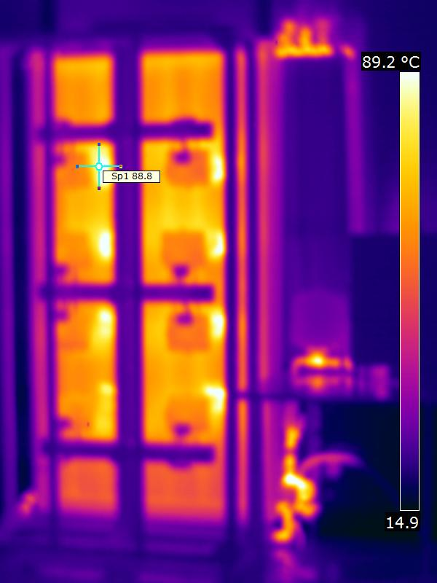
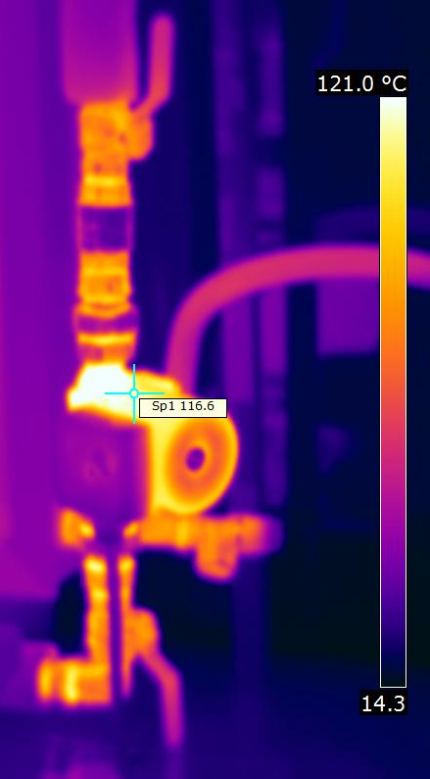
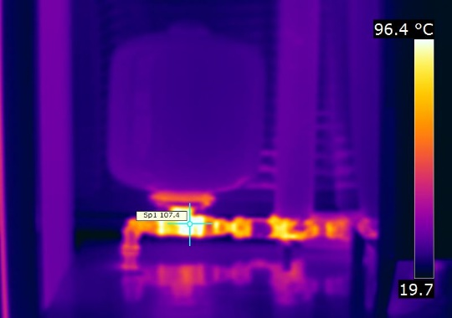
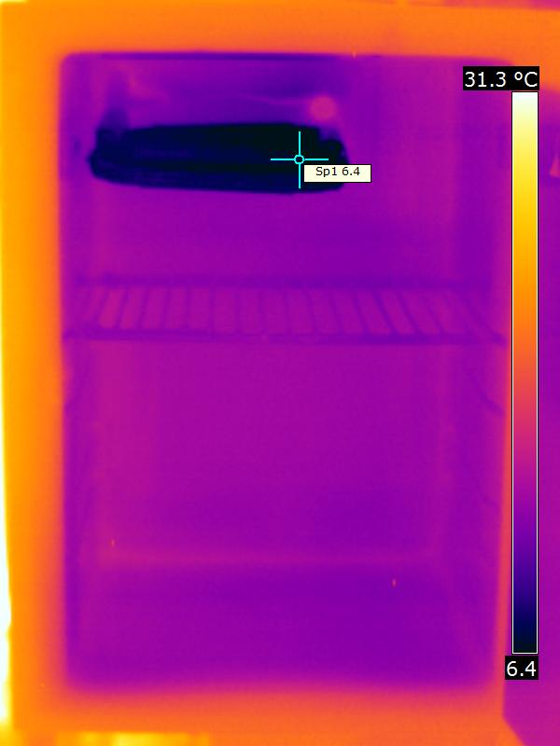
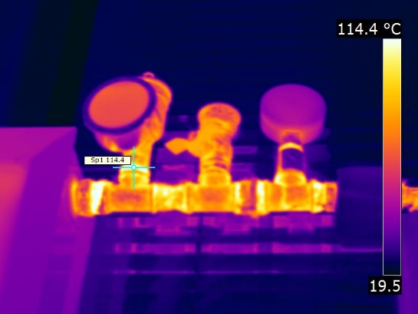
Main results – Refrigerator
Student Branch at The University of Algarve

Slide 6
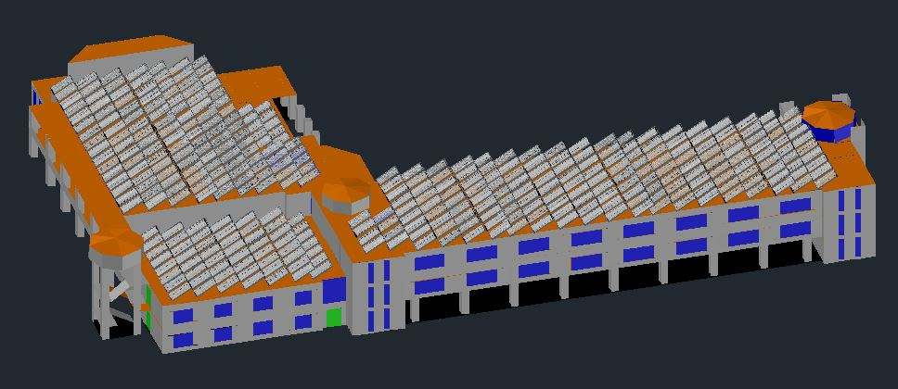
Methodology - air-conditioning
Student Branch at The University of Algarve

Slide 7
Main results – Energy consumption
Consumption (KW.h) | Winter | Summer | Winter | Summer
HVAC system off | 0 | 0 | 0 | 0
HVAC with PMV control (-0,7) steam compression | 251,61 | -1378,58 | 105,91 | -649,90
HVAC with PMV control (-0,7) solar collectors | 234,42 | -747,50 | 97,76 | -747,50
HVAC with Tar control (preferred) steam compression | 236,02 | -1340,75 | 103,98 | -584,72
HVAC with Tar control (19ºC winter) (25ºC summer) steam compression | 227,30 | -1747,86 | 99,31 | -803,14
HVAC with Tar control (20ºC winter) (27ºC summer) steam compression | 359,91 | -1425,57 | 157,57 | -654,67
Student Branch at The University of Algarve

Slide 8
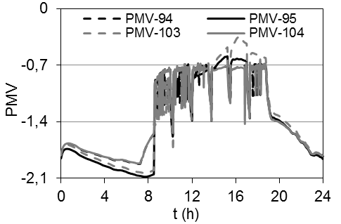
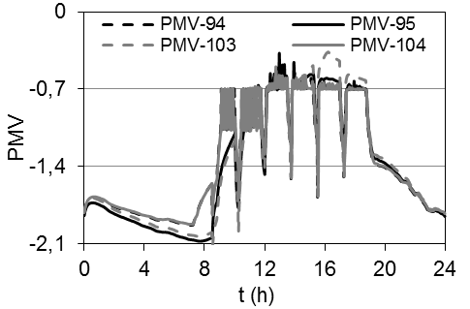
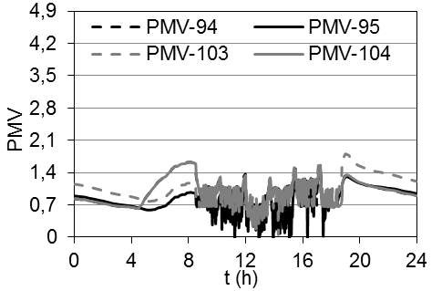
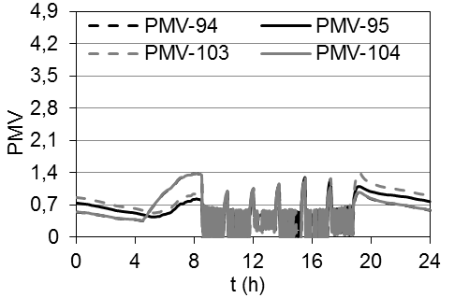
Main results - PMV
Winter Temperature control (19ºC)
Winter Solar system
Summer Temperature control (25ºC)
Summer Solar system
Student Branch at The University of Algarve

Slide 9
Conclusions
The solar system was developed and the refrigerator system, that operates with water/ammonia, was adapted;
The numerical model that simulates both the refrigerator and the air-conditioning systems were built and applied;
The energy consumption from solar air-conditioning, using this system, guarantees energy savings for the entire building in winter conditions, and for 1/3 of the classrooms, in summer conditions;
Regarding comfort conditions the solar air-conditioning system proves to be efficient for the whole building while during the summer the system can only guarantee comfortable conditions for 10 classrooms.
Student Branch at The University of Algarve

Slide 10
Research team
Cooperators:
Eusébio Conceição (Ph. D);
Cláudia Nunes (Master);
Laura Bento (Master);
Camilo Portela (Lab. Assistant);
Mª Manuela Lúcio (Master);
António Sousa (Ph. D student);
João Gomes (Ph. D student);
Melanie Sousa (Master student);
João Esteves (Master student);
Rui Leonardo (Master student);
João Cavalaria (Master student);
André Caravela (Master student);
Tiago Carvalho (Master student).
Subjects:
Renewable Energy and Energy Conservation;
Energy and Buildings;
Heat and Mass Transference;
Heat and Mass Transference Phenomenon;
Noise.
Student Branch at The University of Algarve

Slide 11
Thank you for your attention!
Student Branch at The University of Algarve

