Slide 1
Stirling Engine Micro CHP
Sara Alhasan
Civil & Environmental Engineering
Nam Kang
Mechanical, Automotive, & Materials Engineering
Notes:
Nam

Slide 2
Presentation Overview
Introduction
Research Objectives and Scope
System Configuration
Safety Precautions
University of Windsor ASHRAE Project Video
Notes:
Nam

Slide 3
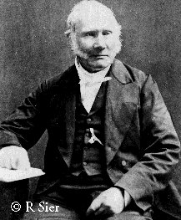
Introduction- History
Reverend Dr. Robert Stirling
Patented Heat Economizer (Regenerator) in 1816 and the Stirling Air engine with his brother James Stirling
[1]
Robert Stirling [1]

Slide 4
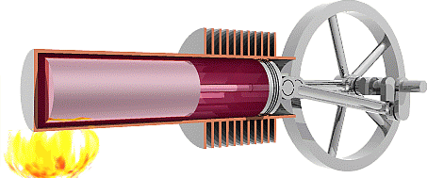
Introduction- Characteristics
High efficiency
Clean burning and low emission
Various fuel capability
Low noise and vibration
Reliable
Closed cycle containing fixed amount of working fluid with low specific heat
[2]
Stirling Engine

Slide 5
Introduction- So How Does It Work? (P-v, T-s Diagram)
Pressure, P
Qin
Qin
1
TH=constant
Temperature, T
TH
2
2
1
Qreg
ds
V=constant
V=constant
Qreg
4
1
2
3
4
3
TL
4
3
TL=constant
Qout
Qout
Volume, V
Entropy, S
1-2 Isothermal expansion: Heat addition from external source
2-3 Constant volume heat transfer: Internal heat transfer from the gas to the regenerator
3-4 Isothermal compression: Heat rejection to the external sink
4-1 Constant volume heat transfer: Internal heat transfer from the regenerator to the gas
[3]

Slide 6
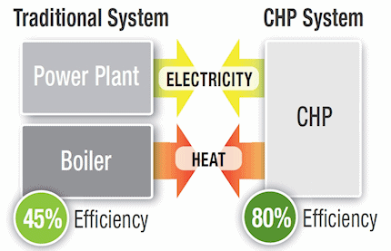
Introduction- micro-CHP
Combined Heat Power
Domestic/residential appliance [7]
Utilizes waste heat for heating [8]
Combination of power generation and heating increases the efficiency [9]
Environmentally conscience alternative
Cogeneration [10]
Green Energy [11]

Slide 7
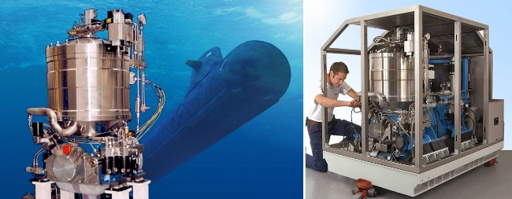
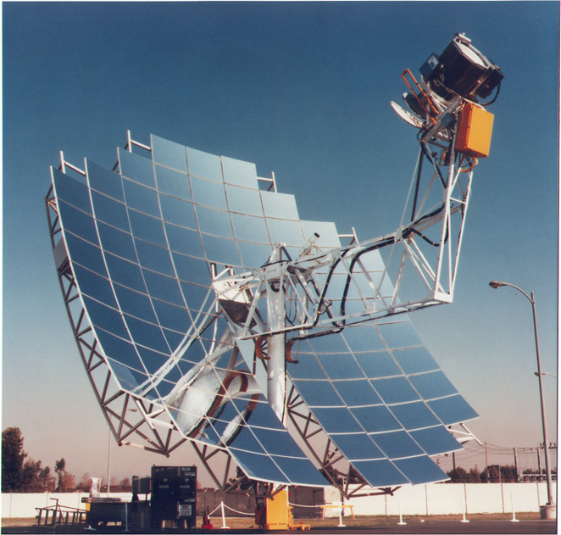
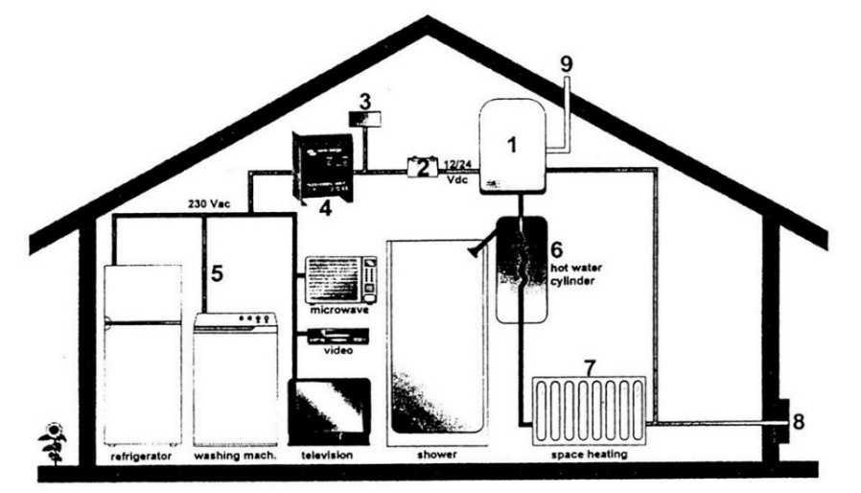
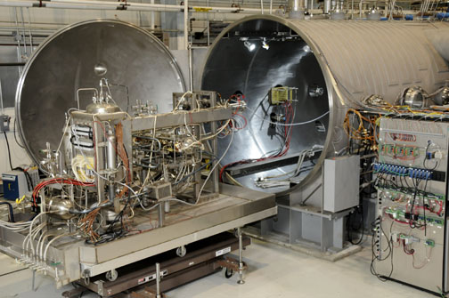
Common Uses of Stirling Engine
Marine Engines [4]
Solar Energy [4]
Domestic Use [4]
Nuclear Reactor [4]
Notes:
Sara

Slide 8
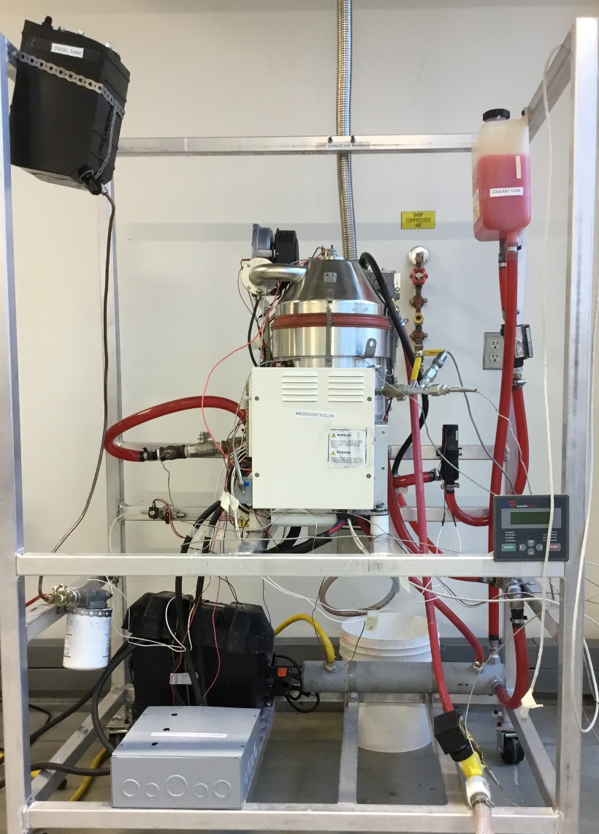
System Configuration
Fuel
Air
2
2
1
11
7
1 | Coolant Tank
2 | Diesel Tank
3 | Burner
4 | Stirling Engine
5 | Alternator
6 | Battery
7 | Exhaust heat-exchanger
8 | Microcontroller
9 | Fuel Pump
10 | Secondary heat-exchanger
11 | Air Pump
Burner
Exhaust Heat-Exchanger
1
Water Outlet
3
Thermal Energy
3
8
4
4
Stirling Engine
Coolant
Heat-Exchanger
5
5
9
11
Water Inlet
6
8
Mechanical Energy
6
10
Alternator
10
Fig.17 Stirling Engine CHP
Electrical Energy

Slide 9
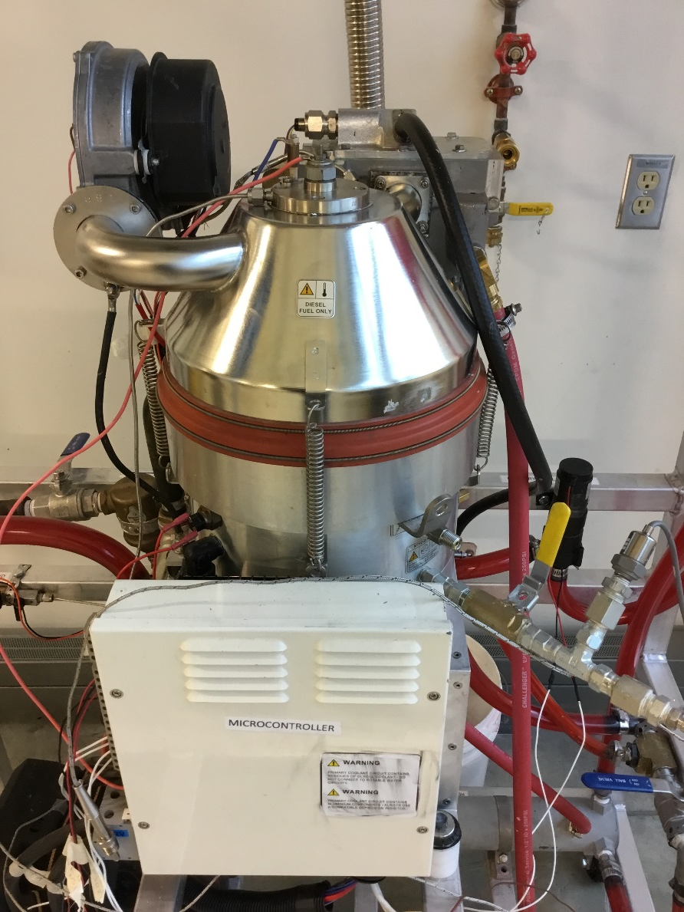
Design Project Objectives
To design and construct a lab scale natural gas burner powered Stirling engine micro-CHP for combines power generation and heating
The natural gas burner will provide the heat source to run the engine for producing electrical/ mechanical power
The waste heat is captured for space and water heating
Stirling Engine CHP
Notes:
Sara

Slide 10
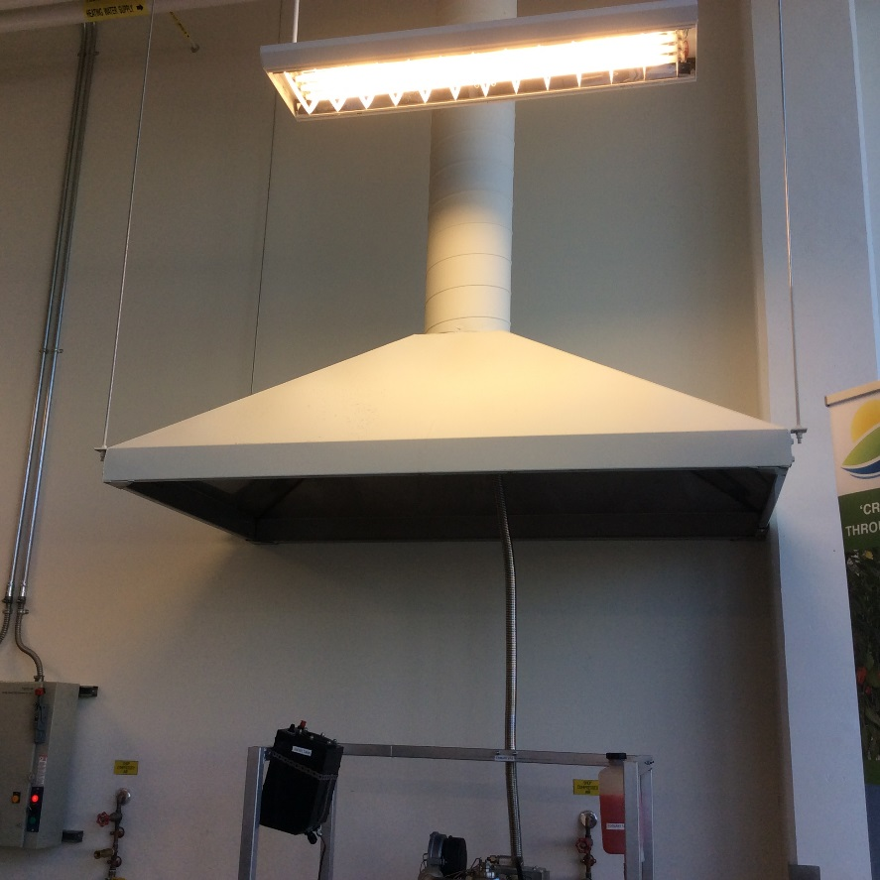
Safety Precautions
WhisperGen Safety Precaution Manual
Warning signs on the WhisperGen –high pressure nitrogen (up to 35 bar), hot surface, and flame sensors
Exhaust gases must be vented outside closed areas- Ventilation System
High temperature resistance material for sealants
Attention to any leaks
Ventilation System

Slide 11
University of Windsor: ASHRAE Project Video
https://www.youtube.com/watch?v=m785Gwf6Ops

Slide 12
Acknowledgements
ASHRAE
Turbulence & Energy Laboratory
Dr. David Ting
Dr. Graham Reader
Prashant Pradip
Notes:
Sara

Slide 13
Thank you!
Notes:
Sara

Slide 14
References:
[1] “Robert Stirling,” [Online] Available: https://en.wikipedia.org/wiki/Robert_Stirling [Access date: Sept, 2015]
[2] I. Oelrich and F. Riddell. “Evaluation of potential military application of stirling engines,” Institue for defense analyses., Alexandria, VA, Tech, Rep. ADA201000, Jul. 1988 [Access date: Sept, 2015]
[3] Çengel, Yunus A, and Michael A. Boles. ”Thermodynamics: An Engineering Approach,” Boston: McGraw-Hill, 2001. P.P 502-506.
[4] “Application of Stirling Engine,” [Online] Avaiable: https://en.wikipedia.org/wiki/Applications_of_the_Stirling_engine [Access date: Sept, 2015]
[5] G. Ikram and S. McGlaun. “MSI Striling Engine heatsink,” [Online]. Available:http://www.dailytech.com/MSI+Showcases+Stirling+Engine+Heatsink/article10918.htm, Feb. 2008 [Access date: Jan, 2016]
[6] D. Phillips, “Why Aviation needs the Stirling engine,”[Online] Available:http://www.airsport-corp.com/fourpartstirling.html, 1994 [Access date: Dec, 2015]
[7] Manning, M et al. “Integration and monitoring of microCHP systems in residential application at the Canadian Centre for Housing Technology,” Canadian Centre for Housing Technology., Ottawa, ON, [Online.] Available: http://www.ccht-cctr.gc.ca/eng/projects/chp_stirling.html., Apr. 2008 [Access date: Nov, 2015]
[8] N. Farra. “Efficiency and Emissions Study of a Residential Micro–cogeneration System Based on a Stirling Engine and Fuelled by Diesel and Ethano,l”. M.S. thesis, Dept. Mech. Eng., Toronto Univ., Toronto, ON, 2010.

Slide 15
References:
[9] Entchev, E et al., “Micro generation technology assessment at the Canadian Centre for Housing Technology,” Canadian Centre for Housing Technology., Ottawa, ON, Energy and Buildings, [Online.] Available: http://www.ccht-cctr.gc.ca/eng/projects/chp_stirling.html., Sept. 2004. [Access date: Oct, 2015]
[10] M. Khan, “EFFICIENCY AND EMISSIONS STUDY OF A RESIDENTIAL MICROCOGENERATION SYSTEM BASED ON A MODIFIED STIRLING ENGINE AND FUELLED BY A WOOD DERIVED FAST PYROLYSIS LIQUID-ETHANOL BLEND,” M.S. thesis, Dept. Mech. Eng., Toronto Univ., Toronto, ON, 2012.
[11] Bell, M et al., “Development of Micro Combined Heat and Power Technology Assessment Capability at the Canadian Centre for Housing Technology,” Canadian Centre for Housing Technology., Ottawa, ON, [Online.] Available: http://www.ccht-cctr.gc.ca/eng/projects/chp_stirling.html., Dec. 2003 [Access date: Oct, 2015]

