Slide 1
Student Activities CRC Workshop
Design Competition
Notes:
The intent of this slide is to introduce the Student Design Competition – estimate less than 30 seconds – This entire Session should take 40-50 minutes to complete

Slide 2
Overview
4 major categories
HVAC Design Calculations
HVAC System Selection
ISBD (Integrated System Building Design)
Applied Engineering Challenge
Each category has 1st, 2nd, 3rd & “Rising Star” awards
Students from all over the world can participate including technology and architectural schools. They do not have to be ASHRAE Student Branches
Its purpose is to promote ASHRAE (and the HVACR industry) to as wide a spectrum of students as possible
Notes:
The intent is to provide an overview of the Design Competition – estimate is 3-4 minutes

Slide 3
Basis of the Project
Multi-story building located somewhere in the world with Schematic Architectural drawings
OPR is developed to illustrate building use and owner expectations
Each category has explanations to assist the intent and expectations for the students
Not everything students need will be there (purposely)
We want students to reach out to mentors.
Notes:
This slide illustrates the basic elements of the design competition – estimate is 3-4 minutes

Slide 4
HVAC Design Calculations
Intended for schools with a limited exposure to HVAC and/or technology schools with limited engineering exposure
Students Must:
Complete Heat Gain/Heat Loss Calculations
Follow ASHRAE Standards 55, 62.1 & 90.1
Design a complete HVAC system (given)
Illustrate the design process (the how factor)
Notes:
This slide illustrates the HVAC Design Calculations category – estimate is 3-4 minutes

Slide 5
HVAC System Selection
Intended for schools with a deeper exposure to HVAC
Students Must:
Complete a full Life Cycle Analysis of the building to determine the best HVAC System Selection
Follow ASHRAE Standard 189.1
Persuade the reader (creativity)
Illustrate why and how to support “HVAC System of Choice”
Notes:
This slide illustrates the HVAC System Selection category – estimate is 3-4 minutes

Slide 6
ISBD
Intended for schools with a deep exposure to integrated building design and high performance buildings
Students Must:
Redesign the building to illustrate an energy efficient sustainable design that approaches “ZERO ENERGY”
Follow LEED and ASHRAE Standard 189.1
Teams should illustrate integrated design process (architects, engineers and others working as one)
Notes:
This slide illustrates the HVAC System Selection category – estimate is 3-4 minutes

Slide 7
Applied Engineering Challenge
Intended for all Engineering Programs with the intent to challenge students to solve an engineering problem related environment issues that impact people
Students Must:
Analyze the given problem which could involve energy, environmental issues, renewable energy applied to engineering challenges, etc…
Illustrate with detailed engineering how the problem can be uniquely solved
Notes:
This slide illustrates the Applied Engineering Challenge category – estimate is 3-4 minutes

Slide 8
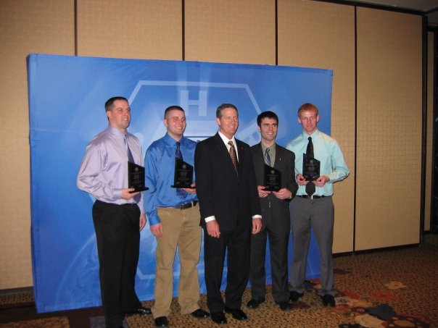
Award Winning Teams
Winning teams are recognized by ASHRAE
Students are given plaques
Schools are given compensation for coming to the Student Program
Notes:
The intent of this slide is to illustrate the great benefit ASHRAE gives to students – estimate is 2-3 minutes

Slide 9
The Process
Teams need to register with ASHRAE
Due Dates (timeline):
Teams must submit in first week of May (date given on ASHRAE website)
Local chapters must judge first level by mid May (date given on ASHRAE website) – THIS IS YOU!
Region judging is done by SAC RVC – completed by June 1
Society judging is done at summer annual meeting in June
First week of August winning teams are notified
Notes:
This slide illustrates the HVAC System Selection category – estimate is 3-4 minutes

