Slide 1
Student Activities CRC Workshop

Slide 2
K-12 Purpose
As “baby boomers” retire, ASHRAE membership has a high probability of shrinking (there is a strong need for membership replacement)
Kids are often unaware of what STEM careers are all about
ASHRAE is a key partner in STEM awareness
Each chapter should have a K-12 champion organizing membership involvement with K-12
K-12/STEM Chapter Leadership Award (like full circle)
Youth Outreach Award
Notes:
The intent is to explain the purpose of K-12 and illustrate its importance to ASHRAE – estimate is 2-3 minutes

Slide 3
K-12 Activities
Reaching Students Grades K-5
Donate your time! Utilize the K-12 resources on the ASHRAE Student Zone for local school visits.
Experiments
Use request form for posters, brochures, giveaways and videos
Presentation aides
K-12 Discussion Forum
www.ashrae.org/ashraek12
Notes:
This slide illustrates that even young kids can enjoy the experience of STEM related activities and open their minds

Slide 4
K-12 Activities
Reaching Students Grades 6-8
Visit guidance counselors, science/math teachers and gifted coordinators
Tell them about your job
Show ASHRAE videos
Sponsor tours and awards
Participate in a science fair or activity with the Girl Scouts
Host a National Engineers Week activity (2nd week in February)
Utilize activities, resources and discussion forum
Request Brochures
www.ashrae.org/ashraek12
Notes:
This slide illustrates the importance of reaching out to middle school age kids and get them to see potential careers with STEM/HVAC before they are influenced by others

Slide 5
K-12 Activities
Reaching Students Grades 9-12
Visit classes, counselors, science/math teachers & gifted coordinators
Organize visits of local colleges
Organize local technical tours
Tell them about your job
Serve on career panels or in career fairs
Recommend high school classes to take
Recommend colleges, Universities, trade and vocational schools
Host a National Engineers Week activity (2nd week in February)
Request Brochures
www.ashrae.org/ashraek12
Notes:
This slide is for visits to high school age kids and illustrating careers related to STEM & HVAC

Slide 6
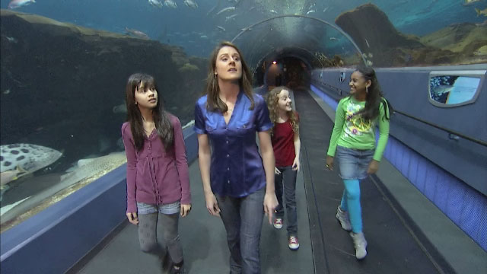
K-12 Activities
Introduce a Girl to Engineering
ASHRAE has a promotional video aimed at middle school-aged girls introducing them engineering
Filmed at Georgia Aquarium
Demonstrates how HVAC&R engineering is important to the well being of the marine life within the facility, as well as visitors
Video to be featured on ASHRAE K-12 website
Play Video
www.ashrae.org/ashraek12
Notes:
This will demonstrate the ASHRAE K-12 website and play the video of the Georgia Aquarium

Slide 7
K-12 Activities
K-12 Activity Demo
Notes:
This is where you add the demonstrations for group engagement

Slide 8
K-12
How have you connected with K-12 schools?
What K-12/STEM programs are your chapters involved in?

