Slide 1
Student Activities CRC Workshop
Post High

Slide 2
Post High
What is it?
It is the local university, college or technical (secondary) school branch within the local chapter area.
Why is it important?
Membership, membership, membership!!!
Future of our industry and ASHRAE
_{v}
Notes:
The intent is to illustrate that Post High is the heart of Student Activities and becomes the breeding ground for future membership – estimate is 2-3 minutes

Slide 3
Local Student Branch
Student Branches are located on college/university campuses and are connected to ASHRAE Chapters or Regions.
The purpose of the student branch is to get more students interested in our industry.
Resource (Website within the Student Zone)
https://www.ashrae.org/membership--conferences/student-zone/student-branches
Search for Existing Student Branches
Manual for Student Branch Operations
Presentations for leadership & student recruitment
Starting a new branch
Key to success is having an avid/supportive advisor.
Student Branch Advisors pay the same membership fee & conference fees as students.
Notes:
This is an overview of what it takes to create a student branch and where resources are located for your use – estimate is 4-5 minutes

Slide 4
Local Student Branch
Student Branches are REQUIRED to report yearly to Society by May 31st. (Both reports are simple online forms.)
Student Branch Status Report
http://xp20.ashrae.org/STUDENT/frmstat.htm
Student Branch Secretary/Treasurer’s Report
http://xp20.ashrae.org/STUDENT/frmsecy.htm
Student Branches that do no complete these reports will become “Inactive”.
Notes:
This is an overview of what it takes to create a student branch and where resources are located for your use – estimate is 4-5 minutes

Slide 5
Student Membership
Who can be a Student Member of ASHRAE?
Any student who is enrolled in:
Community College
Technical College
4-year University Undergraduate Program
Graduate Programs
Student Memberships are currently not available for students who are not post high school, however ASHRAE has many opportunities for these students which will be covered later.
Notes:
Overview of who can be a student member

Slide 6
Student Membership
Why would a student want to be a member of ASHRAE?
Technical Knowledge (resources)
Cost Benefits
Society Benefits
Networking Opportunities
Professional Development
Career Exploration
Scholarship Potential
Added Value to Employers
Access to the ASHRAE Website
Notes:
This is an overview of this session – estimate is 2-3 minutes

Slide 7
Student Retention
Why is it important?
Student membership is annual.
Need to keep students involved so they stay ASHRAE members and become future leaders of our industry.
Get the local chapter involved.
Organize student events with the local chapter.
Industry connection is critical to instilling a higher value and level of connection to ASHRAE.
Work with branch advisors to get student memberships renewed.
Notes:
The intent of this slide to illustrate the importance of student membership renewal and student involvement – estimate is 2-3 minutes

Slide 8
Student Retention
Tracking Students:
Tracking students can be difficult as they potentially move every year and may lose their university email addresses after graduation.
Try to track students with:
Alternate email addresses
University & home (parent’s) mailing addresses
Cell phone/text messages
A few months prior to graduation, survey students for their future plans and pass on contact information to the local chapters if they are moving.
Notes:
The intent of this slide to illustrate the importance of student membership renewal and student involvement – estimate is 2-3 minutes

Slide 9
Student Membership Transition
SMART Start Program for transition into society
Voting rights as full associate member of ASHRAE
Free manuals during this time period
Cost Benefit ($410 savings over 3 years)
1st year is $20
2nd year is $73
3rd year is $94
Notes:
JOE
The intent of this slide is to illustrate the great benefits of becoming an ASHRAE member via the SMART Start Program - estimate 2-3 minutes

Slide 10
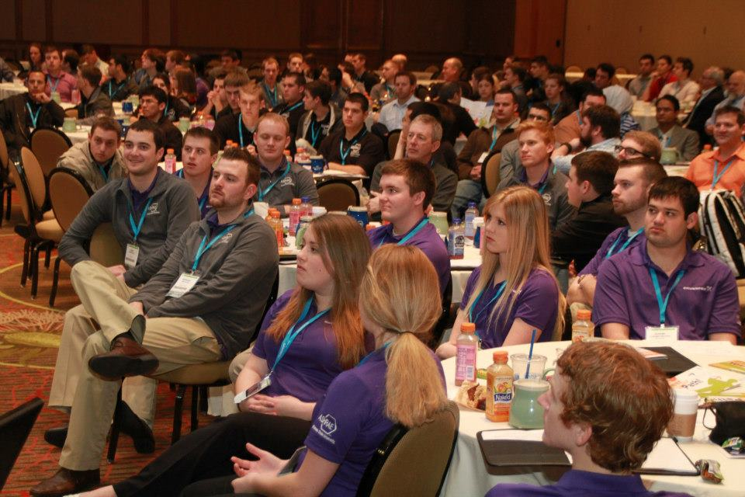
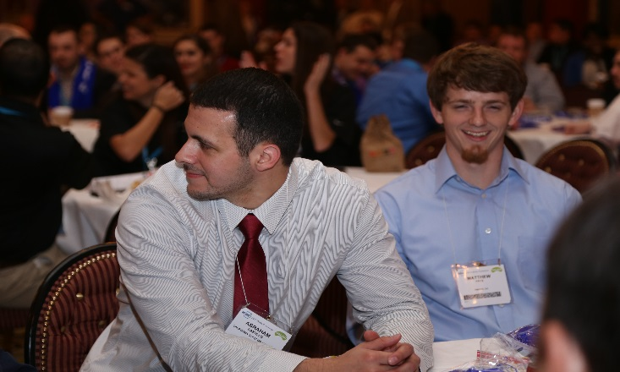
Student Program
Every winter conference has a multi-day student program.
400 to 500 students from student branches around the world attend.
Students get exposure to society members, mentoring, and much more during the program.
Students are recognized for awards.
Student presentations of award winning grant projects.
Special student tour.
Student Congress.
Notes:
BILL
The intent of this slide to further illustrate the student program at the winter meeting – estimate is 3-5 minutes

Slide 11
Student Preparation
Student branches need to prepare for the student program at the winter meeting.
Plan for costs (raise funds, get sponsors, etc…)
Work with the local chapter and school.
Each student needs to register for the reduced Student Rate.
This provides them with full registration to the Conference (a $500+ value).
Make sure to plan a visit to the AHR Expo.
Program starts on Saturday and ends on Monday.
Make sure travel plans coordinate with required activities.
Notes:
The intent of this slide to illustrate the needed planning for student branches if they are to attend the winter meeting – estimate is 2-3 minutes

Slide 12
Scholarships
There are many scholarships available to ASHRAE Student Members. Details can be found here:
https://www.ashrae.org/membership--conferences/student-zone/scholarships-and-grants/ashrae-scholarship-program-and-stem

Slide 13
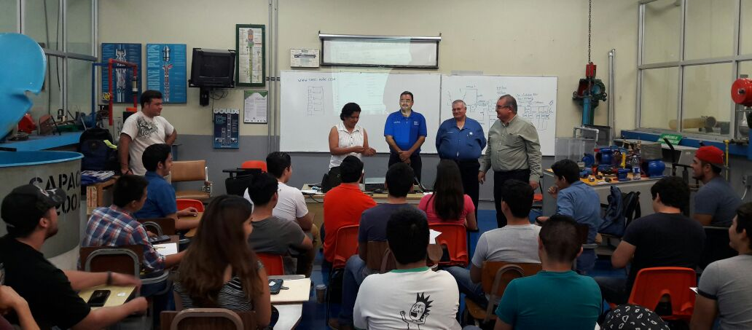
How can the local chapter support your student members?
Notes:
Things to bring up:
Local speakers for branches
Mentorship programs
Free or discounted chapter Technical meetings/events
Get ideas from the audience

Slide 14
Lessons Learned
Chapters should make contact with the Student Branch Advisors and Student Officers early in the academic year.
Provide opportunities for the Student Members to participate in Chapter activities.
Along with your Chapter officers, visit the student branches on campus.
Plan early for the Student Program at the Winter Conference
Other ideas?
Notes:
Drive discussion within the group for ideas

