Slide 1
Student Activities CRC Workshop
Introduction and Overview

Slide 2
Welcome and Introductions
Introductions (training team and participants)
Name
Chapter & Position
One reason why you’re interested in Student Activities
What is one thing that you want to learn today?

Slide 3
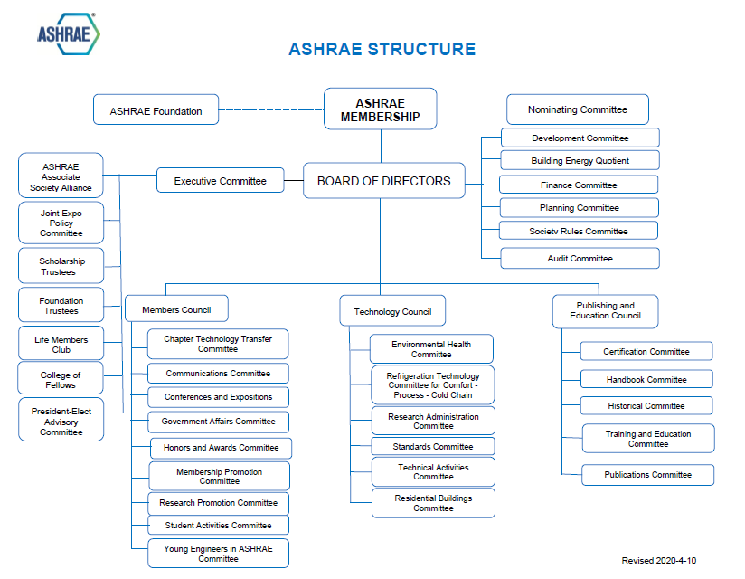
Notes:
The intent is to illustrate the overall structure of ASHRAE with a very general explanation – estimate is 2-3 minutes

Slide 4
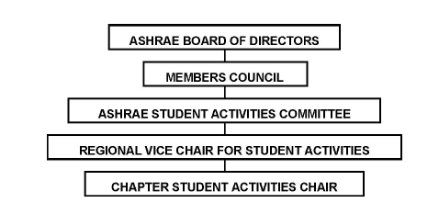
SA Org Chart
Notes:
The intent of this slide is to illustrate the connection of SAC to the structure of ASHRAE – estimate is 1-2 minutes

Slide 5
What Are The Purposes of SA
Goals
Encourage the study of HVAC&R
Promote careers in the HVAC&R industry
Introduce ASHRAE student membership
Support existing ASHRAE student branches and encourage the development of new ASHRAE student branches
Promote grant and design competition programs
Promote math and science to K-12 students and describe how the study of math & science can lead to an exciting career in engineering
Video: ASHRAE: Shaping Tomorrow’s Built Environment Today
Notes:
The intent of this slide is to illustrate what the core of SA is all about – estimate is 3 minutes plus time for the video

Slide 6
What Are The Purposes of SA
“…we in ASHRAE have a responsibility to our Society to encourage students to obtain an education that will allow them to enter our industry.”
- Student Activities Handbook for Chapter Chairs

Slide 7
What Are The Purposes of SA
Motivation
Student Involvement is critical to membership retention within ASHRAE
Baby-Boomers are the large lump in the snake (not enough “X” & “Y” generation membership to replace these active members)
Chapter Sustainability is linked to this need
Leadership for tomorrow = need for mentoring today
ASHRAE is bringing together many factions of research, design, construction, energy, sustainability, and the environment – it is not just an HVAC engineering society
Expanding membership diversity
Notes:
The intent of this slide to create the “Need” behind why ASHRAE supports SAC – estimate is 4-5 minutes

Slide 8
SAC Responsibilities and Our Agenda for Today
Topic 1
Topic 2
Topic 3
Running Reports & PAOE
Planning, MBOs
Notes:
RVCs will need to update this page

