Slide 1

THIS IS ASHRAE
Society Year 2023-2024
Photo of ASHRAE Global Headquarters Building
August 2023

Slide 2
ASHRAE Overview
MISSION
To serve humanity by advancing the arts and sciences of heating, ventilation, air conditioning, refrigeration and their allied fields.
VISION
A healthy and sustainable built environment for all.
INDUSTRY CLASSIFICATION
Consulting Engineers
Contractors
Manufacturers
Manufacturing Representatives
Government, Health & Education
Design Build
Architects
      52,000+
      Members
      130+ Countries
198 Chapters
15 Regions
5,500+
Student Members
400+
Student
Branches
Founded
in
1894

Slide 3
What We Do and How We Do It
33 Standing Committees
130+ Standards and
Guidelines Committees
100+ Technical Committees
300+ Publications
7 Certification Programs
200+ Educational Courses
Research
Scholarships
Serve as pipeline for providing technical information to members, chapters, companies and government officials
1
Develop standards and technical guidelines to improve the built environment
2
3
Offer continuing education for industry professionals
4
Serve as networking tool for industry professionals

Slide 4



ASHRAE Journal
ASHRAE’s official monthly publication provides detailed insight on the latest HVACR technologies and applications for consulting engineers and professionals in the industry.
Articles are peer-reviewed and focus on technical topics, including green buildings, decarbonization, indoor air quality, energy management, thermal storage and alternative refrigerants.
ASHRAE Journal Podcast Discussions with leading ASHRAE experts to expand knowledge in the HVACR industry.
New! Hot Air Brief talks with ASHRAE Journal authors on HVACR content published in the Journal.
ashrae.org/ashraejournal

Slide 5


ASHRAE Handbook
ASHRAE Handbook – Print Version
Continuously refined and updated, ASHRAE has published its Handbook series since 1920s
Volumes cover HVAC&R fundamentals, systems, equipment
and a wide variety of applications
Handbooks are also available in the ASHRAE Technology Portal
ashrae.org/handbook
ASHRAE Handbook Online
Mobile device responsive
Content from all four current Handbook volumes plus extra features such as videos, animations, spreadsheets and more
Easier than ever to search across all volumes, print, ask questions about technical content, access bonus features and look up new terminology
Eligible ASHRAE members can choose an ASHRAE Handbook Online subscription at a discounted rate during membership renewal
ashrae.org/handbookonline

Slide 6
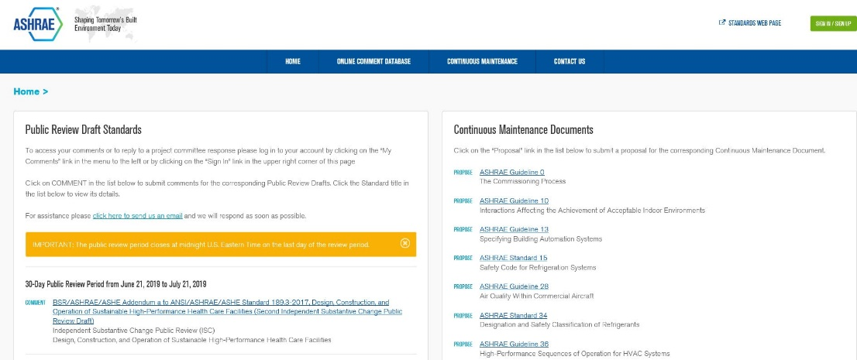
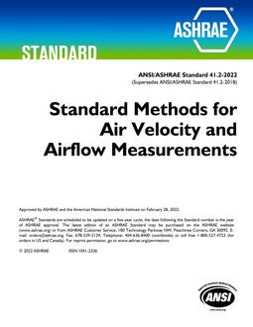
Standards and Online Standards
Review Database
The Online Standards Review Database allows
access to public review drafts for standards, guidelines
and addenda and to submit comments.
The system offers a dashboard which highlights items that require attention, provides quick links to individual and committee comments, continuous maintenance proposals and outstanding ballot results.
ashrae.org/publicreviews
Developing standards since 1922
130+ active standard or guideline projects
Standards are reviewed and republished to ensure they are up-to-date, e.g., existing code-intended standards are on a three-year review cycle
ashrae.org/standards
Notes:
All standards go through public review and comment.
Existing standards are reviewed every three years.
Standards that are on continuous maintenance are republished with new addenda every three years.
Code utilized standards are republished every three years

Slide 7
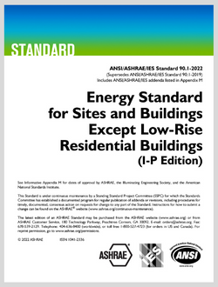

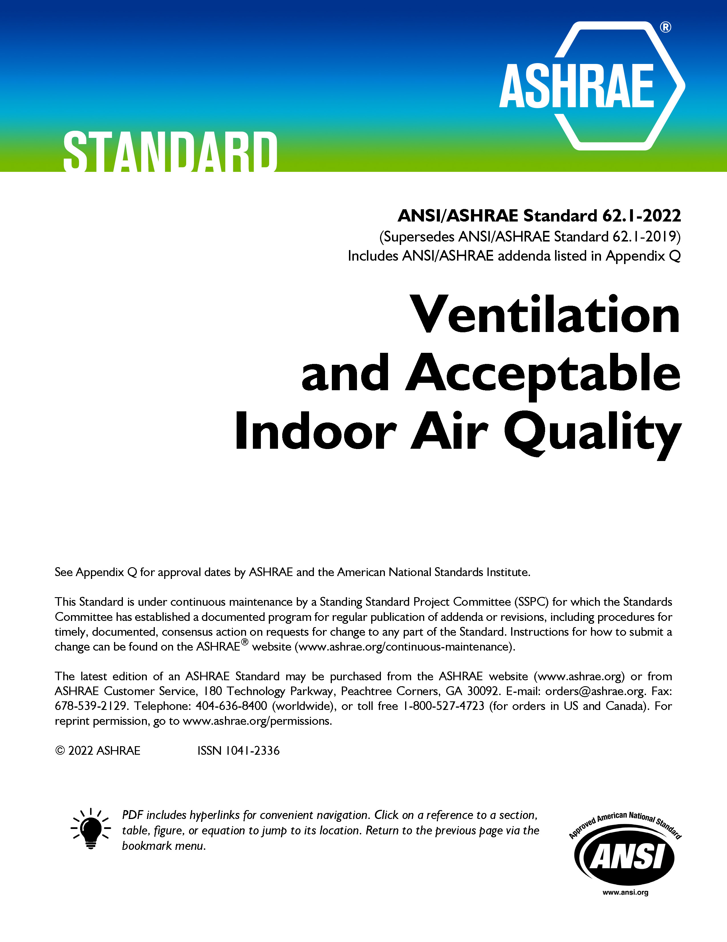
Well-Recognized Standards
ASHRAE Standard 15, Safety Standard for Refrigeration Systems and Designation and Classification of Refrigerants
ASHRAE Standard 90.1, Energy Standard for Sites and Buildings Except Low-Rise Residential Buildings
ASHRAE Standard 62.2, Ventilation and Acceptable Indoor Air Quality in Residential Buildings
ASHRAE Standard 34, Designation and Safety Classification of Refrigerants
ASHRAE Standard 55, Thermal Environmental Conditions for Human Occupancy
ASHRAE Standard 62.1, Ventilation for Acceptable Indoor Air Quality
ASHRAE Standard 188, Legionellosis: Risk Management for Building Water Systems
2021 International Green Construction Code (IgCC): Powered by ASHRAE/ICC/USGBC/IES Standard 189.1-2021
ASHRAE Standard 241, Control of Infectious Aerosols
ashrae.org/standards

Slide 8

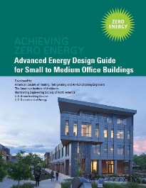


Advanced Energy Design Guides
Advanced Energy Design Guides are published in coordination with partners to promote building efficiency.
Building Specific Guidance that addresses various project aspects with multiple strategies that move the building design incrementally toward the zero-energy goal.
Zero energy goals and strategies will also move buildings towards decarbonization.
Advanced Energy Design Guide for K-12 School Buildings – Achieving Zero Energy
Applicable to all sizes and types of K-12 school construction.
Advanced Energy Design Guide for Small to Medium Office Buildings – Achieving Zero Energy
Applicable to office buildings 10,000 to 100,000 ft² with a building height of less than 75 feet.
Advanced Energy Design Guide for Multifamily Residential Buildings – Achieving Zero Energy
Applicable to construction of new multifamily buildings
covered by ANSI/ASHRAE/IES Standard 90.1
ashrae.org/freeaedg

Slide 9


ASHRAE Tech Hour and ASHRAE 365 App
Tech Hour videos are available within the ASHRAE 365 App. Tech Hour videos introduce the latest technical content presented by some of ASHRAE’s brightest minds. Participants may be eligible to receive one PDH.
  Tech Hour #1: Optimize Occupant Health, Building Energy Performance and Revenue through Indoor-Air Hydration
  Tech Hour #2: Where Have All the Ethics Gone?
  Tech Hour #3: Commissioning
  Tech Hour #4: Building EQ
  Tech Hour #5: Decarbonizing Healthcare
  Tech Hour #6: Emotional Intelligence
36,000+ downloads!
ASHRAE Events & Topical Conferences
Professional Development Resources
Volunteer and Member Resources
ashrae.org/365
ashrae.org/techhour

Slide 10
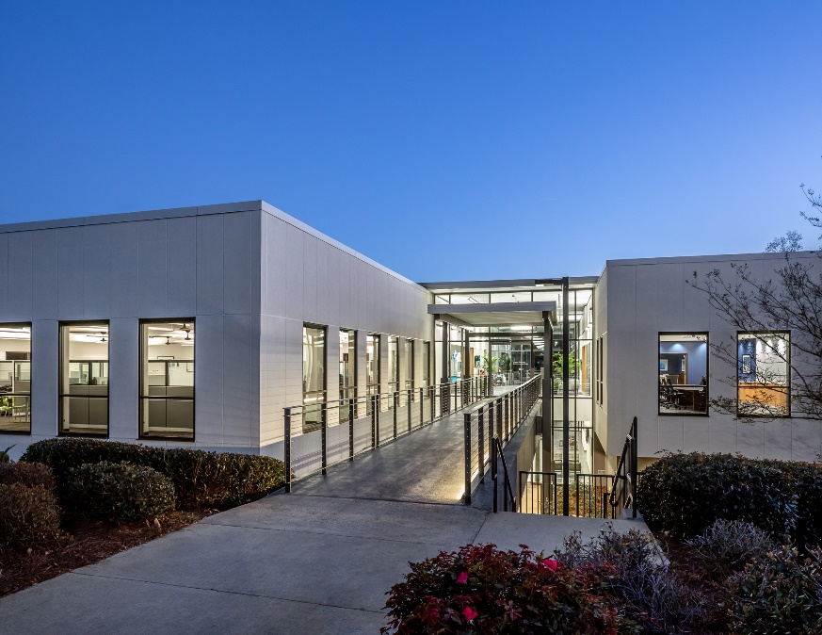
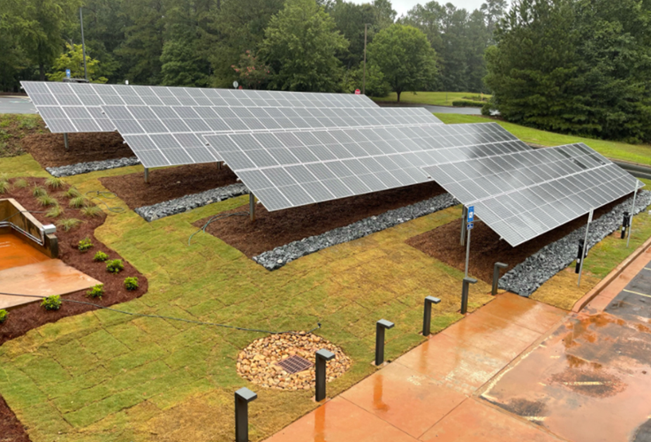
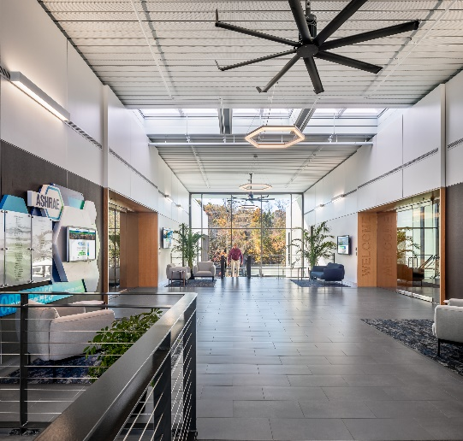
ASHRAE New Global Headquarters
New HQ Building Campaign
Total Raised: $10.35M
All Cash and Pledges: $6,545,653
Gifts of Equipment & Services: $3,807,940 (List Value)
Breakdown:
Largest Gift: $5,000,000 – NIBE
ASHRAE Foundation: $300,000
Members: $203,153
# of Corporate Donors: 33
180 Technology Parkway
Peachtree Corners, Ga
Moved in: October 2020
PV Installed: August 2021
Achieved net-zero status: August 2021
Renovated building demonstrates the latest HVAC&R equipment and technology
View building information, watch the technical tour and more.
ashrae.org/newhq

Slide 11
Career Path Examples in HVACR
Consulting Engineer
Decides on mechanical system type and requirements for each building and designs the system
Research & Design (R&D) Engineer
Investigates new learnings for the HVACR industry and/or develops new products.
Sales Engineer
Works to sell complex technical products in the industry by answering questions, providing training to consulting engineers, and generating quotes for projects.
The Role
The Role
The Role
Consulting engineers work for companies or firms of people, similar to a law firm or a medical practice. These companies sell their consulting services to building owners & architects.
Some R&D Engineers work for academic institutions. They get money for research efforts through grants and private donors.
Other R&D Engineers work for equipment manufacturers. Their work is geared toward developing new products that consulting engineers use in their designs.
Finally, some R&D Engineers work for national laboratories. Their work is publicly funded and available to anyone to read.
Most sales engineers work for a distributor or a manufacturer’s representative (MR). These companies are paid by equipment manufacturers when they sell their equipment.
Some sales engineers work directly for an original equipment manufacturer (OEMs). In this case, the sales engineer is either managing distributors/MRs, or, they are selling directly to consulting engineers
Who They Work for
Who They Work for
Who They Work for

Slide 12
You Could Work For…
Mechanical Products & Technology
Application of those products/technology
Installation and Operation of those products/technology
Contractor
installer
Universities & National Labs
researchers
Engineering Firm
design/specification
Facility Team / Building Owner
owner/operator/funder
Specialized Consulting
design/optimization
Commissioning Agent
testing/adjusting/QA
Original Equipment Manufacturers (OEMs)
creators/producers
provides support as needed
Distributors / MRs (Manufacturer’s Representatives)
sales and installation
Government Entities
regulates products, application, installation

Slide 13
Young Engineers in ASHRAE (YEA) + Student Program
ASHRAE has a robust Student Program catering to the needs of students at every age. Resources for Student Members include:
Scholarships & Grants
Awards and Competitions
Local Involvement at Student Branch and ASHRAE Chapter & Region Level
Special Discounts and resources
ASHRAE also offers resources for K-12 volunteers and educators.
The Young Engineers in ASHRAE (YEA) committee focuses on offering relevant programs and services to young professional ASHRAE members (35 years old and younger).
YEA Leadership Weekends provide the opportunity for future leaders of ASHRAE to learn more about ASHRAE Society, developing soft skills, and networking with other young professionals
Leadership U program allows YEA members to shadow ASHRAE Vice Presidents during Winter and Annual Conferences
YEA Scholarship for HVAC Design Essentials Training
ashrae.org/yea
ashrae.org/students

Slide 14





Student Membership Benefits:
Career Assistance
We can help you find an internship or full-time job
Conference Discounts
Reduced registration fees for our conferences
Funding
Scholarships and grants are available
Networking
Connect with industry professionals
Just $25!

Slide 15
Opportunities for Students

Slide 16
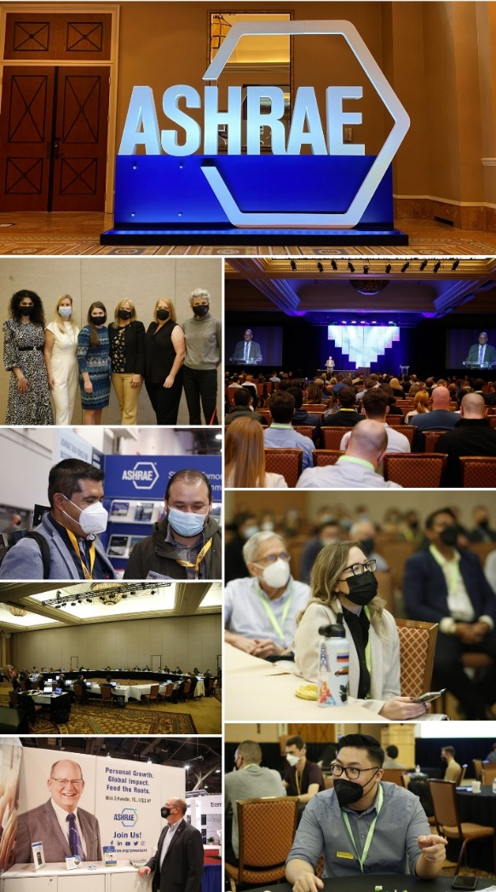
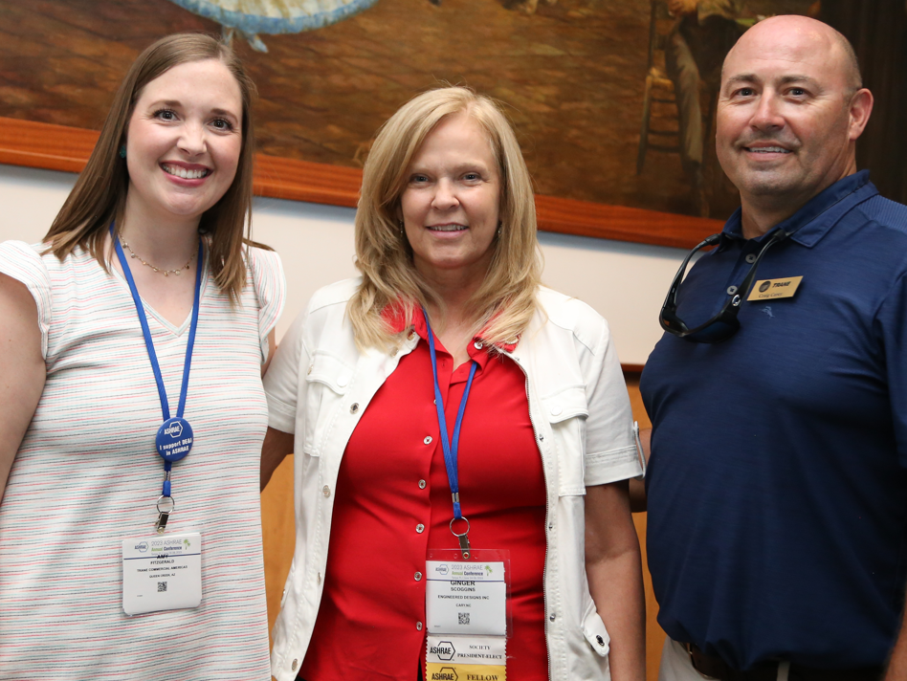
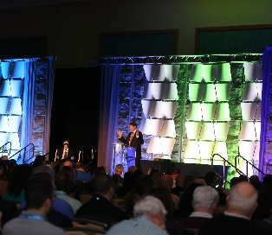
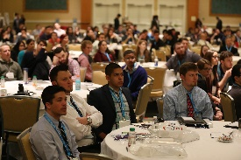



ASHRAE Conferences
ASHRAE conferences feature peer-reviewed papers and presentations with hands-on information. Attendees earn professional development hours (PDHs), keep up-to-date on the latest technologies, and network with colleagues.
AHR Mexico
Sep 19 – 21, 2023 | Mexico City, Mexico
2024 ASHRAE Annual Conference
Jun 22 – 26, 2024 | Indianapolis, IN
2023 Building Performance Analysis Conference
Sep 11 – 13, 2023 | Austin, TX
The Sixth International Conference on Efficient Building Design
Oct 3–4, 2024 | Beirut, Lebanon
International Building Decarbonization Conference
April 17-19, 2024| Madrid, Spain
2024 ASHRAE Winter Conference & AHR Expo
January 20 – 24, 2024| Chicago, IL
  Student Program Features:
  Career Panel
  Technical Tour of a Local Facility
  Engaging Keynote
  Connect with other students
ashrae.org/conferences

Slide 17
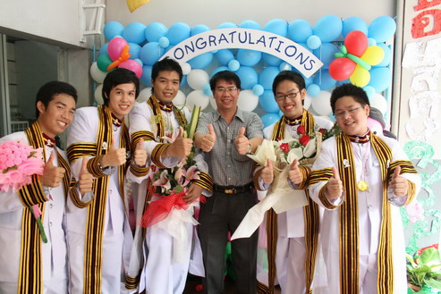

ASHRAE Student Design Competition
ASHRAE sponsors this annual competition to give students practical HVAC experience.
Design or select the HVAC system for a building.
Develop a sustainable building design using the integrated building design process.
Evaluate and audit building energy consumption for buildings in operation.
Learn more at ashrae.org/students

Slide 18
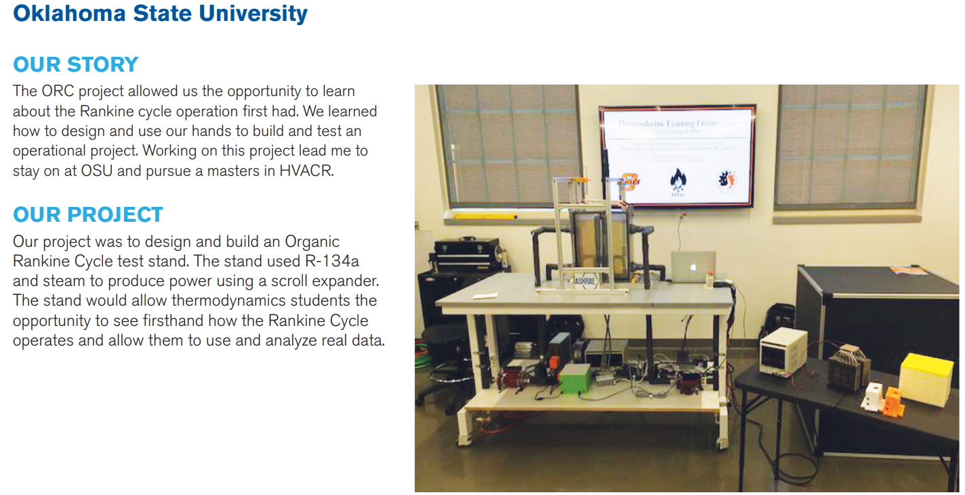

Undergraduate Program Equipment Grant
Grant funding for projects that help increase student knowledge, learning and awareness of the HVAC&R industry through the design and construction of senior projects.
Up to $5,000 is available per projects. Application deadline is December 15th annually.
Learn more at ashrae.org/students

Slide 19

ASHRAE Foundation Scholarships
Society Scholarships
Chapter-Awarded Scholarships
Require a minimum of $100,000 for an individual to establish a named scholarship
Require a minimum contribution of $60,000 for chapters or regions
Selection criteria must be established in accordance with the ASHRAE Scholarship Program Guidelines
ASHRAE Scholarship Trustees select the scholarship recipients
Require a minimum contribution of $30,000
Scholarships can be funded through current fundraising efforts or with chapter assets
Chapters can establish the selection criteria
Chapters select the scholarship recipients
ASHRAE awards $450,000 in scholarships
each year!
foundation.ashrae.biz

Slide 20


Slide 21


Scholarships
“Thank you for investing in students like myself and in our education! Continuing my studies would not be possible without the generous support from scholarship sponsors like yourself. Thanks to you, I am one step closer to reaching my education and career goals. This term my fees are paid off and I do not have to fret about paying any debt.”
We want to help you pay for your education!
Chapter, Regional, and Society-level scholarships are available – most awards are between $3,000 to $10,000.
Society Application Deadlines
December 1 annually for most scholarships.
May 1 annually for Freshman Engineering Scholarship
Chapter and Regional scholarship application deadlines vary; check with your local chapter for more details.
Stephen Batsa, Dalhousie University – Mechanical Engineering – Henry Adams Scholarship 2020-2021
Learn more at ashrae.org/scholarships

Slide 22
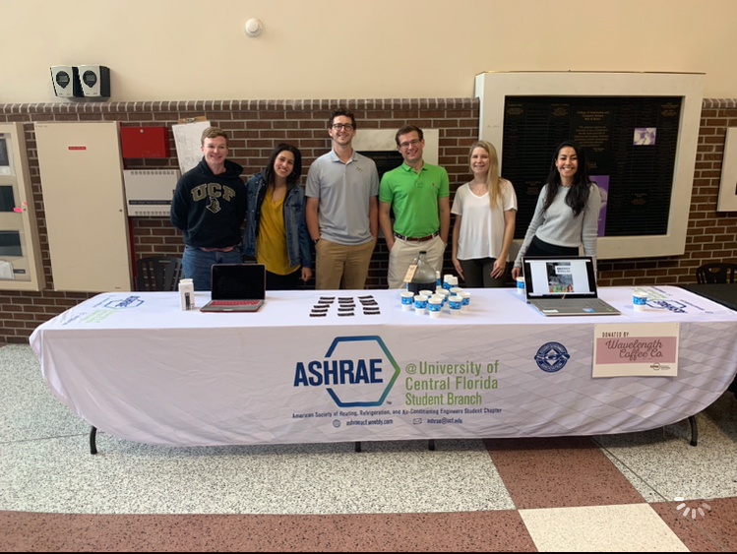
Leadership Opportunities
Become a student leader and start learning these in-demand skills for engineers:
Collaboration
Communication
Project Management
Relationship-building
People management
Plus:
Travel to conferences
Learn even more about the HVACR industry
Build relationships with ASHRAE volunteers – local industry professionals!

Slide 23
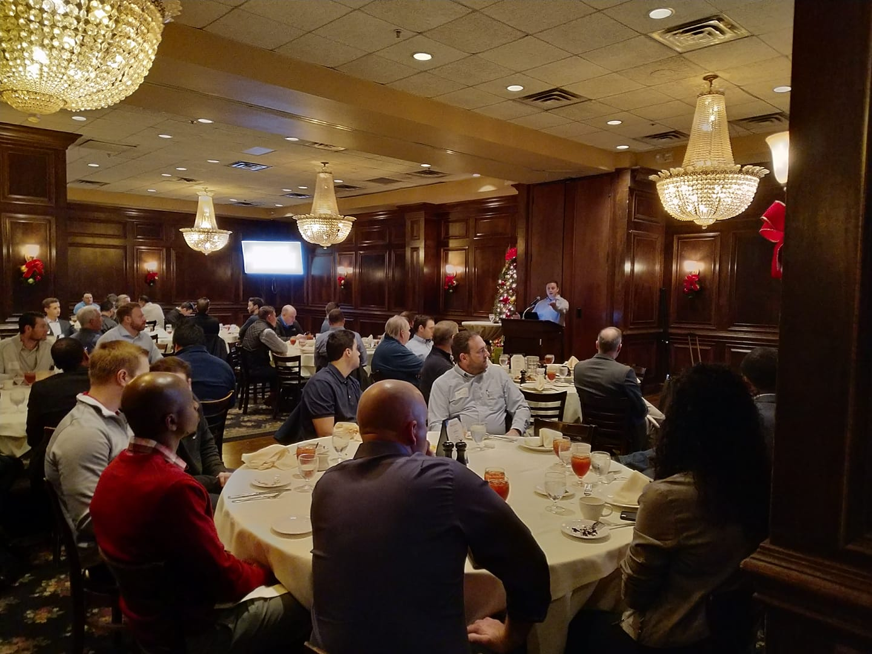
Network with Local Professionals
Students can attend local chapter events for free or reduced costs.
Network with ASHRAE members to meet industry leaders and learn about different career paths
Discover local companies and opportunities
Learn about the latest in technology during technical tours and chapter meetings
You can also participate in chapter activities like:
Attend Young Engineers in ASHRAE (YEA) events
K-12 outreach events
Women in ASHRAE networking events
“Day on the Hill” and other Government Activities

Slide 24
Virtual Events
Student Roundtables
Virtual events with student members around the world to participate in live or watch on-demand. Past topics include:
Getting Ready for the Workplace
ASHRAE Headquarters – Design Process
Interactive Career Panel
Back to the Future: Our Industry in 2030
Using Embedded Tube Radiant Cooling Systems to Maximize Energy Efficiency
An Inclusion Mindset

Slide 25


Might be an ASHRAE Member after you graduate?
This money-saving program is only available to students who have been a ASHRAE Student Member for at least one year.
With SmartStart, you unlock a lower ASHRAE membership rate for your first three years after graduate. You must have been a student member!
ashrae.org/smartstart

Slide 26
SmartStart Program
 | Student Member | Associate Member Year 1 | Associate Member Year 2 | Associate Member Year 2
Normal Dues | $25 | $260 | $260 | $260
Smart Start Membership Dues | $25 | $25 | $100 | $130
SAVINGS |  | $235 | $160 | $130
Save $525 in Membership Dues!
ashrae.org/smartstart

Slide 27


Join ASHRAE Today!
Just $25!
Start Here:

Slide 28
Questions & Comments
Questions?
students@ashrae.org

