Slide 1

Shaping Tomorrow’s Built Environment Today
THIS IS
ASHRAE
Society Year 2024-2025
ashrae.org
August 2024
Notes:
Add tagline and HQ building

Slide 2


ASHRAE Overview
16 Regions
190+ Chapters
400+ Student Branches
Mission
To serve humanity by advancing the arts and sciences of heating, ventilation, air conditioning, refrigeration and their allied fields.
Vision
A healthy and sustainable built environment for all.
      53,000+ Members
      130+ Countries
Industry Classification
Consulting Engineers | Contractors | Manufacturers/Manufacturing Representatives
Government | Health & Education | Design Build | Architects
      200+ Standards
      and Guidelines

Slide 3
What We Do and How We Do It
33 Standing Committees
130+ Standards and
Guidelines Committees
100+ Technical Committees
300+ Publications
7 Certification Programs
200+ Educational Courses
Research
Scholarships
1.
  Serve as pipeline for providing technical information to members, chapters, companies and government officials
  Develop standards and technical guidelines to improve the built environment
  Offer continuing education for industry professionals
  Serve as networking tool for industry professionals
2.
3.
4.

Slide 4




ASHRAE Journal
ASHRAE’s official monthly publication provides detailed insight on the latest HVACR technologies and applications for consulting engineers and professionals in the industry.
Articles are peer-reviewed and focus on technical topics, including green buildings, decarbonization, indoor air quality, energy management, thermal storage and alternative refrigerants.
ASHRAE Journal Podcast Discussions with leading ASHRAE experts to expand knowledge in the HVACR industry.
New! Hot Air Brief talks with ASHRAE Journal authors on HVACR content published in the Journal.
ashrae.org/ashraejournal

Slide 5

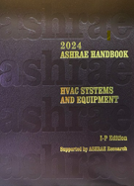
ASHRAE Handbook
ashrae.org/handbook
ASHRAE Handbook – Print Version
Continuously refined and updated, ASHRAE has published its Handbook series since 1920s
Volumes cover HVAC&R fundamentals, systems, equipment
and a wide variety of applications
Handbooks are also available in the ASHRAE Technology Portal
Available in hardback, PDF, and as an interactive handbook online.
ASHRAE Handbook Online
Mobile device responsive
Content from all four current Handbook volumes plus extra features such as videos, animations, spreadsheets and more
Easier than ever to search across all volumes, print, ask questions about technical content, access bonus features and look up new terminology
Eligible ASHRAE members can choose an ASHRAE Handbook Online subscription at a discounted rate during membership renewal

Slide 6
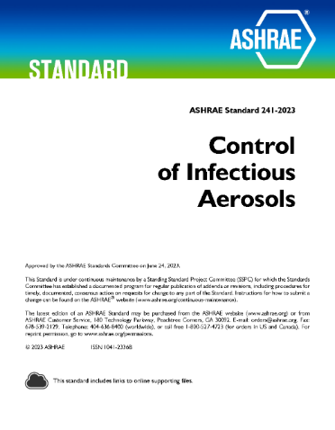
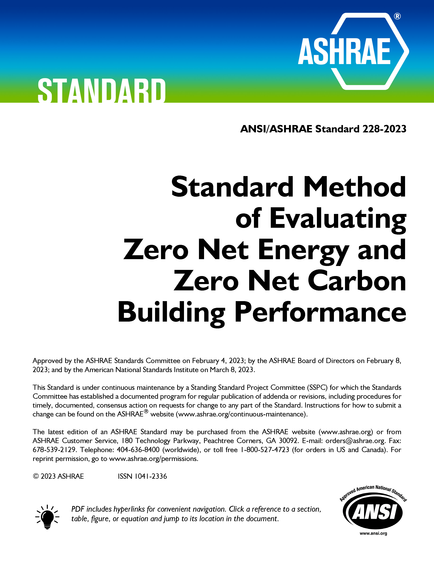
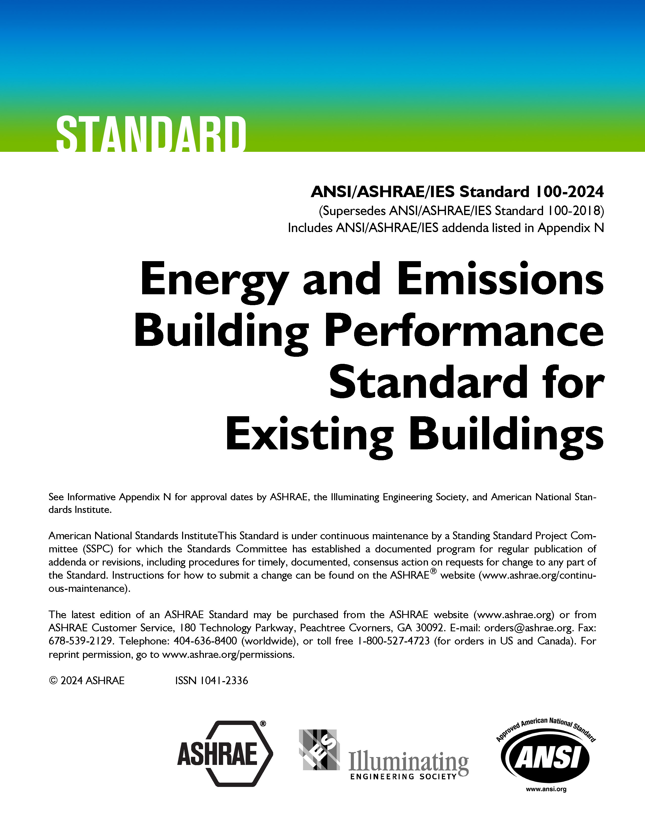
Well-Recognized Standards
ashrae.org/bookstore
PROFESSIONAL DEVELOPMENT
MEMBERSHIP
ASHRAE Standard 15, Safety Standard for Refrigeration Systems and Designation and Classification of Refrigerants
ASHRAE Standard 90.1, Energy Standard for Sites and Buildings Except Low-Rise Residential Buildings
ASHRAE Standard 62.2, Ventilation and Acceptable Indoor Air Quality in Residential Buildings
ASHRAE Standard 34, Designation and Safety Classification of Refrigerants
ASHRAE Standard 55, Thermal Environmental Conditions for Human Occupancy
ASHRAE Standard 62.1, Ventilation for Acceptable Indoor Air Quality
ASHRAE Standard 188, Legionellosis: Risk Management for Building Water Systems
2021 International Green Construction Code (IgCC): Powered by ASHRAE/ICC/USGBC/IES Standard 189.1-2021
ASHRAE Standard 241, Control of Infectious Aerosols
Now Available in Spanish
First of Its Kind
Newly Updated for 2024
Notes:
Standard 241: establishes minimum requirements aimed at reducing the risk of disease transmission through exposure to infectious aerosols in new buildings, existing buildings, and major renovations. Now available in Spanish!
Standard 228: sets requirements for evaluating whether a building or group of buildings meets a definition of “zero net energy” or a definition of “zero net carbon” during building operation.
New 2024 Update of Standard 100: This essential ASHRAE resource offers over 100 typical energy efficiency measures (EEMs) that can be applied to enable buildings to meet set energy targets, identifying commonly applied elements that can improve building performance.

Slide 7
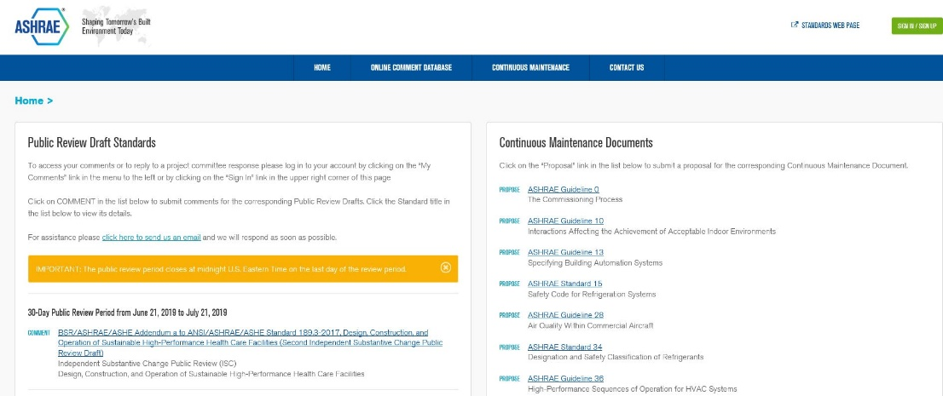
What is the Online Standards
Review Database?
The Online Standards Review Database allows
access to public review drafts for standards, guidelines and addenda and to submit comments.
The system offers a dashboard which highlights items that require attention, provides quick links to individual and committee comments, continuous maintenance proposals and outstanding ballot results.
Developing standards since 1922
130+ active standard or guideline projects
Standards are reviewed and republished to ensure they are up-to-date, e.g., existing code-intended standards are on a three-year review cycle
ashrae.org/publicreviews
ashrae.org/standards
Notes:
All standards go through public review and comment.
Existing standards are reviewed every three years.
Standards that are on continuous maintenance are republished with new addenda every three years.
Code utilized standards are republished every three years

Slide 8

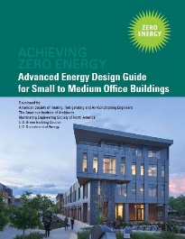


Advanced Energy Design Guides
Advanced Energy Design Guides are published in coordination with partners to promote building efficiency.
Building Specific Guidance that addresses various project aspects with multiple strategies that move the building design incrementally toward the zero-energy goal.
Zero energy goals and strategies will also move buildings towards decarbonization.
Advanced Energy Design Guide for K-12 School Buildings – Achieving Zero Energy
Applicable to all sizes and types of K-12 school construction.
Advanced Energy Design Guide for Small to Medium Office Buildings – Achieving Zero Energy
Applicable to office buildings 10,000 to 100,000 ft² with a building height of less than 75 feet.
Advanced Energy Design Guide for Multifamily Residential Buildings – Achieving Zero Energy
Applicable to construction of new multifamily buildings
covered by ANSI/ASHRAE/IES Standard 90.1
ashrae.org/freeaedg

Slide 9
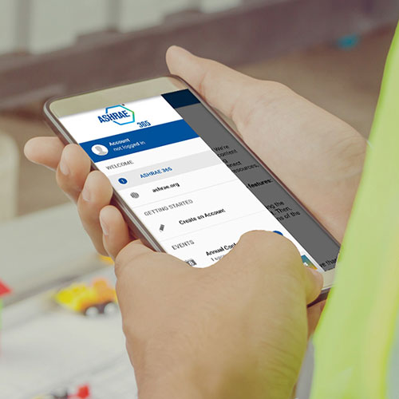

Stay Current with the ASHRAE 365 App
ASHRAE 365 is a free app providing year-round
updates on all things ASHRAE. Download in your app store.
Learn more at ashrae.org/365.
Notes:
Events
ASHRAE Conferences, Chapters Regional Conferences, Topical Conferences, Events Calendars, and Virtual Conferences as well as access exclusive technical content from ASHRAE Tech Hour.
Connect
Notifications and news pertinent to the Society and quick access to all of ASHRAE’s social media. Ability to direct message with fellow conference attendees.
Membership & Support
Chapter details, Distinguished Lecturers program resources, information on how to support the Society through donations or volunteering, and how to get in touch.
Resources section with access to ASHRAE volunteer resources, Standards and Guidelines information, continuing education courses as well as search features for industry jobs and materials to help you engage others with ASHRAE.

Slide 10
Career Path Examples in HVACR
Consulting Engineer
Decides on mechanical system type and requirements for each building and designs the system
Research & Design (R&D) Engineer
Investigates new learnings for the HVACR industry and/or develops new products.
Sales Engineer
Works to sell complex technical products in the industry by answering questions, providing training to consulting engineers, and generating quotes for projects.
The Role
The Role
The Role
Consulting engineers work for companies or firms of people, similar to a law firm or a medical practice. These companies sell their consulting services to building owners & architects.
Some R&D Engineers work for academic institutions. They get money for research efforts through grants and private donors.
Other R&D Engineers work for equipment manufacturers. Their work is geared toward developing new products that consulting engineers use in their designs.
Finally, some R&D Engineers work for national laboratories. Their work is publicly funded and available to anyone to read.
Most sales engineers work for a distributor or a manufacturer’s representative (MR). These companies are paid by equipment manufacturers when they sell their equipment.
Some sales engineers work directly for an original equipment manufacturer (OEMs). In this case, the sales engineer is either managing distributors/MRs, or, they are selling directly to consulting engineers
Who They Work for
Who They Work for
Who They Work for

Slide 11
You Could Work For…
Mechanical Products & Technology
Application of those products/technology
Installation and Operation of those products/technology
Contractor
installer
Universities & National Labs
researchers
Engineering Firm
design/specification
Facility Team / Building Owner
owner/operator/funder
Specialized Consulting
design/optimization
Commissioning Agent
testing/adjusting/QA
Original Equipment Manufacturers (OEMs)
creators/producers
provides support as needed
Distributors / MRs (Manufacturer’s Representatives)
sales and installation
Government Entities
regulates products, application, installation

Slide 12

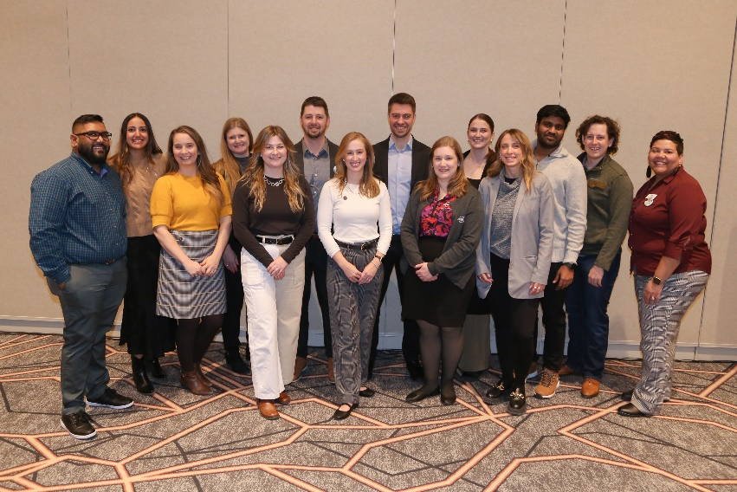
Empowering the Future
The Young Engineers in ASHRAE (YEA) committee focuses on offering relevant programs and services to young professional ASHRAE members (35 years old and younger).
ASHRAE has a robust Student Program catering to the needs of students at every age. Resources for student members include:
YEA Leadership Weekends
Leadership U
YEA Decarbonization Challenge
YEA HVAC Design Essential Scholarships
Scholarships & Grants
Awards and Competitions
Student Branches
Student Store
ASHRAE also offers resources for K-12 volunteers and educators
ashrae.org/yea
ashrae.org/students
Notes:
A primary focus of the Young Engineers in ASHRAE committee is to attract and develop members for future membership and leadership in ASHRAE and the HVAC&R industry. This is done through an exciting range of events and programming such as:
YEA Leadership Weekends – which provides an opportunity for young engineers to learn more about the Society, develop soft skills and network with other professionals.
Leadership U – where YEA members shadow ASHRAE officers during the ASHRAE Winter and Annual Conferences. LeaDRS is an ASHRAE regional program similar to the Leadership U.
YEA Decarbonization Challenge – was created to align with ASHRAE’s focus on decarbonization. It is a year-long competitive fund ($1,000-$10,000) program granted within local chapters to implement decarbonization projects.
YEA HVAC Design Essentials Scholarships – offers YEA members free registration in ASHRAE’s HVAC Design training courses.
ASHRAE offers a wide variety of programs and resources for K-12 students and educators.

Slide 13





Student Membership Benefits:
Career Assistance
We can help you find an internship or full-time job
Conference Discounts
Reduced registration fees for our conferences
Funding
Scholarships and grants are available
Networking
Connect with industry professionals
Just $30!

Slide 14
Opportunities for Students

Slide 15
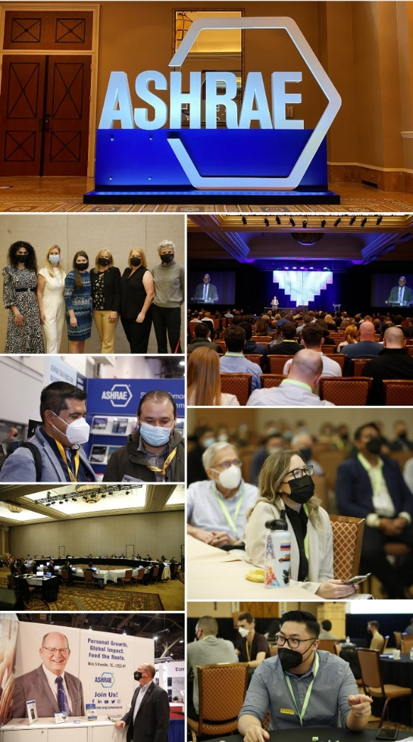
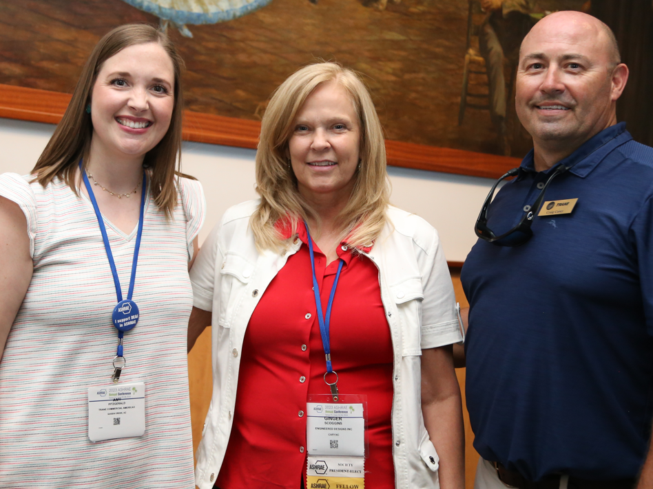
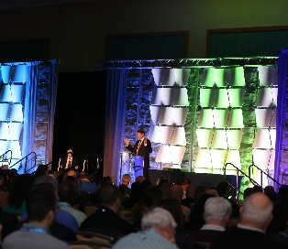
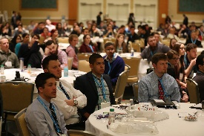



ASHRAE Conferences
ASHRAE conferences feature peer-reviewed papers and presentations with hands-on information. Attendees earn professional development hours (PDHs), keep up-to-date on the latest technologies, and network with colleagues.
AHR Mexico
Sep 19 – 21, 2023 | Mexico City, Mexico
2024 ASHRAE Annual Conference
Jun 22 – 26, 2024 | Indianapolis, IN
2023 Building Performance Analysis Conference
Sep 11 – 13, 2023 | Austin, TX
The Sixth International Conference on Efficient Building Design
Oct 3–4, 2024 | Beirut, Lebanon
International Building Decarbonization Conference
April 17-19, 2024| Madrid, Spain
2024 ASHRAE Winter Conference & AHR Expo
January 20 – 24, 2024| Chicago, IL
  Student Program Features:
  Career Panel
  Technical Tour of a Local Facility
  Engaging Keynote
  Connect with other students
ashrae.org/conferences

Slide 16
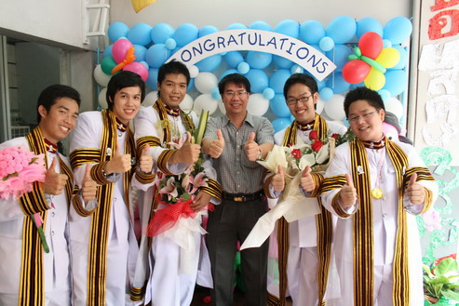

ASHRAE Student Design Competition
ASHRAE sponsors this annual competition to give students practical HVAC experience.
Design or select the HVAC system for a building.
Develop a sustainable building design using the integrated building design process.
Evaluate and audit building energy consumption for buildings in operation.
Learn more at ashrae.org/students

Slide 17
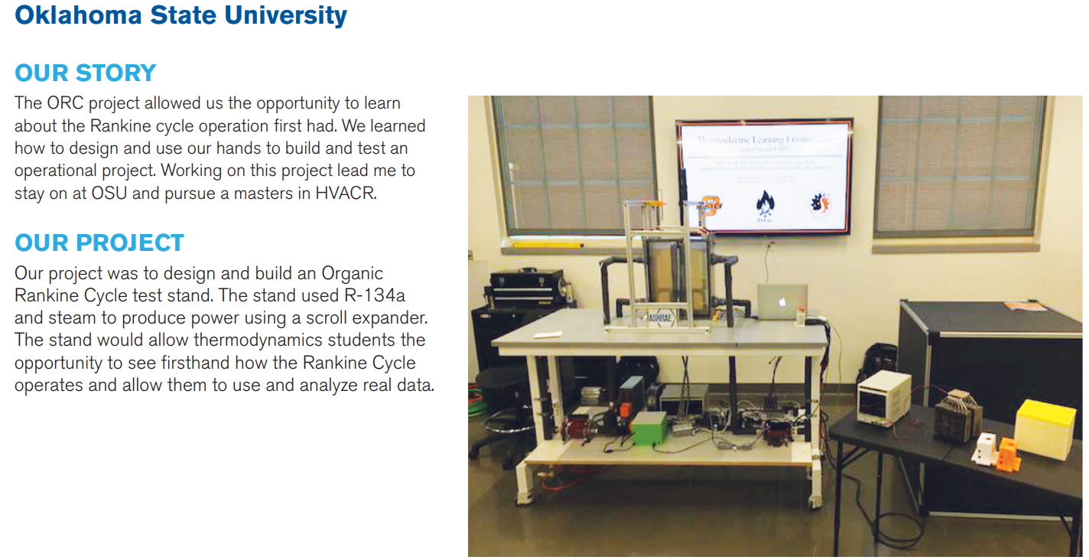

Undergraduate Program Equipment Grant
Grant funding for projects that help increase student knowledge, learning and awareness of the HVAC&R industry through the design and construction of senior projects.
Up to $5,000 is available per project with the top applicant receiving up to $25,000! Application deadline is December 15th annually.
Learn more at ashrae.org/students

Slide 18

ASHRAE Foundation Scholarships
Society Scholarships
Chapter-Awarded Scholarships
Require a minimum of $100,000 for an individual to establish a named scholarship
Require a minimum contribution of $60,000 for chapters or regions
Selection criteria must be established in accordance with the ASHRAE Scholarship Program Guidelines
ASHRAE Scholarship Trustees select the scholarship recipients
Require a minimum contribution of $30,000
Scholarships can be funded through current fundraising efforts or with chapter assets
Chapters can establish the selection criteria
Chapters select the scholarship recipients
ASHRAE awards $450,000 in scholarships
each year!
foundation.ashrae.biz

Slide 19


Slide 20


Scholarships
“Thank you for investing in students like myself and in our education! Continuing my studies would not be possible without the generous support from scholarship sponsors like yourself. Thanks to you, I am one step closer to reaching my education and career goals. This term my fees are paid off and I do not have to fret about paying any debt.”
We want to help you pay for your education!
Chapter, Regional, and Society-level scholarships are available – most awards are between $3,000 to $10,000.
Society Application Deadlines
December 1 annually for most scholarships.
May 1 annually for Freshman Engineering Scholarship
Chapter and Regional scholarship application deadlines vary; check with your local chapter for more details.
Stephen Batsa, Dalhousie University – Mechanical Engineering – Henry Adams Scholarship 2020-2021
Learn more at ashrae.org/scholarships

Slide 21
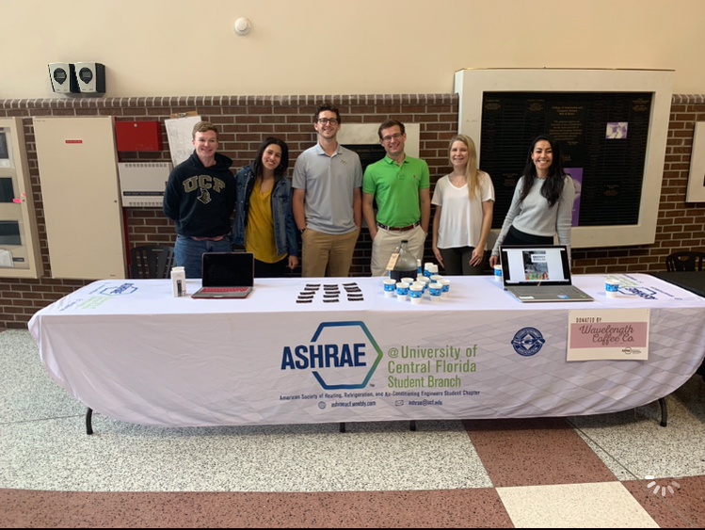
Leadership Opportunities
Become a student leader and start learning these in-demand skills for engineers:
Collaboration
Communication
Project Management
Relationship-building
People management
Plus:
Travel to conferences
Learn even more about the HVACR industry
Build relationships with ASHRAE volunteers – local industry professionals!

Slide 22
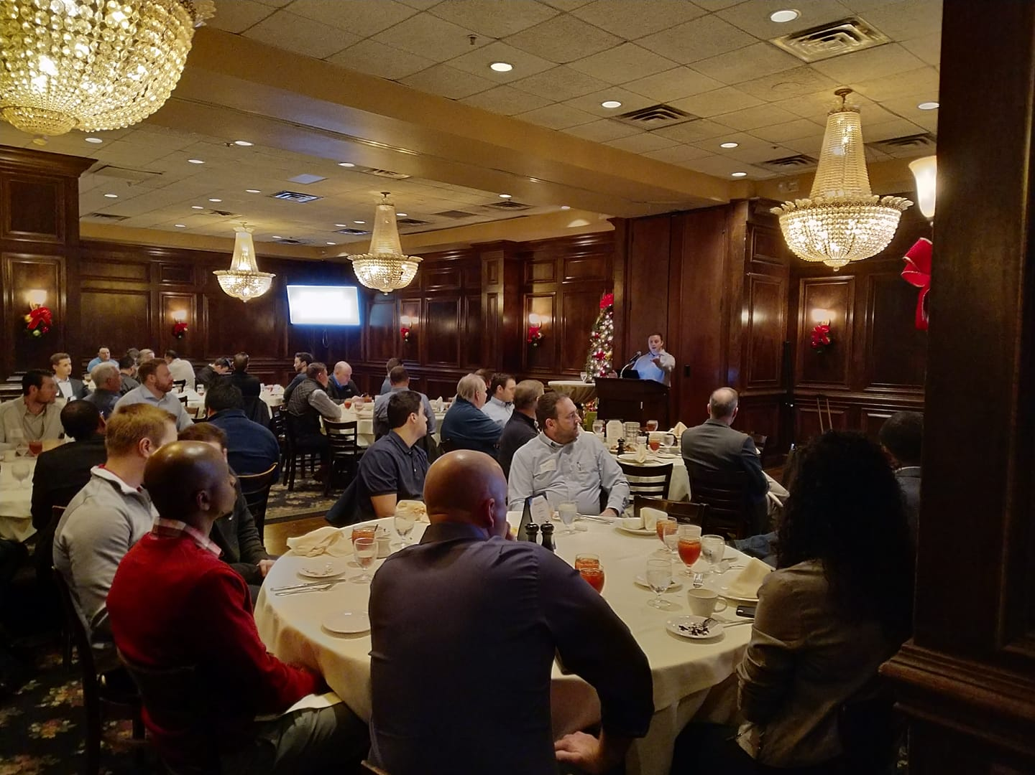
Network with Local Professionals
Students can attend local chapter events for free or reduced costs.
Network with ASHRAE members to meet industry leaders and learn about different career paths
Discover local companies and opportunities
Learn about the latest in technology during technical tours and chapter meetings
You can also participate in chapter activities like:
Attend Young Engineers in ASHRAE (YEA) events
K-12 outreach events
Women in ASHRAE networking events
“Day on the Hill” and other Government Activities

Slide 23
Virtual Events
Student Roundtables
Virtual events with student members around the world to participate in live or watch on-demand. Past topics include:
Getting Ready for the Workplace
ASHRAE Headquarters – Design Process
Interactive Career Panel
Back to the Future: Our Industry in 2030
Using Embedded Tube Radiant Cooling Systems to Maximize Energy Efficiency
An Inclusion Mindset

Slide 24


Might be an ASHRAE Member after you graduate?
This money-saving program is only available to students who have been a ASHRAE Student Member for at least one year.
With SmartStart, you unlock a lower ASHRAE membership rate for your first three years after graduate. You must have been a student member!
ashrae.org/smartstart

Slide 25
SmartStart Program
 | Student Member | Associate Member Year 1 | Associate Member Year 2 | Associate Member Year 2
Normal Dues | $30 | $285 | $285 | $285
Smart Start Membership Dues |  | $30 | $105 | $145
SAVINGS |  | $255 | $180 | $140
Save $575 in Membership Dues!
ashrae.org/smartstart

Slide 26


Join ASHRAE Today!
Just $30!
Start Here:

Slide 27
Questions & Comments
Questions?
students@ashrae.org

