Slide 1
The New ASHRAE Headquarters
The story of an office building, a building past it’s prime, showing the world …
“What’s Possible”
ASHRAE Student Congress
Notes:
Title slide. Add the name of the group being presented to and the date.

Slide 2
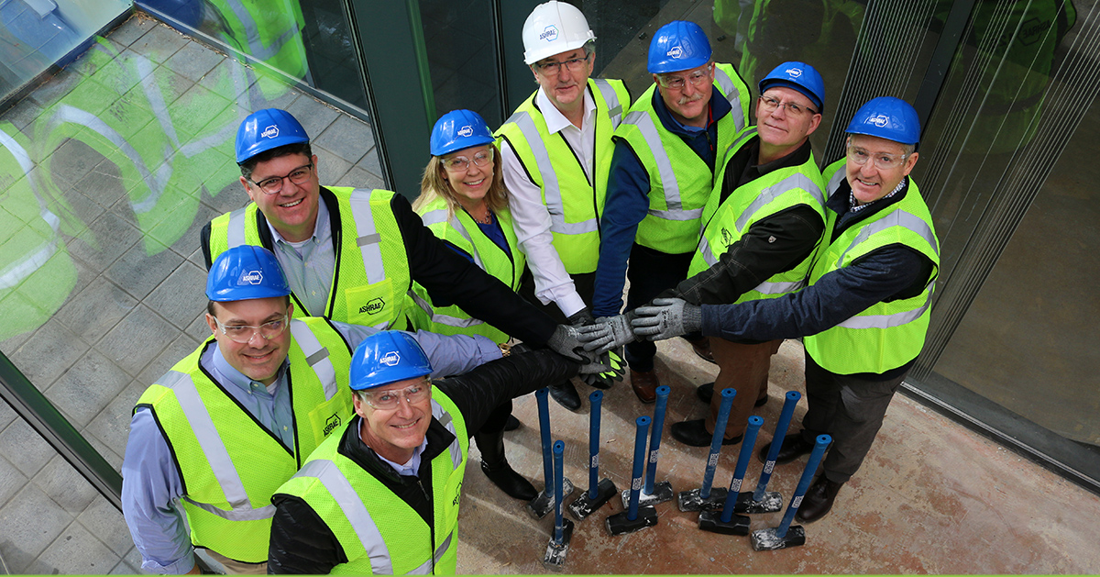
About
ASHRAE Headquarters Building Ad Hoc Committee: (L to R)
Jeff Littleton, Michael Cooper, Blake Ellis, Ginger Scoggins (Chair), Darryl Boyce, Don Brandt, Tim McGinn (Technical Advisory Subcommittee Chair), Kent Peterson
Notes:
Slide to introduce the speaker, who is ideally one of the Ad Hoc members.

Slide 3
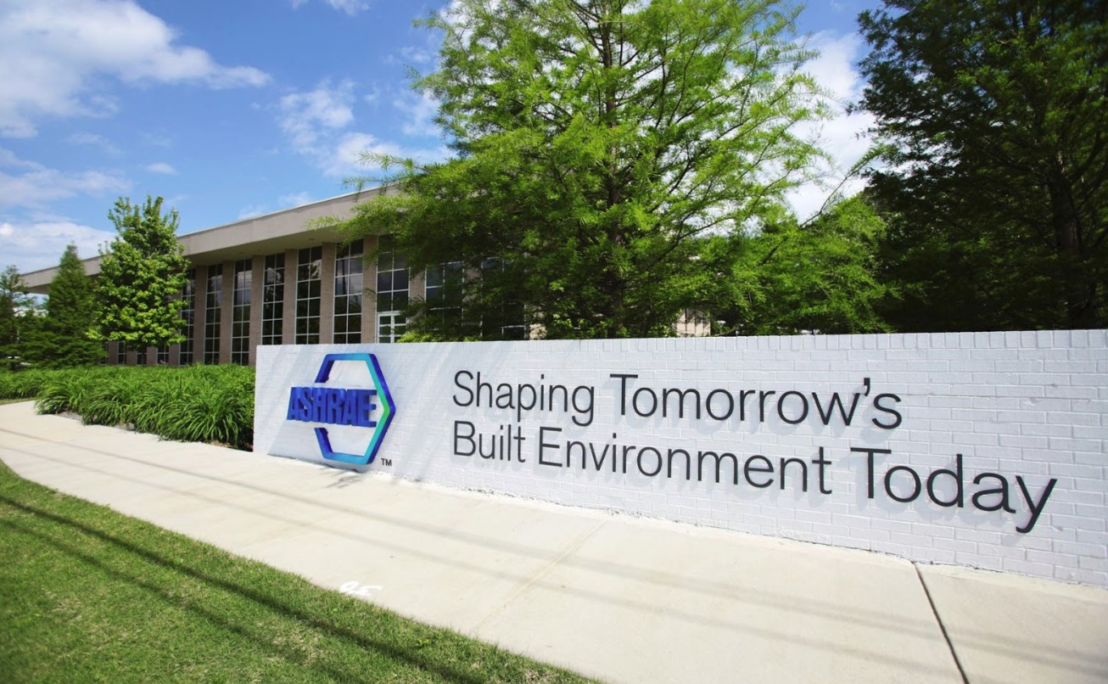
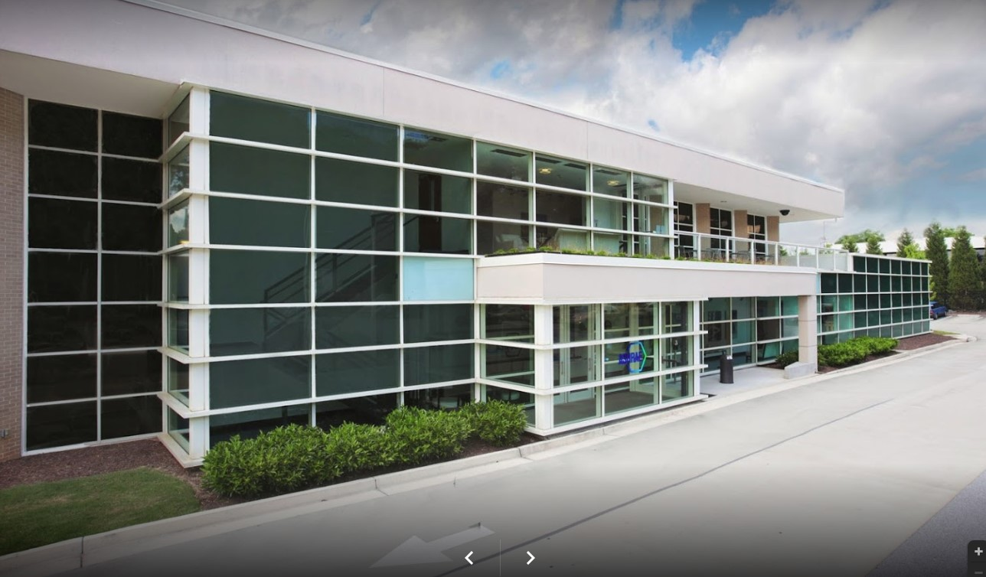
Legacy ASHRAE Headquarters
1791 Tullie Circle NE, Atlanta, GA
35,000 sq. ft. building – 2 stories with learning center on 1st level
Renovated in 2010 to LEED Platinum level
Notes:
Description of the existing ASHRAE HQ as many chapter members might not have ever been to Atlanta.

Slide 4
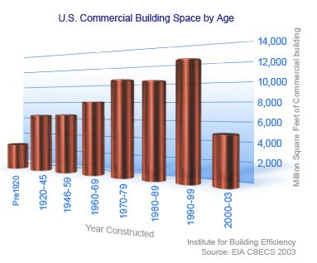
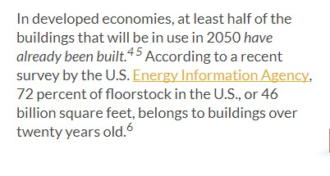

What is our Story?
Project Goal
Project Goal:
To renovate a 1970’s building into a high-performing net-zero-ready facility in a cost-effective method that can be replicated in the industry.
“Our organization relies on harvesting the technical knowledge, volunteer energy, and expertise of our members. We want this space to inspire visitors to participate and honor them for their volunteer service and commitment.”
– Jeff Littleton, Executive VP for ASHRAE
Notes:
Project goal: Show how to renovate an existing building into a high performance building.

Slide 5
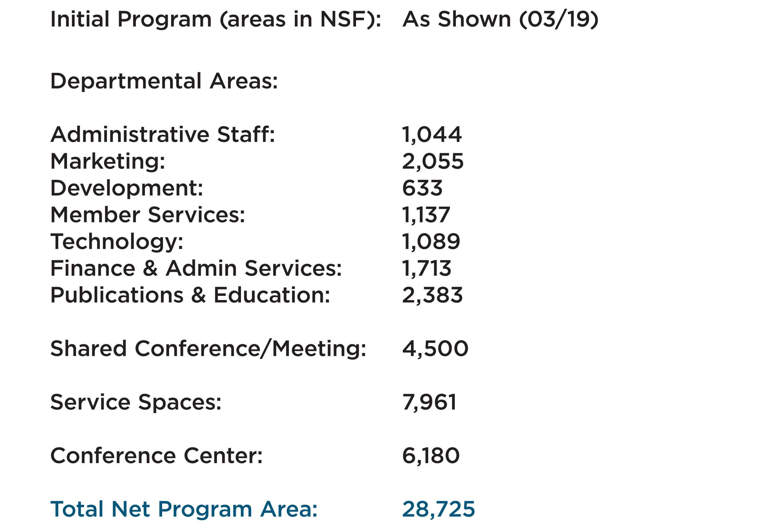
Program Summary
Gross Program Area: 44,000 gsf (approx.)
Notes:
Initial program developed for 44,000 GSF. Note that 180 TP is 66,000 GSF, which will cause some of our budget issues that we encounter later.

Slide 6
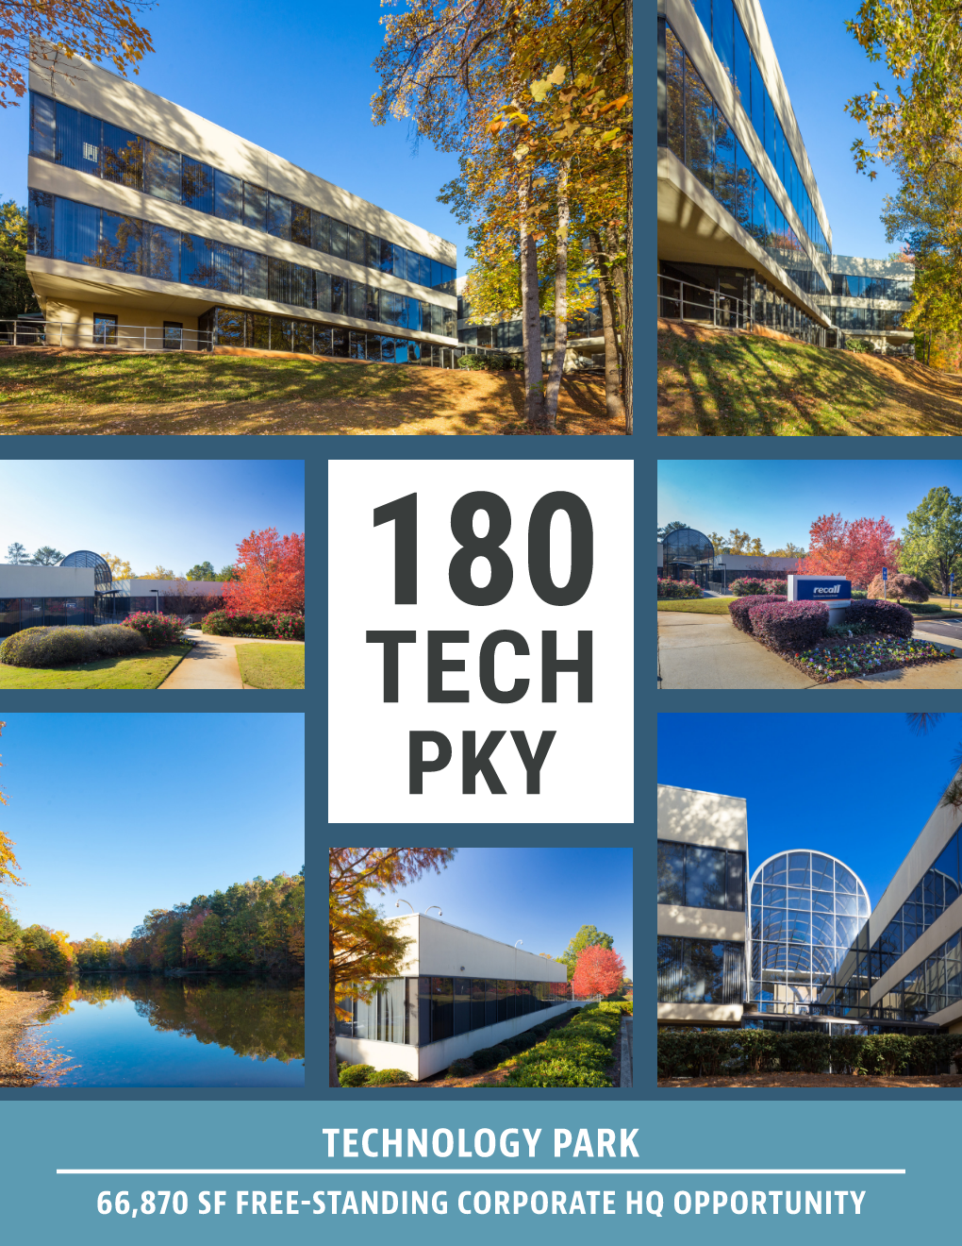
Program Summary
Gross Program Area: 44,000 gsf (approx.)
Notes:
Initial program developed for 44,000 GSF. Note that 180 TP is 66,000 GSF, which will cause some of our budget issues that we encounter later.

Slide 7
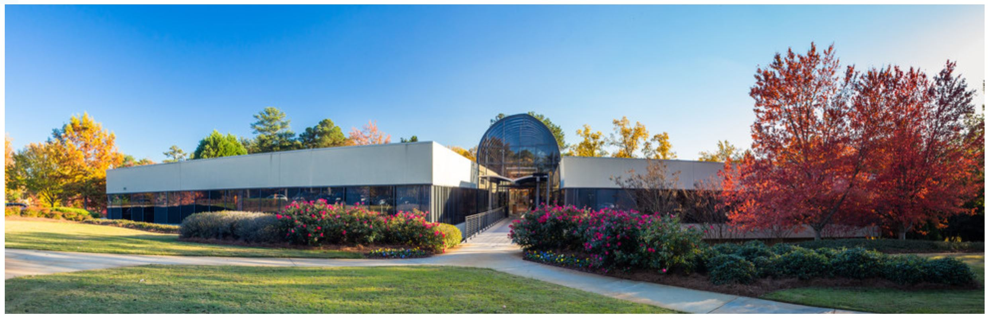
New ASHRAE Headquarters
180 Technology Parkway, Peachtree Corners, GA
66,000 sq. ft. building – 3 stories
Built in 1970’s
Purchased by ASHRAE in December 2018

Slide 8
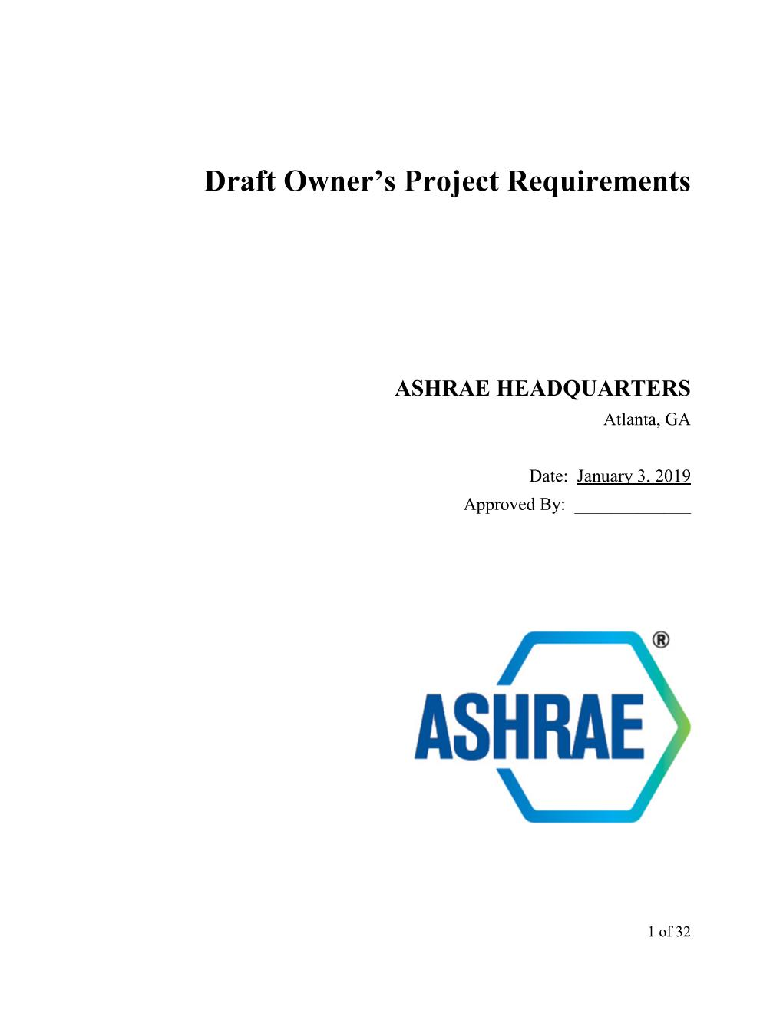
Owner’s Project Requirements
Owner’s Project Requirements (OPR) document establishes owner goals:
Mission Critical Items:
  SAFETY – Safe work environment and construction
  AFFORDABLE – Constructed within the available budget
  ASHRAE STANDARDS – Exceed applicable ASHRAE Standards
  ACCOUSTICS – Exceed Acoustical levels for Office Environments
  NET ZERO ENERGY READY – Requires low EUI levels
Notes:
A Technical Advisory Subcommittee was formed and developed the ASHRAE Owner’s Project Requirements

Slide 9
Owner’s Project Requirements (OPR)
Item | OPR
ASHRAE 189.1-2017 | Exceed Requirements
Demand Side Site Energy Consumption | 21.4 kBTU/SF/year 15 kBTU/SF/year (stretch)
Water Efficiency | Obtain 11 of 11 LEED Water Use Efficiency Points
Daytime Plug Load | 0.04 W/SF
Acoustics | Exceed requirements by 3-5 NC/RNC
Outside Air Rate | 1.3 times ASHRAE 62.1
Outside Air Control | Demand Control Ventilation (DCV) for high occupancy spaces
Daylighting | Majority of Occupants achieve generous daylighting 55% of the time
Resiliency | Achieve resiliency in OPR
Notes:
Table of major OPR elements. The column at the right will be filled out at the end of the presentation

Slide 10
Schedule Constraints
January 2019: Design Team Selection
February 2019: Construction Manager Selection
April 1, 2019: Schematic Design Complete
May 15, 2019: Design Development Complete
August 1, 2019: Construction Documents Complete
September 15, 2019 – Start Construction Phase
August 15, 2020 – Construction Complete
August – September 2020 – Commissioning Efforts
October 2020 – Full Occupancy
Notes:
Summary of the Level 1 schedule.

Slide 11
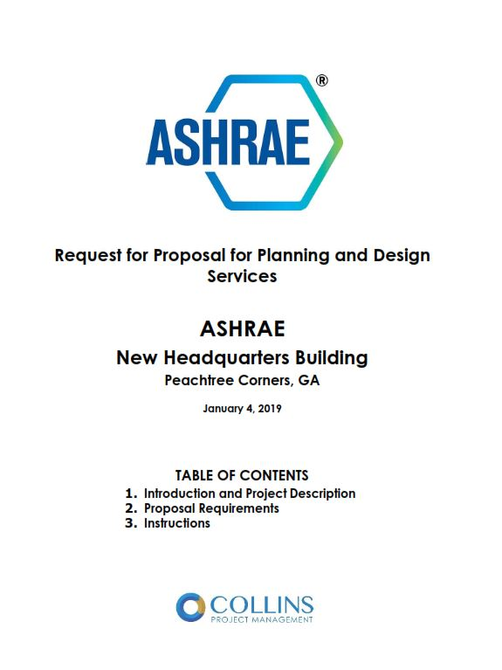
How Do We Achieve Our Project Goals?
Set Construction Budget
Set Project Schedule: Move out October 2020
Set Project Criteria: OPR
Hire the right team!

Slide 12
Project Execution Method
Decision #1: Utilize a Project Manager
  ASHRAE doesn’t have Project Managers on staff
  Needed to have day to day management of design team and contractor team
  Ad Hoc developed an RFQ for a Project Manager
Decision #2: Utilize Construction Manager at Risk
  Wanted early contractor involvement
  Atlanta market not familiar with Integrated Project Delivery
Decision #3: Hire Project Team
  Project Manager helped manage RFP’s and select Design, Commissioning and Construction Manager
Notes:
Summary of the early decisions made by the Ad Hoc to form the team.

Slide 13
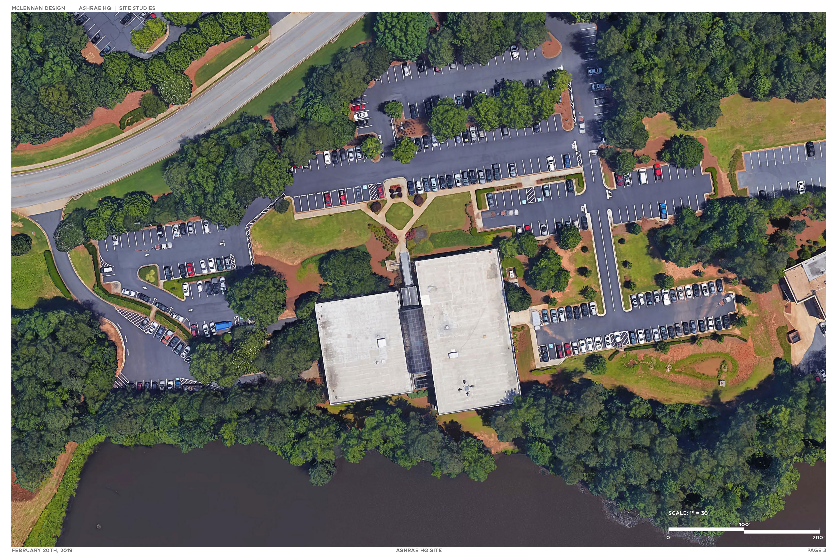
Notes:
Site plan of 180 Technology Parkway

Slide 14
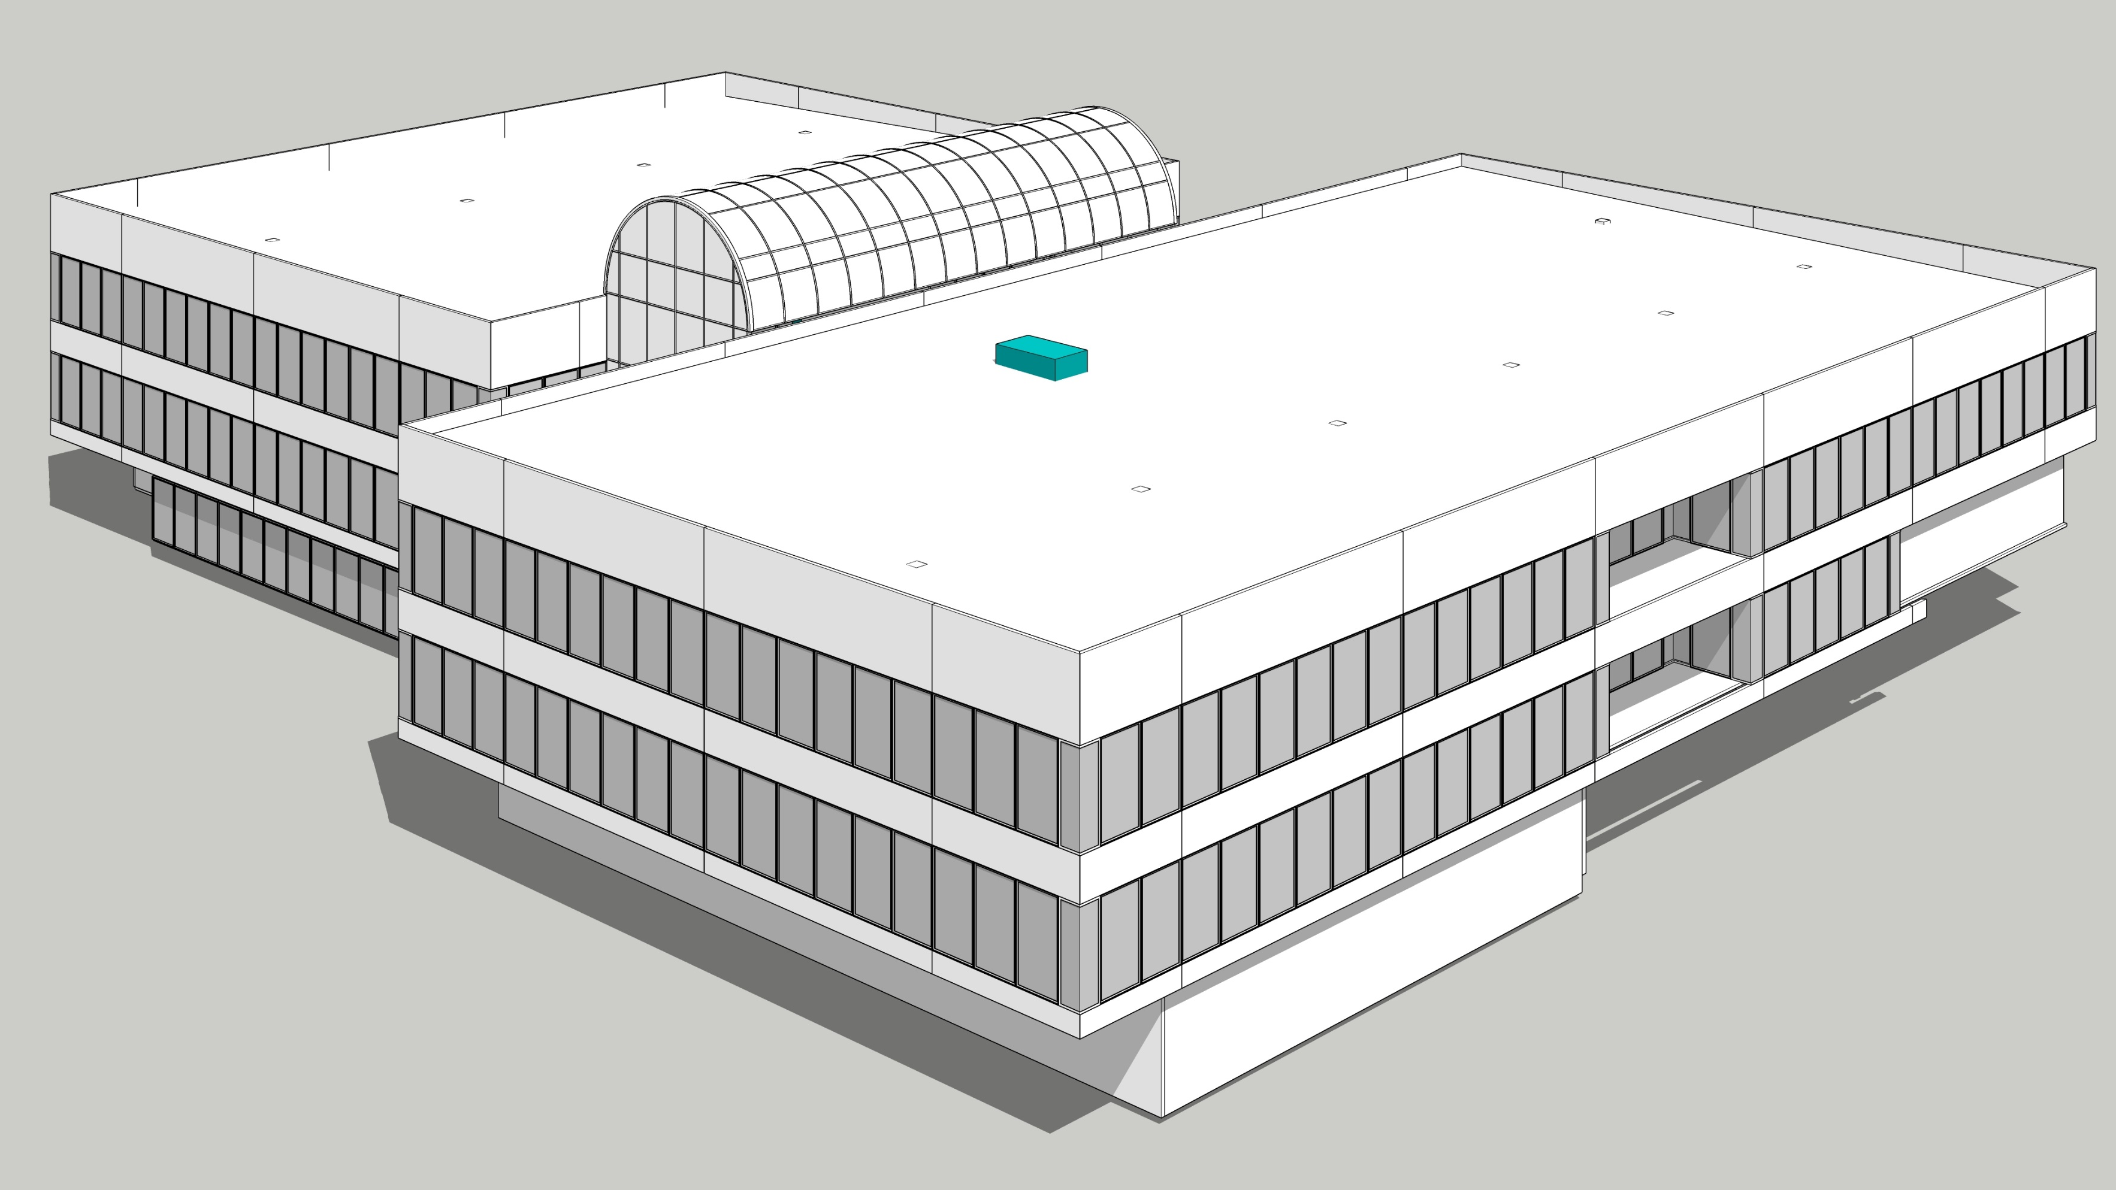
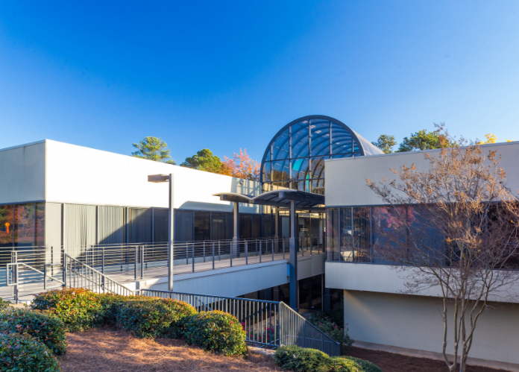
Existing Structure
Notes:
Existing structure:
One full story above grade,
One story mostly above grade
Partial lower level.
All glass barrel vault entrance with strip windows.

Slide 15
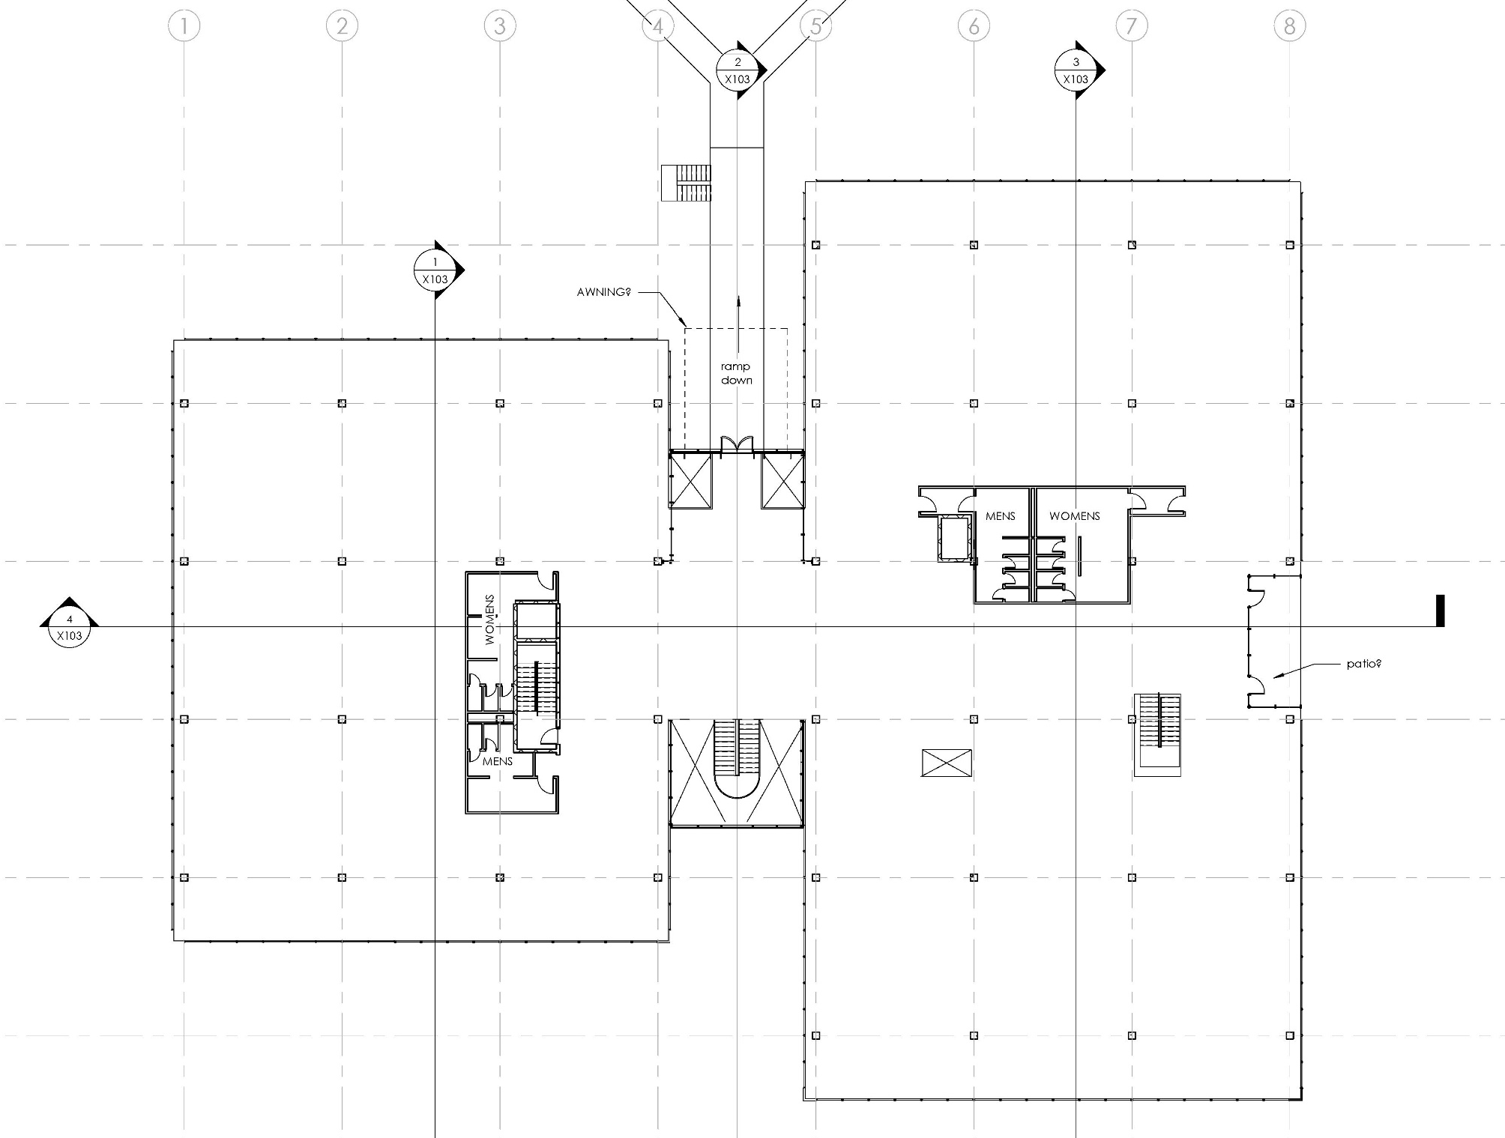
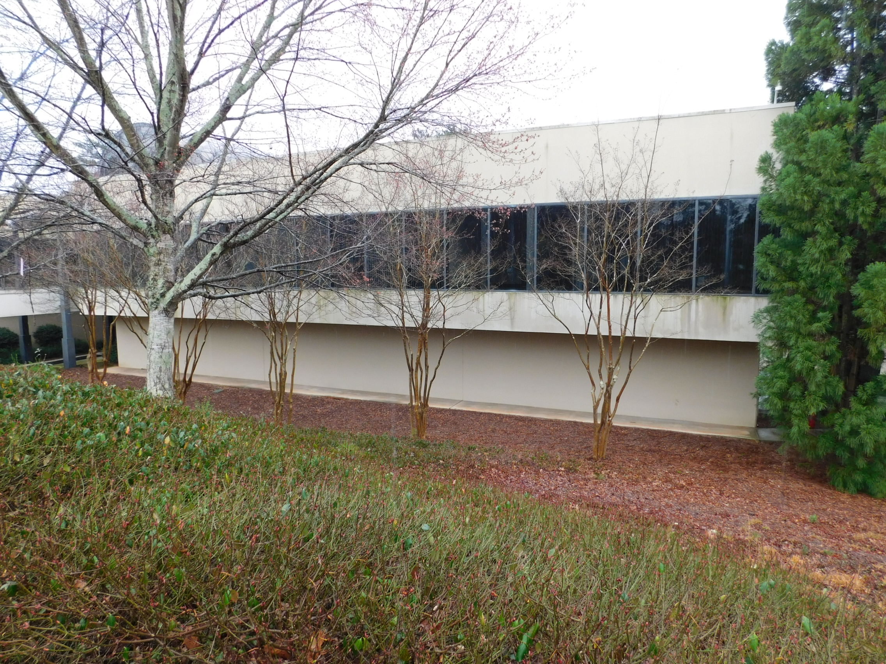
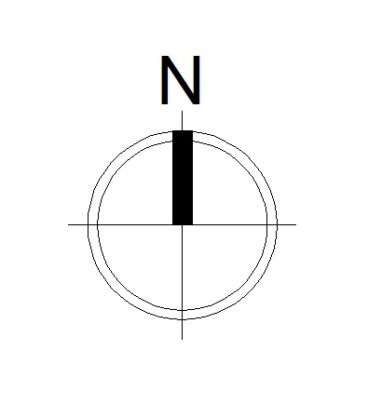
Existing Upper Level Floor Plan
Notes:
- Building is split by the center common space under the barrel roof.

Slide 16
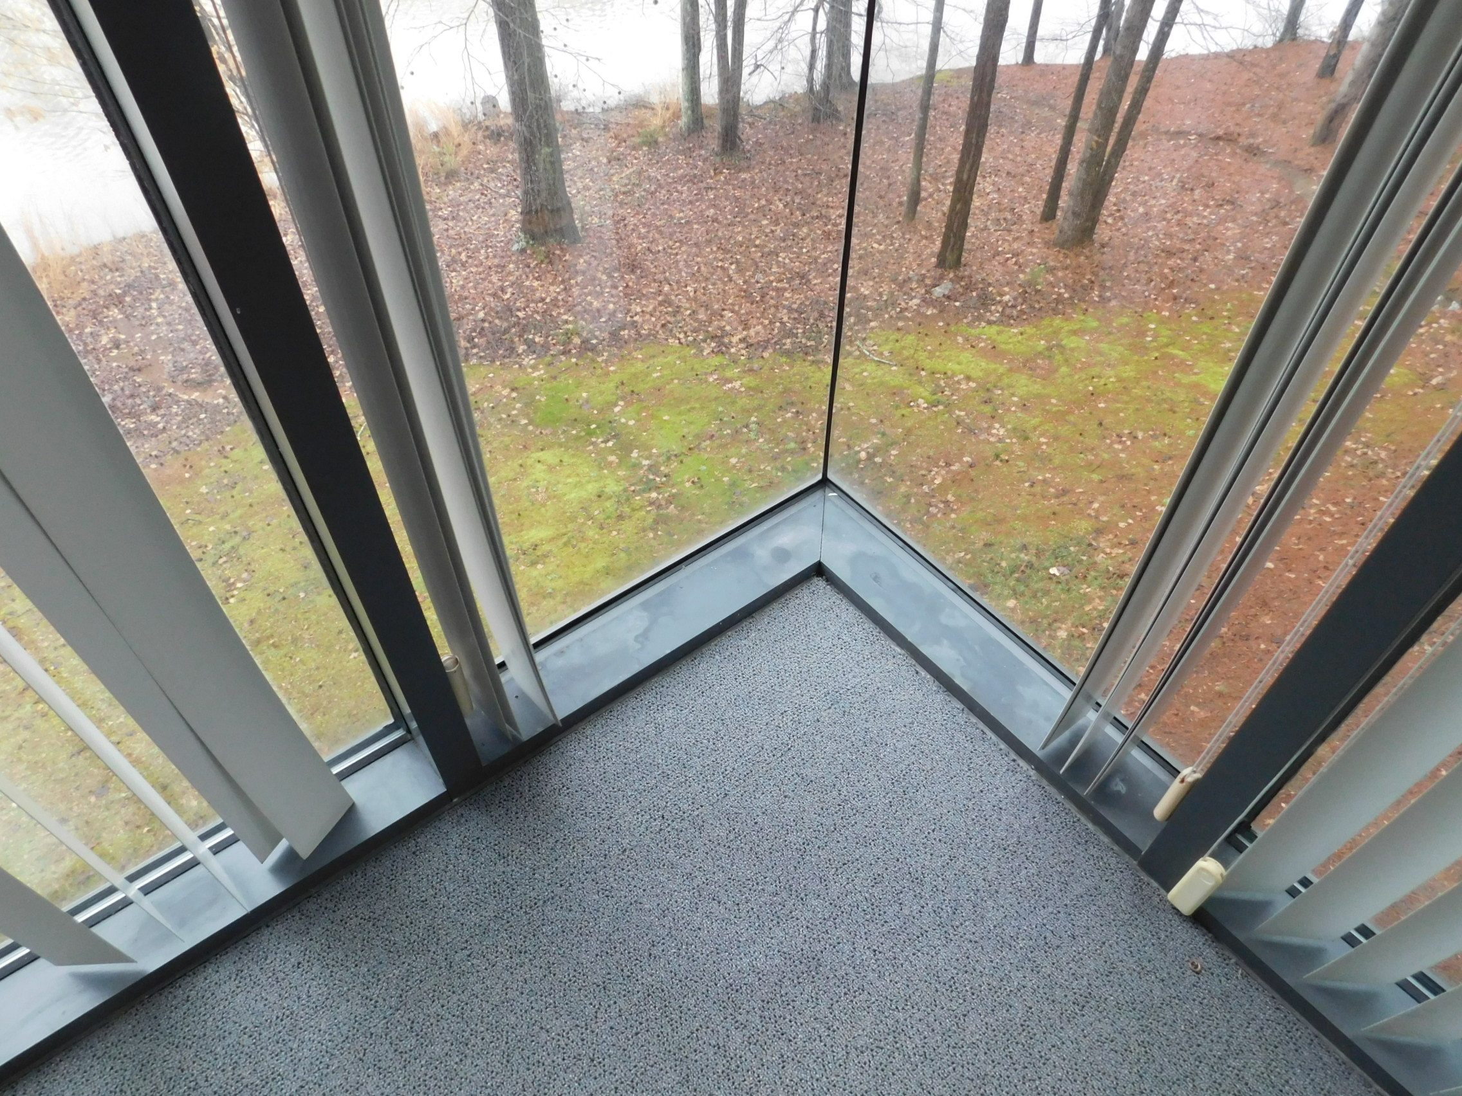
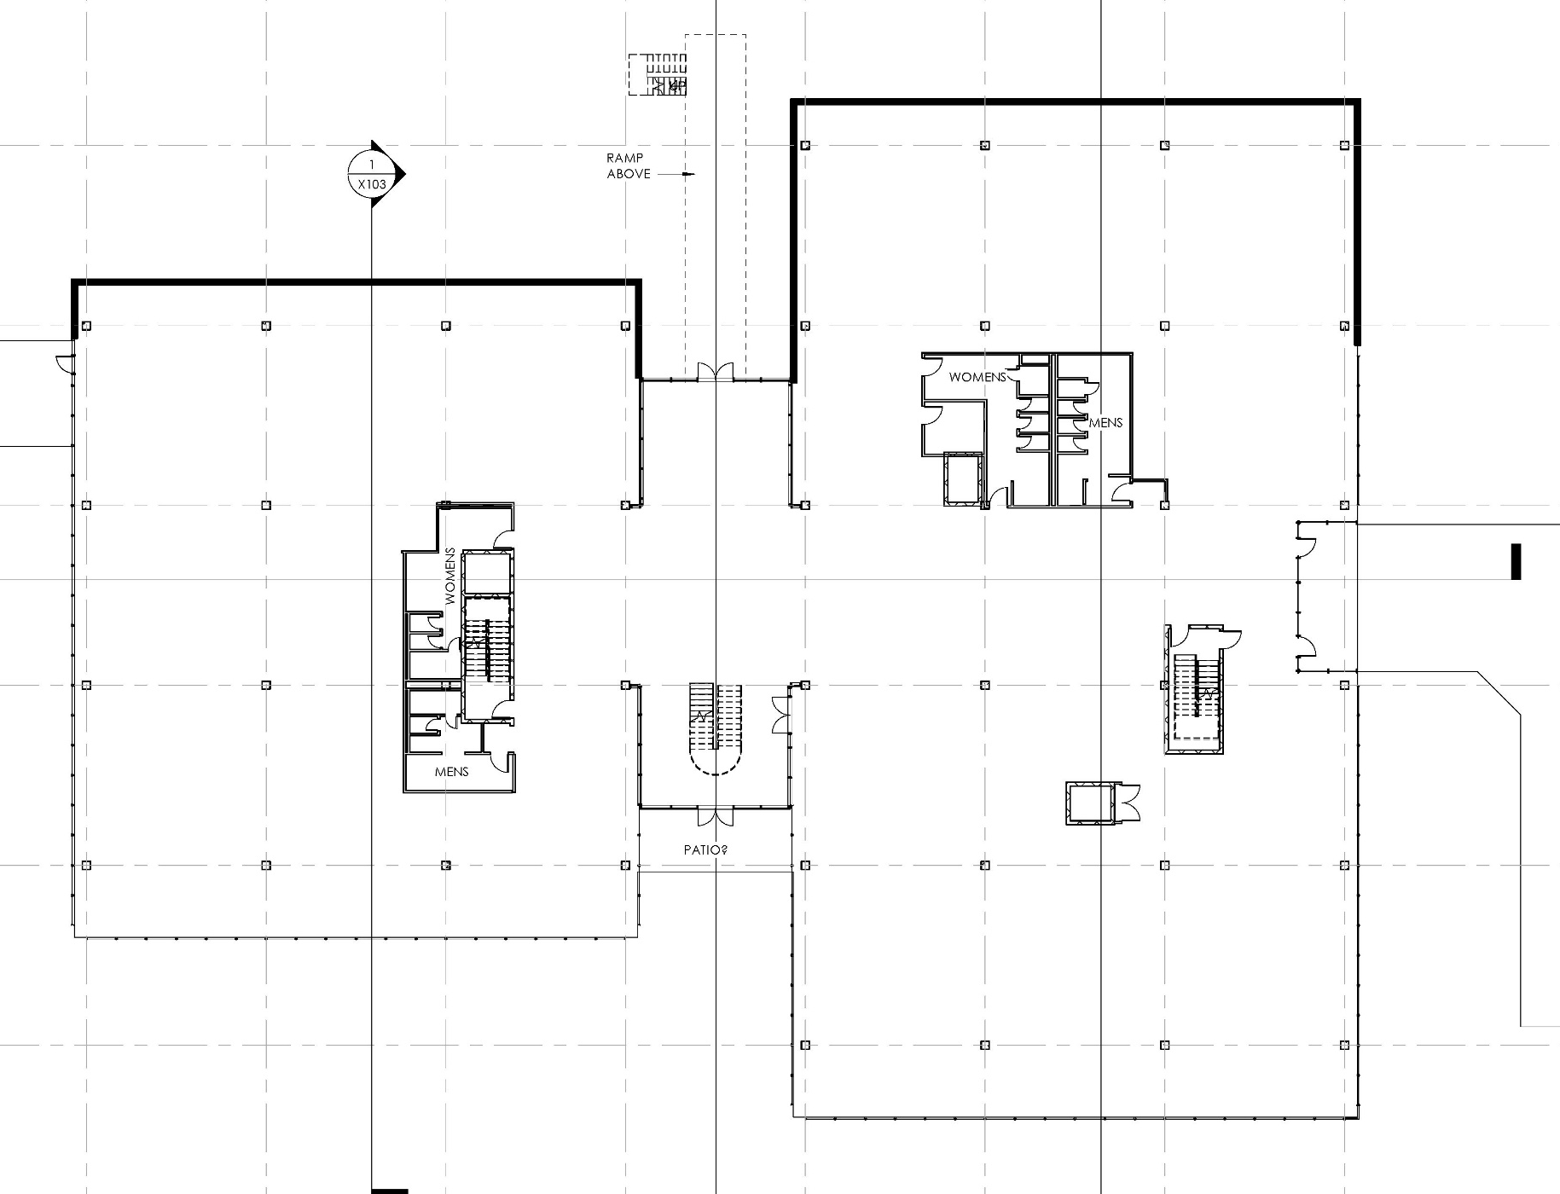
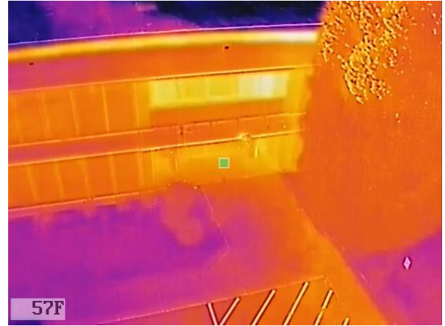
Existing Middle Level Floor Plan
Notes:
Similar to Upper Level, except north walls are below grade
East entrance direct to lower level from lower parking lot.

Slide 17
Climate Factors: Atlanta, Georgia
Key Climate Design Drivers
Summer: May to September (Avg. OA>70°F)
  Extreme Hot Week: Jul 6 - Jul 12, Maximum Temp= 98.1°F (36.7°C) and increasing
  Exterior shading beneficial May-September
Winter: December to February (Avg. OA< 50⁰F)
  Extreme Cold Week: Jan 6 to Jan 12, Minimum Temp= 9.0°F (-12.8C)
  Leverage passive solar gains
Diurnal Swing: Average Diurnal swing 15-24°F
Ground and Water Temperatures: Stable ground (and lake) temperatures
Annual Temperature Profiles
Atlanta-Hartsfield-Jackson.Intl.AP TMY3 Weather File
WINTER
(Dec2nd–Feb23rd)
SUMMER OVERHEAT PERIOD
(May 24th – September 26)
90⁰F
COMFORT BAND
71⁰F
71⁰F
OUTDOOR AIR TEMPERATURE (F)
52⁰F
47⁰F
28⁰F
DIURNAL AIR TEMPERATURE SWING (F)
24⁰F
15⁰F
Notes:
Climate factors for Atlanta, GA

Slide 18
Primary Envelope Factors
Window to Wall Ratios (WWR)
Important to define the optimum area of openings relative to achieving daylight autonomy goals, as well as maximize the thermal efficiency of the wall.
Air Infiltration and Insulation
Where was the optimal R-Value for each part of the exterior envelope and how were we containing air infiltration.
Notes:
Summary of the primary envelope factors addressed.

Slide 19
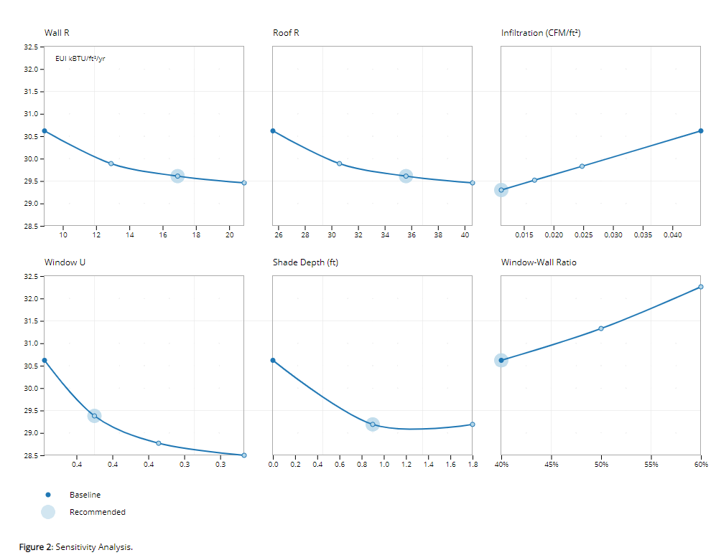
Envelope Sensitivity Analysis
Preliminary envelope performance targets based on point of diminishing Energy Use Intensity (EUI) savings shown at right:
Parameter | Existing Performance | ASHRAE 90.1-2016 | Recommended
Wall Assembly | U-0.3 (R-3.0) | U-0.122 (R-8.0) | U-0.058 (R-17)
Roof Assembly | U0.047 (R-21) | U-0.039 (R-25) | U-0.028 (R-35)
Window Assembly | U-0.59 SHGC-0.52 | U-0.45 SHGC-0.25 | U-0.40 SHGC-0.25
Window to Wall Ratio | ~50% | 40% | 40%
External Shade Depth | N/A | N/A | 1’ (to be further optimized for visual, thermal comfort)
Infiltration | 0.025 cfm/ft² | 0.045 cfm/ft² | 0.011 cfm/ft²
ASHRAE NZE AEDG recommends
R-15.6 wall for Climate Zone 3!
Interactive Graph: https://www.elementa.nyc/projects/ashrae/
Notes:
Sensitivity analysis of several envelope factors and how they impacted the overall EUI.
See the note regarding what the ASHRAE Net Zero Energy Advanced Energy Design Guide recommends.

Slide 20
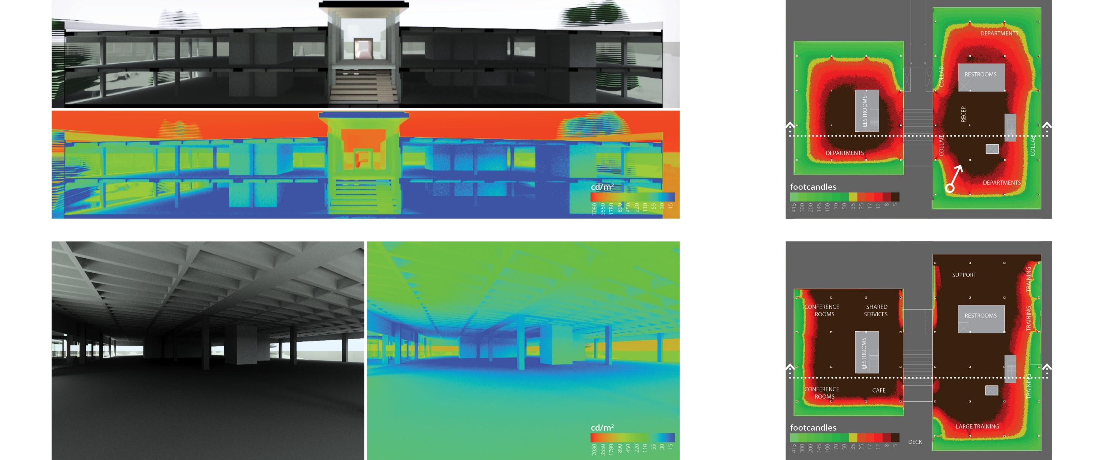
Daylight Patterns - Existing
Section View and Falsecolor Luminance Map, Equinox at 12pm, Clear Sky with Sun
Daylight Illuminance, Uniform Overcast Sky – Top Floor
35% Daylit Floor Area
Perspective View and Falsecolor Luminance Map, Equinox at 12pm, Clear Sky with Sun
Daylight Illuminance, Uniform Overcast Sky – Mid Floor
17% Daylit Floor Area
Notes:
Existing daylighting patterns

Slide 21
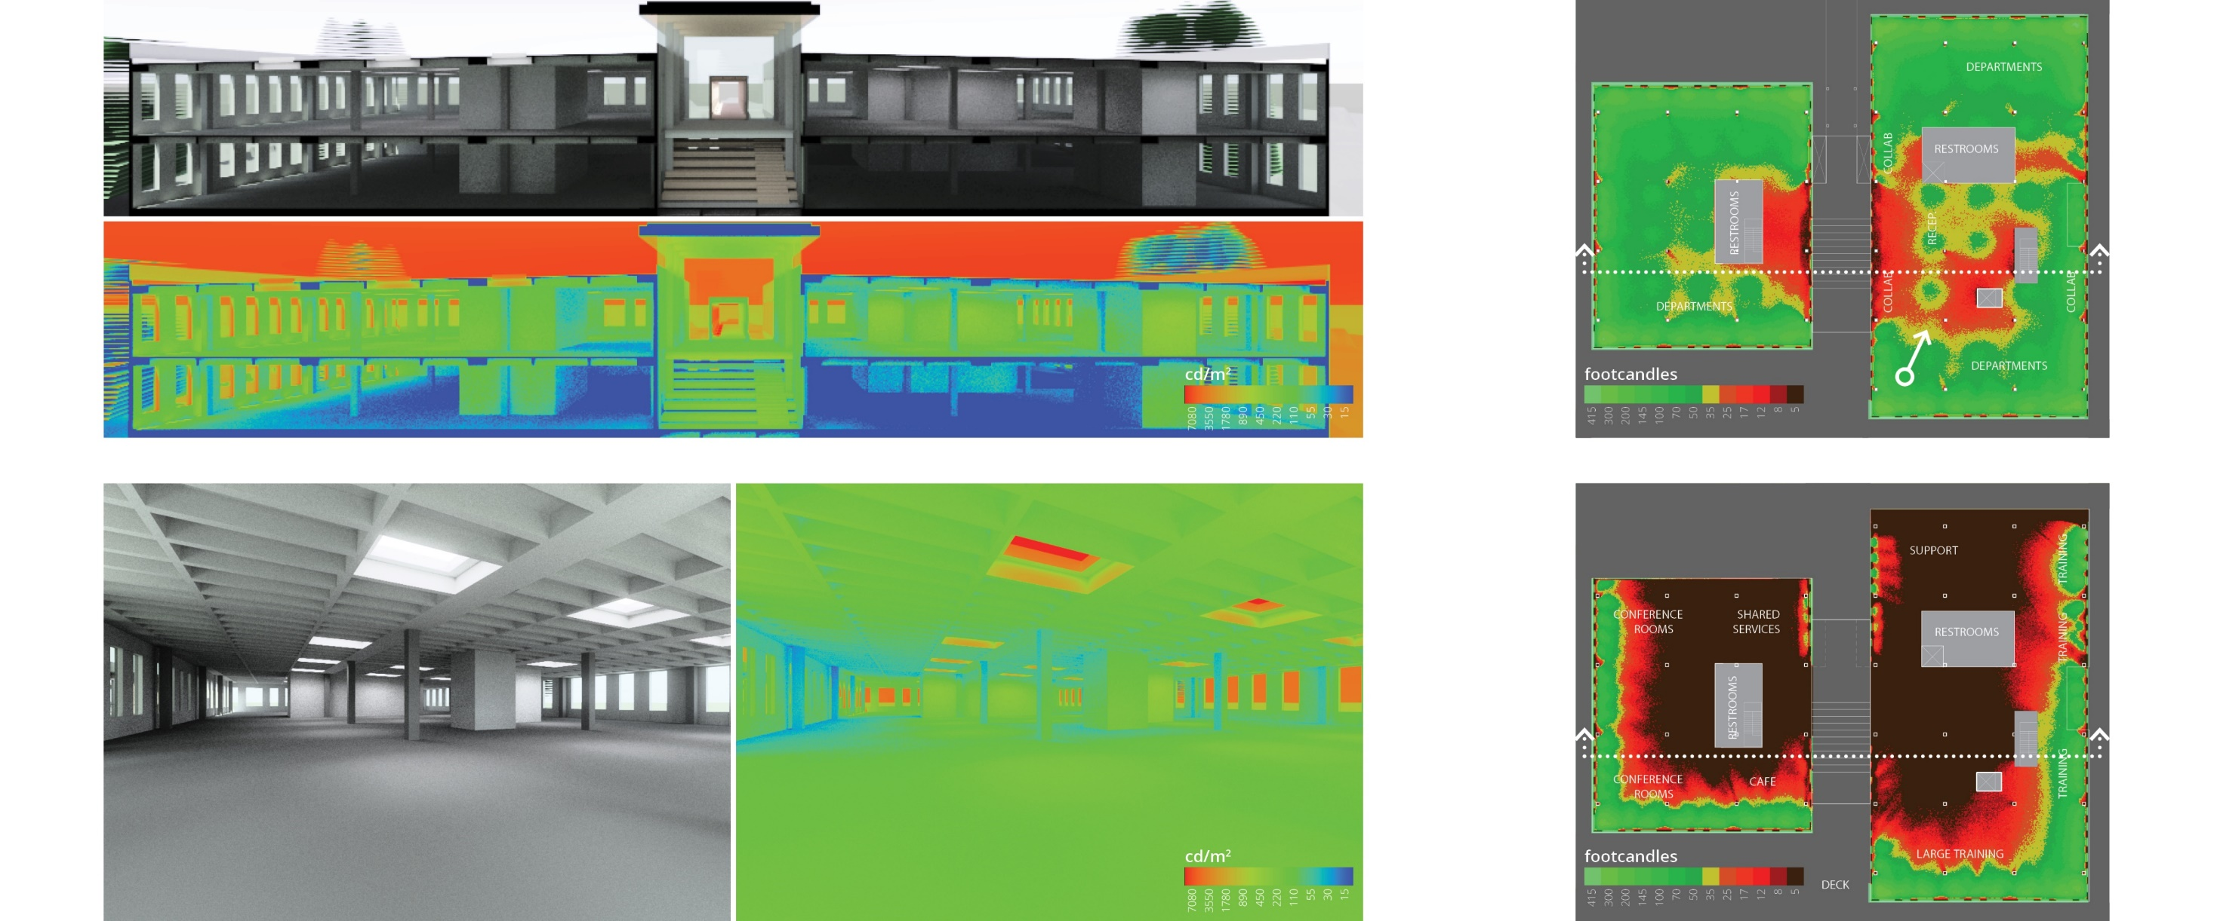
Daylight Patterns – WWR (40% N/S, 30% E/W) 25 Skylights
Section View and Falsecolor Luminance Map, Equinox at 12pm, Clear Sky with Sun
Daylight Illuminance, Uniform Overcast Sky – Top Floor
79% Daylit Floor Area
Perspective View and Falsecolor Luminance Map, Equinox at 12pm, Clear Sky with Sun
Daylight Illuminance, Uniform Overcast Sky – Mid Floor
23% Daylit Floor Area
Notes:
Daylighting patterns with:
40% WWR N & S
30% WWR E & W
Tall Window Head
New Sill
25 Skylights

Slide 22
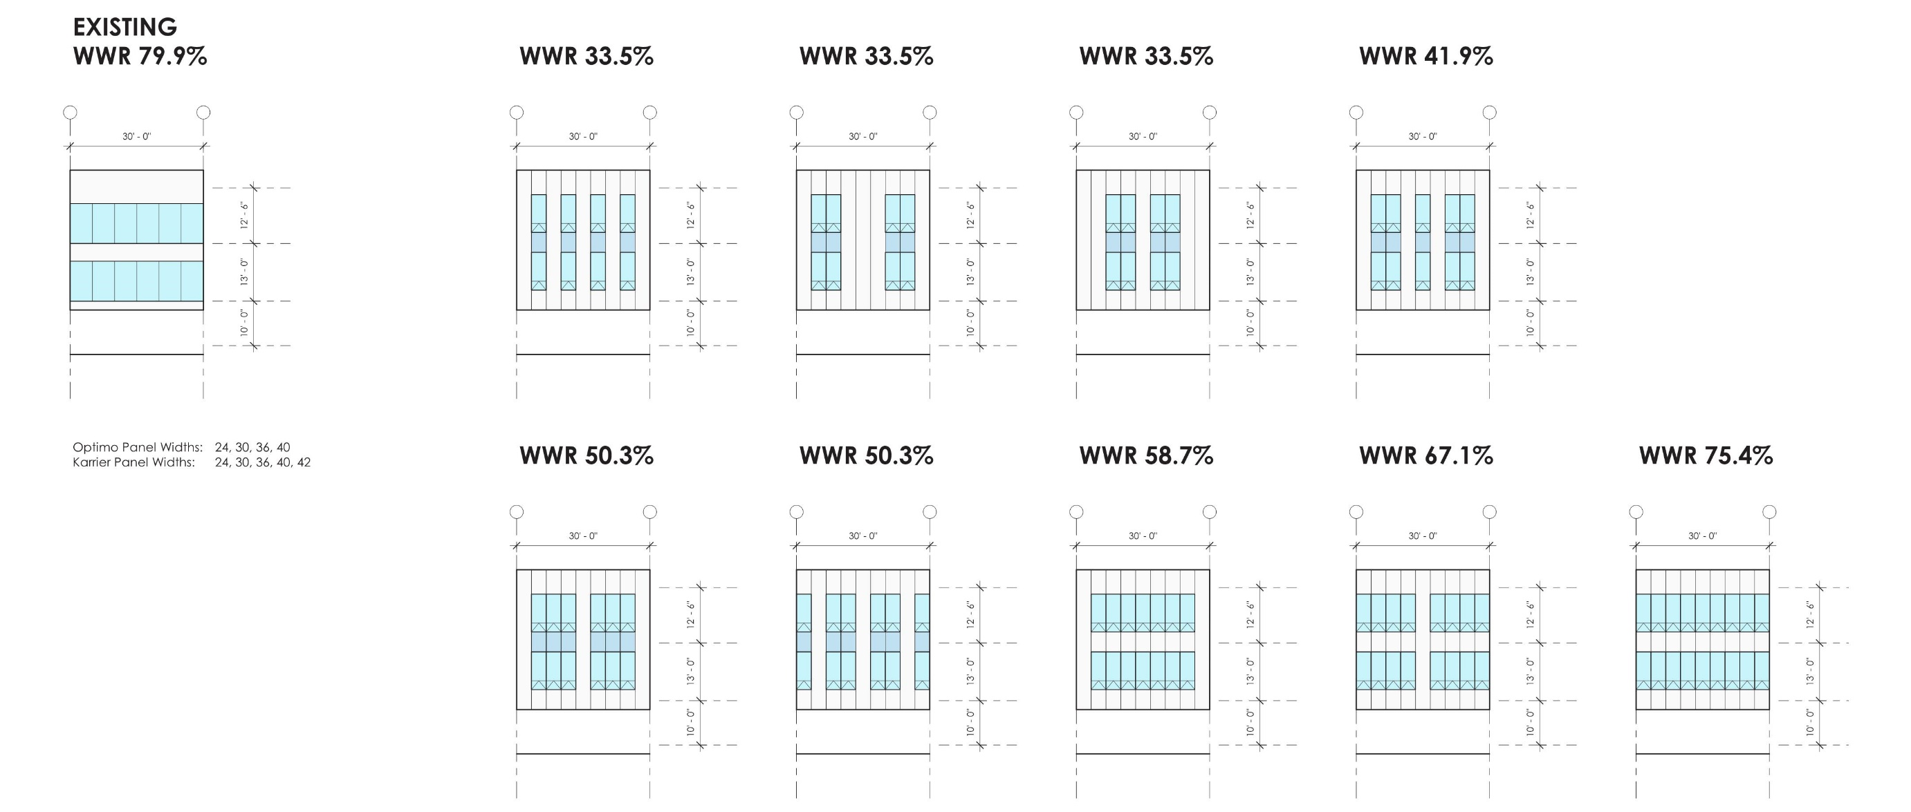
Final Window Wall Ratios
East and West
North and South

Slide 23
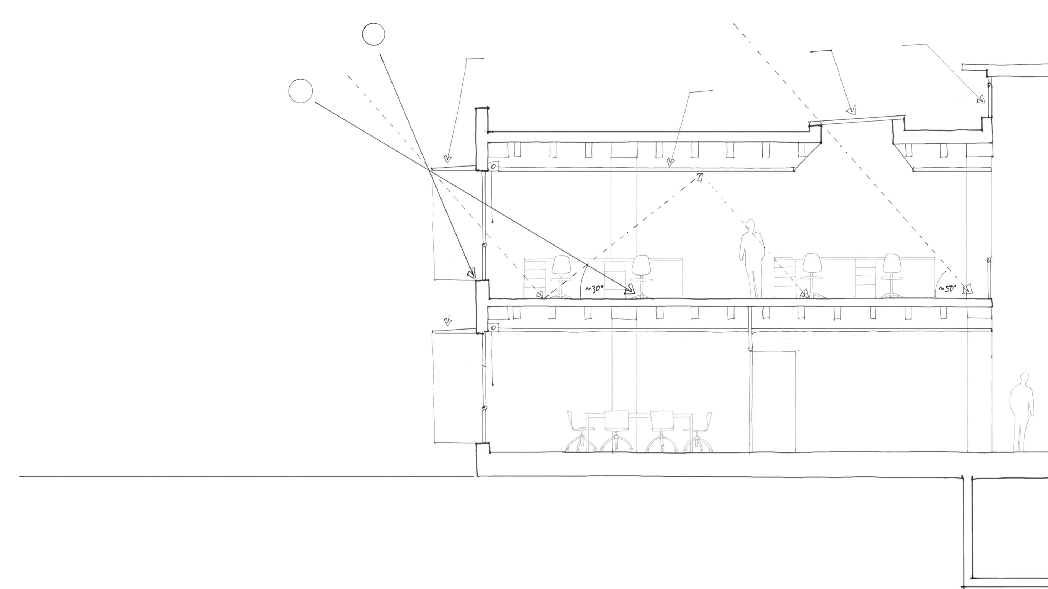
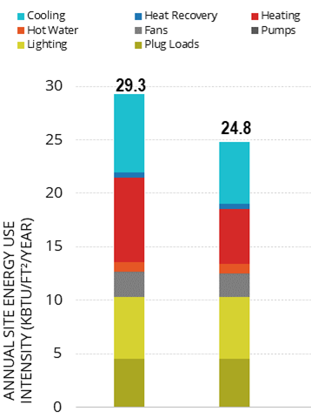
High Performance Envelope
New skylight
Roof monitor
External shades
Light colored ceiling to reflect daylight
Baseline
Design
Recommended
Envelope
Recommended Envelope
R17 Walls | R35 Roof
U-0.4 | SHGC-0.25
~32% WWR (30% E/W, 40% N/S)
Minimum 1’ overhangs
Infiltration < 0.1 cfm/sf façade @ 75 pa
Notes:
Summary of the recommended envelope

Slide 24
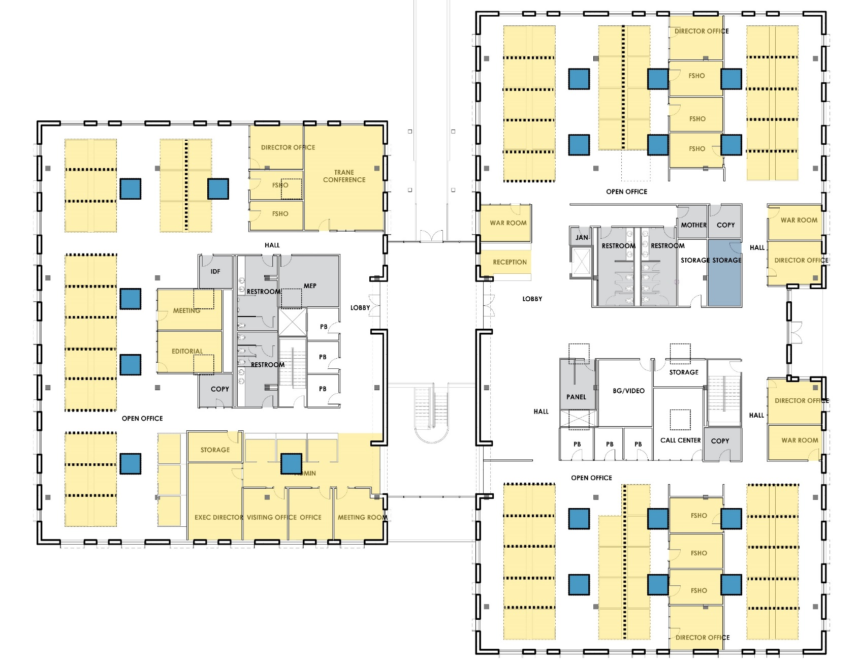
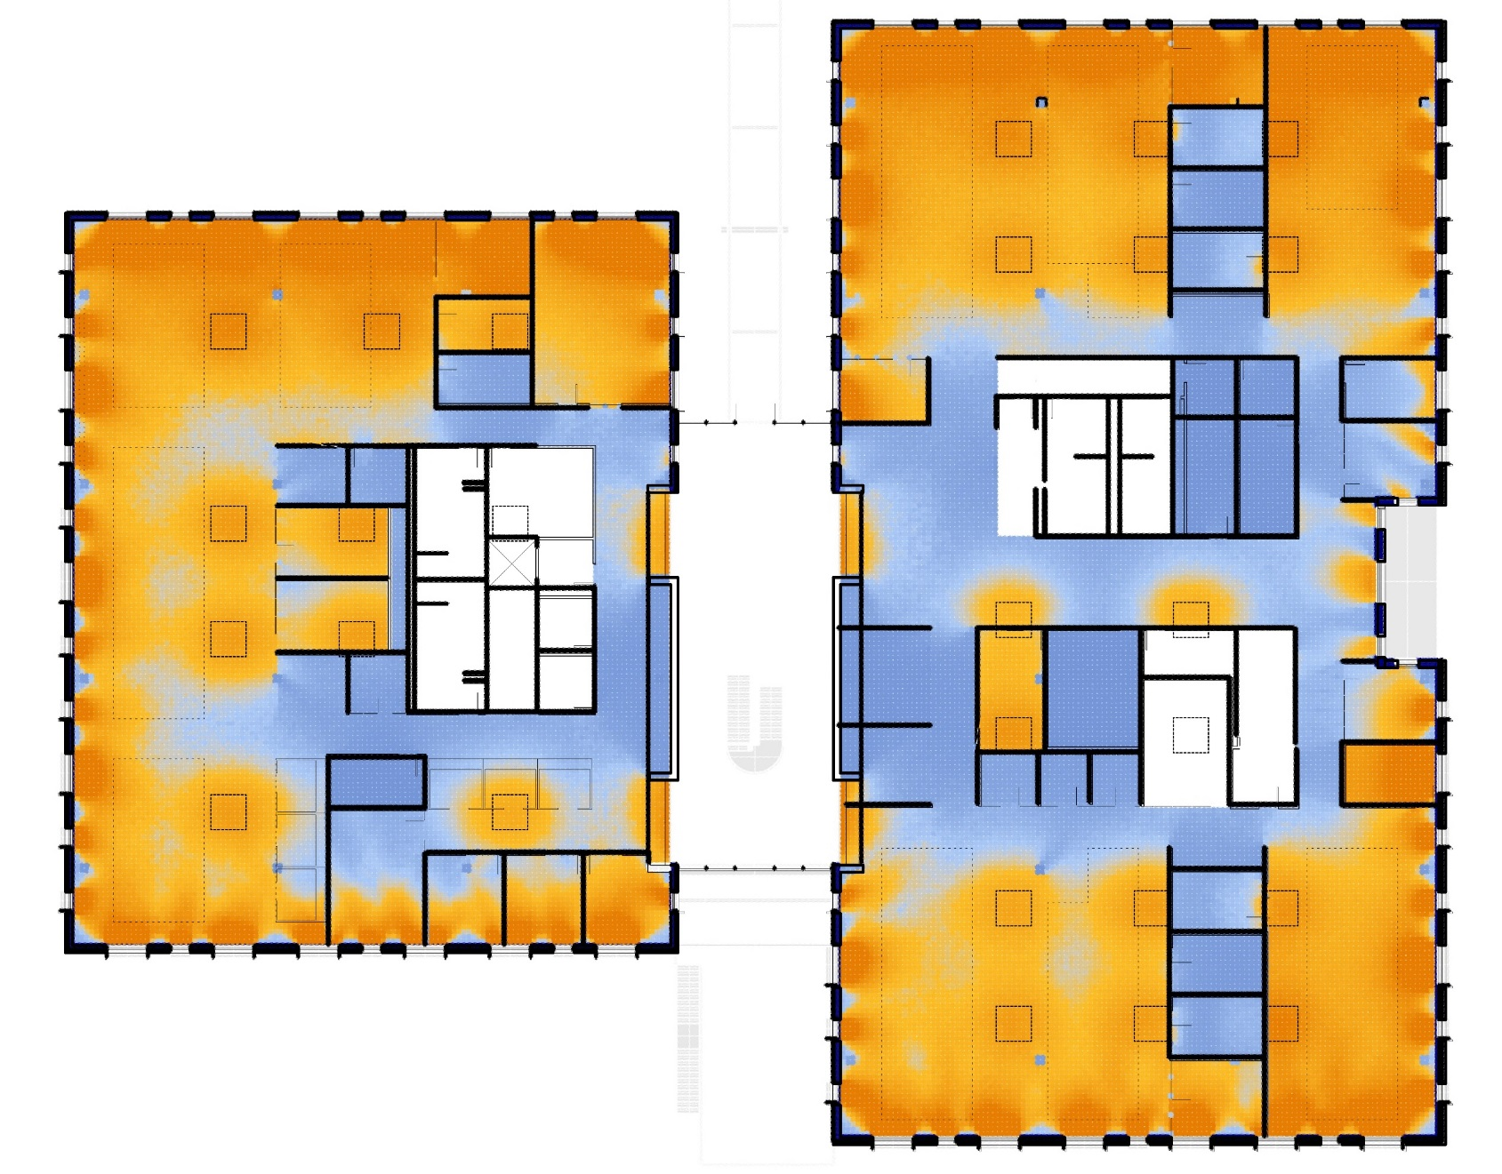
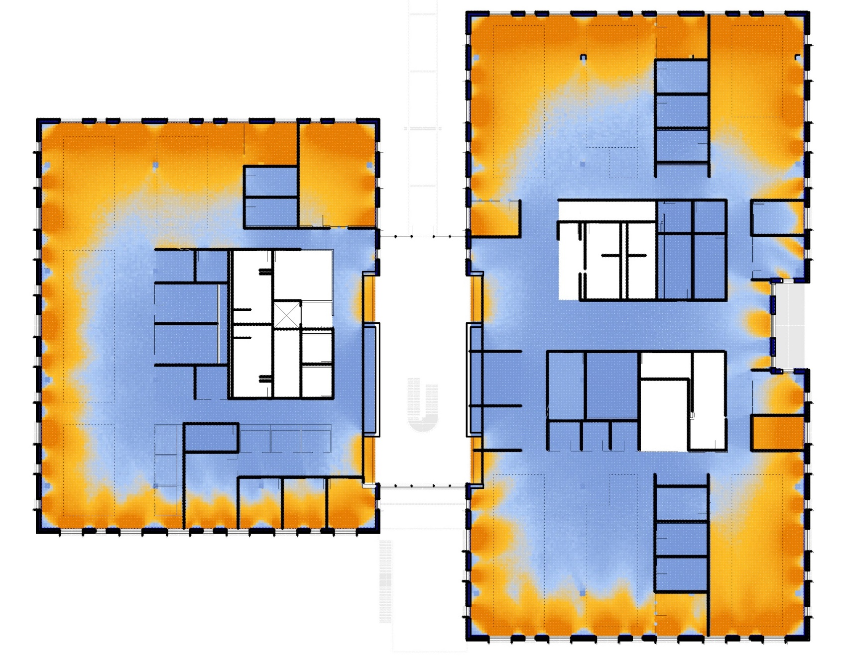
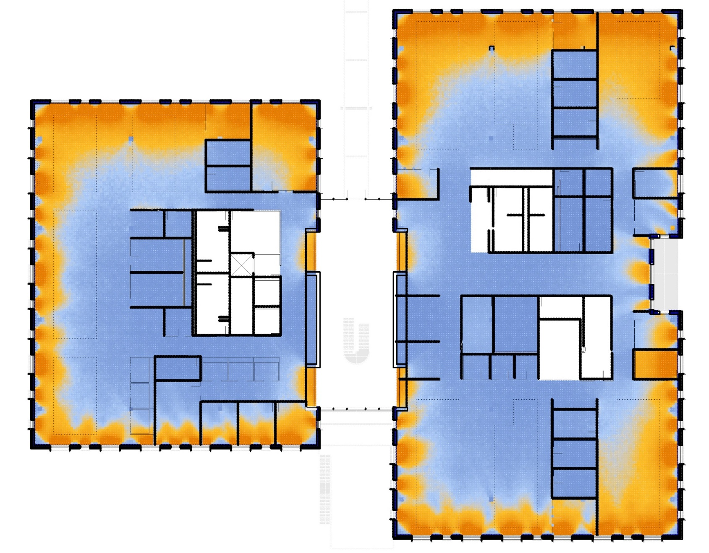
Daylight Strategies
Skylights
Doubles the daylit floor area on the upper floor
Provides useful daylight illuminance to 70% of work areas
Offers significant opportunity for electric light dimming.
The 18 skylights shown at right (in blue) provided the best impact according to ASHARE’s consultant
Raised Windows
Raising the window height increases the daylit floor area percentage from 36-46%.
Interior Desk Layout
Tall and/or opaque desk partitions running parallel to the façade must be avoided in order to maintain side-lighting benefits.
MAINTAIN LOW (<3.5’), GLAZED, OR NO PARTITIONS PARALLEL TO THE FACADE
AT A MINIMUM, THESE 18 SKYLIGHTS SHOULD BE RETAINED.
CONSIDER ADDING WINDOWS FOR BORROWED LIGHT FROM ATRIUM
SOLID PARTITIONS, IF NECESSARY, SHOULD BE PLACED PERPENDICULAR TO THE FAÇADE TO MAINTAIN SIDELIGHTING BENEFITS AND DAYLIGHT DISTRIBUTION

Slide 25
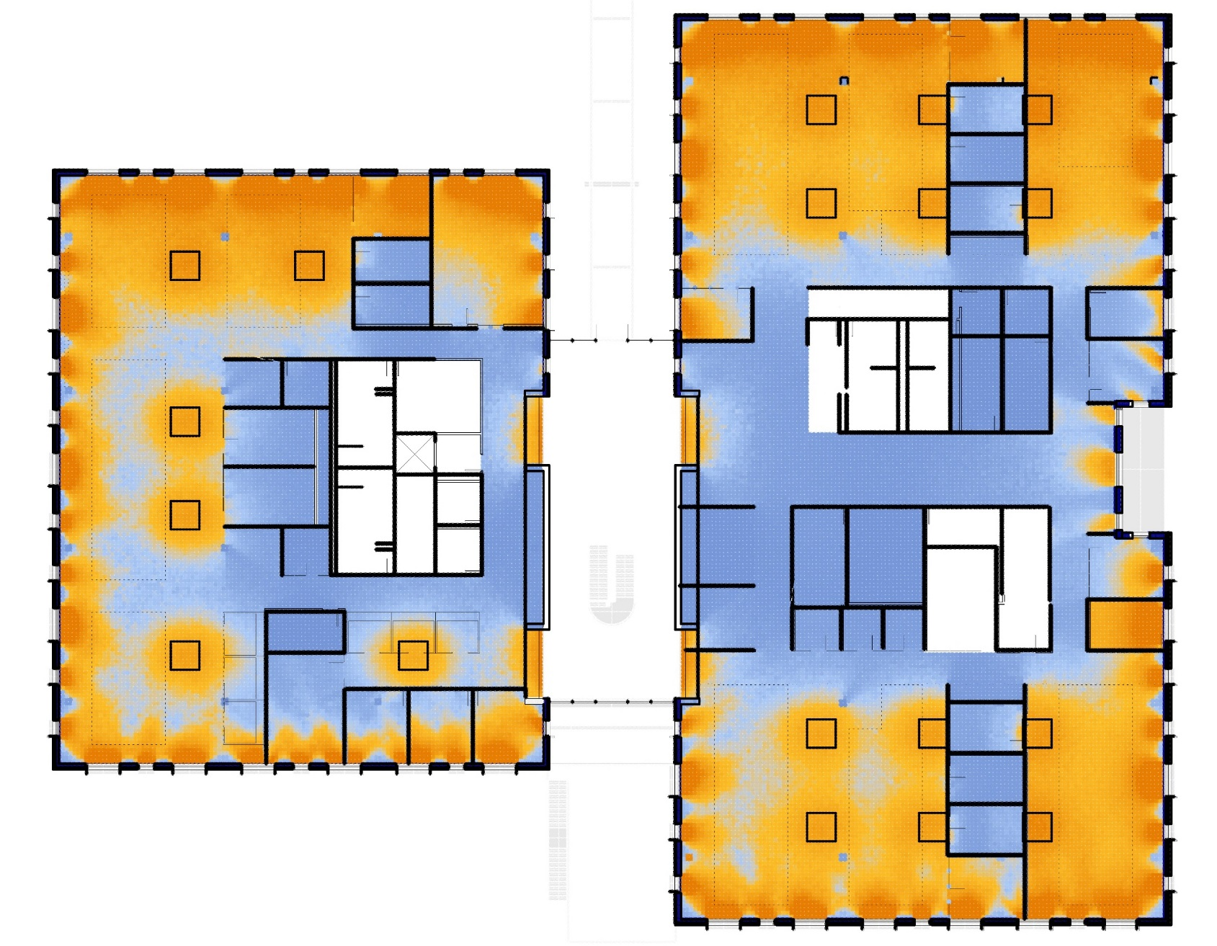
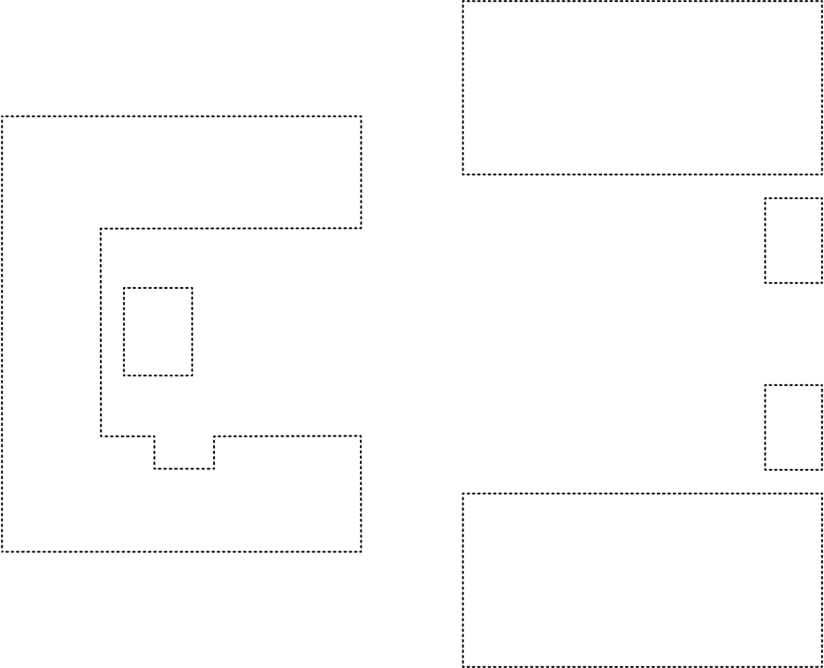

Daylight Strategies – 18 Skylights
57%
Percentage of regularly occupied work spaces on the upper level with useful daylight illuminance (>300 lux) at the work plane
Illuminance (lux) (9/21, noon - Uniform Sky )
300
1000
200
0
Useful Daylight Illuminance (>300 lux, not to exceed 4,000)
Notes:
Decision to stick with the 18 skylights that provided the

Slide 26
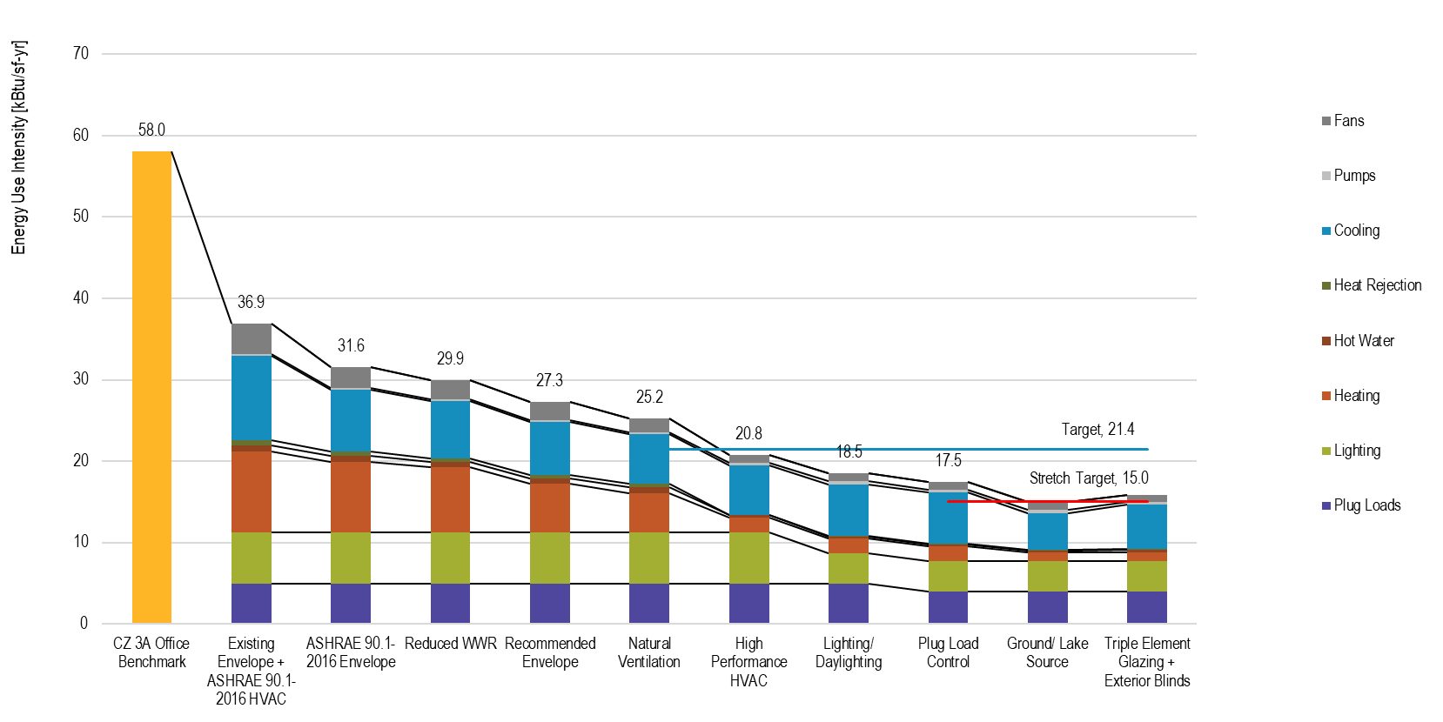
Path to Net Zero Energy (NZE) – HVAC Systems
Notes:
After the envelope, the next focus is the HVAC systems

Slide 27
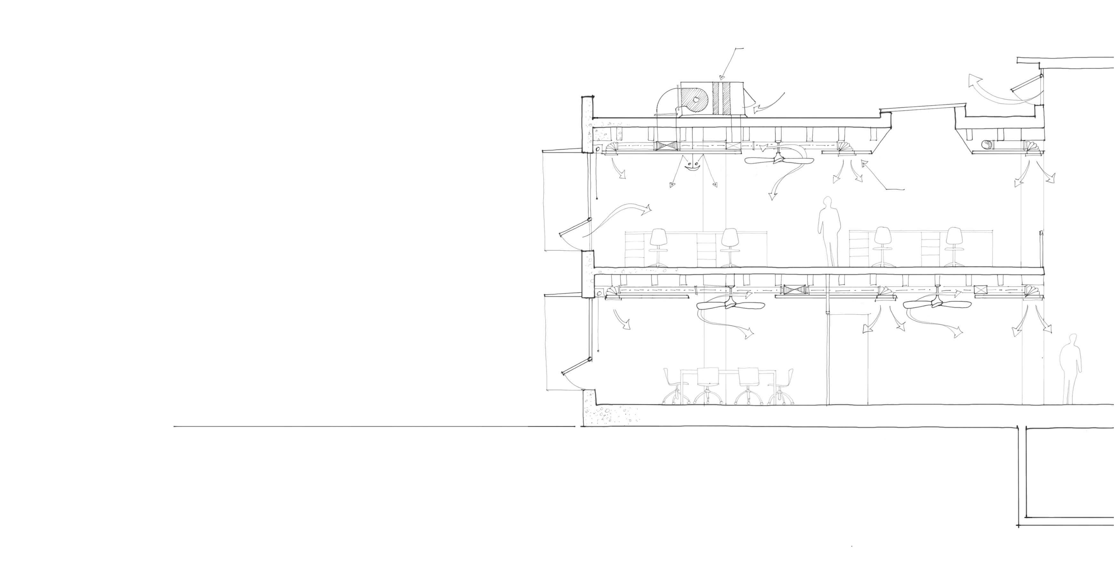
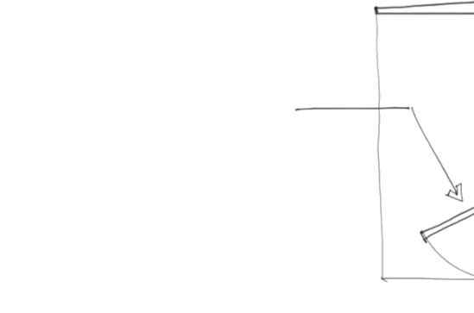
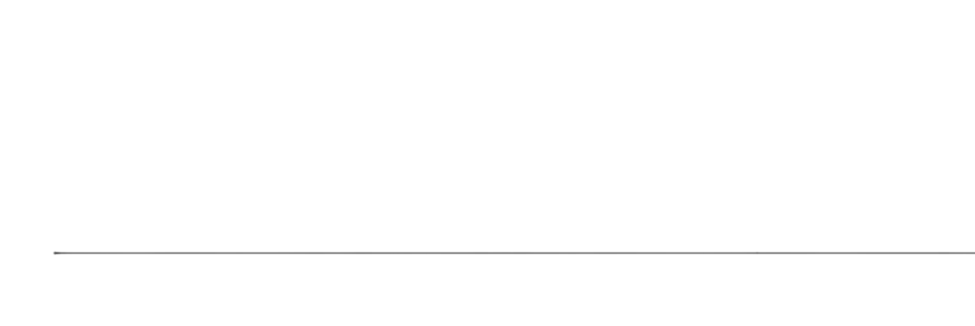
HVAC Option 1: All-Air Heat Pump System
TZHP
Ceiling fans (bidirectional)
System Type
Rooftop Packaged Thermodynamically Zoned ASHPs with DOAS, enthalpy heat recovery, DCV, and a desiccant wheel
Air Distribution Options
Overhead, Mixed Air
Mixed-Mode Ventilation
Operable windows and atrium exhaust
Ceiling fans with reverse control
Night-Flush / Airside Economizer
Fan-assisted night flush
Operable windows for natural ventilation
Overhead air distribution

Slide 28
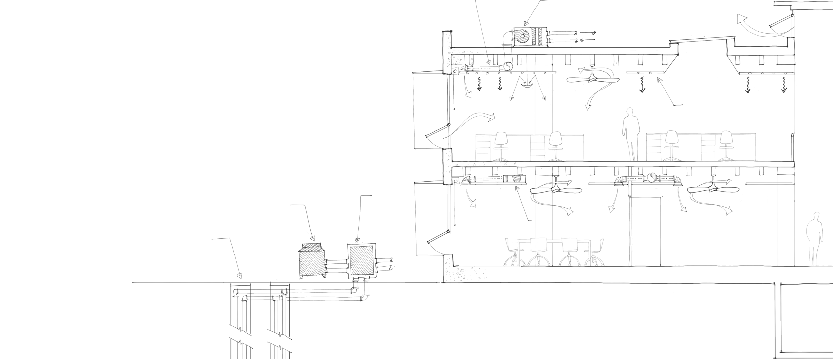
HVAC Option 2: Hydronic Systems
DOAS distribution
DOAS
Ceiling fans (bidirectional)
DOAS
With enthalpy heat recovery and DCV
Option 1A: Add desiccant wheel
Option 1B: Add DX Trim Coil
CW Terminal Unit Options
Radiant Ceiling Panels
Sensible Fan Terminal Units
Heat Pump Options
Air-Cooled HP
Night-Flush & Mixed-Mode Ventilation
See Previous
Radiant Sails
Air-Cooled
FCU

Slide 29
All-Air Heat Pump vs Hydronic System
Path to NZE Recap
NZE Target 21.4 kBTU/ft²/yr
Stretch Target 15.0 kBTU/ft²/yr
Option 1: All-Air Heat Pump System
Option 2: Hydronic System

Slide 30
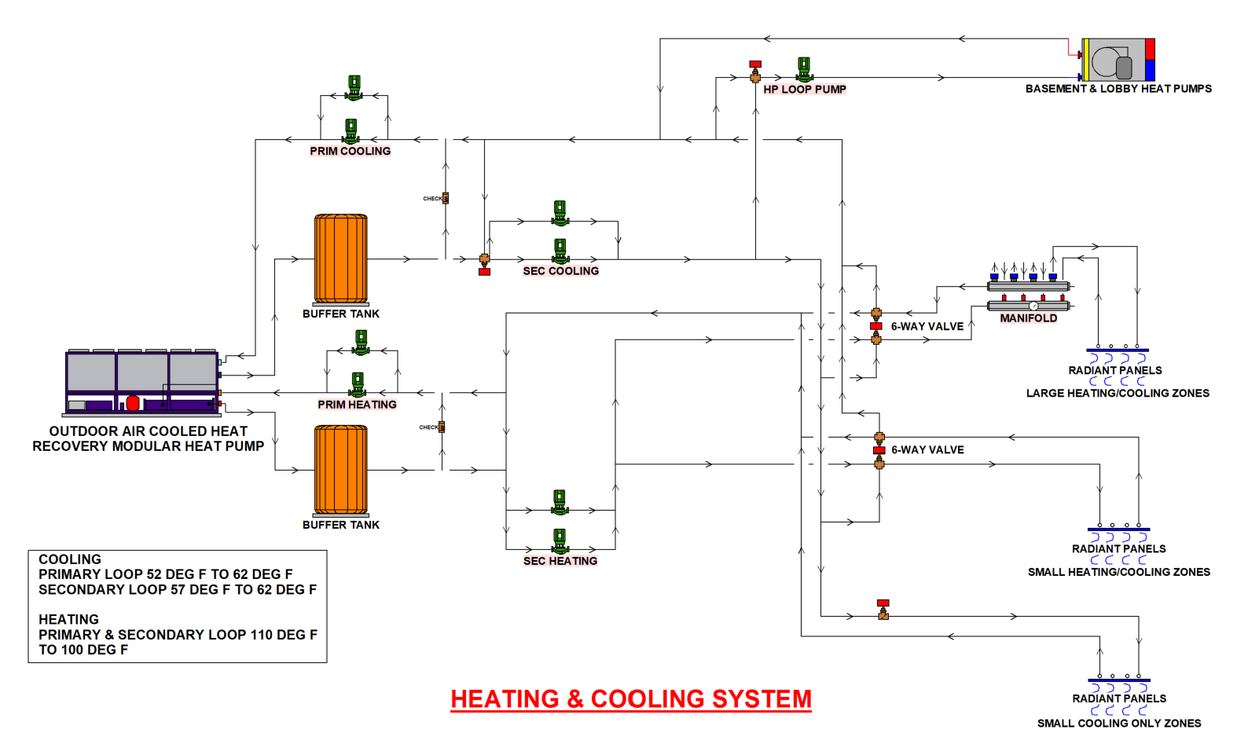

Slide 31
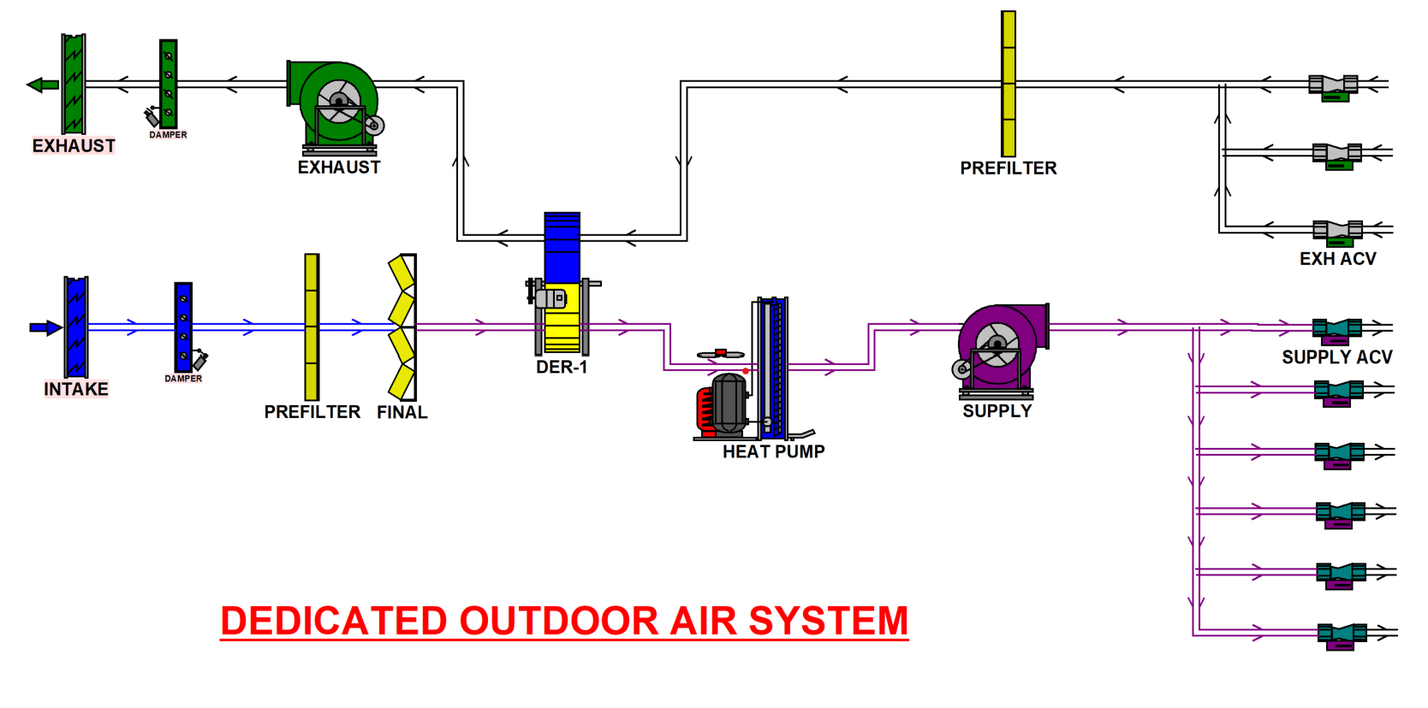

Slide 32
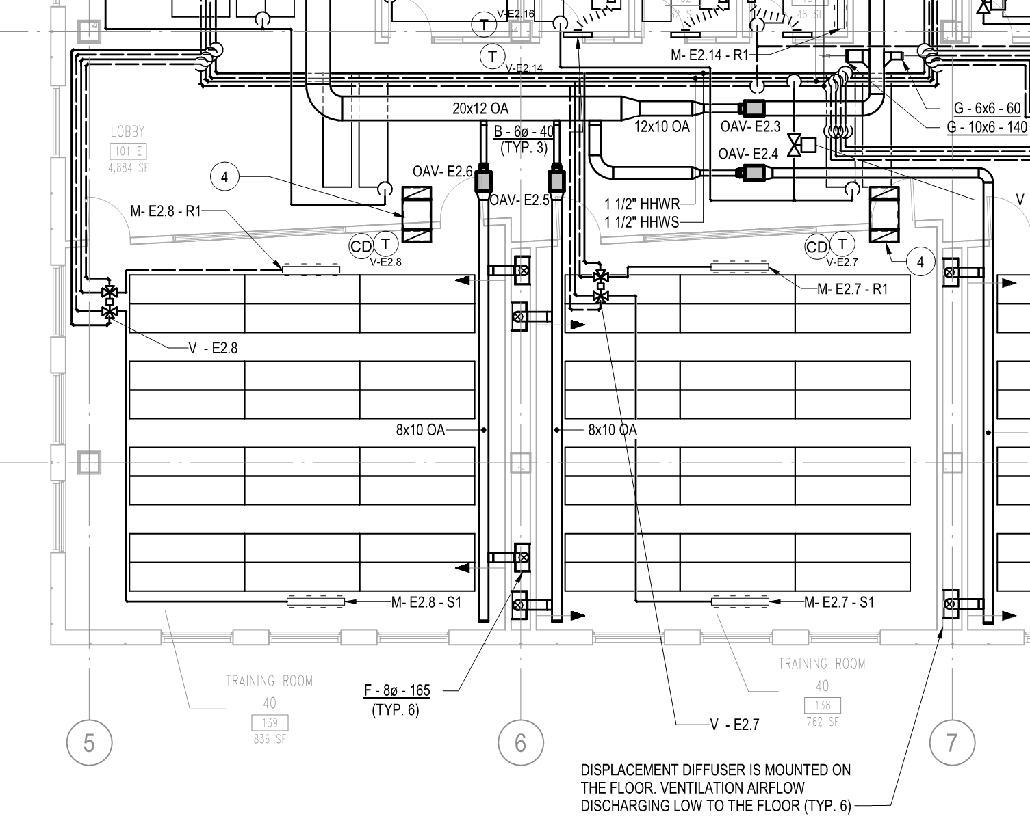
Classroom HVAC

Slide 33
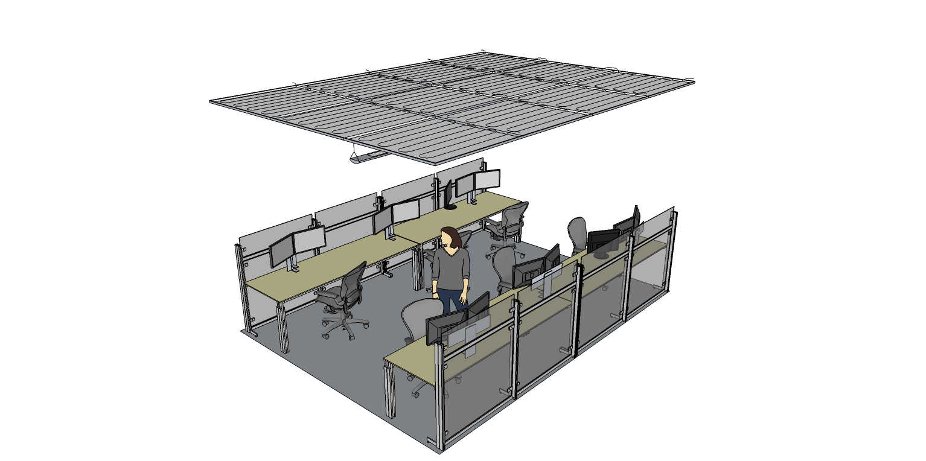
Overhead Radiant Systems
Radiant Panels form clouds above the occupied spaces
All heating and cooling in these spaces are provided by the panels.
Ventilation is cool/neutral temperature air delivered directly to the space and not directly responsible for temperature control within the zone.
Notes:
Option 2 selected.
Review system

Slide 34
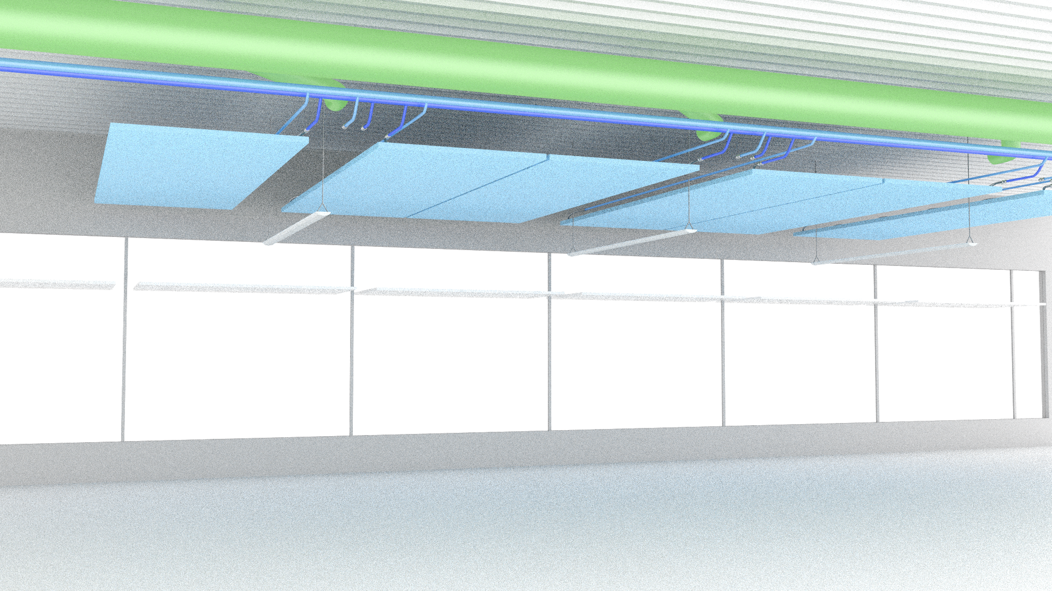
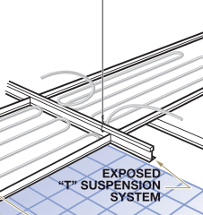
Open Office Overhead Radiant Systems
Areas between the clouds are open to structure
Rigid piping in exposed areas for aesthetic reasons.
Insulation on supply piping only.
Duct distribution is only for ventilation quantities only (about 0.15 cfm/sf)
Constant volume air distribution with Fabric Duct
Ceiling fans increase air mixing and induce capacity.
Notes:
Review system

Slide 35
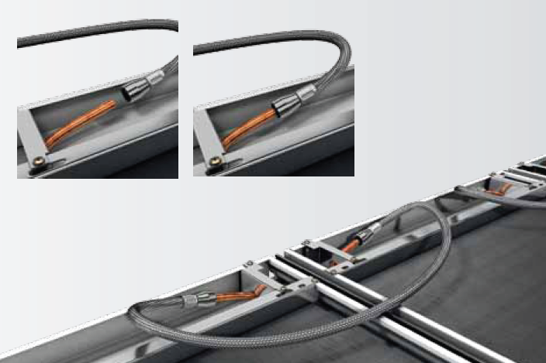
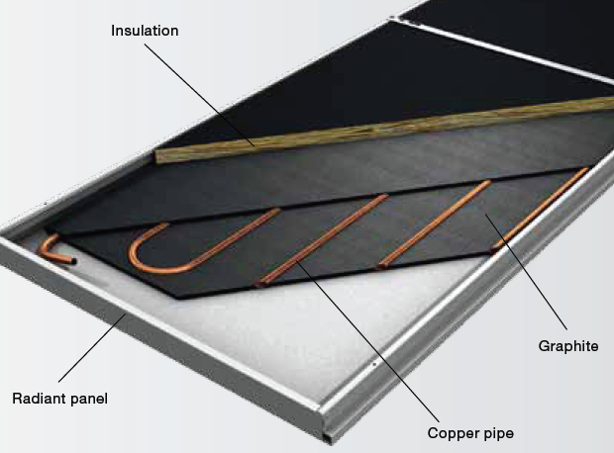
Overhead Radiant Systems
Multi-pass single circuit coil
Panels piped in series (up to 64 square feet of active panel)
Quick disconnects for hoses allow for ease of installation and replacement
PEX Piping to panels
Notes:
Review system
Maybe point out that the mechanical contractor was unfamiliar with radiant panels and when looking at the piping details, they envisioned many labor hours per panel versus the straightforward quick connections.

Slide 36
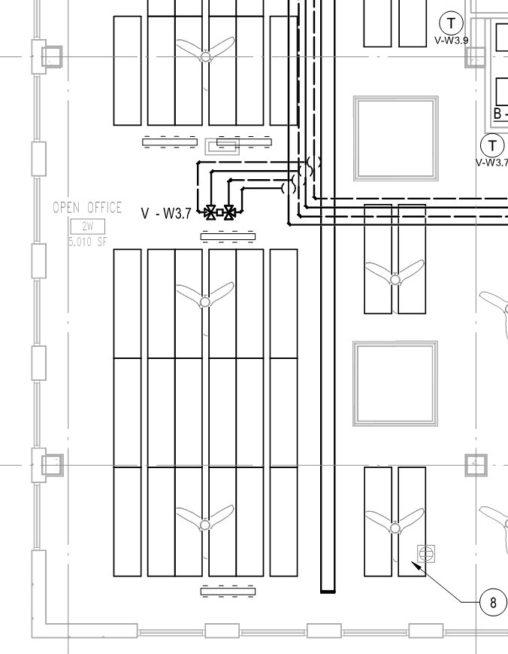
Open Office HVAC

Slide 37
Path to Net Zero
Notes:
Target achieved and getting closer to the stretch goal

Slide 38
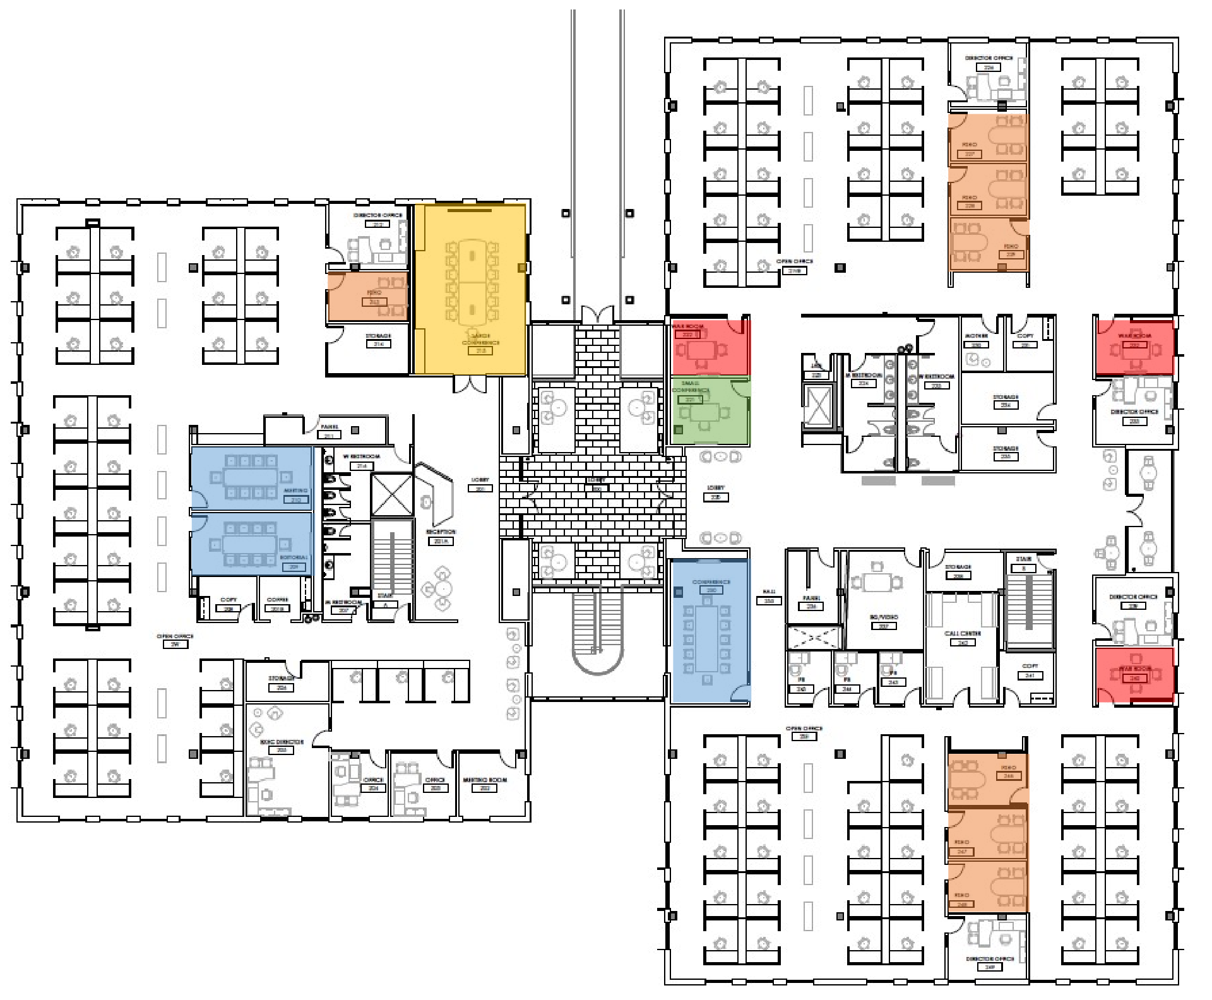
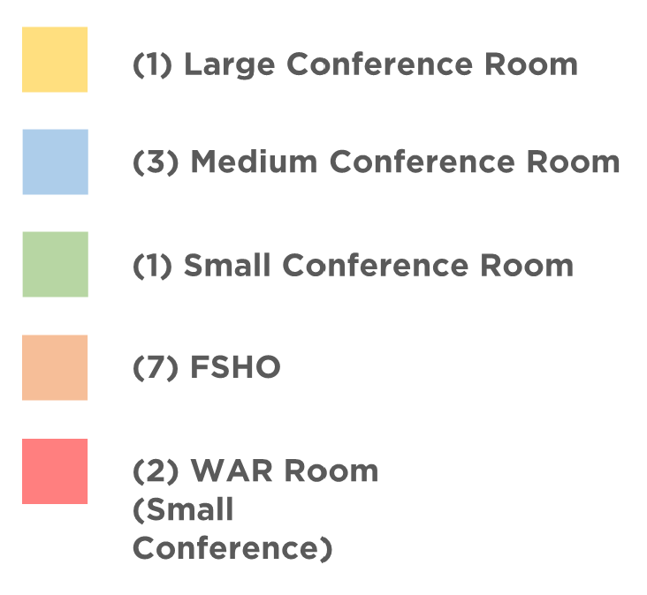
Upper Level
f

Slide 39
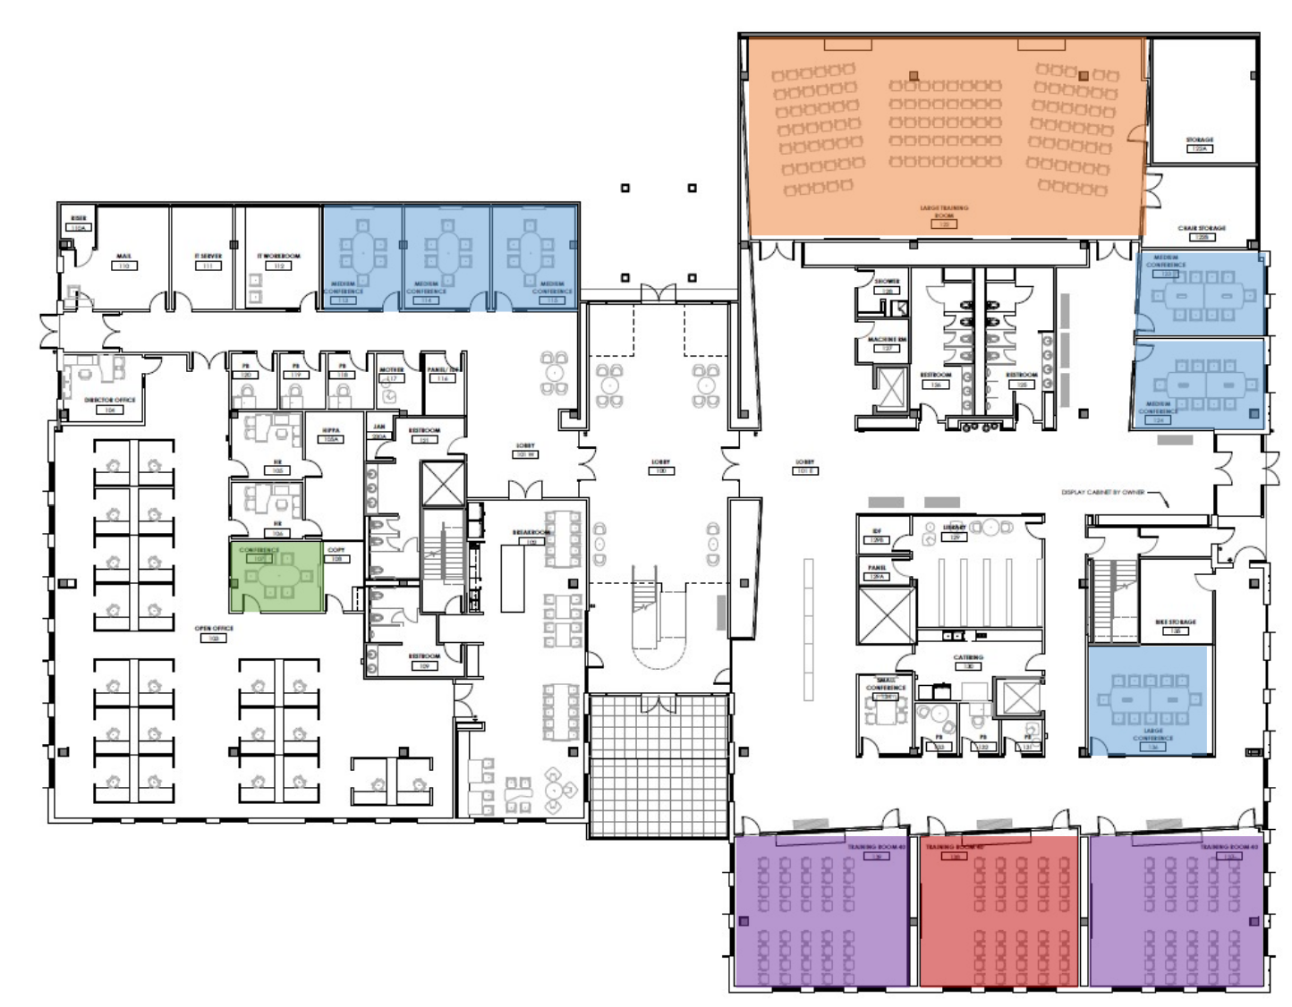
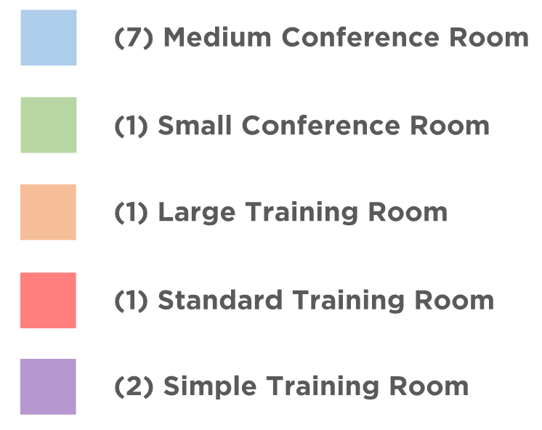
Middle Level
f

Slide 40
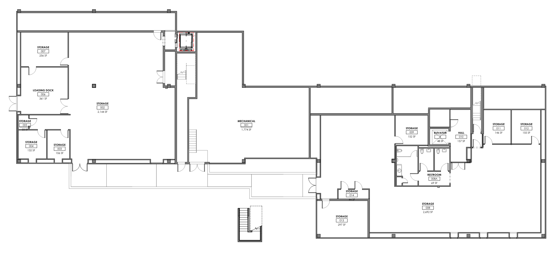
Lower Level

Slide 41


Construction Photos – January 2020

Slide 42

Move In Photos – Oct 2020

Slide 43

Move In Photos – Oct 2020

Slide 44

Move In Photos – Oct 2020

Slide 45

Move In Photos – Oct 2020

Slide 46

Move In Photos – Oct 2020

Slide 47

Move In Photos – Oct 2020

Slide 48

Move In Photos – Oct 2020

Slide 49

Move In Photos – Oct 2020

Slide 50

Move In Photos – Oct 2020

Slide 51

Construction Photos – August 2020

Slide 52


Construction Photos – July 2020

Slide 53


Construction Photos – August 2020

Slide 54

Construction Photos – August 2020

Slide 55

Tree Cover
Pipeline Right of Way
Notes:
Summary of the site plan trees that show the difficulties for additional ground mounted PV.
Possibly note that location of the gas pipeline and the inability to build PV in that location.
This stresses the need to keep the EUIs low and the closer to the stretch goals, the greater the chances of being net zero.

Slide 56

Construction – Adding Solar PV
Capacity:
250kW AC
Capped by Georgia Power Net Metering
Costs:
PV $500,000
Site $50,000
Total $550,000

Slide 57

PV Installation

Slide 58
Project Budget
 | Pre-Design November 2018 | Mid-Design July 2019 | GMP November 2019
Pre-Development Costs | $4,750,000 | $4,750,000 | $4,733,950
Consulting Services | $1,375,000 | $1,375,000 | $1,551,780
Construction* | $7,800,000 | $10,155,000 | $12,349,837
FF&E | $675,000 | $675,000 | $904,682
Admin & Misc | $50,000 | $50,000 | $30,000
Contingency | $1,100,000 | $1,100,000 | $429,751
Total | $15,750,000 | $18,105,000 | $20,000,000
* Less donated equipment
Note: Solar PV not included in project scope

Slide 59

This is YOUR Building….. Visit When in Atlanta!
Notes:
Remind ASHRAE members this is their building. They can stop by whenever they are in Atlanta, even if they need a space to work for a few hours.

Slide 60








Thank you to ASHRAE’s Team
Project Manager
Architect
Construction Manager
Commissioning Agent
Design Architect
Mechanical Contractor
Mechanical, Electrical, Plumbing & Fire Protection
Electrical Contractor

Slide 61
Thank You

