Slide 1
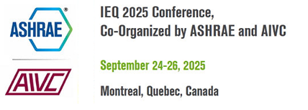
Title
Author(s)
Poster Requirements
IEQ 2025 Conference poster dimensions:
Maximum height is 48 inches
Maximum width is 36 inches
You are responsible for printing your poster and bringing it to the conference. You must also put it up and take it down. The poster is mounted to a cork presentation board. Tacks will be provided.
The top of the poster should include:
paper title; full name(s) of author(s) and company affiliation(s); logo(s) and any acknowledgments.
In addition, the poster should include these elements:
Objectives
Key parts of procedures and methods
Results
Conclusions

