Slide 1




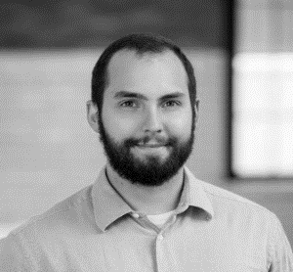
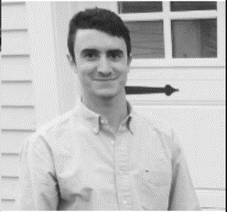




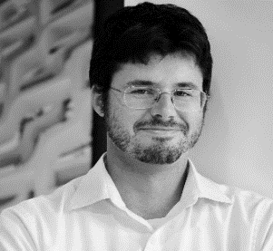
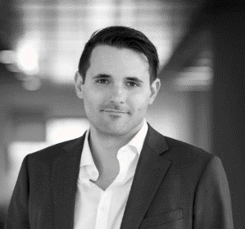
2018 ASHRAE LowDown Showdown
Modeling Competition
2018 Building Performance
Analysis Conference and SimBuild
Team MuZero: “Muse” for net “Zero” Deign
Amir Rezaei
Andy VanMater
Brian Bassett
Colin Hale
Conor Rielly
James Marsh
Leo Yang
Nhan Bui
Michael Mowrer
Patrick Dempsey
Will Ransom

Slide 2
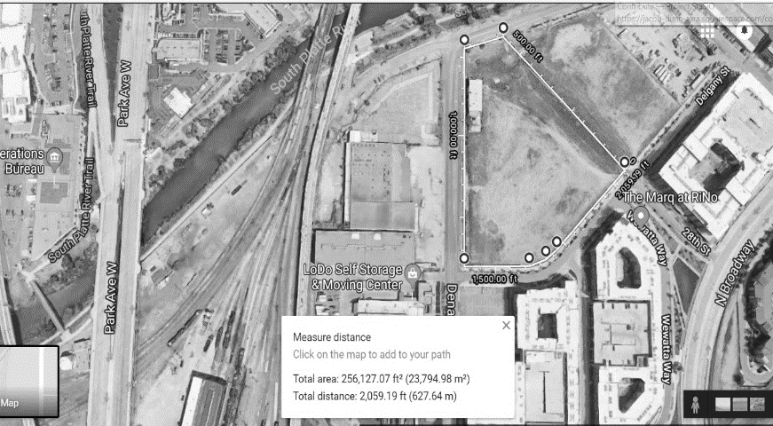
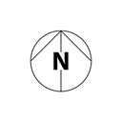
RiNo Art District
Low
Average
High
334 Hours DB > 80
778 Hours DB > 80
1,055 Hours DB > 80
4,104 Hours DB < 50
4,211 Hours DB < 50
3,791 Hours DB < 50
2018 ASHRAE LowDown Showdown Modeling Competition
Notes:
Talk about site and climate data
I used work near there!
Big idea: burry it!

Slide 3
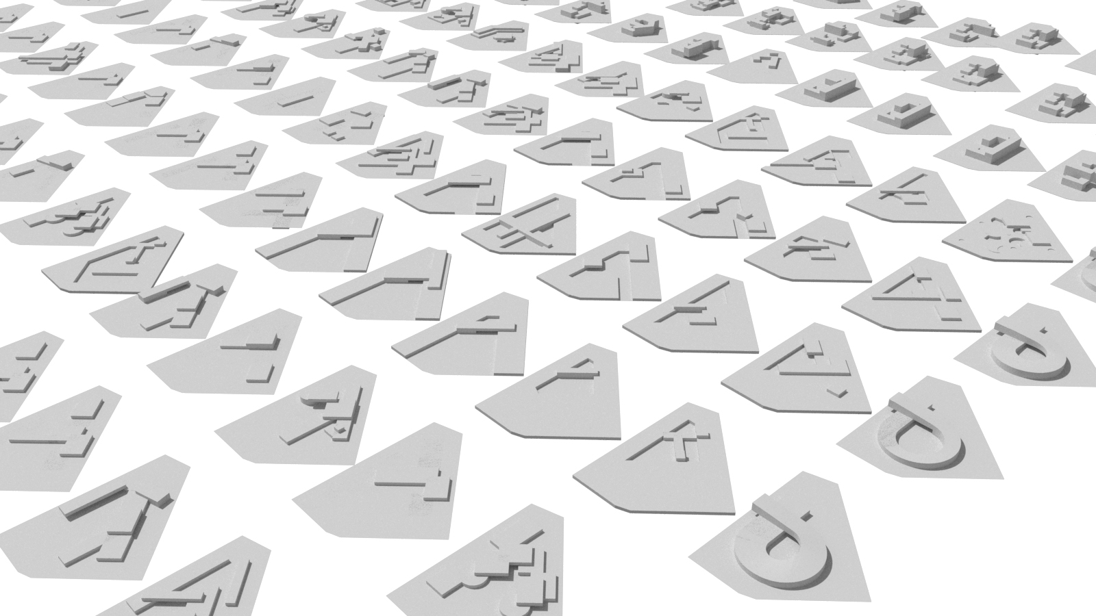
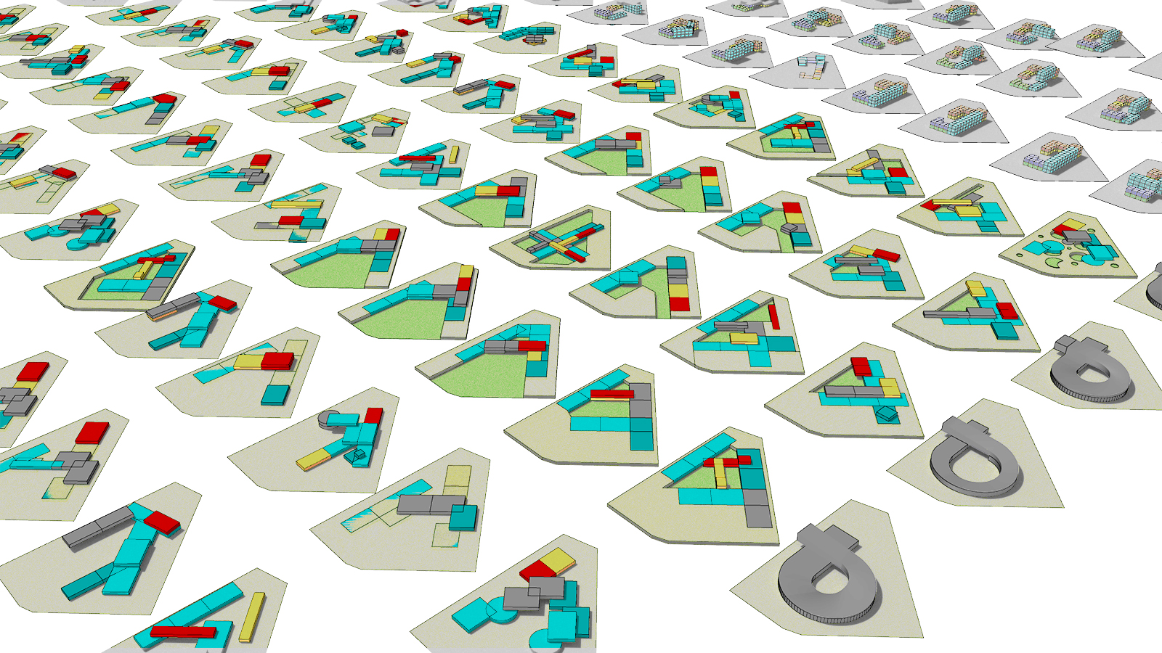
2018 ASHRAE LowDown Showdown Modeling Competition
Notes:
Form finding journey to gradient from buried to above ground!
Gradient of needs!
Program Needs:
Circulation
Temperature
Humidity
Daylight
Comfort

Slide 4
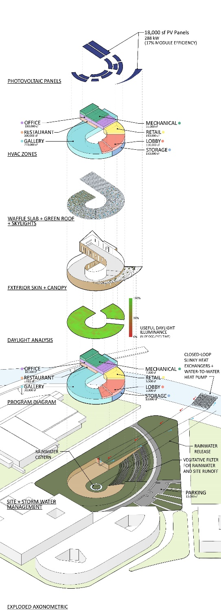






2018 ASHRAE LowDown Showdown Modeling Competition

Slide 5
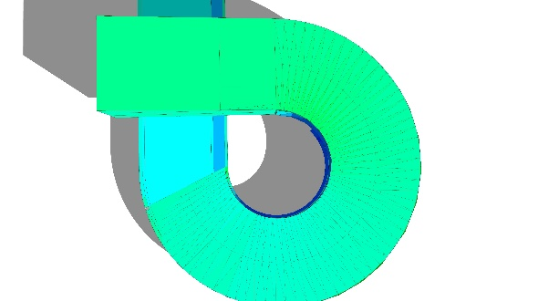
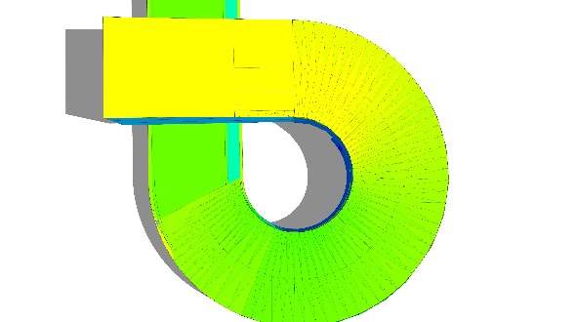
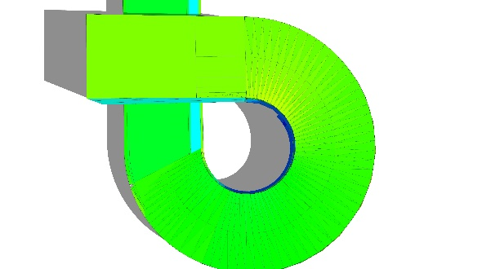
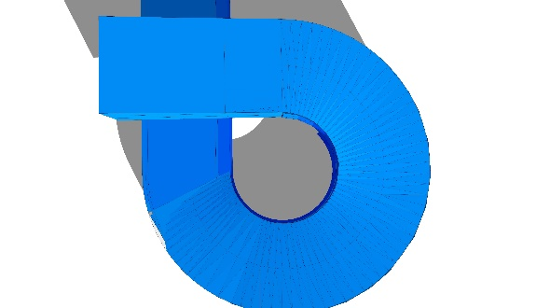
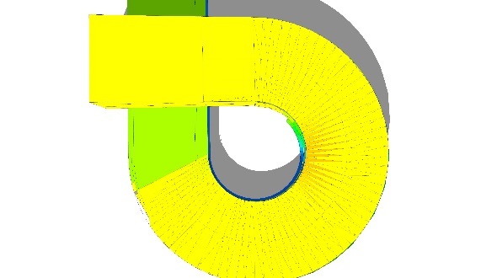
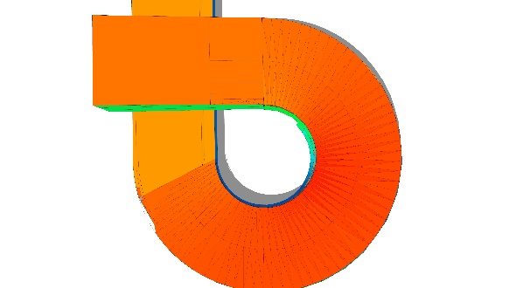
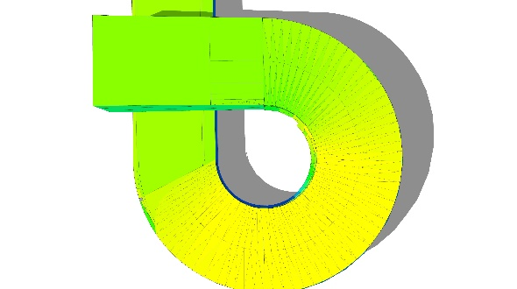
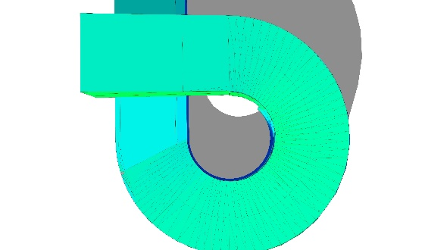
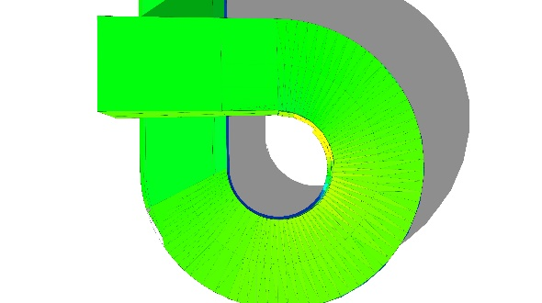
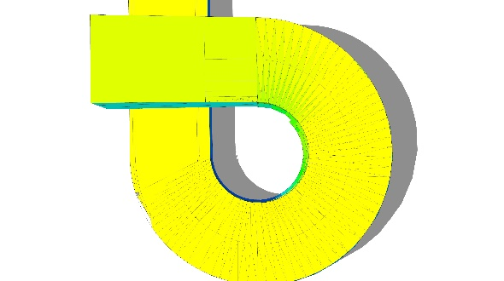
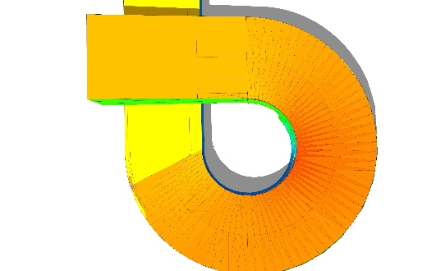
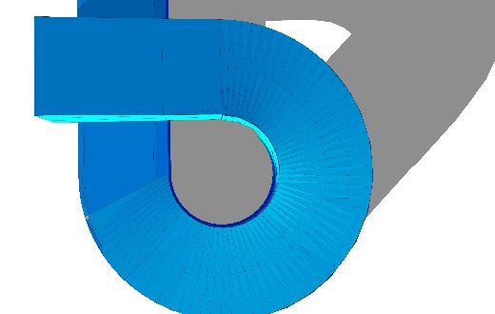


3/20
6/20
8/15
12/20
9 am
1 pm
3 pm
2018 ASHRAE LowDown Showdown Modeling Competition

Slide 6
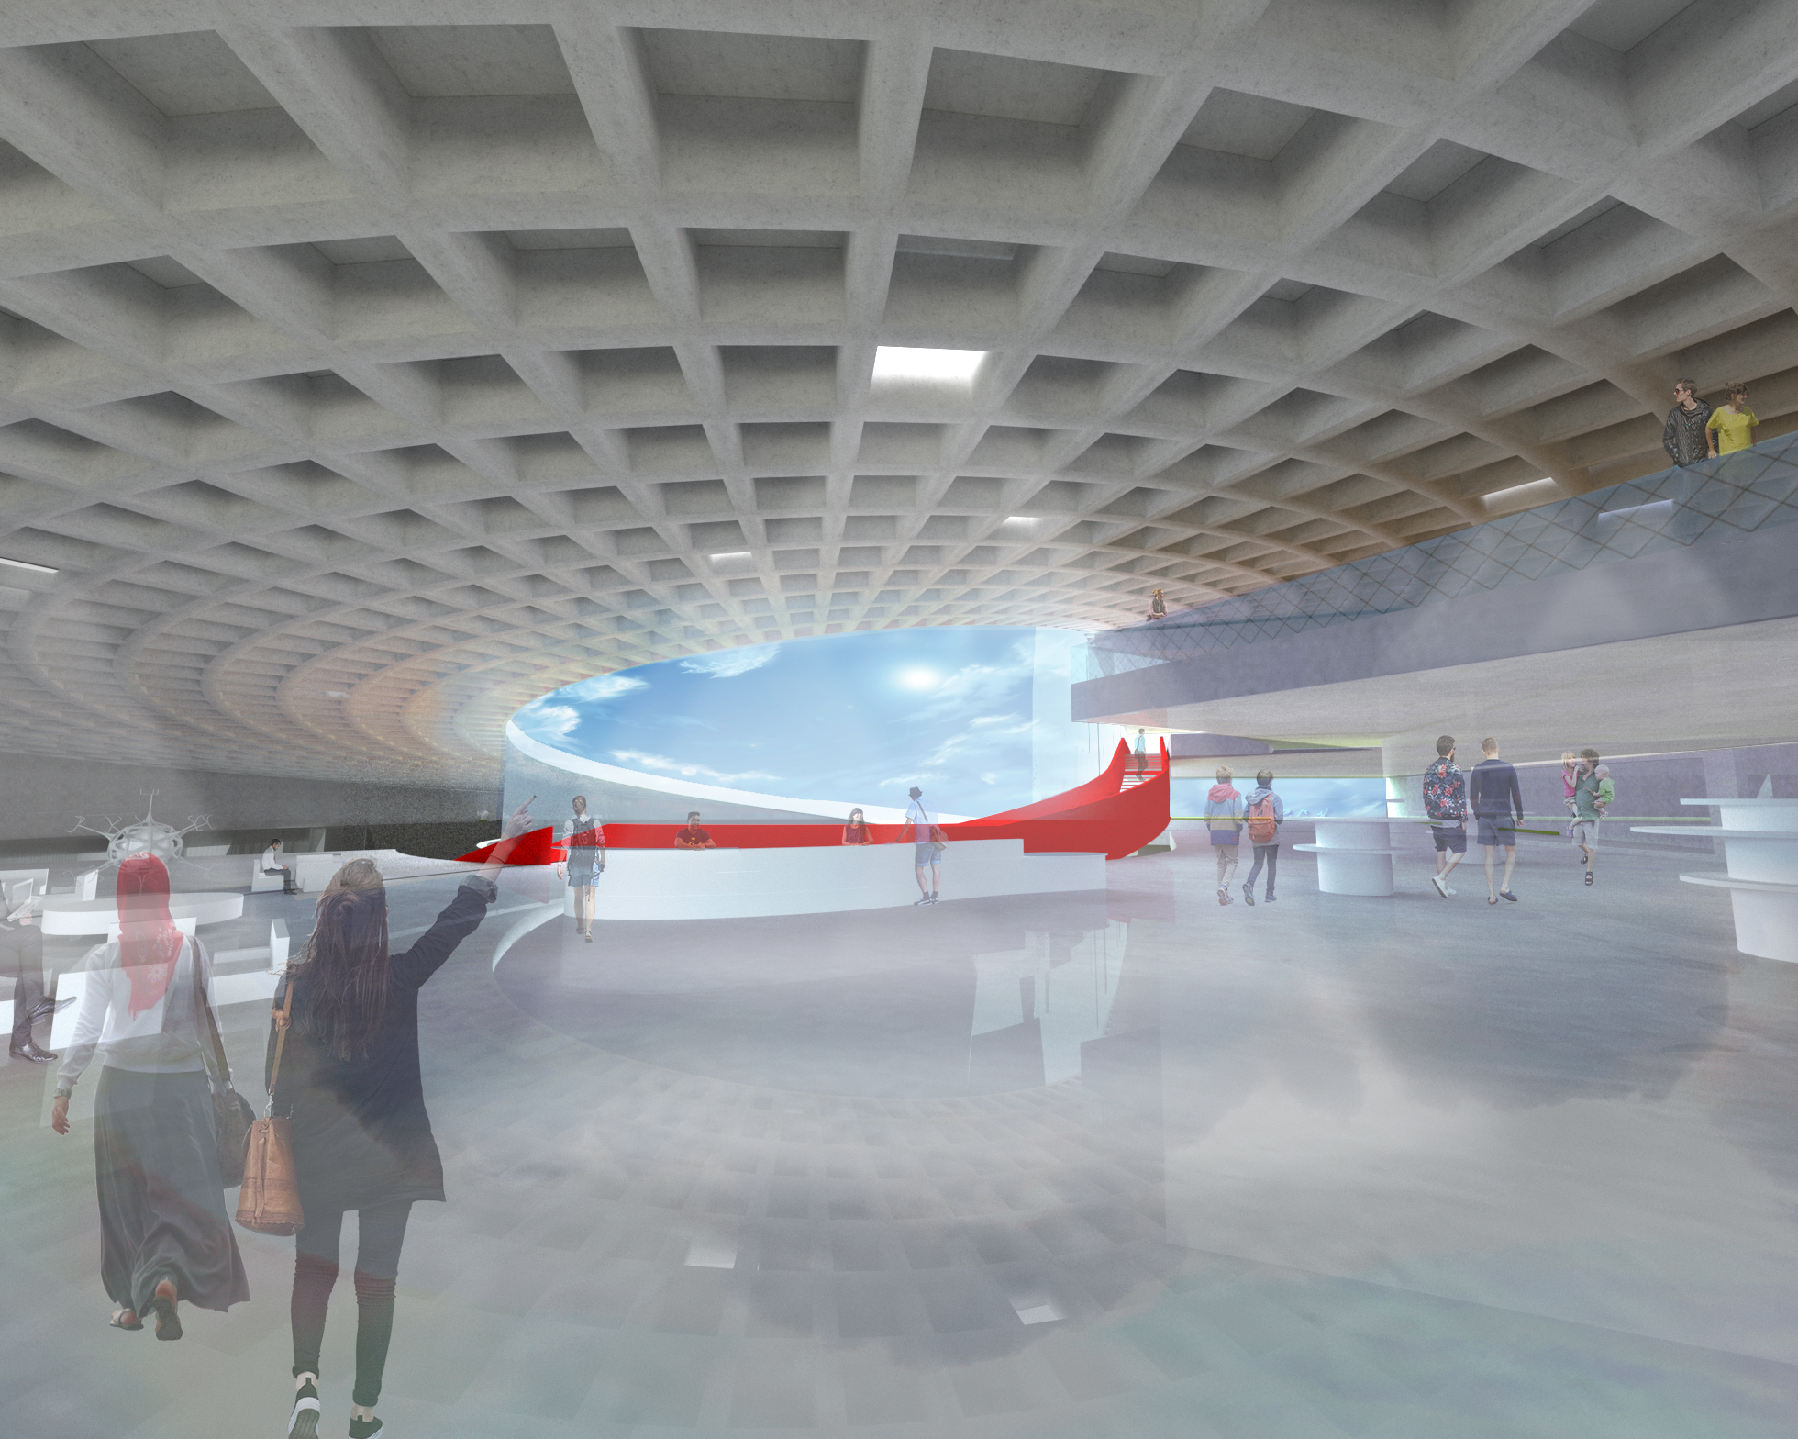
2018 ASHRAE LowDown Showdown Modeling Competition

Slide 7
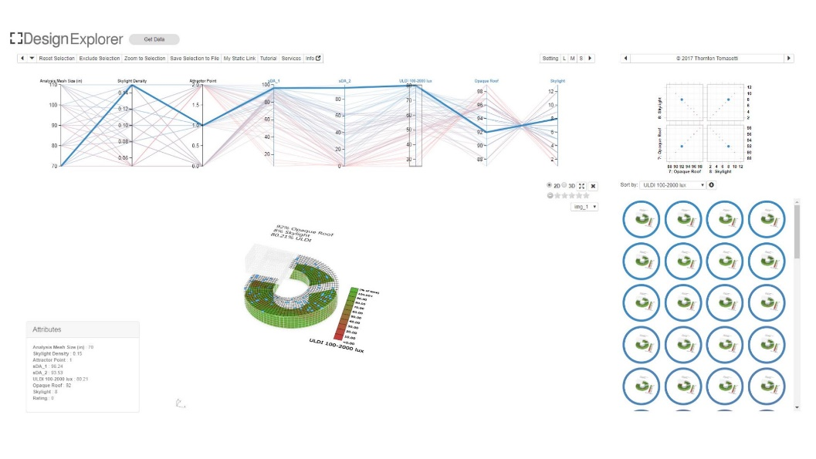
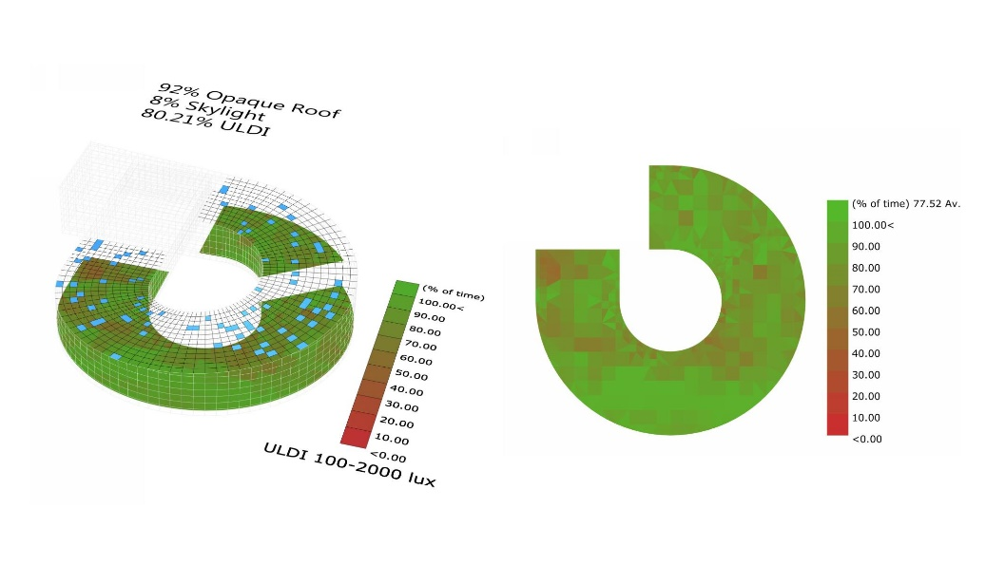
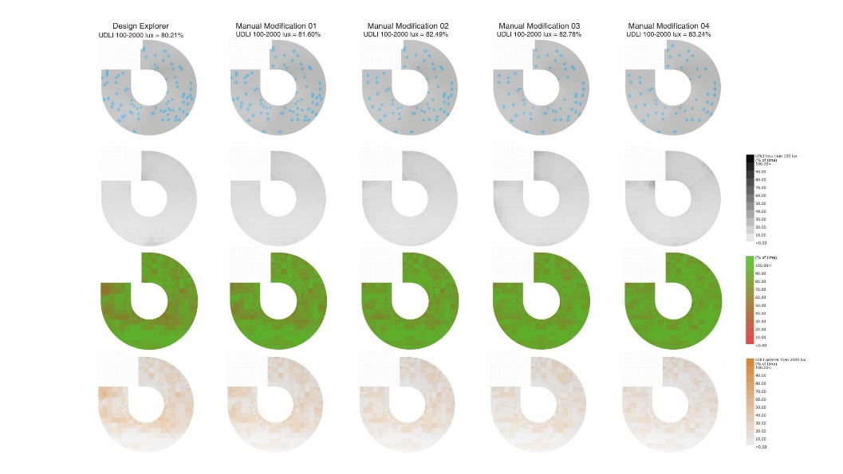
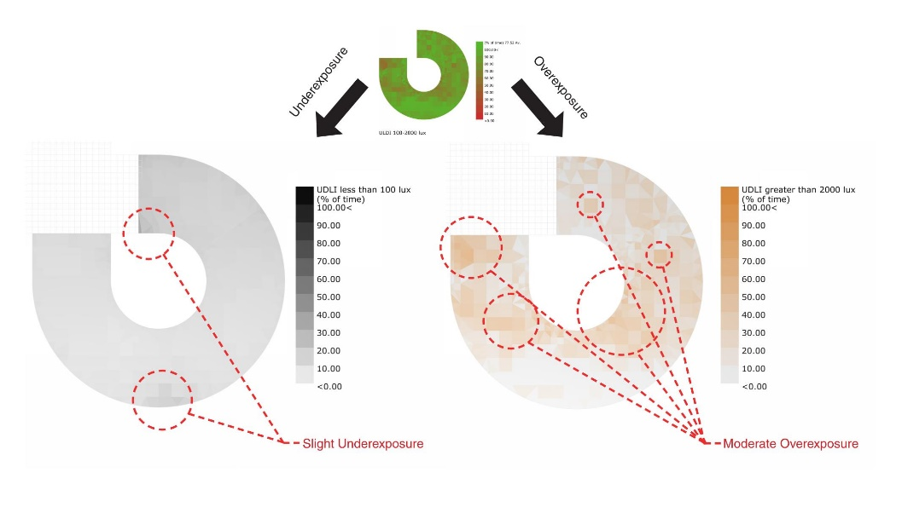

2018 ASHRAE LowDown Showdown Modeling Competition

Slide 8
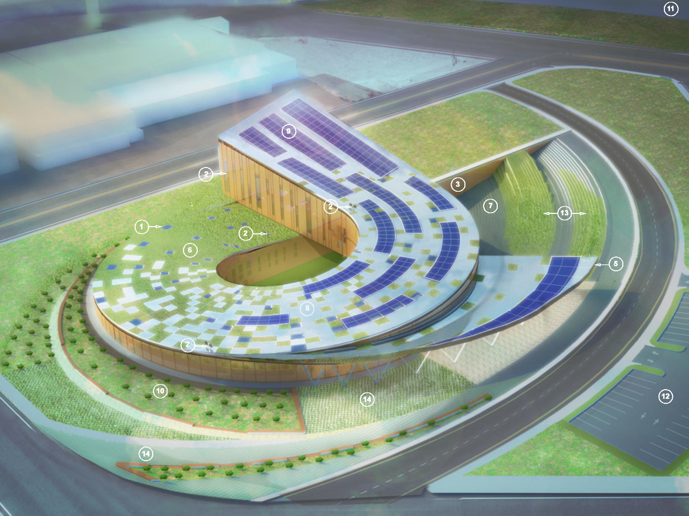
?
1. Translucent Skylights
2. Fiber-optic daylight
3. Underground exhibit walls + high mass
4. Strategic glazing placement & thermal property optimization
5. Southeast entrance shading canopy
6. Green roof
8. Refective roof panels
9. PV panels
13. Stormwater sewage connection from bioswales
14. Permeable landscaping
2018 ASHRAE LowDown Showdown Modeling Competition

Slide 9
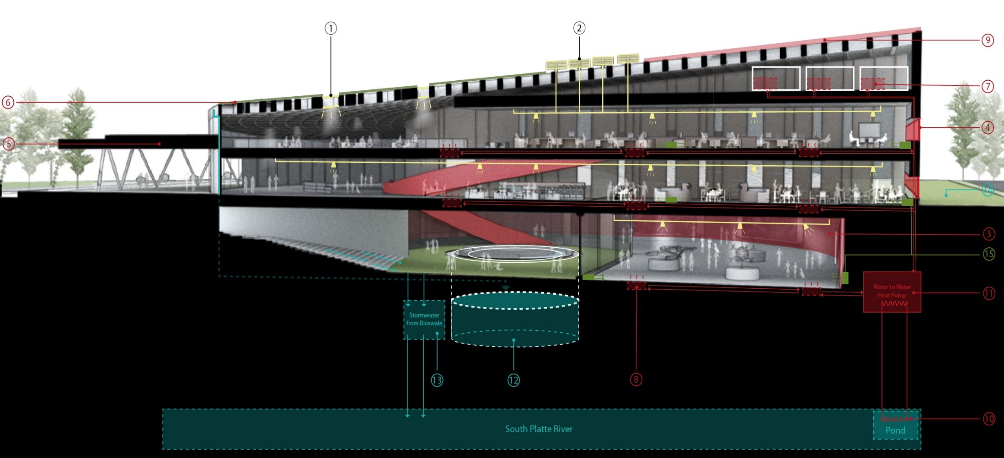
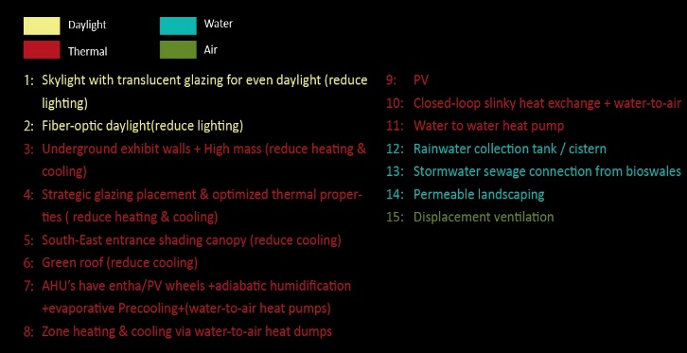
1. Translucent Skylights
2. Fiber-optic daylight
3. Underground exhibit walls + high mass
4. Strategic glazing placement & thermal property optimization
5. Southeast entrance shading canopy
7. AHUs: Enthalpy wheel + Adiabatic humidification + w2ahp
8. Zone water-to-air heat pump (w2ahp)
10. Closed-loop slinky heat exchanger
12. Rainwater collection tank
15. Displacement ventilation
2018 ASHRAE LowDown Showdown Modeling Competition

Slide 10
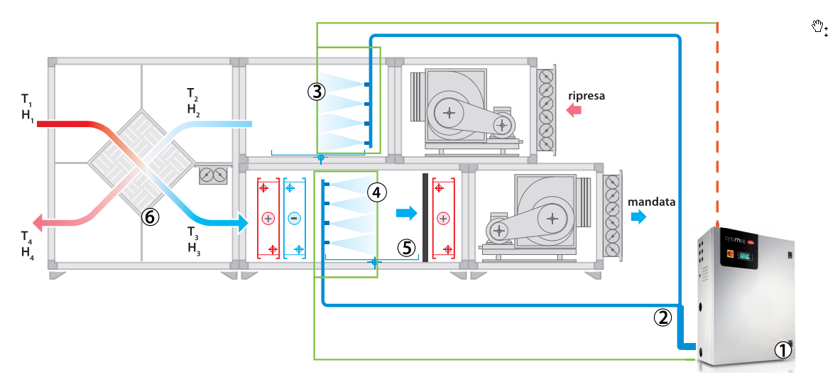
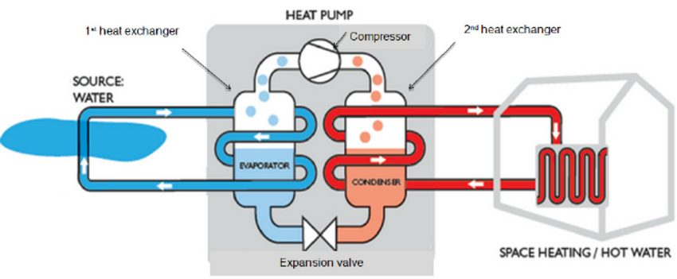
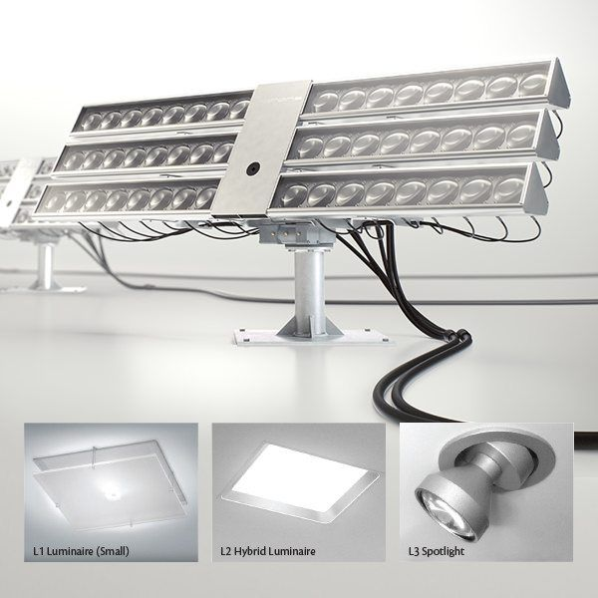
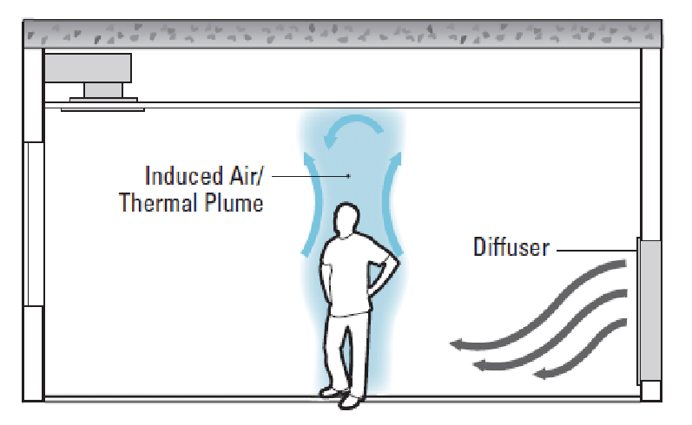
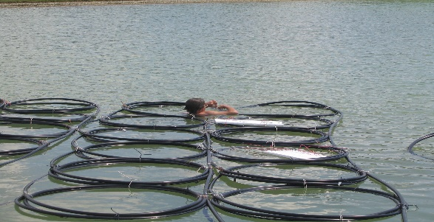
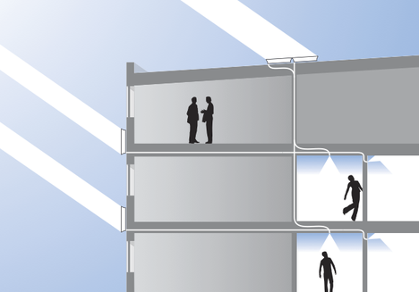
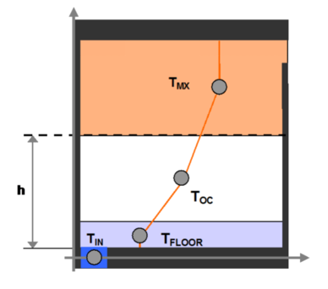
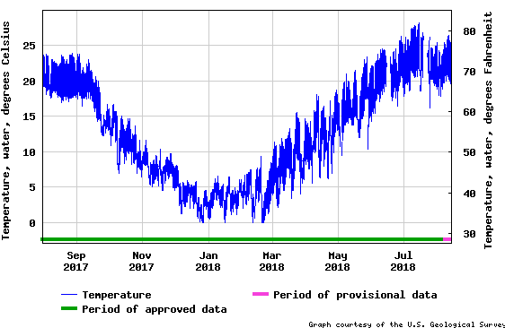
Air
Daylight
Water
Adiabatic Humidification/Pre-cool
Water-to-Air Heat Pump
Fiber Optic Daylight Collectors
Image credit
Displacement Ventilation
Slinky Loop Heat Exchangers
Daylight Distribution
Image credit
Displacement Ventilation
River Water Temperatures
2018 ASHRAE LowDown Showdown Modeling Competition
Notes:
Adiabatic humidification/pre-cooling:
1.8 kW/GPM water atomizer v.s. 165 kW/GPM Steam Production
Fiberoptic curtesy links for images:
https://www.parans.com/
http://lidamama.info

Slide 11
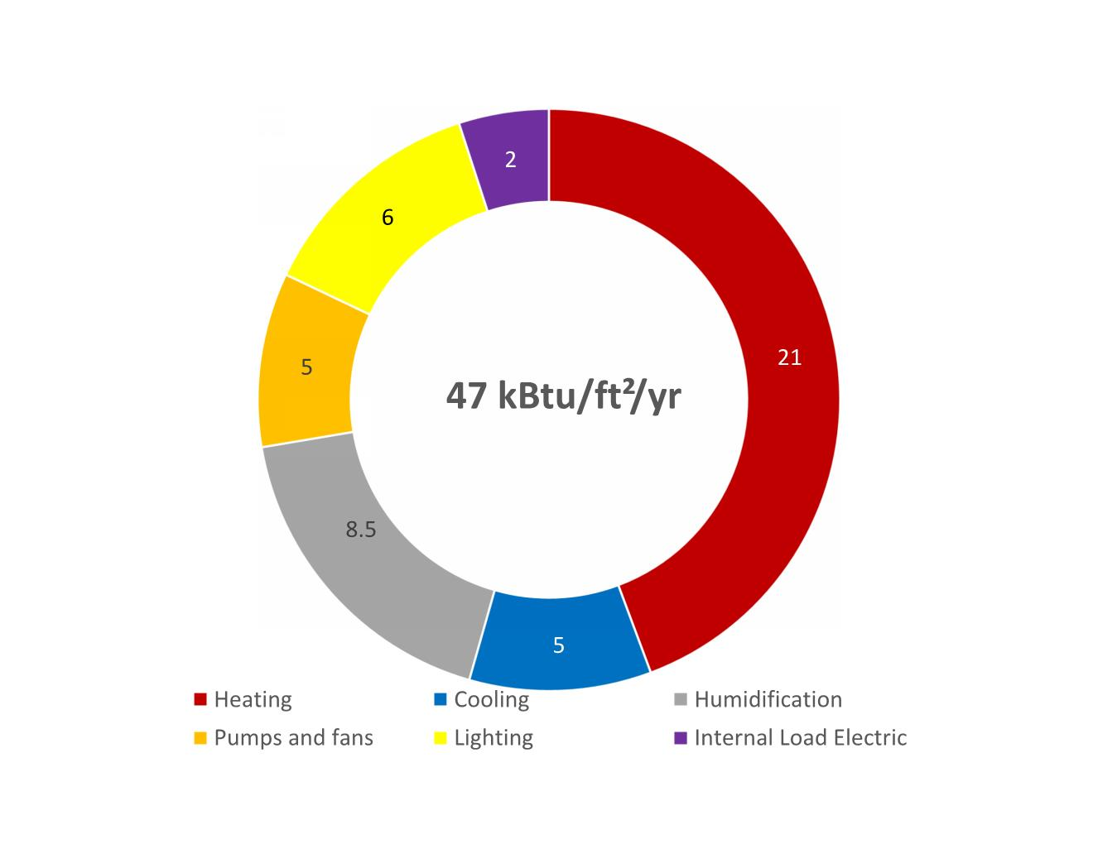
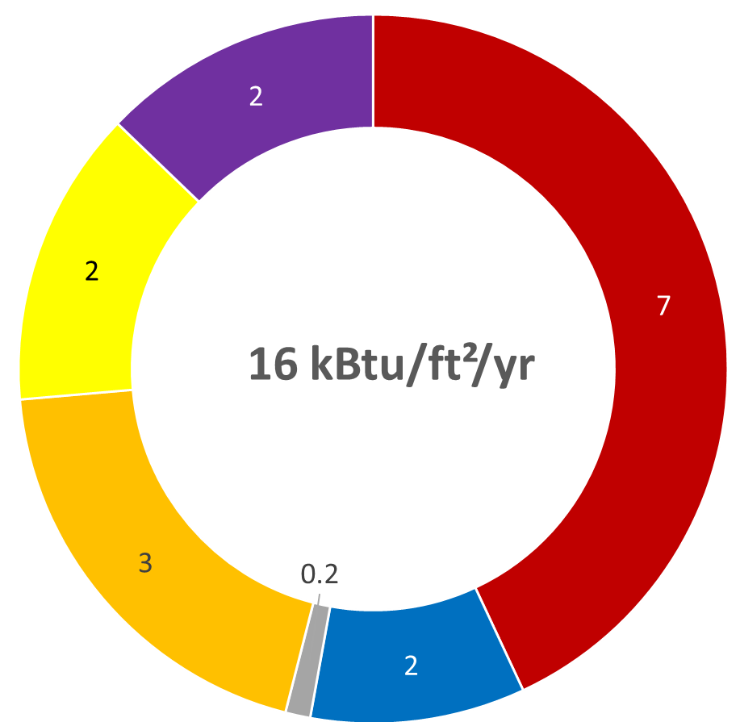

Baseline
Design
High Weather
Design
Avg/Low Weather
Description of Each Measure | Change in Annual Energy Use | Annual Energy Cost Savings | Estimated Incremental Cost |  | Change in EUI | Simple Payback
 | kBtu | $ | $ | $/ft² | kBtu/ft² | Years
Addition of skylights + fiberoptic | 284,491 | $6,752 | $57,000 | 0.8 | 4.0 | 8
Addition of enthalpy wheel | 702,082 | $9,056 | $7,500 | 0.1 | 9.9 | 1
DOAS (HPs) + pond slinky loop | 2,043,822 | $25,836 | $142,084 | 2.0 | 28.8 | 5
Adiabatic humidification/pre-cooling | 194,123 | $2,007 | $15,000 | 0.2 | 2.7 | 7
2018 ASHRAE LowDown Showdown Modeling Competition
Notes:
The metrics for the table above come directly from your input spreadsheet, both units will be available in the spreadsheet, please fill out the table as it is on the slide here.

Slide 12
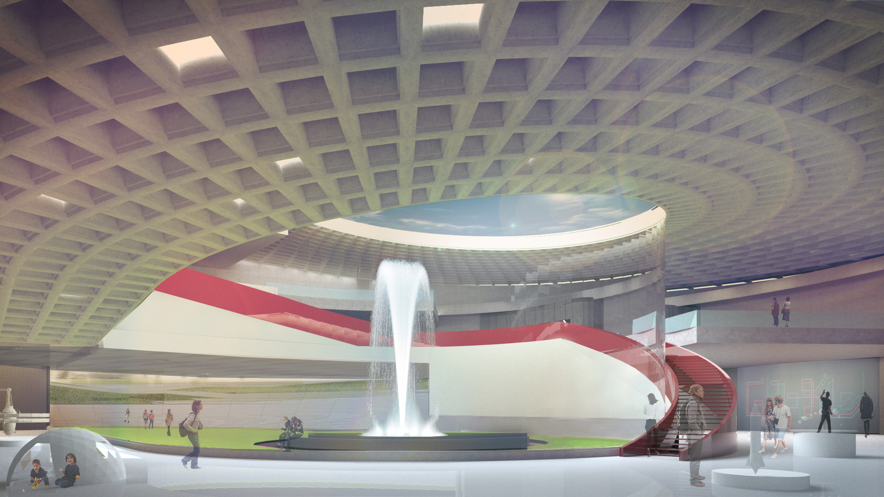
Key Strategies:
Daylighting
Buried load-intensive spaces!
Separation of OA from total
Water source heat pump
River water source/sink
No Steam!
PV
2018 ASHRAE LowDown Showdown Modeling Competition

