Slide 1
2020 Building Performance Analysis Conference and SimBuild
co-organized by ASHRAE and IBPSA-USA
Overall Session Type, # and Title (i.e. Seminar 32 – Energy Efficient Design for Large Buildings) Use Font size 40
John Doe, Credentials
Company Name
jdoe@email.com
Office Number (if you want)
Cell Number (if you want)
Presenter Company Logo
Presentation Title
(i.e. Opportunities for Savings in Large Hospitals) use Font Size 32
Notes:
1

Slide 2
Learning Objectives
These are the Overall Session Objectives that were submitted for CEU approval for the session.
This text must be included on all presentations
Objective 1
Objective 2
Objective 3
Objective 4
Notes:
2

Slide 3
Acknowledgements
Content: If you want to thank others for their help, only their names and affiliations can be listed (John Doe – TCY HVAC)
No images or logos allowed
No emails or phone numbers allowed
List Potential Bias
Notes:
3

Slide 4
Outline/Agenda
In accordance with the Conferences & Expositions Committee (CEC) Commercialism Policy, you may not:
Reference or display trade names, logos, or products of HVAC&R related organizations
Infer that ASHRAE approves or endorses any product, software, or system for any reason.
Presentations must be submitted in advance
Presentations will be reviewed for commercialism. Once approved, no additional changes can be made.
Any changes requested must be made by the presenter.
Speakers who do not submit a presentation in advance or have a rejected presentation on file will not be allowed to present.
Review your e-mails for specific deadlines and upload instructions
Notes:
4

Slide 5
Outline/Agenda
No Hyperlinks
Research, programs, policy, legislation or name of organizations, software, government agencies and government-sponsored agencies may be referenced only in order to maintain presentation clarity and relevance. Modeling software products can be listed once and afterwards refer to generically (software 1, software 2)
Notes:
5

Slide 6
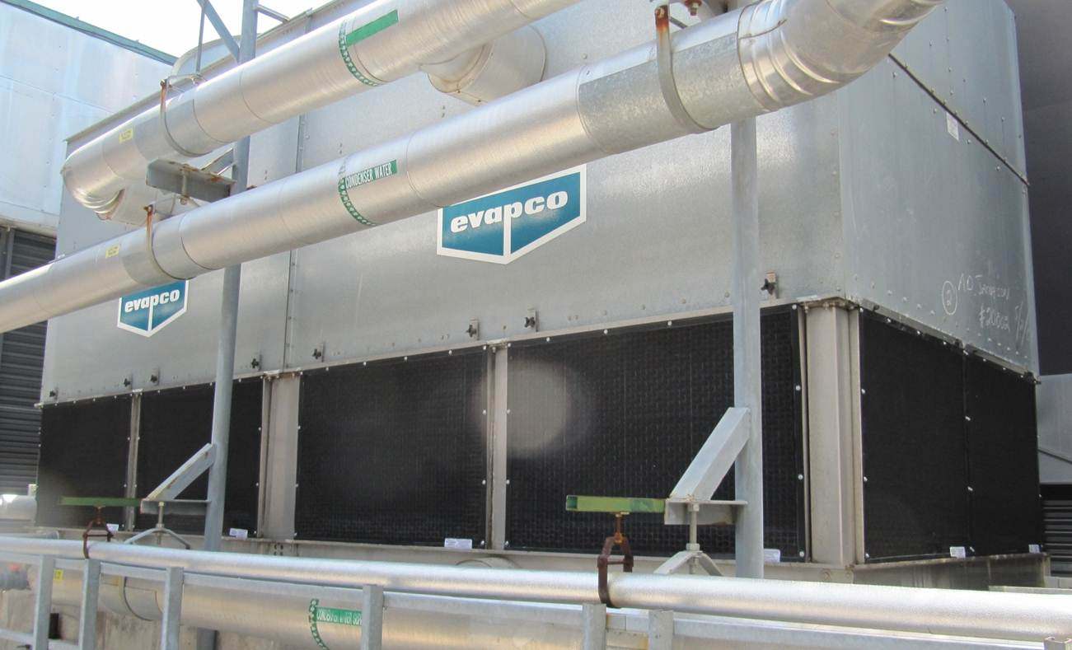
Outline/Agenda
In accordance with CEC policy, any logos of HVAC&R related organizations in images must be covered.
In PowerPoint, click Insert → Shape → Choose Shape.
On the Format tab you can change the color of your shape.
You can also Ctrl+Click on your main image + covered shapes, right click, and select “group” so all pieces move and re-size together.
Covered logos here

Slide 7
Outline/Agenda
Timing
Be mindful of the number of slides in your presentation.
Remember to keep time for Q&A
Slide design
Consider the amount of text on your slides.
Text smaller than size 20 will not be able to be seen by most audience members.
Use visuals instead of text when possible
Notes:
7

Slide 8
Conclusions
Conclusions can be listed here.
Notes:
8

Slide 9
Bibliography
Name, Author’s. 2018. Title of the presentation: (subtitle included if applicable). Presented at the 2018 Building Performance Analysis Conference, Atlanta, Georgia, September 26-28.
Notes:
9

Slide 10
QUESTIONS?
Name
name@emailaddress.com
(You may include names and email addresses of non-presenting authors on the last slide)
Instruction – this slide cannot have logo or images. Only what is shown.
Notes:
10

