Slide 1
Zero Heroes
v
2022 ASHRAE Low Down Showdown
2022 Building Performance
Analysis Conference
2022 ASHRAE LowDown Showdown Modeling Competition

Slide 2
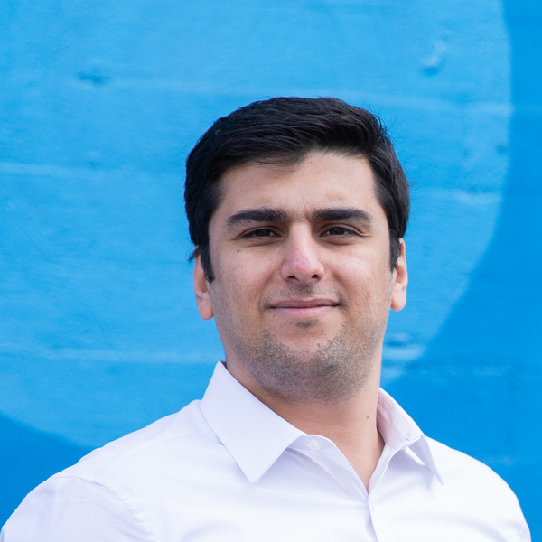
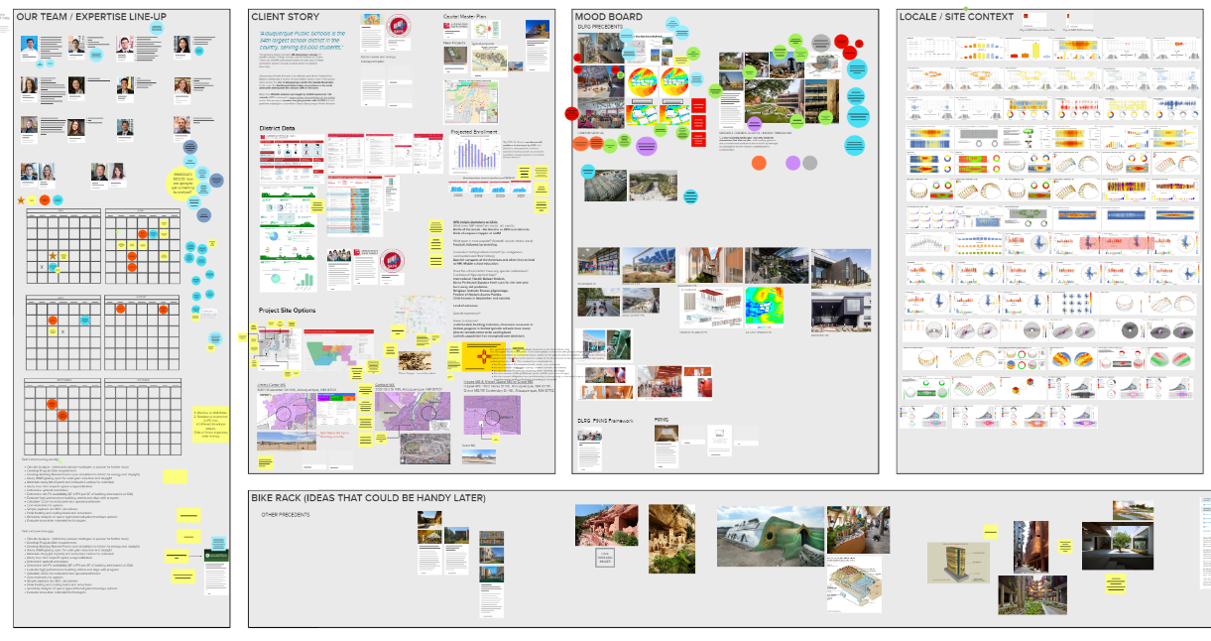
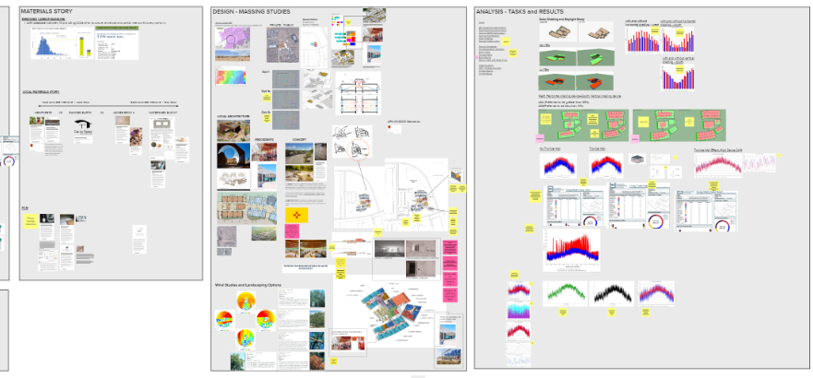
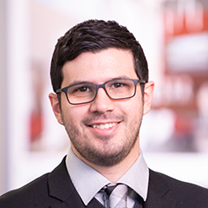
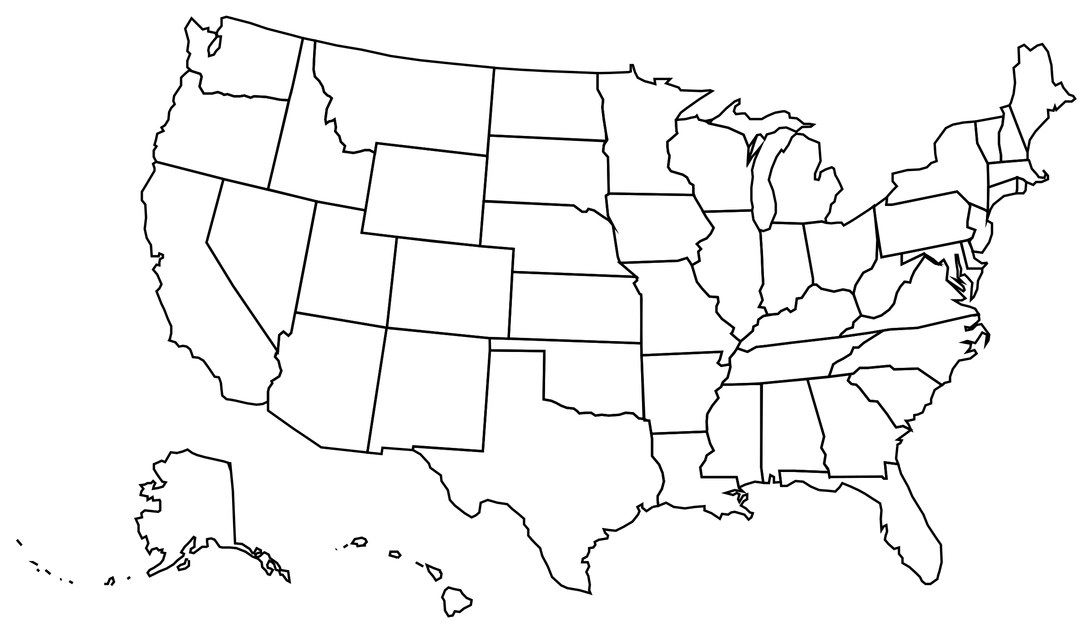
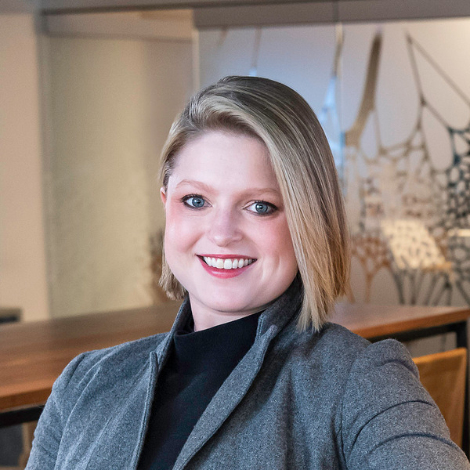
Our Team
Zero Heroes
Nathan Kegel
Shona O'Dea
Anthony Montez
Mahdi Afkhamiaghda
MN
IL
NY
CA
C0
Mural Board
Andrew Eckhoff
Thu Nguyen
Danielle Steele
Rajat Wadhwa
MO
TX
Jill Maltby-Abbott
Chris Flynn*
Xuyang Jin
Matt Conway
* From Albuquerque

Slide 3
Guiding Principles + Beyond Competition Parameters
Zero Heroes
Simplicity / Passive / Low maintenance
Future Climate Ready
Not a “one-off” building; strategies can be understood and applied across the District and State of New Mexico
Community Shelter from natural disasters (wildfires, heat waves)
EPDs strongly preferred
Albuquerque Public Schools Standards
City of Albuquerque Climate Action Plan
New Mexico Energy Transition Act of 2019
Mandates 100% renewable grid by 2045
50% renewable by 2035

Slide 4
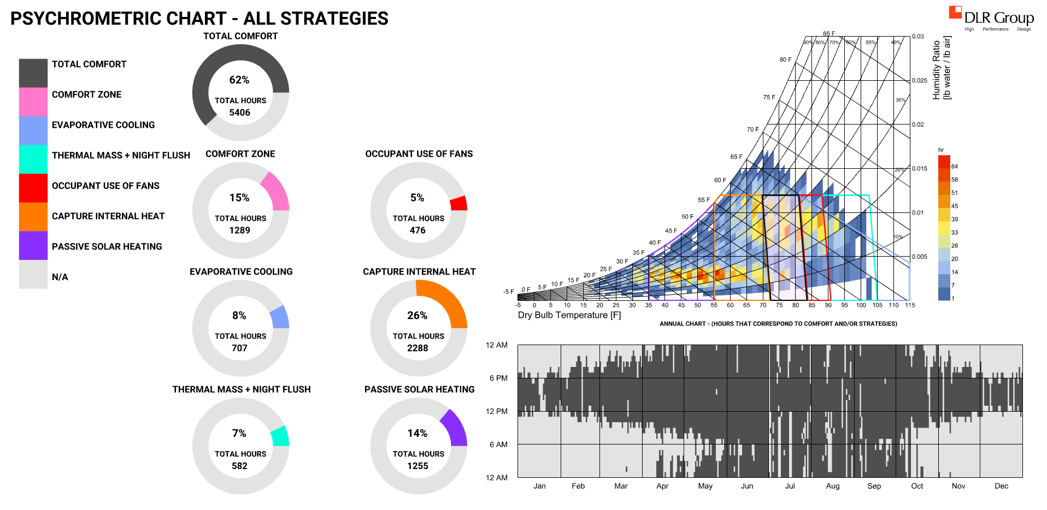
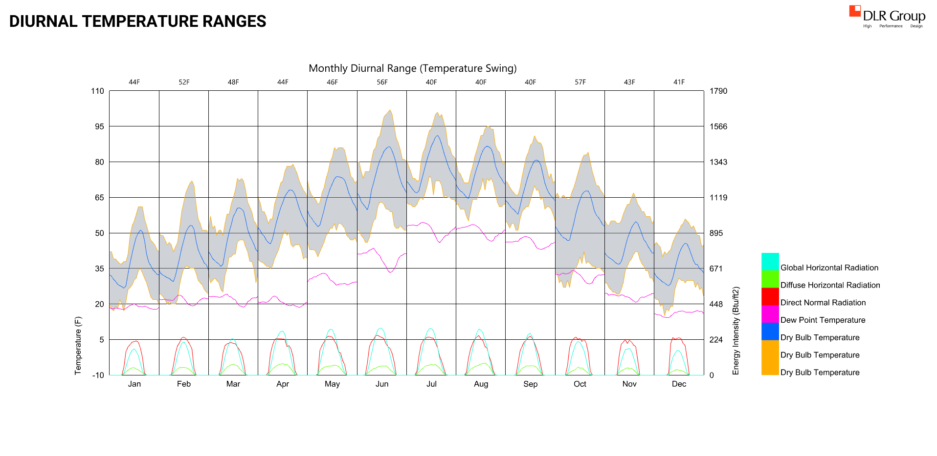
Climate Analysis - Passive Design Thermal Comfort
Zero Heroes
Climate Character:
High diurnal swing (30+ F on most days)
Sunny year-round
Wind (generally more consistent during day)
Dry (~8” annual precip. historically)
High Elevation (negative latent load)
We have: sun, wind, ground with generally high thermal conductivity (limestone base)
We don’t have: water (and even less in the future)
Passive Design Strategies:
Thermal mass + Night Flush
Brise Soleil
Optimized Program (reduce total SF built)
Future Climate: Hotter and Drier – accounted for this in design and modeling assumptions

Slide 5
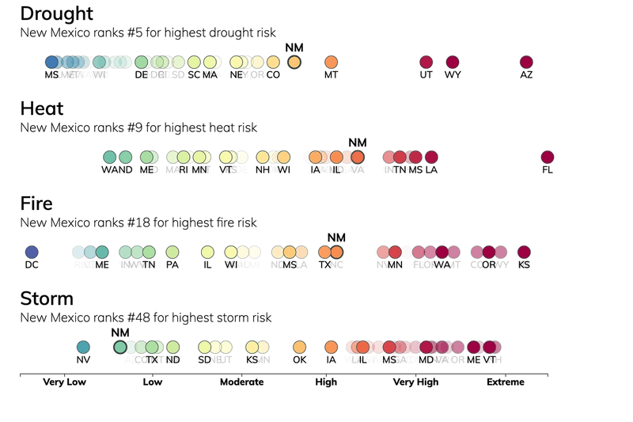
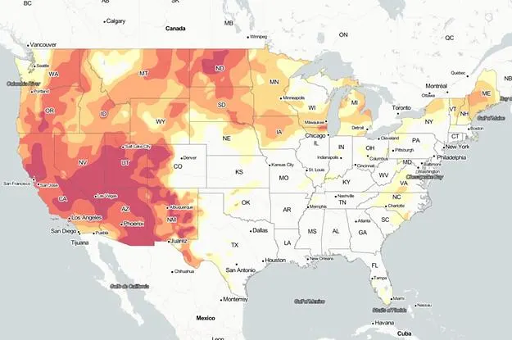
Future Climate Change and Risk
Zero Heroes
https://climatecheck.com/newmexico
2021 Wildfire Impact on Air Quality

Slide 6
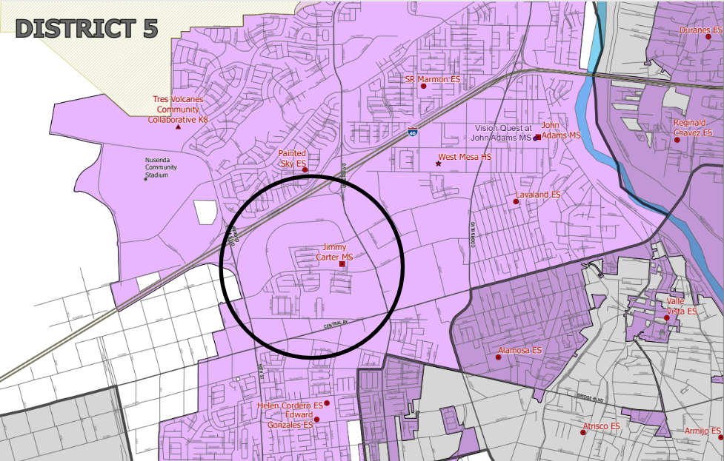
Site Selection
Zero Heroes
DAYTONA RD NW
LOS VOLCANES RD NW
ARROYO RD
Jimmy Carter Middle School

Slide 7
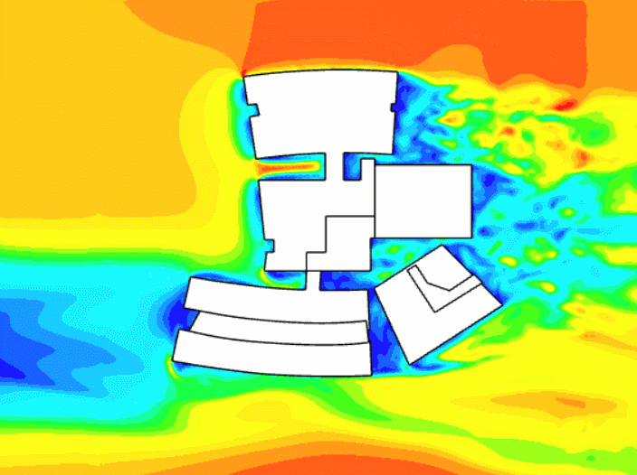
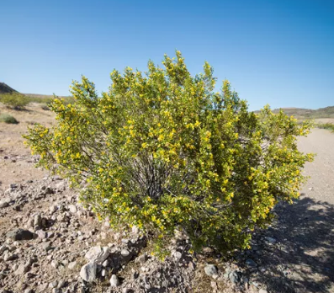
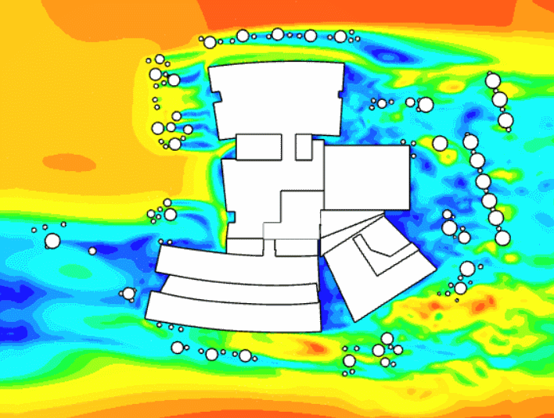
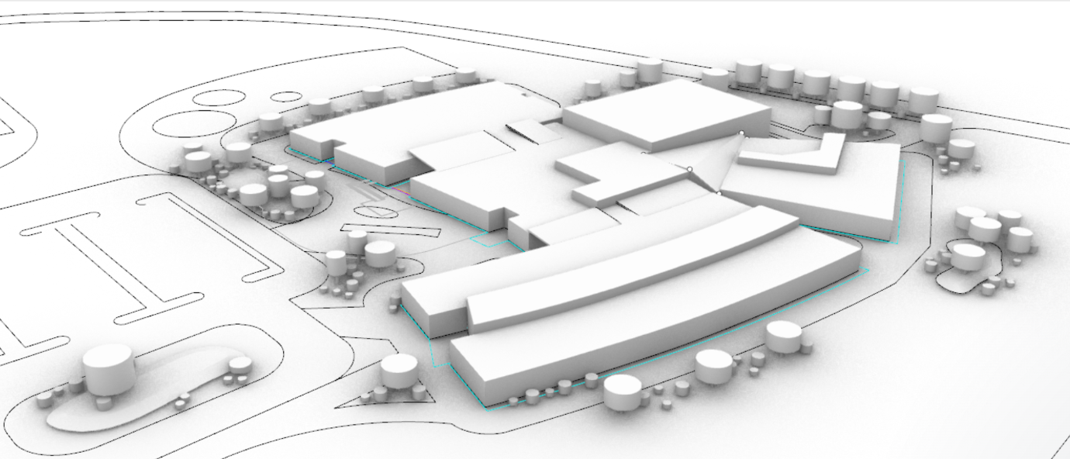
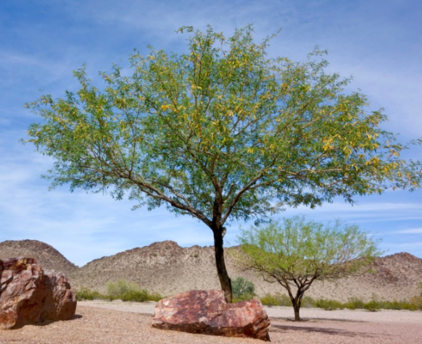
Exterior Wind Comfort
Zero Heroes
Landscaping strategically planned to expand comfortable outdoor learning spaces
Chose native plants that are low to no maintenance
Convective losses reduced, decreasing overall cooling and heating costs
Overlay the landscape ?

Slide 8
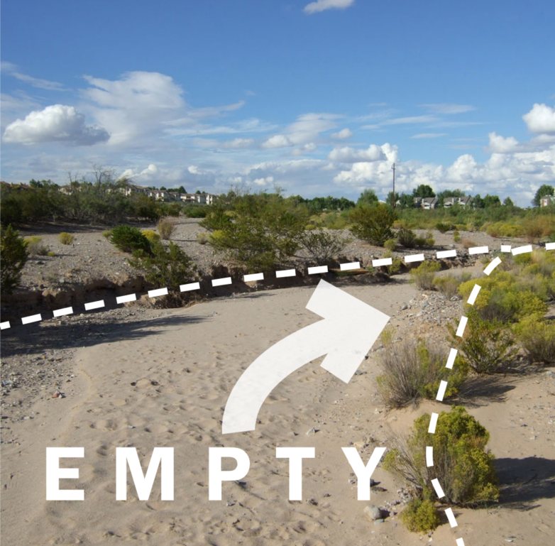
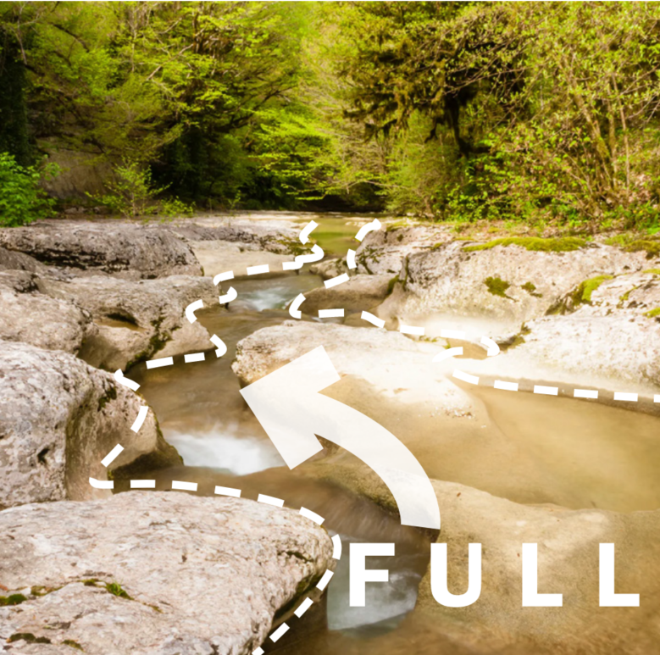
72,700 sf Building
3% Reduction from 75,000 sf
Connects to adjacent existing middle school forming K-8 learning campus
Creativity & Innovation Arroyo
2022 ASHRAE LowDown Showdown Modeling Competition

Slide 9
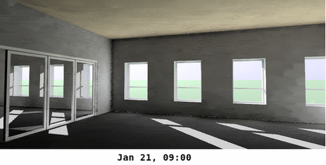
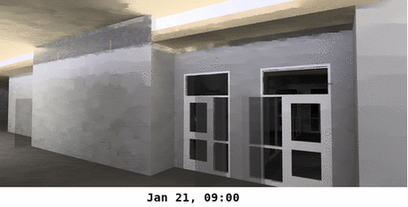
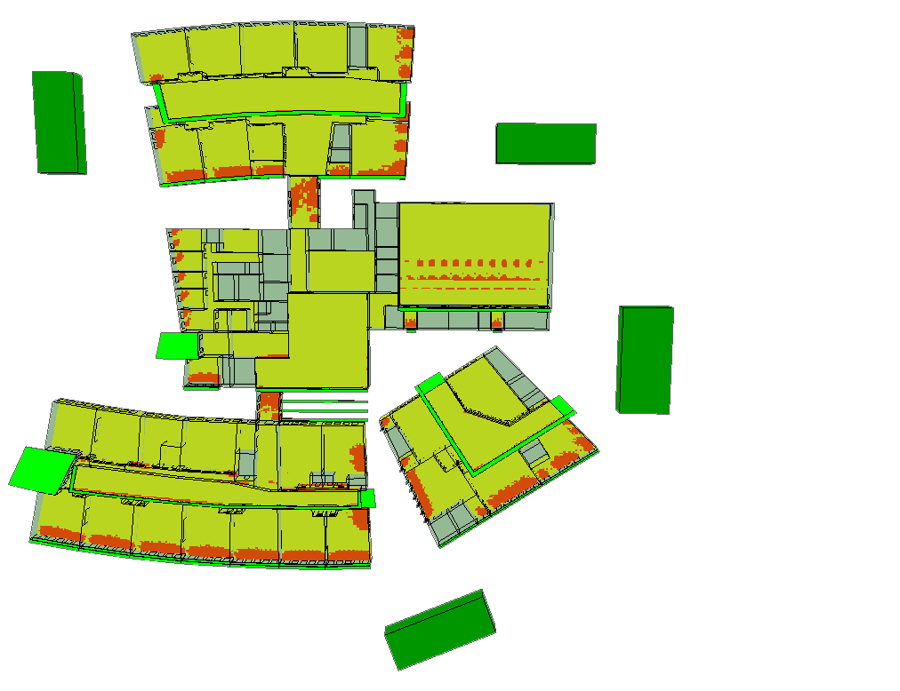
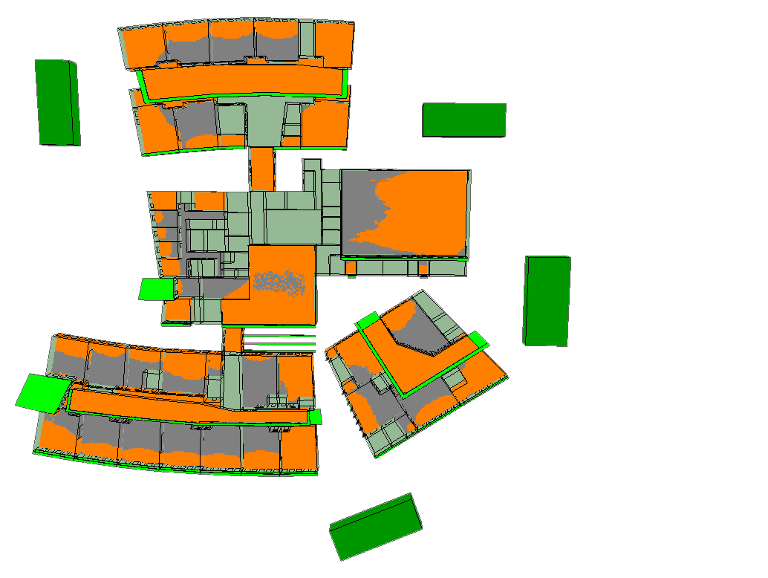
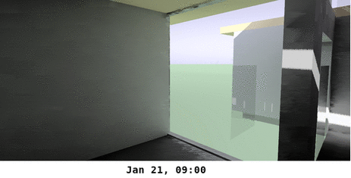
Daylight & Visual Comfort
Period = 8:00 – 16:00
Zero Heroes
Clerestories to provide interior daylight and passive solar heating in winter
Minimize WWR (balance natural light, comfort, peak load, and energy)
Designing for comfort utilizing a combination of active and passive systems (WELL)
ASE (1000, 250) = 9.2 %
sDA (300,50%)= 75%

Slide 10
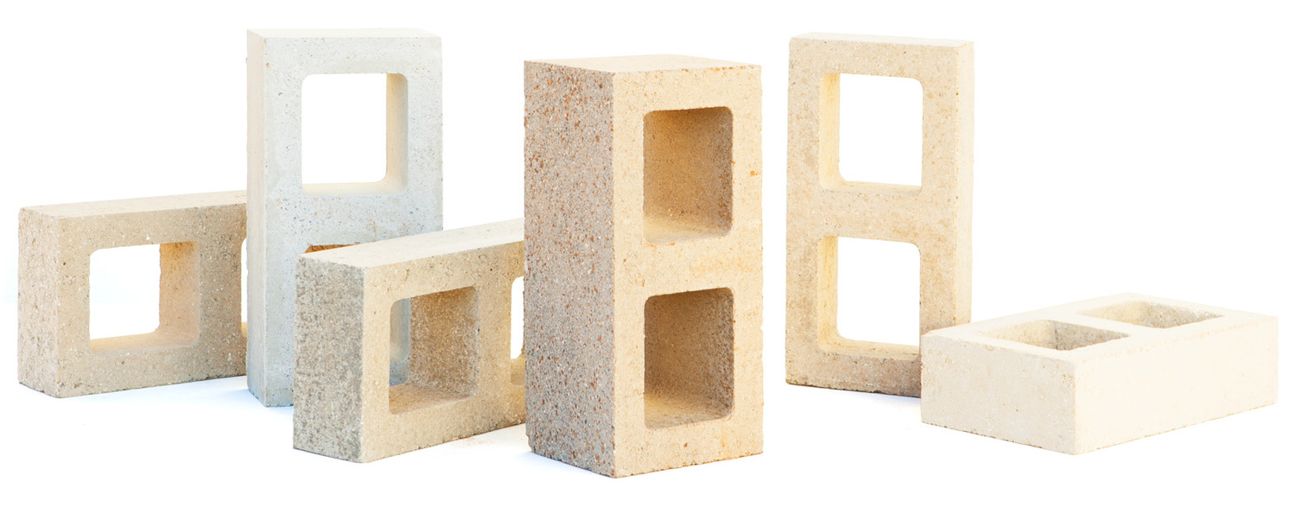
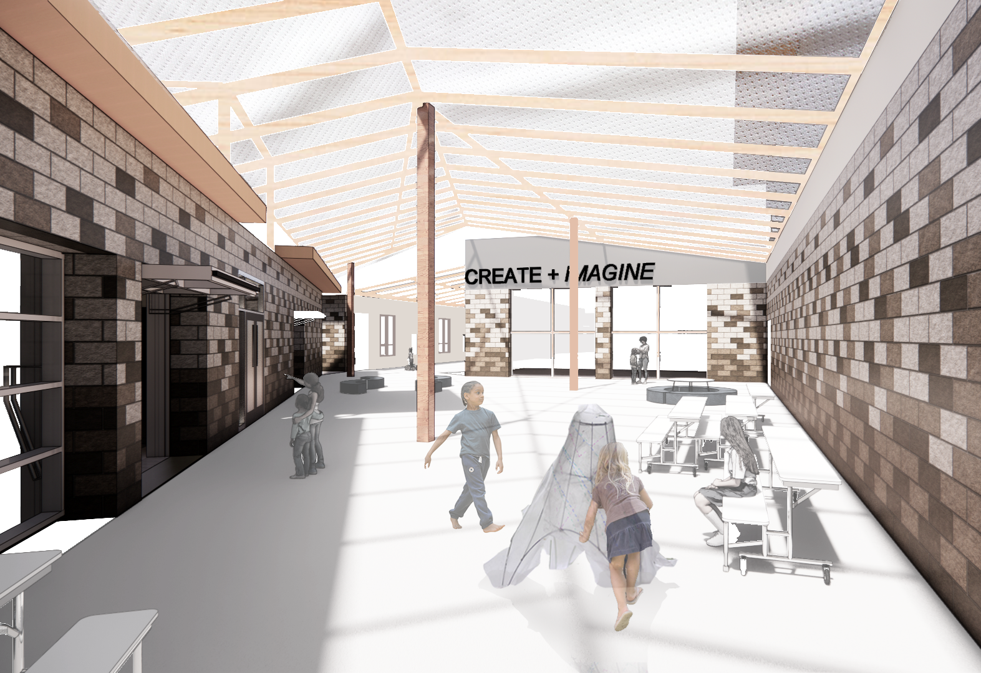
Creativity & Innovation + Passive Design with Thermal Mass
Zero Heroes
Notes:
note night flush

Slide 11
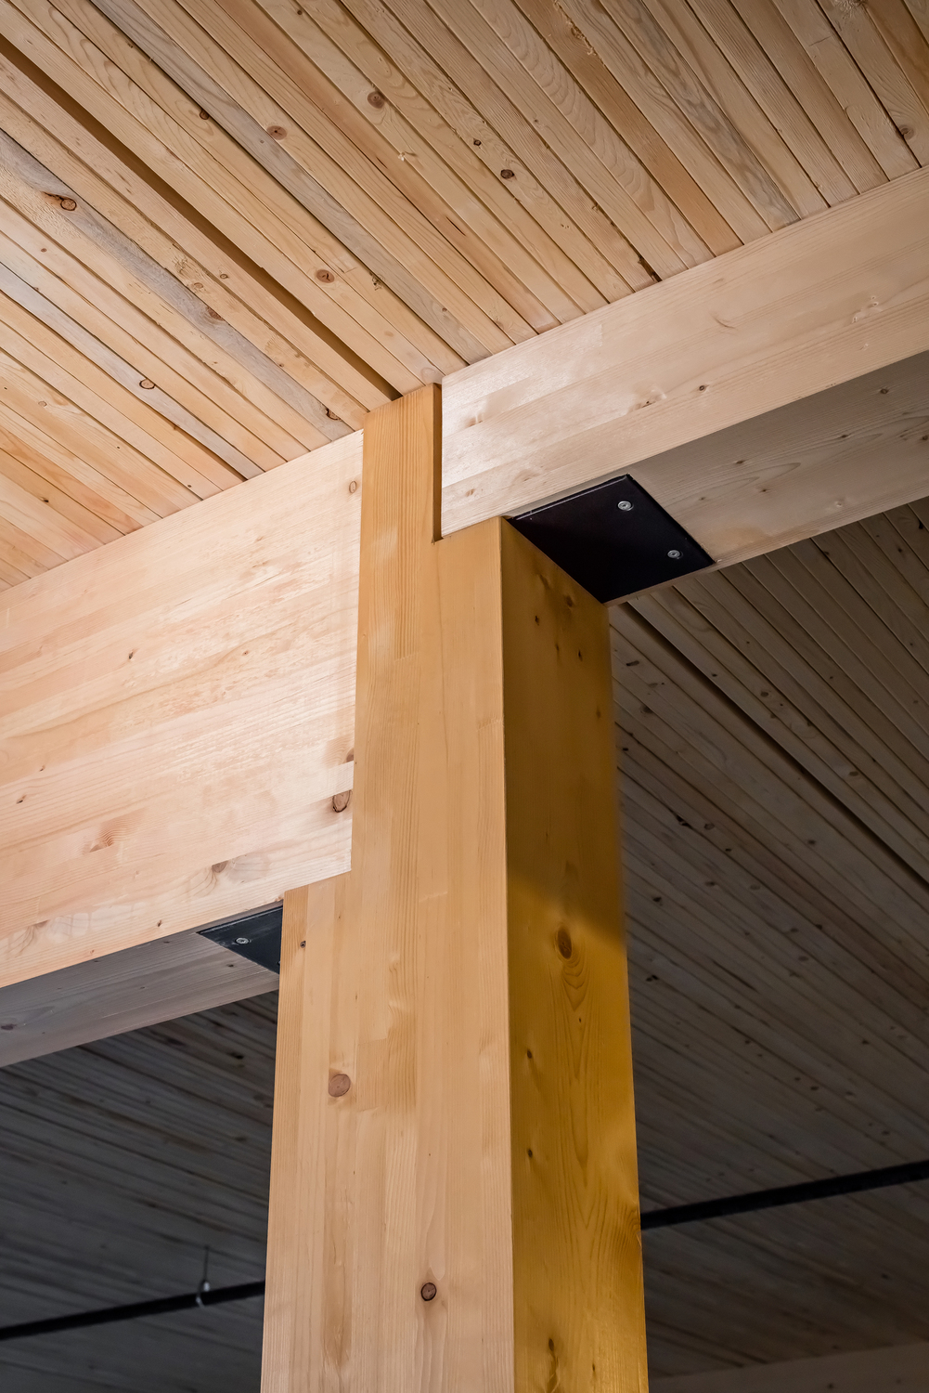
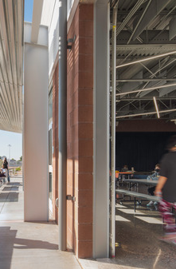
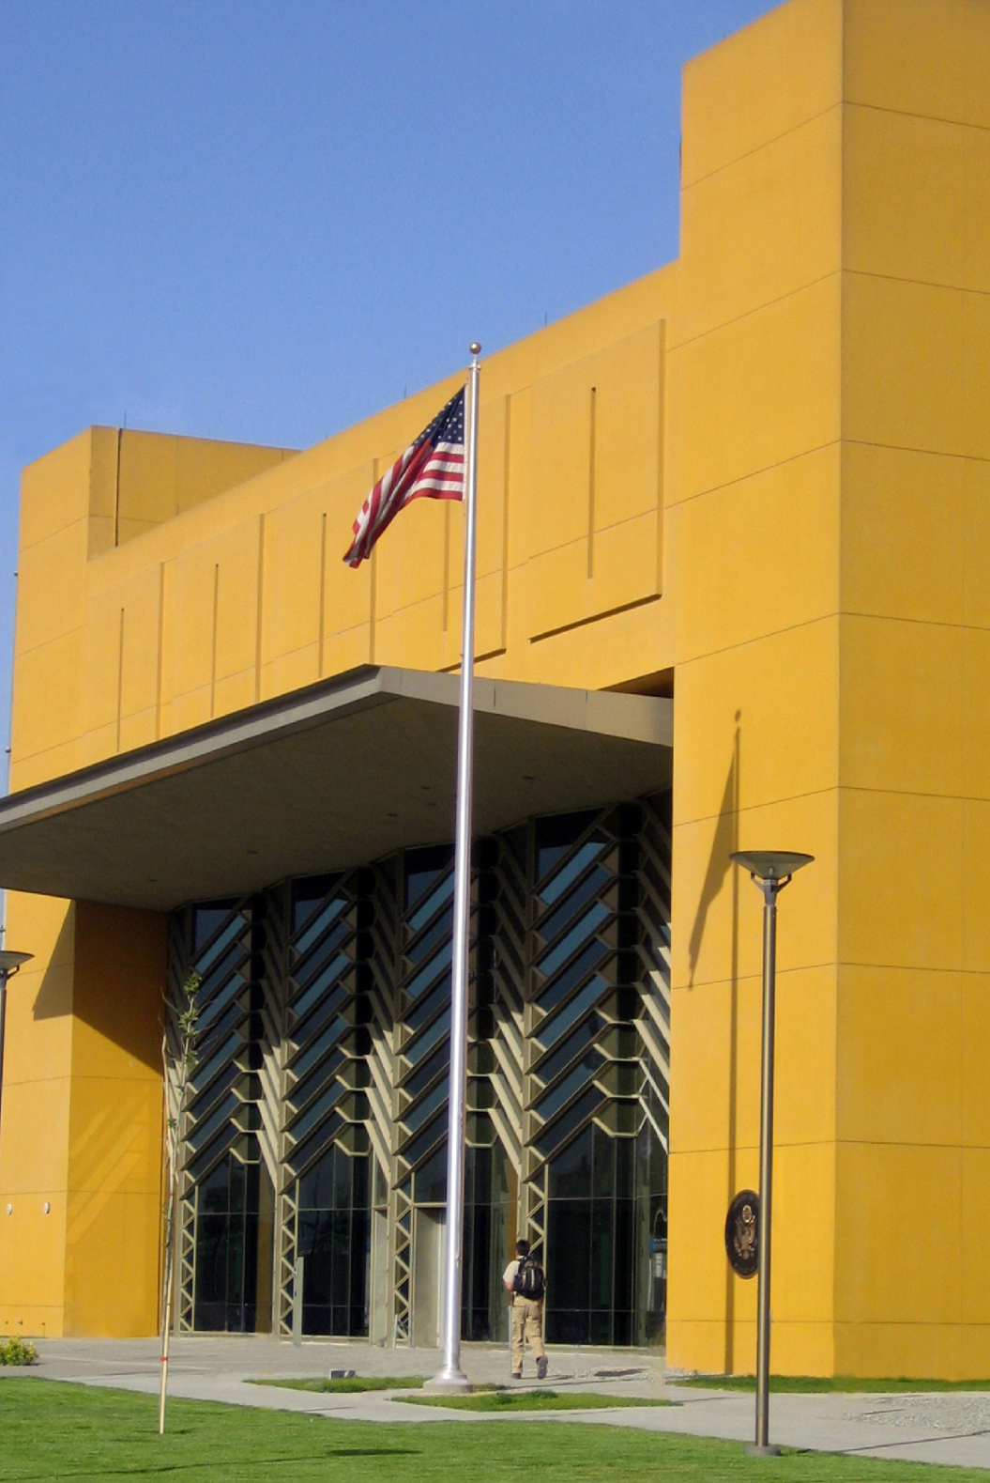
Carbon Mitigation Measures Embodied Carbon x Wall Assemblies
Zero Heroes
30' long x 12' tall wall section studies:
?
Assembly
*does not include structure beyond wall assembly
Wood-clad CLT
Reinforced compressed earth block (CEB)
(loadbearing)
Steel-supported unreinforced concrete masonry unit (CMU)
(non-loadbearing)
Stucco over wood studs
PEMB
Tally projections
*biogenic carbon turned on
kgCO2e
least intensive GWP
realistic to site with optimized GWP
most intensive GWP
-1,006
3,075
3,302
6,050
35,092
EPA equivalency* *US passenger vehicles driven for 1 year
Notes:
Clarify regional nature of material CEB / Watershed block.
Here, you'll see the start of an embodied carbon story across our industry specific to schools. The team started with that per discipline breakdown and focused on where we could push / pull on different disciplines and challenge ourselves to optimize.
We took a peek at DLR Group's portfolio for highest to lowest projections. Not surprisingly, CMU was a wonderful fit operationally – but this team found Compressed Earth Block to respect the vernacular, optimize both the architectural wall assembly tied double dipping for structural.

Slide 12
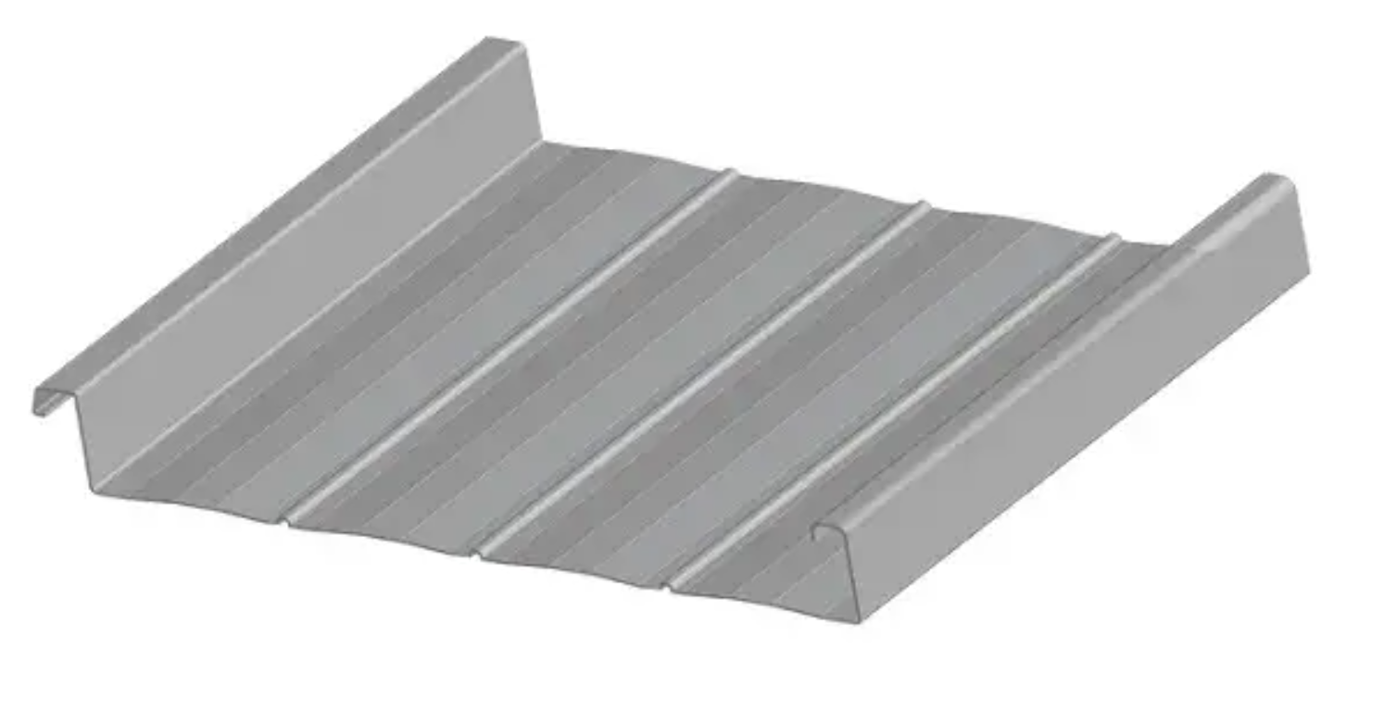
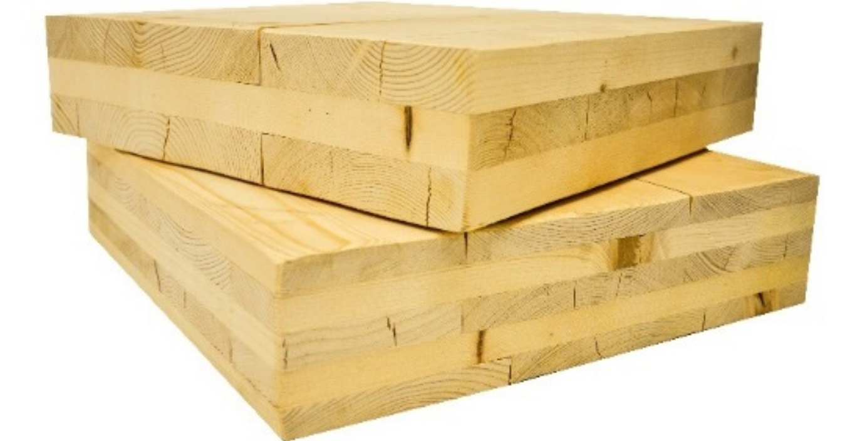
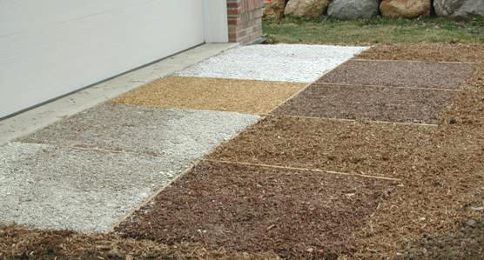
Carbon Mitigation Measures Embodied Carbon
Zero Heroes
WBLCA:
reinforced compressed earth block (CEB) as enclosure and interior finish
(loadbearing)
most intensive GWP
CLT ceiling deck / structure under insulated standing seam metal roof
Bonded EWF play surface (engineered wood fibers) in lieu of artificial turf for BPA/PFAS/and recycled rubber avoidance (lead)
Notes:
- avoidance of finishes at the exterior wall – direct to functional walls as demising partitions
-

Slide 13
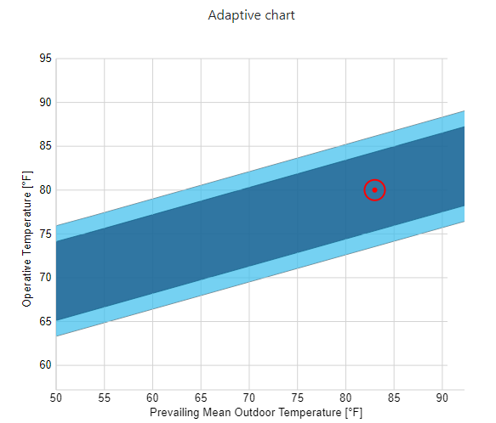
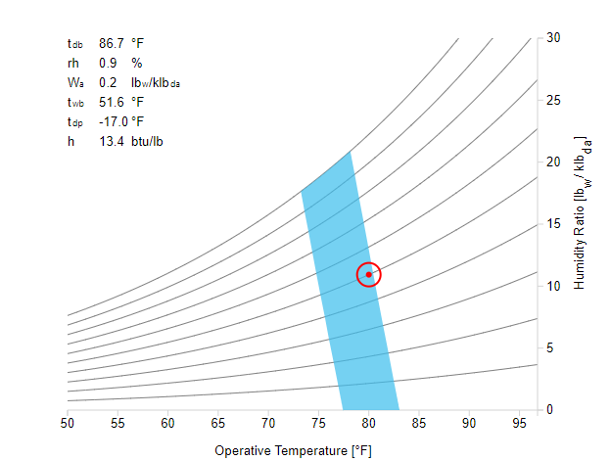
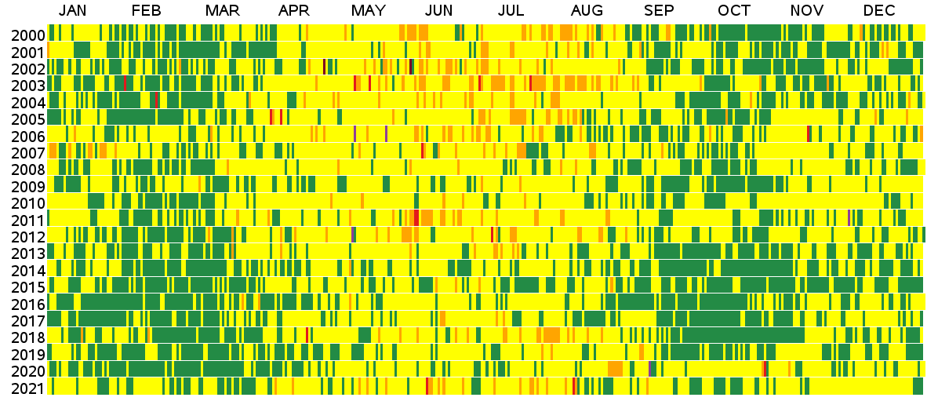
Comfort & Air Quality
Zero Heroes
Adaptive model used for most spaces where operable windows and ceiling fans are available
AQI may limit passive availability, especially in a future that has more wildfires which negatively impact AQ. Therefore, need to have hybrid approach to comfort and air quality.
Good (<=50)
Moderate for Sensitive Groups (101-150)
Very Unhealthy (201-300)
Moderate (51-100)
Unhealthy (151-200)
Hazardous (>=301)
Adaptive model
PMV model
Daily AQI Values, Albuquerque, NM,2000 to 2021
Source: U.S EPA AirData

Slide 14
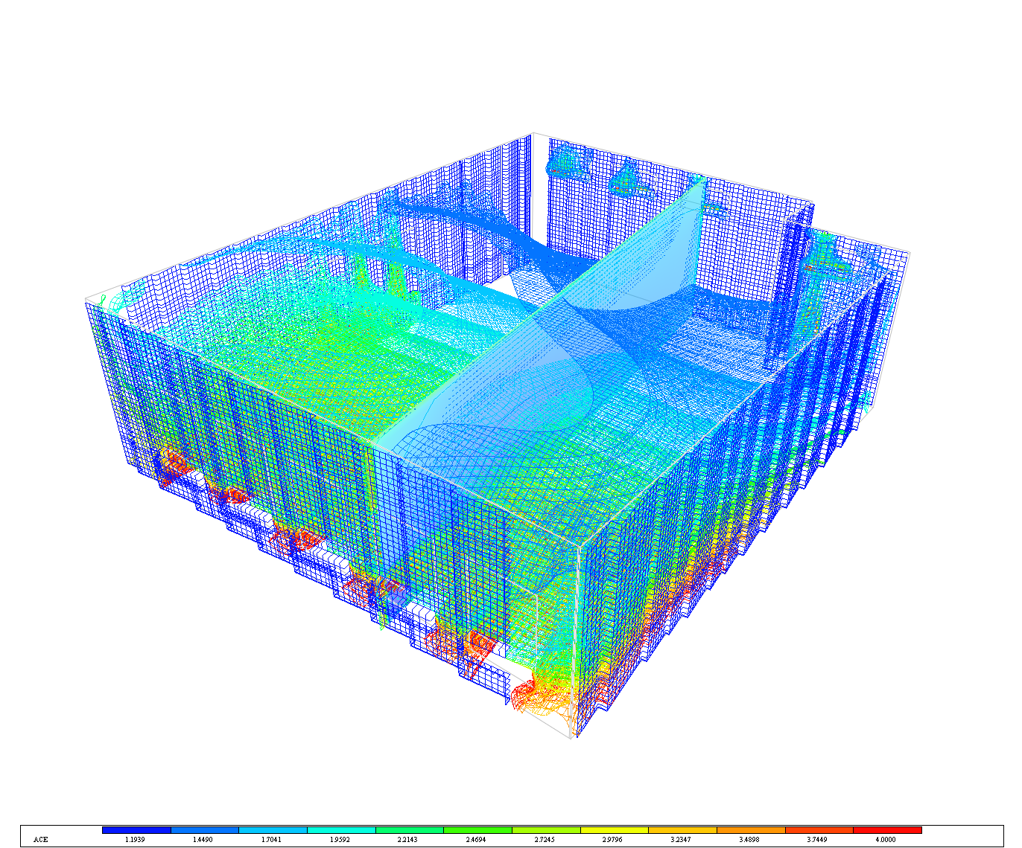
Indoor Air Quality & Thermal Comfort
Air Change Effectiveness – Passive Night Flush (fans off)
Zero Heroes
ASHRAE 62.1 IAQP method used for minimum ventilation calculations
Reduced min. OA by 46% relative to VRP method
Reduced HVAC heating and cooling equipment size by ~20%
Sorbent air cleaning technology used
First Cost Neutral
Continuous IAQ monitoring with demand control ventilation
Night Flush provides fresh air in the space at the start of each morning (outdoor AQ permitting)
Thermal comfort modeled using CFD
2022 ASHRAE LowDown Showdown Modeling Competition

Slide 15
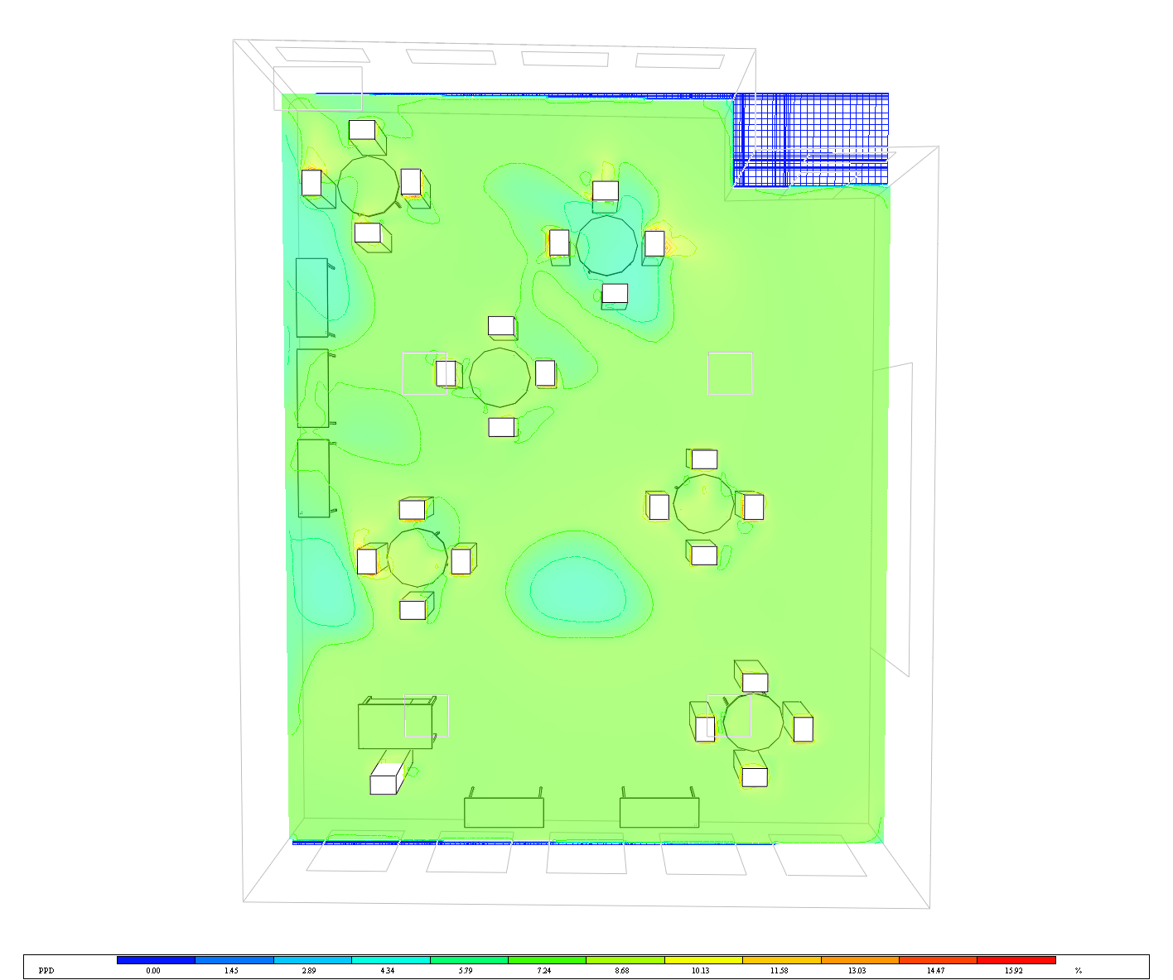
Comfort – PPD (Design Day Summer afternoon, HVAC on)
Zero Heroes
PPD at 4’-6” AFF (chest/shoulder/head)
PPD at 6” AFF (ankles)

Slide 16
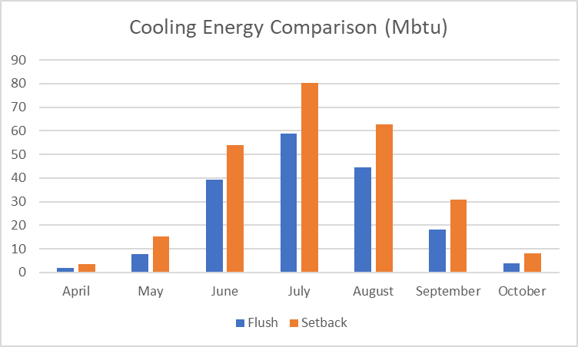
Comfort and Energy Savings
Zero Heroes
Thermal Mass Effect in Winters on the Room Temperature [ Jan 6]
Peak temp reduced and delayed
Night Flush effect in Summer on the Room Temperature [ Jul 9]
“pre-cooling” of mass (“thermal battery”)
No Energy needed to cool the building in summer nighttime – assuming night flush available (Air Quality dependent)
Design Optimizes passive comfort opportunity from climate data and uses thermal mass instead of high levels of insulation (reduced embodied carbon)
Night Flush saves 80.5 Mbtu/h per year in cooling energy
(and reduces night time electrical consumption, reducing “dirtiest” grid hours)

Slide 17
Water Conservation Strategies
Zero Heroes
Utilized Roof Rainwater Harvesting (70,000 sf)
75% Annual Rainfall (accounting for reduced annual precip in future) rate at 90% Collection Efficiency resulted in ~275,000 gallons/year of water captured for indoor flush fixtures (non-potable use)
Implementation of Low-Flow Water Closets (1.1 gpf) and Waterless Urinals (1 gallon/72 hours) resulted in annual consumption of 213,000 gallons/year
Rainwater Harvesting ideally offsets water consumption for plumbing flush fixtures.
Leads to 173,000 gallons/year consumed. A 74% reduction in consumption compared to Energy Star’s 10 gal/sf Indoor Water Use Intensity estimate for K-12 Schools
2022 ASHRAE LowDown Showdown Modeling Competition

Slide 18
Water Conservation Strategies
Zero Heroes
Native drought resistant plants were selected for the earth berms that shelter the building from wind
Playfield (30,000 sf) – Half-and-Half Mix of Kentucky Bluegrass & Bermudagrass (more drought tolerant and adaptive for future climate)
517,000 gallons/year required for watering.
21% reduction compared to 100% Kentucky Bluegrass (APS standard)
Utilized Parking Lot for Rainwater Harvesting (70,000 sf): 275,000 gallons/year
243,000 gallons/year supplemented
63% reduction in watering costs
Below-grade drip irrigation system to reduce water evaporation by 90%.
2022 ASHRAE LowDown Showdown Modeling Competition

Slide 19
Carbon Mitigation Measures Total Carbon
Zero Heroes
TC = ((EUI*A) - (RE)) *CF + ((EC+BC*VBC)/BL)
Total Carbon
Energy Use Intensity
Area
Renewable Energy
Conversion Factor
Embodied Carbon
Biogenic
Carbon
Volume
Expected
Building Life
From electricity to GHG emissions
-
kgCO2/yr
kwh/ft^2 yr
ft^2
kwh/yr
kgCO2
KgCO2/ft^2
ft^2
75 yrs
TC BASELINE = 574,986.6 + 3,606,202
88 tree seedlings proposed
(allowed to grow for 10 years min.)
=
-5,420 kgCO2e
TC PROPOSED = -168,940.8 +2,323,963
2022 ASHRAE LowDown Showdown Modeling Competition

Slide 20
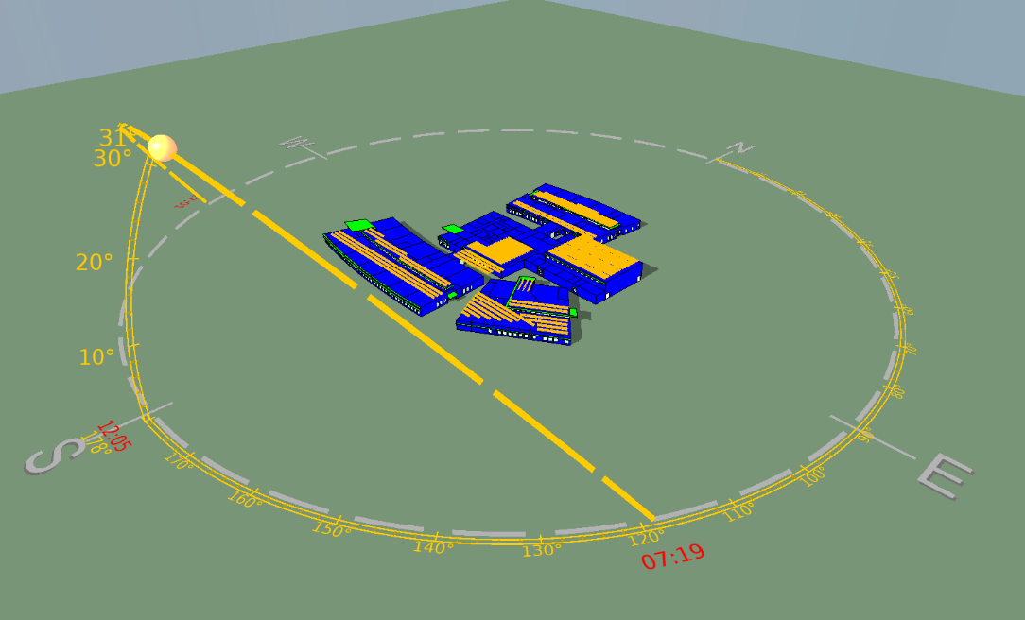
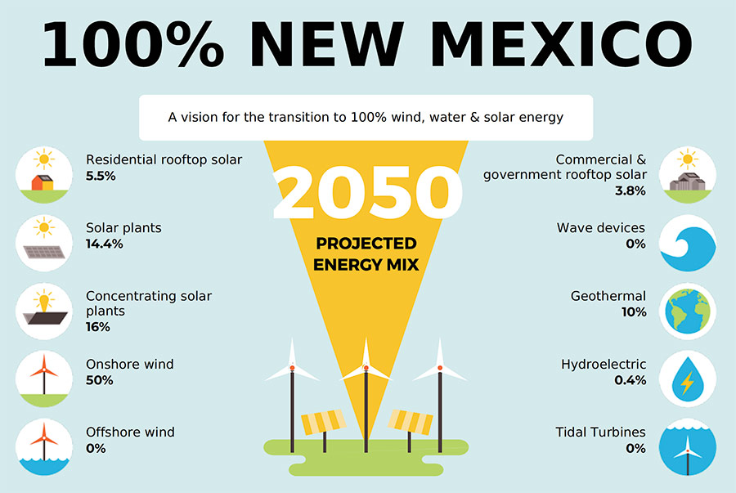
Cleaning the NM Power Grid
Zero Heroes
Site solar and battery (building as a microgrid) contributes to cleaning the New Mexico power grid
Source: American Solar Energy Society

Slide 21
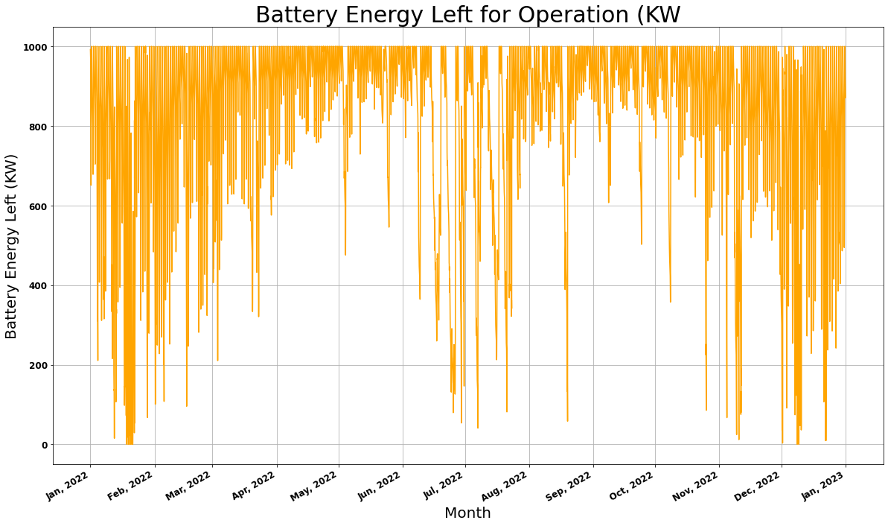
Resiliency & Operational Carbon Reduction
Zero Heroes
Solar Hot water for OA preheat (with GSHP backup)
Solar Hot water for DHW (with HPHWH backup)
1 MWh Battery
Helps Reduce the Burden on Grid + backup power
Site as a microgrid
67% of the year capable of operating off-grid
Charged during the Day time (Greener Grid + onsite PV system)
Close to 200 hrs of reliance on grid annually
1356 Hours of Green energy sent to the grid annually
$50,000 worth of extra energy sent to grid ($0.03/kWH)

Slide 22
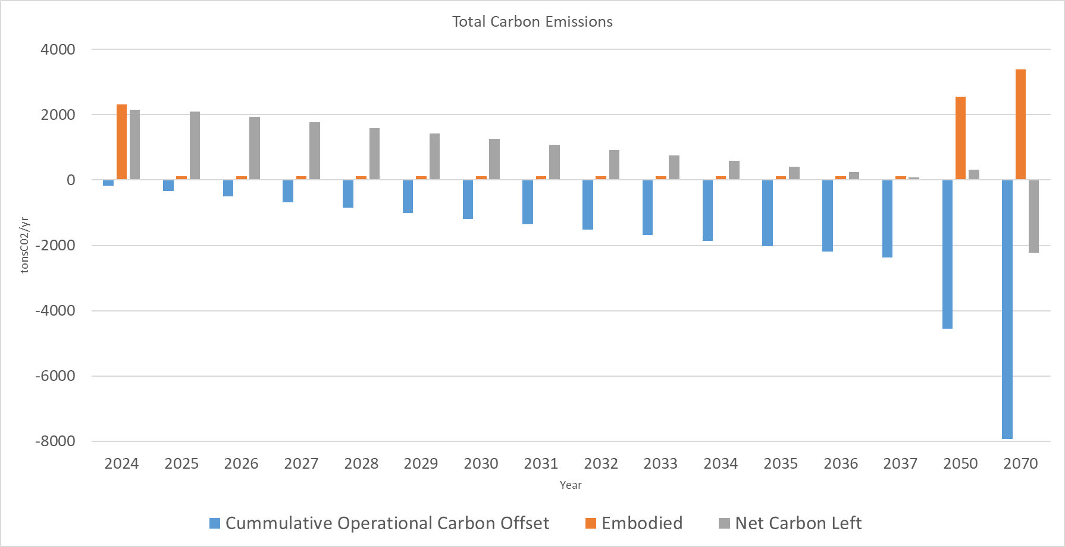
Carbon Mitigation Measures Total Carbon
Zero Heroes
Carbon Neutral

Slide 23
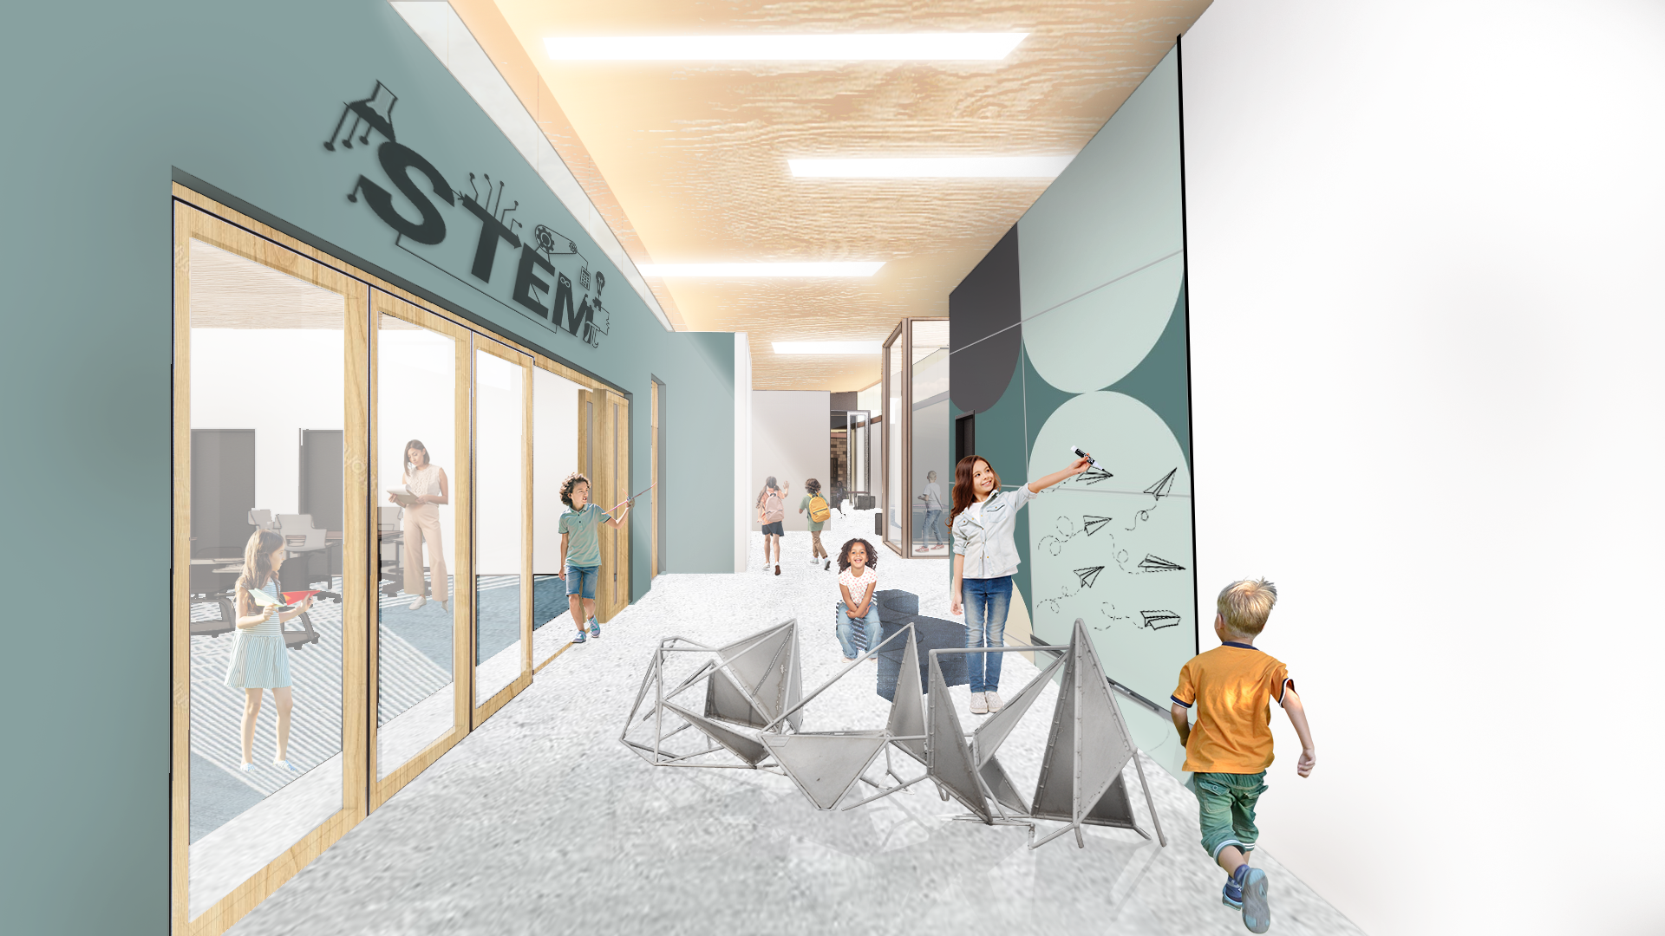
Required Metrics
Zero Heroes
 | IP | SI
Total Annual Energy Use | 1,536,599 kBtu | 450,332kWh
Total Annual Water Use | 172,292 Gals | 652,197 Liters
Total Annual Onsite Energy Production | 2,234,402 kBtu | 654,839kWh
Annual Energy & Water Cost | 1.1 $/ft2 | 12 $/m2
Site EUI | 20.4 kBtu/ft2 | 66.68kWh/m2
Source EUI | 66 kBtu/ft2 yr | 208 kWh/m2
Annual CO2e Emissions | -1.7637 IbCO2e/SF | -9 kg CO2e / ft2

Slide 24
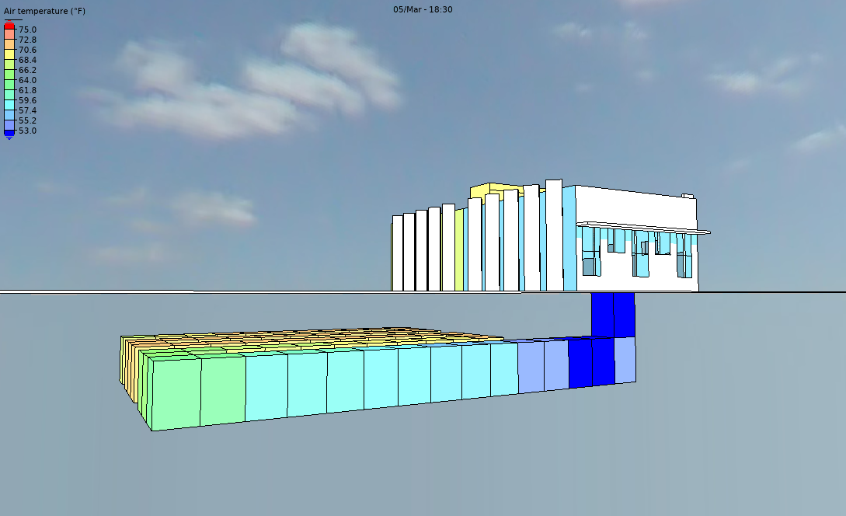
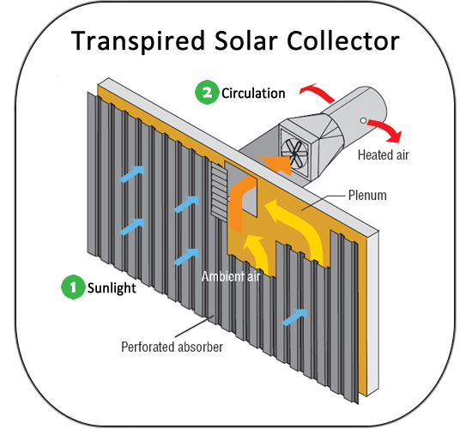
Strategies Explored and Abandoned
Zero Heroes
Earth tube for preconditioning OA
Similar in effect to an enthalpy wheel; but more costly
Maintenance concerns
Radon concerns
Elimination of mechanical cooling
Hotter future climate would require mechanical cooling from April-October
Significantly limits adaptability and durability of the building
Phase Change Materials (PCM)
Eliminated because no EPD’s available plus cost. Less adaptable than HVAC system.
Transpired Solar Collector for preconditioning of OA
Less effective than enthalpy wheel, interrupted architectural intent
Evaporative Cooling
While very effective, the lack of water in Albuquerque (especially in the future) eliminated this from consideration

Slide 25
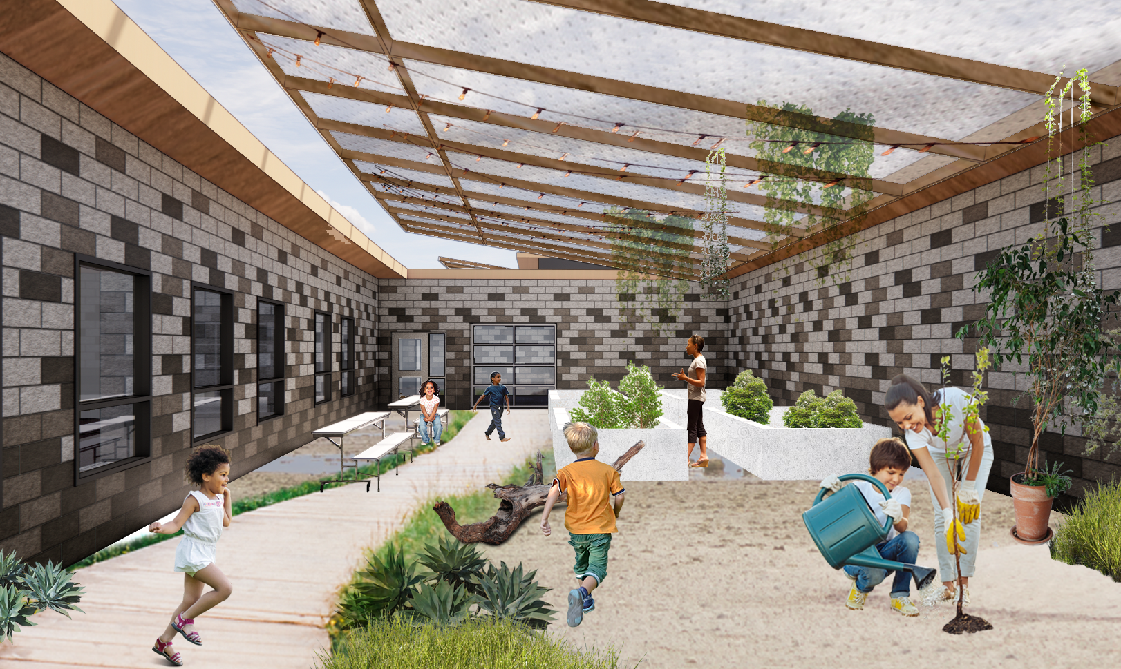
Conclusions
Zero Heroes
Start with the end in mind: target date for zero carbon
Understand the grid and the plan for the grid
Understand climate to reduce peaks
Assess future climate risk
EUI/peak load
AQI/IAQ
Extreme weather events
Water
Prioritize Passive strategies for present and future climates
Understand time of use in the era when the grid is forecast to be dirtiest
Make multiple forecasts and be wrong a lot
2022 ASHRAE LowDown Showdown Modeling Competition

Slide 26
ZERO HEROS

Slide 27
APPENDIX
Zero Heroes

Slide 28
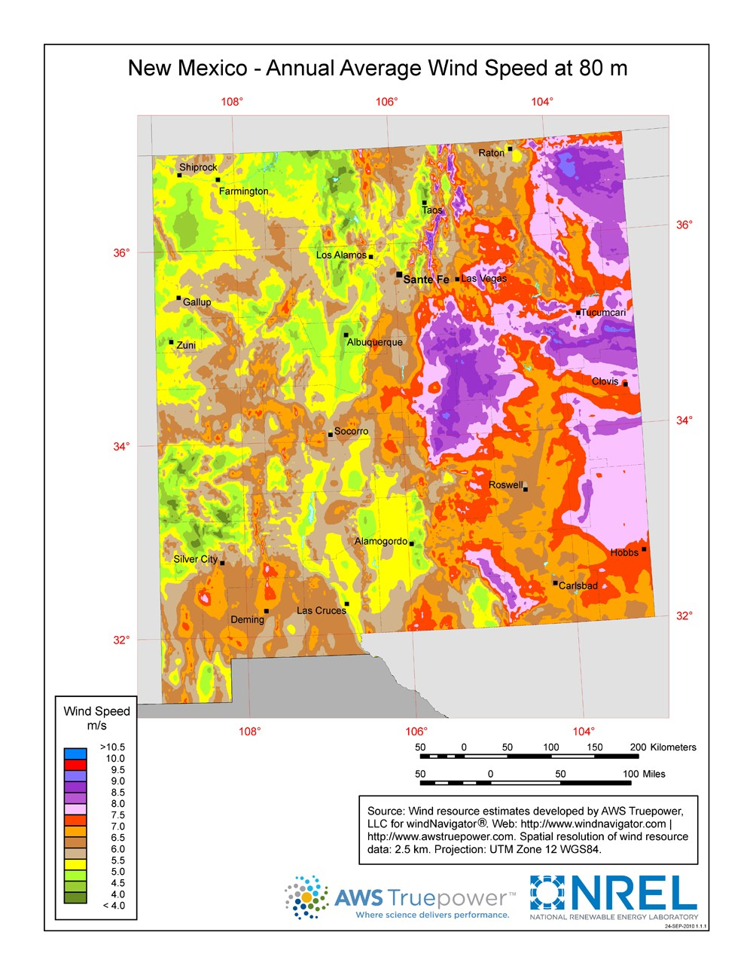
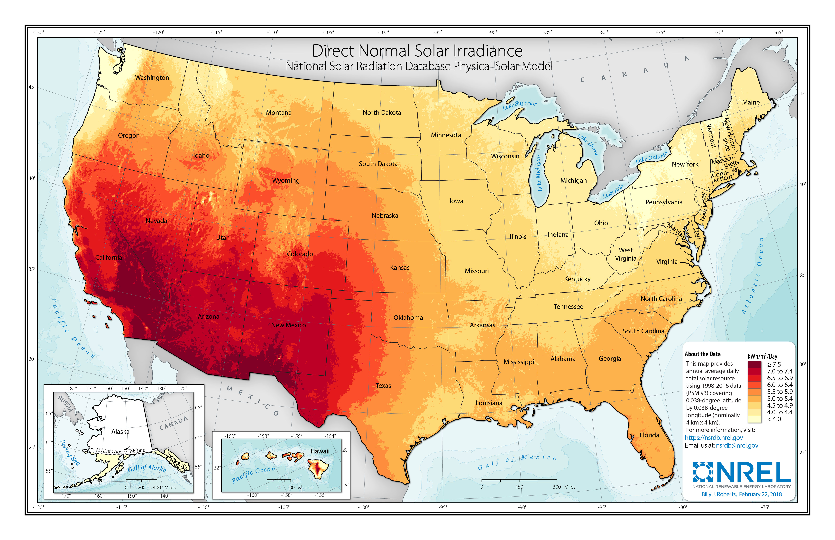
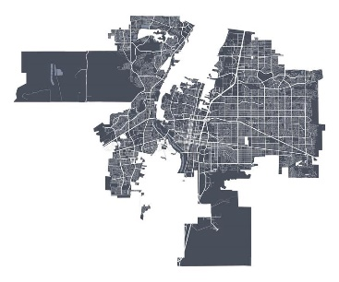
Renewable Energy – Wind and Solar
Zero Heroes

Slide 29
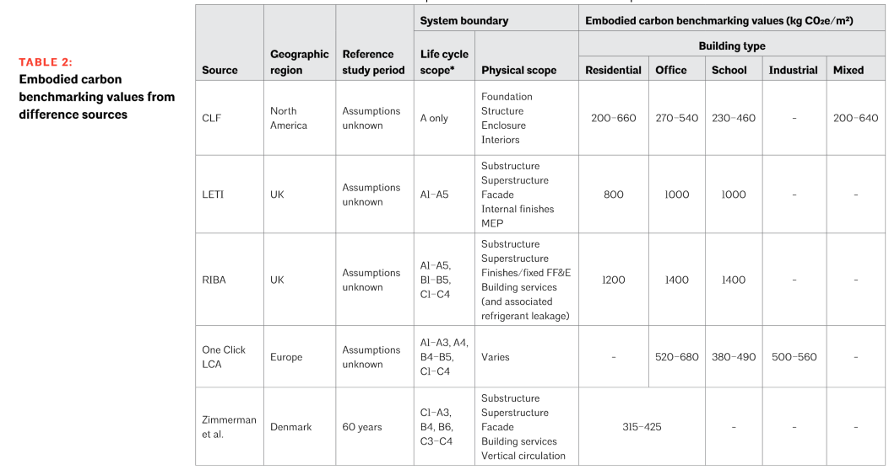
Resources
Zero Heroes
https://watershedmaterials.com/
AIA-CLF Embodied Carbon Toolkit

