Slide 1
2023 ASHRAE LowDown Showdown Modeling Competition
2023 Building Performance
Analysis Conference
THE CARBON LIGHTERS 2023
Alfonso E. Hernandez
Mili Kyropoulou
Emir Pekdemir
Kyleen Rockwell
Captain & Daylight
Designer
Design & Performance Integrator
Energy & Thermal
Ideator
Energy & Thermal Integrator
Bai (Brianna) Shixue
Yiwei Huang
Rosa Martell
Felipe Perez Villarreal
Energy & Comfort
Integrator
Photovoltaics
Integrator
Embodied Carbon Specialist
Lead Design
2023 ASHRAE LowDown Showdown Modeling Competition
2023 ASHRAE LowDown Showdown Modeling Competition

Slide 2
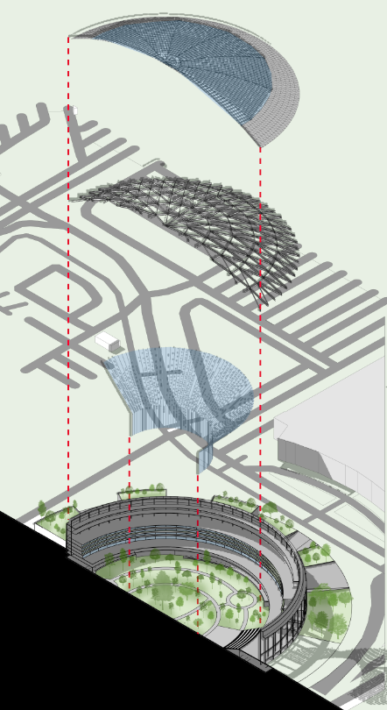
THE CARBON LIGHTERS 2023
2023 ASHRAE LowDown Showdown Modeling Competition

Slide 3
Total Annual Energy
15,449,144
kBtu/yr
Site EUI
23.5
kBtu/sf yr
Source EUI
74.1
kBtu/sf yr
Annual Op. Carbon
1.99
kgCO2e/sf yr
Total Embodied Carbon
94,253,677
kgCO2e yr
Annual Water Usage
299,767
gallons
Annual Energy Cost
0.60
$/sf
THE CARBON LIGHTERS 2023
Annual Water Cost
0.005
$/sf
Total Annual Op. Cost
0.605
$/sf
Total Onsite Energy Gen.
125,593,517
kBtu/yr
2023 ASHRAE LowDown Showdown Modeling Competition

Slide 4
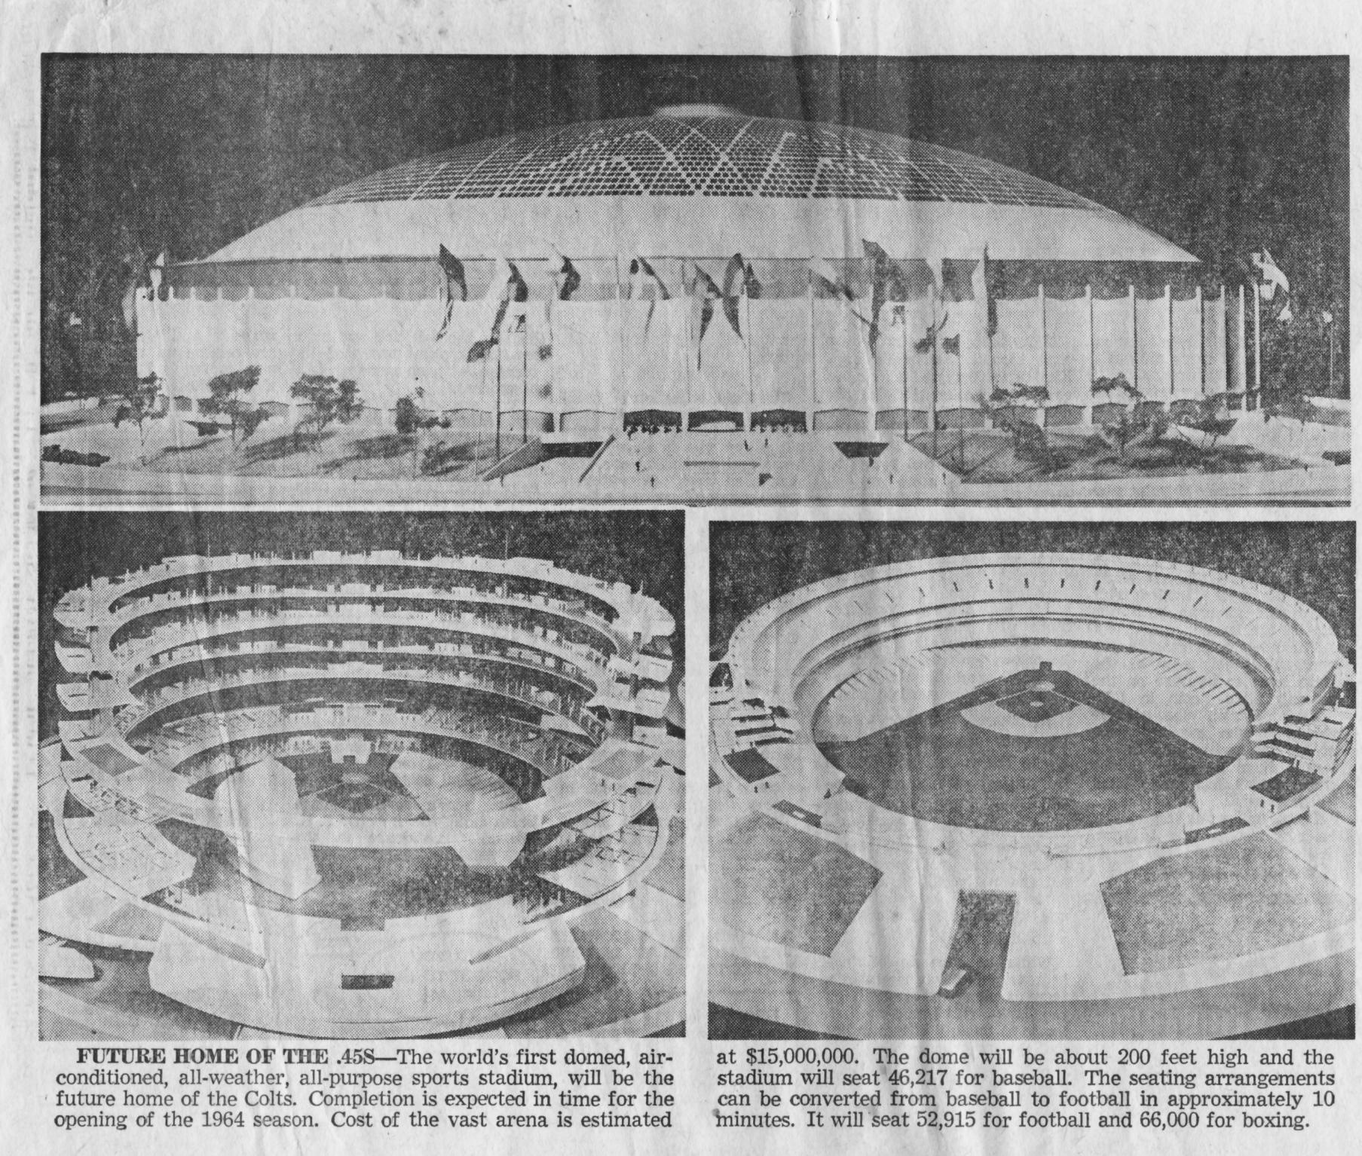
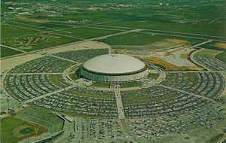
2023 ASHRAE LowDown Showdown Modeling Competition

Slide 5
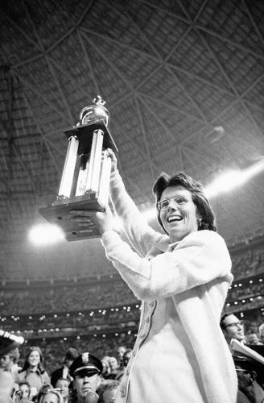
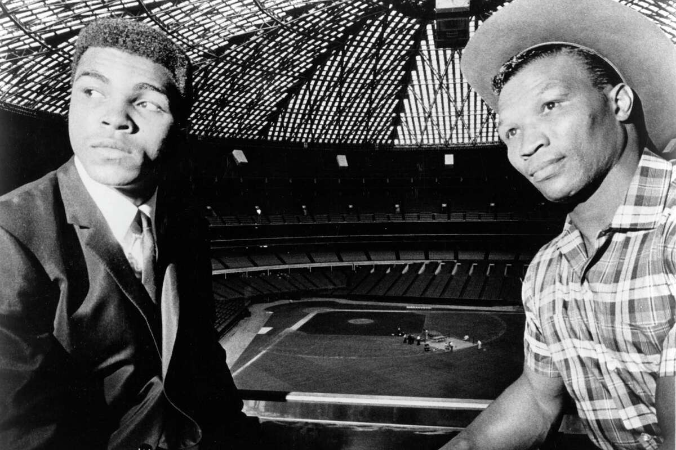
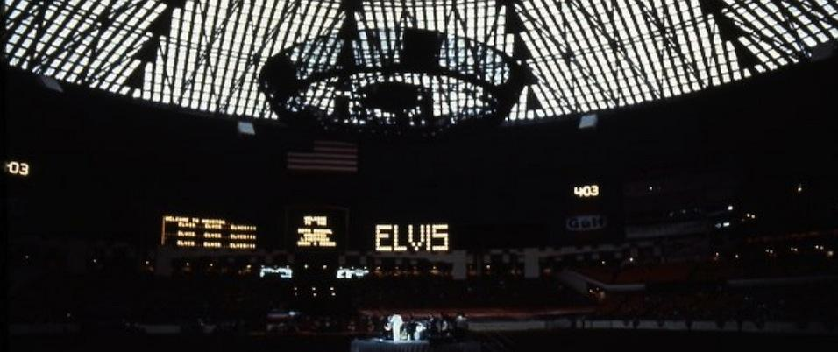
2023 ASHRAE LowDown Showdown Modeling Competition

Slide 6
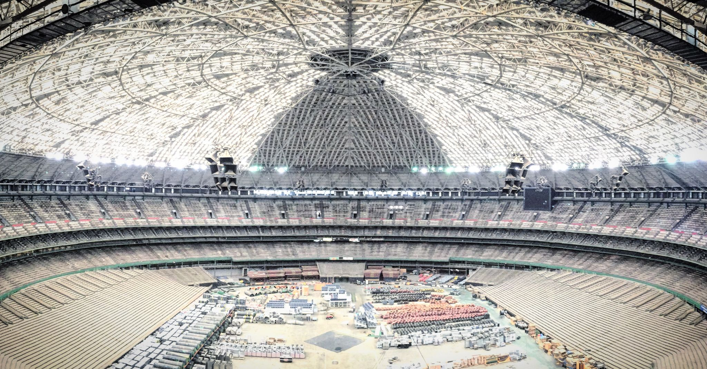
2023 ASHRAE LowDown Showdown Modeling Competition

Slide 7
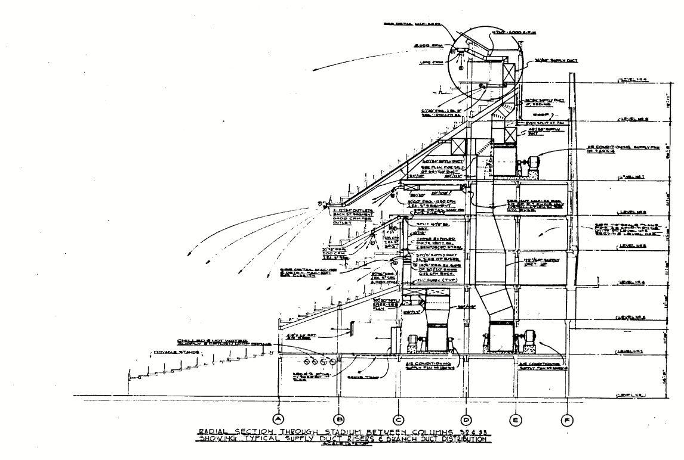
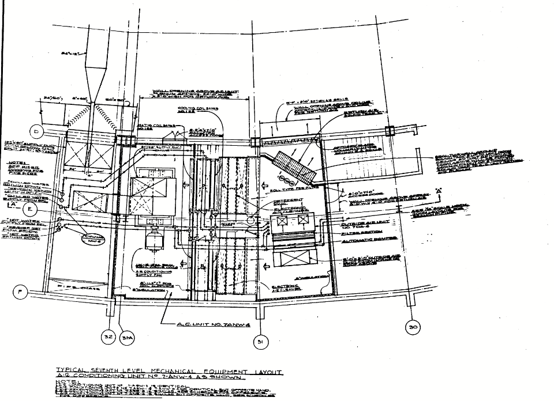
2023 ASHRAE LowDown Showdown Modeling Competition

Slide 8
SITE CONSIDERATIONS
2023 ASHRAE LowDown Showdown Modeling Competition

Slide 9
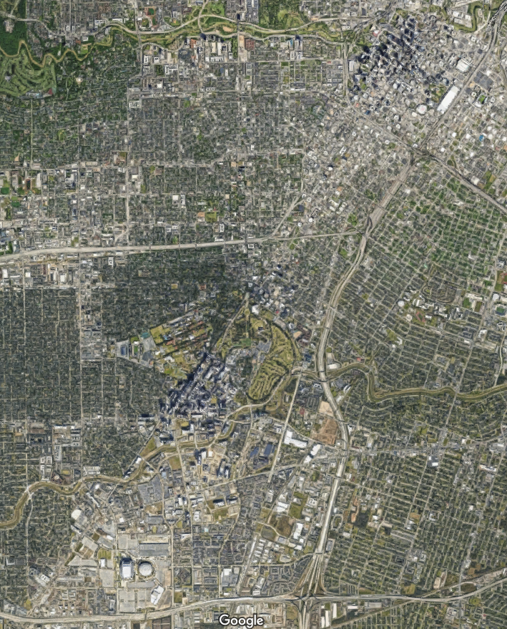
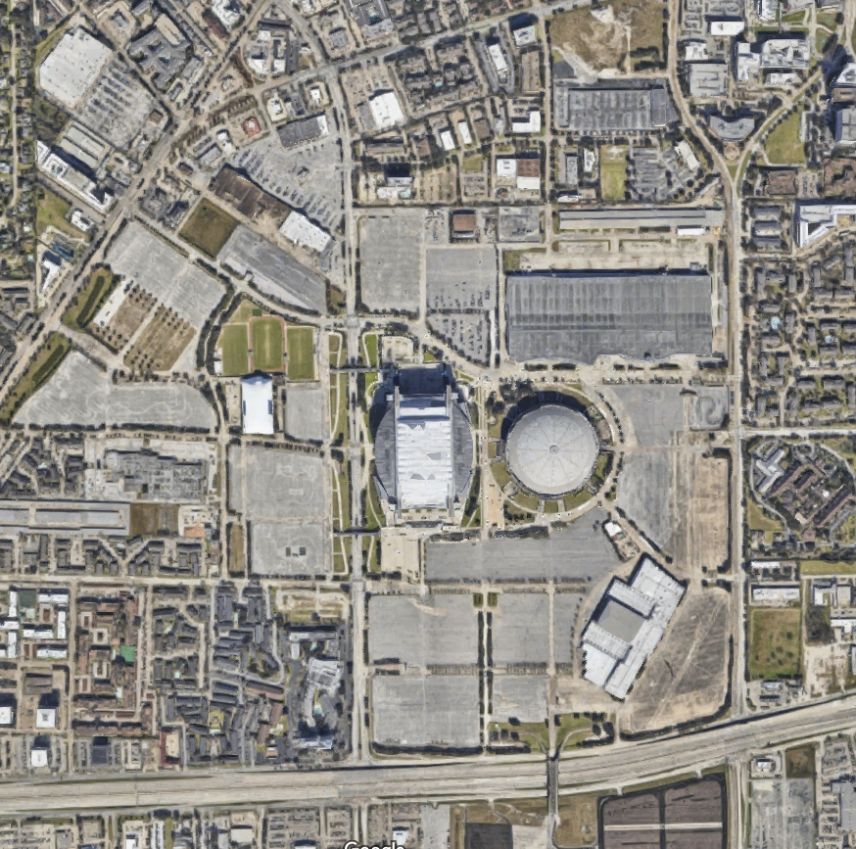
2023 ASHRAE LowDown Showdown Modeling Competition

Slide 10
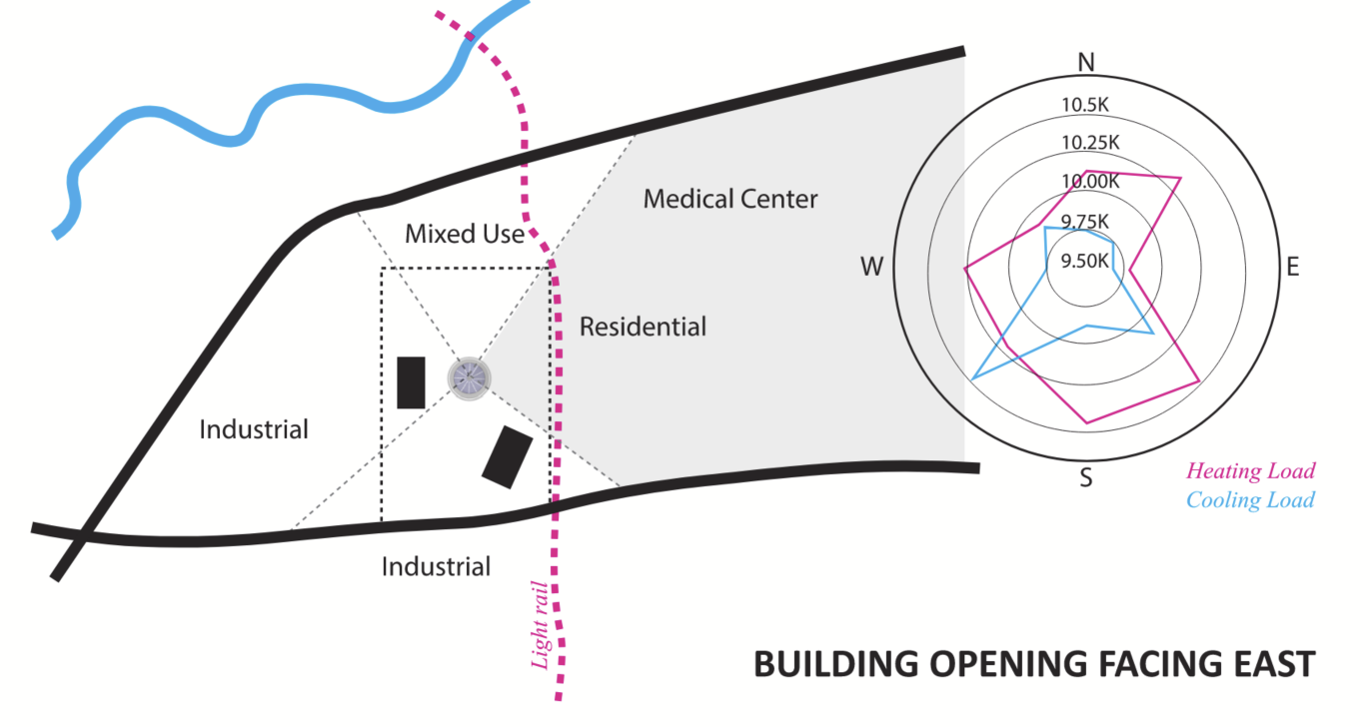
2023 ASHRAE LowDown Showdown Modeling Competition

Slide 11
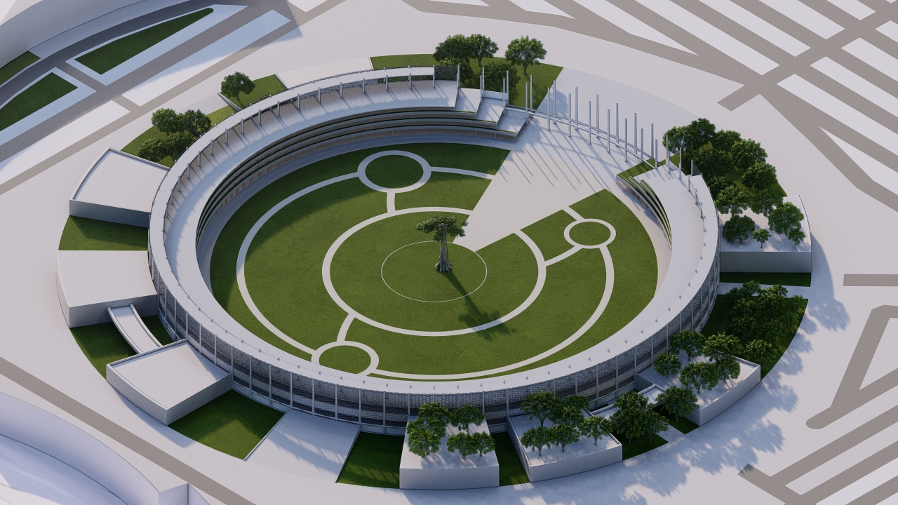
2023 ASHRAE LowDown Showdown Modeling Competition

Slide 12
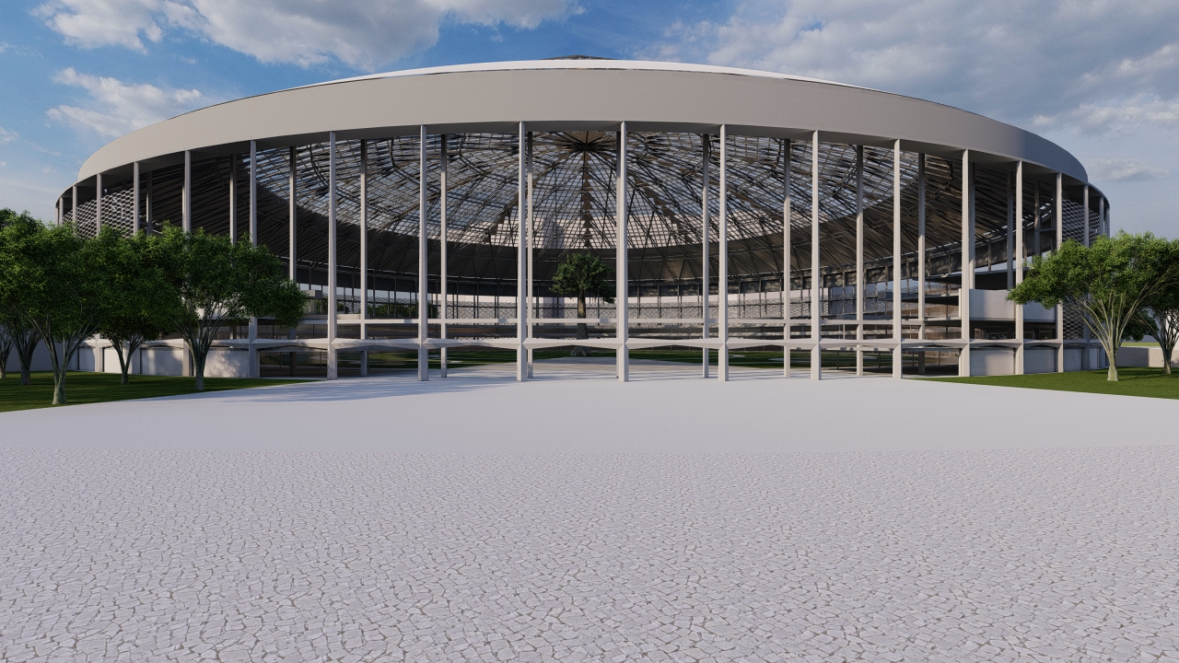
2023 ASHRAE LowDown Showdown Modeling Competition

Slide 13
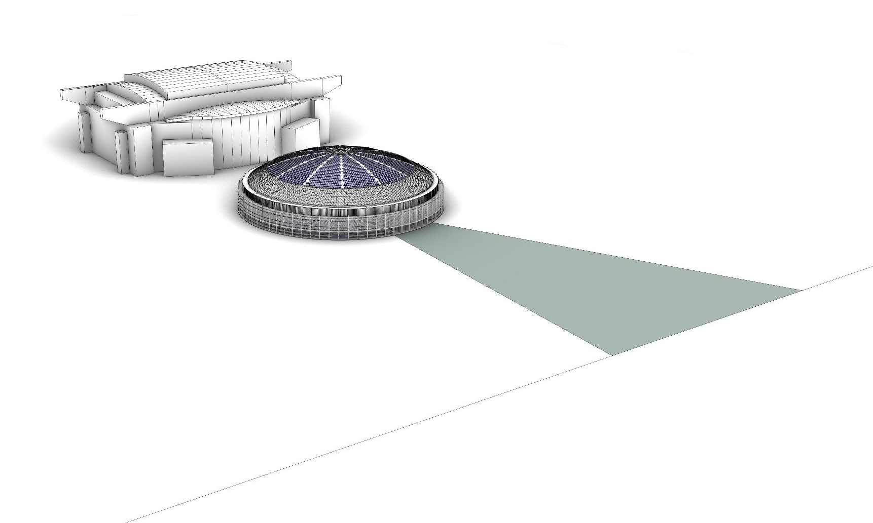
LIGHT RAIL
2023 ASHRAE LowDown Showdown Modeling Competition

Slide 14
CLIMATE
2023 ASHRAE LowDown Showdown Modeling Competition

Slide 15
Low precipitation in summer
SAN FRANCISCO
High comfortable hours
NEW YORK
Short comfortable range in shoulder seasons
High precipitation in hot seasons
HOUSTON
Decent number of comfortable hours in shoulder seasons
2023 ASHRAE LowDown Showdown Modeling Competition

Slide 16
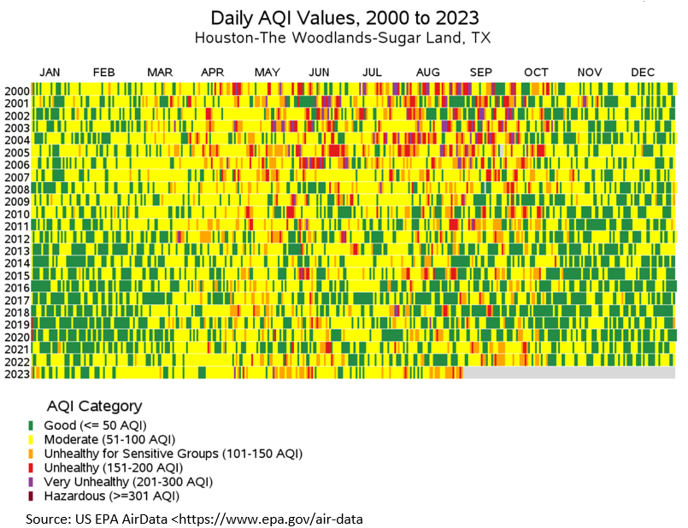
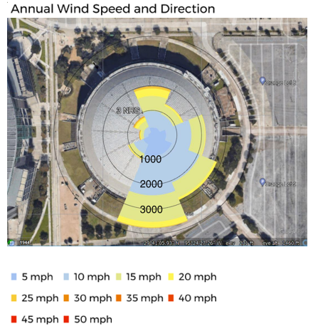
More clean air in recent years
In shoulder season AQI is good
Nearby sites are mainly parking lots,
Less turbulent wind patterns expected
2023 ASHRAE LowDown Showdown Modeling Competition

Slide 17
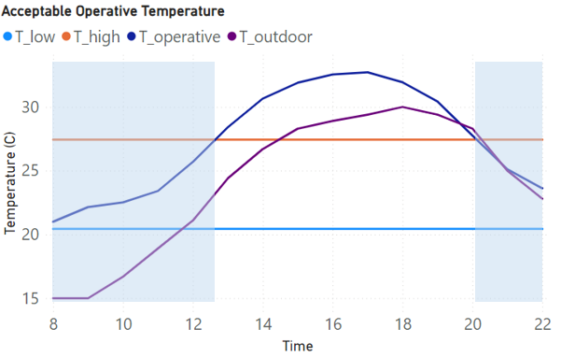
THERMAL AUTONOMY ANALYSIS
No HVAC system
Occupants are free to adapt their clothing to the thermal conditions within a range at least as wide as 0.5 to 1.0 clo.
The difference between operative temperature and acceptable temperature range was analyzed
Automatically control door, retractable skylight
Occupied hours 8:00 AM- 20:00 PM
2023 ASHRAE LowDown Showdown Modeling Competition

Slide 18
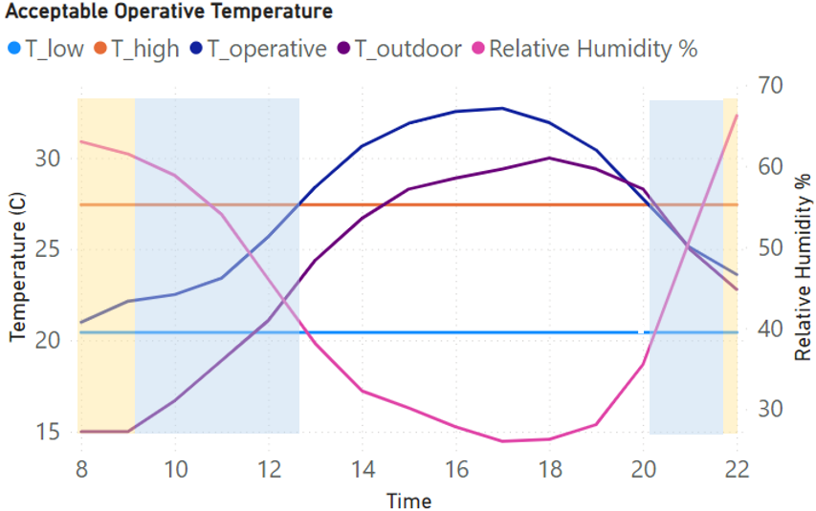
ADAPTIVE COMFORT ANALYSIS - HOT & HUMID WEATHER
THERMAL AUTONOMY ANALYSIS
2023 ASHRAE LowDown Showdown Modeling Competition

Slide 19
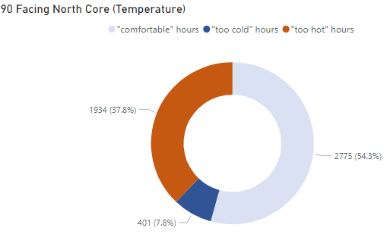
Degree (F) outside the comfortable range
THERMAL AUTONOMY ANALYSIS
Too Cold Too Hot
2023 ASHRAE LowDown Showdown Modeling Competition

Slide 20
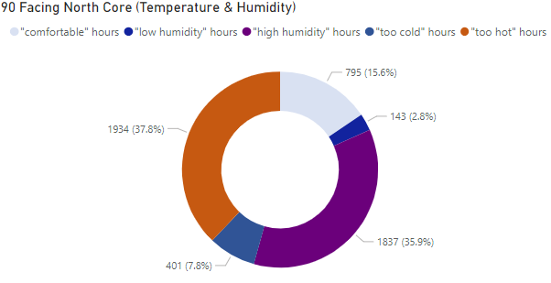
Degree (F) outside the comfortable range
THERMAL AUTONOMY ANALYSIS
hot & humid weather
Too Cold Too Hot
2023 ASHRAE LowDown Showdown Modeling Competition

Slide 21
summary of thermal autonomy analysis by opening facing
THERMAL AUTONOMY ANALYSIS
2023 ASHRAE LowDown Showdown Modeling Competition

Slide 22
CLIMATE CHANGE SCENARIO
2023 ASHRAE LowDown Showdown Modeling Competition

Slide 23
future weather files – different generation method
CLIMATE CHANGE SCENARIO
2023 ASHRAE LowDown Showdown Modeling Competition

Slide 24
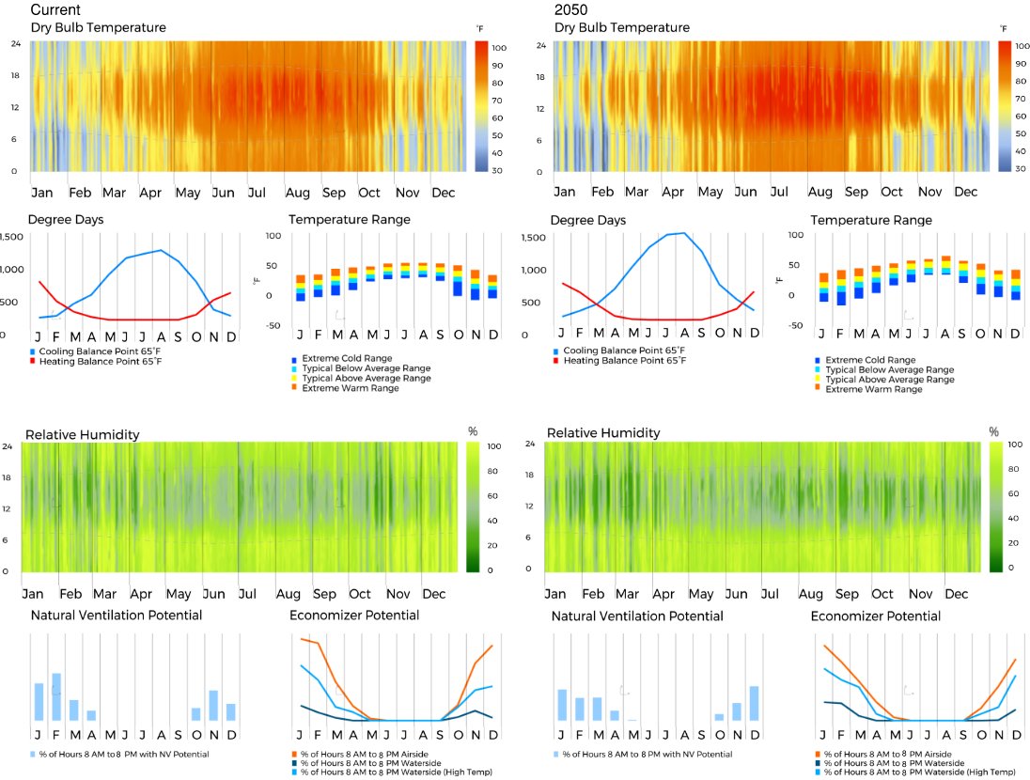
Temperature increases
More cooling to be expected
Dryer weather
Comfortable hours decrease,
but this is only based on the weather file itself
2023 ASHRAE LowDown Showdown Modeling Competition

Slide 25
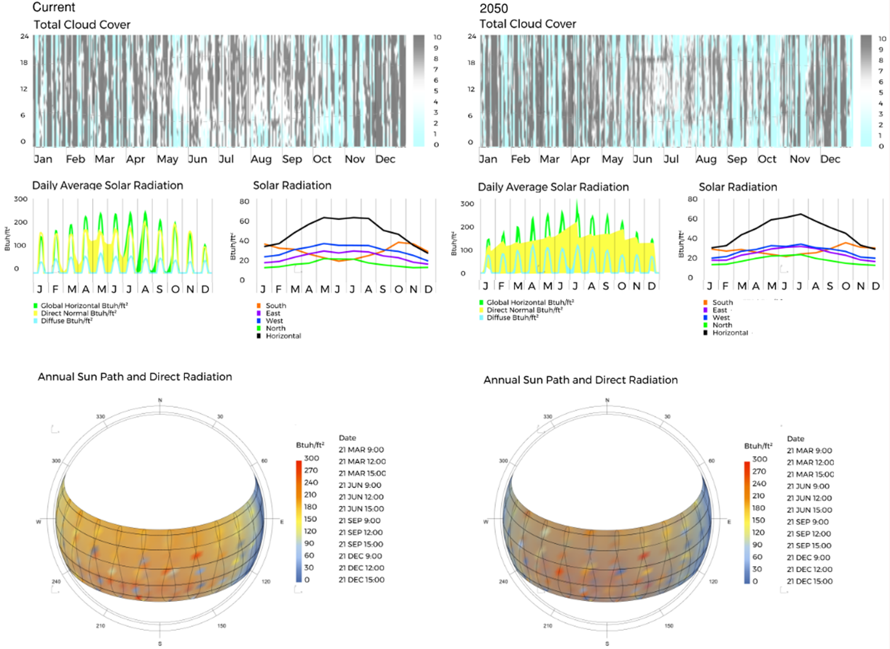
Cloud Cover decreases
Direct Solar Radiation may increase as cloud cover decreases
2023 ASHRAE LowDown Showdown Modeling Competition

Slide 26
THERMAL AUTONOMY ANALYSIS
Degree (F) outside the comfortable range
CLIMATE CHANGE SCENARIO
Too Cold Too Hot
2023 ASHRAE LowDown Showdown Modeling Competition

Slide 27
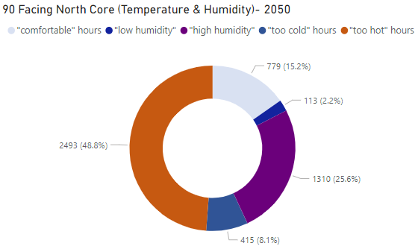
THERMAL AUTONOMY ANALYSIS
Degree (F) outside the comfortable range
CLIMATE CHANGE SCENARIO
Too Cold Too Hot
2023 ASHRAE LowDown Showdown Modeling Competition

Slide 28
SENSITIVITY STUDIES
2023 ASHRAE LowDown Showdown Modeling Competition

Slide 29
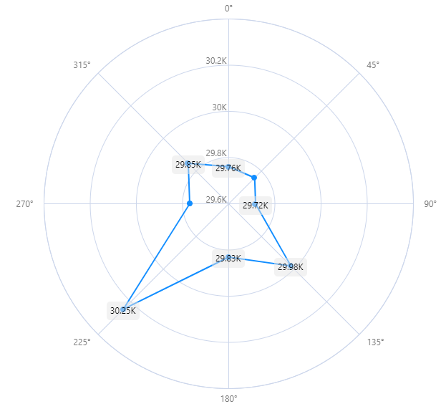
Summary of peak cooling and heating load by opening facing - HVAC included
SUMMARY OF PEAK HEATING AND COOLING LOAD BY OPENING PER ORIENTATION - HVAC INCLUDED
optimized orientation
2023 ASHRAE LowDown Showdown Modeling Competition

Slide 30
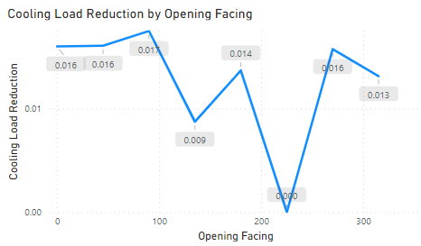
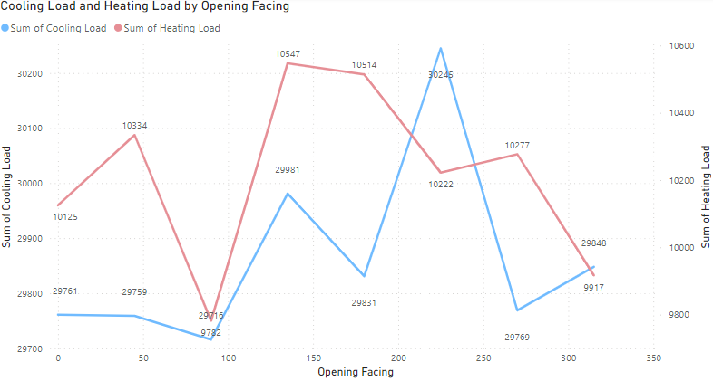
SUMMARY OF PEAK HEATING AND COOLING LOAD BY OPENING PER ORIENTATION - HVAC INCLUDED
2023 ASHRAE LowDown Showdown Modeling Competition

Slide 31
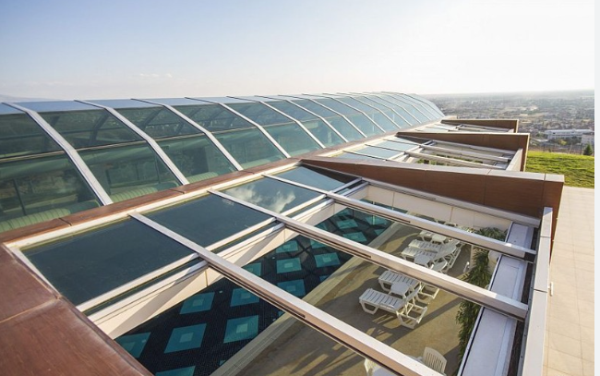
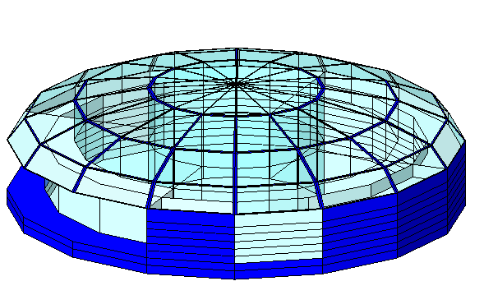
SKYLIGHT SHGC SENSITIVITY STUDY
6.27%
0.25
optimized point
SHGC-0.25
2023 ASHRAE LowDown Showdown Modeling Competition

Slide 32
DESIGN
2023 ASHRAE LowDown Showdown Modeling Competition

Slide 33
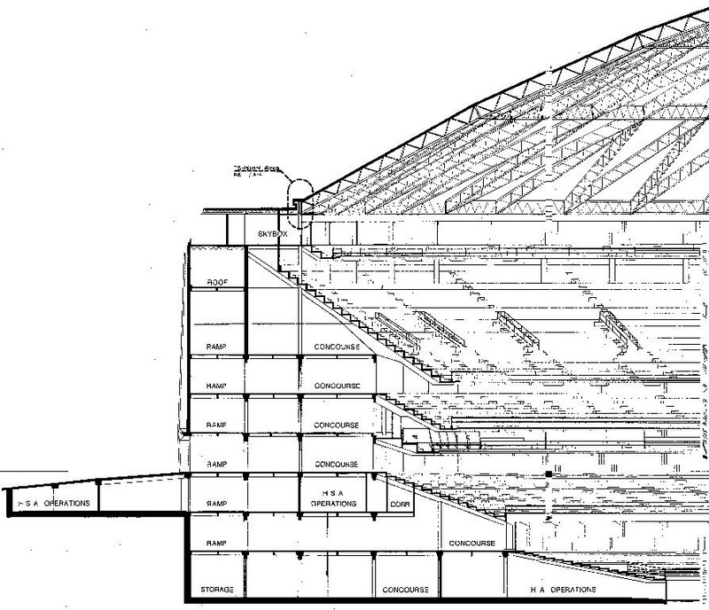
2023 ASHRAE LowDown Showdown Modeling Competition

Slide 34
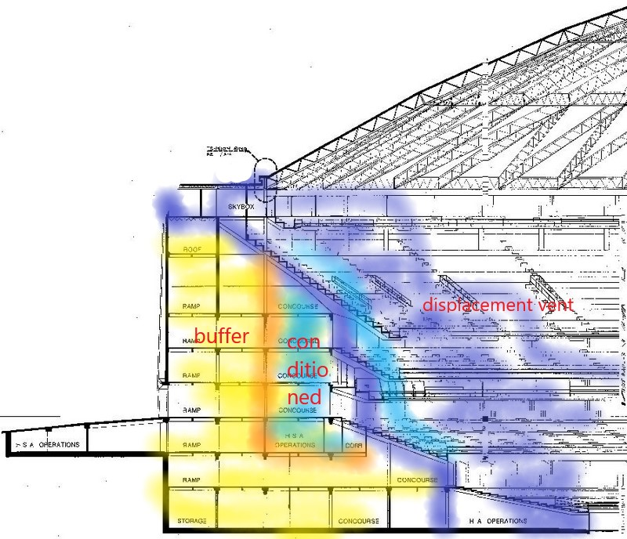
2023 ASHRAE LowDown Showdown Modeling Competition

Slide 35
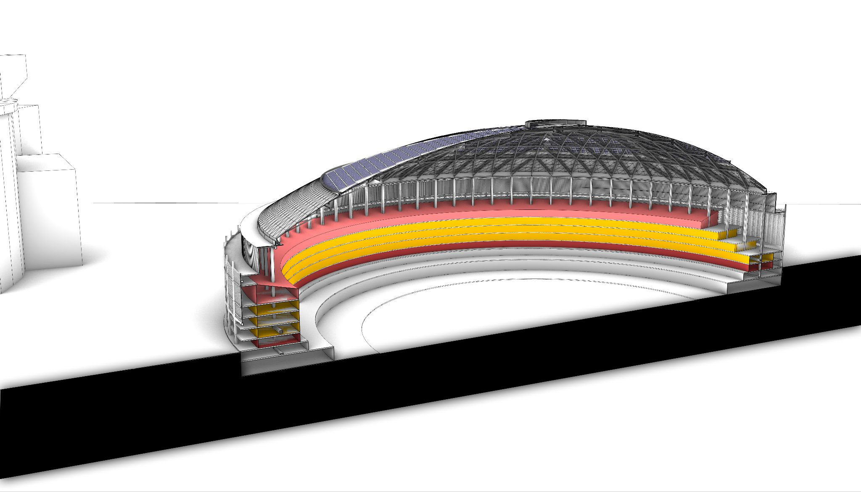
IMMERSIVE EXP & MUSEUM
HOTEL
RETAIL & F&B
BOH & PARKING
2023 ASHRAE LowDown Showdown Modeling Competition

Slide 36
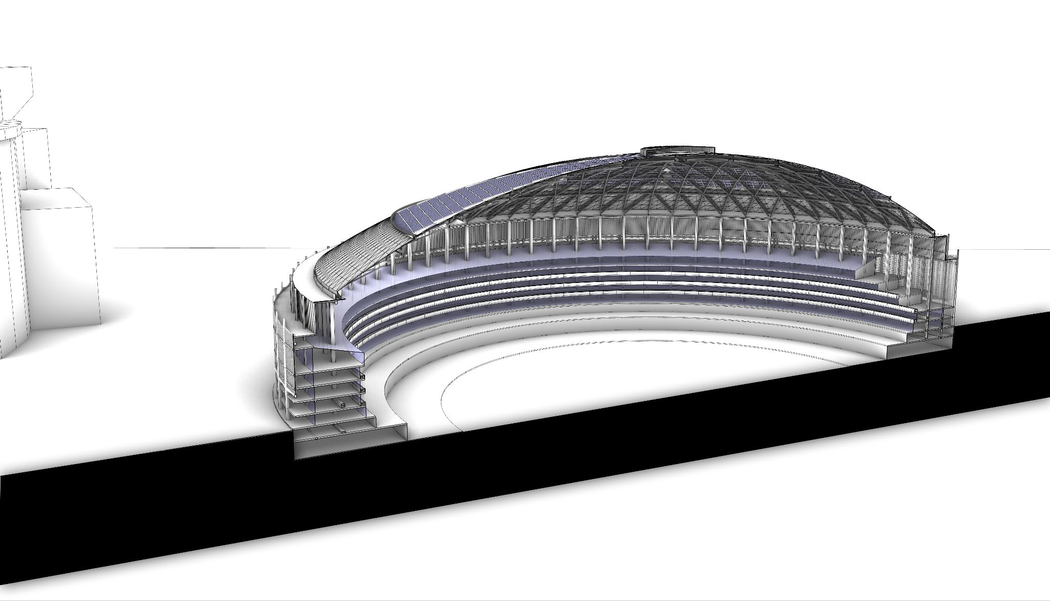
etfe skylights
museum with glass ceiling
hotel with planters & balconies
outer thermal buffer
2023 ASHRAE LowDown Showdown Modeling Competition

Slide 37
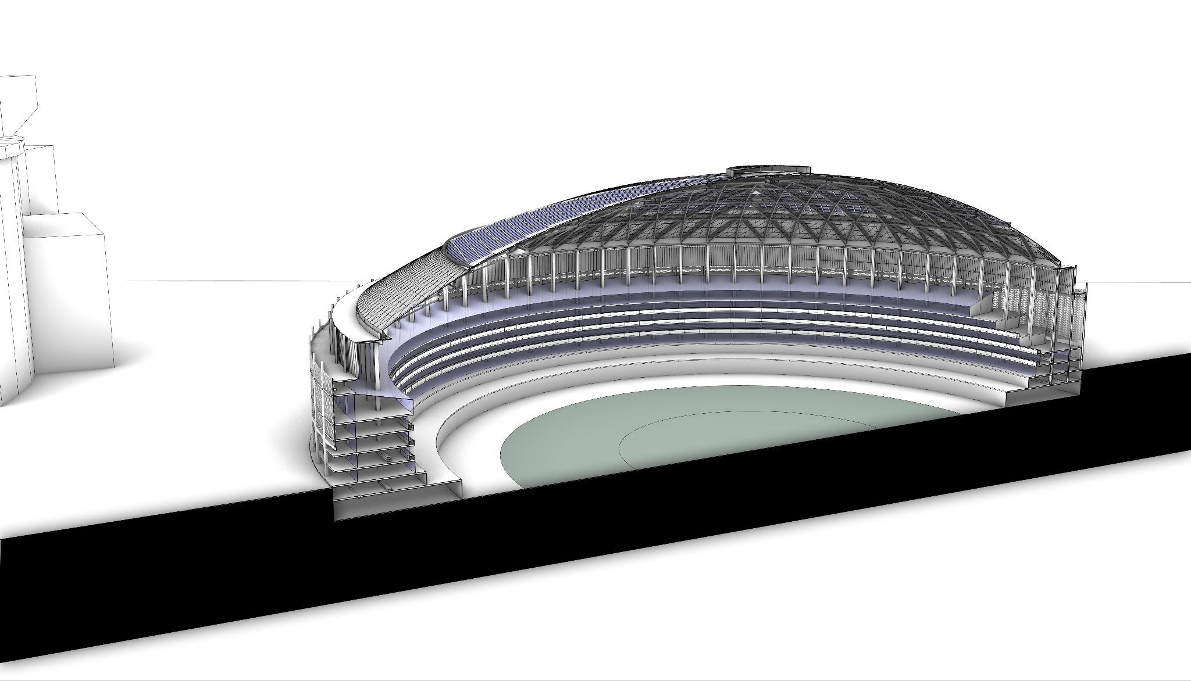
vegetation as focal point
2023 ASHRAE LowDown Showdown Modeling Competition

Slide 38
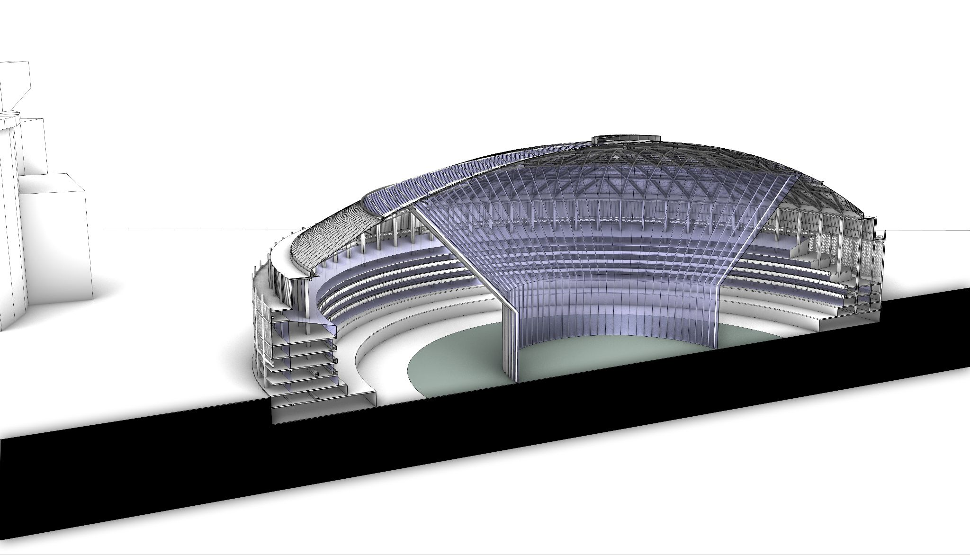
indoor street
indoor park
2023 ASHRAE LowDown Showdown Modeling Competition

Slide 39
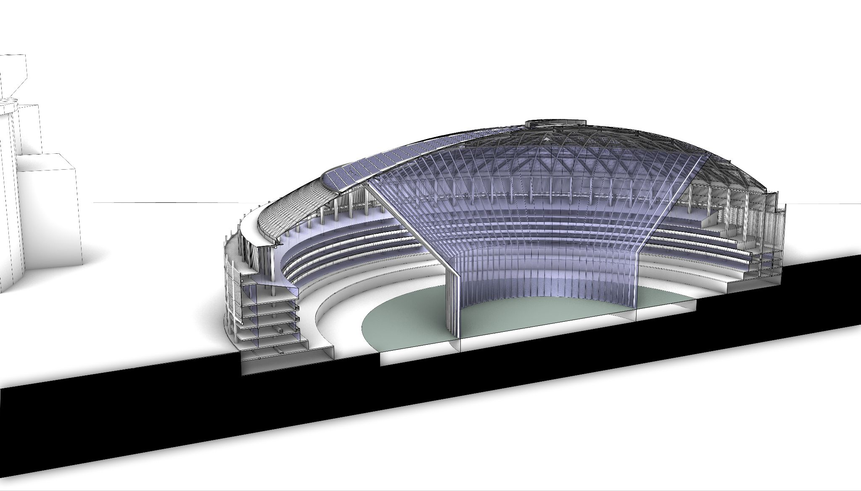
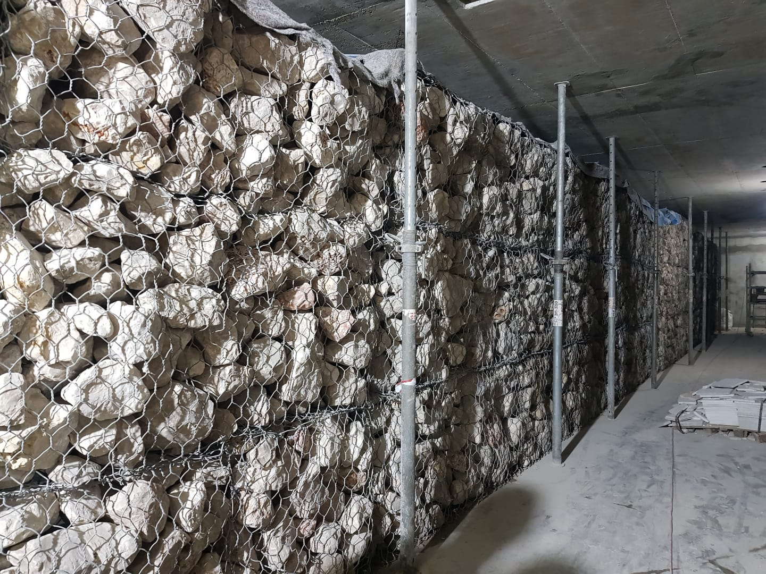
displacement ventilation
humidity control
cond.
thermal labyrinth
spot cooling
2023 ASHRAE LowDown Showdown Modeling Competition

Slide 40
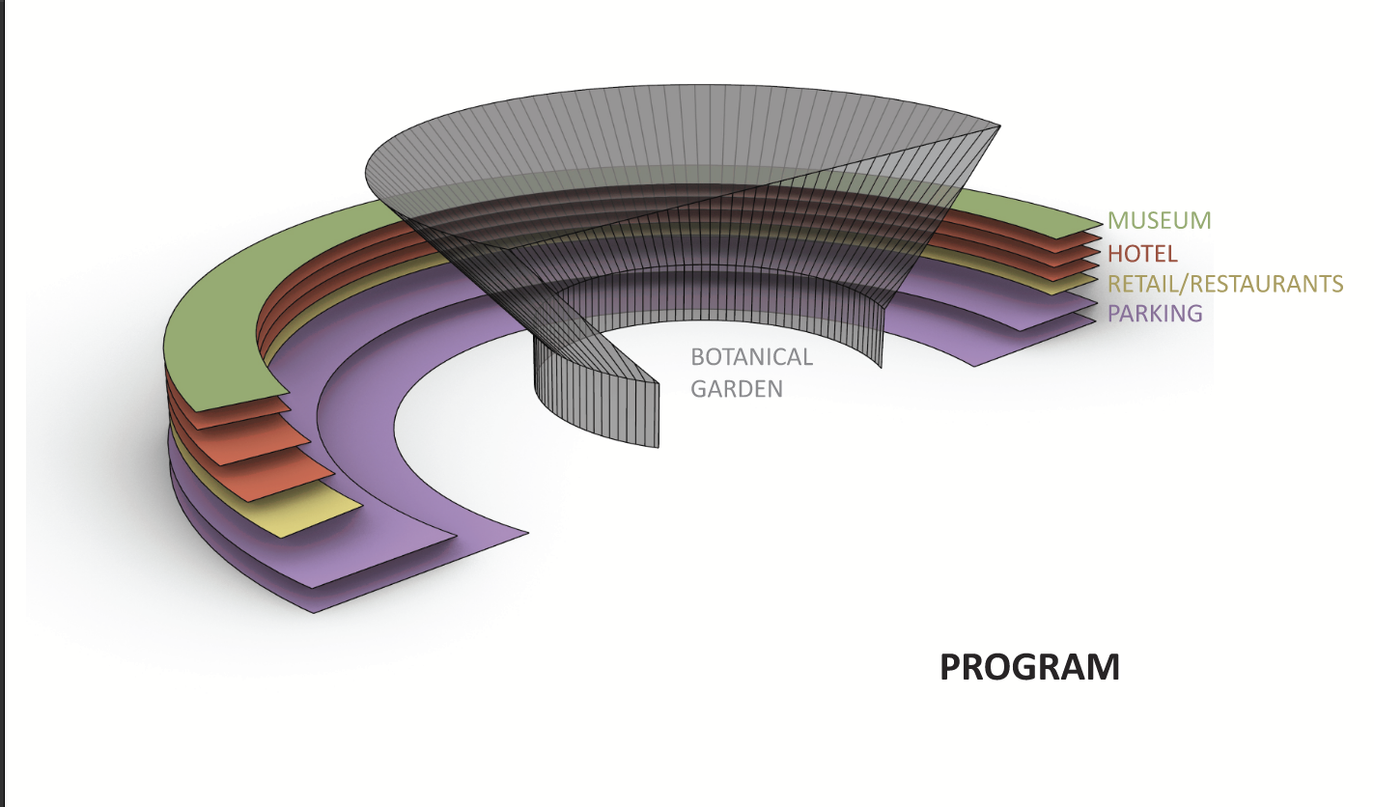
68,316 sf
199,362 sf
77,726 sf
448,378 sf
45,238 sf
2023 ASHRAE LowDown Showdown Modeling Competition

Slide 41
ENERGY
2023 ASHRAE LowDown Showdown Modeling Competition

Slide 42
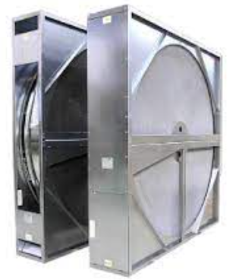
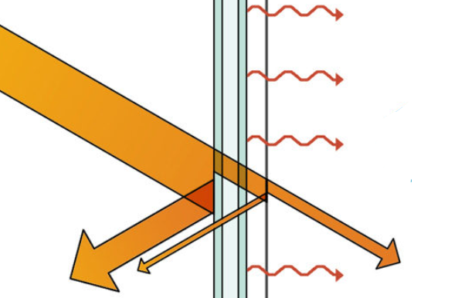
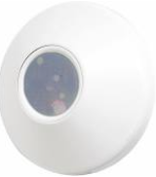
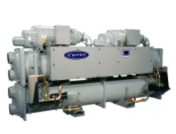
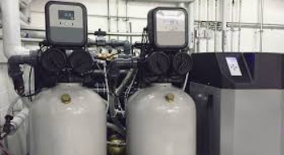
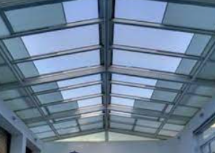
ENERGY SAVINGS
Improved skylight SHGC 0.25
DOAS – enthalpy wheels
Heat recovery chiller
Condensate recovery
Natural Ventilation & Adaptive comfort
Stratified cooling
Buffer thermal zone
Daylight sensor control, efficient LED lighting
Parking garage lighting from skylight
2023 ASHRAE LowDown Showdown Modeling Competition

Slide 43
ENERGY EFFICIENCY MEASURES
Improved skylight SHGC 0.25 (etfe + vision glass)
DOAS – enthalpy wheels
Heat recovery chiller
Condensate recovery
Natural Ventilation & Adaptive comfort for shoulder seasons
Stratified cooling for indoor street (spot cooling + displacement ventilation)
Outer buffer thermal zone
Precondition using the underground thermal labyrinth
Optimized LPDs (Daylight sensor control, LED lighting)
Parking garage lighting from skylight
2023 ASHRAE LowDown Showdown Modeling Competition

Slide 44
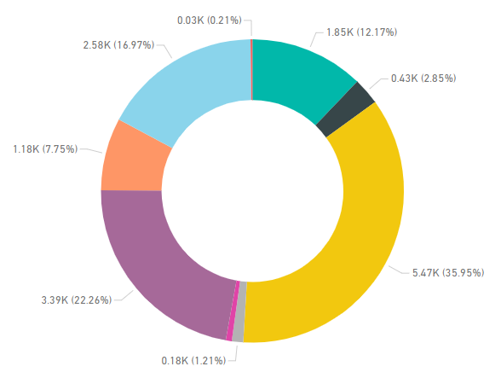
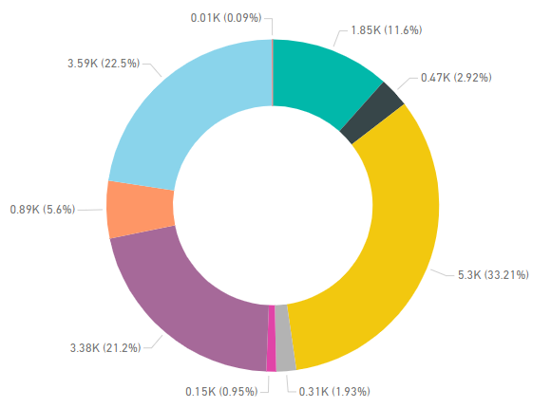
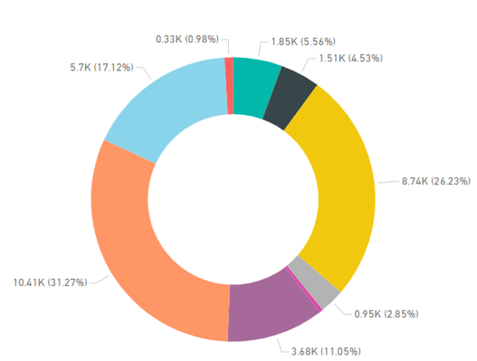
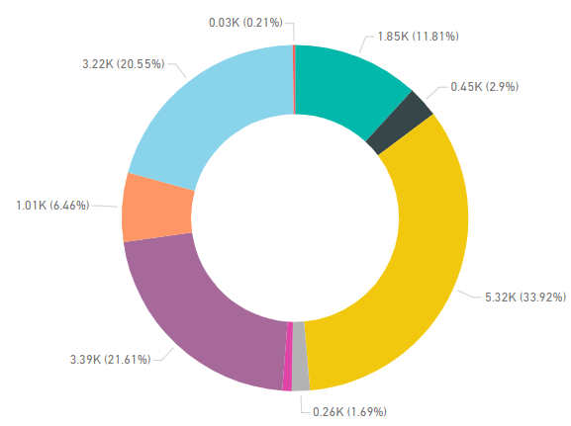
ENERGY MODEL BREAKDOWN W/ CLIMATE CHANGE SCENARIO (MBtu)
combined effect of multiple EEMs
Additional cooling tower
23.5 kBtu/sf-yr
24.3 kBtu/sf-yr
GSHP not recommended
potential imbalance in soil heat
Proposed
Proposed- 2080
cooling dominated
50.7 kBtu/sf-yr
23.9 kBtu/sf-yr
lighting/ DHW energy might be reduced further
Baseline
Proposed- 2050
2023 ASHRAE LowDown Showdown Modeling Competition

Slide 45
CARBON
2023 ASHRAE LowDown Showdown Modeling Competition

Slide 46
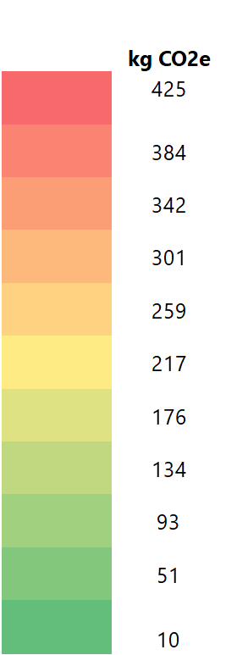
OPERATIONAL CARBON
1.99 kg CO2e/SF-yr
2023
0.60 kg CO2e/SF-yr
2030
0.35 kg CO2e/SF-yr
2050
2023 ASHRAE LowDown Showdown Modeling Competition

Slide 47
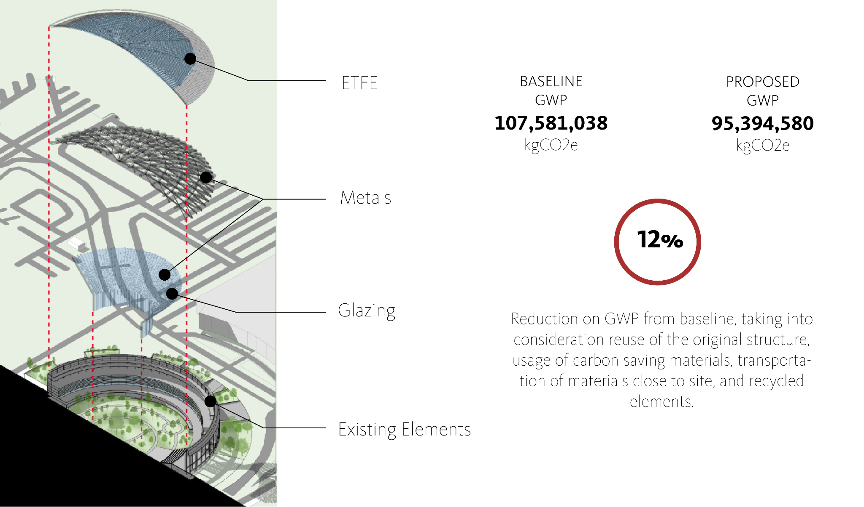
EMBODIED CARBON
2023 ASHRAE LowDown Showdown Modeling Competition

Slide 48
EMBODIED CARBON
2023 ASHRAE LowDown Showdown Modeling Competition

Slide 49
CARBON MITIGATION MEASURES
Existing Concrete Structure maintained as much as possible (only 12% removed to allow for opening)
Diverse programming contributed to lower the reliance on A/C by introducing Mixed Mode and Displacement Ventilation Strategies
Adaptive comfort was studied in order to broaden the comfort band and lower the reliance on A/C
Daylighting was seized to lower the reliance on artificial lighting
The project has the potential to become off grid with proper large scale battery storage
2023 ASHRAE LowDown Showdown Modeling Competition

Slide 50
DAYLIGHT
2023 ASHRAE LowDown Showdown Modeling Competition

Slide 51
97.8 % of occupiable areas receive more than 300 lux during occupied hours
no conditions of potential glare were observed
2023 ASHRAE LowDown Showdown Modeling Competition

Slide 52
ONSITE GENERATION
2023 ASHRAE LowDown Showdown Modeling Competition

Slide 53
2023 ASHRAE LowDown Showdown Modeling Competition

Slide 54
WATER
2023 ASHRAE LowDown Showdown Modeling Competition

Slide 55
WATER EFFICIENCY MEASURES
Indoor Fixtures were designed to have 50% lower rates than code
No irrigation from potable water
Rainwater & Condensate from the entire site will be collected and stored in underground tanks
Toilets & Cooling Tower to use reclaimed water
https://cms.esi.info/Media/productImages/Sustainable_Drainage_Systems_GEOlight_stormwater_management_units_1.jpg
2023 ASHRAE LowDown Showdown Modeling Competition

Slide 56
INDOOR AIR QUALITY
2023 ASHRAE LowDown Showdown Modeling Competition

Slide 57
INDOOR AIR QUALITY DASHBOARD
Air quality awareness
Infection risk indicator
Measured from actual supply/return CO2 concentration
WELL, RESET threshold incorporated
Integrated with skylight control
2023 ASHRAE LowDown Showdown Modeling Competition

Slide 58
real-time time series data forwarding via URL to AWS & Power BI
INDOOR AIR QUALITY DASHBOARD
serverless lambda function for real time processing:
indoor air quality,
energy,
marginal carbon emission.
2023 ASHRAE LowDown Showdown Modeling Competition

Slide 59
INDOOR AIR QUALITY DASHBOARD
Focusing on preserving art, chemical transformation
MERV13 filter
2023 ASHRAE LowDown Showdown Modeling Competition

Slide 60
2023 ASHRAE LowDown Showdown Modeling Competition

Slide 61
RESULTS SUMMARY
 | IP | SI
Total Annual Energy Use | 15,219,857 kBtu | 4,459,639 kWh
Total Annual Water Use | 299,767 Gallons | 1,134,741 liters
Total Annual Onsite Energy Production | 125,593,517 kBtu | 36,800,725 kWh
Annual Energy & Water Cost | 0.605 $/sf | 0.054 $/m2
Site EUI | 23.5 kBtu/sf yr | 76.50 kWh/m2
Source EUI | 74.1 kBtu/sf yr | 241.24 kWh/m2
Annual CO2e Emissions | 1.99 kgCO2e/sf yr | 1.99 kgCO2e/sf yr
Embodied CO2e | 94,253,677 kgCO2e | 94,253,677 kgCO2e
2023 ASHRAE LowDown Showdown Modeling Competition

Slide 62
CONCLUSIONS
Few buildings are as historically iconic and impactful in terms of architecture & engineering as the Astrodome. With this in mind, the team worked towards creating a design that aimed to repurpose it by adapting it to our climate change drive times while giving it a new life as an urban hub with multiple, diverse uses. The team strived to keep the existing geometry as intact as possible while incorporating new uses, adapting each one of these new uses to the best performance optimization strategy possible and to the best possible location within the existing structure.
Additionally, the team looked beyond the building in order to incorporate more urban oriented and site oriented strategies, which contributed to the overall performance of the design. Opening the building to the East contributed on the creation of an “indoor street” and a botanical garden while a strategy of shading of the existing parking lot justified the incorporation of photovoltaics canopies, which will produce close to 8 times more than what the new design will require.
The project is by far netzero energy and netzero carbon!
THE CARBON LIGHTERS 2023
2023 ASHRAE LowDown Showdown Modeling Competition

