Slide 1
2017 ASHRAE LowDown Showdown Modeling Competition
2017 Building Performance
Analysis Conference
Retrofit of Existing Storage Warehouse Facility
SANDSTORM STOPPERS
Presentation By
Junaid Bin Naseer
Senior Mechanical Engineer [AECOM]

Slide 2
Team & Software Used
Name | Role
Junaid Bin Naseer | Captain/Modeler
Christopher King | Coach
Ali Haidar | Mechanical Designer
Hasan Karaway | Architect
Software Name | Purpose
IES VE 2017 | Energy Modeling and Cooling Load
Relux | Lighting Calculations
2017 ASHRAE LowDown Showdown Modeling Competition

Slide 3
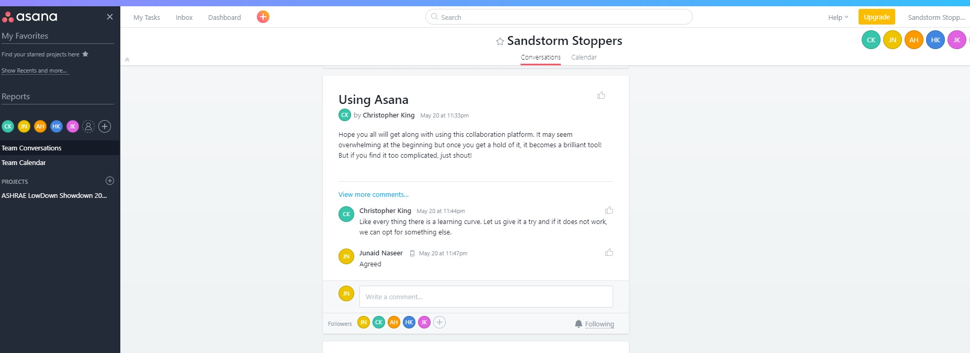
Team Collaboration 01
2017 ASHRAE LowDown Showdown Modeling Competition

Slide 4
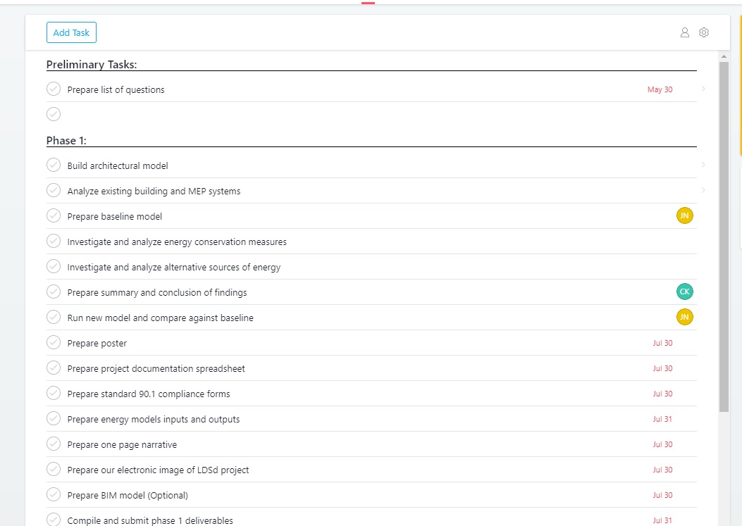
Team Collaboration 02
2017 ASHRAE LowDown Showdown Modeling Competition

Slide 5
Approach to Achieve Net Zero
Understanding Climate Zone
Evaluating Potential Savings from Renewables
Modeling and Analyzing Existing Building Energy Consumption
Potential Energy Conservation Measures including Passive and Active
Conclusion
2017 ASHRAE LowDown Showdown Modeling Competition

Slide 6
Understanding Climate Zone
Zone 4A – Warm and Humid
Weather File – Andrews Air Base
Max Temp 37.8°C DB [100.04 °F]
Min Temp -18.9°C DB [-2.02 °F]
Mean Temp 13.0 °C DB [55.4 °F]
Max Humidity Ratio 26.0 g/kg [182 grains/lbs]
2017 ASHRAE LowDown Showdown Modeling Competition

Slide 7
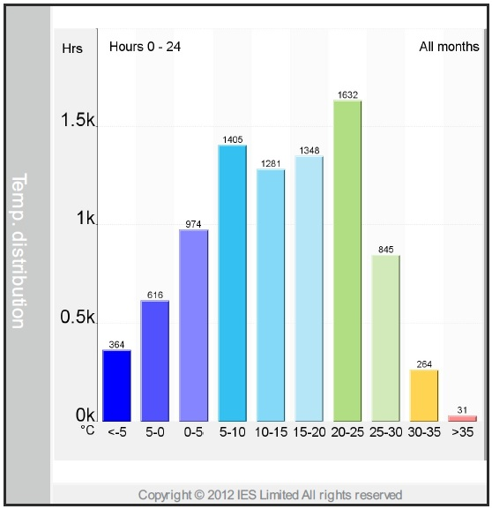
Temperature Distribution
Temperature is in range of -5 to 15 °C for approximately 4,619 hours ; Heating Requirement
Temperature is in range of 20-35 °C for approximately 2,772 hours; Cooling Requirement
Heating will dominate the energy consumption
2017 ASHRAE LowDown Showdown Modeling Competition

Slide 8
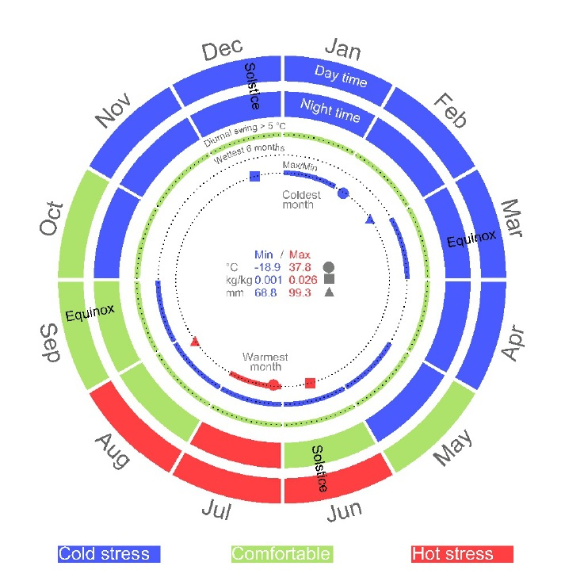
Hot, Cold, & Temperate Months
November till April – Heating Season
June till August – Cooling Season
May, Sept, & October – Comfortable Season
6 Months of Heating
3 Months of Cooling
3 Months of Temperate Climate
2017 ASHRAE LowDown Showdown Modeling Competition

Slide 9
Renewable Energy
Selected Renewable Type = Photovoltaic Panels
Type of PV Panel = Mono Crystalline
Power Output Range = 320 – 335 W
Dimensions = 1,978 mm Height X 992 mm Width
# of Panels = 491
Inclination = 32°
Azimuth = 32.27 °
Annual Electricity Generated = 231,194 kWh/year [788,834 kBTU/year]
Cost (Retail + Labour) per Watt = $ 3.87
Total Watt = 164,315
Total Cost = $ 635,893
2017 ASHRAE LowDown Showdown Modeling Competition

Slide 10
Renewable Energy Generation Per Month
2017 ASHRAE LowDown Showdown Modeling Competition

Slide 11
Modeling Existing Building
Architecture - PDF to CAD with Dimensions
Height of Building
Assumptions
2017 ASHRAE LowDown Showdown Modeling Competition

Slide 12
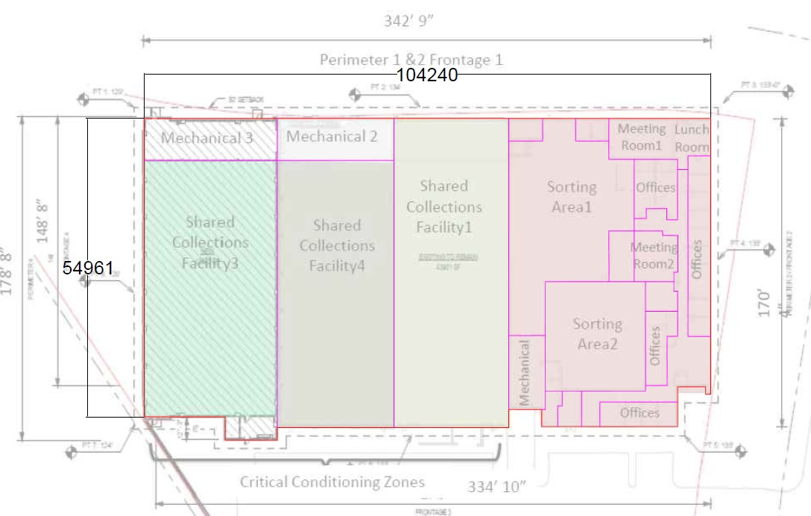
Modeled Floor Plan
Dimensions in MM
2017 ASHRAE LowDown Showdown Modeling Competition

Slide 13
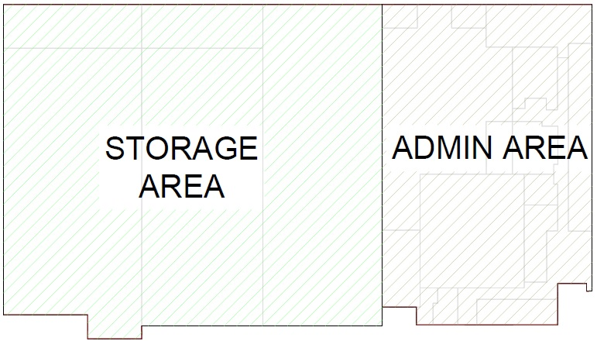
Building Architecture Zoning
2017 ASHRAE LowDown Showdown Modeling Competition

Slide 14
Height of Building
STORAGE AREA HEIGHT = 13.4 m
ADMIN BUILDING
Height = 5.40 m
2017 ASHRAE LowDown Showdown Modeling Competition

Slide 15
Assumptions
Modeled Area of 64,635 ft² does not match with 43,492 ft²
ADMIN Zone Floor to False Ceiling Height of 4.50 meter [14.76 feet]
ADMIN Zone Ceiling Height of 1.00 meter [3.28 feet]
Glazing is considered only for ADMIN Zone
Glazing Sill Height 1.50 meter [4.92 feet]
Glazing Height 2.20 meter [7.20 feet]
Building is oriented 309 due north
Peak Staff Occupancy 41 People
2017 ASHRAE LowDown Showdown Modeling Competition

Slide 16
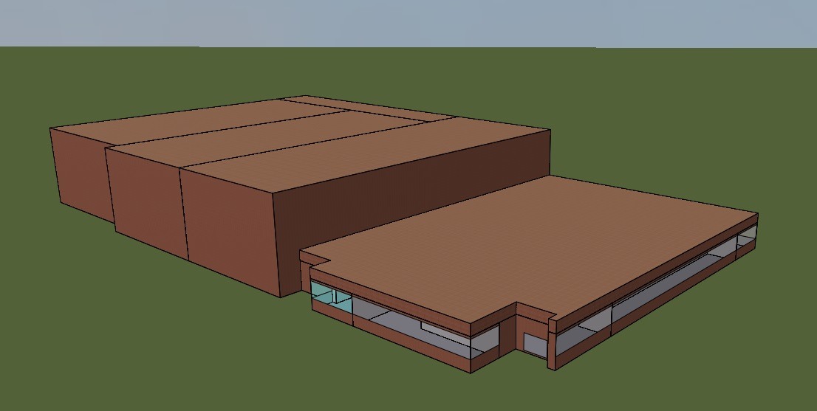
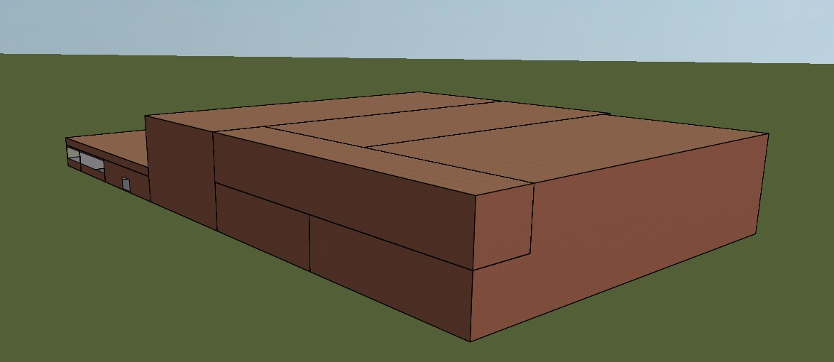
Existing Building Model 3D Model
Front Perspective View
Back Perspective View
2017 ASHRAE LowDown Showdown Modeling Competition

Slide 17
Modeled ADMIN Zone Areas
Sr # | Space Tag | Area (m²) | Area (ft²)
1 | C00: Corridor 01 | 192 | 2,063
2 | M00: Mech 00 | 92 | 987
3 | X01: Sorting Area 01 | 726 | 7,811
4 | X02: Meeting Room 01 | 89 | 957
5 | X03: Lunch Room | 54 | 578
6 | X04: External Office 01 | 139 | 1,492
7 | X05: External Office 02 | 92 | 995
8 | X06: Sorting Area 02 | 371 | 3,995
9 | X07: Internal Office 01 | 95 | 1,019
10 | X08: Meeting Room 02 | 72 | 771
11 | X09: Internal Office 02 | 80 | 866
12 | X10: External Office 03 | 46 | 492
 |  | 2,046 | 22,024
2017 ASHRAE LowDown Showdown Modeling Competition

Slide 18
Modeled STORAGE Zone Areas
Sr # | Space Tag | Area (m²) | Area (ft²)
1 | M01: Mech 02 & 03 | 192 | 2,063
2 | S00: SCF 01 | 1,202 | 12,943
3 | S01: SCF 02 | 1,221 | 13,143
4 | S02: SCF 03 | 1,346 | 14,487
 |  | 3,961 | 42,637
2017 ASHRAE LowDown Showdown Modeling Competition

Slide 19
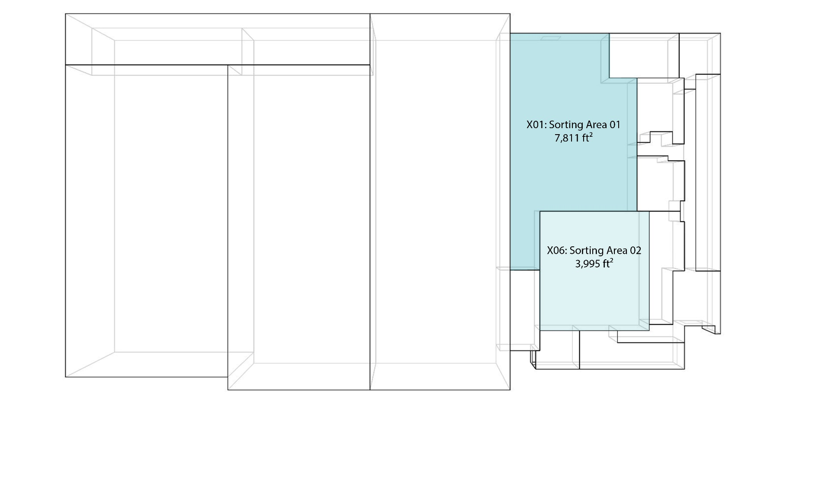
Sorting Spaces
2017 ASHRAE LowDown Showdown Modeling Competition

Slide 20
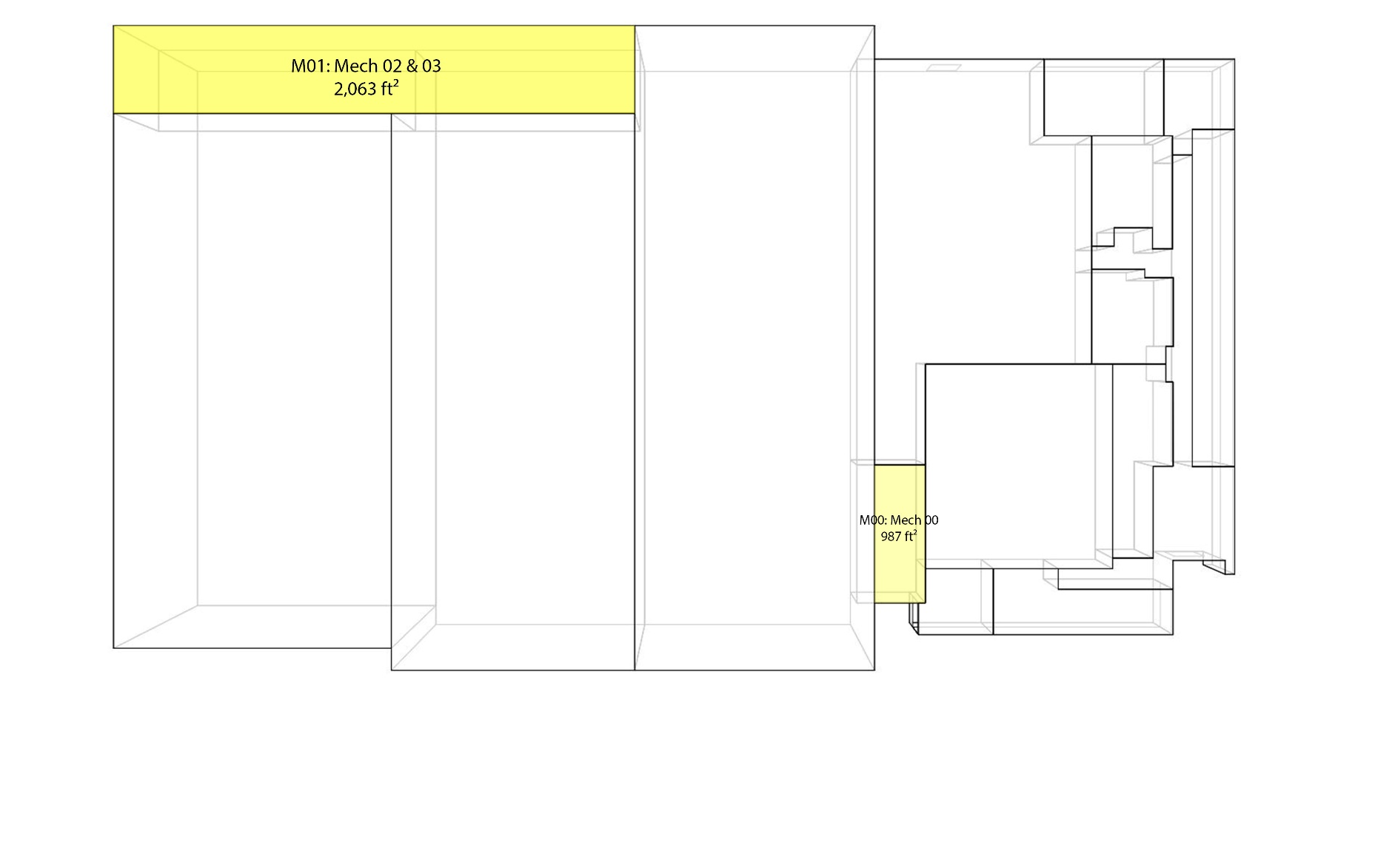
Mechanical Spaces
2017 ASHRAE LowDown Showdown Modeling Competition

Slide 21
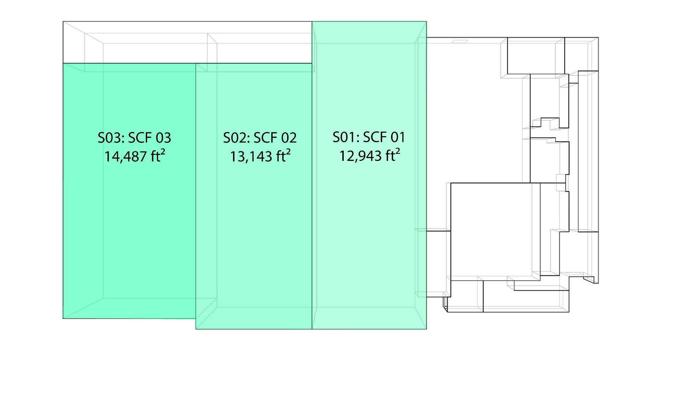
Shared Collection Facilities
2017 ASHRAE LowDown Showdown Modeling Competition

Slide 22
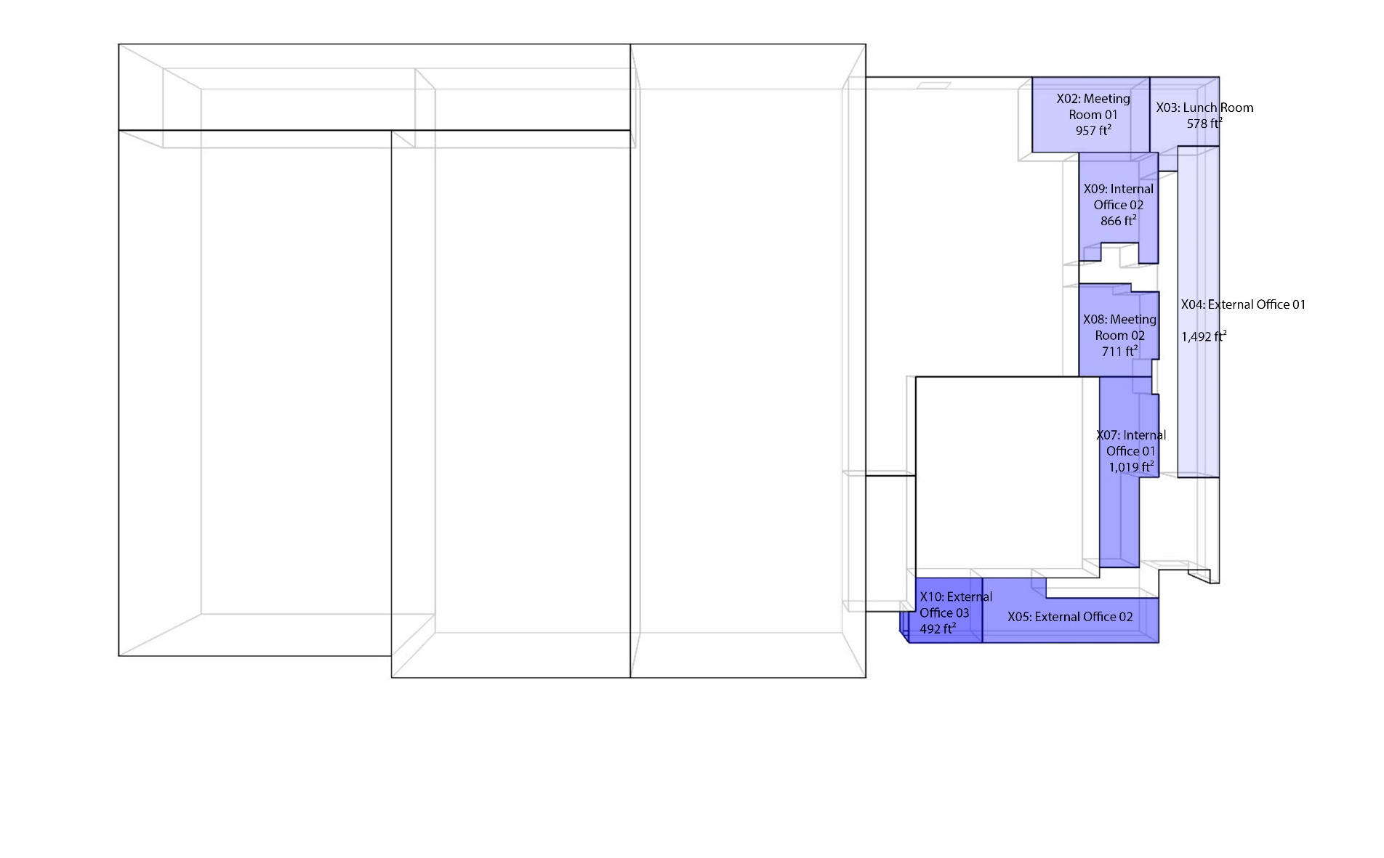
Office Spaces
2017 ASHRAE LowDown Showdown Modeling Competition

Slide 23
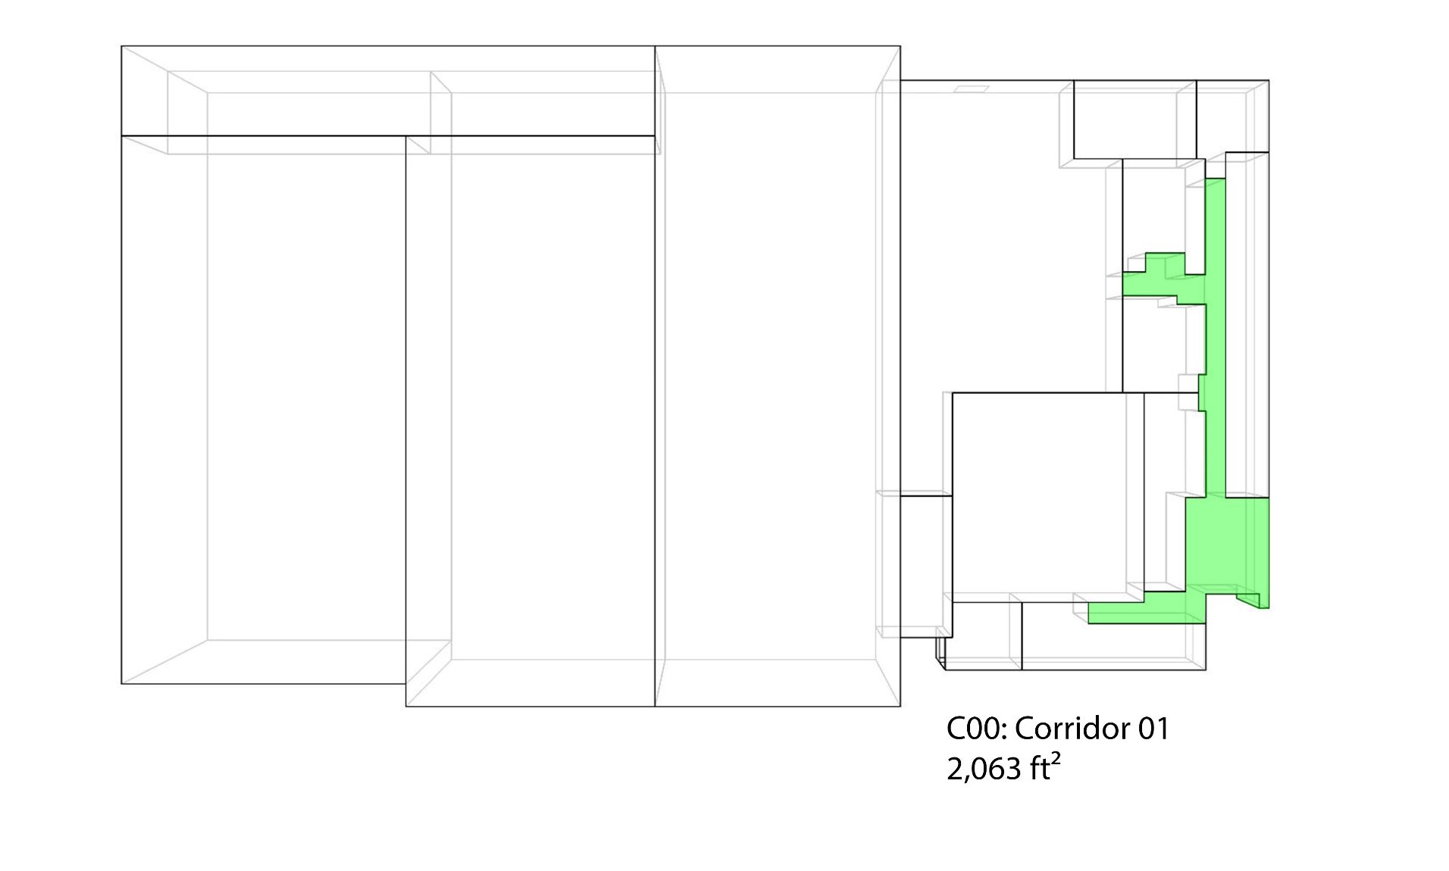
Corridor
2017 ASHRAE LowDown Showdown Modeling Competition

Slide 24
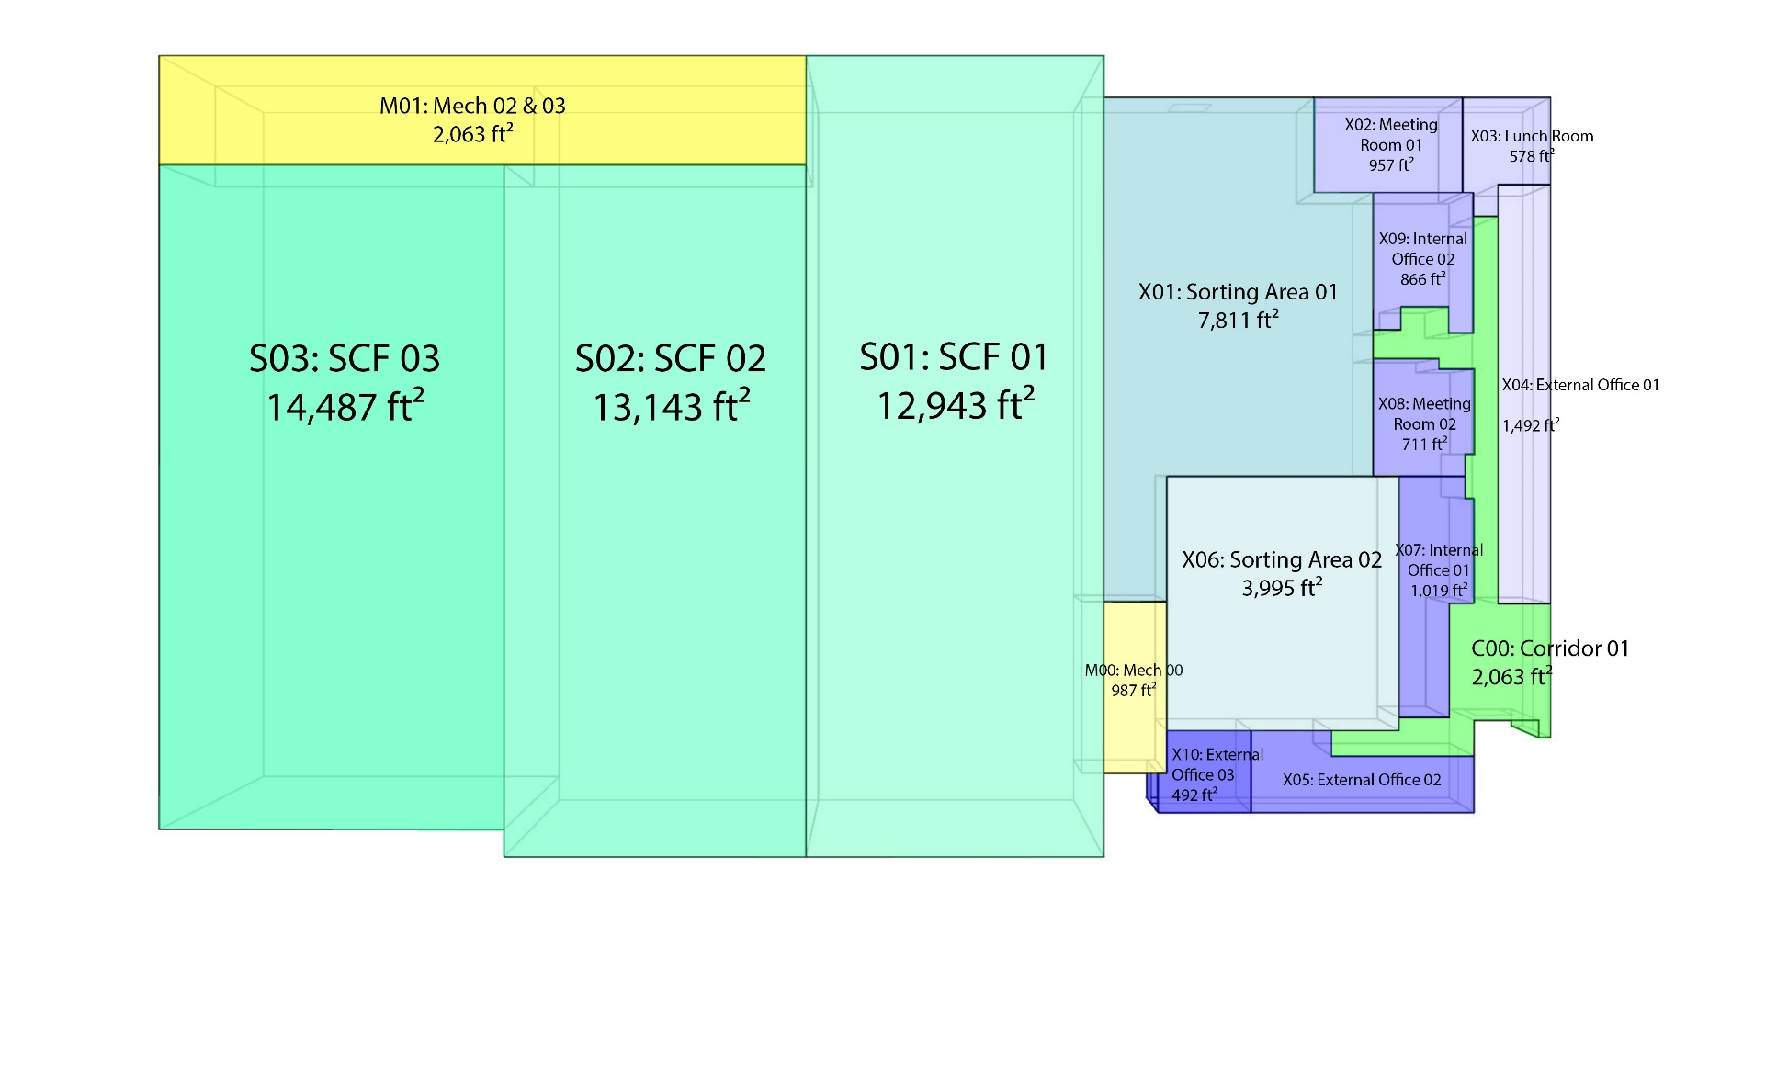
All Spaces
2017 ASHRAE LowDown Showdown Modeling Competition

Slide 25
Wall & Roof U-Values
S # | Building Component | Element Type (Outside to Inside) | Thickness (in) | R-Value (°F-ft².h/BTU) | R-Value (m².°K/W)
1 | Roof | Bitumen Roofing Membrane |  |  | 0.00
2 | Roof | Apa Rated Oriented Strand Board | 0.5 | 0.5 | 0.09
3 | Roof | Rigid Polyiso Insulation | 3.2 | 39.6 | 6.97
 |  |  | 3.7 | U-Value | 0.14 W/m².K [0.025 BTU/h. ft².°F]
S # | Building Component | Element Type (Outside to Inside) | Thickness (in) | R-Value (°F-ft².h/BTU) | R-Value (m².°K/W)
1 | Wall Type 1 | Outside Resistance |  |  | 0.04
2 | Wall Type 1 | Nom Insulated CMU | 8 | 5.5 | 0.97
3 | Wall Type 1 | Air, Water, & Vapor Barrier Membrane |  |  | 0.00
4 | Wall Type 1 | Thermal Insulation Board | 3 | 19.5 | 3.43
5 | Wall Type 1 | Cavity | 1 3/8 | 1.9 | 0.33
6 | Wall Type 1 | Nom Split Face CMU | 4 | 1.6 | 0.28
7 | Wall Type 1 | Inside Resistance |  |  | 0.12
 |  |  |  | U-Value | 0.19 [0.033 BTU/h. ft².°F]
2017 ASHRAE LowDown Showdown Modeling Competition

Slide 26
External Glazing, Ground U-Value, & Infiltration
External Glazing – 3.20 W/m².K [0.56 BTU/h. ft².°F] and SHGC 0.40
External Glazing Ratio – 32 % (240 m²/739m² of Admin Area Only)
Sill Height – 1.50 meter
Glazing Height – 2.20 meter
Ground Edge Insulation Width X Thickness 80mm X 610 mm
Ground Edge Insulation U-Value 0.025 W/m.K [0.014 BTU.ft/h. ft².°F]
Infiltration 1.50 L/s.m².Facade
2017 ASHRAE LowDown Showdown Modeling Competition

Slide 27
Thermal, Lighting & Equipment Input
Zone Description | Room Temperature Summer (°F) | Room Temperature Winter (°F) | Room Humidity (%) | Lighting (W/ft²) | Equipment (W/ft²) | Occupancy (ft²/person) /[Nos]
Shared Collection Facility | 60 | 60 | 40 | 1.7 |  | 1 each
Mechanical Room | 80 | 55 |  | 1.5 |  | 1 each
Offices | 75 | 70 |  | 1.1 | 0.9 | 28.1 [57]
Circulation | 75 | 70 |  | 0.5 |  | 0
Meeting Rooms | 75 | 70 |  | 1.1 | 0.9 | 13.33 [12]
2017 ASHRAE LowDown Showdown Modeling Competition

Slide 28
Annual Ground Temperature 2011-2016
2017 ASHRAE LowDown Showdown Modeling Competition

Slide 29
Challenges Faced in ADMIN HVAC System
Data Provided OFFICE VAV REHEAT Installed in 1970
Our Assumptions
Standard Rooftop Package Unit with Variable Speed Fan and VAV Reheat
Outdoor Air Requirement 1,400 L/s [3,000 cfm]
Supply Air Fan 4,419 L/s [3,000 cfm]
VAV Fan maximum turndown of 30%
Fan Power was adjusted to match existing system consumption
Reheat Coil for Spaces Exposed to External Conditions
2017 ASHRAE LowDown Showdown Modeling Competition

Slide 30
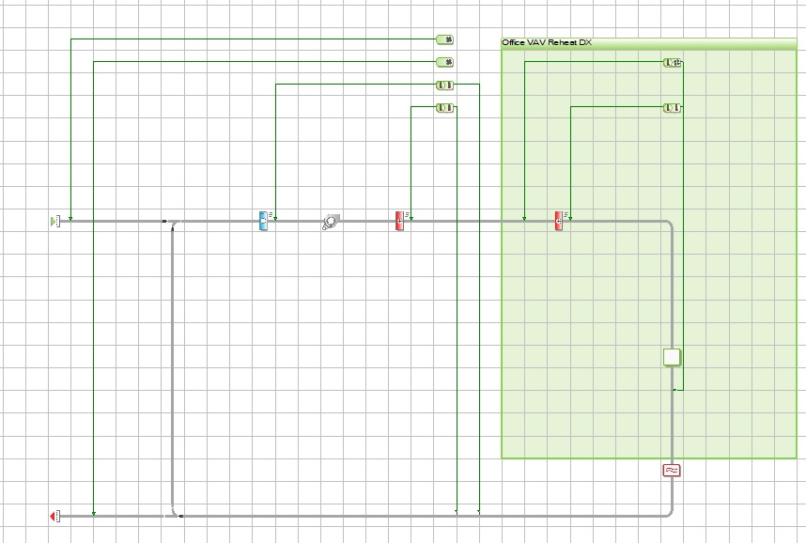
HVAC Existing Building Data/ADMIN ZONE
Supply Fan
Flowrate 4,419 L/s
SFP 3.40 W/L/s
Reheat Coil for Spaces Exposed to External
DX Cooling Efficiency
6.2 EER
@AHRI
THERMAL SPACE
COMMON RETURN
2017 ASHRAE LowDown Showdown Modeling Competition

Slide 31
Challenges Faced in SCF-01 HVAC System
Data Provided Module 1: Liebert CRAC-type DX System Installed 2011
Unable to find data on this type of system
Our Assumptions
Standard Rooftop Package Unit with Constant Speed Fan
Main Electric Heating Coil Inside the Unit
Fan Power was adjusted to match existing system consumption
Airflow rate similar to AHU-03 i.e. 8,178 L/s [17,400 cfm]
2017 ASHRAE LowDown Showdown Modeling Competition

Slide 32
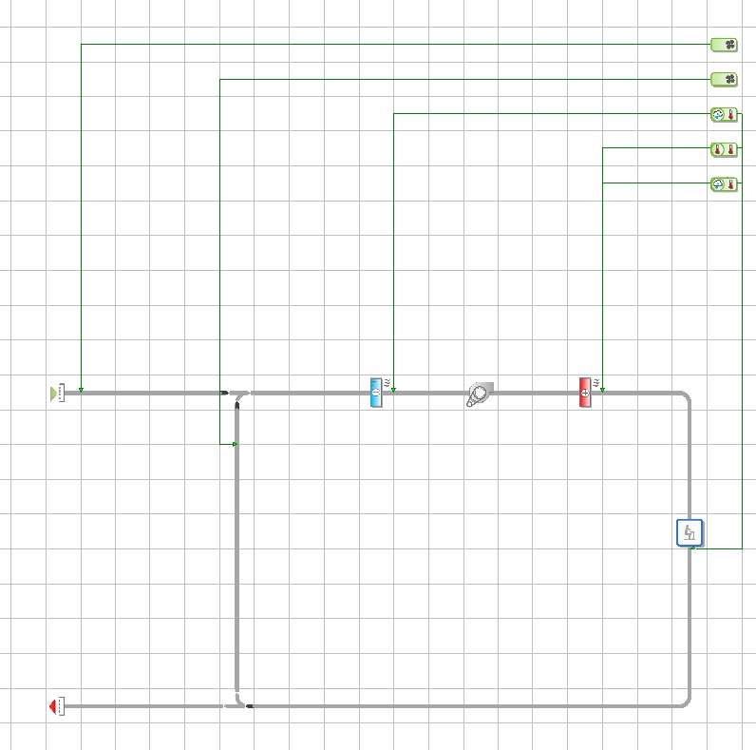
HVAC Existing Building Data/SCF-01
Supply Fan
Flowrate 8,178L/s
SFP 4.50 W/L/s
Electric Heating Coil
60 kW
DX Cooling Efficiency
7.2 EER
@AHRI
THERMAL SPACE
2017 ASHRAE LowDown Showdown Modeling Competition

Slide 33
Challenges Faced in SCF-02 HVAC System
Data Provided AHU-01 is similar to AHU-03
Discrepancies between control schematics and BMS Screenshot
Airflow rate is not similar to AHU-03
Our Assumptions
AHU-01 serving SCF-02 is with Active Desiccant Wheel and Reactivation Air Fan
One Main Electric Heating Coil Inside the Unit
Airflow is 6,323 L/s [13,400 cfm]
2017 ASHRAE LowDown Showdown Modeling Competition

Slide 34
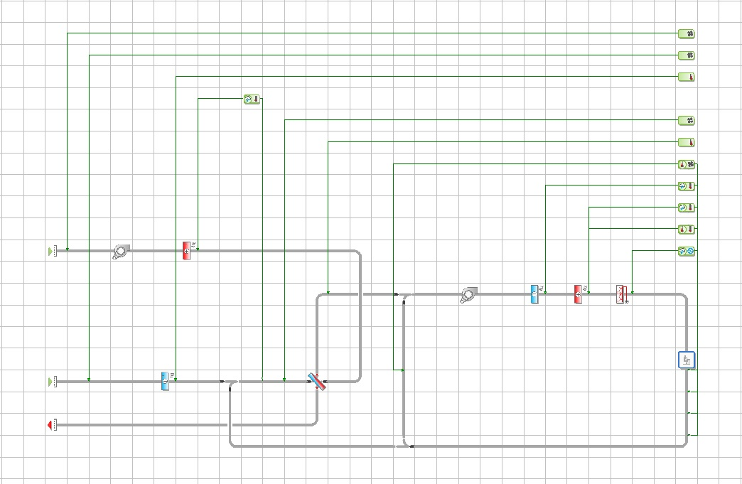
HVAC Existing Building Data/SCF-02
Reactivation Air Fan
Flowrate 300 L/s
SFP 3.00 W/L/s
Reactivation Heater
40 kW
Dehumidification Wheel
SAF
Flowrate 6,323 L/s
SFP 4.50 W/L/s
OA Coil
16 kW
AHU Coil
71.74 kW
Electric Heating Coil
50 kW
2017 ASHRAE LowDown Showdown Modeling Competition

Slide 35
Challenges Faced in SCF-03 HVAC System
Data Provided Control Schematics, BMS Screenshot, & Schedule
Discrepancies between control schematics and BMS Screenshot
Our Assumptions
The unit is Performance Climate Changer with CDQ wheel and without Reactivation air fan and heater from Trane
Specific Fan Power per schedule should be 1.40 W/L/s but was adjusted to match metered energy consumption and was increased to 3.00 W/L/s
Airflow is 8,178 L/s [17,400 cfm]
2017 ASHRAE LowDown Showdown Modeling Competition

Slide 36
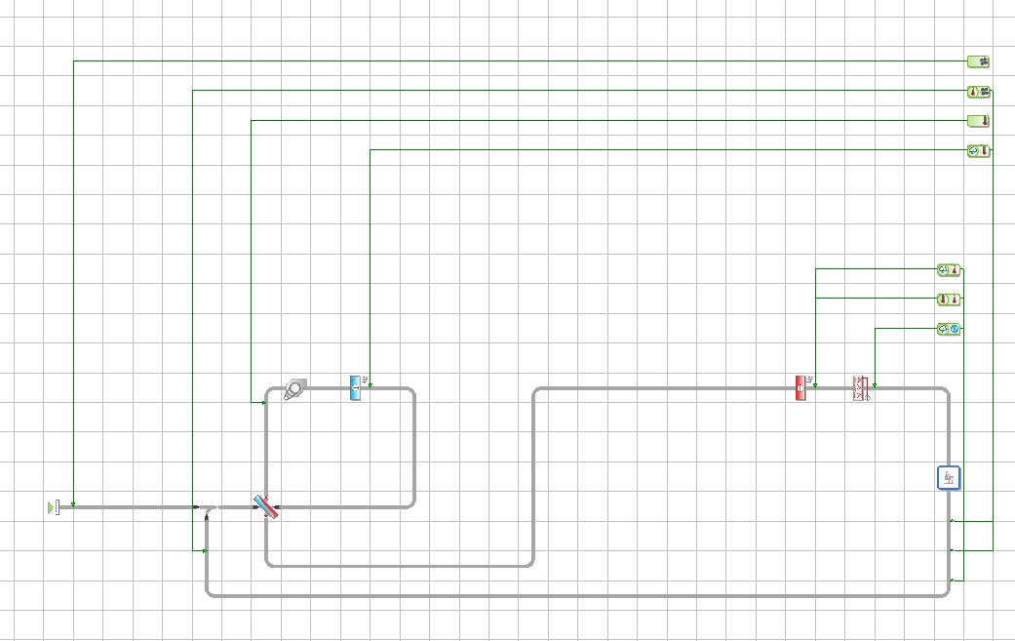
HVAC Existing Building Data/SCF-03
AHU Coil
71.74 kW
Electric Heating Coil
60 kW
Supply Air Fan
Flowrate 8,178 L/s
SFP 3.00 W/L/s
Dehumidification Wheel
2017 ASHRAE LowDown Showdown Modeling Competition

Slide 37
Challenges Faced in Hydronic HVAC System
Data Provided Air Cooled Scroll Chiller from Trane
No Data on Chilled Water Pump Power
Our Assumptions
Efficiencies of Unit were modeled using CGAM Air Cooled Trane Chiller Product Catalogue
Assumed Chilled Water Pump Power 6.30 kW
2017 ASHRAE LowDown Showdown Modeling Competition

Slide 38
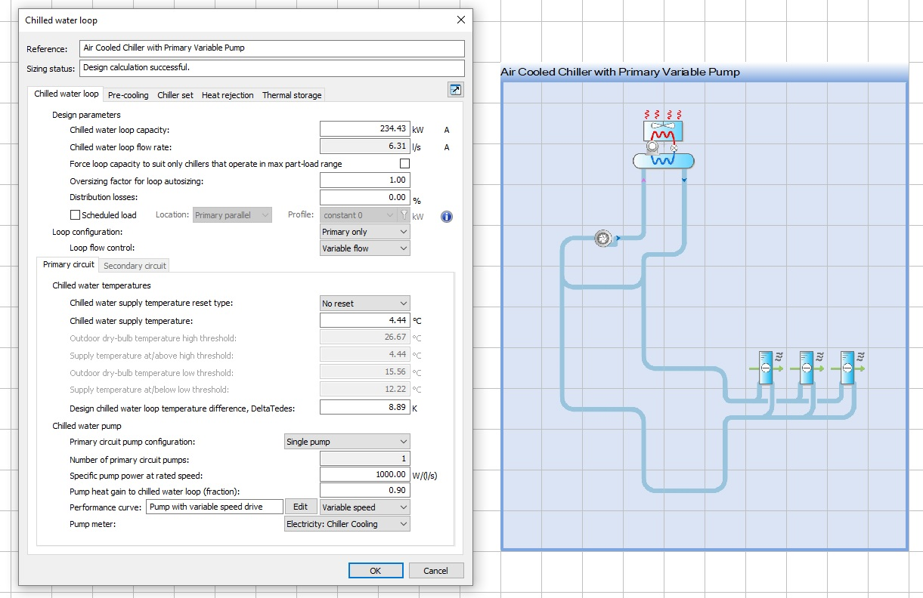
Hydronic System
Air Cooled Chiller
Trane CGAM
COP 2.96 @ AHRI [EER 10]
Delta T 8.89 K
CHWST 4.44 °C [40 °F]
CHWP SPP
1000 W/L/s [63 W/gpm]
Variable Chilled Water Pump
Chilled Water Coils of AHU-01 & AHU-03
2017 ASHRAE LowDown Showdown Modeling Competition

Slide 39
ADMIN ZONE Metered Vs Simulated Energy Consumption (kWh)
Metered 549,382 kWh
Simulated 521,407 kWh
Error 5.00%
2017 ASHRAE LowDown Showdown Modeling Competition

Slide 40
SCF ZONE Metered Vs Simulated Energy Consumption (kWh)
Metered 2,668,124 kWh
Simulated 2,383,926 kWh
Error 11.00%
2017 ASHRAE LowDown Showdown Modeling Competition

Slide 41
Metered Vs Simulated Energy Consumption
2017 ASHRAE LowDown Showdown Modeling Competition

Slide 42
Simulated Energy Consumption Breakdown
Metered 3,217,506 kWh
Simulated 2,864,176 kWh
Error 11.00%
2017 ASHRAE LowDown Showdown Modeling Competition

Slide 43
Energy Conservation Measures
Reduction in Window U-Value from 3.2 W/m².K to 0.73 W/m².K
Reduction in Infiltration 1.5 L/s.m².fac to 0.5 L/s.m².fac
Reduced Setpoint of Heating from 16°C (60 °F) to 15°C (59 °F) for Storage Zone Only
Reduction of Current Lighting to LED
Package Outdoor Heat Pump with Energy Recovery Wheel for ADMIN Zone
Replacement of RTU-1 with Package Unit which includes CDQ Wheel
Replacement of Centrifugal Fans with Direct Drive Plenum Fans
2017 ASHRAE LowDown Showdown Modeling Competition

Slide 44
1. Window U-Value from 3.20 to 0.73 W/m².K
Area of Glazing 240 m² [2,582 ft²]
Cost per ft² $ 52
Installation & Profit $ 52 X 1.34 = $ 70
Total Cost $ 180, 768
Change in EUI - 32 kWh/year
Annual Energy Saved 192,842 kWh [657,977 kBTU]
US Dollars Saved $ 15,427/year [8 cents per kWh]
2017 ASHRAE LowDown Showdown Modeling Competition

Slide 45
ECM_01 Window Monthly Energy Consumption
Simulated 2,861,055kWh
Window 2,668,213 kWh
EUI Change -32 kWh/year [7.0%]
2017 ASHRAE LowDown Showdown Modeling Competition

Slide 46
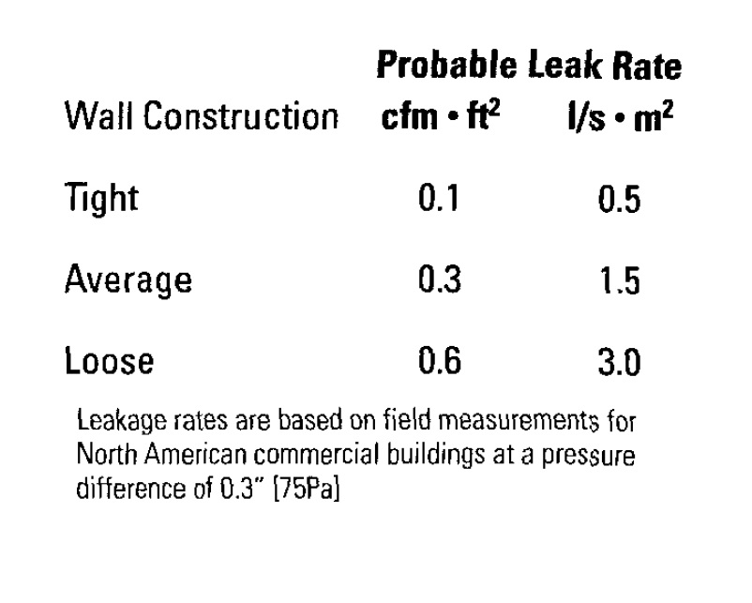
2. Infiltration from 1.5 L/s.m².fac to 0.5 L/s.m².fac
Assumptions based on Book “Humidity Control Design Guide For Commercial and Institutional Building” by Lewis G. Harriman, G.W. Brundrett, & R. Kittler
Retrofit Building
Existing Building
Cost $5,000 [Assumed]
Change in EUI -116 kWh/year
Annual Energy Saved -112,351 kWh [383,342 kBTU]
US Dollars Saved $9,000/year
2017 ASHRAE LowDown Showdown Modeling Competition

Slide 47
ECM_02 Infiltration Monthly Energy Consumption
Simulated 2,861,055 kWh
Infiltration 2,748,704 kWh
2017 ASHRAE LowDown Showdown Modeling Competition

Slide 48
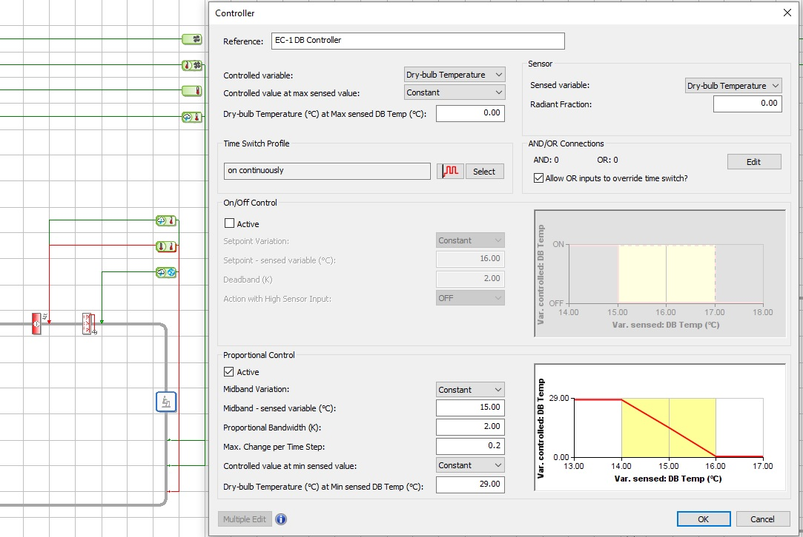
3. Heating Setpoint from 16 °C to 15 °C [01]
2017 ASHRAE LowDown Showdown Modeling Competition

Slide 49
3. Heating Setpoint from 16 °C to 15 °C [02]
Change in EUI -33 kWh/year
Annual Energy Saved 199,987 kWh [682,356 kBTU]
US Dollars Saved $16,000/year
2017 ASHRAE LowDown Showdown Modeling Competition

Slide 50
ECM_03 Heating Setpoint Monthly Energy Consumption
Simulated 2,861,055kWh
Setpoint 2,661,068 kWh
EUI Change -33 kWh/year [7.0%]
2017 ASHRAE LowDown Showdown Modeling Competition

Slide 51
4.Replacement of Current Lighting with LED_01
Lighting calculations based on IES NA.
Software used Relux
Existing Building Lighting Power 98.15 kW
Existing Building Lighting Power Density 16.76 W/m² [1.56 W/ft²]
Retrofit Installed Lighting Power 42.2 kW
Retrofit Installed Lighting Power Density 7.20 W/m² [0.67 W/ft²]
57% Reduction in Installed Lighting
LED Cost Per 60 W Bulb $ 36
LED Cost $ 25,320
Installation & Profit $ 25,320 X 1.38 = $ 35,000
2017 ASHRAE LowDown Showdown Modeling Competition

Slide 52
4.Replacement of Current Lighting with LED_02
Change in EUI -116 kWh/year
Annual Energy Saved 699,441 kWh [2,386,492 kBTU]
US Dollars Saved $56,000/year
2017 ASHRAE LowDown Showdown Modeling Competition

Slide 53
4.Replacement of Current Lighting with LED
Simulated 2,861,055kWh
LED 2,161,614kWh
EUI Change -116 kWh/year [24.0%]
2017 ASHRAE LowDown Showdown Modeling Competition

Slide 54
5. Package Outdoor Heat Pump with Energy Recovery Wheel for ADMIN Zone_01
Cooling Unit Size 51.4 kW [175 kBTU]/Heating Unit Size 51 kW [174 kBTU]
Cooling Efficiency of Unit 3.10 COP [EER 10.6] @ AHRI
COP Heat Pump 3.2 @ 8.33 °C [47 °F] & 2.0 @ -8.33 °C [17 °F]
Energy Recovery Wheel 75% Total Effectiveness
Change in EUI -42 kWh/year
Annual Energy Saved 253,953 kWh [866,488 kBTU]
US Dollars Saved $20,316/year
2017 ASHRAE LowDown Showdown Modeling Competition

Slide 55
5. Package Outdoor Heat Pump with Energy Recovery Wheel for ADMIN Zone_02
Cost Data Based on Updated Building Sector Appliance & Equipment Costs & Efficiencies
Retail Cost Per 90 kBTU $ 6,400
Installation Cost Per 90 kBTU $ 7,750
Retail Cost Per 175 kBTU $ 12,400 [Estimated]
Installation Cost Per 175 KBTu $ 15,100 [Estimated]
Energy Recovery Wheel Cost $ 1,200 [Estimated]
Gross Cost $ 17,300
Total Cost on Site $ 35,000 [Removing Old Unit, Transportation, & Misc]
2017 ASHRAE LowDown Showdown Modeling Competition

Slide 56
ECM_05 Pkg OA HP ADMIN Monthly Energy Consumption
Simulated 2,861,055kWh
Pkg OA HP 2,607,102 kWh
EUI Change -42kWh/year [9.0%]
2017 ASHRAE LowDown Showdown Modeling Competition

Slide 57
6. Replacement of RTU-1 with Package Unit that includes CDQ Wheel_01
Cooling Unit Size 43.4 kW [148 kBTU]/Heating Unit Size 21.3 kW [74 kBTU]
Cooling Efficiency of Unit 4.70 COP [EER 16] @ AHRI
Change in EUI -50 kWh/year
Annual Energy Saved 298,599 kWh [866,488 kBTU]
US Dollars Saved $23,888/year
2017 ASHRAE LowDown Showdown Modeling Competition

Slide 58
6. Replacement of RTU-1 with Package Unit that includes CDQ Wheel_02
Cost Data Based on Updated Building Sector Appliance & Equipment Costs & Efficiencies
Retail Cost Per 90 kBTU $ 22,500
Installation Cost Per 90 kBTU $ 25,500
Retail Cost Per 148 kBTU $ 37,000 [Estimated]
Installation Cost Per 148 KBTu $ 40,800 [Estimated]
Dehumidification Wheel Cost $ 6,000 [Assumed]
Total Cost on Site $ 46,800 [Removing Old Unit, Transportation, & Misc]
2017 ASHRAE LowDown Showdown Modeling Competition

Slide 59
ECM_06 Replacement of RTU-1 Monthly Energy Consumption
Simulated 2,861,055kWh
SCF-01 RTU 2,562,456 kWh
EUI Change -50 kWh/year [10%]
2017 ASHRAE LowDown Showdown Modeling Competition

Slide 60
7. Replacement of Centrifugal with Plenum Fans
Location | Existing SFP W/L/s [W/cfm] | Retrofit SFP W/L/s [W/cfm]
ADMIN Zone | 3.40 [1.60] | 1.0 [0.50]
SCF-01 | 4.50 [2.12] | 1.0 [0.50]
SCF-02 | 3.00 [1.41] | 1.2 [0.60]
SCF-03 | 3.00 [1.41] | 1.2 [0.60]
Capital Cost $ 20,000
Change in EUI -104 kWh/year
Annual Energy Saved 623,398 kWh [2,127,034 kBTU]
US Dollars Saved $49,871/year
2017 ASHRAE LowDown Showdown Modeling Competition

Slide 61
7. Replacement of Centrifugal with Plenum Fans
Simulated 2,861,055kWh
Plenum Fan 2,237,657 kWh
EUI Change -104 kWh/year [22%]
2017 ASHRAE LowDown Showdown Modeling Competition

Slide 62
Energy Use Intensity Comparison for ECMs
4.0 %
6.7 %
7.0 %
9.0 %
10 %
22 %
24%
2017 ASHRAE LowDown Showdown Modeling Competition

Slide 63
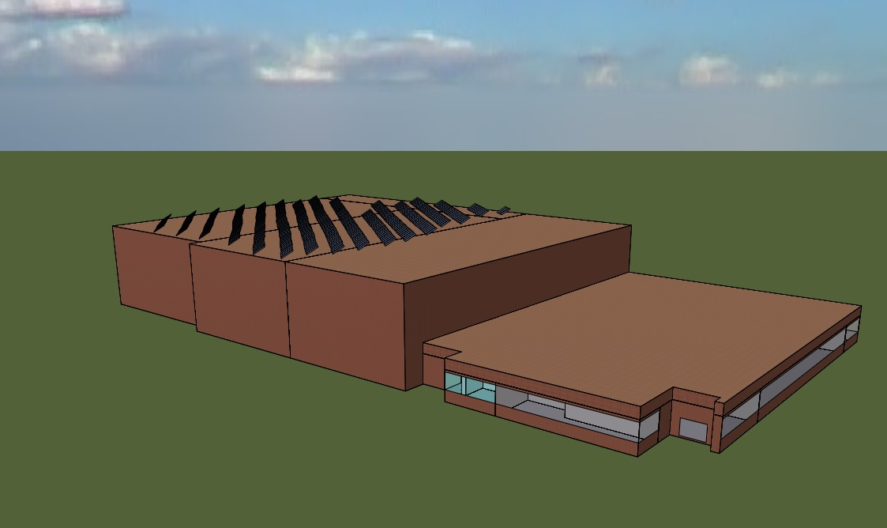
Retrofit Building with Solar Panels
2017 ASHRAE LowDown Showdown Modeling Competition

Slide 64
Combined ECMs
All ECMs 405,233 kWh
EUI Change -409 kWh/year [86%]
2017 ASHRAE LowDown Showdown Modeling Competition

Slide 65
Retrofit Building Energy Consumption by Component
2017 ASHRAE LowDown Showdown Modeling Competition

Slide 66
Cost Saving Per Year
ECM Description | Capital Cost | Savings/Year | Payback (Years)
ECM-01 Window | $ 180,768 | $ 15,427 | 12.0
ECM-02 Infiltration | $ 5,000 | $ 9,000 | 0.6
ECM-03 Setpoint | $ 0 | $ 16,000 | 0.0
ECM-04 LED | $ 35,000 | $ 56,000 | 0.6
ECM-05 Pkg HP ADMIN | $ 35,000 | $ 20,316 | 2.0
ECM-06 RTU-1 Replacement | $ 46,800 | $ 23,888 | 2.0
ECM-07 Plenum Fans | $ 20,000 | $ 49,871 | 0.4
Total Cost | $ 322, 568 | $ 190,502 | 1.70
2017 ASHRAE LowDown Showdown Modeling Competition

Slide 67
Total Cost Savings
ECM Description | Capital Cost | Savings | Energy Saved [kWh]
PV Panel | $ 635,893 | $ 18,500 | 231,193
All ECMS | $ 322,568 | $ 190,502 | 2,380,571
Total Cost | $ 958,461 | $ 209,002
Dollars Saved in First Year $ 209,002
Dollars Saved from Second Year $ 18,500
Total Payback Time 40 Years
2017 ASHRAE LowDown Showdown Modeling Competition

Slide 68
Summary
LDSd Result Summary | Existing Building_Metered | Existing Building_Simulated | Retrofit Building
Total Energy Usage (kBTus) | 10,978,130 | 9,772,568 | 1,382,655
Site EUI (kBTU/sf) | 170 | 151 | 21
Source EUI (kBTU/sf) | 533 | 475 | 67
Annual Electricity Usage (kWh) | 3,217,506 | 2,864,176 | 405,233
Annual NG Usage (Therms) | 0 | 0 | 0
Annual Water Usage (Gallons) | * | * | *
Annual Electricity Cost (US $) | 404,791 | 360,339 | 85,254
Annual NG Cost (US $) | 0 | 0 | 0
Annual Water Costs (US $) | * | * | *
Total Annual Costs (US $) | 404,791 | 360,339 | 85,254
CPSF (US $/sf) | 6.26 | 5.57 | 1.32
Total Energy Generation (kBTUs) | 0 | 0 | 788,834
Net Zero Energy (kBTUs) | N/A | N/A | 593,821
Carbon Equivalent (0.63 kg/kWh) | 2,027,029 | 1,804,431 | 110,459
2017 ASHRAE LowDown Showdown Modeling Competition

Slide 69
Conclusion
We are consuming 174,039 kWh [593,821 kBTUs] more than generated electricity through Photovoltaic Panels.
We have not achieved net zero energy but we were able to reduce energy consumption by approximately 87% without using renewable energy.
Possible alternatives to achieve net zero
Increasing area of photovoltaic panel from 10,000 ft² to approximately 18,000 ft².
Exploring possibility of vertical ground source heat pumps to reduce heating energy as heating is approximately 40% of total energy usage in retrofit building model.
Reducing Heating Temperature from 16 °C [60 °F] to 12 °C [53 °F] in months of heating for shared collection facility.
2017 ASHRAE LowDown Showdown Modeling Competition

Slide 70
End
Thank you for your time
Any Questions?
2017 ASHRAE LowDown Showdown Modeling Competition

