Slide 1
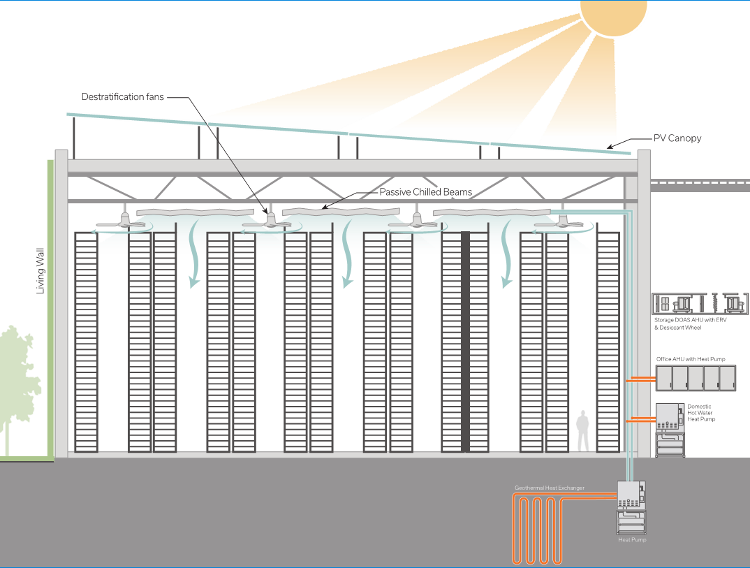
2017 ASHRAE LowDown Showdown Modeling Competition
2017 Building Performance
Analysis Conference
Sustainability Savants
Presentation content goes here.

Slide 2
Overview
Project Approach
Existing Building Modeling/Calibration
Proposed Design
Proposed Building Modeling
Renewables
Results/Outcomes
Lessons Learned
2017 ASHRAE LowDown Showdown Modeling Competition

Slide 3
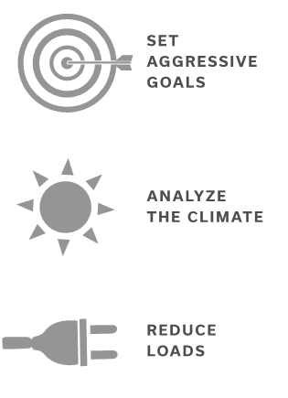
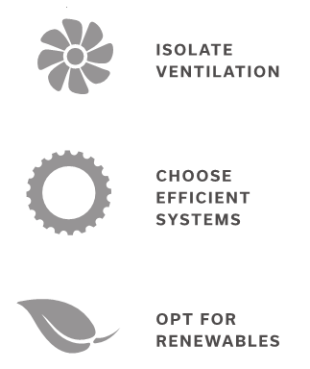
Project Approach – 6 Steps
2017 ASHRAE LowDown Showdown Modeling Competition

Slide 4
Design Goals
Understand main consumers of energy in building as existing and devise ways to minimize their impact
Solutions for efficient offices are generally well-known, so focus efforts on making storage as efficient as possible
Develop an innovative, interactive design that reduces building energy as much as possible
Apply renewables (in the form of PV) to approach Net Zero Energy
2017 ASHRAE LowDown Showdown Modeling Competition

Slide 5
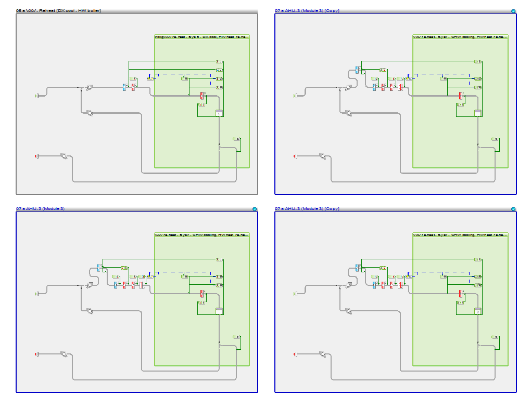
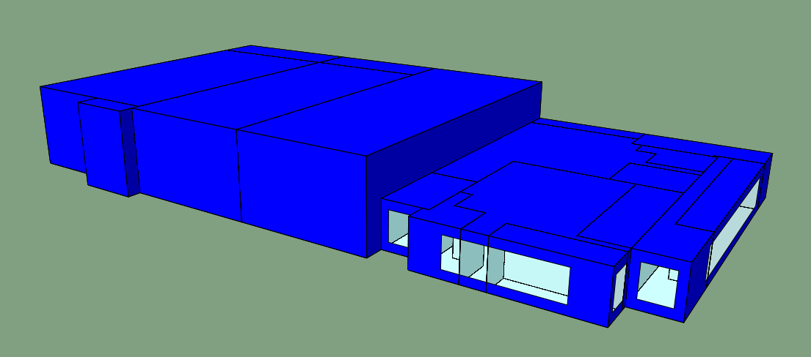
Modeling Baseline
Drafted from design documents
Large amount of airflow through AHUs
2017 ASHRAE LowDown Showdown Modeling Competition

Slide 6
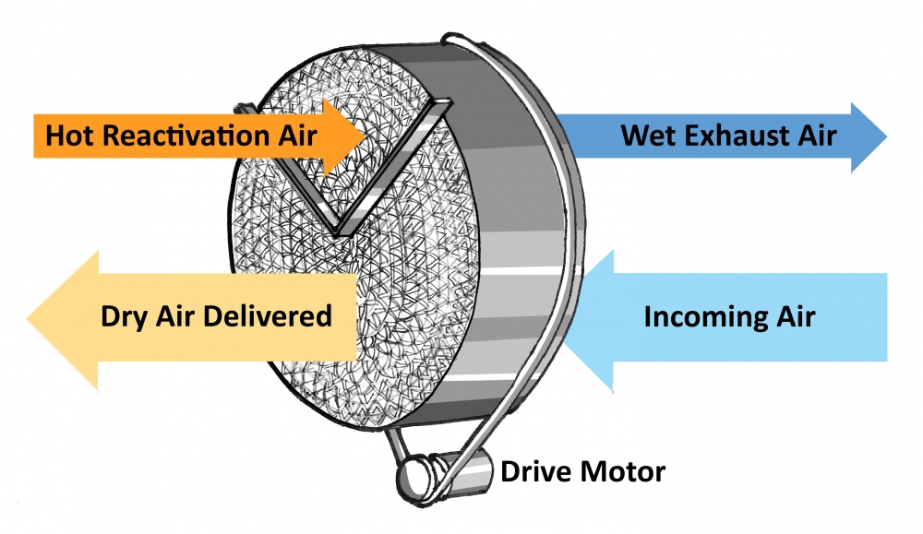
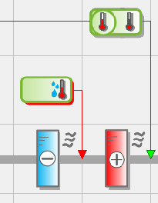
Desiccant Wheel
Not modeled directly with IES
Modeled with additional cooling+heating coil
Overestimates energy usage
2017 ASHRAE LowDown Showdown Modeling Competition

Slide 7
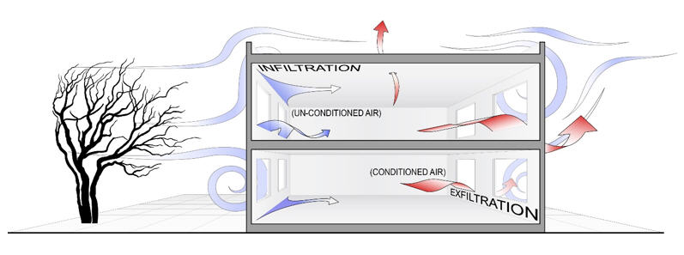
Calibration
Limited variables we could change
Infiltration unknown and often underestimated
Fan static pressure
Chiller efficiency
2017 ASHRAE LowDown Showdown Modeling Competition

Slide 8
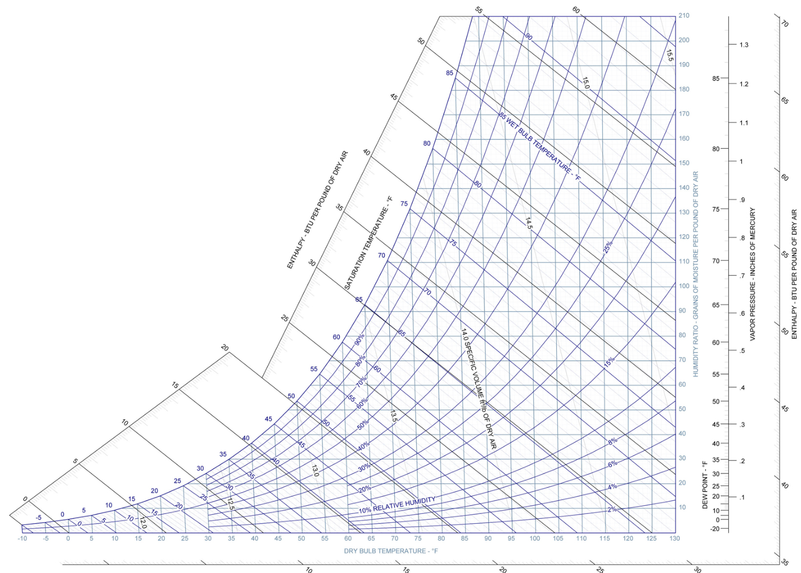
Building Loads
Summer Design Conditions
Setpoint
Winter Design Conditions
Requires cooling/dehumid
Heating, humid
Cooling, humid

Slide 9
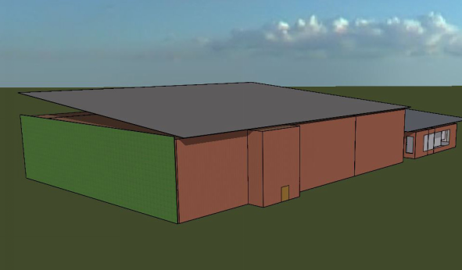
Envelope Gains
Add insulation on vertical walls
Fly roof shades building from overhead direct solar gain and provides PV platform
Reduced infiltration via verifying building tightness and increasing operational awareness

Slide 10
Reduced Lighting
Existing lighting power density = 1.5 W/sf
Proposed lighting power density = 0.6 W/sf
“Follow Me” style occupancy controls
Large floor plate
Only a small fraction of space needs lit at any given instant—where the workers are
Resultant ~75% decrease in lighting energy

Slide 11
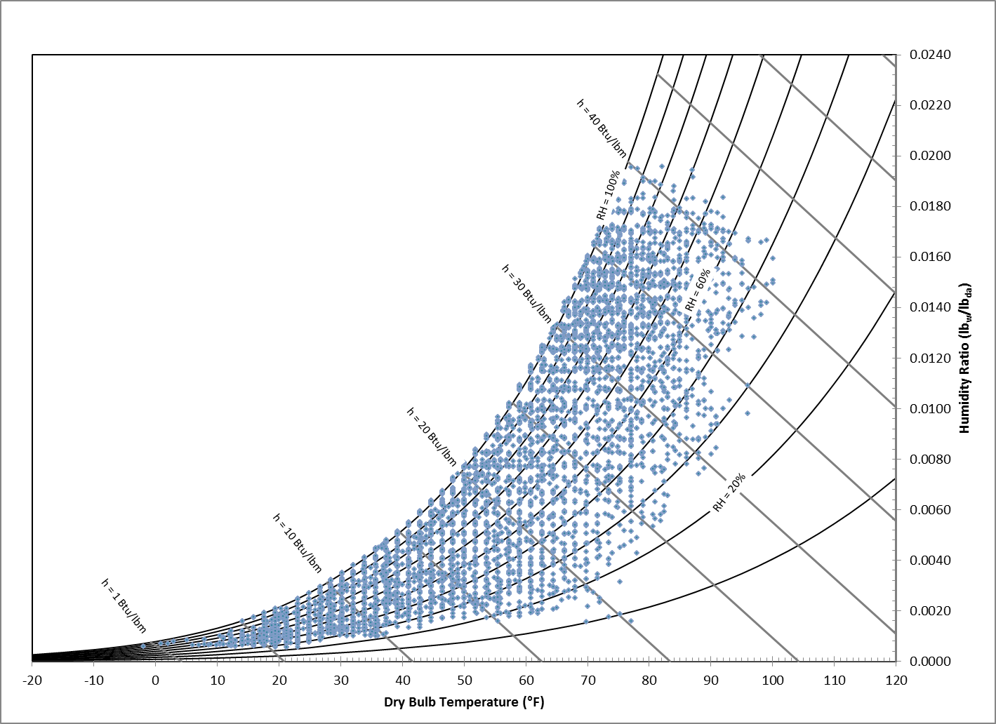
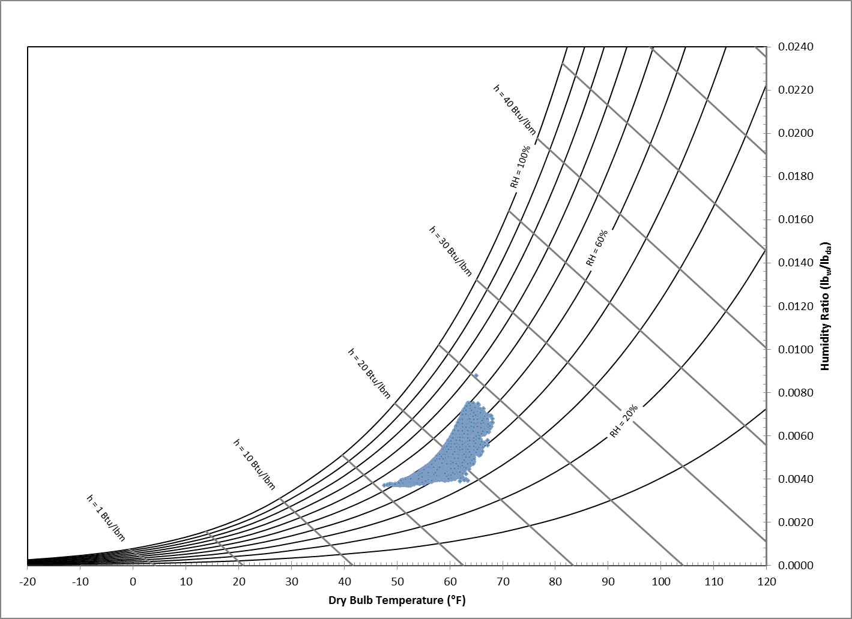
Heat Recovery

Slide 12
Isolating Ventilation
Reducing loads means ventilation can be decoupled from other space conditioning
Deliver code-required outside air (600 CFM per bay) at interior design conditions
Low-RPM large-diameter ceiling fans for destratification
Utilize efficient secondary system to handle envelope and internal loads

Slide 13
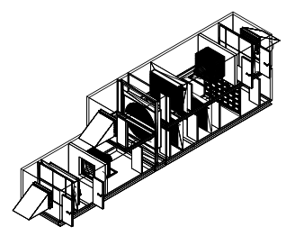
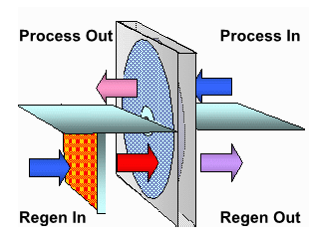
Custom AHU for Storage Bays
Hydronic preheat
Desiccant dehumidification with hot gas regeneration
DX coil
Evaporative pad humidifier
Powered exhaust with 80% effective total heat recovery wheel

Slide 14
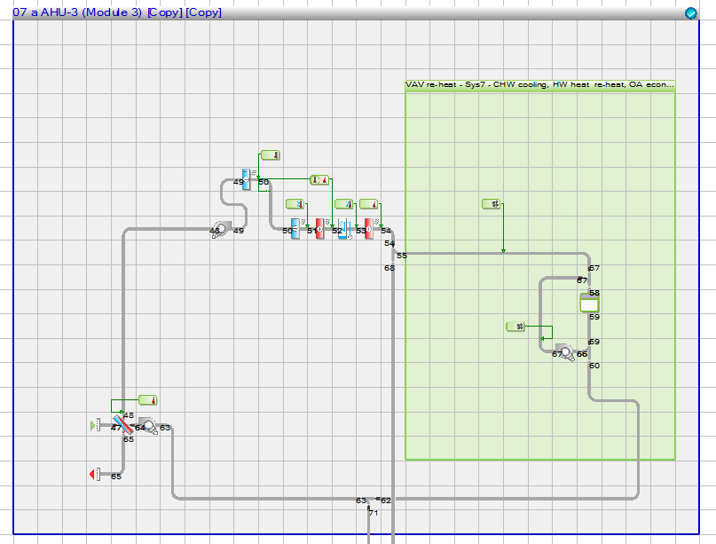
Modeling Proposed
Challenges
Heat Recovery
Desiccant Wheel
Chilled Beams
Ceiling Fans
Geo Loop
2017 ASHRAE LowDown Showdown Modeling Competition

Slide 15
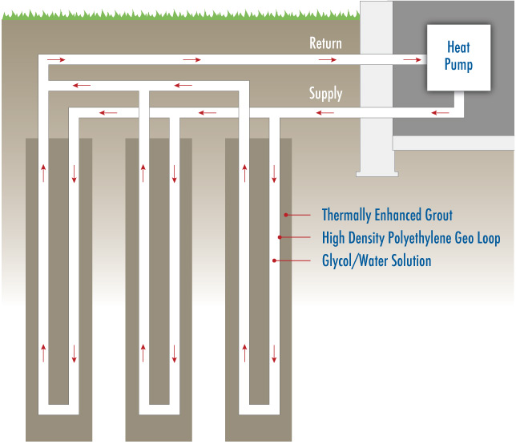
Modeling Proposed
2017 ASHRAE LowDown Showdown Modeling Competition

Slide 16
Holding Set Point
2017 ASHRAE LowDown Showdown Modeling Competition
Line chart of storage space temperature and relative humidity through year
Transition
Histogram/bar chart showing indoor air temperature of office showing it within setpoint during occupied hours

Slide 17
Renewables
Use 10,000sf of roof canopy for PV
Analysis with NREL’s PVWatts tool estimates 1,179 kWh/kW of installed PV
Panel density of 18 W/sf -> 180kW array
Provides EUI offset of 11 kBtu/sf/yr

Slide 18
Energy Breakdown
2017 ASHRAE LowDown Showdown Modeling Competition

Slide 19
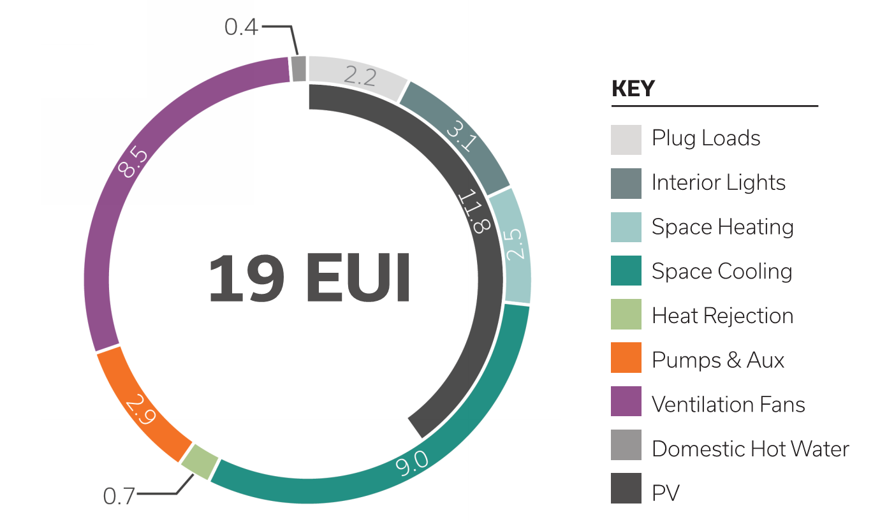
Final Energy Use Breakdown
2017 ASHRAE LowDown Showdown Modeling Competition

Slide 20
Lessons Learned
Time overhead when coordinating with offices in multiple locations can be appreciable
Calibrating a model with limited design data requires setting a “good enough” criteria
Underestimated time required to create reasonable workaround for desiccant simulation
Load reduction was key in creating a highly efficient design

Slide 21
Results Summary
LDSd Results Summary | Baseline | Sustainability Savants
Total Energy Usage (kBtu) | 10,600,000 | 1,800,000
Site EUI (kBtu/sf/year) | 173 | 18.6
Source EUI (kBtu/sf/year) | 535 | 55.3
Annual Electricity Usage (kWh) | 3,105,000 | 528,000
Annual Water Usage (gal) | 12,500 | 12,500
Annual Electricity Cost | $250,900 | $25,500
Annual Water Cost | $500 | $500
Total Annual Costs | $251,400 | $26,000
Cost Per Square Foot | $4.10 | $0.42
Total Energy Generation (kBtu) | 0 | 724,000
Net Energy (kBtu) | 10,594,000 | 1,078,000
Carbon Equivalent (tons CO₂/year) | 2,160 | 220
2017 ASHRAE LowDown Showdown Modeling Competition

