Slide 1
ASHRAE Honors and Awards Committee
Honors and Awards Program

Slide 2
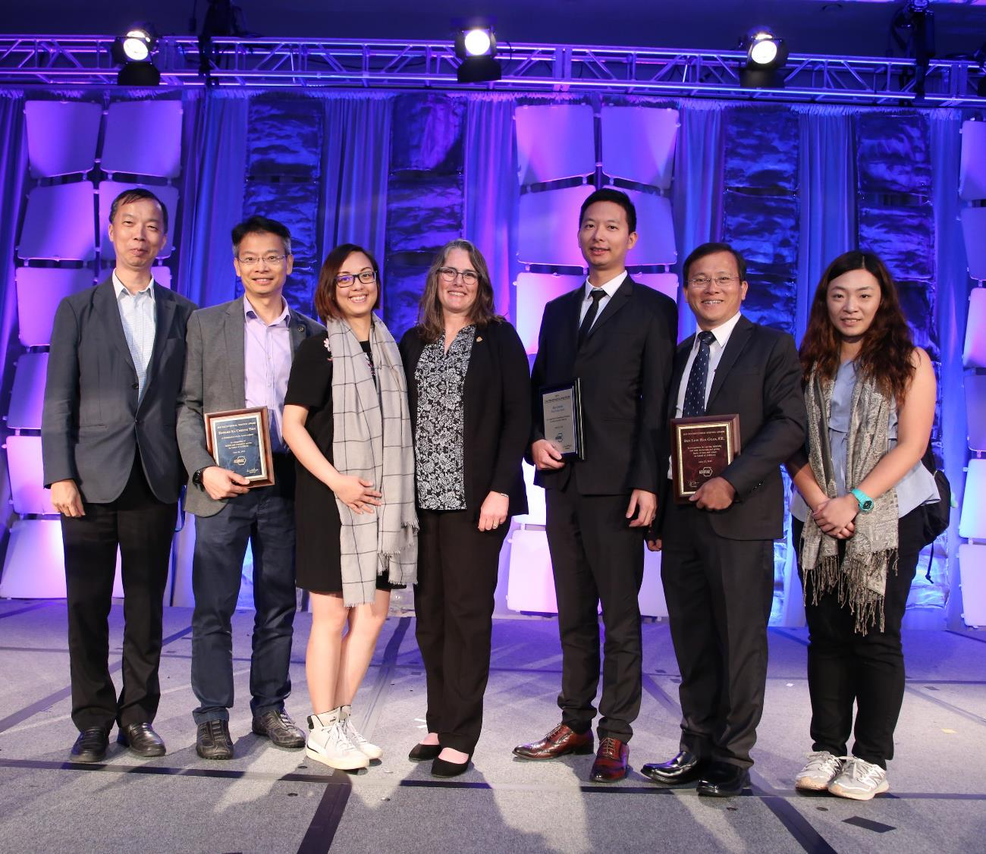
ASHRAE Honors and Awards Program
Overseen by the ASHRAE Honors and Awards Committee
Award information can be found at www.ashrae.org/honors.
Awards are conferred annual in six categories:
Personal Honors
Personal Awards for General Society Activities
Personal Awards for Specific Society Activities
Paper Awards
Society Awards to Groups or Chapters
Chapter and Regional Awards
Notes:
ASHRAE Honors and Awards advance the purpose of the Society by recognizing outstanding contributions to the HVAC&R industry. Respected leaders and new professionals contribute to the advancement of HVAC&R, serve ASHRAE and its members, and participate in civic and community affairs. ASHRAE award recipients exemplify the best in industry by continually bringing credit to the profession.
All nomination instructions for all awards is provided at www.ashrae.org/honors.

Slide 3
Who Can Make Nominations?
Personal Honors & Personal Awards for General Society Activities
Chapters, Regions, committees or individual ASHRAE members
Personal Awards for Specific Society Activities & Society Awards to Groups or Chapters
Committee or Council sponsoring the award
Paper Awards
Committee sponsoring the award
Regional and Chapter Awards
Delegate from a candidate’s chapter at the Chapters Regional Conference (CRC)

Slide 4
Honors and Awards Flowchart
Notes:
Flowchart is posted on the H&A webpage (www.ashrae.org/Honors) and available in printouts.

Slide 5
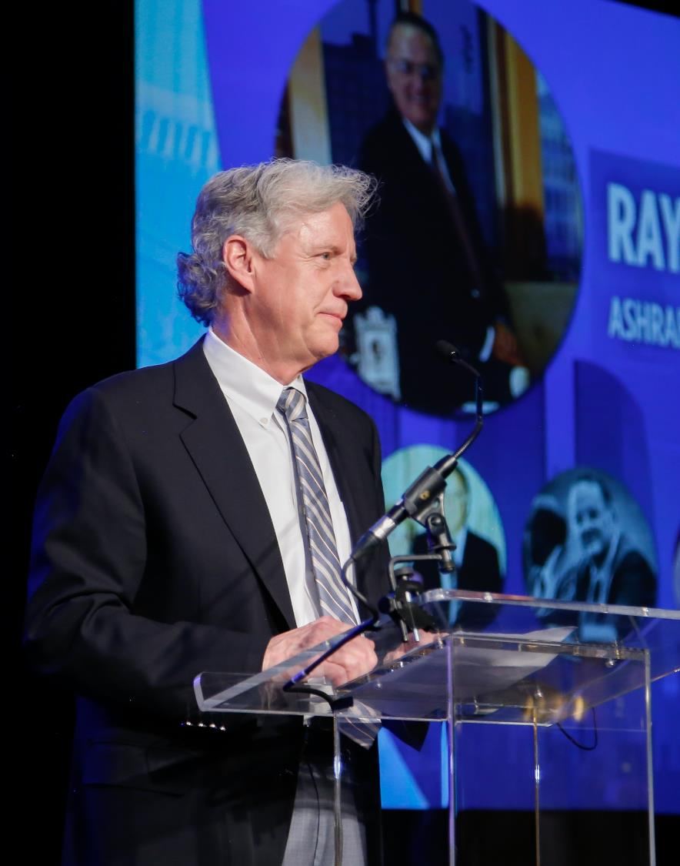
Personal Honors
ASHRAE Hall of Fame
Honors deceased members who have made milestone contributions to the growth of ASHRAE-related technology. Inducted individuals must have been an ASHRAE member (any grade) or a member of a predecessor Society and must have shown evidence of distinction in the Society, either technically or academically.
Nomination deadline: December 1
ASHRAE Pioneers of the Industry
Honors deceased individuals who have made milestone contributions to the growth of HVAC&R. Inducted individuals must have shown evidence or distinction, either technically or academically.
Nomination deadline: December 1
Notes:
Any award with a nomination deadline listed in red should be submitted to HonorsandAwards@ashrae.org.

Slide 6
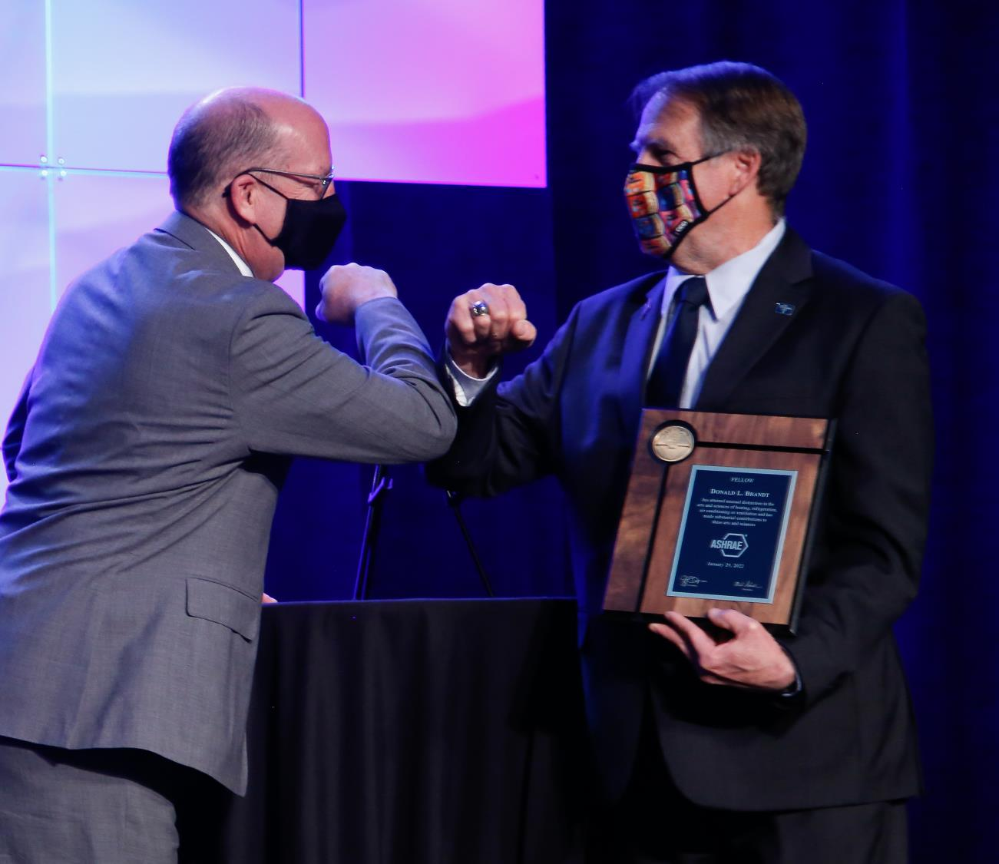
Personal Honors
F. Paul Anderson Award
Society’s highest award that honors members for notable achievement or outstanding work/service in any ASHRAE-related field.
Nomination deadline: December 1
ASHRAE Award for Distinguished Public Service
Recognizes ASHRAE members who have performed outstanding public service.
Nomination deadline: December 1
Fellow
Honors members (Full Member for at least ten years) who has attained distinction in the fields of HVAC&R or the allied arts and sciences through invention, research, teaching, design, original work, or as an engineering executive on projects of unusual or important scope.
Nomination deadline: December 1

Slide 7
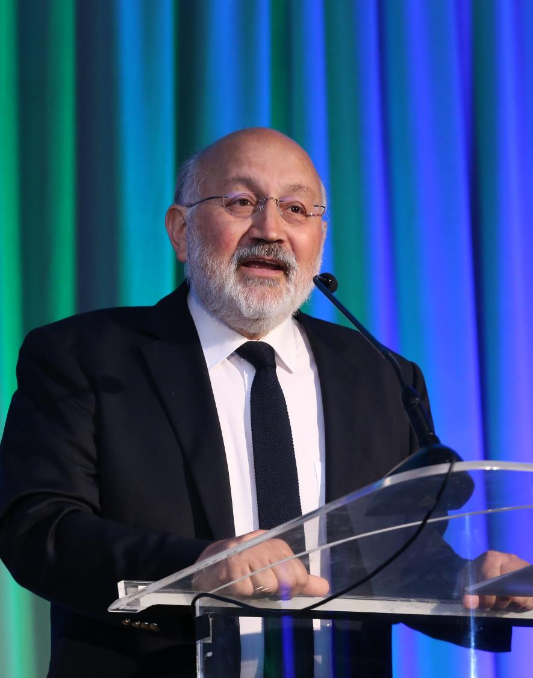
Personal Honors
Andrew T. Boggs Service Award
Recognizes past recipients of the Exceptional Service Award for continuing, unselfish, dedicated, and distinguished service to the Society.
Nomination deadline: May 1
Louise and Bill Holladay Distinguished Fellow Award
Honors Fellows of the Society for continuing preeminence in engineering work or research.
Nomination Deadline: May 1
Honorary Member
Recognizes preeminent professional distinction without regard to whether the individual is or has been a member of the Society.
Nomination deadline: December 1

Slide 8
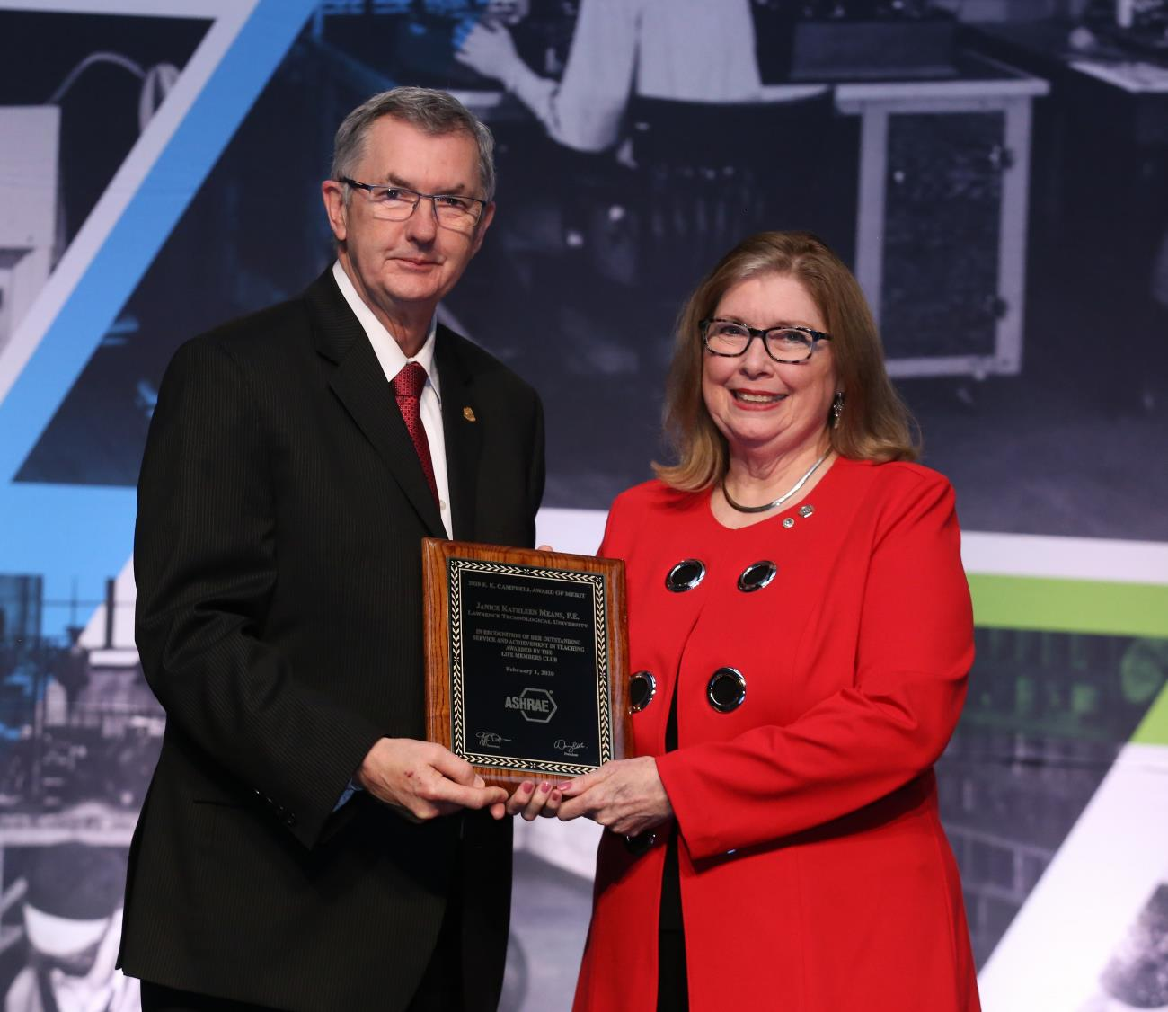
Personal Honors
E.K. Campbell Award of Merit
Honors an individual for outstanding service and achievement in teaching and/or research in a subject related to the industry and professions represented by AHSRAE.
Recommended by the Life Members Club.
YEA Inspirational Leader Award
Recognizes a Young Engineer in ASHRAE (YEA) member who has gone above and beyond to make considerable contributions to the industry and community.
Recommended by the YEA Committee.
Notes:
For any award that lists a recommending committee, that means that specific committee accepts the nominations and recommends a final recipient to the Honors & Awards Committee. Those recommending committees have their own nomination process and deadline.

Slide 9
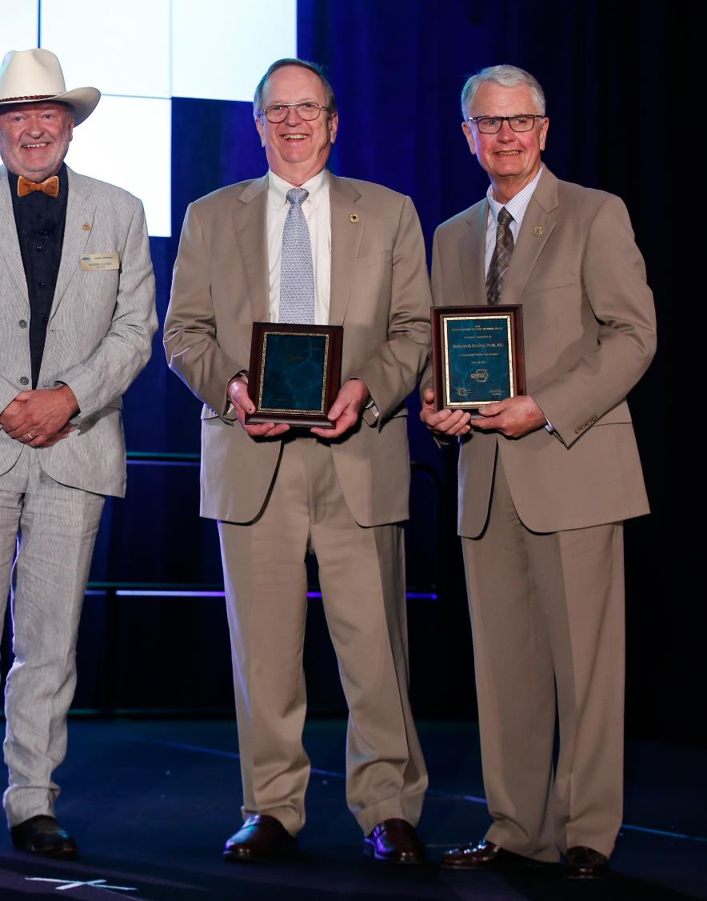
Personal Awards for General Society Activities
Distinguished 50-Year Member Award
Recognizes individuals who have been ASHRAE members for a minimum of 50 years and were a past Society President, Fellow, Distinguished Service Award recipient, or otherwise performed outstanding service for the Society.
Nomination deadline: December 1
Distinguished 75-Year Member Award
Same requirements as above, except 75 years of membership is required.
Nomination deadline: December 1

Slide 10
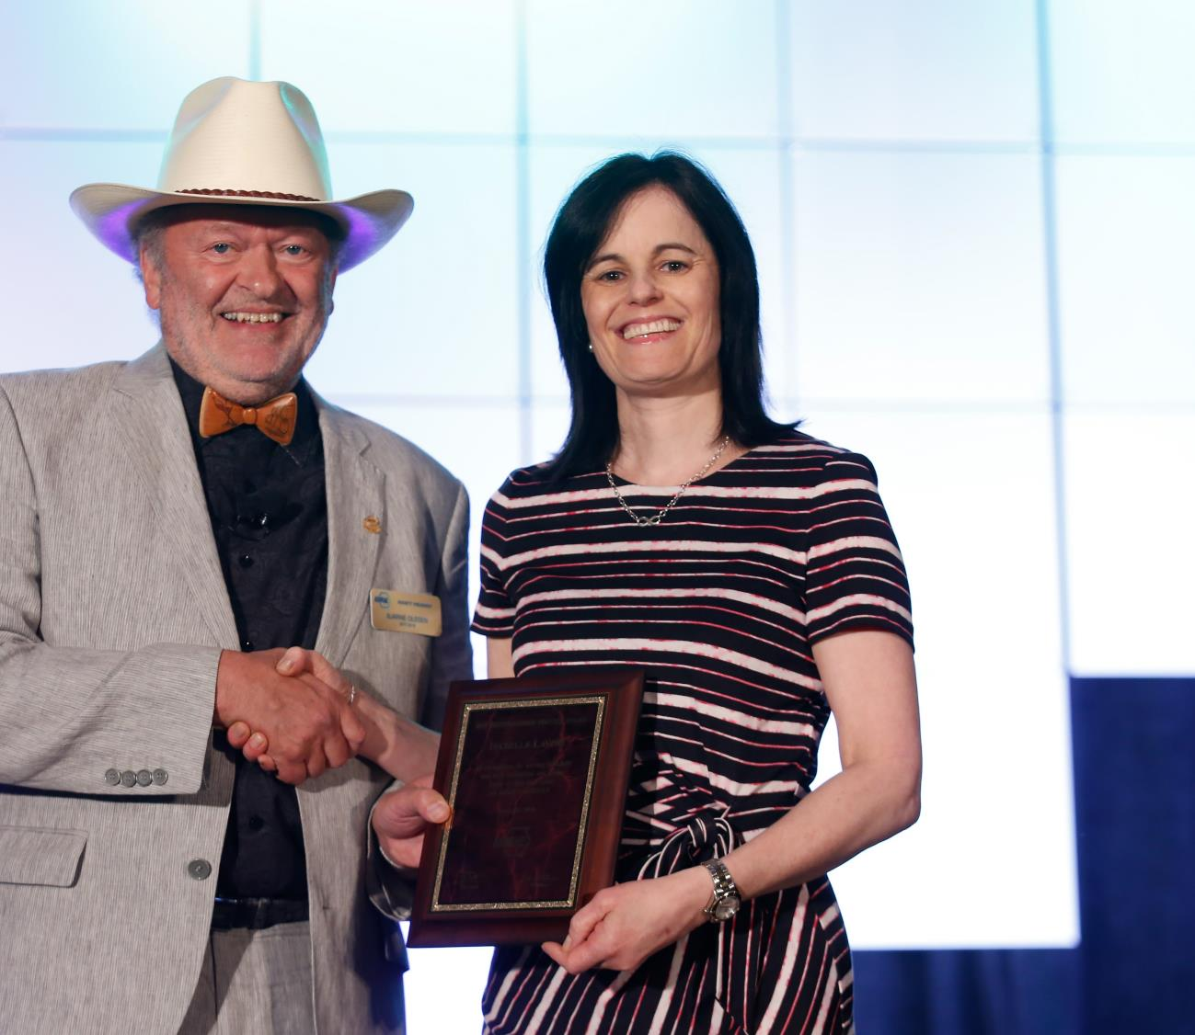
Personal Awards for General Society Activities
Distinguished Service Award (DSA)
Recognizes members who have served the Society faithfully and with distinction or otherwise given freely of their time and talent on behalf of the Society. A minimum of 15 points required on the point tally form.
Nomination deadline: May 1
Exceptional Service Award (ESA)
Similar to the DSA, except 45 points are required on the point tally form and the member must have been a Full Member for at least ten years.
Nomination deadline: May 1
Developing Leader Award
This award recognizes new members who have shown diverse involvement and commitment to ASHRAE withing five years of their Association Member join date.
Recommended by the YEA Committee.

Slide 11
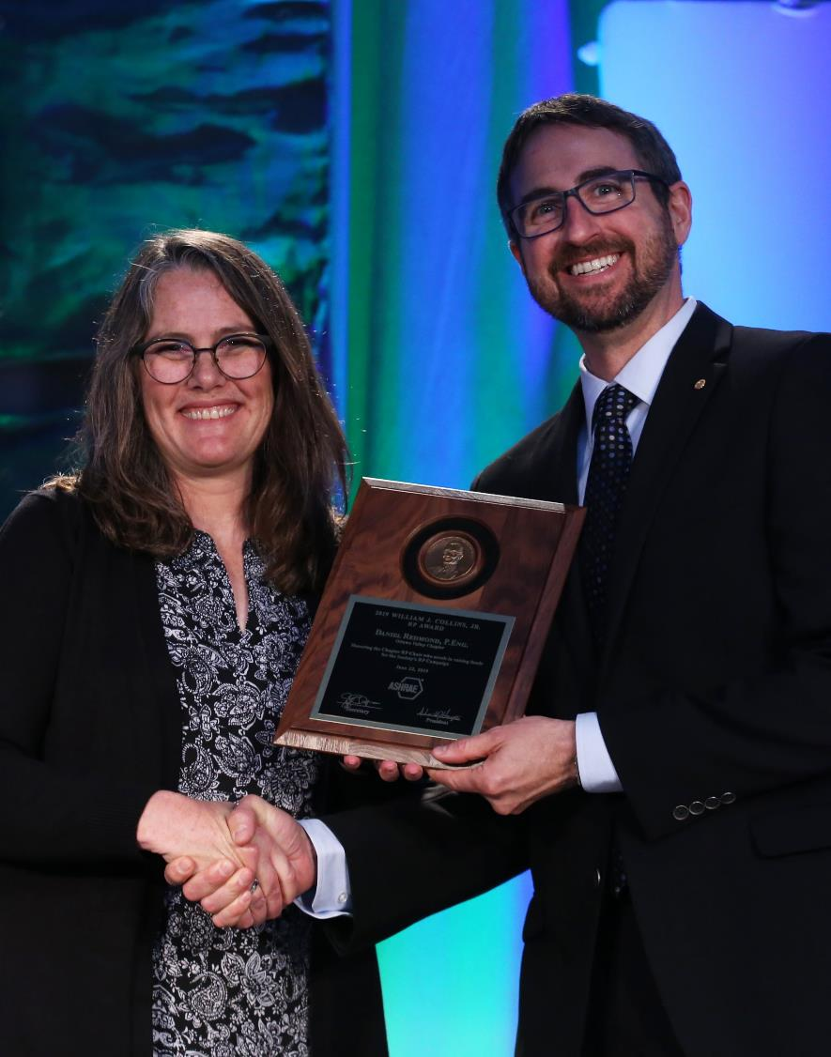
Personal Awards for Specific Society Activities
Lincoln Bouillon Award
Recognizes a member who performs the most outstanding work in increasing the membership of the Society.
Recommended by the Membership Promotion Committee.
William J. Collins, Jr. RP Award
Recognizes the Chapter RP Chair who excels in raising funds for the RP Campaign.
Recommended by the RP Committee.
Homer Addams Award
Recognizes a graduate student who has been engaged in an ASHRAE research project at a university that has graduate programs in the areas of HVAC&R and has achieved a high standard of performance in their work.
Recommended by the Research Administration Committee.

Slide 12
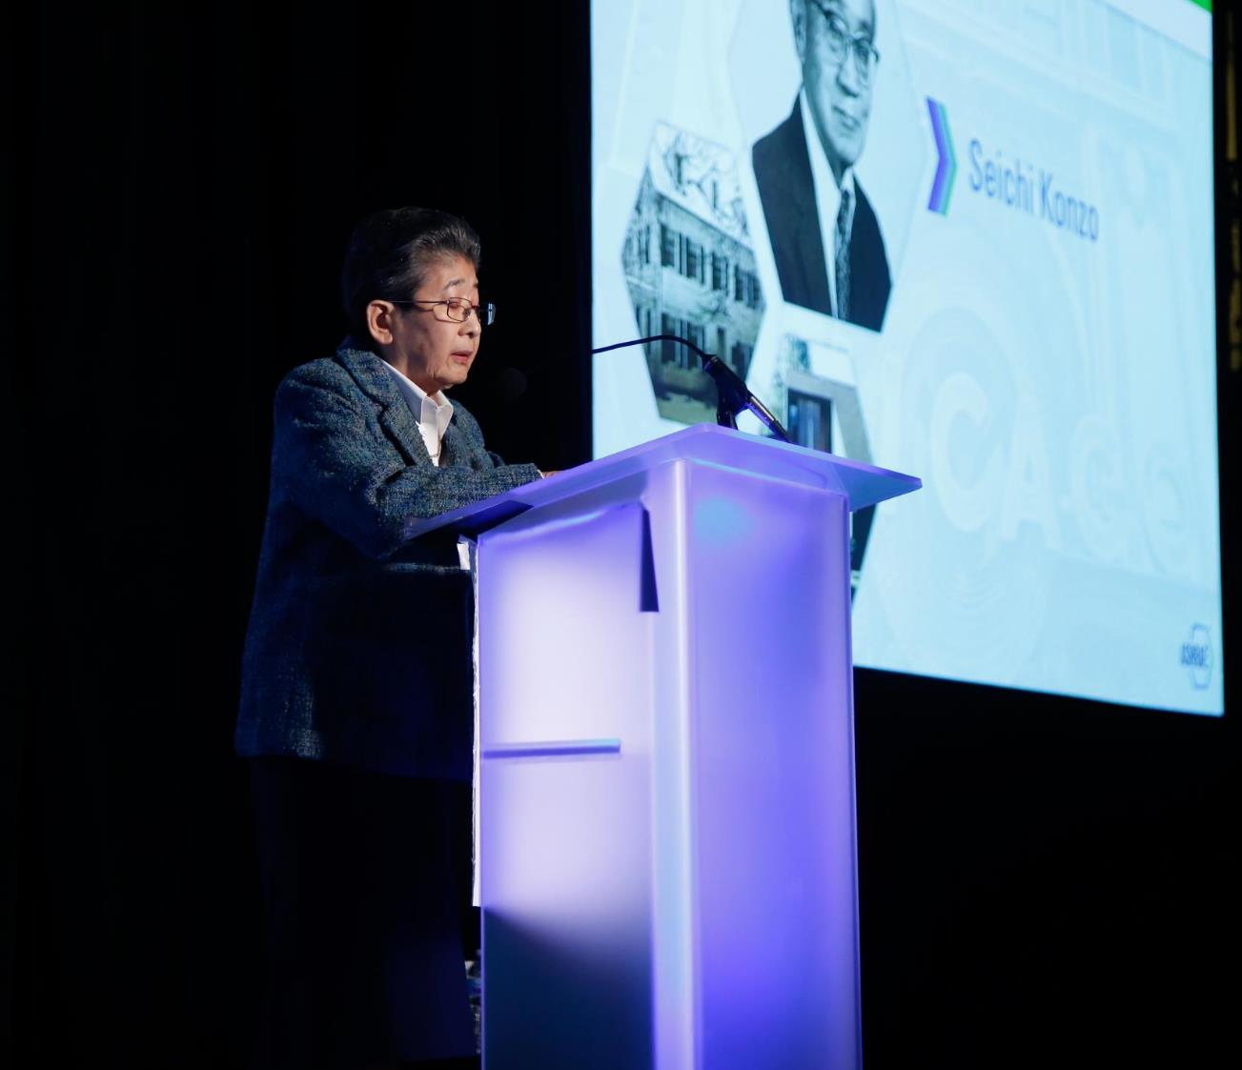
Personal Awards for Specific Society Activities
Ralph G. Nevins Physiology and Human Environment Award
Recognizes an individual under 40 for significant accomplishment in the general area of man’s response to the environment.
Recommended by TC 2.1.
John F. James International Award
Recognizes a member who has done the most to enhance the Society’s international presence.
Recommended by Members Council.
Milton W. Garland Commemorative Comfort – Process – Cold Chain Award for Project Excellence
Recognizes the designer and owner of a Comfort – Process – Cold Chain application that highlights innovation and/or new technologies.
Recommended by the Refrigeration Committee.

Slide 13
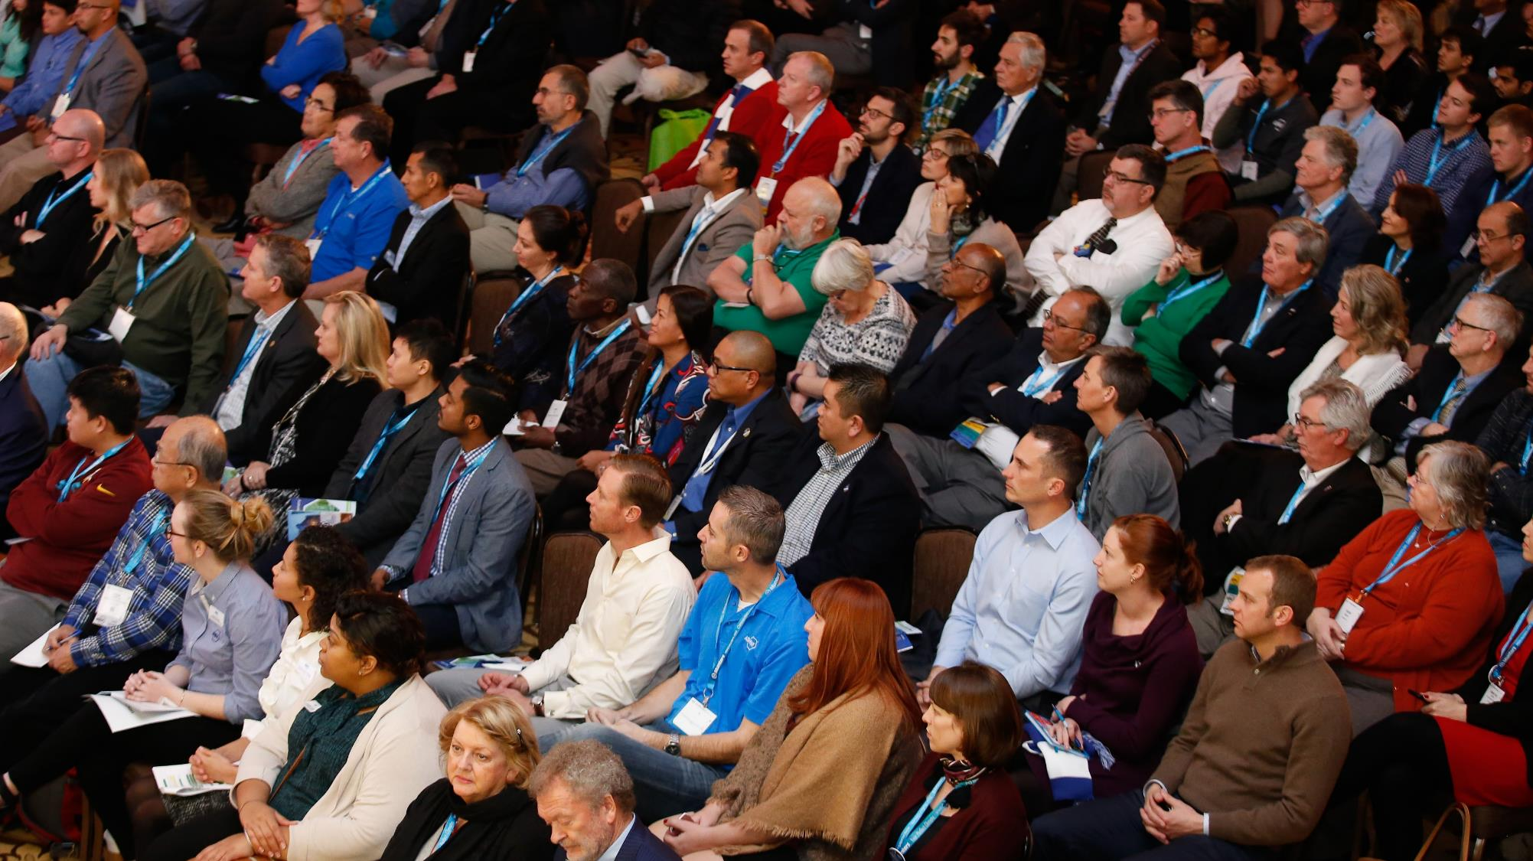
Personal Awards for Specific Society Activities
Standards Achievement Award
Recognizes excellence by a member in their volunteer services in the area of standards leadership and standards technical contributions.
Recommended by the Standards Committee.
Dan Mills Chapter Programs Award
Recognizes a Chapter CTTC Chair or Vice Chair who excels in promoting technical and energy activities of the CTT Committee.
Recommended by the CTT Committee.
Student Activities Achievement Award
Recognizes a Chapter Student Activities Chair for service related to the goals and growth of student activities at all levels.
Recommended by the Student Activities Committee.

Slide 14
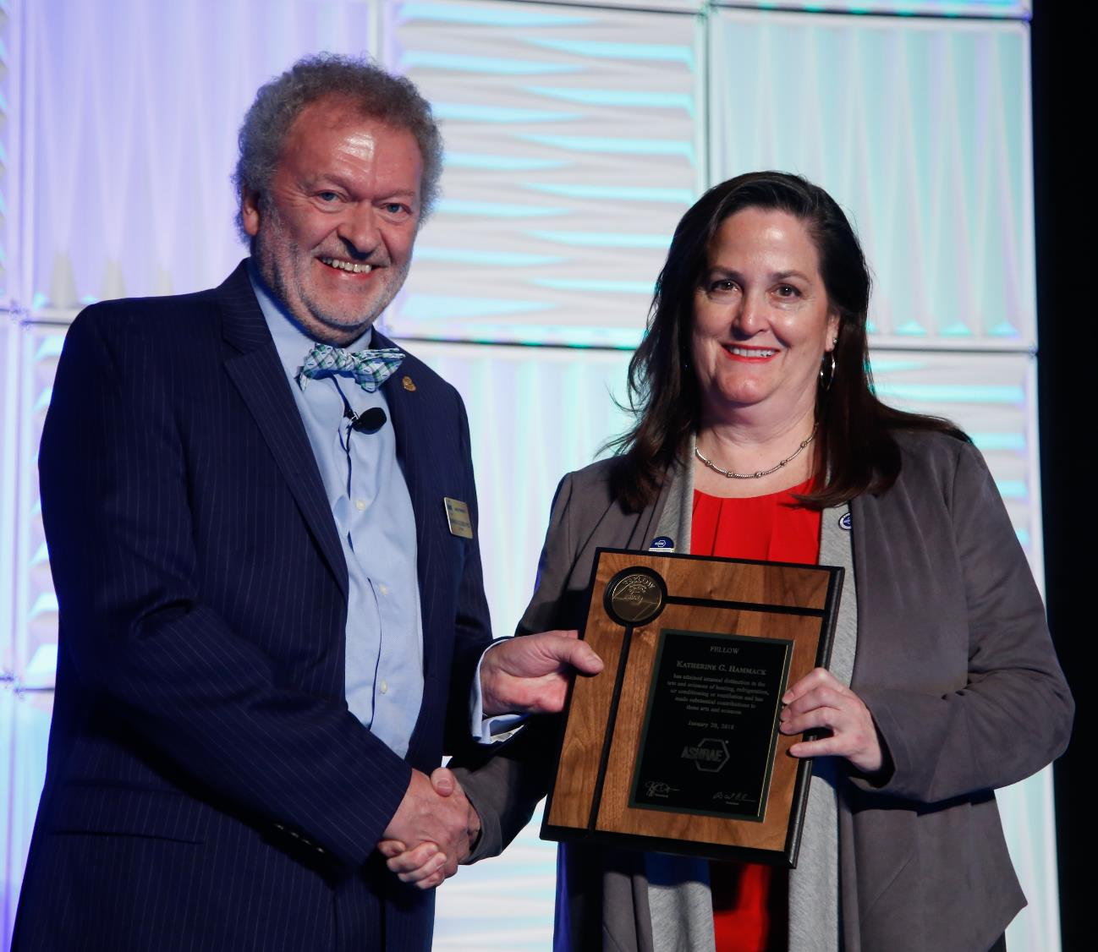
Personal Awards for Specific Society Activities
Lou Flagg Historical Award
Recognizes a Chapter Gold Ribbon Award winner for compiling information on outstanding historical projects or persons related to HVAC&R.
Recommended by the Historical Committee.
George B. Hightower Technical Achievement Award
Recognizes excellence in volunteer service in the area of Technical Committee, Technical Group, and Technical Research Group activities.
Recommended by Technology Council.
Service to ASHRAE Research Award
Recognizes excellence in volunteer services in the area of Society research.
Recommended by Technology Council.

Slide 15
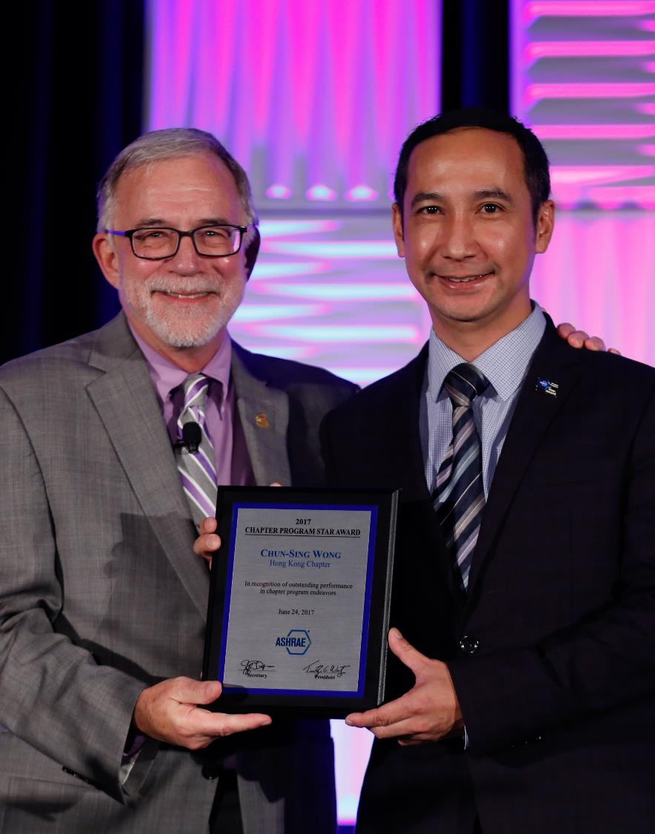
Personal Awards for Specific Society Activities
Donald Bahnfleth Environmental Health Award
Recognizes excellence in volunteer services focused on environmental health issues
Recommended by the Environmental Health Committee.
Lower-GWP Refrigeration and Air-Conditioning Innovation Award
Recognizes individuals who have developed or practiced innovative technological concepts applied in developing countries to minimize global warming potential (GWP) through refrigeration and air-conditioning management.
Recommended by the UN Environment Liaison Committee.
Donald A. Siller Refrigeration Award
Recognizes exceptional performance by a Chapter Refrigeration Chair for planning refrigeration activities.
Recommended by the CTT Committee.

Slide 16
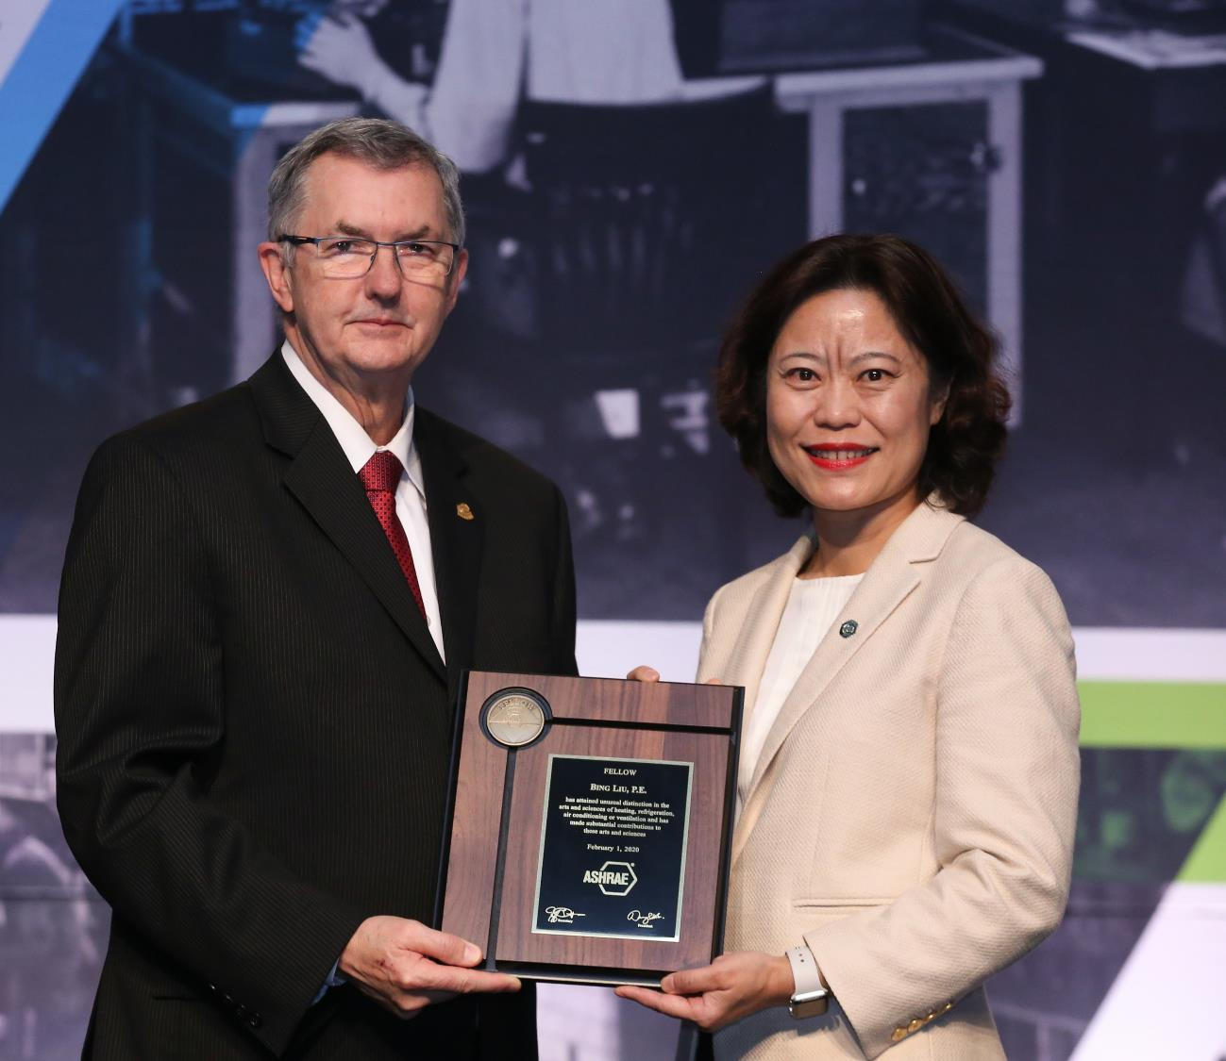
Personal Awards for Specific Society Activities
YEA Award of Individual Excellence
Recognizes YEA members for superior efforts during the preceding Society year in the promotion of the YEA Institute and representation of the 35 and under demographic of ASHRAE.
Recommended by the YEA Committee.
Youth Outreach Award
Recognizes the outstanding effort of a member who actively engages a youth audience in their country, region, or local community through STEM activities.
Recommended by the Student Activities Committee.
Government Affairs Award
Recognizes an individual who demonstrates outstanding effort at the state, provincial, and local government level on technical issues important to ASHRAE.
Recommended by the Government Affairs Committee.

Slide 17
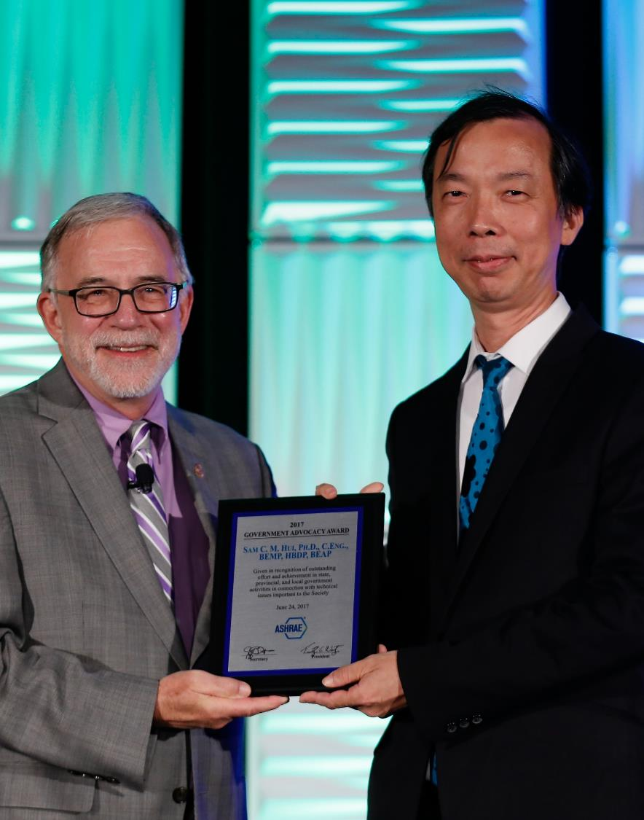
Personal Awards for Specific Society Activities
Energy Genius Award
Assesses building energy performance through the use of the ASHRAE Building EQ Portal program and Building EQ assessment processes.
Recommended by the Building EQ Committee.

Slide 18
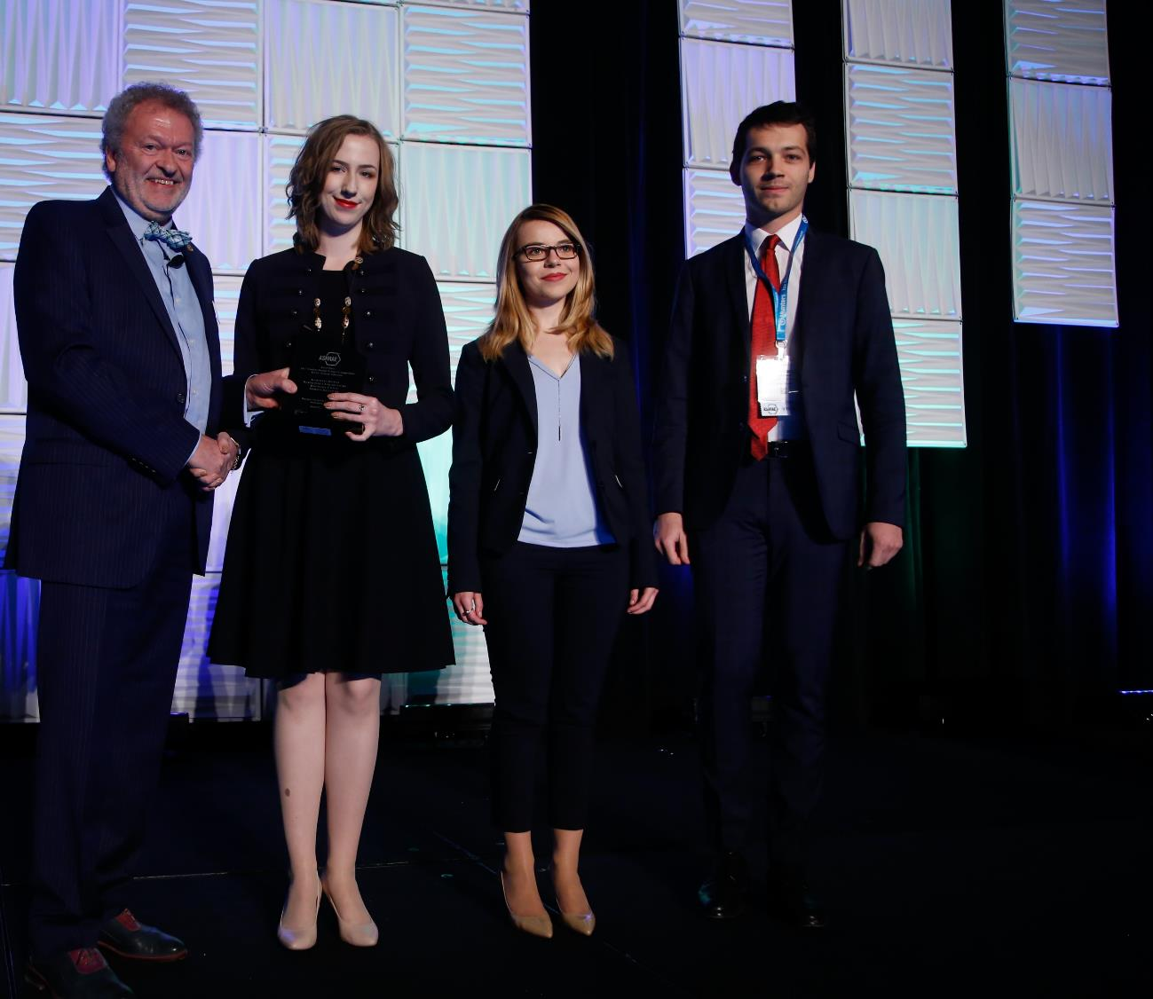
Society Awards to Groups or Chapters
Technology Award and Award for Engineering Excellence
Recognizes successful application of innovate design which incorporates ASHRAE standards for effective energy management, indoor air quality, and mechanical design management.
Recipients are recommended by the CTT Committee.
Student Design Project Competition
Recognizes outstanding student design projects, promotes teamwork, and encourages students to become involved in the dynamic HVAC&R profession.
Recipients are recommended by the Student Activities Committee.

Slide 19
Paper Awards
Crosby Field Award
Recognizes the highest ranked paper for the Society year.
Recommended by the Conferences and Expositions Committee.
Willis H. Carrier Award
Recognizes the best paper by a member 32 years of age or younger.
Recommended by the Conferences and Expositions Committee.
Technical Paper Award
Recognizes the best technical papers presented at Society conferences.
Recommended by the Conferences and Expositions Committee.

Slide 20
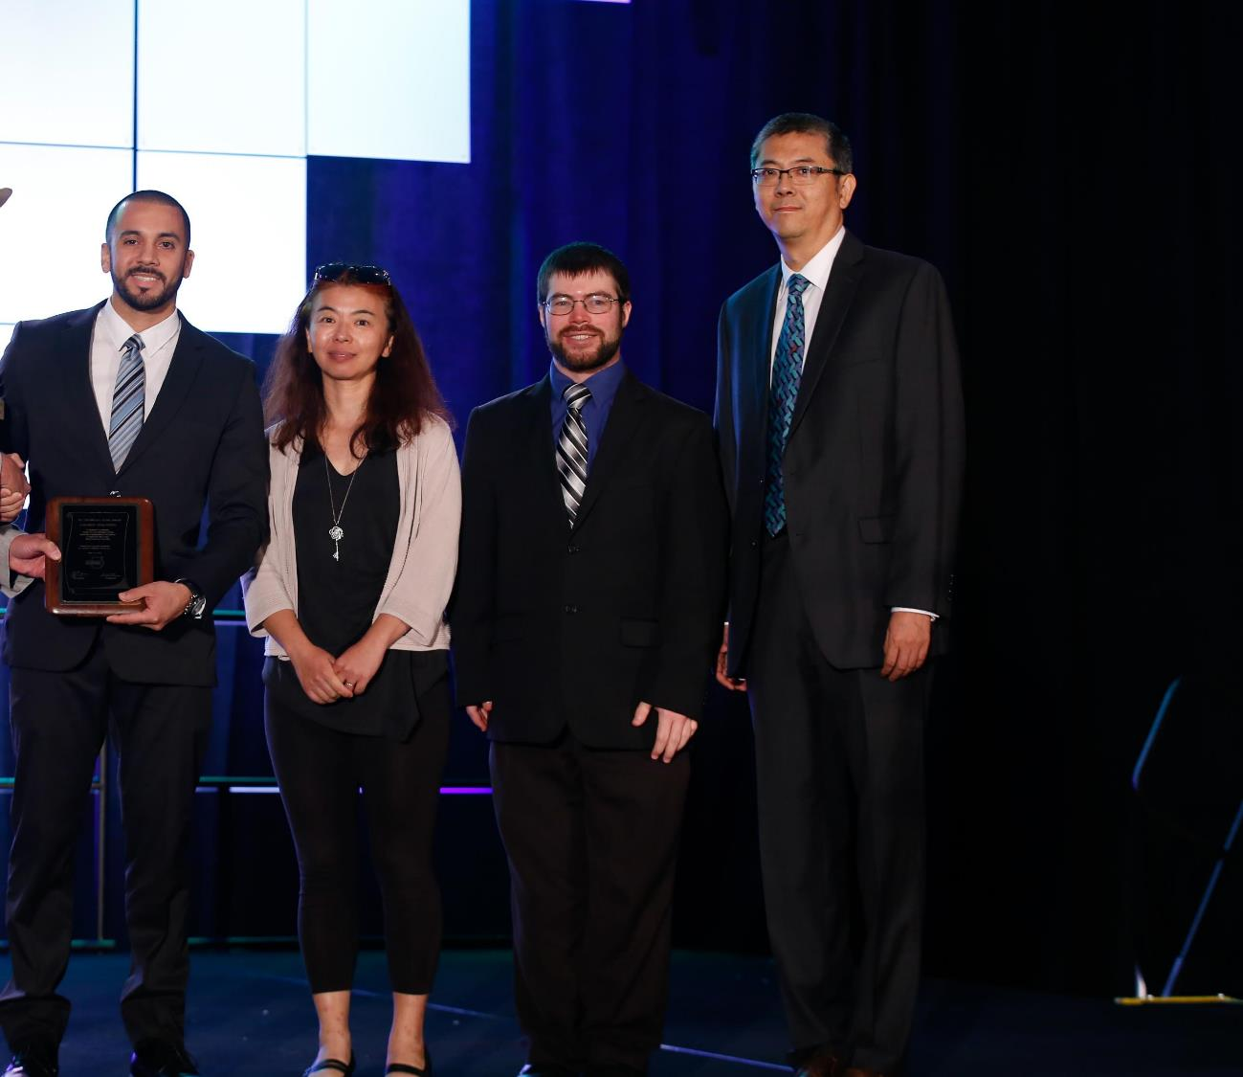
Paper Awards
Poster Presentation Award
Recognizes the best poster session paper from Society conferences.
Recommended by the Conferences and Expositions Committee.
Journal Paper Award
Recognizes the best article published in the ASHRAE Journal for the year.
Recommended by the Publications Committee.
Science and Technology for the Built Environment Best Paper Award
Recognizes the best referred paper published in the volume year of the Science and Technology for the Built Environment, the ASHRAE research journal.
Recommended by the Research Journal Subcommittee.

Slide 21
Chapter and Regional Awards
Regional Award of Merit and Chapter Service Award
Recognizes activities and contributions at the Chapter and Regional level
Ten services points are required for the Regional Award of Merit and 12 points are required for the Chapter Service Award.
Nominations are made by the delegate from the candidate’s chapter at the Chapters Regional Conference (CRC).

Slide 22
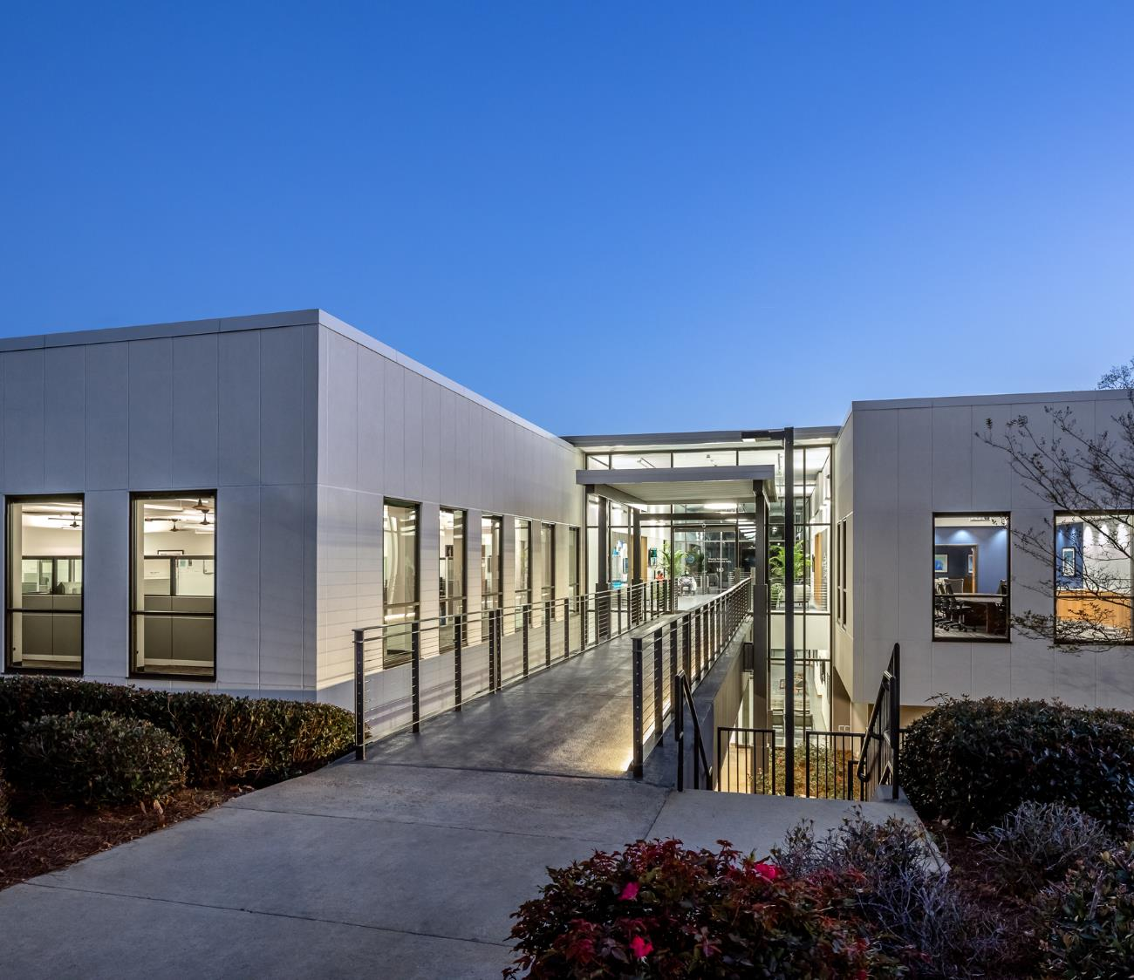
Where To Get More Information
H&A webpage:
www.ashrae.org/honors
Email
HonorsandAwards@ashrae.org
ASHRAE Staff Liaisons
Rhiannon Masterson: rmasterson@ashrae.org
Anastasia Meadows: ameadows@ashrae.org

