Slide 1

ASHRAE Honors and Awards Committee
Honors and Awards Program
Society Year 2024-2025

Slide 2
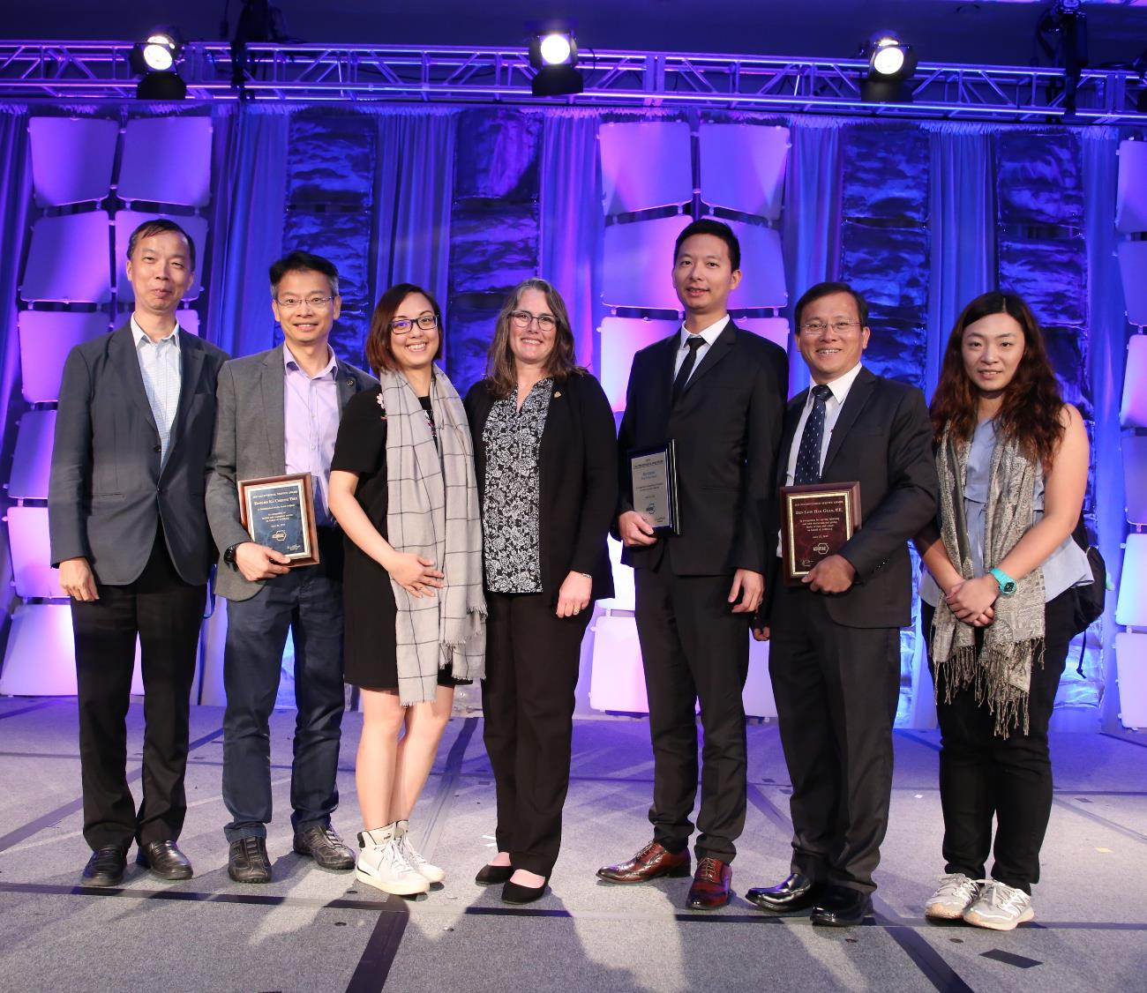
ASHRAE Honors and Awards Program
Overseen by the ASHRAE Honors and Awards Committee
  Award information can be found at www.ashrae.org/honors.
Awards are conferred annual in six categories:
  Personal Honors
  Personal Awards for General Society Activities
  Personal Awards for Specific Society Activities
  Paper Awards
  Society Awards to Groups or Chapters
  Chapter and Regional Awards
Notes:
ASHRAE Honors and Awards advance the purpose of the Society by recognizing outstanding contributions to the HVAC&R industry. Respected leaders and new professionals contribute to the advancement of HVAC&R, serve ASHRAE and its members, and participate in civic and community affairs. ASHRAE award recipients exemplify the best in industry by continually bringing credit to the profession.
All nomination instructions for all awards is provided at www.ashrae.org/honors.

Slide 3

Who Can Make Nominations?
Personal Honors & Personal Awards for General Society Activities
  Chapters, Regions, committees or individual ASHRAE members
Personal Awards for Specific Society Activities & Society Awards to Groups or Chapters
  Committee or Council sponsoring the award
Paper Awards
  Committee sponsoring the award
Regional and Chapter Awards
  Delegate from a candidate’s chapter at the Chapters Regional Conference (CRC)

Slide 4
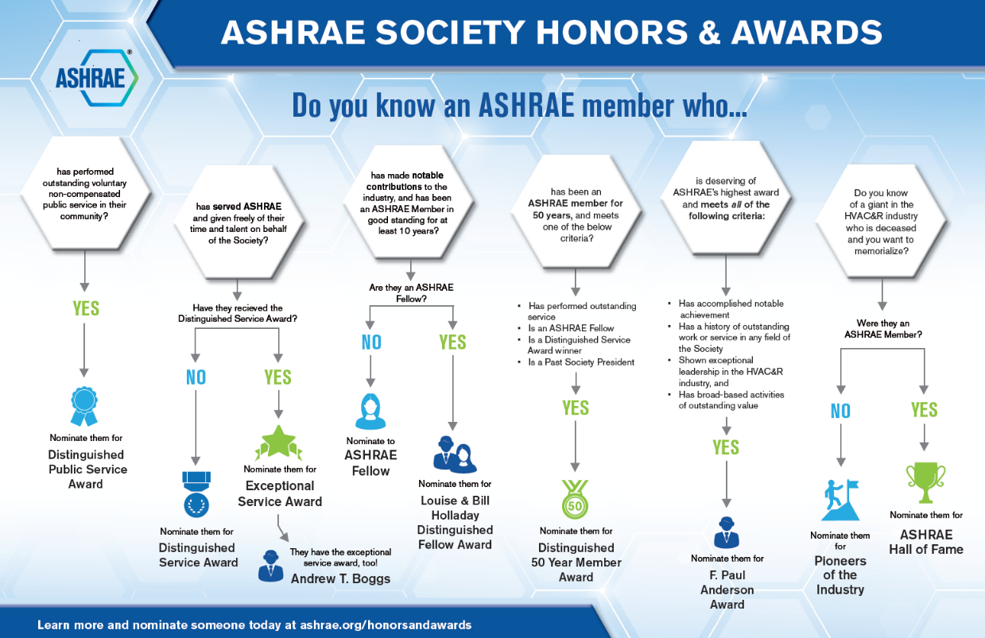
Honors and Awards Flowchart
Notes:
Flowchart is posted on the H&A webpage (www.ashrae.org/Honors) and available in printouts.

Slide 5
Changes to Award Deadlines
Previous Deadline | New Deadline | Award | When will awards be presented?
December 1 | May 1 | ASHRAE Award for Distinguished Public Service ASHRAE Hall of Fame ASHRAE Pioneers of the Industry Fellow F. Paul Anderson Award Honorary Member | 2025 Winter Conference in Orlando
May 1 | December 1 | Andrew T. Boggs Service Award Distinguished Service Award (DSA) Exceptional Service Award (ESA) Louise & Bill Holladay Distinguished Fellow Award | 2025 Annual Conference in Phoenix

Slide 6
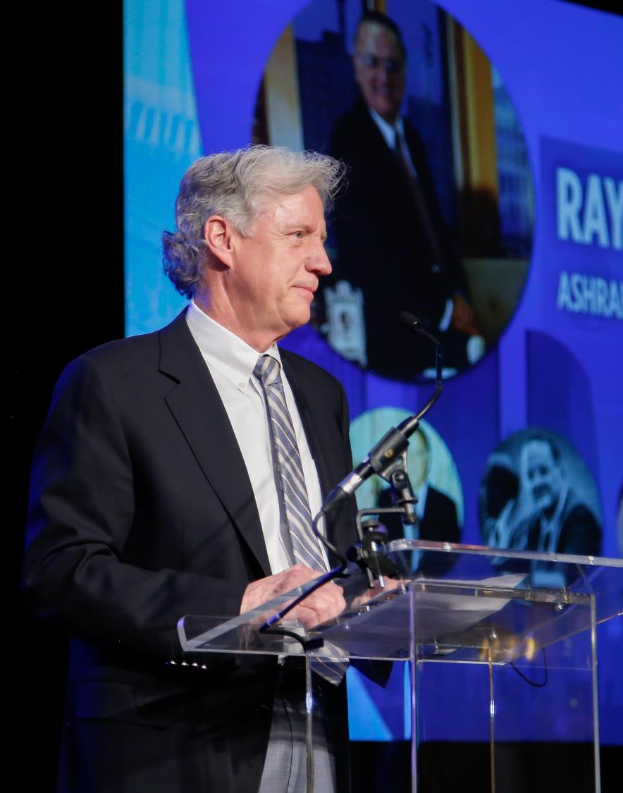
Personal Honors
ASHRAE Hall of Fame
  Honors deceased members who have made milestone contributions to the growth of ASHRAE-related technology. Inducted individuals must have been an ASHRAE member (any grade) or a member of a predecessor Society and must have shown evidence of distinction in the Society, either technically or academically.
  Nomination deadline: May 1
ASHRAE Pioneers of the Industry
  Honors deceased individuals who have made milestone contributions to the growth of HVAC&R. Inducted individuals must have shown evidence or distinction, either technically or academically.
  Nomination deadline: May 1
ASHRAE Award for Distinguished Public Service
  Recognizes ASHRAE members who have performed outstanding public service.
  Nomination deadline: May 1
Notes:
Any award with a nomination deadline listed in red should be submitted to HonorsandAwards@ashrae.org.

Slide 7
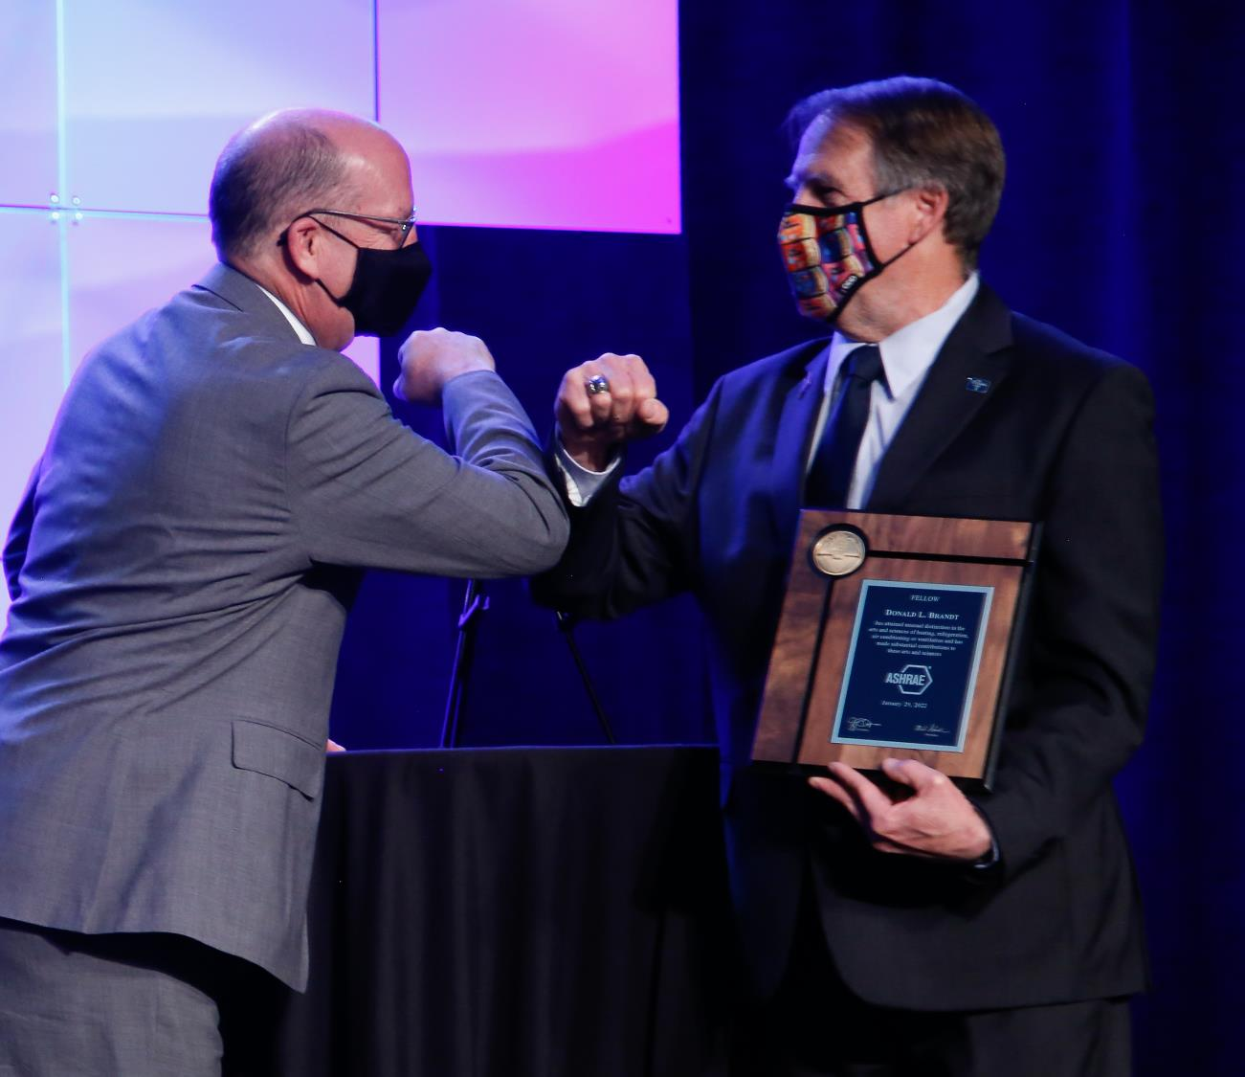
Personal Honors
F. Paul Anderson Award
  Society’s highest award that honors members for notable achievement or outstanding work/service in any ASHRAE-related field.
  Nomination deadline: May 1
Fellow
  Honors members (Full Member for at least ten years) who has attained distinction in the fields of HVAC&R or the allied arts and sciences through invention, research, teaching, design, original work, or as an engineering executive on projects of unusual or important scope.
  Nomination deadline: May 1
Honorary Member
  Recognizes preeminent professional distinction without regard to whether the individual is or has been a member of the Society.
  Nomination deadline: May 1

Slide 8
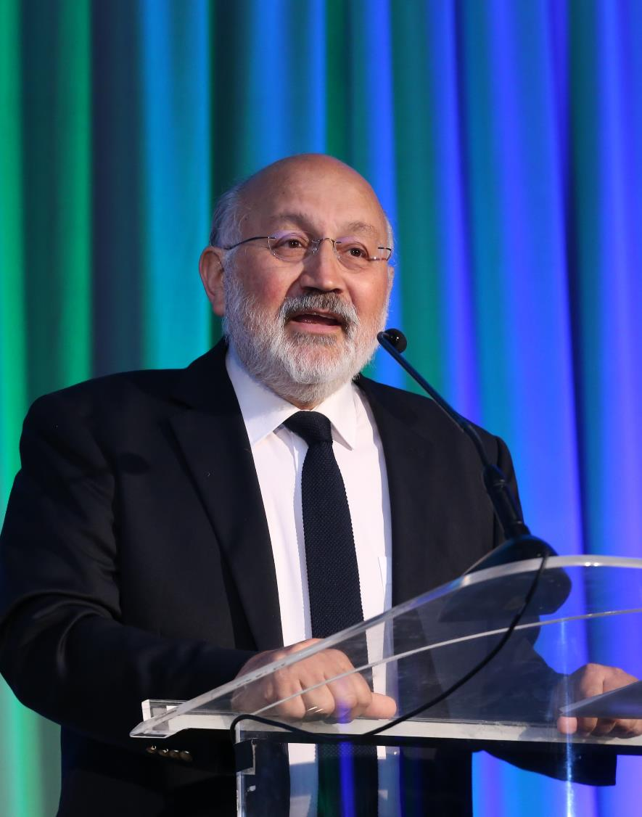
Personal Honors
Andrew T. Boggs Service Award
  Recognizes past recipients of the Exceptional Service Award for continuing, unselfish, dedicated, and distinguished service to the Society.
  Nomination deadline: December 1
Louise and Bill Holladay Distinguished Fellow Award
  Honors Fellows of the Society for continuing preeminence in engineering work or research.
  Nomination Deadline: December 1
Eunice Foote Decarbonization Award
  Recognizes an ASHRAE member for notable achievement, outstanding work or service that is focused on the decarbonization of the built environment.
  Nomination deadline: December 1

Slide 9
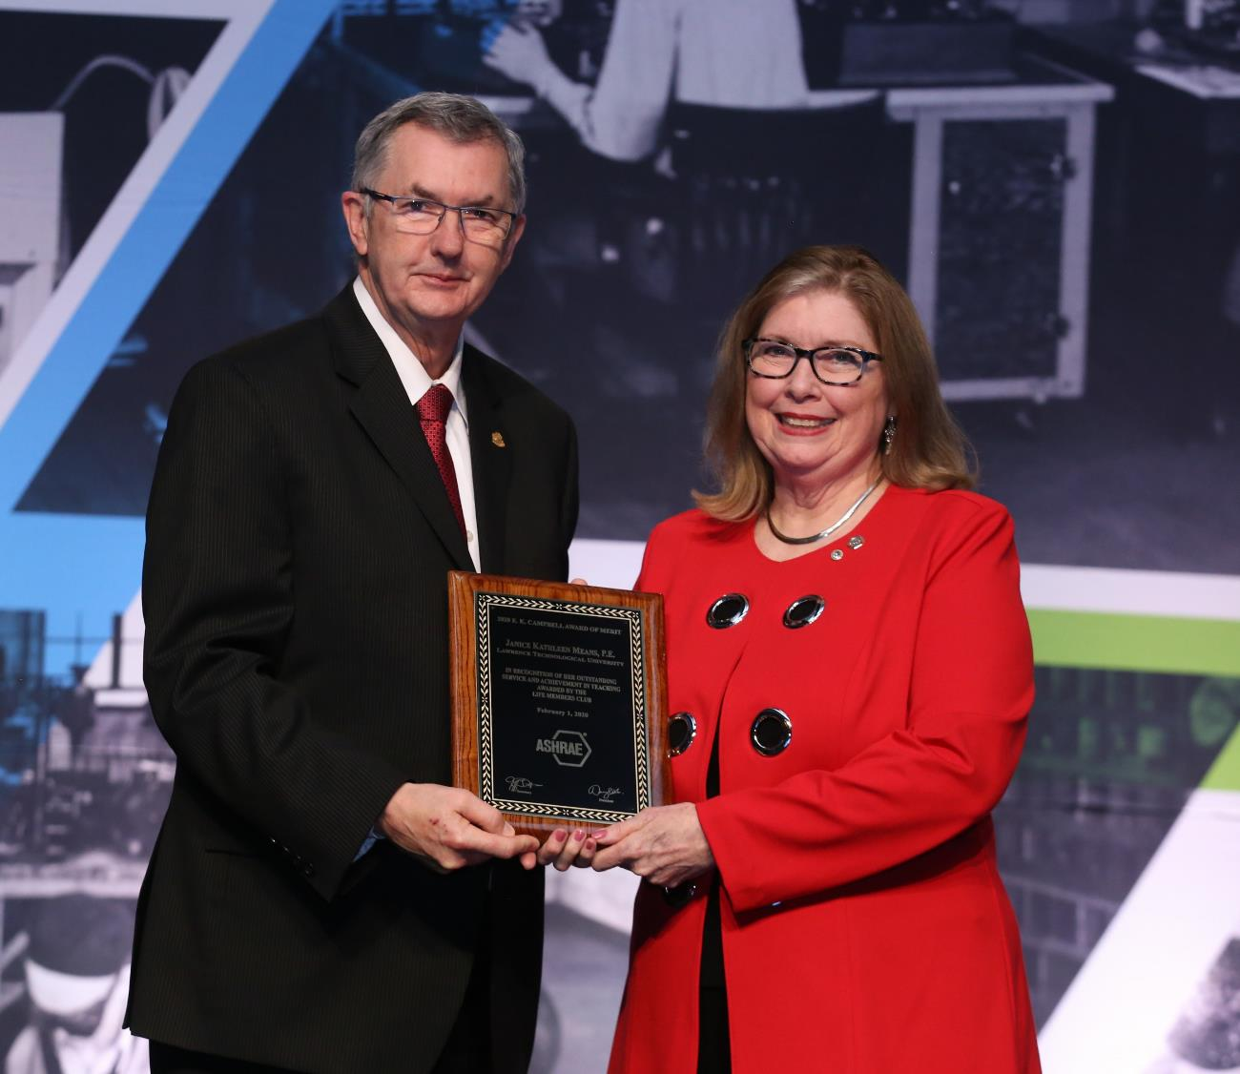
Personal Honors
E.K. Campbell Award of Merit
  Honors an individual for outstanding service and achievement in teaching and/or research in a subject related to the industry and professions represented by AHSRAE.
  Recommended by the Life Members Club.
YEA Inspirational Leader Award
  Recognizes a Young Engineer in ASHRAE (YEA) member who has gone above and beyond to make considerable contributions to the industry and community.
  Recommended by the YEA Committee
Notes:
For any award that lists a recommending committee, that means that specific committee accepts the nominations and recommends a final recipient to the Honors & Awards Committee. Those recommending committees have their own nomination process and deadline.

Slide 10
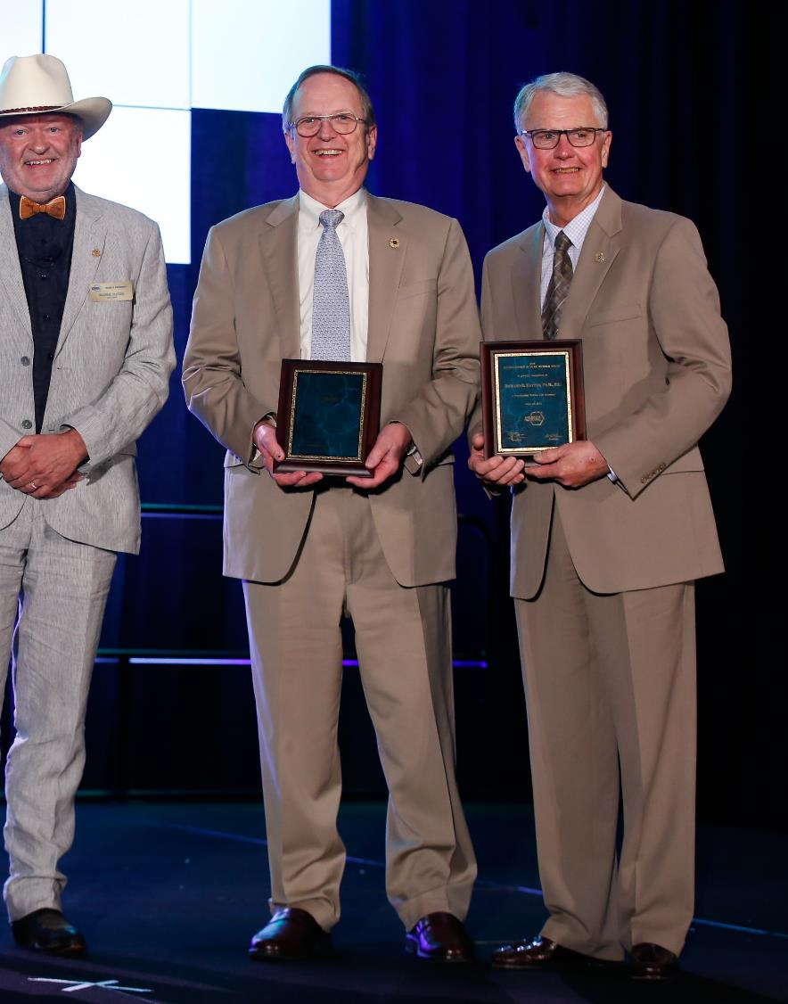
Personal Awards for
General Society Activities
Distinguished 50-Year Member Award
  Recognizes individuals who have been ASHRAE members for a minimum of 50 years and were a past Society President, Fellow, Distinguished Service Award recipient, or otherwise performed outstanding service for the Society.
  Nomination deadline: May 1
Distinguished 75-Year Member Award
  Same requirements as above, except 75 years of membership is required.
  Nomination deadline: May 1

Slide 11
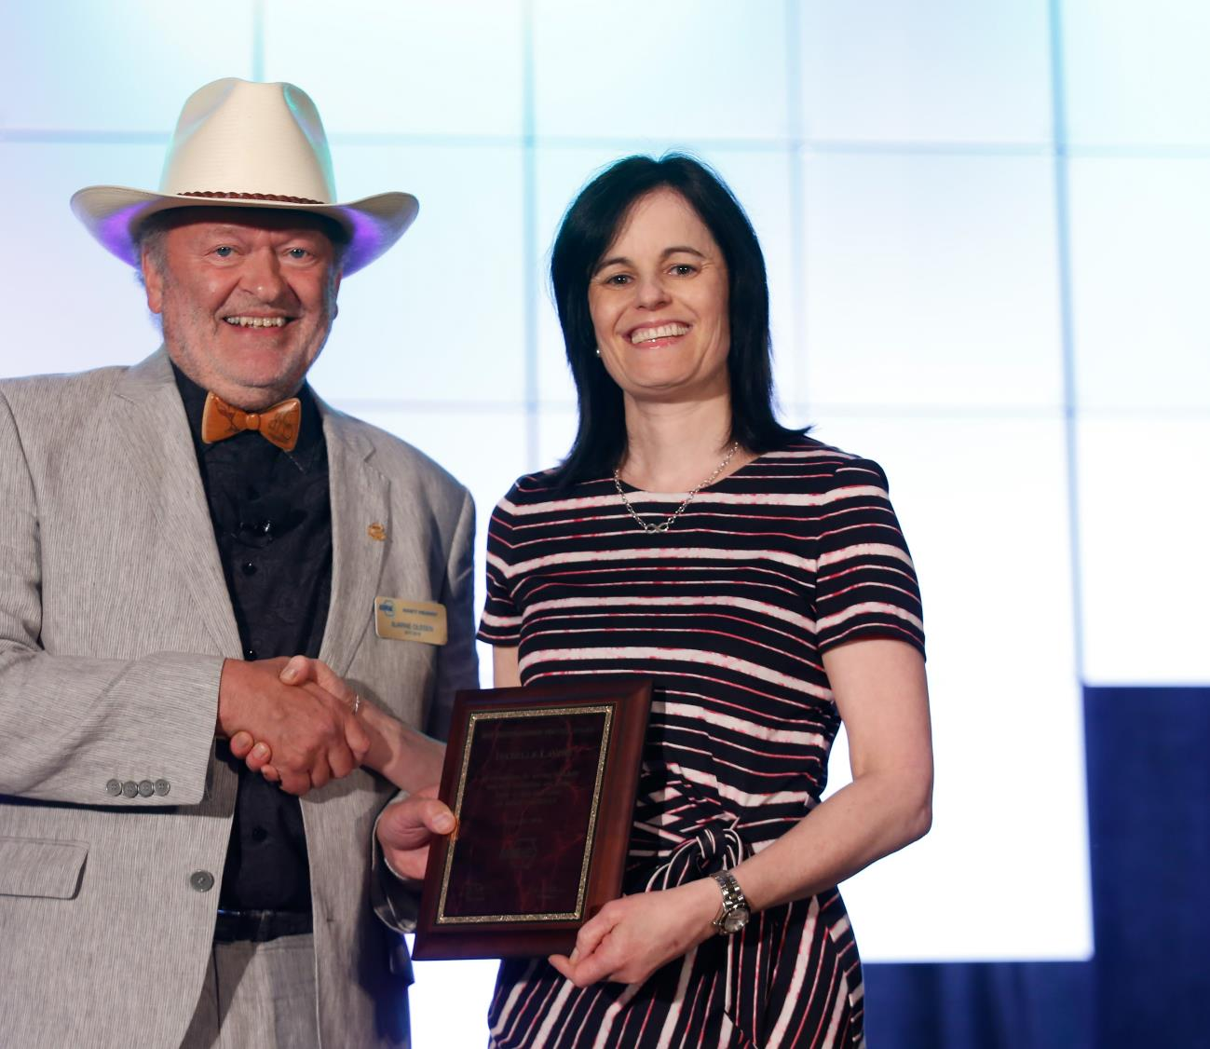
Personal Awards for
General Society Activities
Distinguished Service Award (DSA)
  Recognizes members who have served the Society faithfully and with distinction or otherwise given freely of their time and talent on behalf of the Society. A minimum of 15 points required on the point tally form.
  Nomination deadline: December 1
Exceptional Service Award (ESA)
  Similar to the DSA, except 45 points are required on the point tally form and the member must have been a Full Member for at least ten years.
  Nomination deadline: December 1
Developing Leader Award
  This award recognizes new members who have shown diverse involvement and commitment to ASHRAE withing five years of their Association Member join date.
  Recommended by the YEA Committee

Slide 12
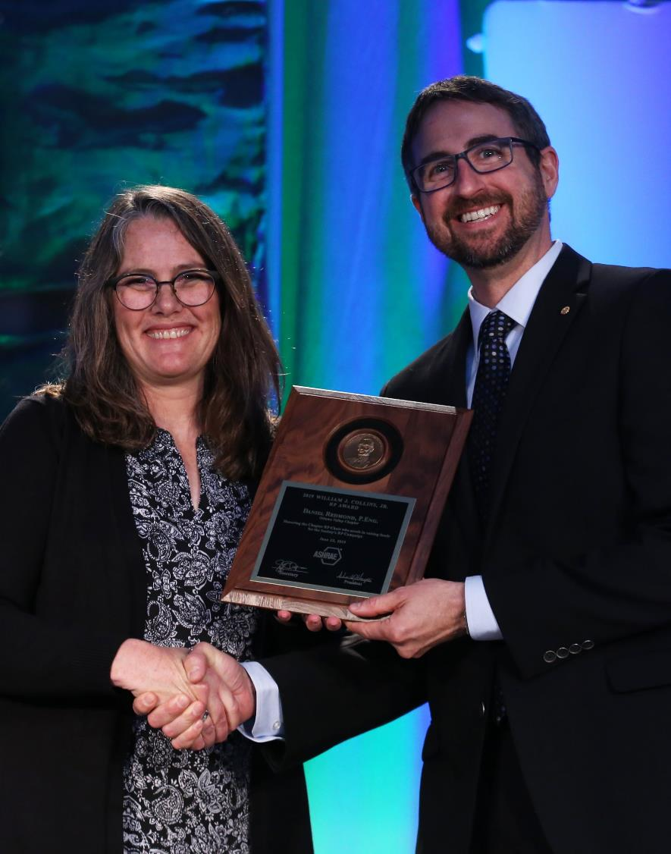
Personal Awards for
Specific Society Activities
Lincoln Bouillon Award
  Recognizes a member who performs the most outstanding work in increasing the membership of the Society.
  Recommended by the Membership Promotion Committee
William J. Collins, Jr. RP Award
  Recognizes the Chapter RP Chair who excels in raising funds for the RP Campaign.
  Recommended by the RP Committee
Homer Addams Award
  Recognizes a graduate student who has been engaged in an ASHRAE research project at a university that has graduate programs in the areas of HVAC&R and has achieved a high standard of performance in their work.
  Recommended by the Research Administration Committee

Slide 13
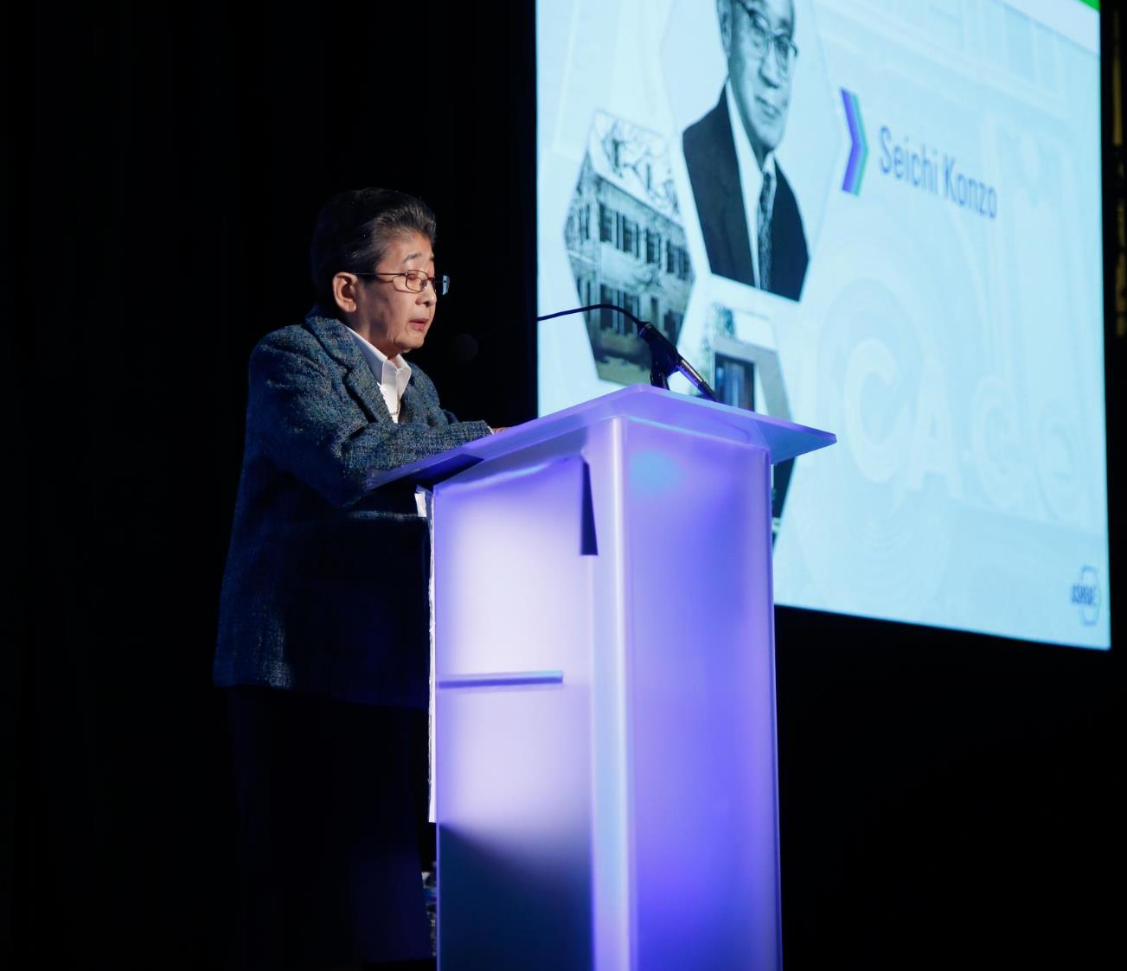
Personal Awards for
Specific Society Activities
Ralph G. Nevins Physiology and Human Environment Award
  Recognizes an individual under 40 for significant accomplishment in the general area of man’s response to the environment.
  Recommended by TC 2.1
John F. James International Award
  Recognizes a member who has done the most to enhance the Society’s international presence.
  Recommended by Members Council
Milton W. Garland Commemorative Comfort – Process – Cold Chain Award for Project Excellence
  Recognizes the designer and owner of a Comfort – Process – Cold Chain application that highlights innovation and/or new technologies.
  Recommended by the Refrigeration Committee

Slide 14
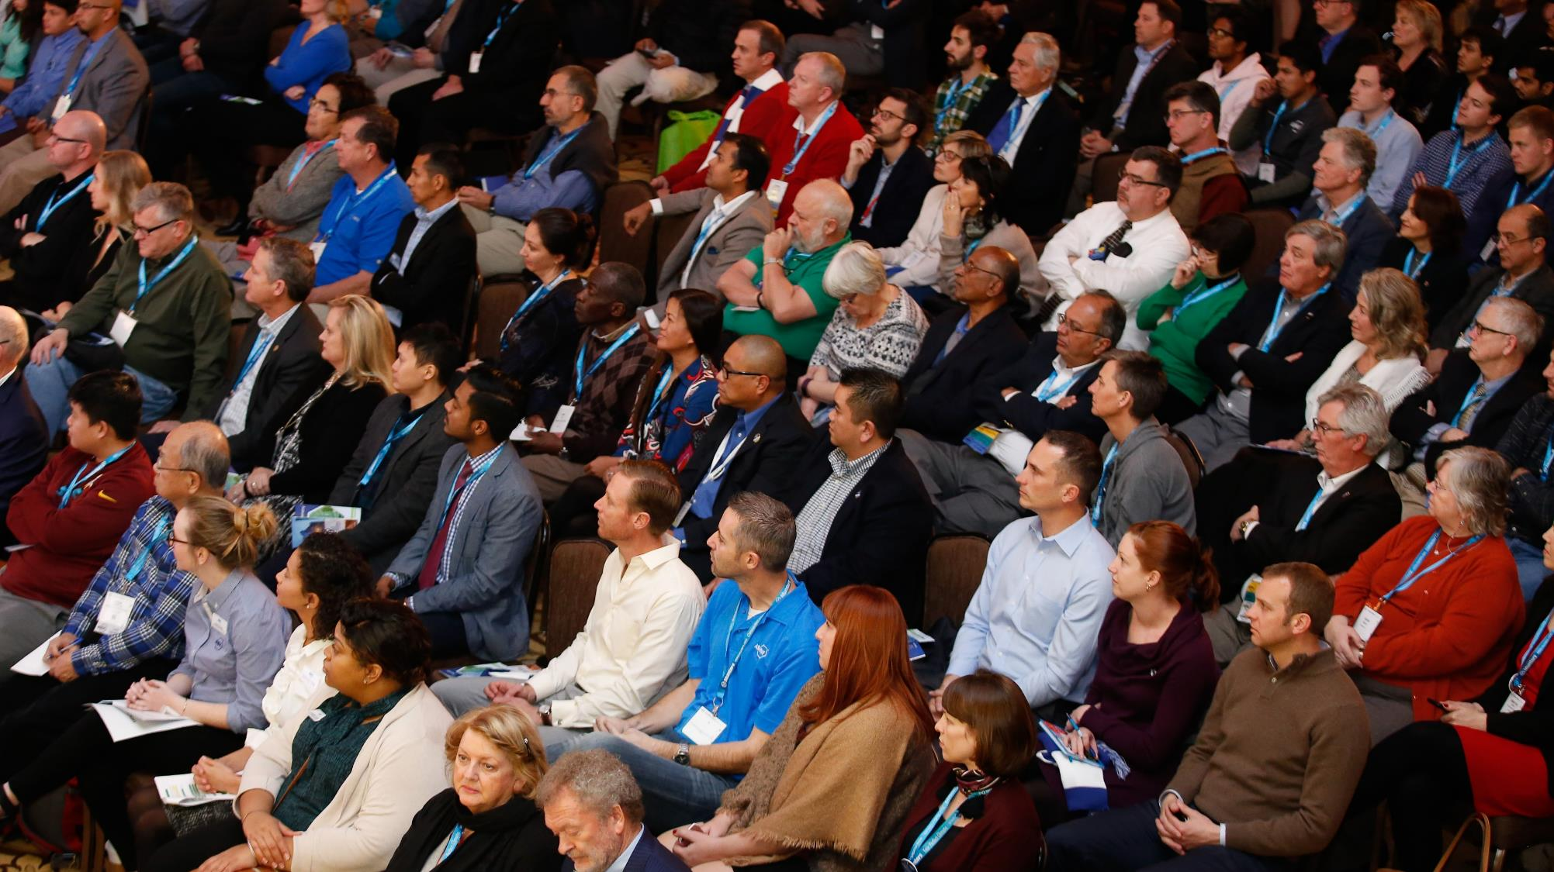
Personal Awards for
Specific Society Activities
Standards Achievement Award
  Recognizes excellence by a member in their volunteer services in the area of standards leadership and standards technical contributions.
  Recommended by the Standards Committee
Dan Mills Chapter Programs Award
  Recognizes a Chapter CTTC Chair or Vice Chair who excels in promoting technical and energy activities of the CTT Committee.
  Recommended by the CTT Committee
Student Activities Achievement Award
  Recognizes a Chapter Student Activities Chair for service related to the goals and growth of student activities at all levels.
  Recommended by the Student Activities Committee

Slide 15
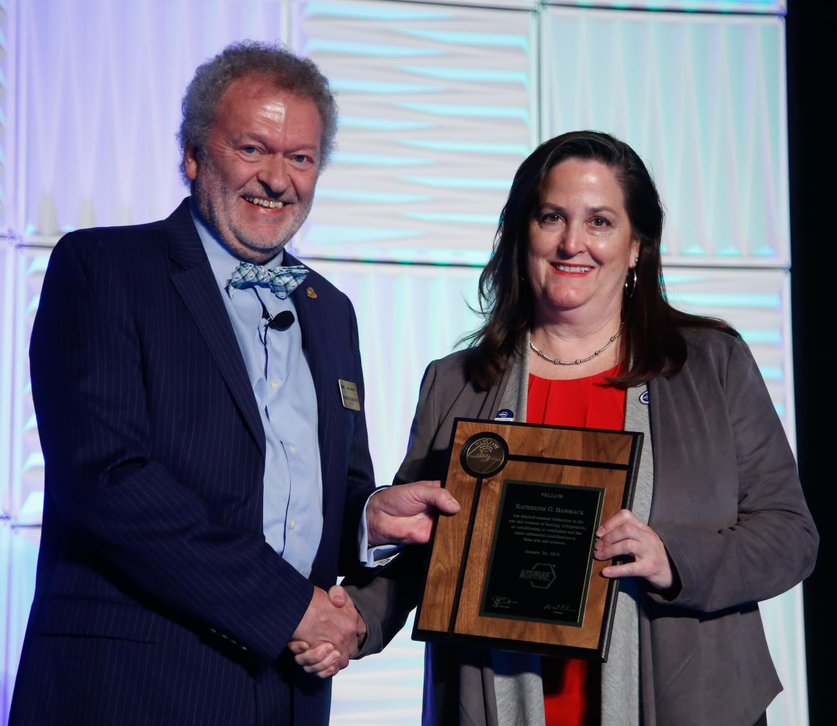
Personal Awards for
Specific Society Activities
Lou Flagg Historical Award
  Recognizes a Chapter Gold Ribbon Award winner for compiling information on outstanding historical projects or persons related to HVAC&R.
  Recommended by the Historical Committee
George B. Hightower Technical Achievement Award
  Recognizes excellence in volunteer service in the area of Technical Committee, Technical Group, and Technical Research Group activities.
  Recommended by Technology Council
Service to ASHRAE Research Award
  Recognizes excellence in volunteer services in the area of Society research.
  Recommended by Technology Council

Slide 16
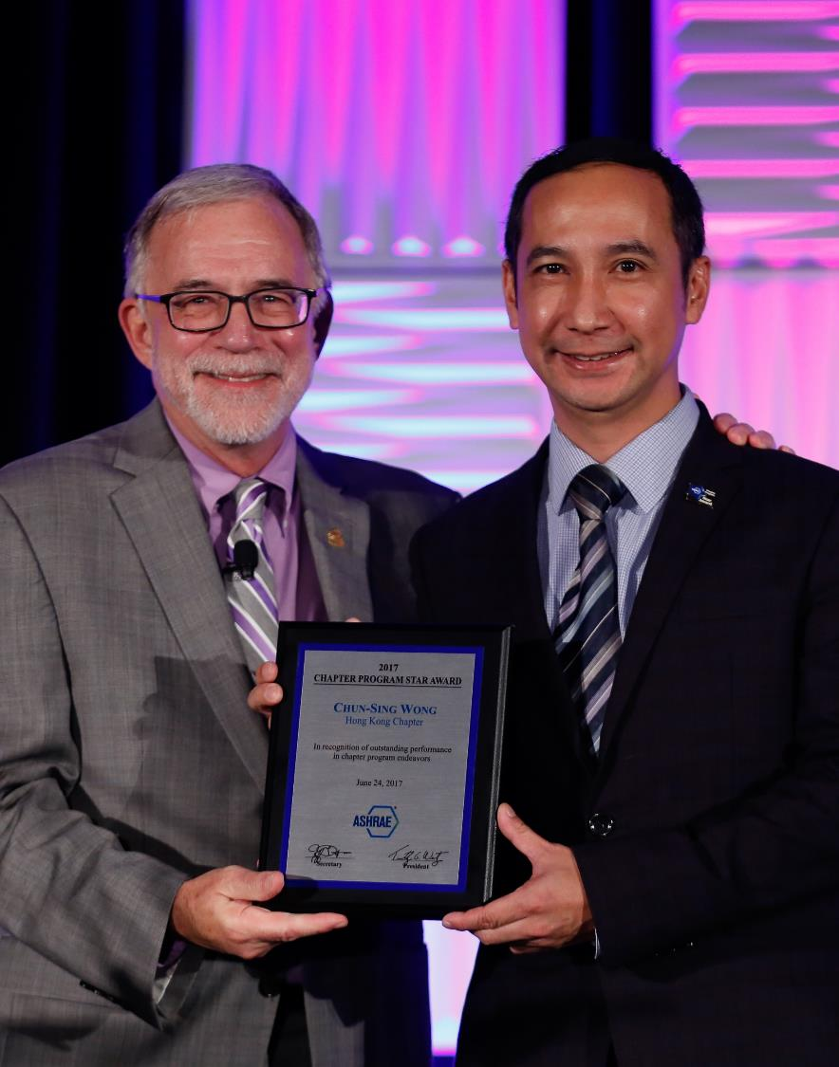
Personal Awards for
Specific Society Activities
Donald Bahnfleth Environmental Health Award
  Recognizes excellence in volunteer services focused on environmental health issues
  Recommended by the Environmental Health Committee
Lower-GWP Refrigeration and Air-Conditioning Innovation Award
  Recognizes individuals who have developed or practiced innovative technological concepts applied in developing countries to minimize global warming potential (GWP) through refrigeration and air-conditioning management.
  Recommended by the UN Environment Liaison Committee
Donald A. Siller Refrigeration Award
  Recognizes exceptional performance by a Chapter Refrigeration Chair for planning refrigeration activities.
  Recommended by the CTT Committee

Slide 17
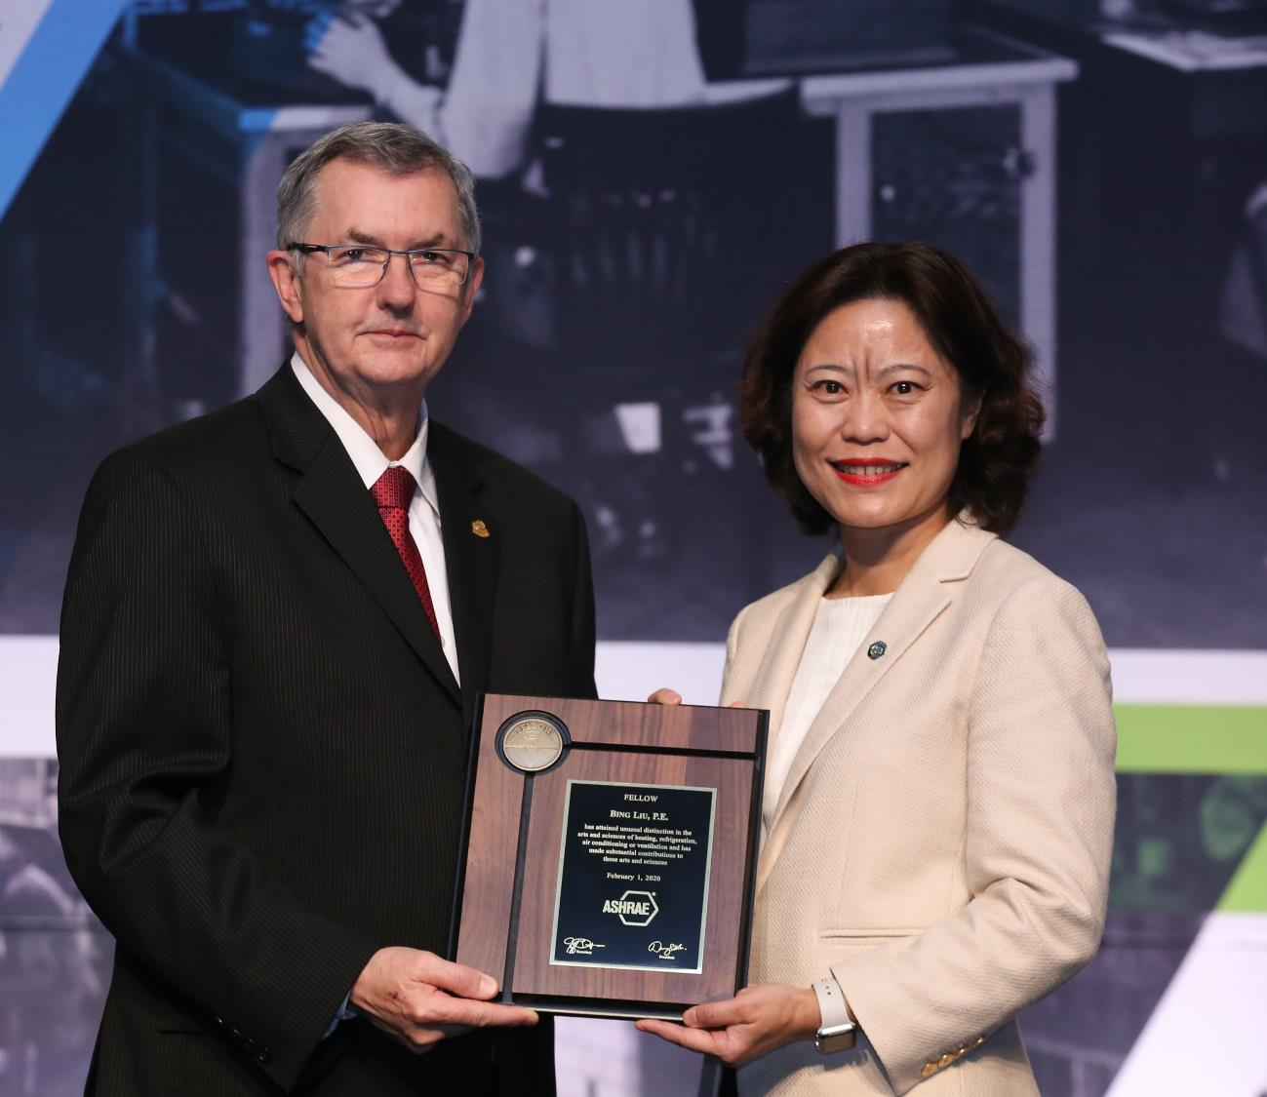
Personal Awards for
Specific Society Activities
YEA Award of Individual Excellence
  Recognizes YEA members for superior efforts during the preceding Society year in the promotion of the YEA Institute and representation of the 35 and under demographic of ASHRAE.
  Recommended by the YEA Committee
Youth Outreach Award
  Recognizes the outstanding effort of a member who actively engages a youth audience in their country, region, or local community through STEM activities.
  Recommended by the Student Activities Committee
Government Affairs Award
  Recognizes an individual who demonstrates outstanding effort at the state, provincial, and local government level on technical issues important to ASHRAE.
  Recommended by the Government Affairs Committee

Slide 18
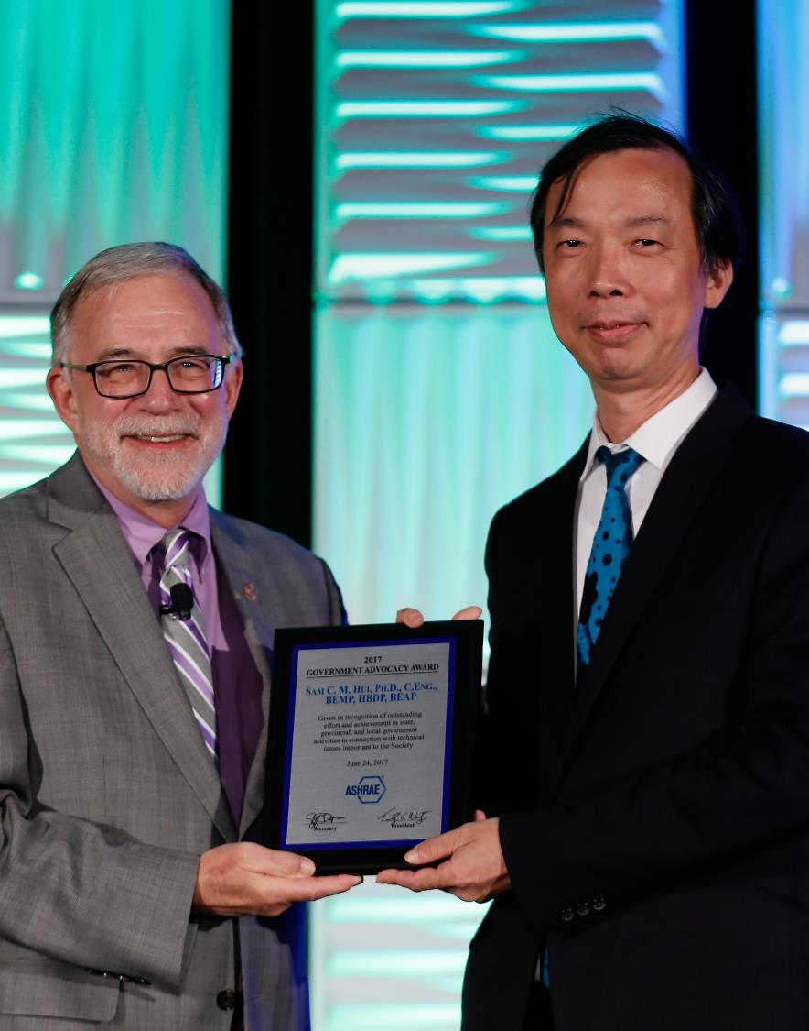
Personal Awards for
Specific Society Activities
Energy Genius Award
  Assesses building energy performance through the use of the ASHRAE Building EQ Portal program and Building EQ assessment processes.
  Recommended by the Building EQ Committee
Residential Buildings Service Award
  Recognizes excellence in volunteer service focused on Residential Building issues. It serves to heighten general membership awareness of, and interest in, Residential Building activities.
  Recommended by the Residential Building Committee

Slide 19
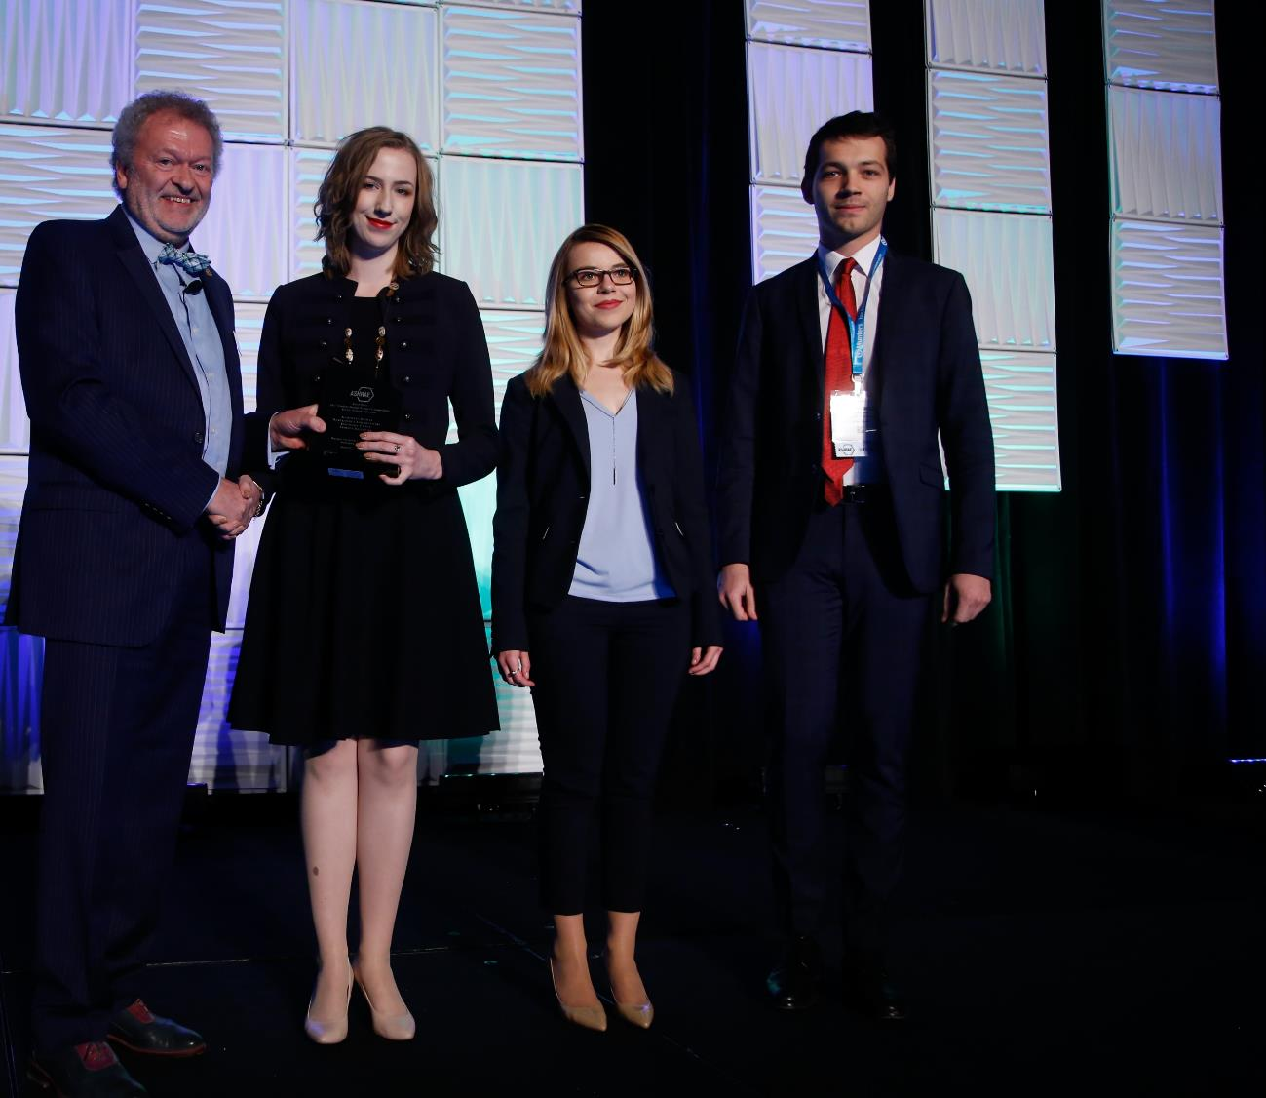
Society Awards to Groups or Chapters
Technology Award and Award for Engineering Excellence
  Recognizes successful application of innovate design which incorporates ASHRAE standards for effective energy management, indoor air quality, and mechanical design management.
  Recipients are recommended by the CTT Committee
Student Design Project Competition
  Recognizes outstanding student design projects, promotes teamwork, and encourages students to become involved in the dynamic HVAC&R profession.
  Recipients are recommended by the Student Activities Committee

Slide 20

Paper Awards
Crosby Field Award
  Recognizes the highest ranked paper for the Society year.
  Recommended by the Conferences and Expositions Committee
Willis H. Carrier Award
  Recognizes the best paper by a member 32 years of age or younger.
  Recommended by the Conferences and Expositions Committee
Best Paper Award
  Recognizes the best papers presented at Society conferences.
  Recommended by the Conferences and Expositions Committee

Slide 21
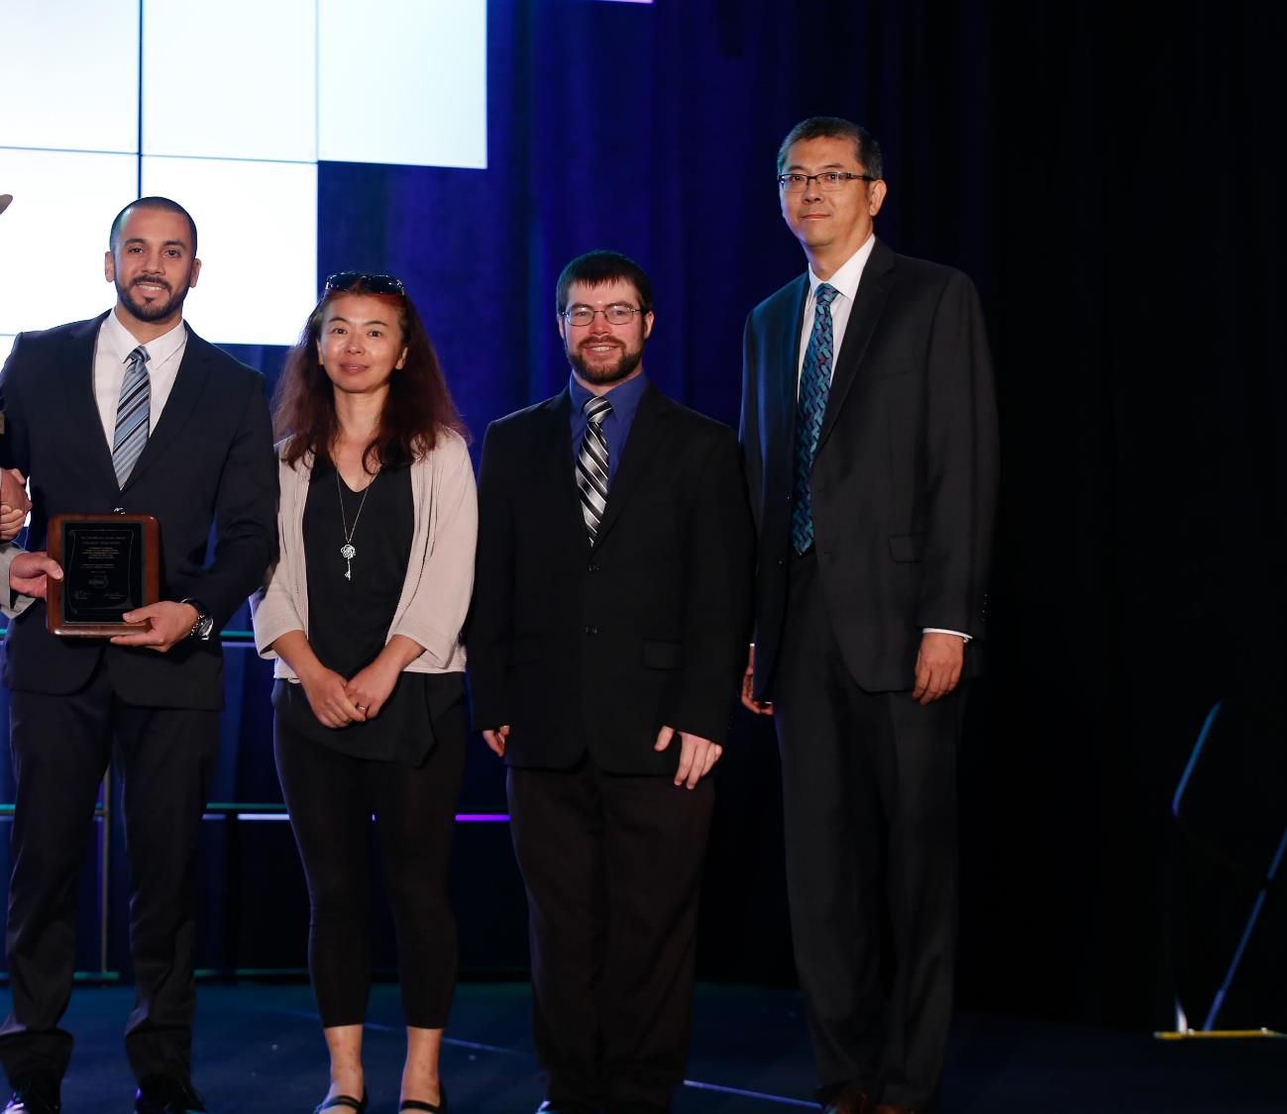
Paper Awards
Poster Presentation Award
  Recognizes the best poster session paper from Society conferences.
  Recommended by the Conferences and Expositions Committee
Journal Paper Award
  Recognizes the best article published in the ASHRAE Journal for the year.
  Recommended by the Publications Committee
Science and Technology for the Built Environment Best Paper Award
  Recognizes the best referred paper published in the volume year of the Science and Technology for the Built Environment, the ASHRAE research journal.
  Recommended by the Research Journal Subcommittee

Slide 22

Chapter and Regional Awards
Regional Award of Merit and Chapter Service Award
  Recognizes activities and contributions at the Chapter and Regional level
  Ten services points are required for the Regional Award of Merit and 12 points are required for the Chapter Service Award.
  Staff will pull a report of eligible recipients who are automatically granted these awards. In addition, nominations may also be made by the delegate from the candidate’s chapter at the CRC.
  Presented during CRC or chapter event.
  H&A Committee does not receive or review nominations for these awards.

Slide 23
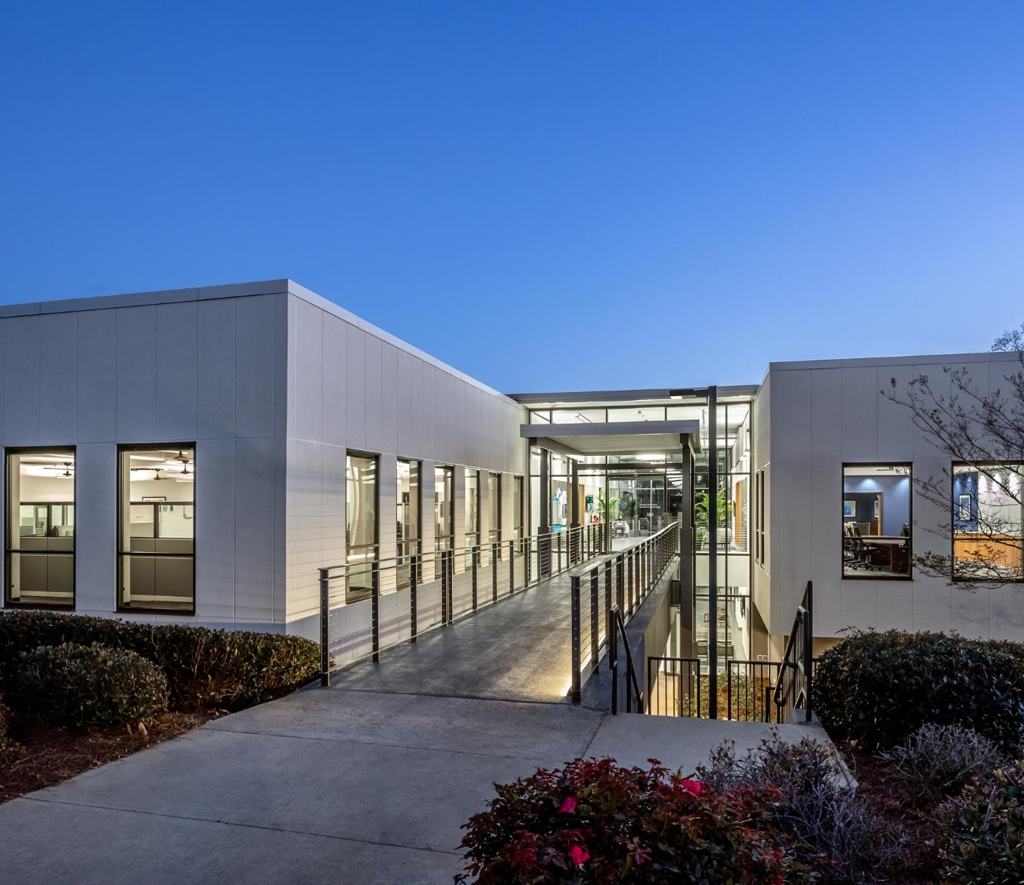
Where To Get More Information
H&A webpage:
  www.ashrae.org/honors
Email
  HonorsandAwards@ashrae.org
ASHRAE Staff Liaisons
  Rhiannon Masterson: rmasterson@ashrae.org
  Anastasia Meadows: ameadows@ashrae.org

