Slide 1
ASHRAE Certification:
Driving Positive Outcomes
Validation
Recognition
Career Development
Notes:
This brief presentation will be on ASHRAE Certification: what it is, how it works and what the benefits are to the certified professional as well as the employer

Slide 2
Guest Facilitator
Insert name
Notes:
- Insert Name

Slide 3
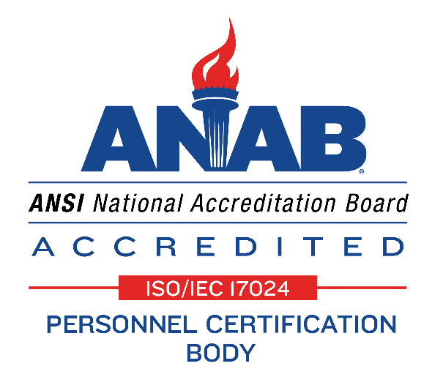
Background
ASHRAE Certification Programs
  Nearly 4,300 certifications earned to date
  Created to meet industry needs as identified by market research
  Developed by subject matter experts, via industry-wide job task analyses
  ANSI/ISO/IEC 17024 accredited
Notes:
Since the first program was founded in 2007, nearly 4,300 ASHRAE certifications have been earned.
Feel free to take your audience to this webpage and search for certificants: https://www.ashrae.org/professional-development/ashrae-certification/find-an-ashrae-certified-professional
ANSI accreditation ensures ASHRAE programs conform to a rigorous, internationally recognized standard (17024) for personnel certification programs.
The 17024 standard addresses certifying body legal status, management of confidentiality and impartiality, governance, recordkeeping, security, certification scheme requirements, appeals and complaints, among other requirements.

Slide 4
What is “Certification”?
Validates competency to do a job
Examinations based on industry-wide Job Task Analyses (JTAs)
Exam questions tied to key job tasks identified during the JTA
Exam passing scores are identified following an analysis of candidate data and the difficulty of the exam questions
Certification Exams have pass – and fail - rates
Notes:
“Key” job tasks = 1) important to successful job performance and 2) frequently done
Passing scores and exam pass rates may be found at ASHRAE.org for each program

Slide 5
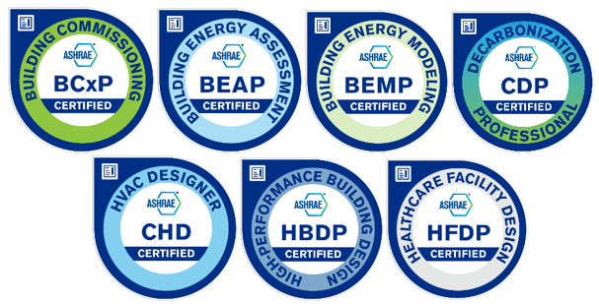
ASHRAE Certification
You’re ASHRAE-Certified.
Now Get the Recognition You’ve Earned.
Notes:
ASHRAE offers seven certification programs in six key built-environment jobs:
:
Building Commissioning Professional (BCxP)
Building Energy Assessment Professional (BEAP)
Building Energy Modeling Professional (BEMP)
Certified Decarbonization Professional (CDP)
Certified HVAC Designer (CHD)
High-Performance Building Design Professional (HBDP)
Healthcare Facility Design Professional (HFDP)

Slide 6
Value to Employers
2021 Survey Results:
ASHRAE Certification is evidence of … competence (90%)
I have greater confidence in the knowledge and skills of ASHRAE-certified job applicants (85%)
ASHRAE Certification has led to additional business opportunities for my company (54%)
If the project team includes an ASHRAE-certified professional, then the project is more likely to be completed on time and under budget, and fulfill stakeholder requirements for quality (52%)
Notes:
2021 survey of ASHRAE-certified professionals who indicated they “influence the HVAC hiring decision”
Young Engineers can raise their profile among their peers and supervisors by earning an ASHRAE Certification

Slide 7
More Value to Employers
Know whom to hire, promote and assign important projects
Incorporate ASHRAE Certification into professional development plans
Enhanced eligibility for local, state and federal contracts
Notes:
Employers know how important in terms of time and money it is to hire the right person. ASHRAE Certification helps Employers identify Young Engineering talent that have demonstrated the critical competencies needed to get the job done well.
Employers know how important it is to retain their up-and-coming Young Engineers. Young Engineers want to grow, be challenged and be recognized. Employers can meet all three of these needs while improving employee retention by setting ASHRAE Certification as a professional develop goal.
More than 35 local, state and national government bodies recognize ASHRAE certifications, including those in Canada and UAE.

Slide 8
Value to Certification Earners
2021 Survey Results:
ASHRAE Certification has provided me with greater recognition (72%)
My credibility in the eyes of my colleagues and supervisor has increased. (69%)
My ASHRAE certification has helped improve my career opportunities. (60%)
My earning power has increased. (43%)
Notes:
2021 survey of ASHRAE-certified professionals
ASHRAE Certification is a great tool/asset for Young Engineers
Certification is a portably credential- you take it with you wherever you go during your engineering career!
Third-party validation of critical, job task competency
Improved opportunity for Young Engineers to be hired, promoted and to earn more
Demonstrated commitment to professional development

Slide 9

5 Steps to Earn and Maintain an ASHRAE Certification
Step 1 - Review the Candidate Guidebook
Eligibility requirements
Examination details
Recertification requirements
Notes:
Downloadable
In particular to determine if you meet the education and work experience criteria to sit for the certification exam, as well as the rules around scheduling and sitting for your certification exam.

Slide 10
Step 2- Submit an Application
Online
5 minutes to complete
Acceptance within 7-10 business days
Notes:
BEAP and BCxP applications may take approximately 15 minutes to complete. These applications also are “savable.”
Other applications take less time to complete.

Slide 11
Application Fees
Certification
USD $495 ASHRAE Member ($295 Developing Economies)
USD $745 non-member
Renewal
USD $245 ASHRAE Member ($145 Developing Economies)
USD $375 non-member
Notes:
Note: three-year certification cycle. So, at just $165 USD per year, ASHRAE certification is a really great value for Members.
Look for occasional 25% discount promotions

Slide 12
Step 3 - Schedule an Examination
Examination at over 1,000 test center locations worldwide
Additional 30 minutes of testing time for non-native English speakers
Notes:
Non-native speakers of English may request and receive an additional 30 minutes of testing time.
Find a test center near you at https://www.kryterion.com/locate-test-center/

Slide 13
Step 4 – Prepare for Your Exam
Exam detailed content outline in Candidate Guidebook
30-question, online, on-demand certification Practice Exams
ASHRAE standards, guidelines and courses
BCxP, BEMP and CHD Certification Study Guides
  Task-by-task self-assessments linked to key ASHRAE resources
  Core and “deep dive” resource break-down
  Exam-length Practice Exam
  Price: $59 Member
Notes:
The detailed content outline (or ‘Exam Blueprint”) for each exam tells you what is tested and how many questions there will be in each part,
The 30-question, online, on-demand certification Practice Exams will help you become more familiar with certification exam content and difficulty.
Note: neither purchasing an ASHRAE standard or guideline nor taking part in an ASHRAE course is required for success on a Certification exam.
Exam questions fall into 3 cognitive groupings: recall, application and analysis.

Slide 14
Step 5 - Renew Your Certification
Demonstrate continuing competence through professional development hours (PDHs)
Three-year recertification cycle
45 PDHs required (BCxP and BEAP 50 PDHs; CHD 30 PDHs) and may be earned in a number of ways from any provider in any language
Notes:
Recertification assures the public, including employers and clients, of continued competence in your chosen field.
PDHs may be earned via continuing education (online or in-person, college courses, conference education), certification exam development, committee work.
Note: BCxPs and BEAPs need 50 PDHs, but half of these may be earned through work experience.
CHDs need 30 PDHs, but half of these may be earned through work experience.

Slide 15
Promote Your Certification!
Certification earner directory at ASHRAE.org
Showcase Certification digital badge in all electronic media
Feature Certification designation (e.g. BCxP) on business cards, email signatures and websites, as well as in proposals/bids.
Notes:
https://www.ashrae.org/professional-development/ashrae-certification/find-an-ashrae-certified-professional

Slide 16
NEW! Digital Badging
You’re ASHRAE-Certified.
Now Get the Recognition You’ve Earned.
Notes:
All ASHRAE certificants are issued a certification digital badge.

Slide 17
Digital Badging
Embedded metadata uniquely linked to you.
Third-party validation.
Shareable in electronic media, including LinkedIn, email, websites, Facebook and X (formerly Twitter)-
Over 42,000 views in all electronic media across all badges!
Instant recognition
Real-time, third-party verification
Notes:
Presenter- be ready to show your own digital badge, including the meta-data, and discuss the various ways you use it and any positive comments folks have made.
Feel free to take your audience to this webpage: https://www.ashrae.org/professional-development/ashrae-certification/ashrae-certification-badges

Slide 18
Chapter PAOE Points
Chapter PAOE Points / Certification
Chapter presentation on Certification / 10 PAOE pts / 5x per year
Chapter website promotion of Certification / 10 PAOE pts / 5x per year
Chapter email or newsletter promotion of Certification / 25 PAOE pts (100 max)
Social media blurb on career benefits / 25 PAOE pts / unlimited #
Certification / 100 PAOE pts / unlimited #
Recertification / 100 PAOE pts / unlimited #

Slide 19
For More Information
Visit www.ashrae.org/certification
E-mail certification@ashrae.org
Phone 678-539-1105, or toll-free 1-800-527-4724 (US and Canada) or 404-636-8400 (worldwide)
Questions?
Notes:
The website landing page for each certification and the respective certification Candidate Guidebooks are great starting points for those interested in learning more.

